Slide 1

How does litter travel to the sea?
Matching game
80% of ocean litter comes from the land.
Use this matching exercise to help pupils understand how litter reaches the sea.
Put pupils into small groups and give each group a litter item board and a set of related cards. Ask pupils to work together to place the cards in order to show the journey that the litter item takes from the land to the sea.
There are four litter items to follow on their journeys. The number of cards in each journey varies to allow for differentiation. Each set of card states ‘1 of’ to indicate how many cards are in the journey.

Slide 2
How does litter travel to the sea?
Fishing net

Slide 3
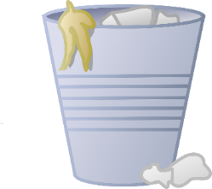
How does litter travel to the sea?
Overflowing bin

Slide 4

How does litter travel to the sea?
Wet wipe

Slide 5
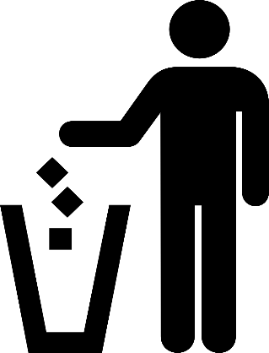
How does litter travel to the sea?
Dropped litter

Slide 6


Fishing net
Sea
1 of 2
1 of 2
Overflowing Bin
Wind
Sea
1 of 3
1 of 3
1 of 3

Slide 7





Wet wipe
Toilet
Drain
River
Sea
1 of 5
1 of 5
1 of 5
1 of 5
1 of 5
Dropped litter
Rain
Drain
River
Sea
1 of 5
1 of 5
1 of 5
1 of 5
1 of 5

Slide 8
Further information for teachers
Fishing nets
Fishing nets – and fishing lines – can break when fishing and fall into the sea; they can also be
blown, washed or thrown overboard, into the sea.
Overflowing bins
Many people have good intentions when they put their rubbish in bins when out and about. But if the bin is full or overflowing this rubbish is often blown away from the bin. If the bin is by the seaside, the rubbish can be blown straight into the sea. If the bin is inland, the rubbish might be blown into a river, which then travels to the sea.
Wet wipes
Some wet wipes break up in the toilet, but a lot of them don’t, that’s why its best to put them in the bin. Some wet wipes contain plastic too. Other things that people put down the toilet are ear cleaners, which can often be found on beach cleans. Drains from toilets lead to water treatment facilities where water is treated to make it clean before being realised into rivers or the sea. But sometimes the water treatment facilities can’t filter out the rubbish items and they end up being released into rivers. Blockages in the sewers (e.g. from fatberg) and flooding also lead to waste
water being released untreated into rivers.
Dropped litter
Litter dropped on the ground can be washed into drains on the road by rain, or blown into drains by wind. These drains eventually connect to rivers and the ocean.

