Slide 1


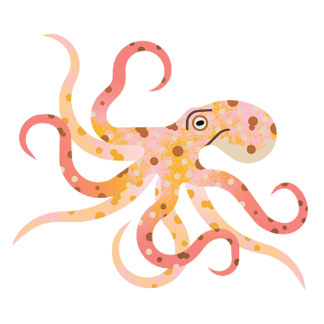
Healthier ocean. Healthier planet.
Presentation for [group name]
by
[presenter name]
https://www.mcsuk.org/
Notes:
Notes for using these slides
You can use these slides and speaker notes when presenting this introductory talk about the Marine Conservation Society.
You don’t need to include all the slides or all the information in the notes.
Feel free to adapt the presentation to you, your audience and the duration of your talk – in fact, we encourage this!
Please do not add new, unbranded slides.
Please also make sure to download the latest version before each talk, as we intend this to be an ever improving and evolving presentation. For example, we will update the content to stay current in line with our campaigns and projects.
If you are using a second screen / projector and wish to see these notes while presenting, go to slide show in the top ribbon → tick “use presenter view” → then start slide show from beginning
Before you start
Before starting your presentation, it is a good idea to make sure you are safe and comfortable in the space. Ask the talk organiser to remove any obstructions that may cause trip hazards, for example.
The talk organiser is responsible for the talk attendees and should make sure they are all safe and comfortable before you start.
Introduce yourself!
Sea Champions bring unique stories and perspective to MCS. We want you to let your audience know a little bit about your background, interests and roles within MCS.
Judge the type and size of group you are presenting to, and with that you can decide whether a round robin of introductions or similar icebreaker would be suitable.

Slide 2

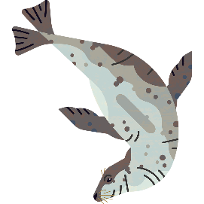

Today we'll cover
The climate crisis
Global targets
Blue Carbon
Project summary
What can you do?
Time for questions.
XX hour
Notes:
Today’s plan of action is as follows… read through the agenda
Housekeeping
Now would be a good time to introduce any rules that might help the presentation run smoothly.
Let attendees know whether you’re happy with questions throughout, or whether you’d prefer them to keep questions until the end.
You could also ask the talk organiser to point out emergency exits.
If your talk is going to be over an hour long, we suggest you schedule in a comfort break.

Slide 3
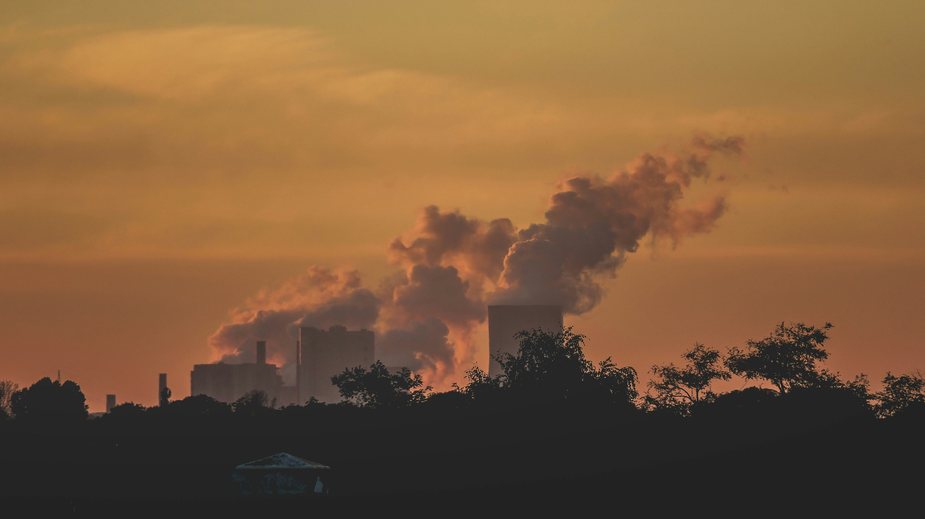
Credit – Paul Pastourmatzis
Notes:
Although Earth’s climate does change over time, because of a variety of natural factors, evidence now clearly shows that human activity is ‘fast-tracking’ current changes.

Slide 4




Solar energy
Greenhouse gases
Atmosphere
Notes:
Since the 1800s, human activities have been the main driver of climate change.
Burning fossil fuels like coal, oil and gas generates greenhouse gas emissions that trap the sun’s heat and raise temperatures.
Greenhouse gas concentrations are at their highest levels in 2 million years, and emissions continue to rise.

Slide 5
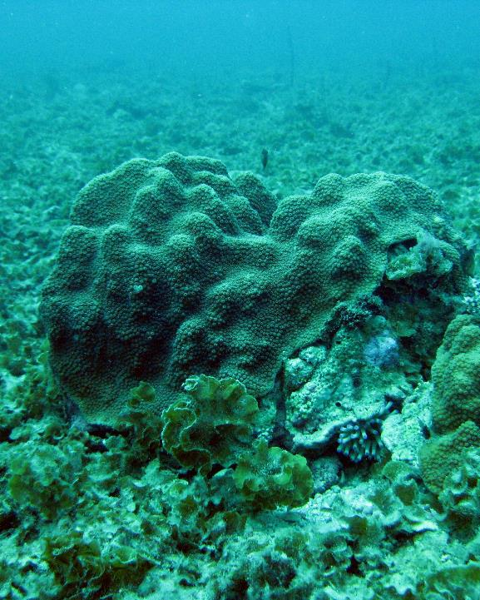

Credit – NOAA
The impacts
Droughts and water scarcity
Fires
Rising sea levels
Flooding
Melting ice caps
Extreme weather, storms
Declining biodiversity.
Notes:
It’s not just about warmer temperatures.
Because the Earth is a system, where everything is connected, the consequences of climate change include intense droughts, water scarcity, severe fires, rising sea levels, flooding, melting polar ice, catastrophic storms and declining biodiversity.

Slide 6
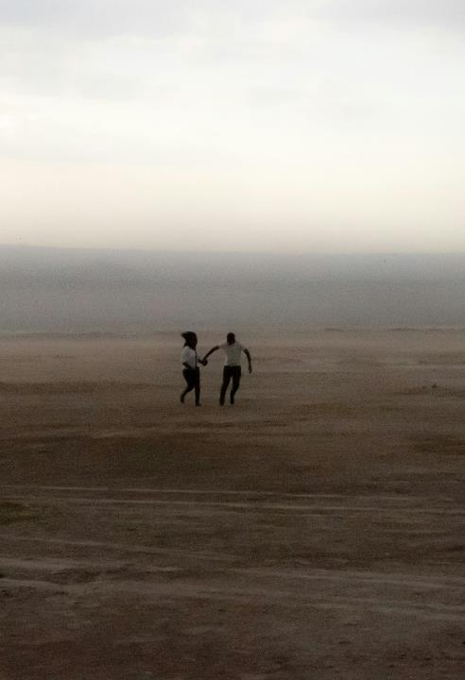

What?
Health
Food
Housing
Safety
Work.
Where/Who?
Small Island Nations
Global South
Warmer climates.
Credit – Carlos Torres, Unsplash
Notes:
Climate change can affect our health, ability to grow food, housing, safety and work.
People in some parts of the world, such as small island nations, much of the Global South, particularly tropical, dry or warm climates, are much more vulnerable to climate impacts.
This is not a future problem. Millions of people around the world are already facing extreme impacts of climate change.

Slide 7

Climate breakdown presents one of the greatest challenges in human history.
Notes:
Climate breakdown presents one of the greatest challenges in human history. We must act now to avoid catastrophe.

Slide 8
What is the UK doing about this?
Global targets
The Paris Agreement – 1.5°C
To prevent irreversible damage
We must act now.
Notes:
Global targets
The UK is a signatory to the Paris Agreement, which aims to keep the global temperature rise this century well below 2ºC above pre-industrial levels and increase our efforts to limit this even further, to 1.5ºC.
Global warming above this level would wipe out entire ecosystems and cause irreversible damage
To enable our ocean to help avoid climate breakdown, we must radically improve the way we use and protect it.
We need an urgent race to net-zero emissions of greenhouse gases to save ourselves and the planet before it is too late.
We know what we must do and we must do it now.

Slide 9

Our ocean is a potential hero in the fight against climate change.
Notes:
Luckily, our ocean is a potential hero in the fight against climate change.
We often think of land-based ecosystems, like trees, absorbing carbon dioxide and helping fight the climate crisis.
Ocean ecosystems do this too!

Slide 10
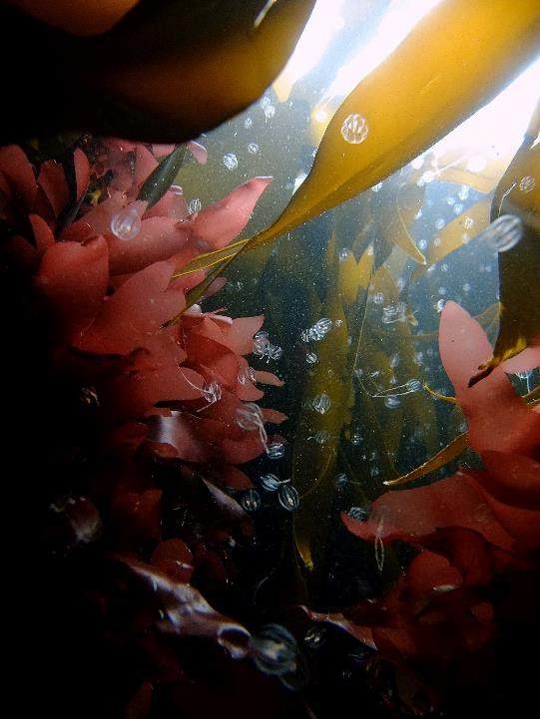
Credit – Peter Bardsley
Blue carbon
Carbon storage in the ocean = blue carbon
25% of all carbon dioxide emissions are captured by the ocean
Ocean food webs
Phytoplankton.
Notes:
Blue carbon is the term used to describe when carbon absorbed from the water and atmosphere and is stored in the world’s seas and coastal ecosystems.
Around a quarter of all carbon dioxide emissions are captured by the ocean.
The storage of blue carbon can be in the plants themselves, like seaweed and seagrass; in the seafloor sediment where plants are rooted; or even in the animals which live in the water, including seabirds, fish and larger mammals.
But most of the carbon captured by the ocean is by phytoplankton – these are tiny, plant like organisms present in vast quantities, they photosynthesise and lock in carbon.

Slide 11
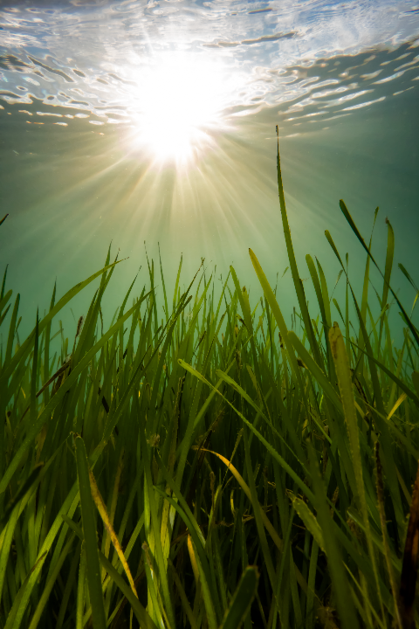
Blue carbon ecosystems
Seagrass, saltmarsh, mangrove
90% of UK seagrass has been lost
Coastal development
Bottom towed fishing.
Credit – Georgie Bull
Notes:
There are a few coastal habitats that are particularly important – these climate hero's are seagrass meadows, saltmarsh and mangrove forests.
These are the “official” blue carbon habitats
Lots of research is currently taking place into other ecosystems that may store carbon – like seafloor mud and shellfish reefs.
In the UK, we have lost around 90% of our seagrass meadows. Other carbon-storing habitats, like saltmarshes, are being destroyed at similarly alarming rates.
Every day, valuable species and habitats that capture and store carbon are being destroyed, mostly by coastal construction and bottom towed fishing. Other factors like anchoring and sewage also play a part.
This is reducing the ocean's ability to help fight the climate crisis.
If the UK is to reach its goal of net zero carbon emissions by 2050, blue carbon solutions must be considered in tandem with those on land.

Slide 12
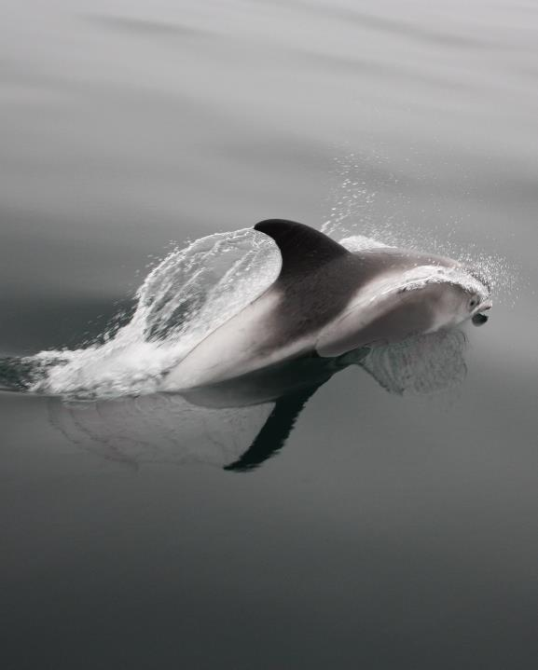
Interlinked issues
Overfishing
Plastic and chemical pollution
Oil and gas.
Notes:
Since ocean food webs and plentiful, healthy ecosystems are SO important for storing carbon, our harmful activities like overfishing and pollution are massively exacerbating the climate crisis.
Plastic and chemical pollution is affecting our marine wildlife, from their metabolic rates to their reproduction and survival, all of which impacts our ocean’s carbon cycle.
At the same time, plastics are made from oil and gas and so their production adds to carbon emissions.

Slide 13
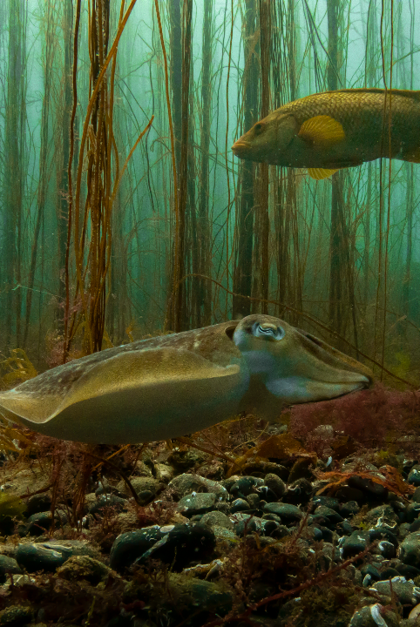
Blue Carbon Quiz!
https://www.mcsuk.org/ocean-emergency/climate-change/how-much-do-you-know-about-blue-carbon/
Credit – Georgie Bull
Notes:
If you have time, you could come out of the presentation here and ask attendees to take part in the blue carbon quiz with you!

Slide 14
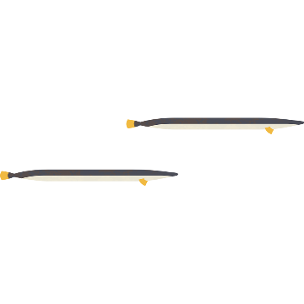
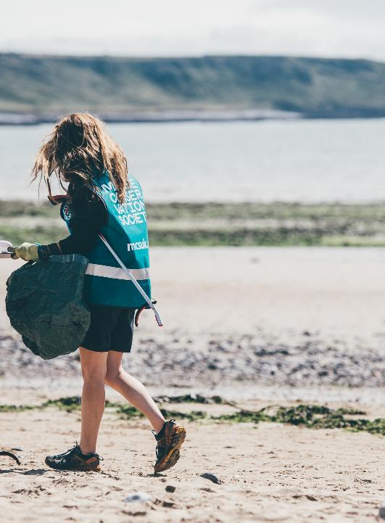
We are a leading UK environmental charity dedicated to protecting our ocean - defending crucial habitats, regenerating vital ecosystems and inspiring volunteers.
We unite communities, governments, and industry, to champion science-based solutions for cleaner, healthier seas to tackle the climate and nature emergency.
Credit – Billy Barraclough
Notes:
At the Marine Conservation Society, we have been the voice of our seas for over 40 years.
We have three key aims: defending crucial habitats, regenerating vital ecosystems and inspiring volunteers. Climate change comes into all three!
We work with everyone from communities to government and industry.
We are always science based in our approach.

Slide 15
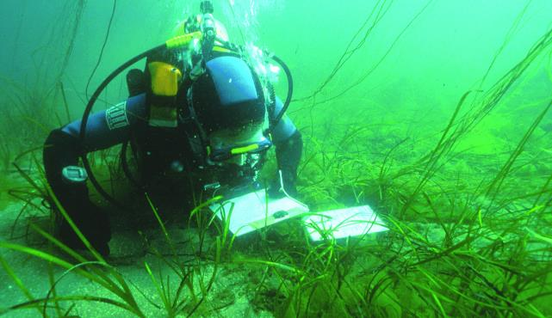
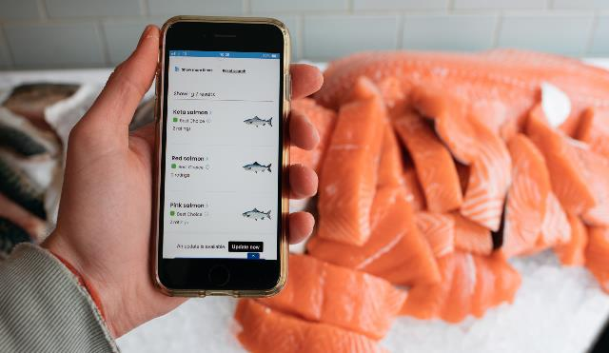
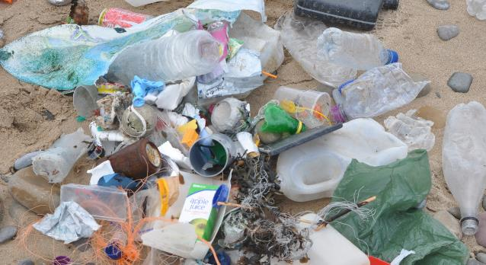
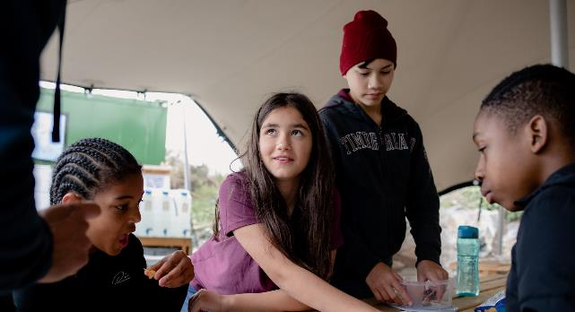
Rewild
Invest
Credit: Sue Scott
Credit: MSC
Educate
Reduce
Credit: MSC
Credit: MSC
Notes:
The ocean can help us make the emissions cuts needed to keep global warming below 1.5 degrees C, if we:
Rewild large swathes of our seabed, for example with seagrass, to protect and restore marine and coastal habitats and marine wildlife populations. Globally, rewilding our waters could deliver carbon dioxide mitigation amounting to billions of tonnes of the emissions savings we need to make.
Invest in developing truly sustainable (or climate and nature positive) fisheries that are less reliant on fossil fuels and don’t overfish or damage the seabed, and, better managed and innovative aquaculture.
Reduce our plastic and chemical footprint, creating cleaner seas, to improve the ocean’s health.
Educate and ensure that everyone understands the crucial role the ocean plays in helping us fight climate change so we can all be much kinder in how we treat it.

Slide 16
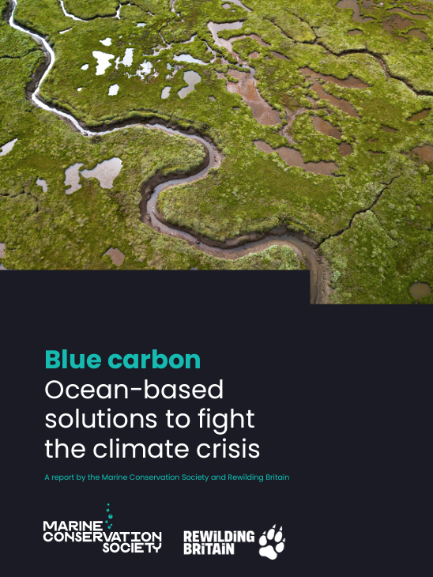
What are we calling for?
Scale up rewilding
Build blue carbon protection into policies and plans
Develop sustainable fisheries & aquaculture.
https://www.mcsuk.org/ocean-emergency/climate-change/blue-carbon/
Credit: MSC
Notes:
The development of a comprehensive Blue Carbon Strategy by the UK Government and devolved administrations, focusing on three key nature-based action areas:
Scaling up marine rewilding for biodiversity and blue carbon benefits.
Integrating blue carbon protection and recovery into climate mitigation and environmental management policies.
Working with the private sector to develop and support sustainable and innovative low-carbon commercial fisheries and aquaculture.
Carbon contained in marine and coastal ecosystems must be considered in the same way as our woodlands and peatbogs… critical to the UK’s carbon strategy.
You can read our recommendations in full in the blue carbon report on the website.
https://www.mcsuk.org/ocean-emergency/climate-change/blue-carbon/

Slide 17
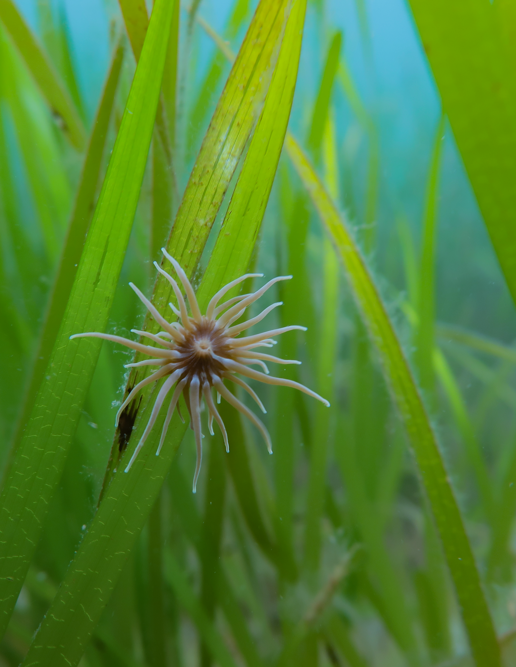
Super seagrass
Flowering plant
Sheltered areas
Very old!
Coastal erosion
Rhizomes
Biodiversity hotspots.
Credit – Georgie Bull
Notes:
At the Marine Conservation Society, we work to restore seagrass in our practical conservation projects
Seagrass is a flowering plant that lives underwater around the UK’s coast in shallow, sheltered areas.
It forms marine meadows which are highly productive ecosystems.
The oldest seagrass meadows are thought to be hundreds of thousands of years old.
Not only does seagrass absorb carbon, but it can reduce the power of waves and reduce coastal erosion.
Seagrass roots (or rhizomes) form a dense mat, that increases the organic enrichment of the sand and muds around the root systems. This is where most of the carbon is stored.
The leaves (fronds) provide vital shelter and food source for molluscs, shrimp, crustaceans, anemones and other invertebrates to thrive in.
The UK’s seagrass meadows are even home to the two species of seahorse - the spiny seahorse and the short snouted seahorse.
They're also breeding grounds for cuttlefish and sharks, and nurseries for cod, plaice and pollock.
So overall, it’s really important for UK biodiversity.

Slide 18
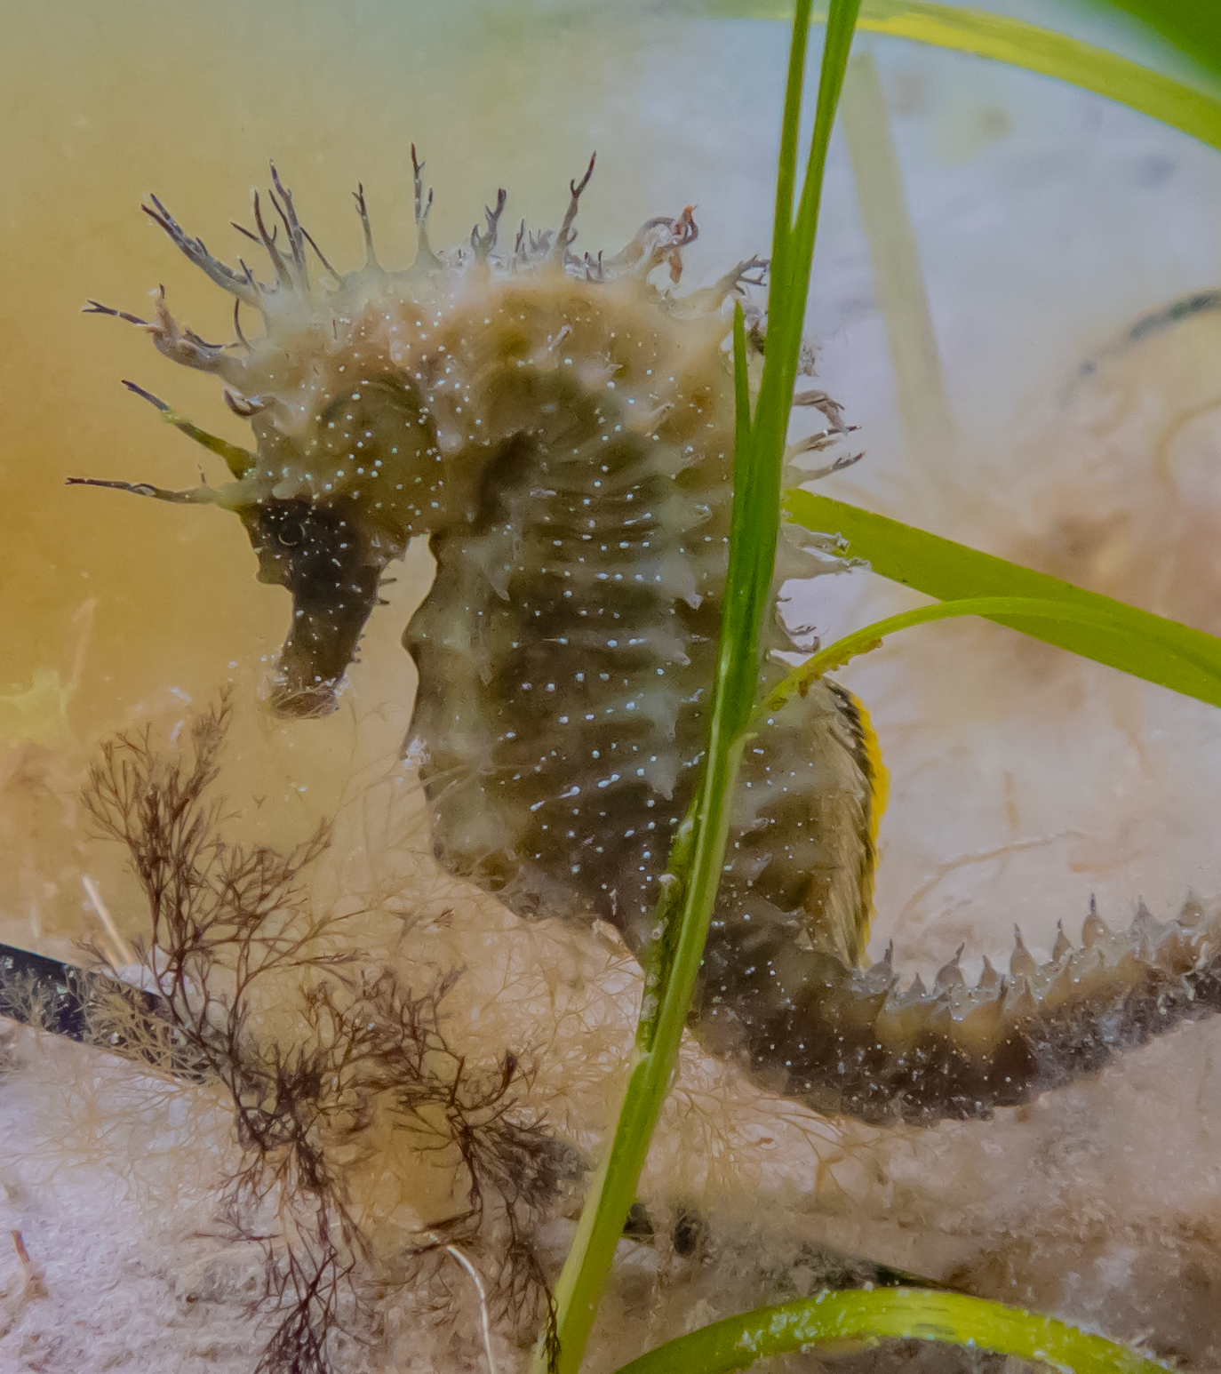
Seagrass decline
Industry
Boats
Storms
Pollution
Recreation
Anchoring / mooring.
Credit – Georgie Bull
Notes:
We now understand that the decline in seagrass has been caused by industrial growth, modification of ports and sheltered harbours, boat traffic, and increasing, stronger storm events.
Pollution within the water column also affects the light getting to the seagrass beds and increases the amount of ‘fouling’ algae on the seagrass strands.
Remaining meadows are damaged by the recreational use of our seas.
Anchoring has been found to rip up seagrass, damaging the grasses and their root systems as the anchors drag along the seabed.
Moored boats also attract boats from outside the harbour which are looking for somewhere safe to anchor; more boats mooring and dropping anchors ultimately causes further damage to the seagrass.

Slide 19

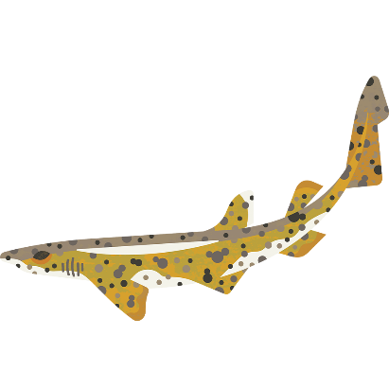
1. Advanced mooring systems
Notes:
Through collaborative projects, the Marine Conservation Society are working to protect, restore and conserve seagrass habitats.
Boating/mooring
Since 2019, we've been working to support the replacement of traditional block-and-chain moorings with sophisticated Advanced Mooring Systems.
Where block and chain systems scrape across the seabed, ripping up seagrass, the advance mooring systems have ‘riser’ chains which are suspended above the seabed using submerged buoys.
An additional benefit is that we’ve used screw piles to secure the riser chain to the seabed rather than the concrete-filled tyres commonly used to hold down moorings.
Already there are signs of seagrass regeneration close to the moorings themselves since installation.

Slide 20


2. Water quality
Notes:
Water quality
The Marine Conservation Society has long been campaigning for significantly improved water quality in our seas.
When waters are polluted there is less light for photosynthesis to take place in marine plants such as seagrass.
Polluted waters also mean an increase in the amount of algae growing on seagrass blades and in the water column – both of which are bad for the health of seagrass.
More needs to be done over combined sewage overflows and farming practices which can leach nitrogen, pesticides and other chemicals into our rivers and ultimately into our coastal waters.

Slide 21
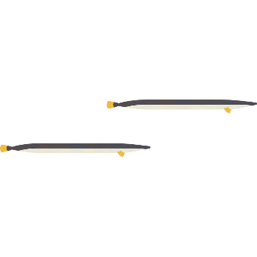
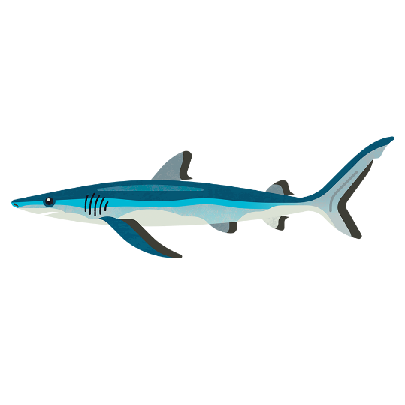
3. Fishing methods
Notes:
Fishing
Since 2009, we've been working to get damaging fishing (trawling, scallop dredging) out of seagrass beds in English Marine Protected Areas (MPAs).
In 2014 we were successful in getting regulators, like the local inshore fishing authorities, to protect all English seagrass beds in MPAs.
Trawlers and dredgers sometimes ‘cleaned their gear’ by towing it through seagrass – thankfully that is now illegal.
However, there is still an issue with recreational fishers digging out bait from muds and intertidal seagrass beds in places such as Essex and the Solent.
It’s essential that this sort of activity is stopped through the use of measures like no access zones, voluntary codes, and information to fishers.

Slide 22
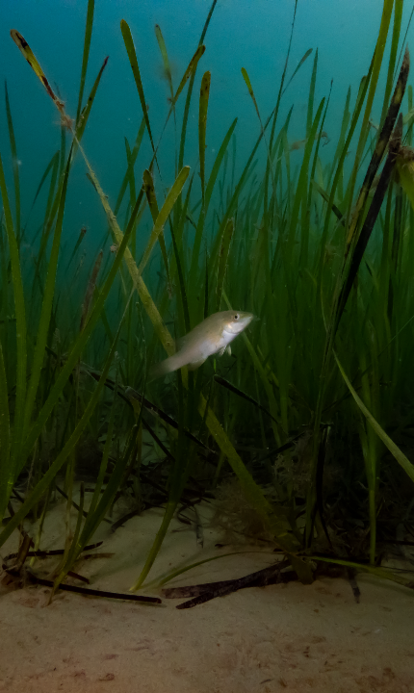
Image Credit – Georgie Bull
Restoration Forth
Restoring 40,000 European flat oysters and four hectares of seagrass.
  Local community → restoration champions
  Expert partners → ensure legacy
Why oysters?
Notes:
I’d also like to take this chance to tell you about one of our current flagship projects, Restoration Forth!
In the Firth of Forth, an area the size of modern Edinburgh was once covered by European flat oyster beds, but by the early 1900s, they were all fished out. Together with our partners, Heriot-Watt University, and the local community, we’re working to restore European flat oysters, and seagrass, in the area.
Restoration Forth is a community-inspired marine restoration project that has reintroduced 40,000 European flat oysters and will restore four hectares of seagrass to the Firth of Forth, Scotland.
The vision of the project is for communities to become the local restoration champions and experts, to ensure further restoration is an ongoing legacy of the project.
Oysters enhance biodiversity and create nursery habitats, they can improve water quality by filtering up to 200 litres of water a day, and contribute to the stabilisation of carbon in the marine environment.

Slide 23
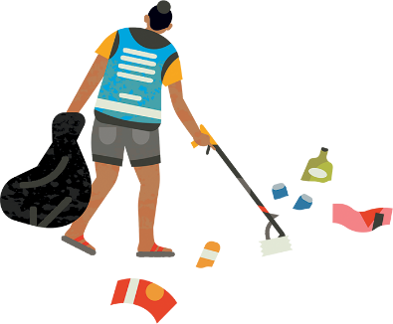
How can I get involved?
Notes:
We hope that by this point, you might be thinking, how I can get involved with the work of MCS?
The next few slides cover the various ways that you can support us…

Slide 24
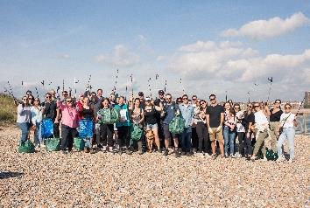
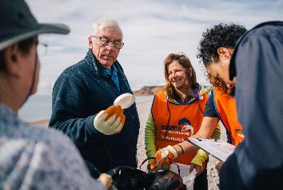
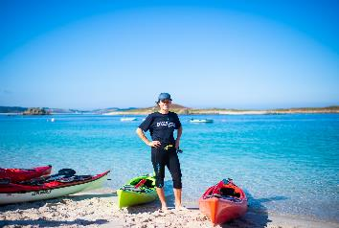

Credit: Billy Barraclough
Credit: Andrew J Brown
Credit: Rhian White
Join
Donate
Fundraise
Notes:
Financial support
Join: By becoming a member you'll support our vital work to protect and restore our ocean. You can choose how much would you’d like your monthly membership to be.
Donate: Your support is vital to help us work for a cleaner, better-protected, healthier ocean: one we can all enjoy.
Fundraise: From organising your own fundraising event to taking on a challenge, there are many ways you can raise money and help fight for the future of our ocean.

Slide 25
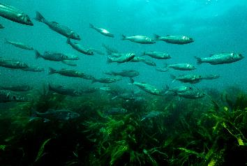
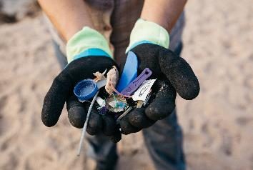
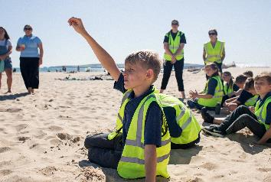
Credit: MSC
Credit: Billy Barraclough
Credit: Billy Barraclough
Choose sustainable seafood
Reduce your plastic footprint
Fun and learning
Notes:
Sustainable seafood: The fish that we eat impacts the health of our ocean and marine life that call it home. Our Good Fish Guide helps you to make informed choices about the seafood on your plate, using a simple traffic light system - Red means Fish to Avoid and Green is a Good Choice.
The GFG can be added as an app to your phone, making it easier to check when you’re at the shops.
Reduce your plastic footprint: 14 million tonnes of plastic end up in our oceans every year, harming our ocean and precious marine life. On our website there’s advice on lots of simple steps you can take to make a big difference and help stop plastic waste.
Fun and learning: Explore our amazing ocean in school or at home with resources for teachers, families and young people available on the MCS website.
Link to share - https://www.mcsuk.org/ocean-emergency/sustainable-seafood/the-good-fish-guide/add-the-good-fish-guide-to-your-phone/

Slide 26
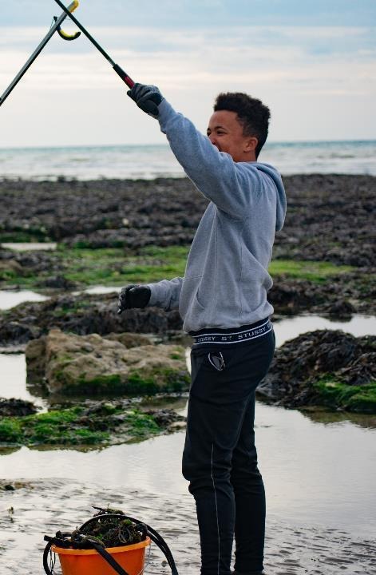
Image Credit – Jack Donavan
Be a Sea Champion
Our Sea Champion volunteers are at the heart of what we do. They give their time and help to achieve our ocean goals
Notes:
Volunteer
Our Sea Champion volunteers are at the heart of what we do.
They help by giving their time, taking part in activities or championing our cause in their local communities.
Sea Champions help by getting more people actively involved in our citizen science, volunteering and campaign work.
We provide training where you can learn new skills, as well as opportunities to meet people at events and online. You'll become part of a growing community who feel proud to be doing their bit for our seas.

Slide 27
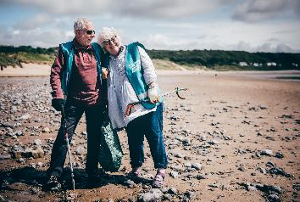
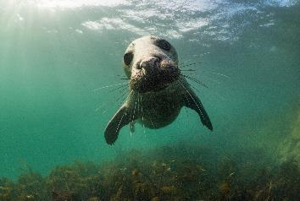
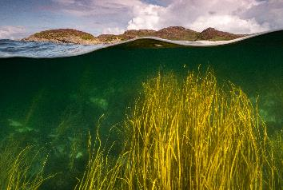
Credit: Aled Llwelyn
Credit: Mark Kirkland
Credit: Mark Kirkland
Beachwatch and Source2Sea
Join a litter clean and survey.
Ocean Voice
Speak up for our ocean.
Citizen Science
Big Seaweed Search
Wildlife sightings
Microplastic surveys
Seasearch
Notes:
Some examples of how you can get involved...
Become a Beachwatch volunteer and join one of our beach clean surveys or look for Source2Sea litter survey if you’re not near to the coast.
Speak up for the Ocean in your local community by taking on one of our Ocean Voice opportunities, as a community presenter offering local talks or representing us in local media.
Get involved as a citizen scientist: This is very flexible – you can do as little or as much as you like, while gathering impactful data for research and policy work. For example.. Big Seaweed Search: This programme helps monitor the impacts of climate change on our marine environment using our online Seaweed ID & survey guide
Visit our website https://www.mcsuk.org/what-you-can-do/volunteering/ to find out more.

Slide 28
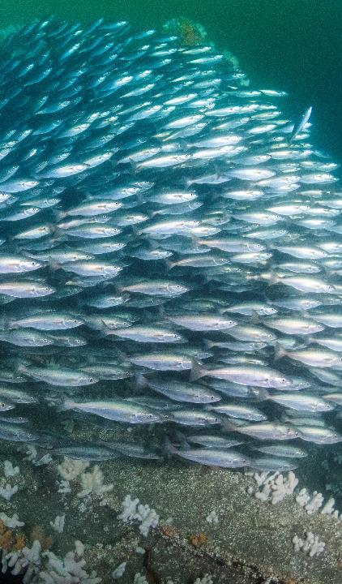





Follow us
Follow us on social media.
Sign up for emails on our website
www.mcsuk.org
Credit: Kirsty Andrews
Notes:
Follow us on social media and sign up for emails on our website to get inspiring stories about the work we're doing to save and recover our oceans, and news about our urgent campaigns for positive change.

Slide 29
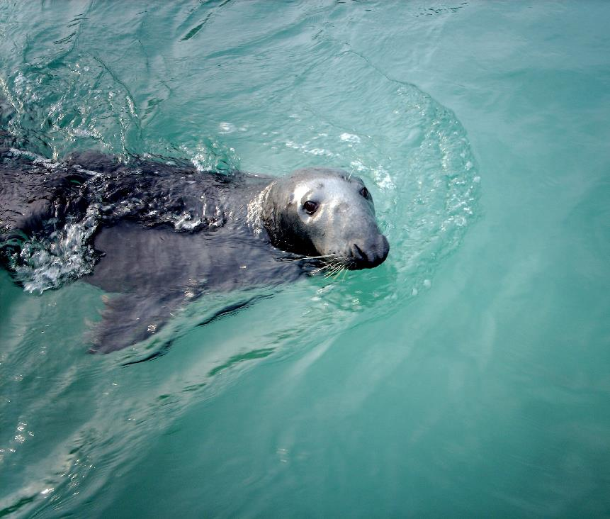
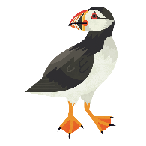

For more information about how to get involved visit:
www.mcsuk.org
Thank you!

