Slide 1
Beach litter
Unfortunately we find a lot of litter on our beaches.
What litter can you see in this picture? How many pieces of litter do you think are on the beach?
There are at least 7,000 miles of coastline in the UK. How much litter do you think is on the UK’s beaches?
© Natasha Ewins
Notes:
So lets have a look at some photos to help show what we’ve been discussing. Can you see the litter in this photo? (point out the colourful litter in all of the rocky area). We unfortunately find lots of litter on our beaches……
(1 minute on this slide)

Slide 2
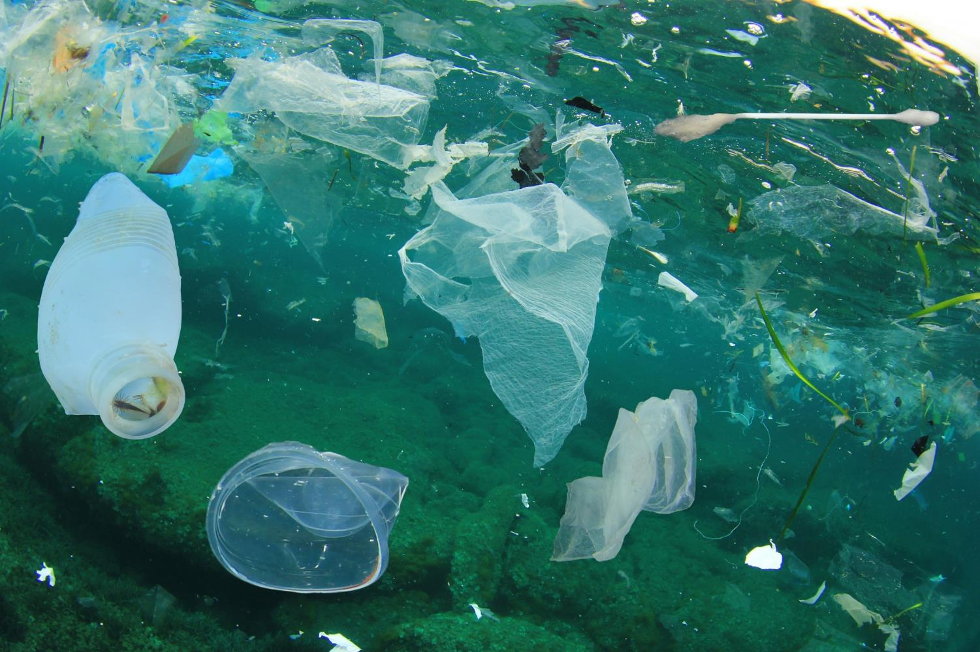
Polluted waters
A lot of the ocean is polluted.
What litter can you see in this picture? What pollution might not be visible?
© Rich Carey via Shutterstock
Notes:
……..and in the ocean to.
What litter can you see in this photo? (take a few suggestions makes sure bottle, cup, plastic bag and cotton ear bud are all pointed out)
(1 minute on this slide)

