Slide 1

Ecosystem Services

Slide 2
Learning Objectives
Describe what the term ‘ecosystem services’ means.
Give examples of services provided by the ocean and categorise these.
Create an infographic to educate and inform others about the value of ecosystem services.

Slide 3
Set the scene
Key Terms
Notes:
Set the scene
Start by defining the term ‘ecosystem.’ A definition is given on the next slide.

Slide 4

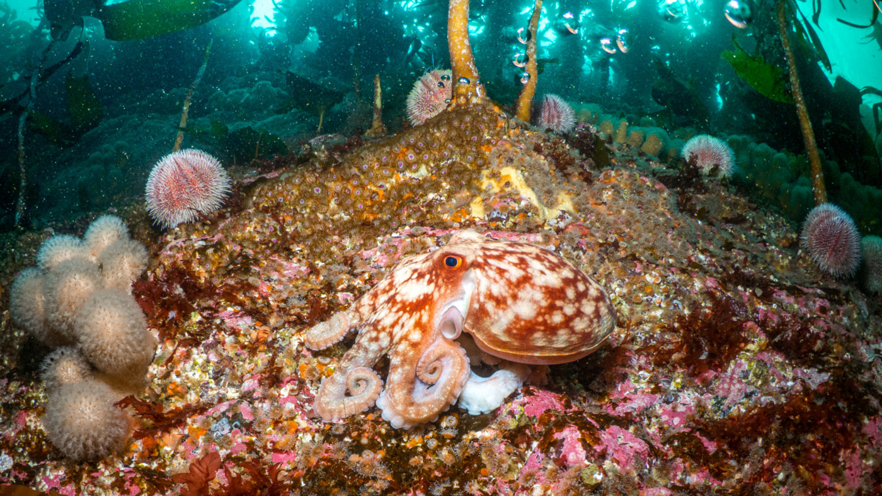
What is an ecosystem?
© Mark Kirkland
Notes:
Question to students – Does anyone know what an ecosystem is?
An ecosystem is a natural environment in which plants and animals interact and interconnect. Ecosystems are influenced by biotic factors, for example, the plants and animals living there, and by abiotic factors, including climate, sediment and water. The term ‘ecosystem’ is used broadly to describe these interactions between biotic and abiotic factors in an environment. For example, an ecosystem could refer to both a small pond and the ocean. An ecosystem refers to a habitat and its community of plants and animals.

Slide 5
Activity 1
Ecosystem Services
Notes:
Activity 1 - What are ecosystem services?
Watch the video on ecosystem services. While watching the video, students should complete the associated ecosystem services worksheet. By the end of the video, students should be able to define: indirect services, direct services, and ethical and aesthetic services.

Slide 6
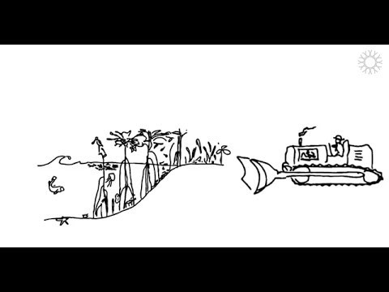
What are ecosystem services?
Notes:
Click the image to play the video – you may need to double click.

Slide 7
Activity 2
Ecosystem Cards
Notes:
Activity 2 - Examples of the indirect, direct and ethical services
Part 1 – Split the class into small groups of 2-3 and hand out ecosystem cards to each group. Students should read through the cards and then create a mind map of the indirect services, direct services, aesthetic and ethical services all these ecosystems provide. They could also add to the mind map with knowledge gained from watching the video in Activity 1 and any of their own ideas. For example, for direct services they could say seagrass beds are nurse habitats for commercial fish. For ethical services, they could say beaches provide recreational activities.
Part 2 - Once students have had time to draft their ideas, discuss each service as a class and create a large mind map for direct, indirect and aesthetic services on your whiteboard, using slides 13-15, incorporating students’ ideas and adding any services that may have been missed using information provided in the Ecosystem Services Fact File.

Slide 8

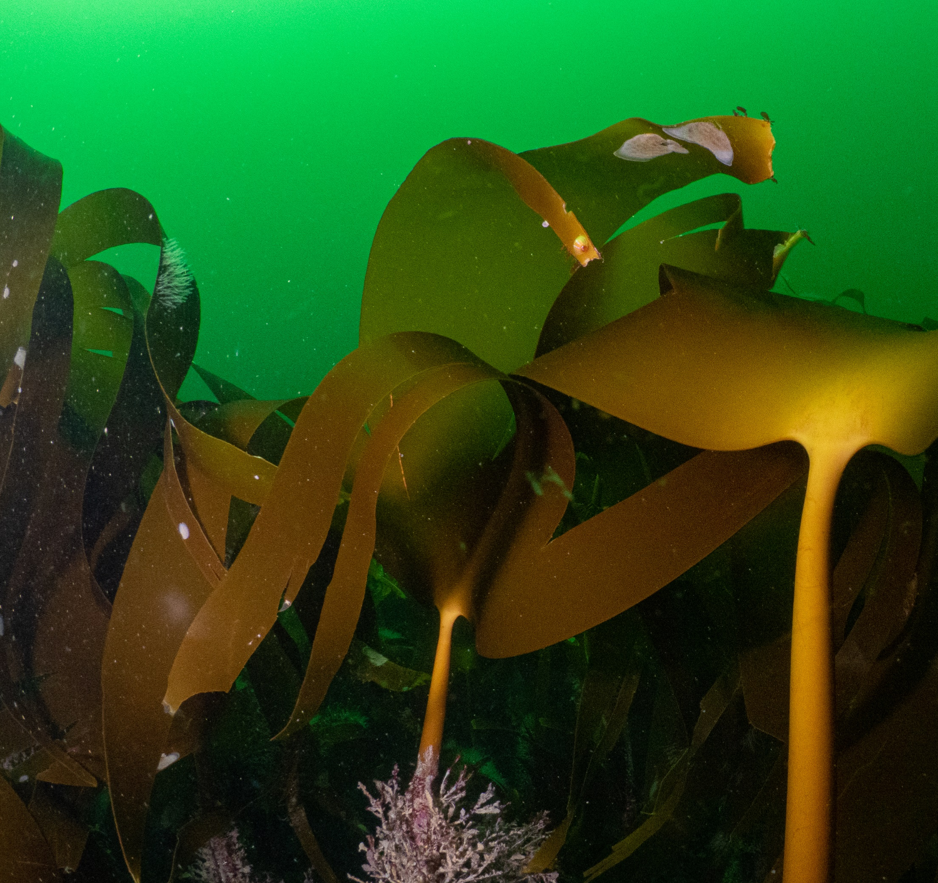
Kelp
Kelp are a type of brown seaweed which are often mistaken for plants, but are actually algae.
As algae they photosynthesise, and through this they produce oxygen.
Through photosynthesis they also absorb carbon dioxide.
The structure of the kelp forms a kind of underwater forest, creating a great habitat for many species to shelter.
This shelter provides a nursery for juvenile fish, including commercially-important species such as cod, pollock and haddock.
Kelp beds can help to reduce wave energy along the coast.

Slide 9
Seagrass
Seagrass is found in calm, shallow, sunlit coastal waters around the world.
It is the only flowering plant in the ocean. Seagrass therefore produces oxygen through photosynthesis.
Seagrass also absorbs and stores carbon dioxide. Seagrass can capture carbon up to 35 times faster than tropical rainforests.
Globally, seagrass meadows are known for their value as fish nurseries for many important species, including flatfish and cuttlefish.
Seagrass meadows are also home to many bivalves, worms, starfish and to rare stalked jellyfish.

Slide 10
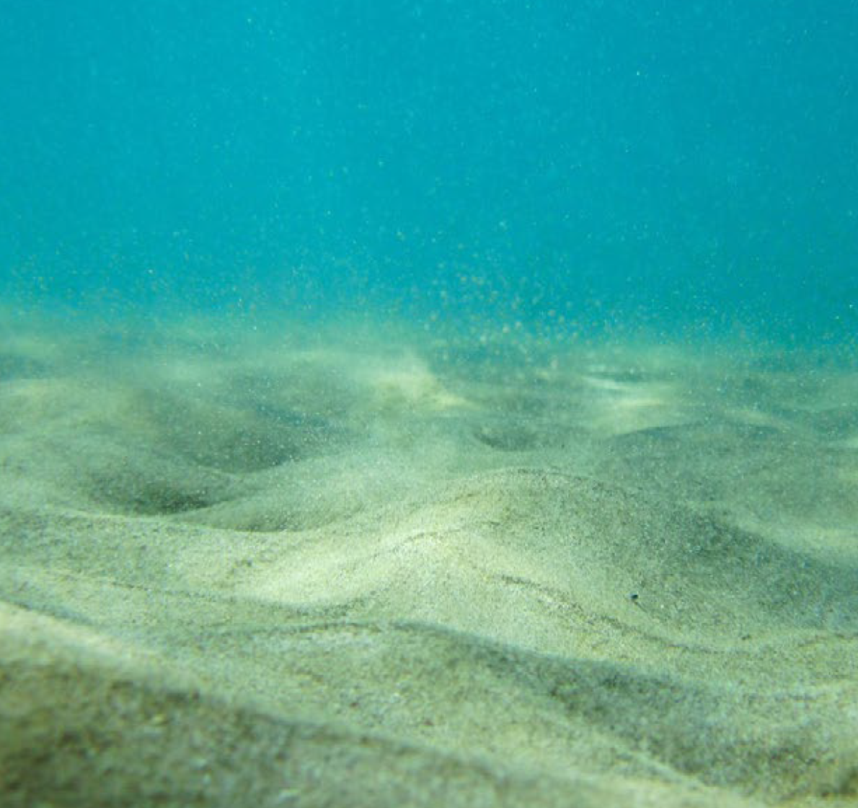
Seabed
It may at first glance look barren, but these areas are home to a large variety of animals including sand eels, rays, sea cucumbers, burrowing urchins, starfish, bivalves and many species of fish and crustaceans like shrimp, prawns and crabs.
Many fish use these areas to hide their eggs in burrows in the seabed.
The ocean provides us with many valuable resources including oil, gas and minerals.
Gravel is extracted from the seabed for use in construction – each year in the UK, around 20 million tonnes of marine sediments are removed.

Slide 11
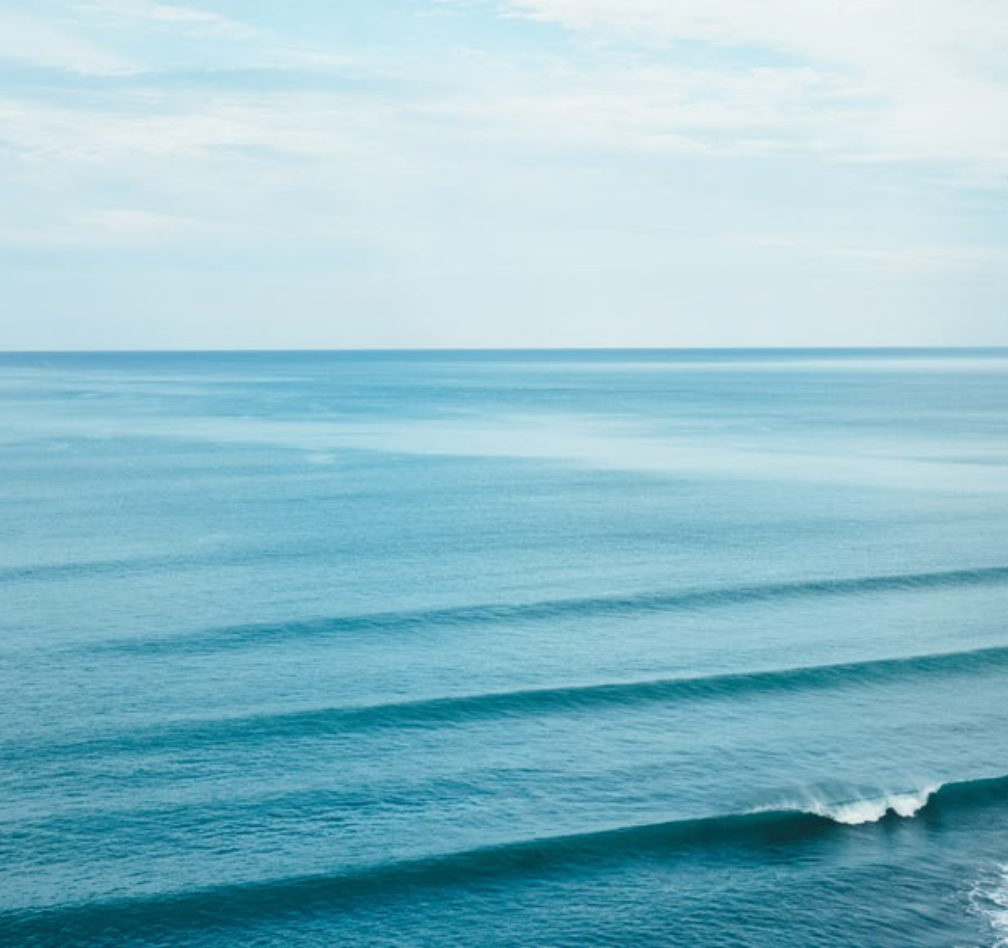
Coastal seas
The ocean is home to a huge variety of animals, from tiny microscopic plankton to huge whales.
Ours seas provide seafood to millions of people and fishing is an important economic industry.
We use the power of the sea to harvest wave and tidal energy, and the large expanse
creates wind and a great place wind turbines.
Ocean currents transport cold water from
the poles and warm water from the tropics.
This mixing of sea temperatures helps to regulate the climate.
The ocean holds 97% of the world’s water and plays a major role in the water cycle.
People enjoy spending time on or near the ocean.

Slide 12
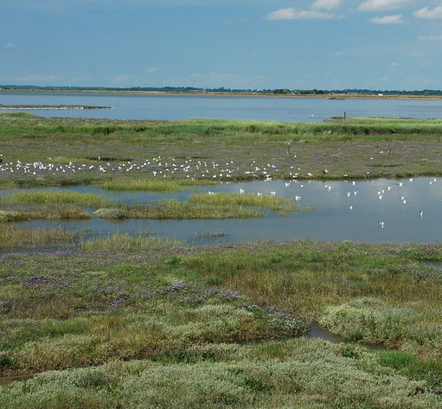
Saltmarsh
The mud in saltmarshes make them a great habitat for worms and borrowing shells, and
this means saltmarshes are also a great
place for birds to feed in.
The plants in saltmarsh habitats produce oxygen and store carbon dioxide through photosynthesis.
Saltmarshes protect our coast from floods
and waves. The structure helps reduce wave energy and the roots of the plants help to stabilise the sediment.
Healthy saltmarshes have the ability to
reduce pollution entering the ocean by filtering nutrients and chemicals coming off the land, but too much pollution will damage these habitats.

Slide 13
Direct services
© Mark Kirkland
Notes:
Activity 2
Part 2 - Once students have had time to draft their ideas, discuss each service as a class and create a large mind map for direct, indirect and aesthetic services on your whiteboard, incorporating students’ ideas and adding any services that may have been missed using information provided in the Fact File.

Slide 14
Indirect services
© Mark Kirkland
Notes:
Activity 2
Part 2 - Once students have had time to draft their ideas, discuss each service as a class and create a large mind map for direct, indirect and aesthetic services on your whiteboard, incorporating students’ ideas and adding any services that may have been missed using information provided in the Fact File.

Slide 15
Aesthetic and ethical services
© Mark Kirkland
Notes:
Activity 2
Part 2 - Once students have had time to draft their ideas, discuss each service as a class and create a large mind map for direct, indirect and aesthetic services on your whiteboard, incorporating students’ ideas and adding any services that may have been missed using information provided in the Fact File.

Slide 16
Activity 3
Ecosystem Infographic
Notes:
Activity 3 - Creating an ecosystems infographic
Display the oyster infographic on the next slide. Go through the infographic together, which shows how oysters are a key species that provide many ecosystem services including water filtration and habitat formation.
Students should use the infographic as inspiration for creating their own. Their infographic should showcase one of the habitats featured in the ecosystem cards, and it should highlight any indirect, direct or cultural ecosystem services of this habitat. To further enhance and provide facts to their infographics, students could also research their chosen habitat online.
Students could work independently or in small groups of 2-3. The website below has lots of infographic templates students could either directly use or use as inspiration:
Recommended website: https://www.canva.com/design/play?category=tACFahzNhT4&locale=en-GB

Slide 17
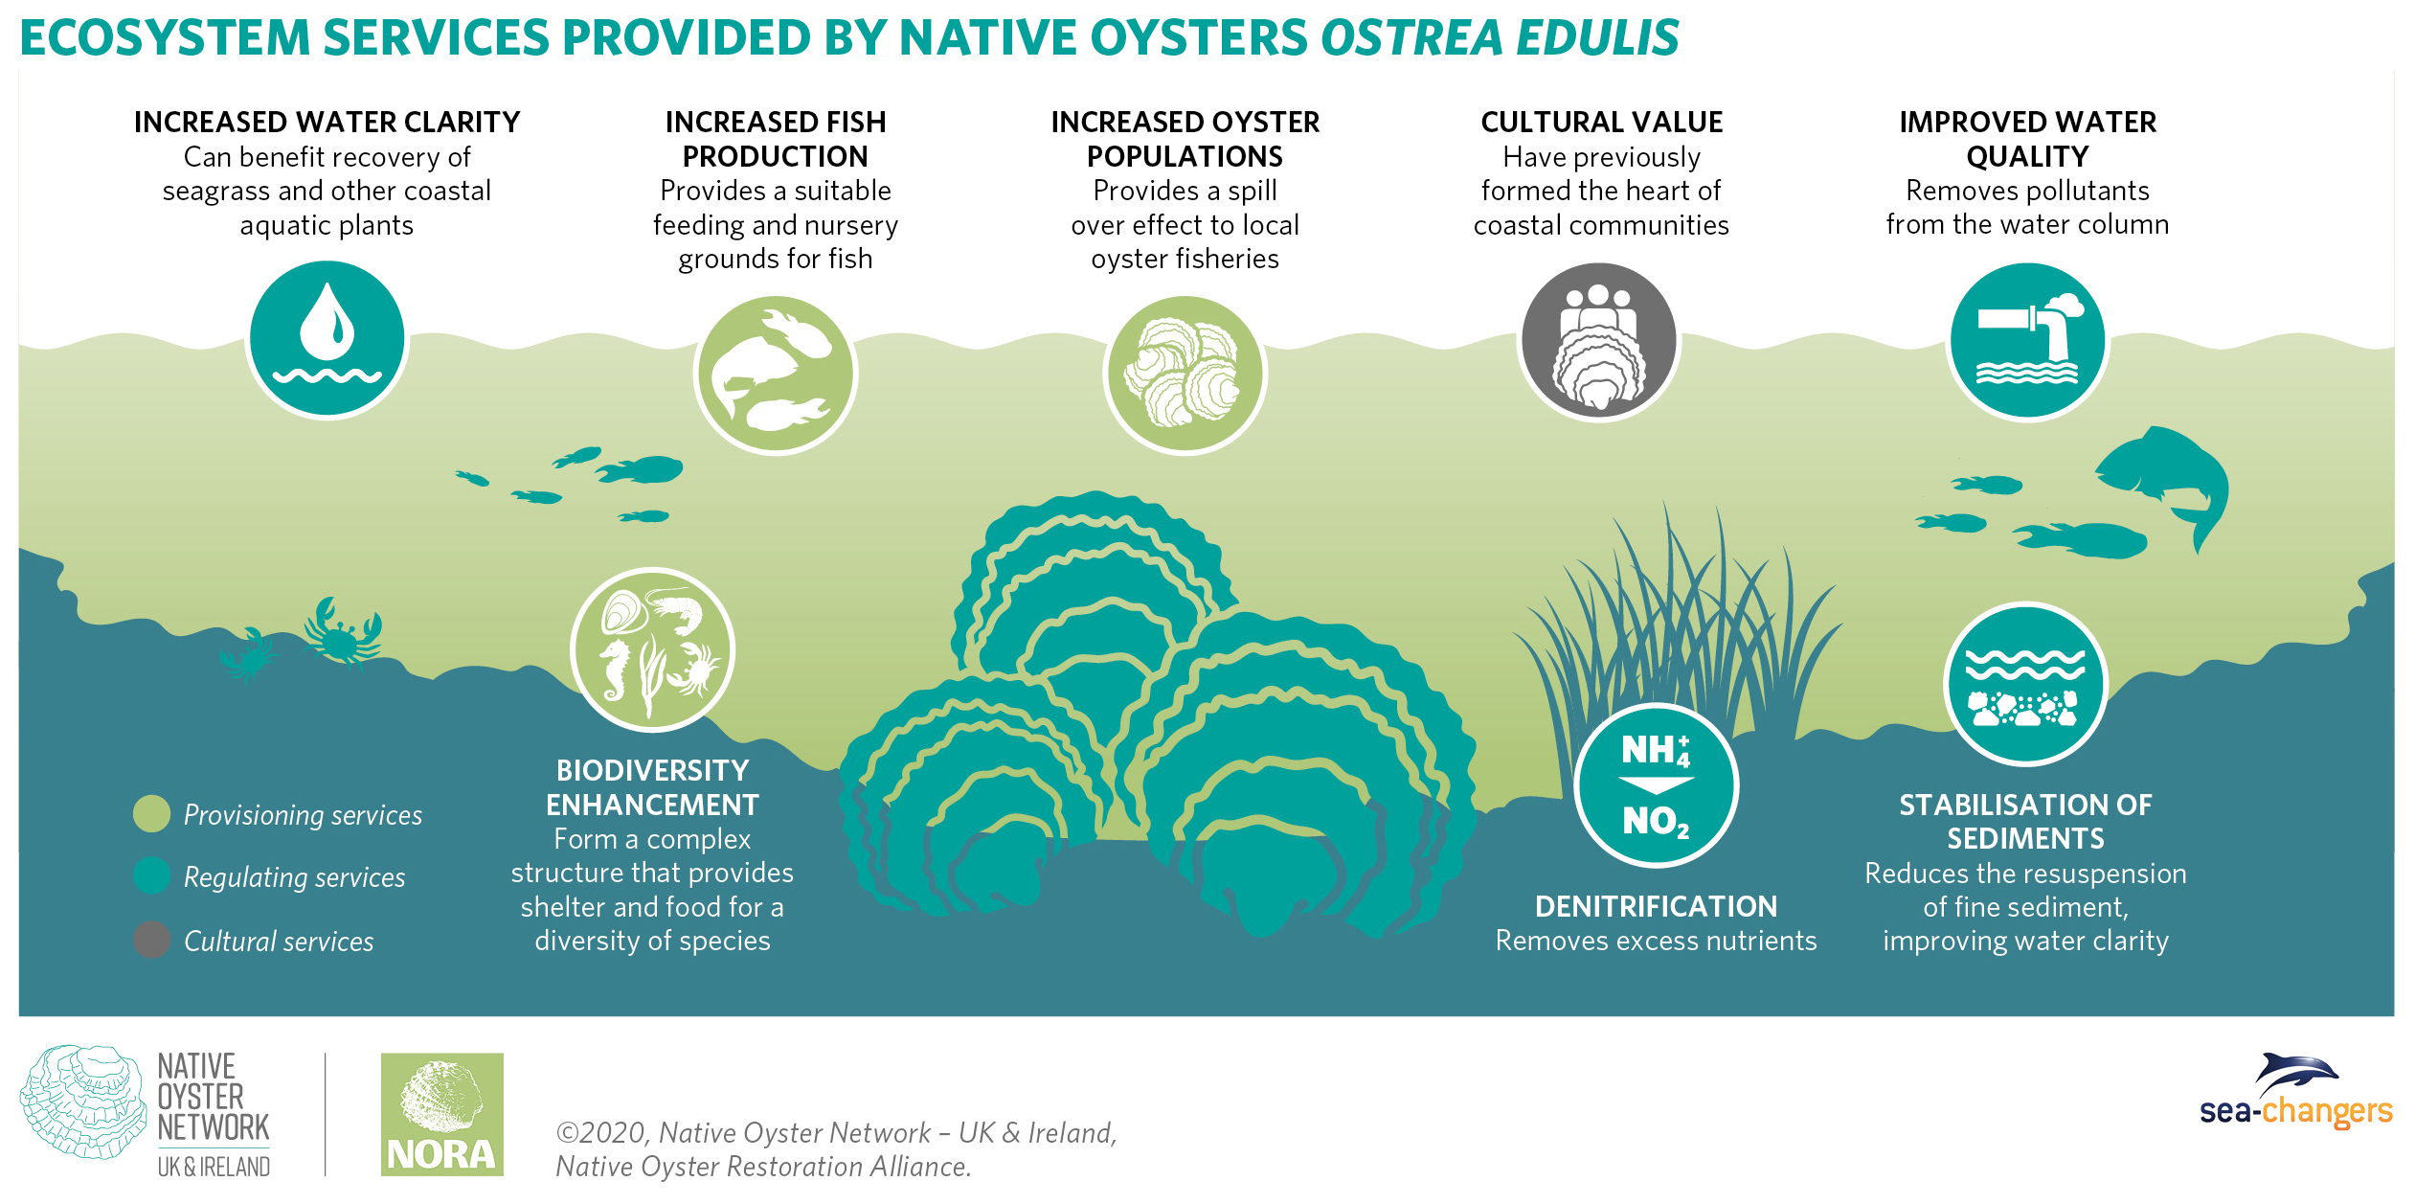
© Mark Kirkland
Notes:
Recommended website: https://www.canva.com/design/play?category=tACFahzNhT4&locale=en-GB

Slide 18
Extension activity
Marine Economy
Notes:
Extension activity – Marine Economy
Students should analyse and interpret data provided in the following Marine Economy of the UK table. Students could create a visual representation of the total outputs for each broad economy sector.

Slide 19
© Mark Kirkland

Slide 20
Extension Activity
30x30 Biodiversity Strategy
Notes:
Extension activity – 30x30 Biodiversity strategy
The ‘Bringing nature back into our lives’ fact sheet summaries the European commission’s biodiversity strategy to increase protection of ecosystems both on land and in the sea to 30% by 2030. Students could use facts and figures in the fact sheet, along with knowledge gained in this lesson, to write a newspaper-style article about the biodiversity strategy, promoting the campaign for 30x30 and discussing why protecting ecosystems and their services is so important. Students could also add to the article by analysing the information in the following slide.

Slide 21
© Mark Kirkland

Slide 22
Extension activity
Mapping Ecosystem Services
Notes:
Mapping ecosystem services activity
The series of maps on the following slides are taken from the Welsh National Marine Plan 2015–2020.
If you have access to a laptop, students could explore the interactive mapping tool on the Welsh Marine Planning Portal http://lle.gov.wales/apps/marineportal/#lat=52.5129&lon=-3.9139&z=8&tgt=false&layers=231,390
For maps along the English coast use: https://explore-marine-plans.marineservices.org.uk/
For maps along the Scottish coast use: https://marinescotland.atkinsgeospatial.com/nmpi/

Slide 23
© Mark Kirkland

Slide 24
© Mark Kirkland

Slide 25
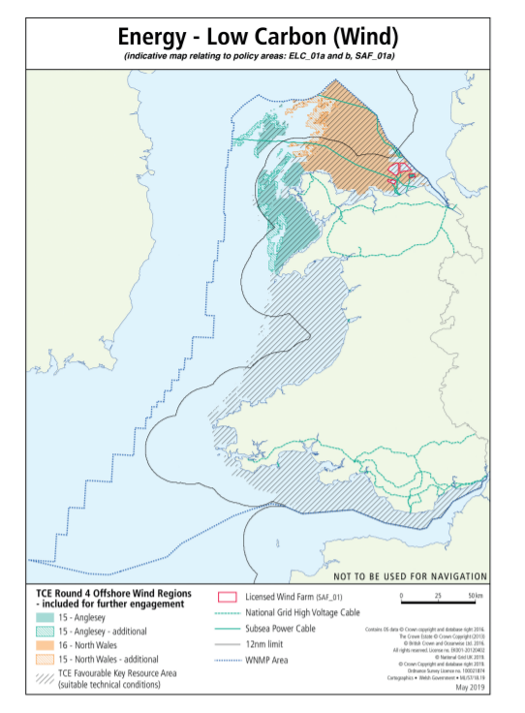
© Mark Kirkland

Slide 26
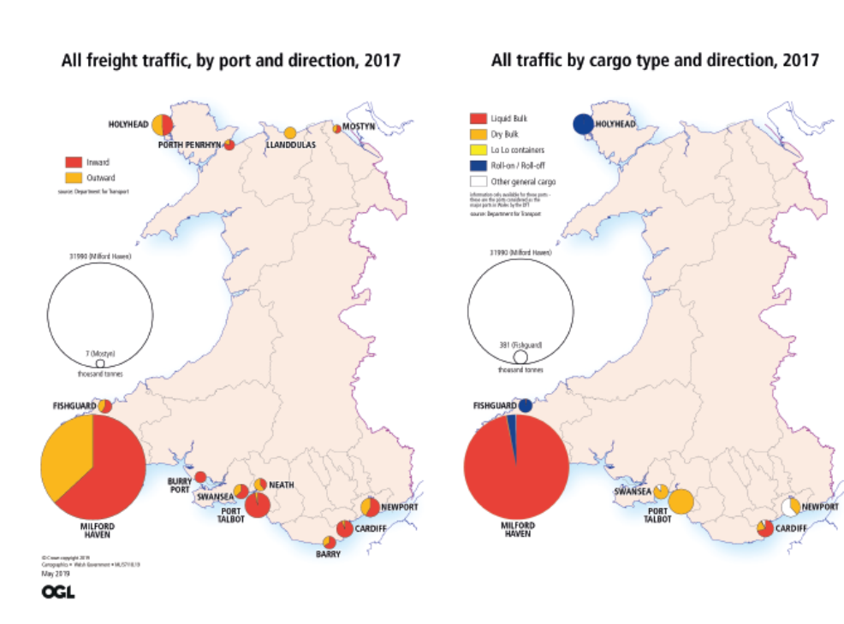
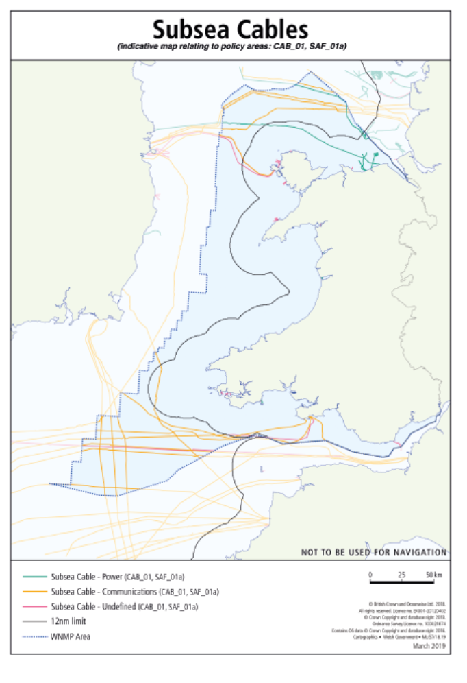
© Mark Kirkland

Slide 27
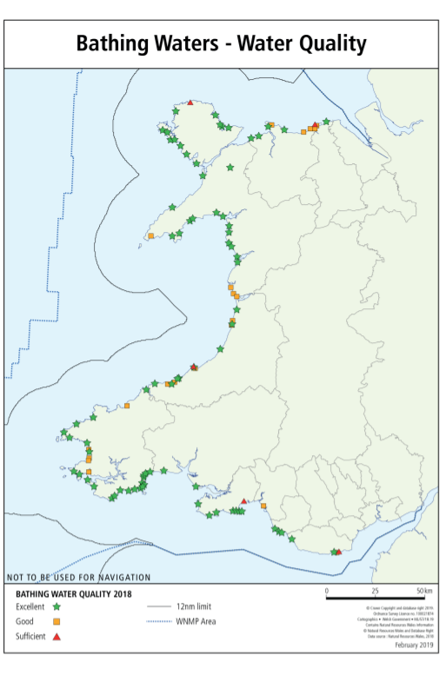
© Mark Kirkland

Slide 28
© Mark Kirkland

Slide 29
© Mark Kirkland

Slide 30
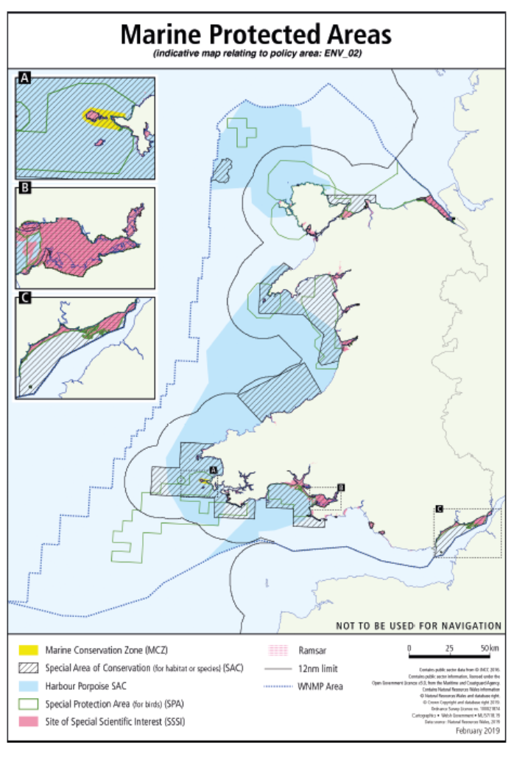
© Mark Kirkland

Slide 31
Reflect
What have you learnt?

Slide 32
Learning Objectives
Can you describe what the term ‘ecosystem services’ means?
Can you give examples of indirect, direct and aesthetic services provided by the ocean?
Why are infographics an important tool in
science communication?
Notes:
Can you describe what the term ‘ecosystem services’ means?
Can you give an example of an indirect, direct and aesthetic service provided by the ocean?
Why are infographics an important tool in science communication?

Slide 33
We will continue to fight for the ocean
and protect wildlife

