Slide 1

Threats to the ocean

Slide 2
Learning Objectives
Be able to explain key threats to the ocean and how these have environmental, economic and social consequences.
Work in groups to identify how stakeholders can work collaboratively to achieve ecosystem based management.
Be able to argue for and against Marine Protected Areas in the ocean through the views of a key stakeholder.

Slide 3
Set the scene
Why is the ocean important?
Notes:
To set the scene, introduce the importance of the ocean by watching the following video, What did the ocean ever do for us?, and discuss some of the ways in which the ocean is vitally important.

Slide 4

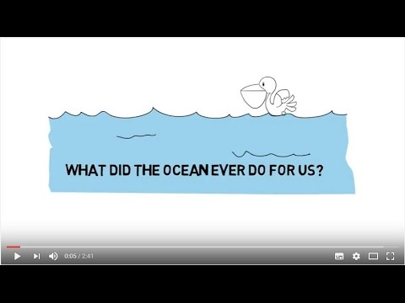
What did the ocean ever do for us?
© Mark Kirkland
Notes:
Click the image to play the video – you may need to double click.

Slide 5
Activity 1
What are the main threats
to the ocean?
Notes:
Activity 1 – What are the main threats to the ocean?
Use the following slides to highlight some of the key threats – notes are provided for each slide to aid you.
For each threat, discuss as a class how the threat will affect the ocean environmentally, as well as how communities and industries who rely on the ocean will be affected economically and socially. Create a table on the whiteboard with column headings for environment, economy and society and fill this out as you work your way through the slides. This will help to highlight how threats to the ocean don’t just harm the environment but have many knock on effects.

Slide 6
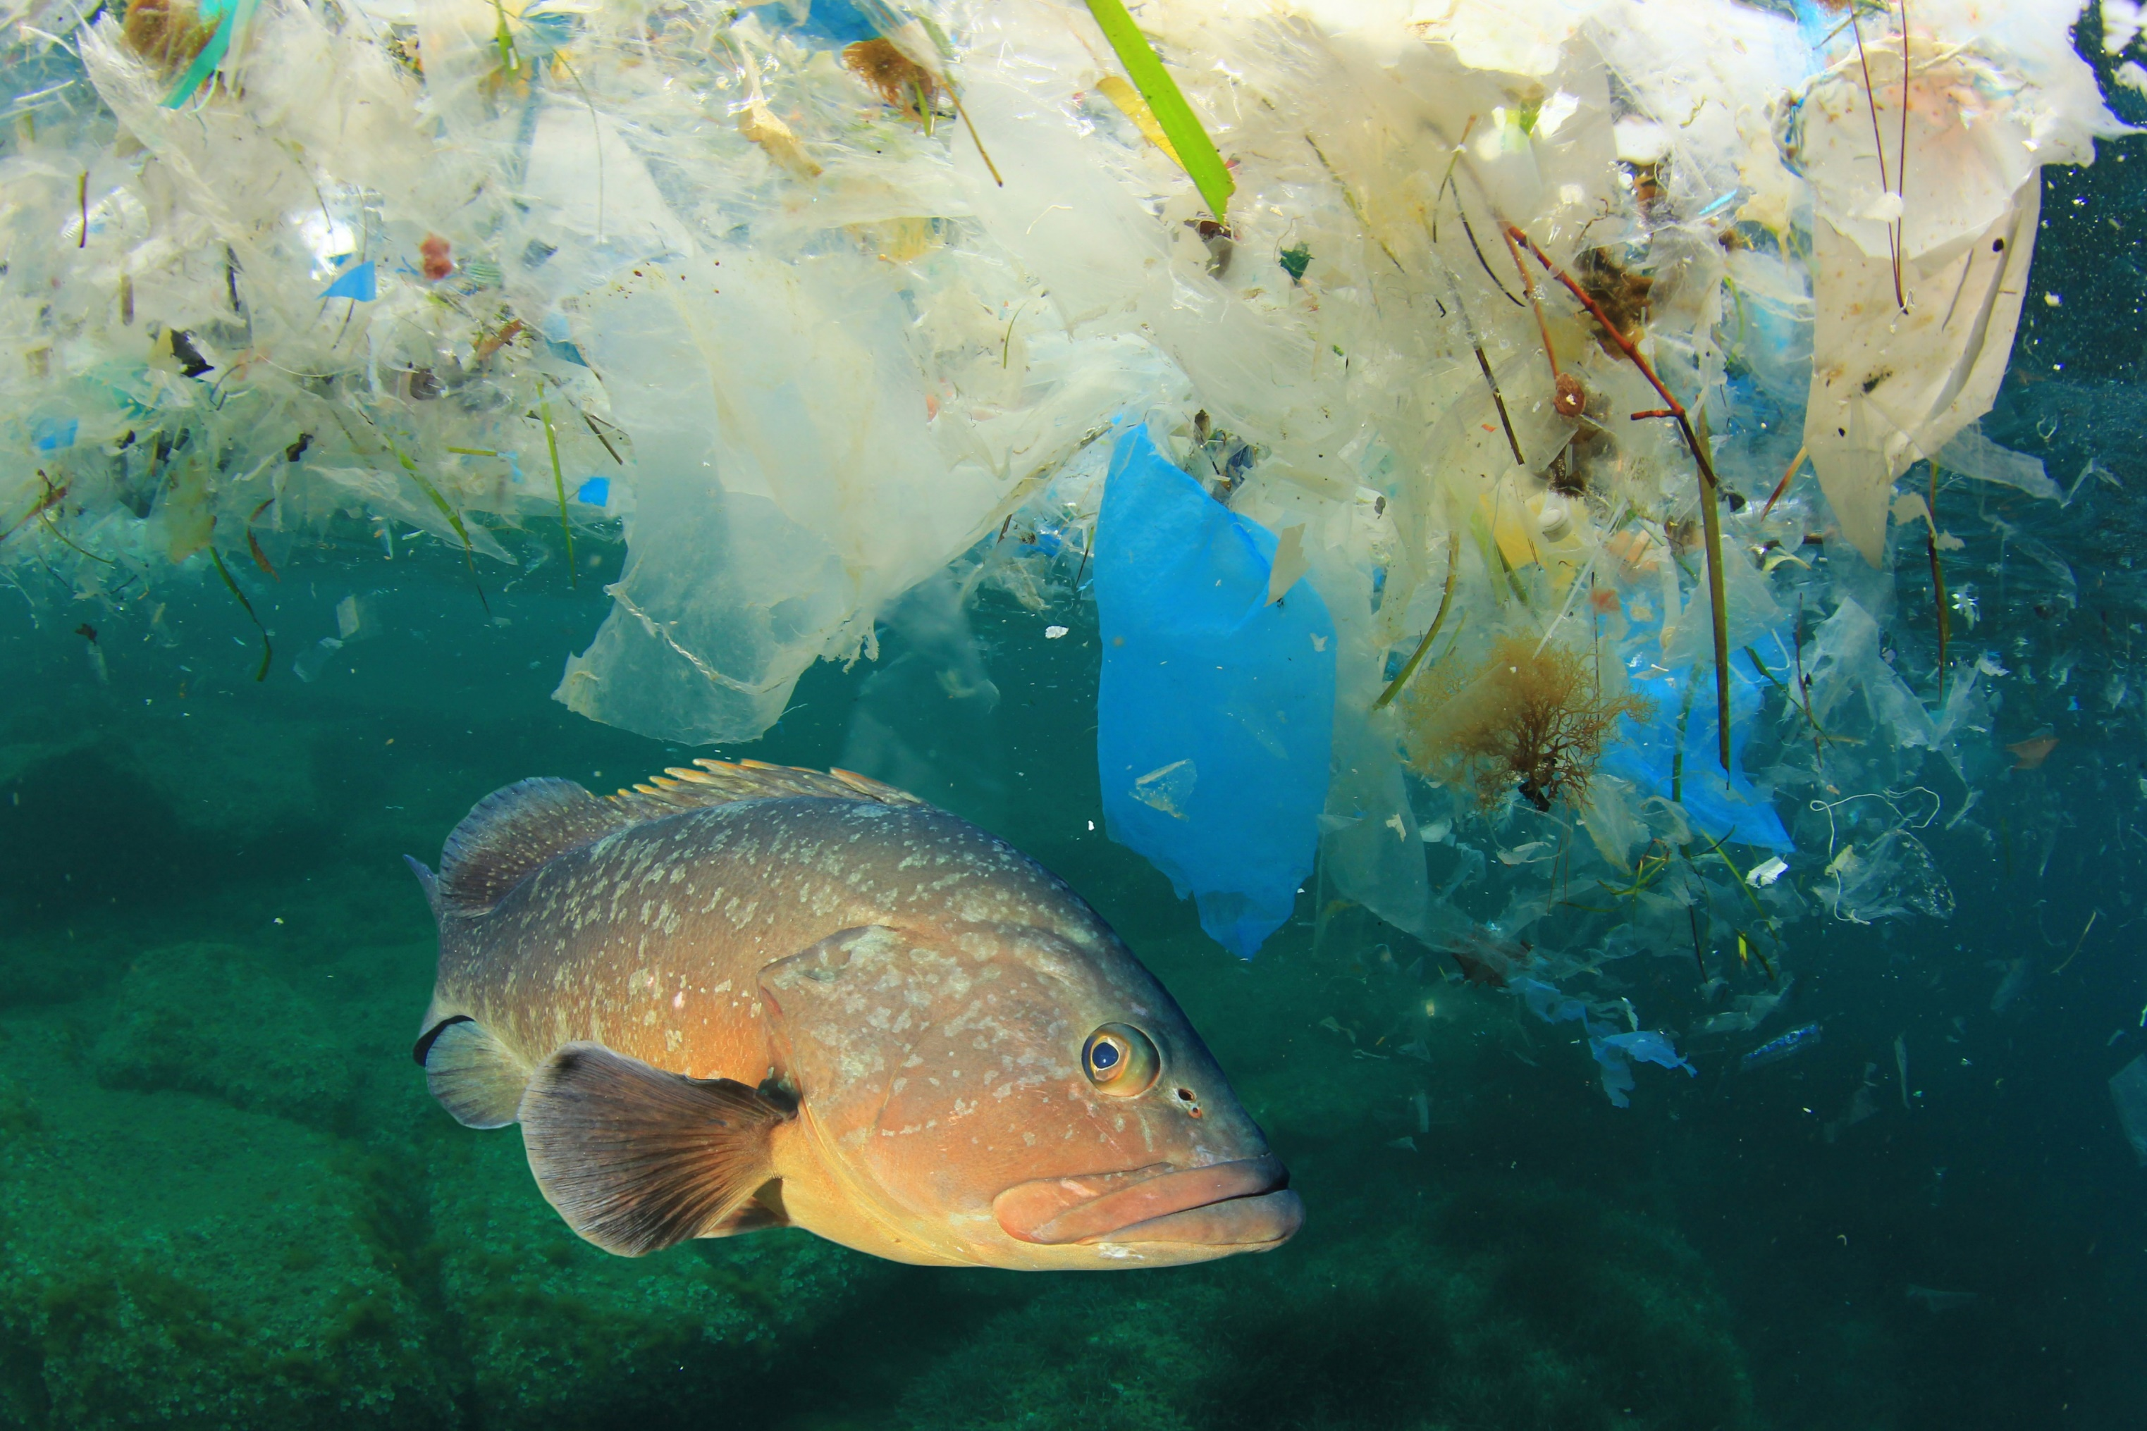
Marine litter
Direct Services
© Rich Carey, Shutterstock
© Mark Kirkland
Notes:
60-90% of marine litter is made of plastic items, which can take hundreds of years to break up.
Litter items can cause harm to all sorts of marine life.
Animals can become entangled in litter, causing injury, reduced mobility and even death.
Ingestion of litter, particularly plastic, is very problematic for marine life who are unable to digest it.

Slide 7
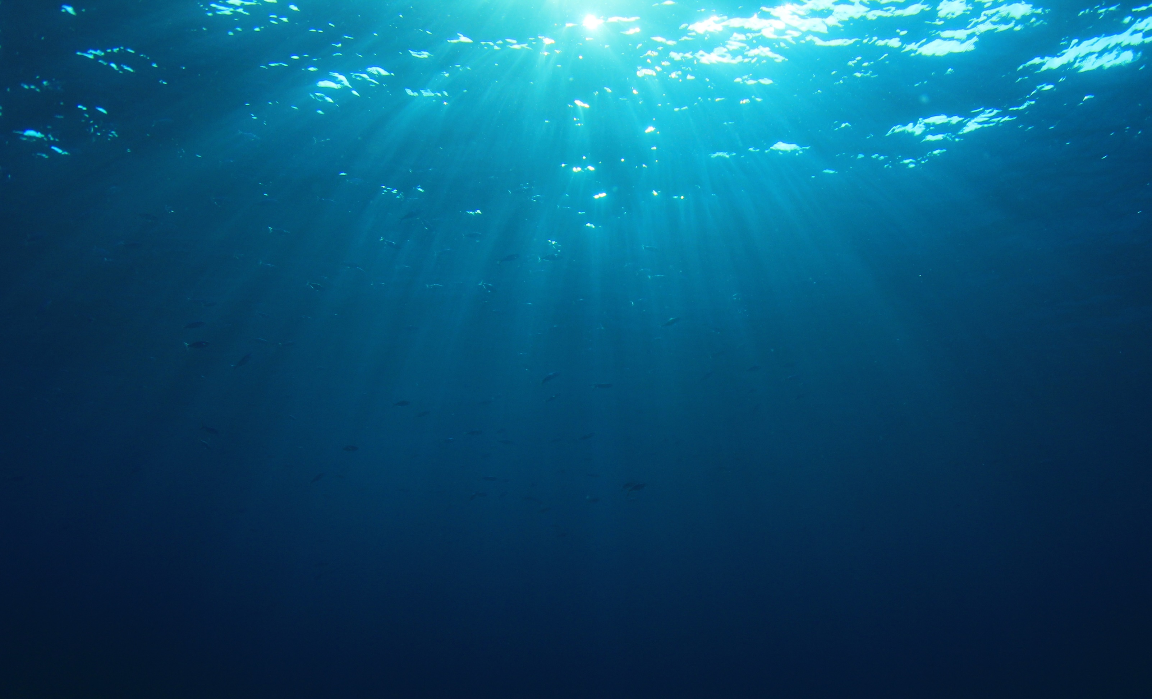
Chemical pollution
Direct Services
© Shutterstock
© Mark Kirkland
Notes:
Chemical pollution is often invisible, but that doesn’t mean it’s not harmful. There are many forms of chemical pollution:
Sewage enters the ocean either treated from water treatment plants or untreated from drains.
Harmful chemicals from factories, industries and even household products are discharged into rivers and eventually find their way to the ocean.
Agriculture runoff entering the ocean contains pesticides and other chemicals which can cause algal blooms, reducing oxygen and harming marine life.
Toxic chemicals can build up in food chains causing harm to a variety of marine life.

Slide 8
Climate change – extreme weather
Direct Services
© Mark Kirkland
© Jean-Christophe Andrévia Pexels
© Rich Carey, Shutterstock
Notes:
Climate change
High temperatures are causing ice to melt and sea levels to rise.
Increasing temperatures in the ocean are also causing corals to bleach and changing migration routes of many species.
Increased storms affects fragile marine habitats like seagrass beds, salt marshes and mangroves.

Slide 9
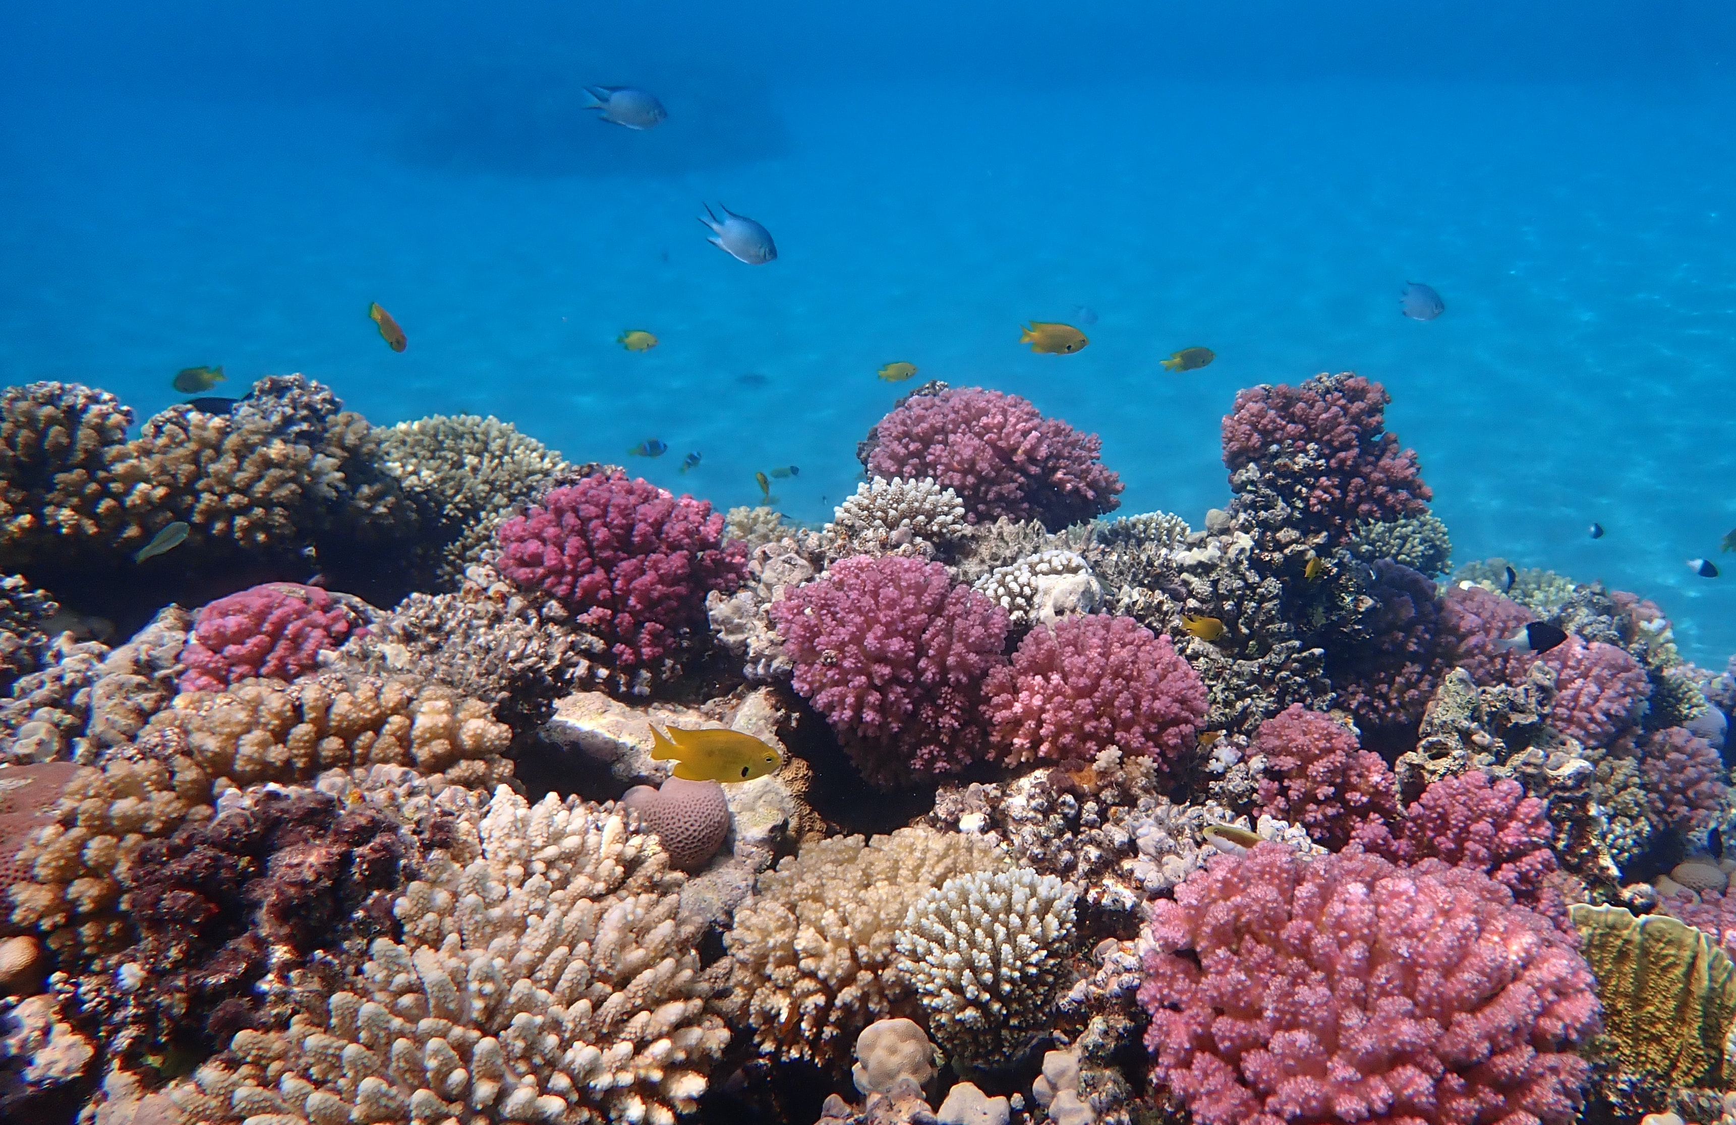
Climate change – ocean acidification
Direct Services
© Mark Kirkland
© Ralf Schlegel via Unsplash
© Rich Carey, Shutterstock
Notes:
Increased carbon dioxide is making the ocean more acidic. This process is known as ocean acidification.
Ocean acidification affects animals with a calcium carbonate skeleton such as corals, some phytoplankton and some seafood like mussels, lobsters, and crabs.

Slide 10
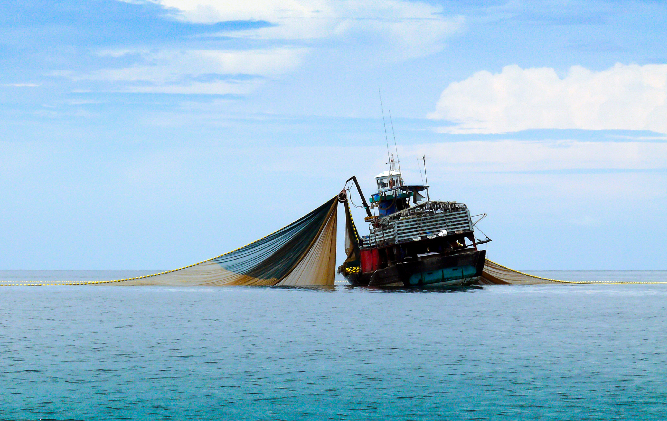
Overfishing
Direct Services
© NarisaFotoSS via Shutterstock
© Mark Kirkland
© Rich Carey, Shutterstock
Notes:
Unsustainable fishing poses a huge threat to marine biodiversity, affecting food chains and causing depleting fish stocks.
During fishing, animals can be accidentally caught along with the ‘target species’. The species that are accidentally caught are known as bycatch.
Bottom trawling, or dredging, are fishing methods that involve scraping heavy machinery along the seafloor, which can be extremely destructive to marine habitats.
Illegal and unregulated fishing can have disastrous effects on the marine environment and harm the livelihood of honest fishers.

Slide 11
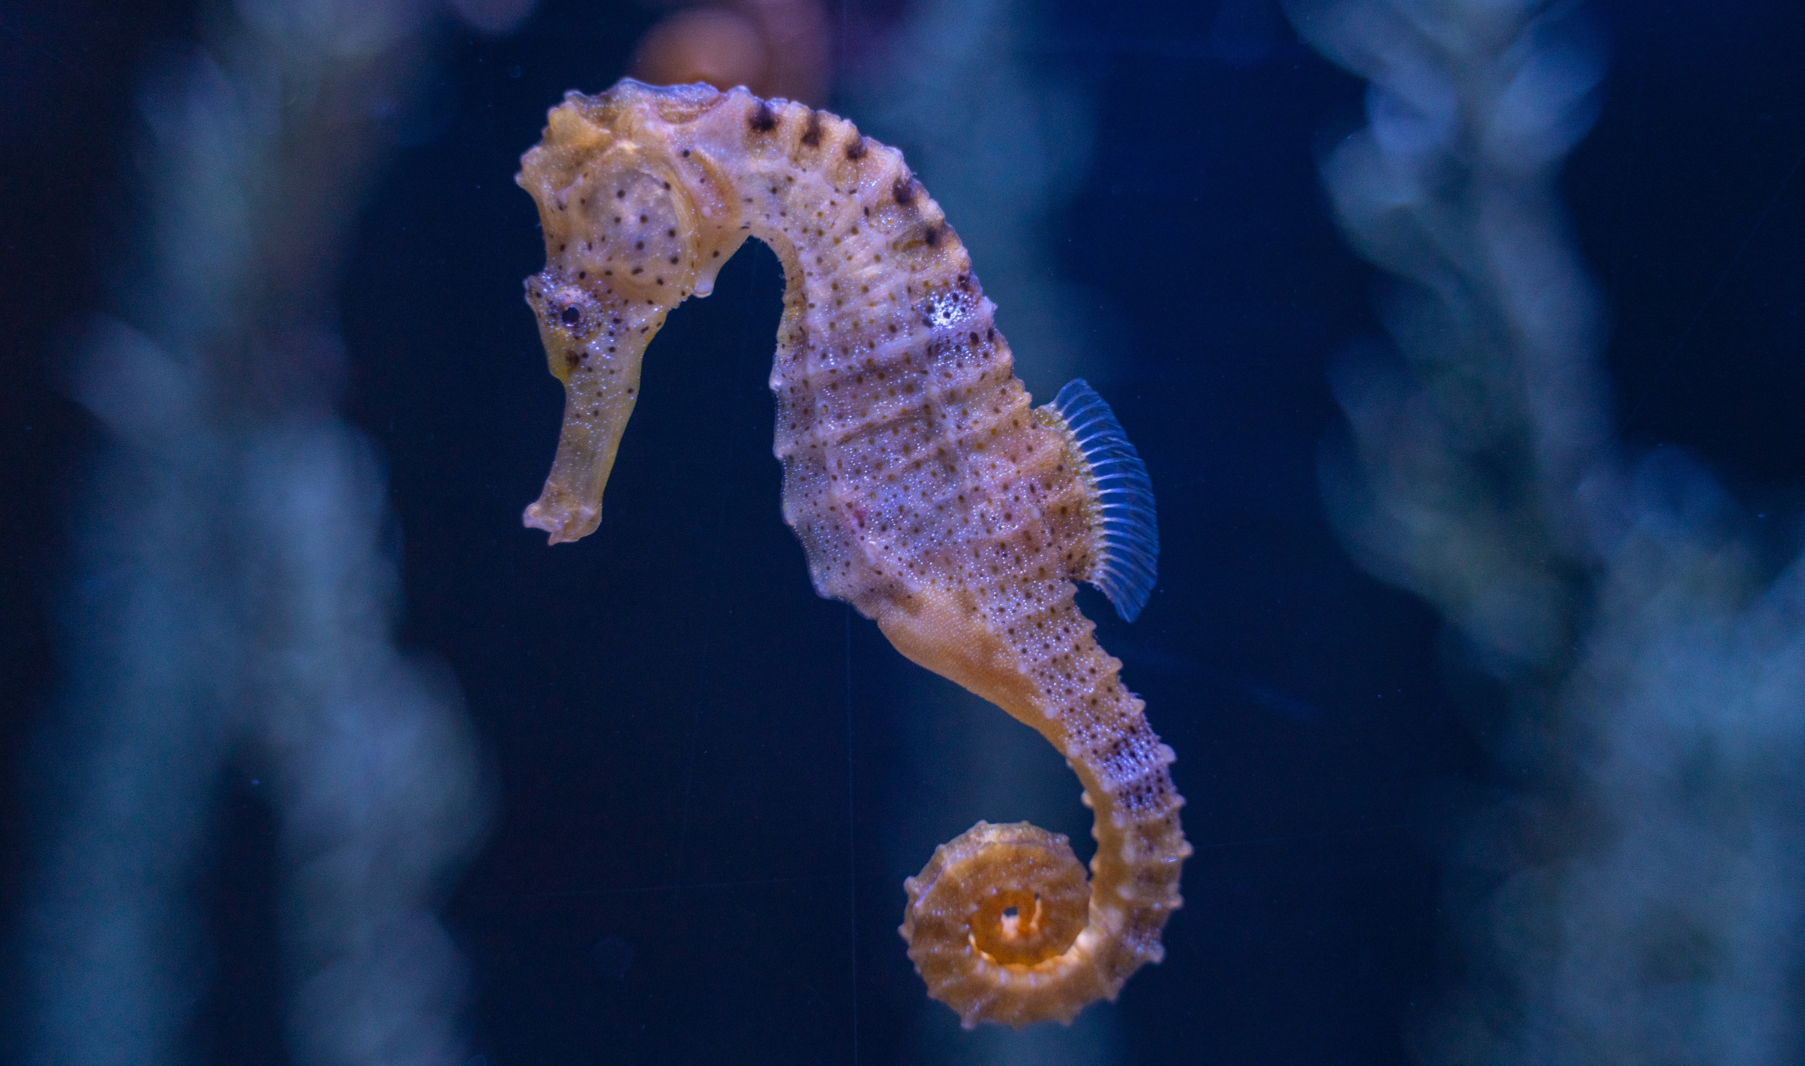
Trafficking of species
Direct Services
© Sergiu Lacob via Pexel
© Mark Kirkland
Notes:
Every year, an estimated 150 million seahorses are caught for the souvenir and medicine trades. As a species, seahorses could be extinct by 2050.
The critically endangered European eel is the centre of the largest wildlife crime in Europe, as illegal trafficking to Asia to be eaten as a delicacy is becoming a multibillion-euro industry.
Sharks are caught and traded illegally. They are used as an ingredient in traditional medicine and as delicacy in shark fin soup.

Slide 12
Oil and gas
Direct Services
© Mark Kirkland
© Elise Aldramvia Pixabay
Notes:
Drilling for oil and gas can pose serious threats, from construction of platforms, transporting of goods, creating pipelines and destructive oil spills.

Slide 13
Construction and dredging
Direct Services
© Simon Annablevia Shutterstock
© Mark Kirkland
Notes:
Construction takes place for many reasons, including building oil and gas rigs, wind turbines, pipelines and coastal development. All can cause harm to the marine environment through destruction of habitats and noise pollution.
Dredging - Sand and gravel is dredged from the seafloor to provide materials for construction, coastal defences, and to increase the depth of shipping channels. Dredging physically damages seafloor communities of plants and animals where the material is removed and where it is deposited.

Slide 14
Recreation
Direct Services
© Andre Mouton via Pixabay
© Mark Kirkland
Notes:
Pressure from recreational development and activities can cause harm to sensitive coastal habitats.
Activities like pleasure boating can cause harm through oil discharge and damage to seabed habitats through anchoring.
Natural coastal habitats are being destroyed to make room for development. This not only directly reduces biodiversity, but also reduces vital functions these habitats provide, such as helping to protect land from erosion and helping to filter nutrient runoff from the land.

Slide 15
Shipping
Direct Services
© Mark Kirkland
© Rich Carey, Shutterstock
© Ian Taylor via Unsplash
Notes:
Shipping can be associated with different kinds of pollution, including noise pollution, emissions, oil spills, container spills, dumping of rubbish at sea, and chemical pollution. It can also directly damage the environment through anchoring, shipwrecks, and contact with large marine mammals.

Slide 16
Activity 2
Ecosystem Based Management
Notes:
Activity 2 – Ecosystem Based Management (EBM)
Use the following video on Ecosystem Based Management to introduce the need for interconnectivity between industries, communities and the marine environment. See the notes on slide 18 to introduce the term ‘stakeholder.’
Split the class into small groups and hand each group a copy of the stakeholder groups cards. This resource shows a selection of key stakeholders in the marine environment. Allocate a stakeholder to each group. Students should mind map:
How the actions of their stakeholder could affect the environment.
The map should then branch out. For each affect, students should consider how they could reduce risk.
Then for each risk, students should consider what other sectors they could work with to share knowledge and experience and why it makes sense to work with that stakeholder.
For example, for the Ministry of Defence:
One of the actions could be testing sonar at sea.
This would then branch out to the risk being noise pollution to marine animals.
They could suggest working with environmental charities to understand how noise pollution affects animals, and understand where are the best areas of the ocean to test sonar which would cause the least harm to animals.
Once students have completed their extended mind maps, they should present their Ecosystem Based Management ideas to the rest of the stakeholders. Stakeholder groups can then decide whether they should work collaboratively. Keep a note of how many links between stakeholders the students come up with.

Slide 17

What is Ecosystem Based Management?
© Mark Kirkland
Notes:
Click the image to play the video – you may need to double click.

Slide 18
What is a stakeholder?
Notes:
Ecosystem Based Management requires stakeholders to work together.
But what is a stakeholder?
A stakeholder is anybody who can affect or is affected by an organization, or a strategy or a project. Stakeholders can be individuals, groups or organisations.
Stakeholder groups interested in activity at sea could include those whose actions affect the marine environment, or whose livelihoods depend on a healthy ocean.

Slide 19
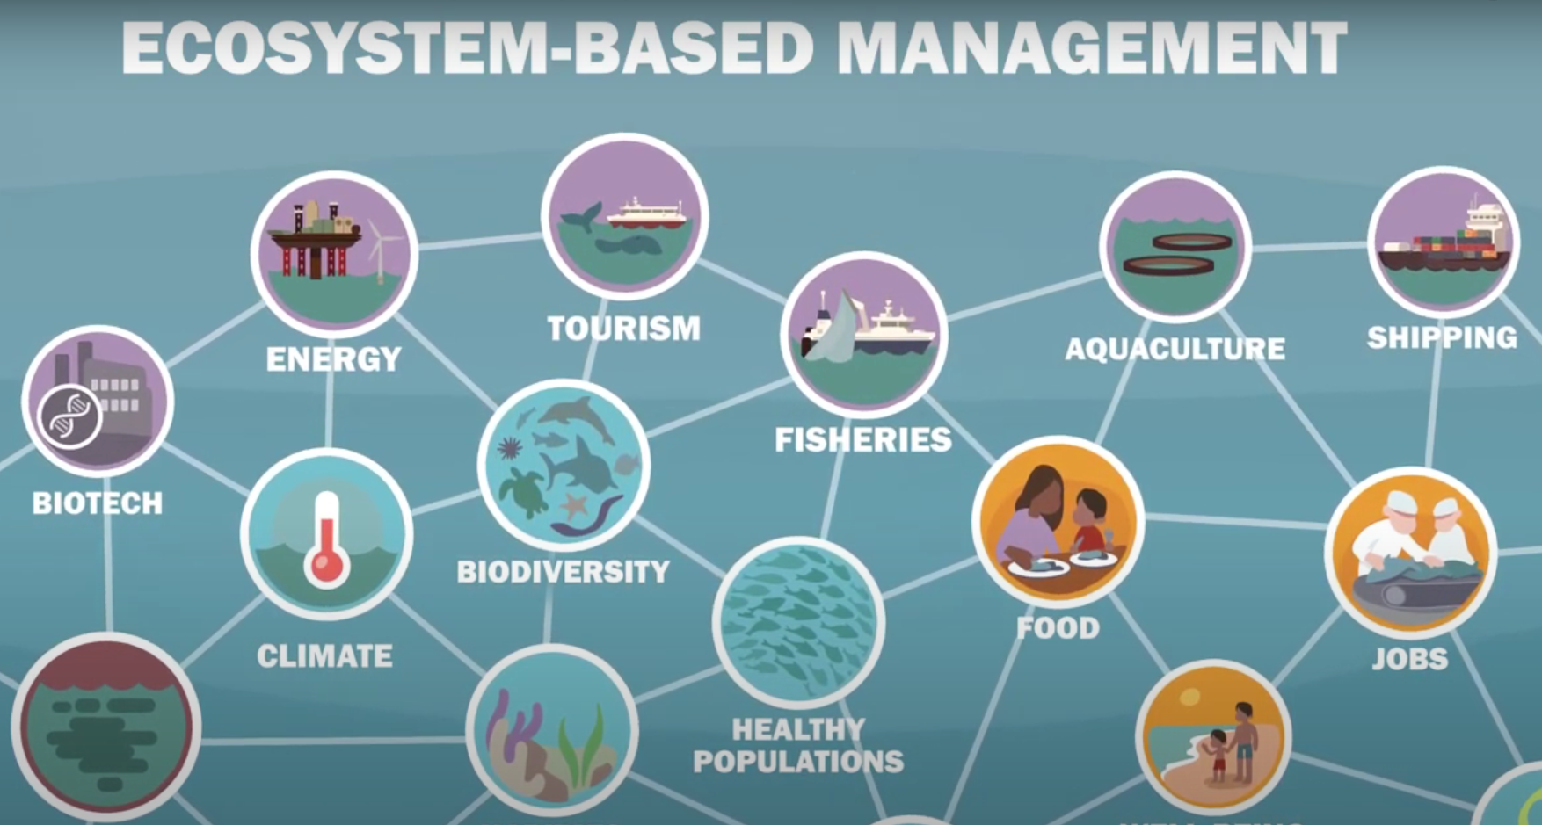
Notes:
In the marine environment there are many different stakeholder groups, such as the fishing industry, shipping, green energy, tourism, oil and gas, the Ministry of Defence, environmental charities, and coastal communities.

Slide 20
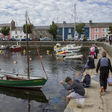
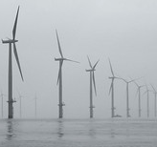
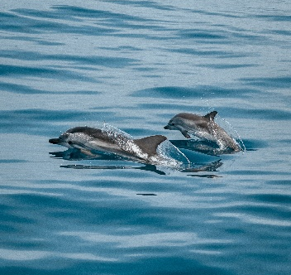
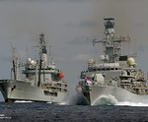
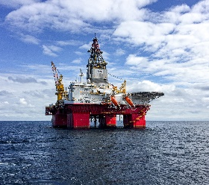
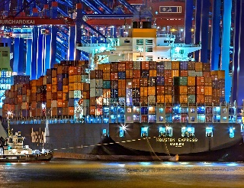
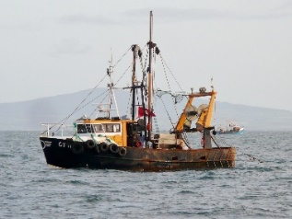

Stakeholder activity
© Mark Kirkland
Notes:
Split the class into small groups and hand each group a copy of the stakeholder groups cards. This resource shows a selection of key stakeholders in the marine environment. Allocate a stakeholder to each group. Students should mind map:
How the actions of their stakeholder could affect the environment.
The map should then branch out. For each affect, students should consider how they could reduce risk.
Then for each risk, students should consider what other sectors they could work with to share knowledge and experience and why it makes sense to work with that stakeholder.
For example, for the Ministry of Defence:
One of the actions could be testing sonar at sea.
This would then branch out to the risk being noise pollution to marine animals.
They could suggest working with environmental charities to understand how noise pollution affects animals, and understand where are the best areas of the ocean to test sonar which would cause the least harm to animals.
Once students have completed their extended mind maps, they should present their Ecosystem Based Management ideas to the rest of the stakeholders. Stakeholder groups can then decide whether they should work collaboratively. Keep a note of how many links between stakeholders the students come up with.

Slide 21
Stakeholder
What is the effect on the marine environment?
How could you reduce this risk?
Who can you collaboratively work with to reduce risk?
Notes:
Students should mind map:
How the actions of their stakeholder could affect the environment.
The map should then branch out. For each effect, students should consider how they could reduce risk.
Then for each risk, students should consider what other sectors they could work with to share knowledge and experience and why it makes sense to work with that stakeholder.

Slide 22
Ministry of Defence
What is the effect on the marine environment?
Testing sonar at sea.
How could you reduce this risk?
Reduce noise pollution in marine wildlife hotspots.
Who can you collaboratively work with to reduce risk?
Working with environmental charities to understand how noise pollution affects animals, and to discuss which areas of the ocean would cause the least risk to wildlife.
Notes:
For example, for Ministry of Defence,
One of the actions could be testing sonar at sea.
This would then branch out to the risk being noise pollution to marine animals.
They could suggest working with environmental charities to understand how noise pollution affects animals, and understand where are the best areas of the ocean to test sonar which would cause the least harm to animals.
Once students have completed their extended mind maps, they should present their ecosystem based management ideas to the rest of the stakeholders. Stakeholder groups can then decide whether they should work collaboratively. Keep a note of how many links between stakeholders the students come up with.

Slide 23
Activity 3
Marine Protected Areas
Notes:
Activity 3 - Marine Protected Areas
There are several management measures which can help to protect the ocean, such a legislations and laws, restoration projects and Marine Protected Areas (MPAs). As a class, watch the short video on the next slide to introduce students to MPAs in your area – there are different videos for each UK country.
In the same stakeholder groups as Activity 2, students should be presented with a scenario of the designation of an MPA in their local area of the ocean. Stakeholder groups should discuss reasons for or against the designation of an MPA. After 5-10 minutes of group discussions, stakeholders should explain to the rest of the class their views. Other stakeholders can challenge them to create heated discussions.
This activity highlights that though MPAs can have great benefits for marine biodiversity, management is a difficult balance between environmental, economic and social needs.

Slide 24

Marine Protected Areas - Wales
© Mark Kirkland
Notes:
USE THIS SLIDE IF BASED IN WALES
There are several management measures which can help to protect the ocean, such a legislations and laws, restoration projects and Marine Protected Areas (MPAs).
As a class, watch the short video introduce students to MPAs in Wales.

Slide 25
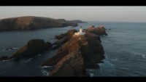
Marine Protected Areas - Scotland
© Mark Kirkland
Notes:
USE THIS SLIDE IF BASED IN SCOTLAND
There are several management measures which can help to protect the ocean, such a legislations and laws, restoration projects and Marine Protected Areas (MPAs).
As a class, watch the short video introduce students to MPAs in Scotland.

Slide 26
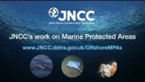
Marine Protected Areas – England
© Mark Kirkland
Notes:
USE THIS SLIDE IF BASED IN ENGLAND
There are several management measures which can help to protect the ocean, such a legislations and laws, restoration projects and Marine Protected Areas (MPAs).
As a class, watch the short video introduce students to MPAs in England.

Slide 27
Marine Protected Area designation
© Mark Kirkland
Notes:
In the same stakeholder groups as Activity 2, students should be presented with a scenario of the designation of an MPA in their local area of the ocean. Stakeholder groups should discuss reasons for or against the designation of an MPA. After 5-10 minutes of group discussions, stakeholders should explain to the rest of the class their views. Other stakeholders can challenge them to create heated discussions.
This activity highlights that though MPAs can have great benefits for marine biodiversity, management is a difficult balance between environmental, economic and social needs.

Slide 28
Reflect
What have you learnt?

Slide 29
Learning Objectives
Be able to explain the key threats to the ocean and how these have environmental, economic and social consequences.
Work in groups to identify how stakeholders can work collaboratively to achieve ecosystem based management.
Be able to argue for and against Marine Protected Areas in the ocean through the views of a key stakeholder.
Notes:
Can you explain how the one of the key threats to the ocean and the environmental, economic and social consequences of this threat.
What is a stakeholder? Why is it important for stakeholders to work collaboratively?
Why is it important for us to fully protect some areas of the ocean?

Slide 30
We will continue to fight for the ocean and protect wildlife

