Slide 1


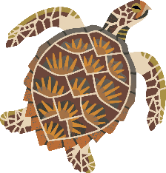
Together for a cleaner ocean!
Presentation for [group name]
by
[presenter name]
https://www.mcsuk.org/
Notes:
VERSION SEPT 2025
Notes for using these slides
You can use these slides and speaker notes when presenting this ocean pollution talk for Marine Conservation Society.
You don’t need to include all the slides or all the information in the notes.
Feel free to adapt the presentation to you, your audience and the duration of your talk – in fact, we encourage this!
Please do not add new, unbranded slides.
Please also make sure to download the latest version before each talk, as we intend this to be an ever improving and evolving presentation. For example, we will update the content to stay current in line with our campaigns and projects.
If you are using a second screen / projector and wish to see these notes while presenting, go to slide show in the top ribbon → tick “use presenter view” → then start slide show from beginning
Before you start
Before starting your presentation, it is a good idea to make sure you are safe and comfortable in the space. Ask the talk organiser to remove any obstructions that may cause trip hazards, for example.
The talk organiser is responsible for the talk attendees and should make sure they are all safe and comfortable before you start.
Introduce yourself!
Sea Champions bring unique stories and perspective to MCS. We want you to let your audience know a little bit about your background, interests and roles within MCS.
Judge the type and size of group you are presenting to, and with that you can decide whether a round robin of introductions or similar icebreaker would be suitable.

Slide 2



Today we'll cover
The pollution problem
Plastics
Sewage
Chemicals
Getting involved
Time for questions
XX hour
Notes:
Today’s plan of action is as follows… read through the agenda
Housekeeping
Now would be a good time to introduce any rules that might help the presentation run smoothly.
Let attendees know whether you’re happy with questions throughout, or whether you’d prefer them to keep questions until the end.
You could also ask the talk organiser to point out emergency exits.
If your talk is going to be over an hour long, we suggest you schedule in a comfort break.

Slide 3
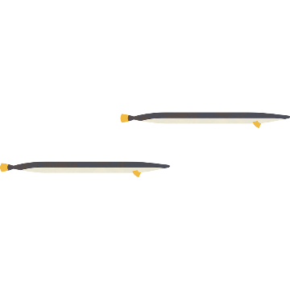
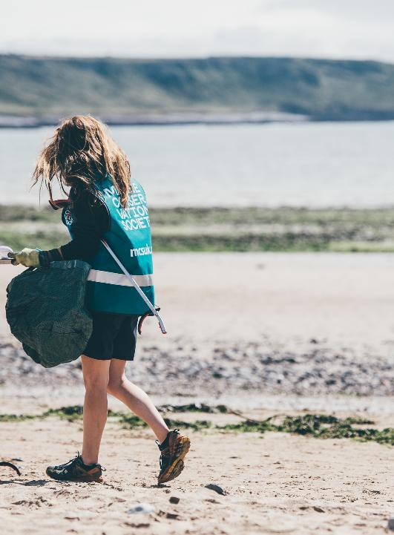
We are a leading UK environmental charity dedicated to protecting our ocean - defending crucial habitats, regenerating vital ecosystems and inspiring volunteers.
We unite communities, governments, and industry, to champion science-based solutions for cleaner, healthier seas to tackle the climate and nature emergency.
Credit – Billy Barraclough
Notes:
First of all, and introduction to us!
At the Marine Conservation Society, we have been the voice of our seas for over 40 years.
We have three key aims: defending crucial habitats, regenerating vital ecosystems and inspiring volunteers.
We work with everyone from communities to government and industry.
We are always science based in our approach.

Slide 4
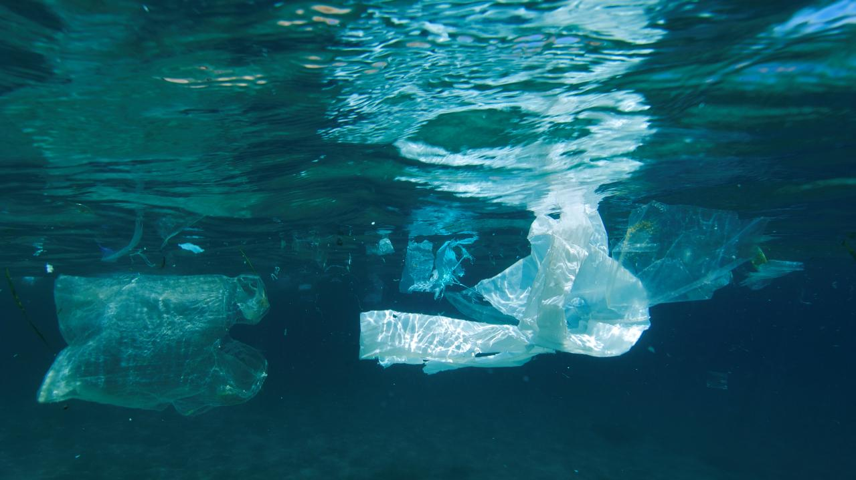
Credit - Gavin Parsons
Look familiar?
Notes:
I’m sure that most of you have visited a local beach or waterway and seen plastic in the environment.
If you haven’t seen it yourself, its likely you’ll have heard about it in the news or on TV.
Sadly, the scene shown in this image is really common.
Visible plastics (known as macro plastics) are the most obvious and well-known form of ocean pollution.
But the story is much more complex in reality.
At MCS, we focus on three types of ocean pollution: plastics, chemicals and sewage.

Slide 5
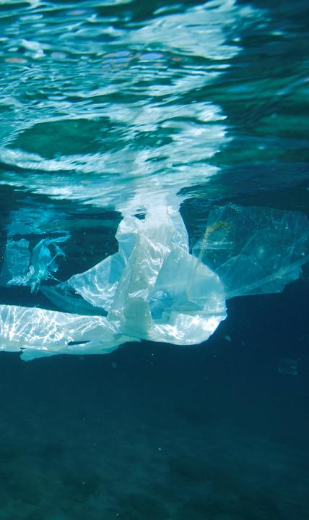
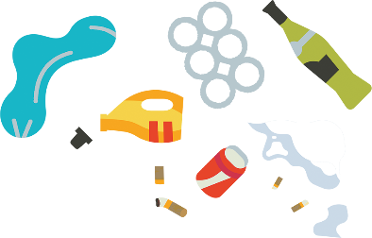
Credit - Gavin Parsons
Ocean pollution
Plastics, chemicals, sewage.
Ocean and land-based pollution.
Driver of biodiversity loss.
  Threatens 37% of marine mammals with extinction.
Notes:
Some pollution originates in the ocean, but most starts its life on our land or in our waterways.
Marine pollution has been reported as one of the five main drivers of the current biodiversity crisis, threatening 37% of marine mammals with extinction.

Slide 6
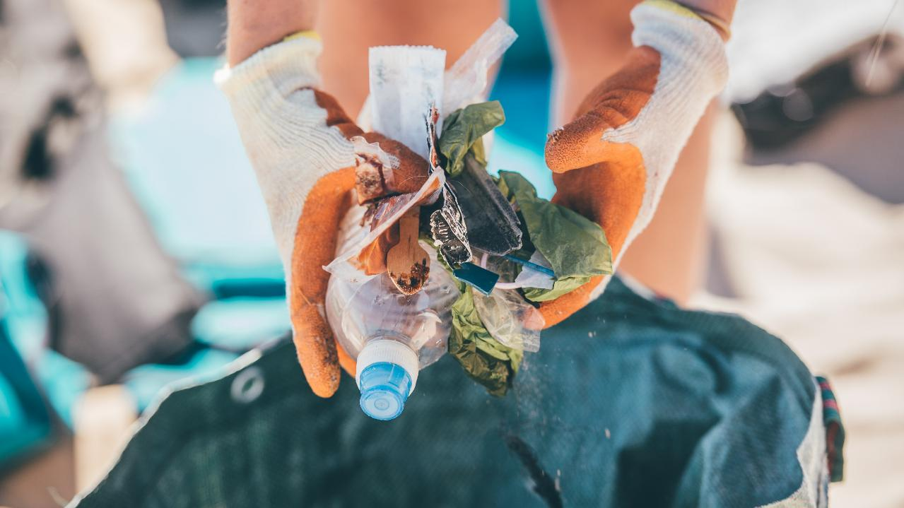
We want...
A cleaner ocean
Credit - Aled Llywelyn
Notes:
For a cleaner ocean: we campaign to stop pollution entering our oceans.
Using science, we track the health of our waters, influence business practice and call for better environmental regulations.
For example, our volunteer beach cleans remove and record the litter on our coastline.
By 2030, we want to see a clear downward trend in ocean pollution.
Over the following slides, I’ll dive deeper into some of the ocean pollutions issues we are facing, and talk about some of the work we are doing to fight for a cleaner ocean.

Slide 7
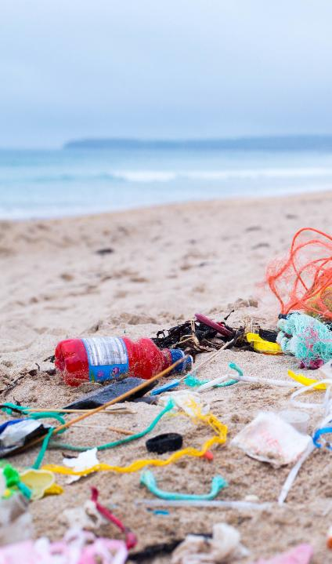

Credit – Natasha Ewins
Plastics
8 - 14 million tonnes of plastic enters our ocean every year.
Fibres, fishing gear, packaging, industrial waste etc.
Microplastics.
Plastic is everywhere!
Entanglement and ingestion.
Notes:
Every year, up to 14 million tonnes (perhaps more!) of plastic enters our ocean.
The BBC has reported that there was an estimate of more than 171 trillion pieces of plastic floating in the ocean.
Plastic pollution comes in many forms, from tiny fibres which shed from clothes when we put them in the wash, to huge industrial-sized fishing gear.
All of this has the potential to degrade into microplastics which are extremely damaging to marine life.
Our ocean may appear vast, but our devastating footprint is found everywhere, with plastic found in the deepest ocean (at the bottom of the Mariana trench) and your local beach.
There are two main ways that plastics harm marine life – entanglement and ingestion.
You may have seen the horrifying photos of seals and seabirds tangled up in plastic packaging and netting, causing injury and even death.
Many animals across the food web also mistake plastic for food and eat it or feed it to their young.

Slide 8

Single-use plastics (SUPs)
SUPs are used once, or for a short period of time, before being thrown away.
SUPs are ingrained in our everyday lives – we need alternatives!
Data driven action - Beachwatch.
Oil and gas in production.
Product design.
Beyond the EU Single-Use Plastics Directive.
Notes:
We've got to switch to using more sustainable products, and UK governments need to do more to bring in legislation that bans single-use plastic being produced.
Our Beachwatch data shows that thousands of single use plastic products are found on UK beaches every year.
Moreover, producing plastics uses fossil fuels (oil and gas) meaning the climate crisis and plastic pollution are dangerously intwined.
In the future, we want all product design to take into account the carbon, plastic and chemical footprint of their product.
We want all UK nations to go further than the EU Single-Use Plastics Directive. This is the piece of legislation that applies measures to the top ten single use plastic items found across the EU. It’s a decent start, but we want to UK to do more than the EU.
The top 10:
Cotton bud sticks
Cutlery, plates, straws and stirrers
Balloons and sticks for balloons
Food containers
Cups for beverages
Beverage containers
Cigarette butts
Plastic bags
Packets and wrappers
Wet wipes and sanitary items

Slide 9
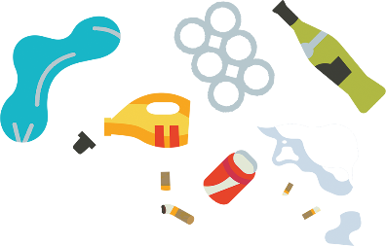
What’s happening in… England
Bans
October 2015: Charge on carrier bags.
October 2020: Ban on plastic cotton buds, stirrers and straws.
October 2023: Ban on plastic plates, trays, bowls, cutlery, balloon sticks and some polystyrene items.
Deposit Return Scheme (DRS)
January 2023: UK Government unveiled its plans to introduce a DRS in England by 2025
January 2025: MPs in Westminster passed the legislation needed for DRS in England and Northern Ireland!
October 2027: DRS due to start
Notes:
You may wish to give an overview of all three nations, or hide the slides for the ones less relevant to your talk/area.
In 2015 a 5p charge for carrier bags was introduced in English supermarkets.
In 2021, the charge was increased to 10p and extended to all businesses.
Statistics show the use of single-use supermarket plastic bags had fallen 98% since this charge.
The Marine Conservation Society now find 80% less single use plastics bags on beaches than before the charge was introduced.
What is a DRS? You pay a small deposit on top of the price of a drink. When finished, you return the drinks container to a collection point - in a supermarket or shop for example - where you get your money back.
DRS reduce litter and help the drive towards a circular economy. We need a DRS because drinks related litter on 93% of beaches.
The regulations that were passed cover England and Northern Ireland, with Scotland then amending the regulations already laid.

Slide 10
What’s happening in… Scotland
Bans
October 2014: Charge on carrier bags.
April 2021: Ban on microbeads and plastic cotton buds.
June 2022: plastic cutlery, plates, straws, beverage stirrers and balloon sticks, as well as some polystyrene.
November 2024: Consultation on single use plastic drinks containers. Awaiting actions from ScotGov.
Scotland's Deposit Return Scheme is now due to be implemented along with the rest of the UK in October 2027.
Bills
June 2024: Circular Economy Bill passed, a huge step in bringing reuse and refill to everyday life in Scotland.
Notes:
You may wish to give an overview of all three nations, or hide the slides for the ones less relevant to your talk/area.
Read from the side.

Slide 11
What’s happening in… Wales
Bans
December 2023: Ban on plastic cotton bud sticks, thin plastic carrier bags and products made of oxo-degradable plastic.
Bills
December 2023: Environmental Protection (Single-use Plastic Products) Bill passed
Deposit Return Scheme:
November 2024: Wales will no longer be proceeding with the joint approach with England, Scotland and Northern Ireland as outlined in April 2024. Instead, Walsh Government will implement a different scheme by 2027, which includes glass.
Notes:
You may wish to give an overview of all three nations, or hide the slides for the ones less relevant to your talk/area.
Read from the slide.
Note: Oxo-degradable plastics quickly fragment into smaller and smaller pieces, called microplastics, but don't break down at the molecular or polymer level like biodegradable and compostable plastics. The resulting microplastics are left in the environment indefinitely.
We respect the Welsh Government's decision to move forward with a Deposit Return Scheme tailored to Wales. While the November 2024 announcement lacked timescales for delivery, we support the goal of implementing a Scheme in Wales by 2027, which includes glass.

Slide 12
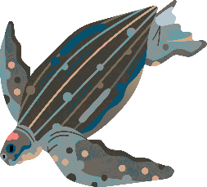
Microplastics
5mm or less.
Cosmetics, fibres, car tyres.
1m tonnes of “primary microplastics”.
35% from washing cycles.
28% from tyre wear.
Glitter.
Pellets.
Notes:
Microplastics are bits of plastic less than 5mm in size.
These microplastics may be from products we use every day such as cosmetics, fibres from fishing gear and the clothes we wear, and even from our car tyres.
Nearly a million tonnes goes into the sea as “primary microplastics”, meaning they’re already less than 5mm in size.
The rest of the microplastics in the ocean come from degrading of larger plastics during their time in the ocean.
It’s estimated that 35% of primary microplastics come from domestic and industrial washing cycles. Up to 700,000 fibres in one cycle! We’re working with industry and government to get all washing machines fitted with a filter.
Road run-off acts as a major pathway to the ocean. It is estimated that around 28% of microplastics that end up in the environment are caused by tyre wear, plus more from paints.
We’re calling on UK governments and the automotive industry to produce a roadmap for reducing microplastics from roads.
Some products, such as decorative glitter, have plastic and microplastics intentionally added to them. We're calling for a ban on all intentionally added microplastics.
We’re also working with other organisations to prevent plastic pellets pollution.
If you have time, show this video about ocean threads: https://vimeo.com/481186590

Slide 13
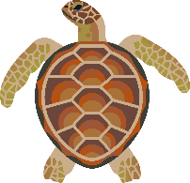
Cigarette buts and vapes
Consistently in the top 5 items.
Filters = 14 years to degrade.
14 million single-use vapes sold each month in the UK.
Can’t recycle vapes easily.
Laura Young, YON
Notes:
Single-use plastic cigarette filters are consistently in the top 5 items found on UK beaches during our Great British Beach Clean.
Filters can take around 14 years to degrade while releasing a cocktail of chemicals, as well as microplastics, into the environment.
Recycling disposable vapes is tricky, as they contain several different materials, including plastic, copper, lithium, and many more.
Laura Young, environmental activist and member of our Youth Ocean Network, has been leading the #BanDisposableVapes campaign, affecting change across the UK.
Due to the work of Laura and others, a ban on disposable vapes, was announced in Jan 2024
From 1 June 2025, it is illegal for businesses to sell or supply single-use vapes!

Slide 14
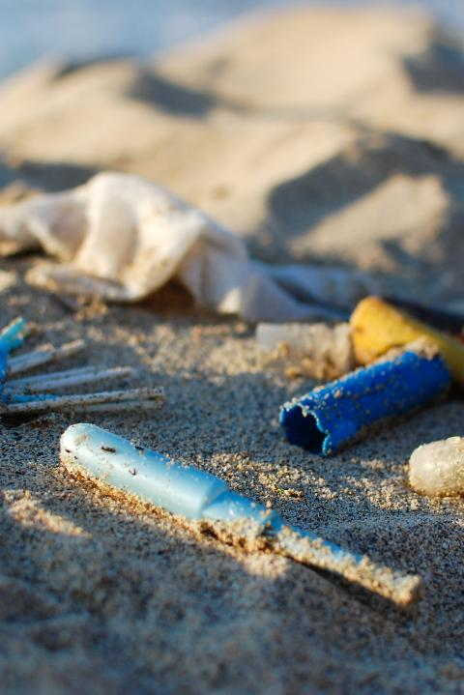
Credit – Natasha Ewins
Sewage
Viruses and bacteria.
Chemicals and microplastics.
Flushed items like wet wipes.
Sewer pipes and storm overflows.
Biodiversity.
Bathing water quality.
Notes:
Raw, untreated waste contains viruses and bacteria, as well as chemicals (e.g. from cleaning) and microplastics.
Unfortunately, undegradable flushed items like wet wipes and sanitary products are common finds on our beaches.
But how do sewage and sewage related products reach our beaches and oceans?
Many of our sewer pipes in the UK collect both rainwater and sewage. Safety valves (also known as storm overflows) were built into them to stop flooding during periods of very heavy rainfall. These storm overflows allow untreated sewage to spill into our rivers, estuaries and seas.
Water companies have become too reliant on using storm overflows to dump raw sewage in our waters, rather than improve their infrastructure.
Sewage damages the health of marine habitats by compromising water quality, which can prevent precious ecosystems like seagrass from surviving.
Sewage also looks and smells unpleasant and can cause serious illness, which makes swimming or spending time at the beach less safe and accessible.

Slide 15

Water quality
Drainage, sewage, misconnections.
Bathing water sites.
Our asks:
  Protect estuaries and coasts
  Include all Marine Protected Areas
  Implement upstream solutions.
Notes:
Pollution affecting water quality at the coast comes from three main sources : water draining from agricultural land and towns during heavy rain; sewage pollution from combined sewer overflows; and misconnections, where homes and businesses drain waste water into surface water pipes instead of the foul sewer.
For more than 30 years we have campaigned for better water quality.
By highlighting which beaches were too dirty to swim in, we put pressure on governments and environmental regulators to introduce better legislation to protect bathing water quality.
At the moment, the UK governments plans are happening slowly, and the changes are not drastic enough
To protect water quality, we asked the UK Government:
For estuaries and coastal waters to be protected from sewage overflow – until recently, they were only protected at bathing water sites.
All marine protected areas (MPAs) to be protected from sewage overflow by including them ALL as high priority sites.
Implement upstream solutions to stop harmful chemicals and microplastics at source.

Slide 16
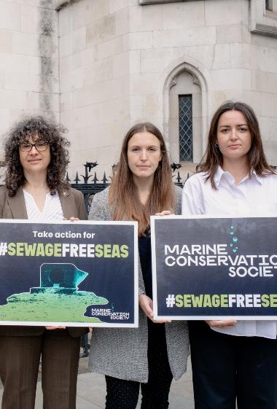
Sewage Free Seas Campaigns
Stop Sewage Pollution
Credit: Billy Barraclough
Notes:
Stop Sewage Pollution – sewage free seas
In November 2022, we took the necessary step of joining as a co-claimant in a legal challenge to compel the UK Government to rewrite its Storm Overflows Discharge Reduction Plan.
In July 2023, we had our day in High Court!
On 15th September 2023, the High Court dismissed our case. Although we didn’t get the result we wanted, we were not disheartened.
The evidence we provided as part of our legal challenge was so compelling that, in the run-up to the hearing, the UK Government launched a consultation.
On 25th September 2023, the UK Government responded to the public consultation by announcing that all storm overflows in England will now be included in the Plan, including all coastal waters and estuaries!

Slide 17

Sewage sludge
Solid waste product from wastewater, organic matter.
Nutrients useful as fertilizer.
Chemicals and microplastics.
Influencing decision makers.
Circular economy.
Notes:
The wastewater from our homes, businesses and industry goes to treatment plants to be cleaned.
As the water is filtered, a solid waste product is formed. This material is known as sewage sludge and tonnes of it is generated in the UK every day.
Its composed largely of organic matter and contains nutrients, such as nitrogen and phosphorus, which makes it a useful fertiliser. Once treated, most sewage sludge is spread over farmland.
Despite being treated, sewage sludge often contains synthetic chemicals and microplastics. These tiny particles are difficult to remove, which means harmful contaminants end up in the soil, enter our rivers and ultimately the sea.
What are we doing?
We are sharing our findings on how microfibres and chemicals are released when sludge is spread on farmland with policymakers, water companies and decision makers.
We agree that sewage sludge is a valuable resource within the circular economy, but it must be properly monitored to ensure it isn't a source of pollution.

Slide 18
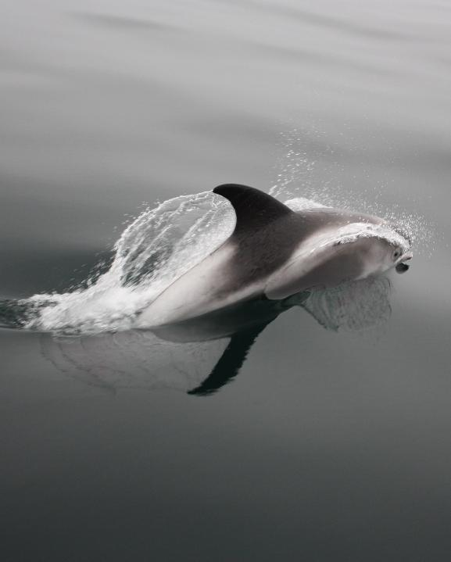
Chemicals
Invisible but deadly.
Marine mammals are at risk.
PFAS, nicknamed ‘forever chemicals’.
Pans, coats, paper…
Impossible to remove.
Notes:
Often invisible to the human eye, harmful chemicals are polluting our ocean and impacting marine life.
Research has shown a range of negative impacts of pollution on marine mammals: reduced fertility in killer whales, to increased risk of infectious disease in harbour porpoises, and reduced blubber production in seal pups.
PFAS (Per- and poly- fluoroalkyl substances), nicknamed ‘forever chemicals’ are a highly persistent group of several thousand chemicals.
PFAS are everywhere. Your non-stick pan? Probably PFAS. Your waterproof coat? Possibly PFAS. Your greaseproof paper? Yep, you guessed it! PFAS.
PFAS are abundant, and currently impossible to remove from the ocean.

Slide 19
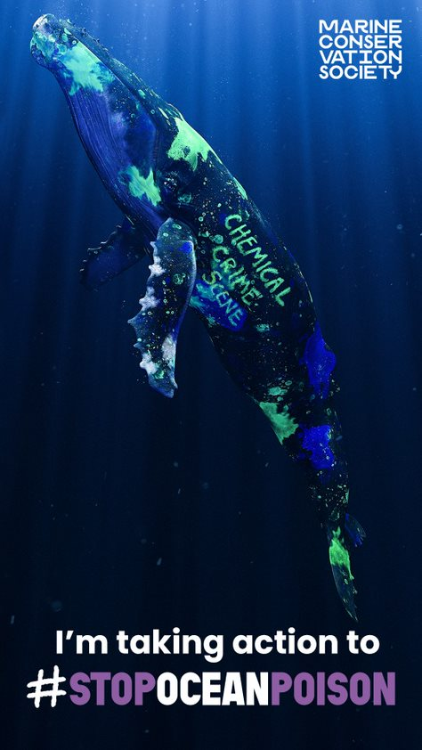
Stop ocean poison
What we’re asking the UK Government to do:
Ban all PFAS (forever chemicals) from non-essential uses and implement a UK chemicals strategy.
Notes:
Harmful chemicals are now present in all water on Earth, poisoning our blue planet.
There's clear evidence that PFAS are accumulating in our ocean, wildlife and our bodies.
We continue to call for the Government to urgently move towards a PFAS-free economy, starting by banning the use of all PFAS forever chemicals in uses where there are alternatives, and asking businesses to remove forever chemicals from their products.
It’s not feasible for the public to completely avoid forever chemicals in the products they purchase. Discerning which products contain forever chemicals and sourcing suitable alternatives would be incredibly difficult. Action needs to come from the top.
Help us demand the changes that will stop forever chemicals ever reaching the sea. If you want to do more, we need your help to spread the word. Talk to your friends, family and colleagues about forever chemicals.

Slide 20
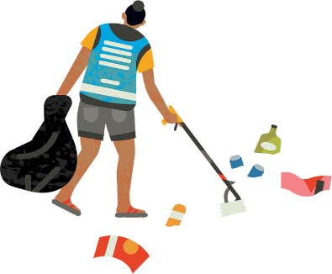
How can I get involved?
Notes:
We hope that by this point, you might be thinking, how I can get involved with the work of MCS?
The next few slides cover the various ways that you can support us…

Slide 21
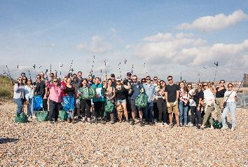
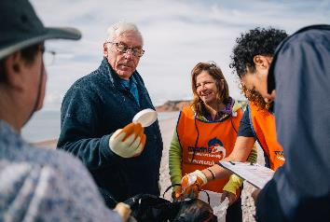
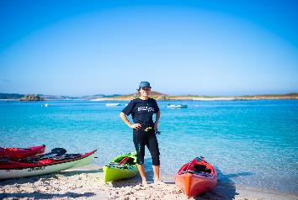

Credit: Billy Barraclough
Credit: Andrew J Brown
Credit: Rhian White
Join
Donate
Fundraise
Notes:
Financial support
Join: By becoming a member you'll support our vital work to protect and restore our ocean. You can choose how much would you’d like your monthly membership to be.
Donate: Your support is vital to help us work for a cleaner, better-protected, healthier ocean: one we can all enjoy.
Fundraise: From organising your own fundraising event to taking on a challenge, there are many ways you can raise money and help fight for the future of our ocean.

Slide 22
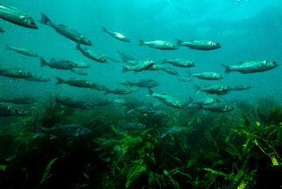
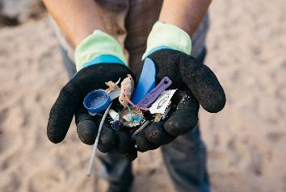
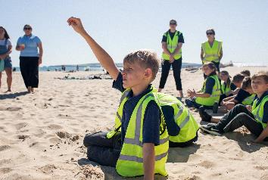
Credit: MSC
Credit: Billy Barraclough
Credit: Billy Barraclough
Choose sustainable seafood
Reduce your plastic footprint
Fun and learning
Notes:
Sustainable seafood: The fish that we eat impacts the health of our ocean and marine life that call it home. Our Good Fish Guide helps you to make informed choices about the seafood on your plate, using a simple traffic light system - Red means Fish to Avoid and Green is a Good Choice.
The GFG can be added as an app to your phone, making it easier to check when you’re at the shops.
Reduce your plastic footprint: 14 million tonnes of plastic end up in our oceans every year, harming our ocean and precious marine life. On our website there’s advice on lots of simple steps you can take to make a big difference and help stop plastic waste.
Fun and learning: Explore our amazing ocean in school or at home with resources for teachers, families and young people available on the MCS website.
Link to share - https://www.mcsuk.org/ocean-emergency/sustainable-seafood/the-good-fish-guide/add-the-good-fish-guide-to-your-phone/

Slide 23
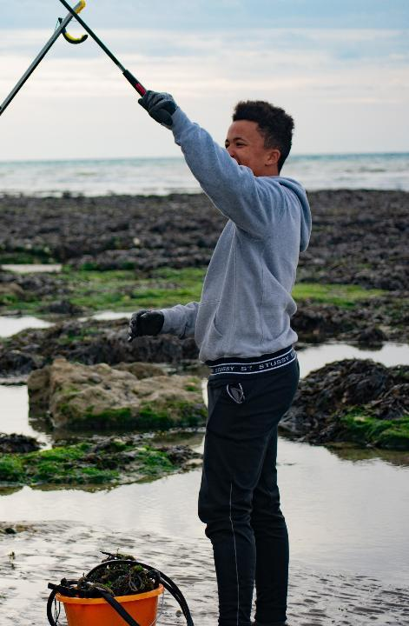
Image Credit – Jack Donavan
Be a Sea Champion
Our Sea Champion volunteers are at the heart of what we do. They give their time and help to achieve our ocean goals
Notes:
Volunteer
Our Sea Champion volunteers are at the heart of what we do.
They help by giving their time, taking part in activities or championing our cause in their local communities.
Sea Champions help by getting more people actively involved in our citizen science, volunteering and campaign work.
We provide training where you can learn new skills, as well as opportunities to meet people at events and online. You'll become part of a growing community who feel proud to be doing their bit for our seas.

Slide 24
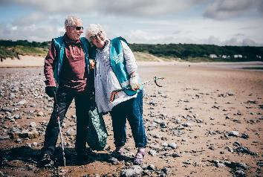
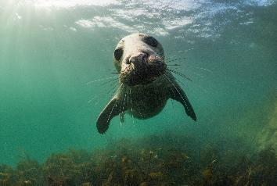
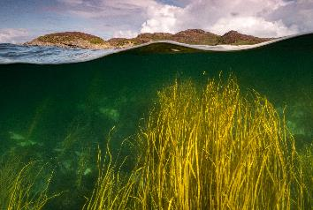
Credit: Aled Llwelyn
Credit: Mark Kirkland
Credit: Mark Kirkland
Beachwatch and Source2Sea
Join a litter clean and survey.
Ocean Voice
Speak up for our ocean.
Citizen Science
Big Seaweed Search
Wildlife sightings
Microplastic surveys
Seasearch
Notes:
Some examples of how you can get involved...
Become a Beachwatch volunteer and join one of our beach clean surveys or look for Source2Sea litter survey if you’re not near to the coast.
Speak up for the Ocean in your local community by taking on one of our Ocean Voice opportunities, as a community presenter offering local talks or representing us in local media.
Get involved as a citizen scientist: This is very flexible – you can do as little or as much as you like, while gathering impactful data for research and policy work. For example.. Big Seaweed Search: This programme helps monitor the impacts of climate change on our marine environment using our online Seaweed ID & survey guide
Visit our website https://www.mcsuk.org/what-you-can-do/volunteering/ to find out more.

Slide 25
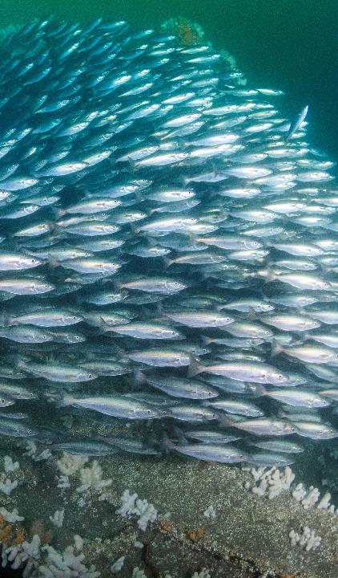





Follow us
Follow us on social media.
Sign up for emails on our website
www.mcsuk.org
Credit: Kirsty Andrews
Notes:
Follow us on social media and sign up for emails on our website to get inspiring stories about the work we're doing to save and recover our oceans, and news about our urgent campaigns for positive change.

Slide 26
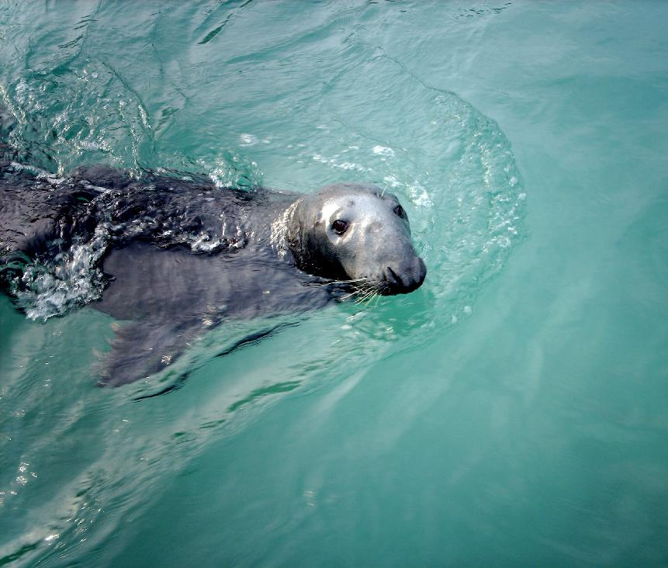


For more information about how to get involved visit:
www.mcsuk.org
Thank you!
Notes:
Thank you!

