Slide 1

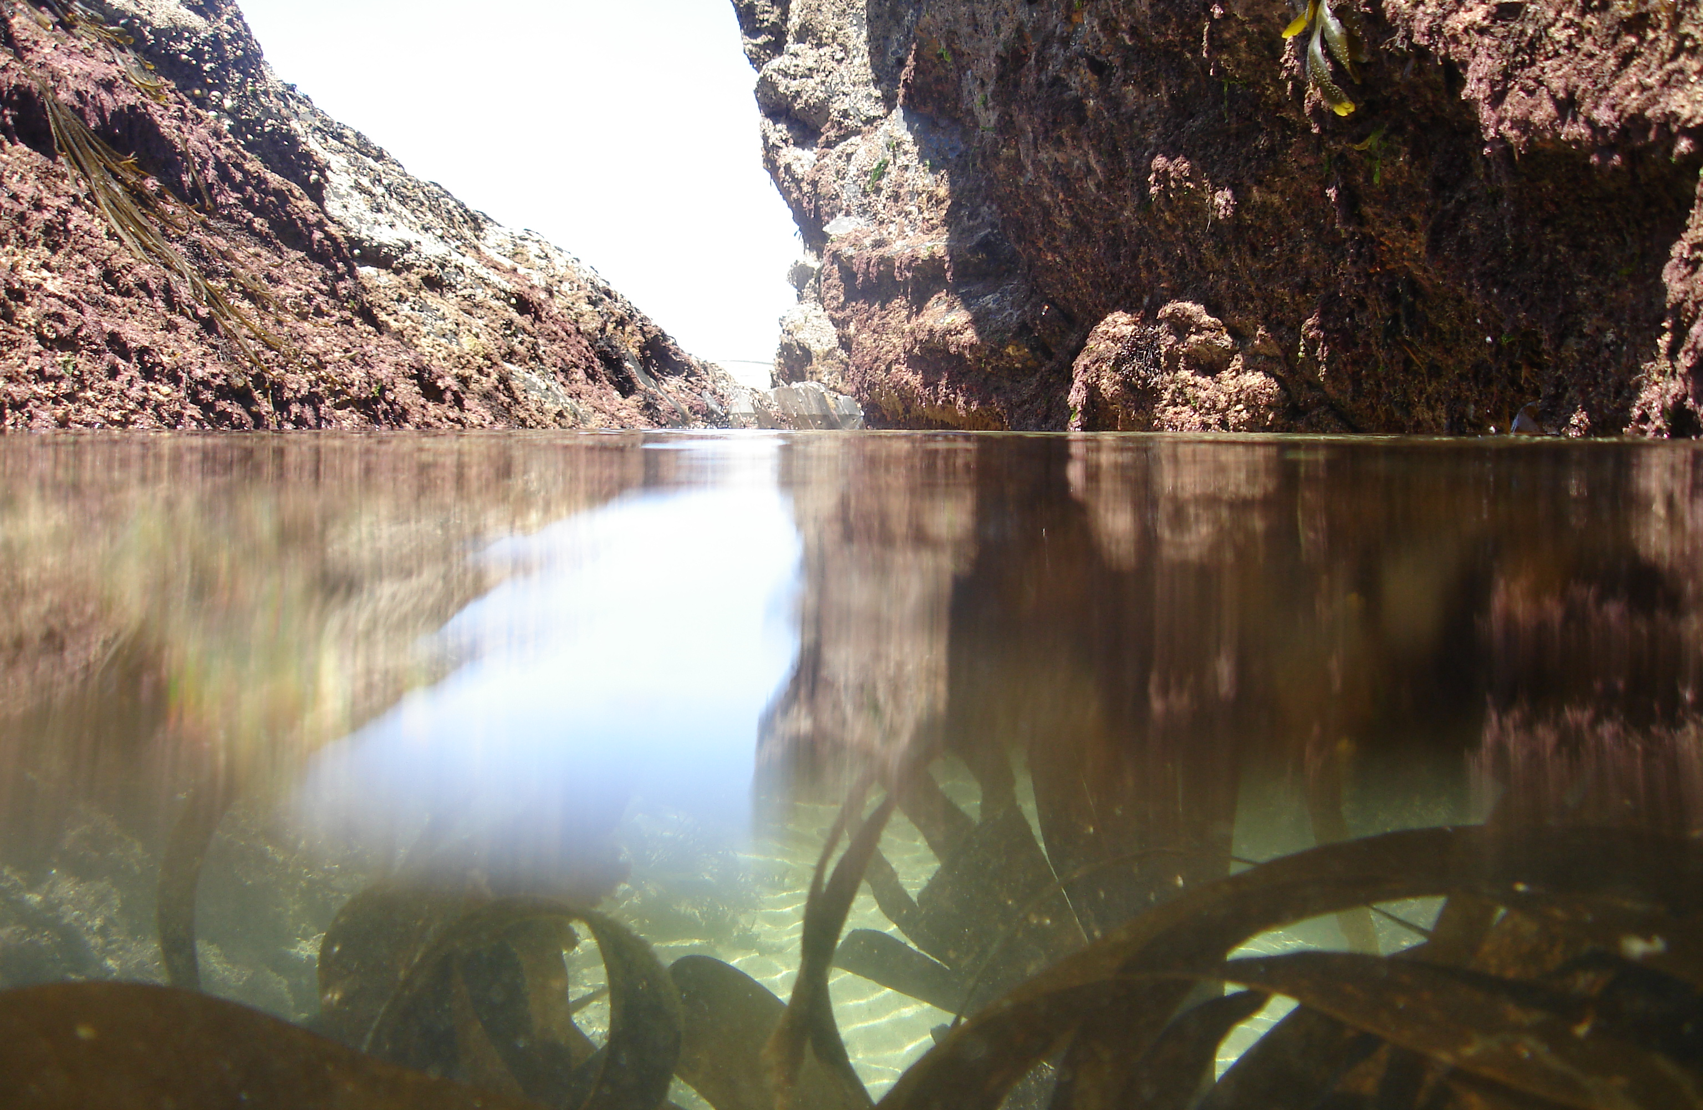
Rockpool Image Reel
© Richard Harrington

Slide 2
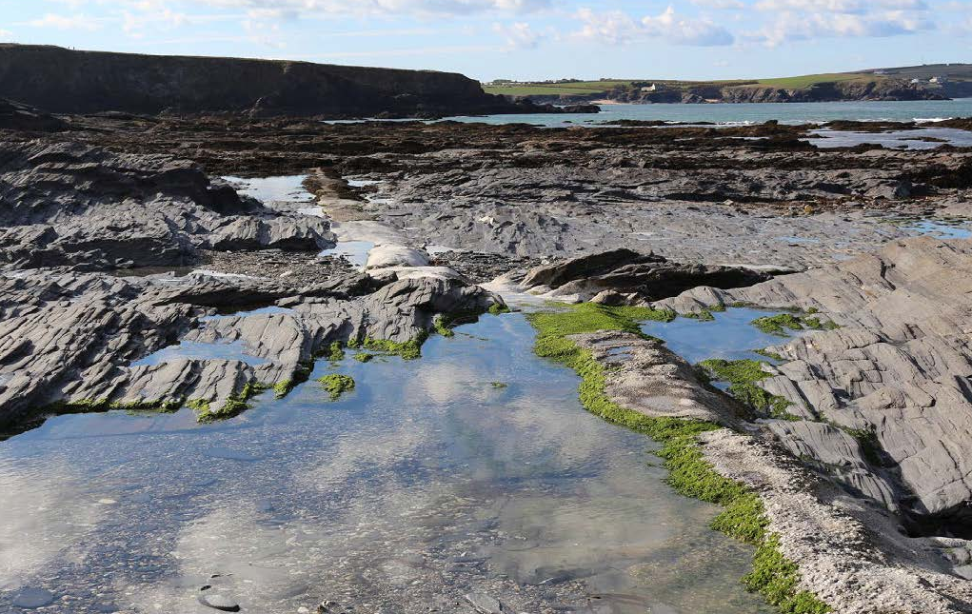
What is a rockpool?

Slide 3
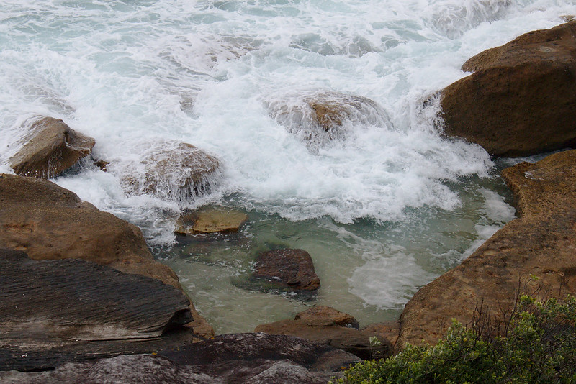
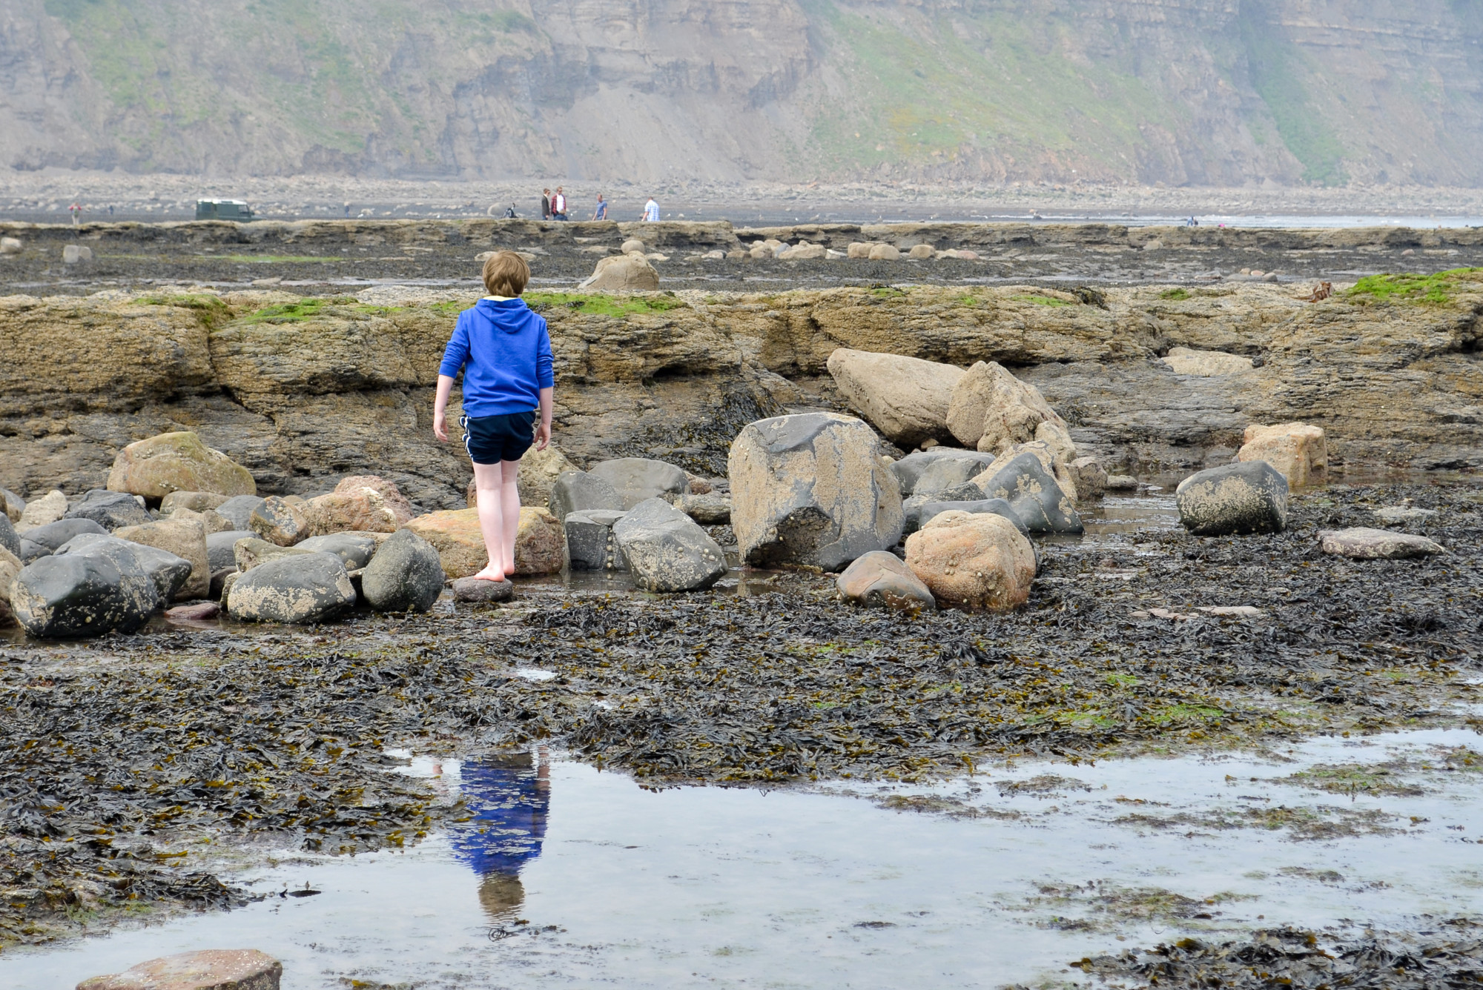
What is it like to live in a rockpool?
© Mary & Andrew via Flickr
© Stuart Askew

Slide 4
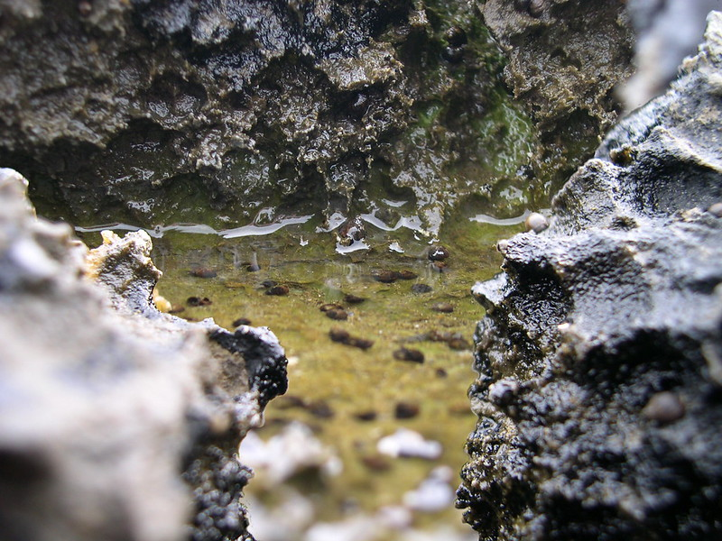
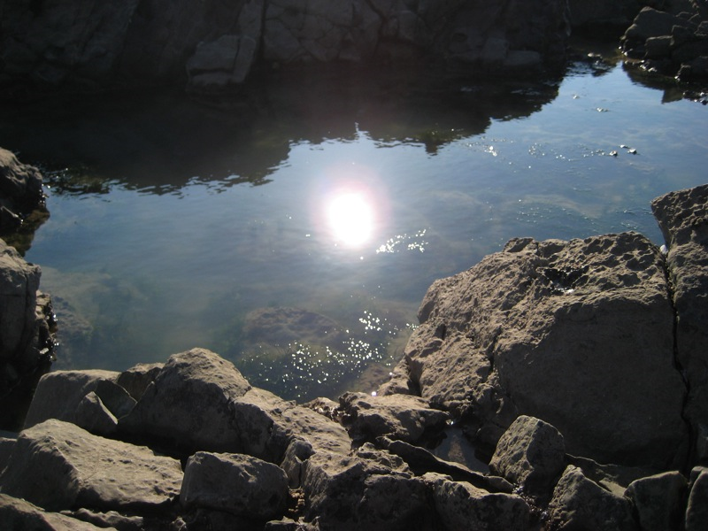
What is it like to live in a rockpool?
© Patrick Wallace via Flickr
© Owen Jell via Flickr

Slide 5
Zonation

Slide 6
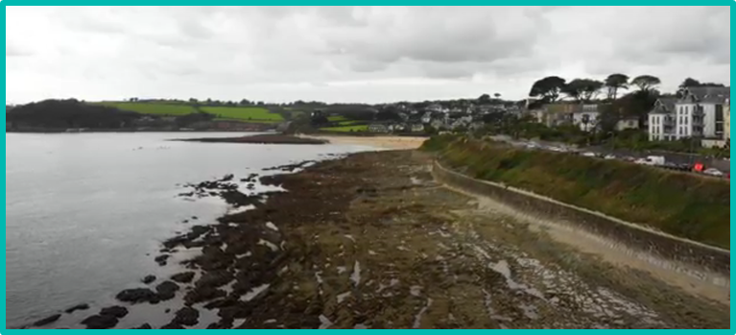
Rockpool zones
Subtidal zone
Lower Zone
Middle Shore
Upper Shore
Splash Zone

Slide 7
Rockpool
Species

Slide 8
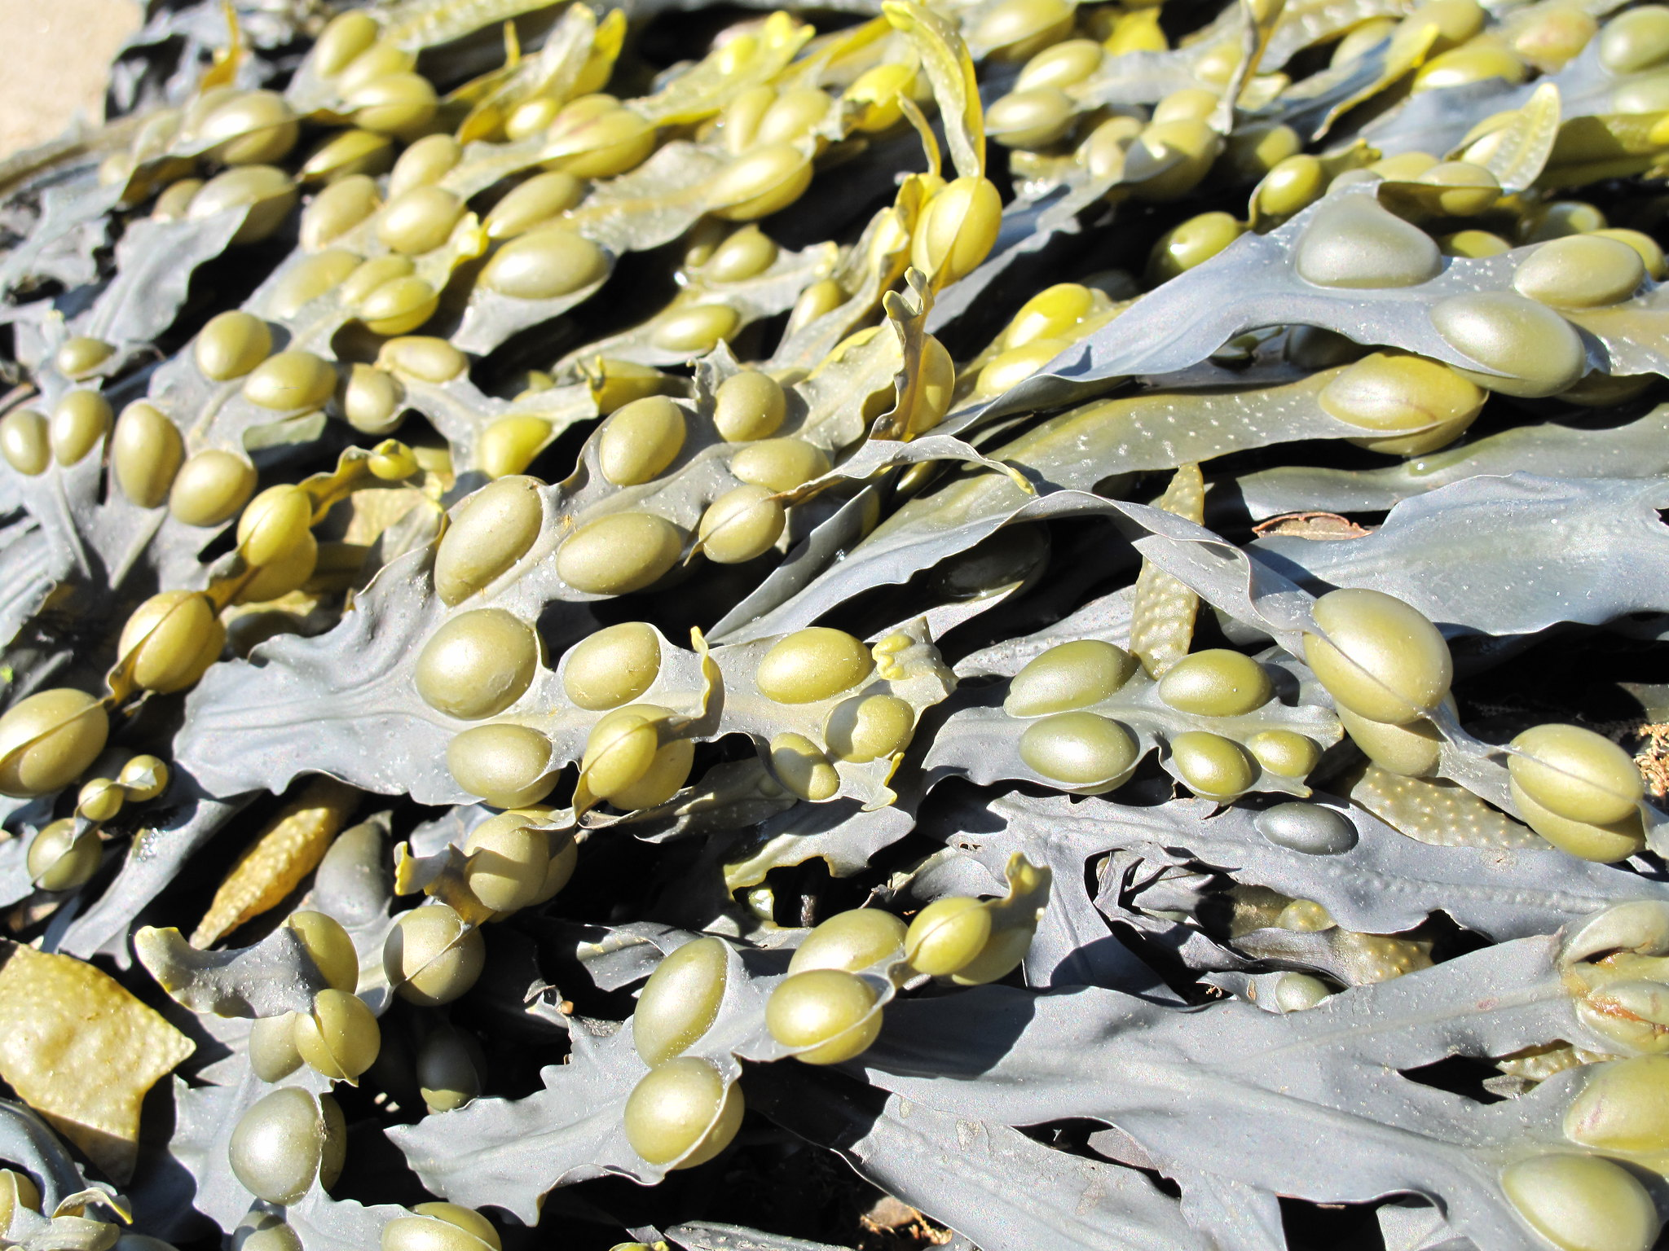
Seaweed
This seaweed is called Bladder wrack. The small air-filled bladders help this seaweed to float towards the surface of the water to photosynthesise.
© Mark Craig

Slide 9
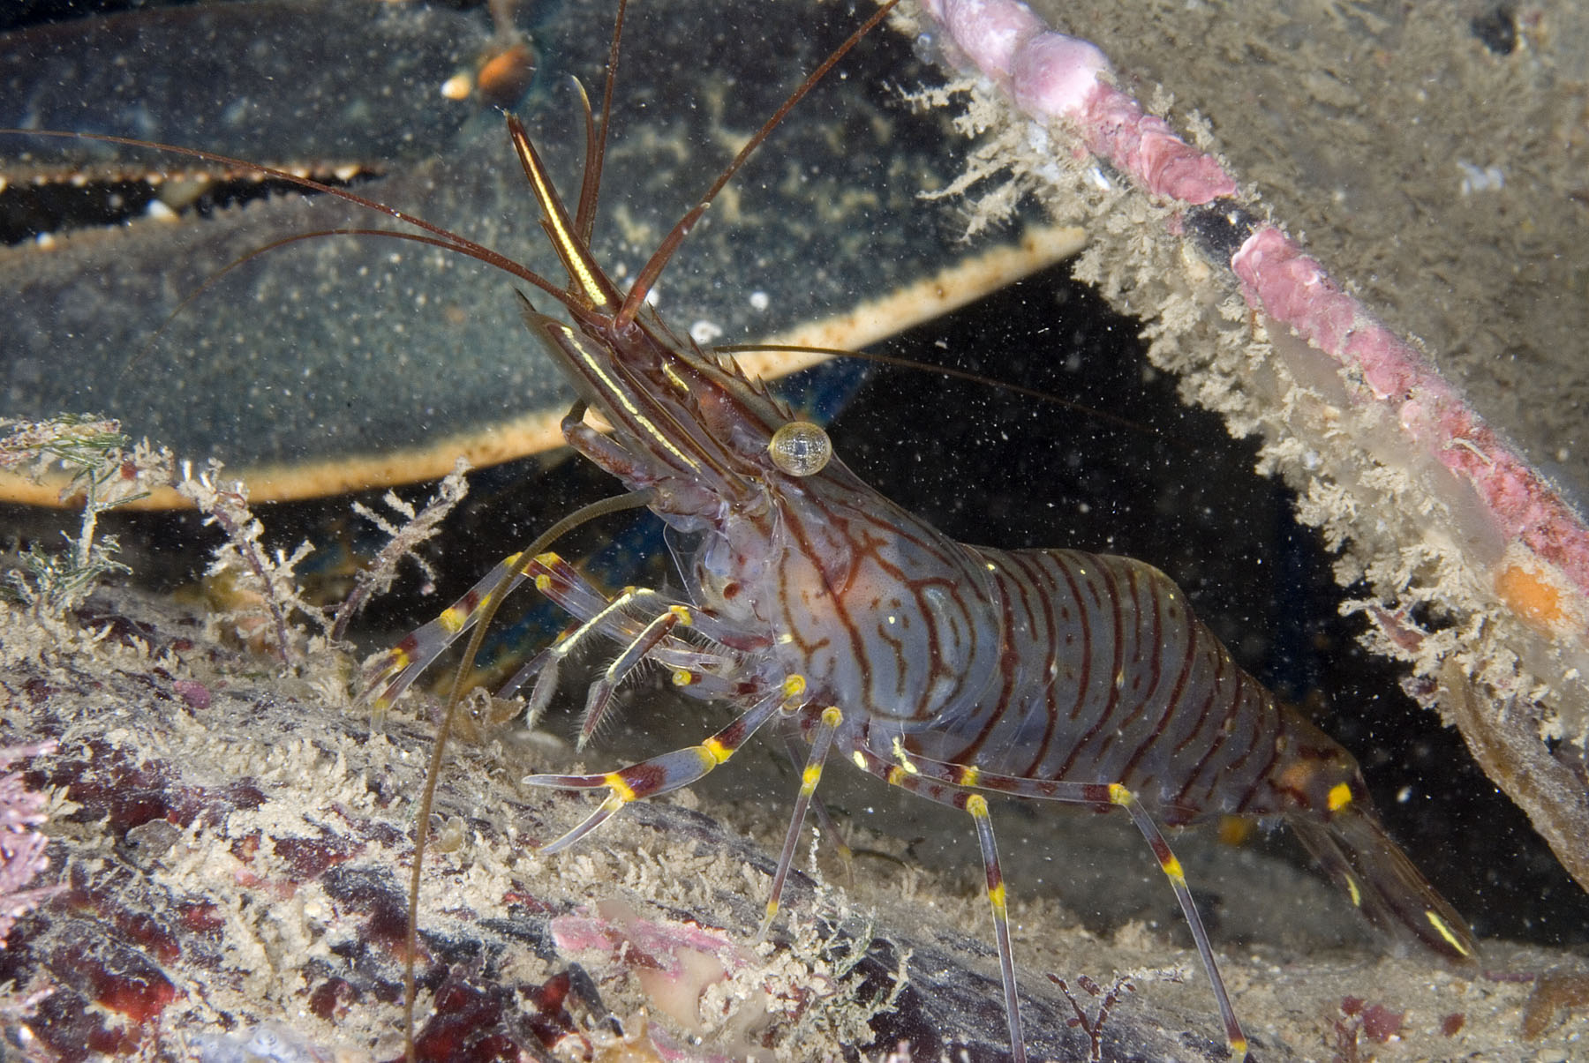
Prawn
Prawns have a transparent body with black stripes. It has a serrated rostrum that looks a bit like a mohican
between its eyes.
© Paul Naylor

Slide 10
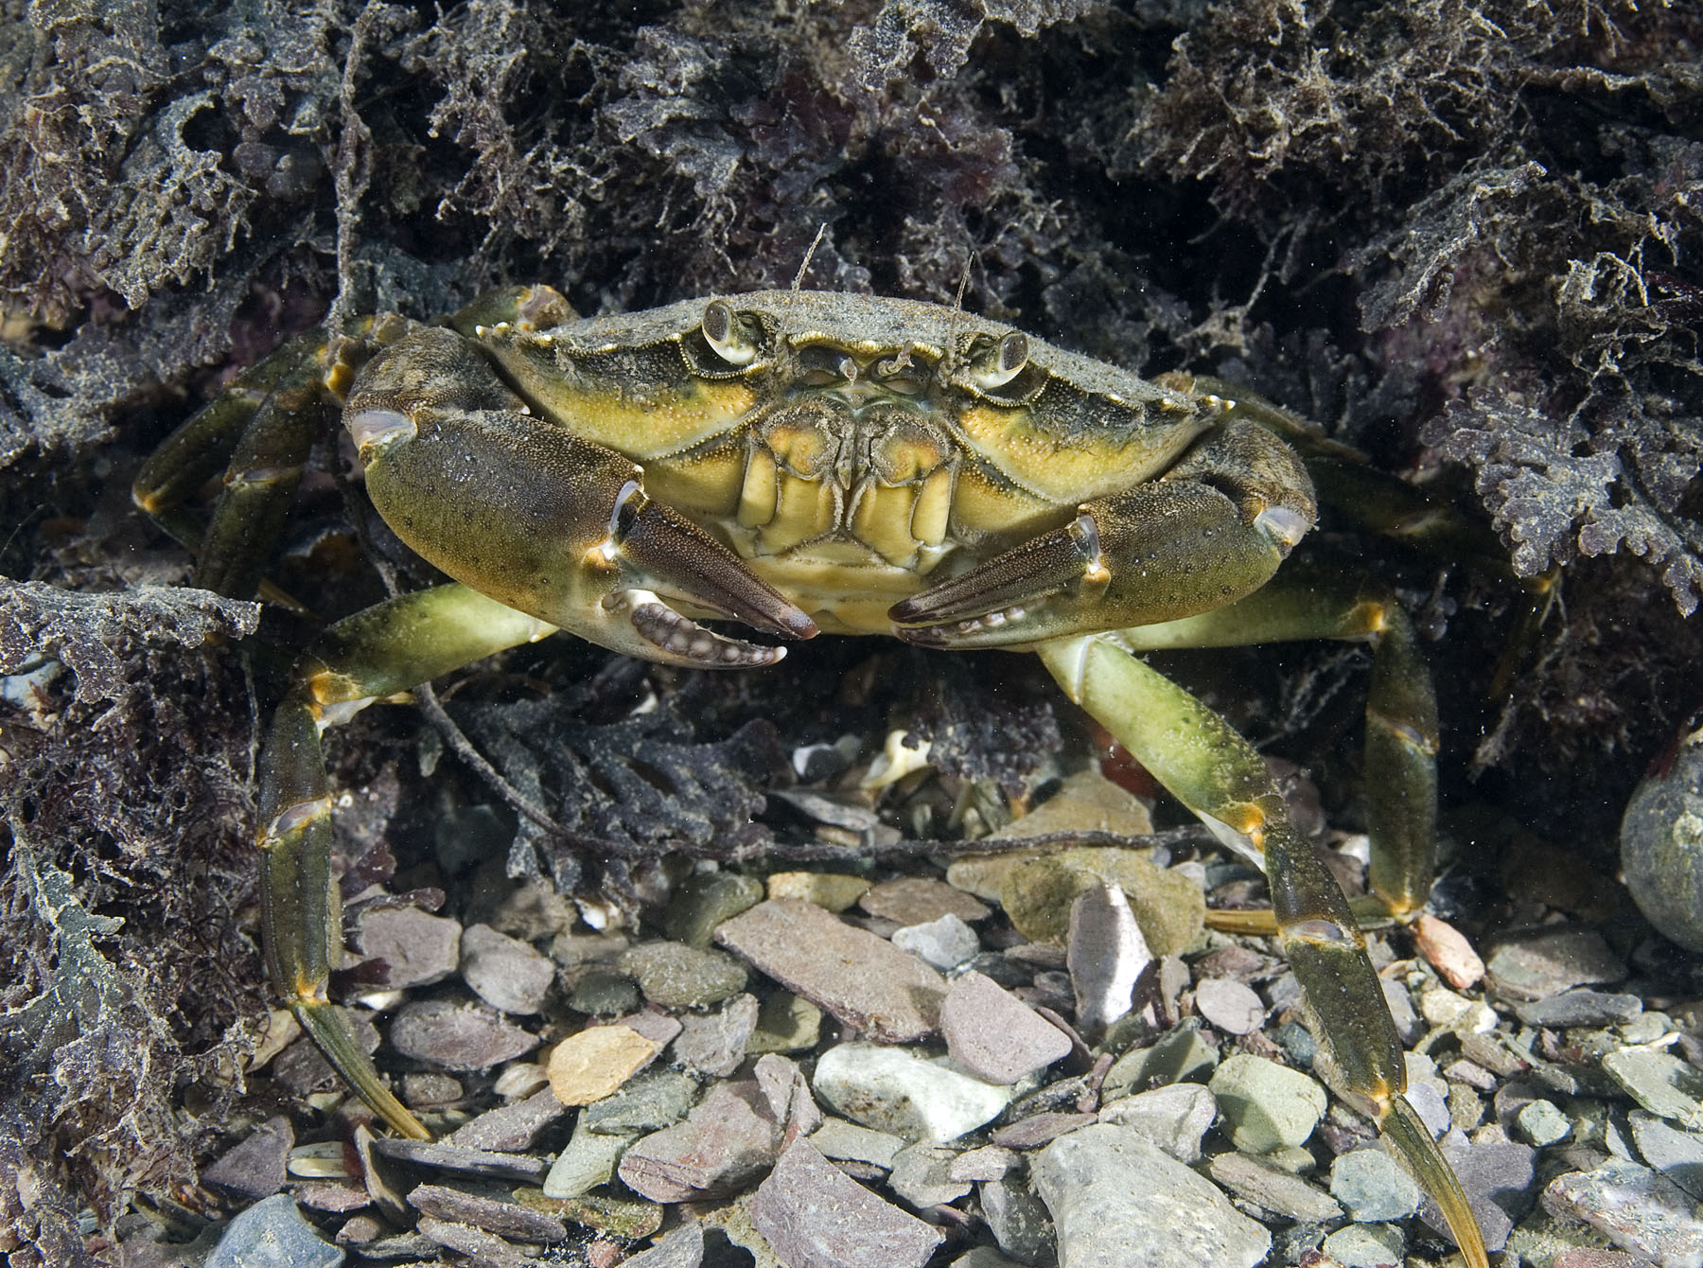
Shore crab
Shore crabs are common rock pool or shallow water species. Males have a triangular shape on their stomachs - females a semi-circular shape.
© Paul Naylor

Slide 11
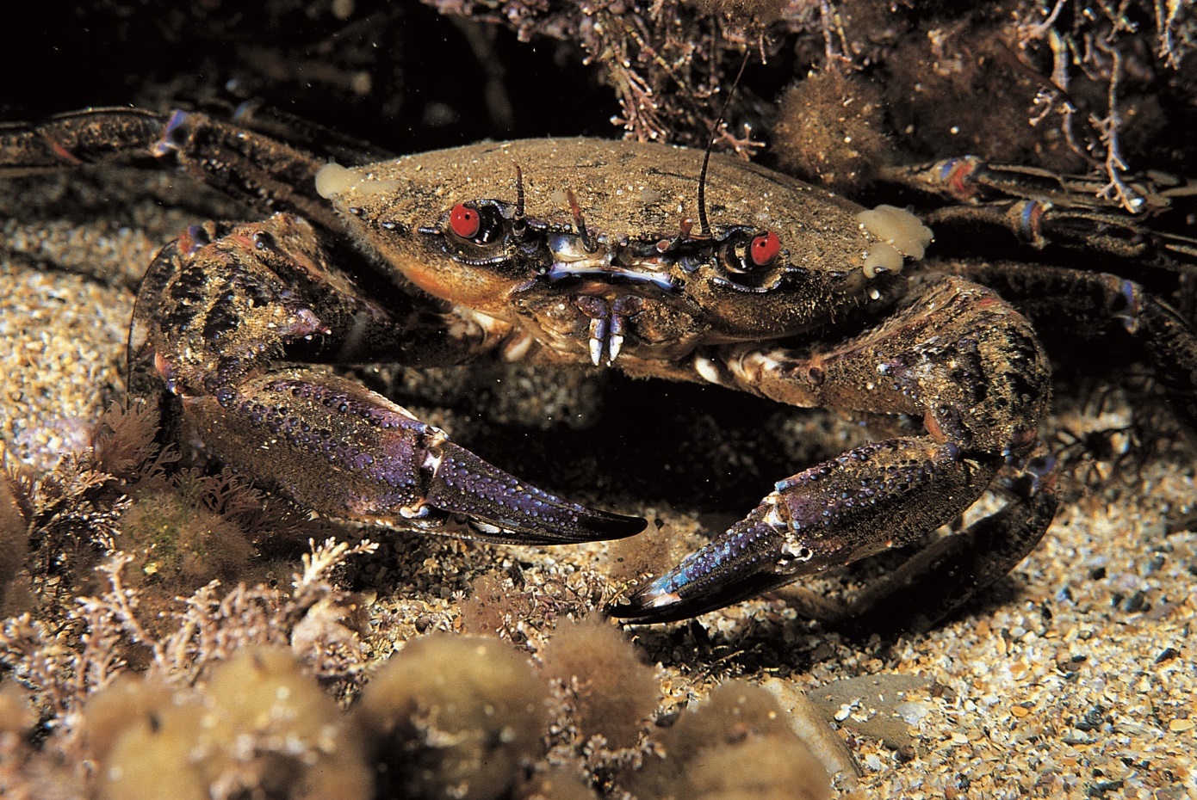
Velvet swimming crab
Its upper shell has a feeling of soft velvet. Its blood red eyes and aggressive behaviour have given it the common name “Devil Crab”.
© Paul Naylor

Slide 12
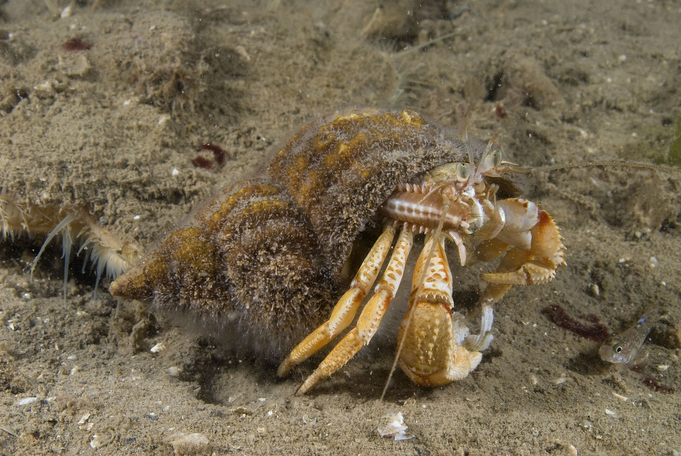
Hermit crab
The most obvious feature is the home a hermit crab lives in: usually a snail shell. Its body is soft and shaped to fit inside spiral-shaped shells.
© Paul Naylor

Slide 13
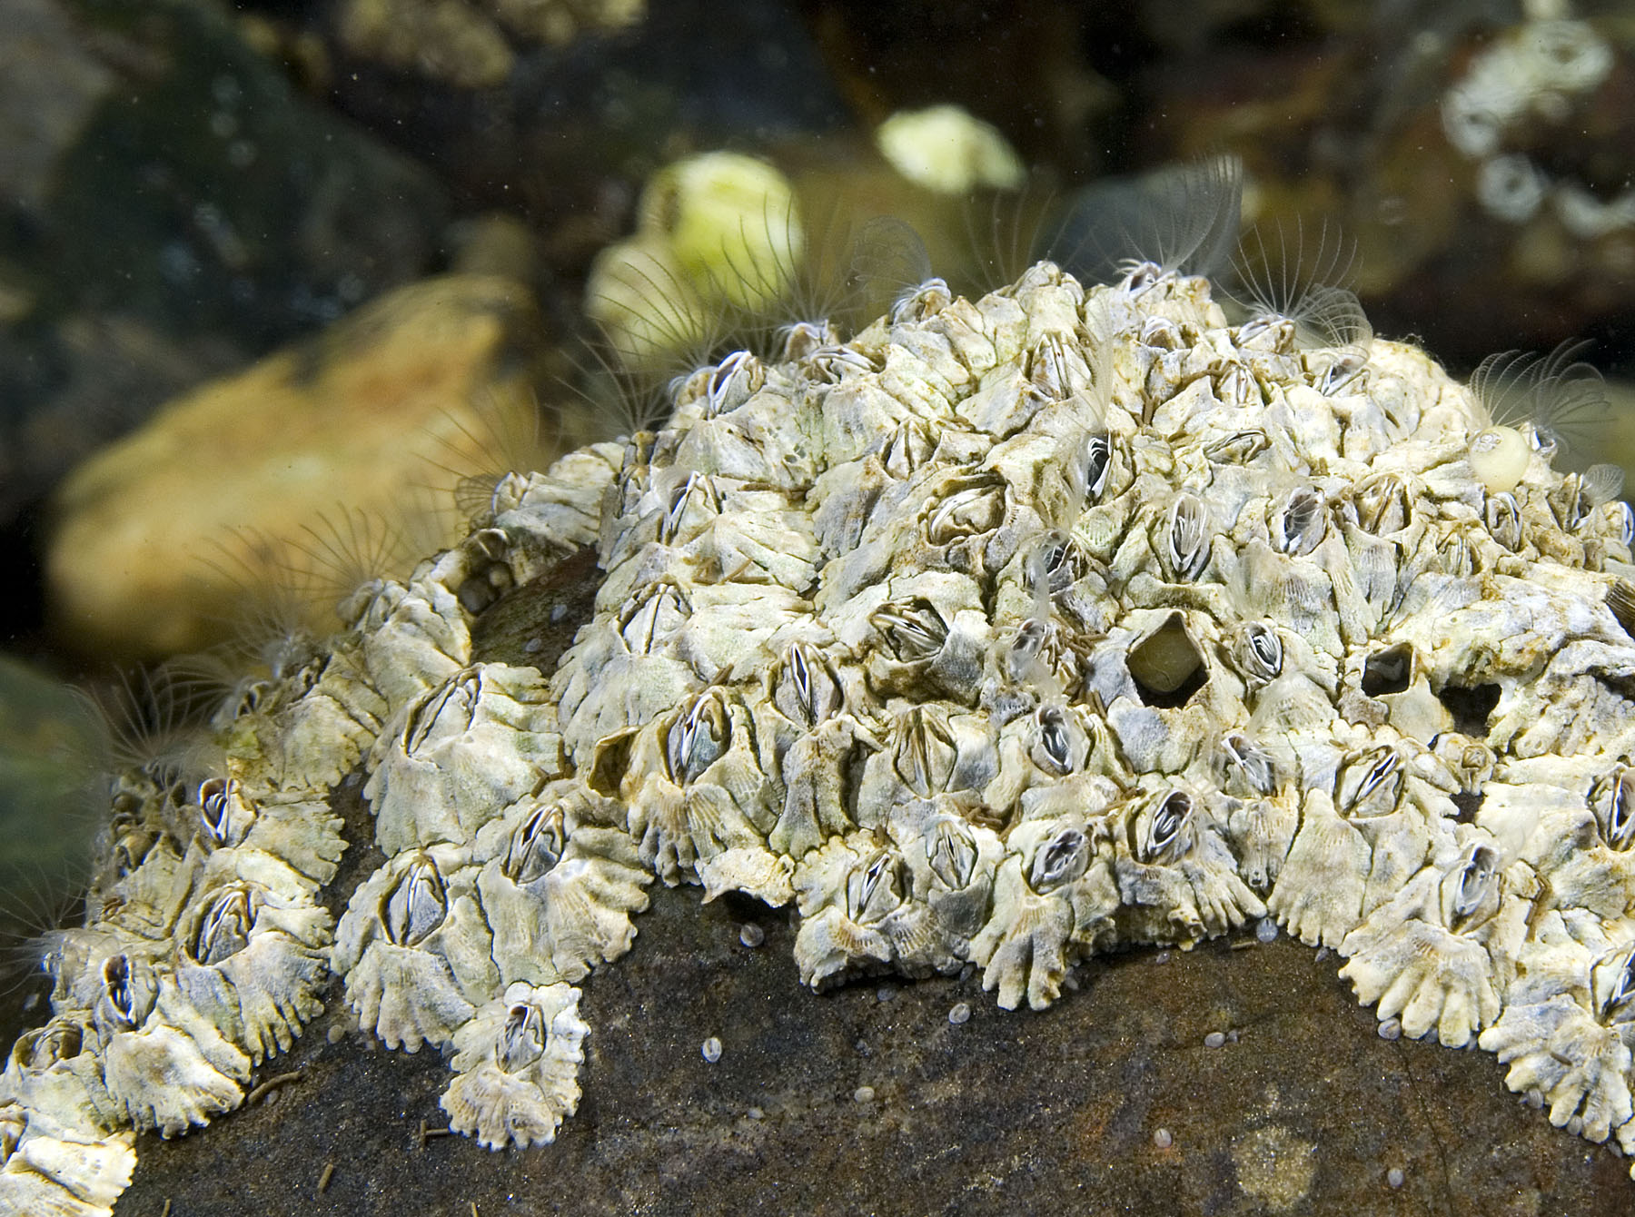
Barnacles
© Paul Naylor
Can you see their legs?
These animals live upside down, permanently stuck to the rock with their legs sticking upwards ready to catch drifting food.

Slide 14
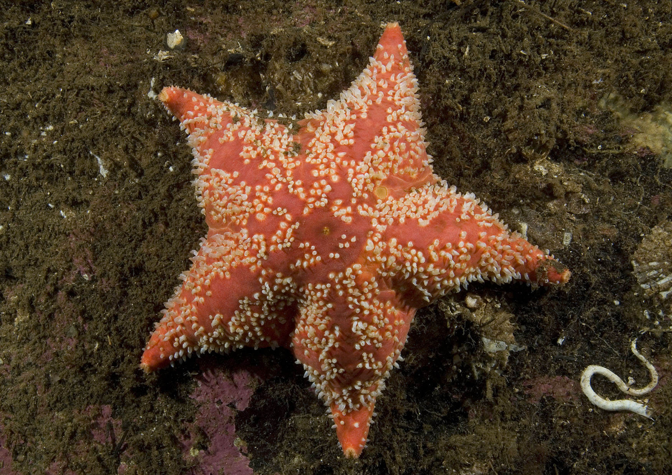
Cushion starfish
Cushion stars are similar to other starfish but have shorter, stubbier arms. They can be found hiding
under rocks.
© Paul Naylor

Slide 15
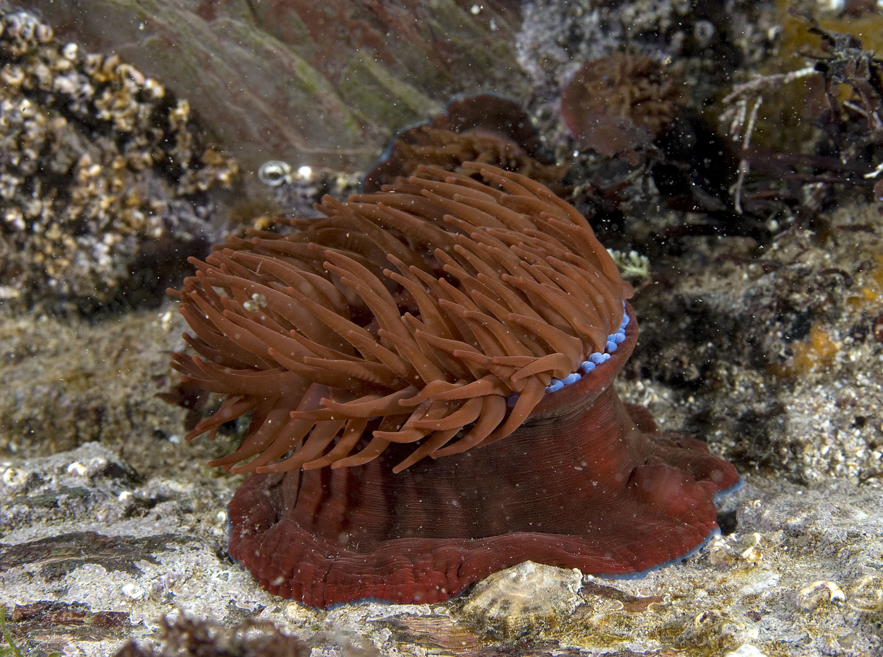
Beadlet anemone
© Paul Naylor
Has a band of ‘beads’ around the top of its body, hence the name. When the tide goes out they retract their tentacles so they won’t dry out.

Slide 16
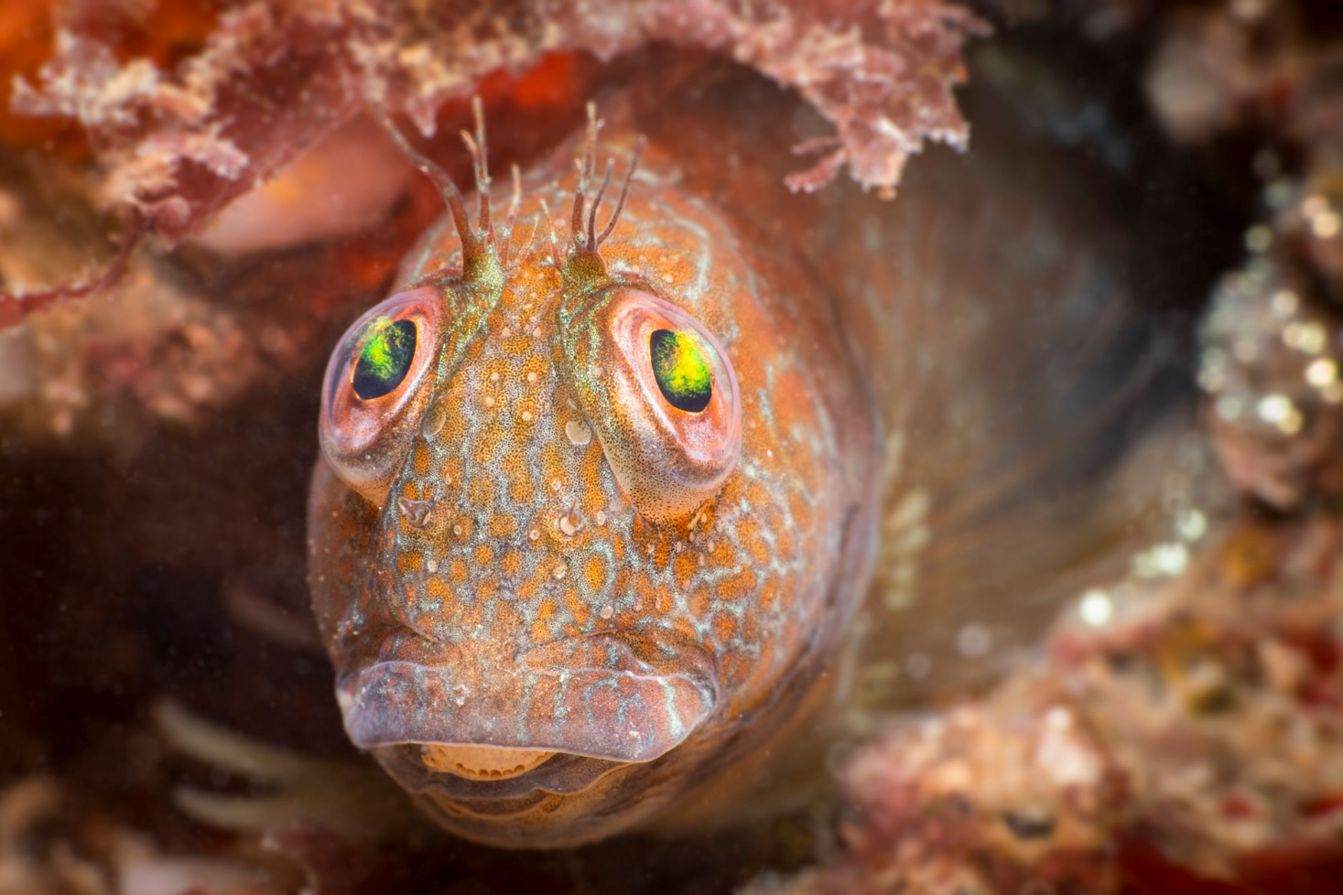
Tompot Blenny
These fish can change colour to blend in with their surroundings.
They have sharp teeth for crunching barnacles off rocks.
© Kirsty Andrews

Slide 17
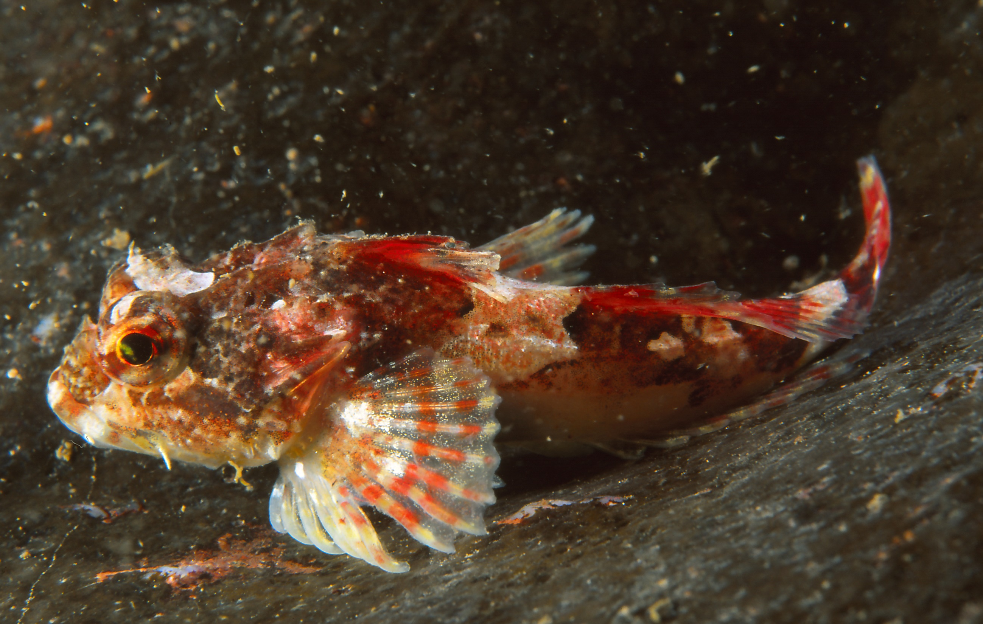
Sea scorpion
Sea scorpions get their names from the spines on their bodies. They are fierce predators with very large mouths capable of eating other fish as large as themselves.
© Valda Butterworth

Slide 18
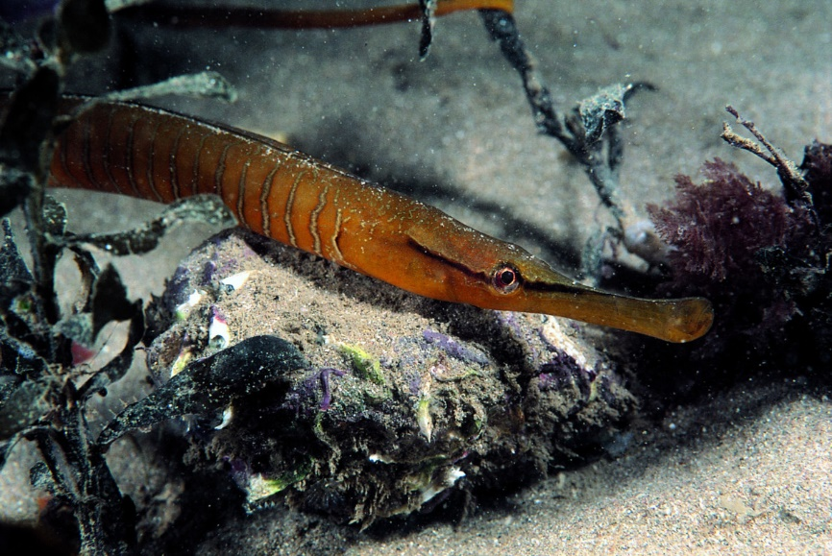
Pipefish
Pipefish are related
to seahorses and share similar characteristics, such as the long nose
and the fact that the males carry the eggs.
© Paul Naylor

Slide 19
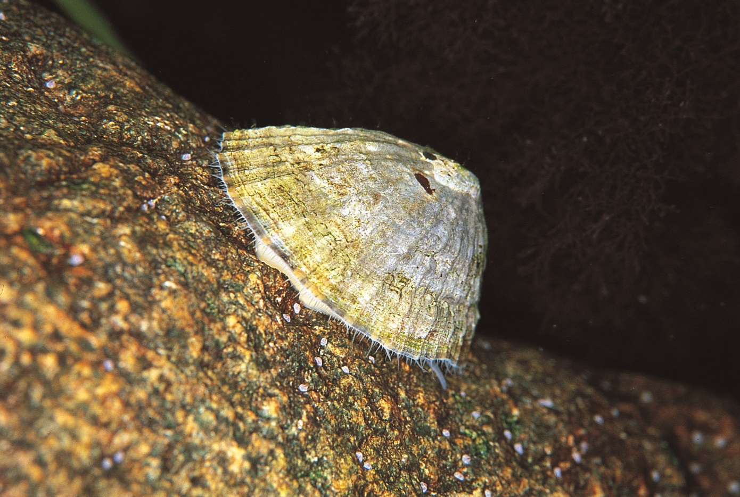
Common limpet
A snail with a homing instinct! It grazes on algae while the tide is in and returns to the same spot, called a home scar, when
the tide retreats.
© Paul Naylor

Slide 20
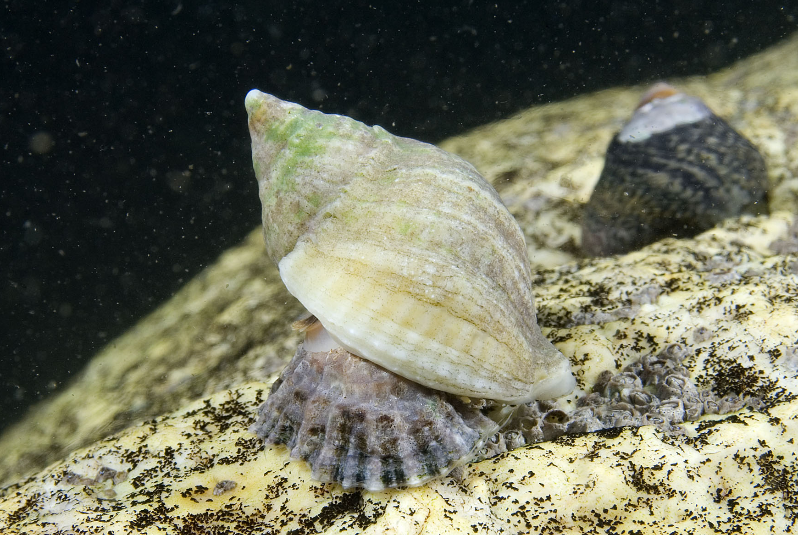
Dog whelk
© Paul Naylor
Meat-eating sea snails that drill holes into limpets, turn their insides into soup and suck up the yummy contents!

Slide 21
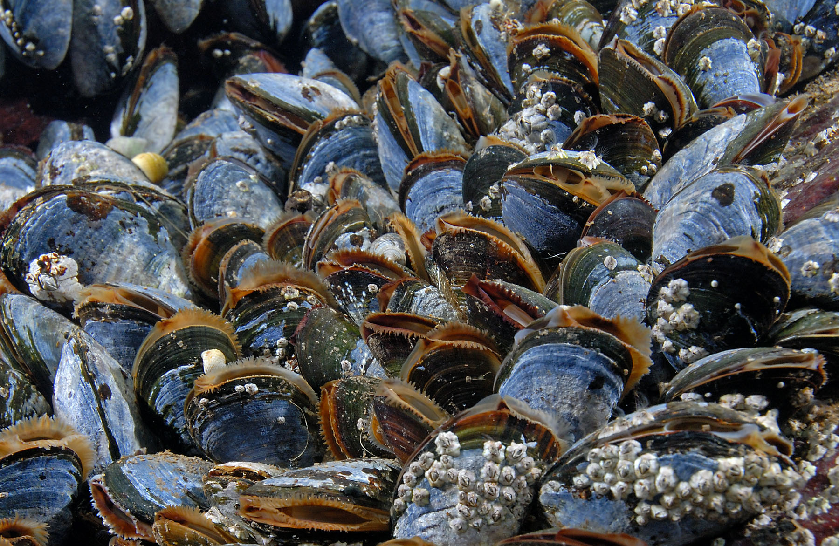
Mussels
© Paul Naylor
Mussels do indeed have very strong muscles that help keep their shells clamped shut. Found attached to the rocks. Their empty shells can also wash ashore.

Slide 22
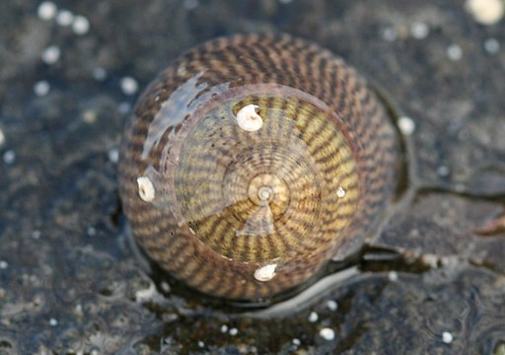
Grey Topshell
The Grey Topshell is a type of marine snail. It is very common on rocky shores all over the UK.

Slide 23
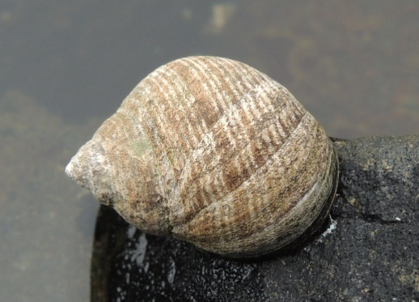
Common periwinkle
The common periwinkle is a very common sea snail on rocky shores. They are edible and a popular seaside snack.
© Anita Gould via Flickr

Slide 24
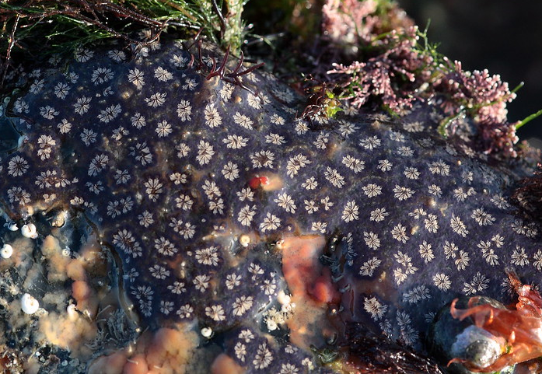
Star Ascidian
© Deryk Tolman via Flickr
This is a colony of animals called sea squirts. They
create a beautiful gelatinous matt across rocks, with 3-12 individuals creating a star shape.

Slide 25
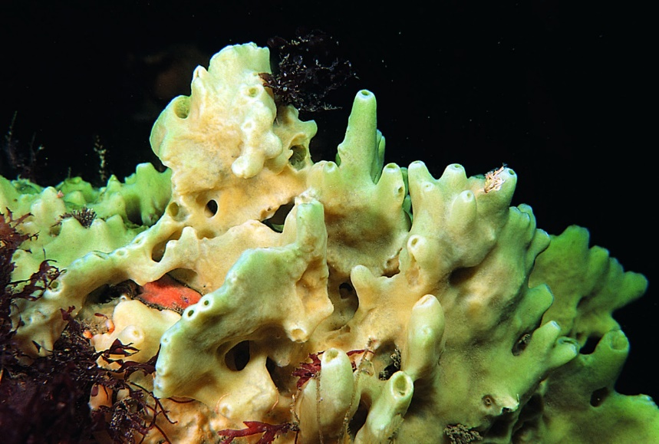
Breadcrumb Sponge
This spongey mass which covers rocks
is actually a species of animal called
a sea sponge.
Their structure is crumbly and ‘breadcrumb’ like.
© Paul Naylor

Slide 26
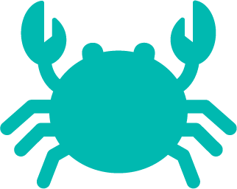





Grouping animals
Crustaceans
Prawn, Shore Crab, Velvet
swimming crab, Hermit crab, Barnacles
Fish
Tompot blenny, sea scorpion, pipefish
Mollusc (sea snails)
Grey top shell, Common periwinkle, Common limpet, Dog whelk
Echinoderm
Cushion starfish
Sea squirt
Star ascidian
Sponge
Breadcrumb sponge
Cnidarian
Beadlet anemone
Notes:
Animals are grouped according to their physical and behavioural characteristics. The animals in the rockpool spotter guide can be grouped into the following groups;

