Slide 1
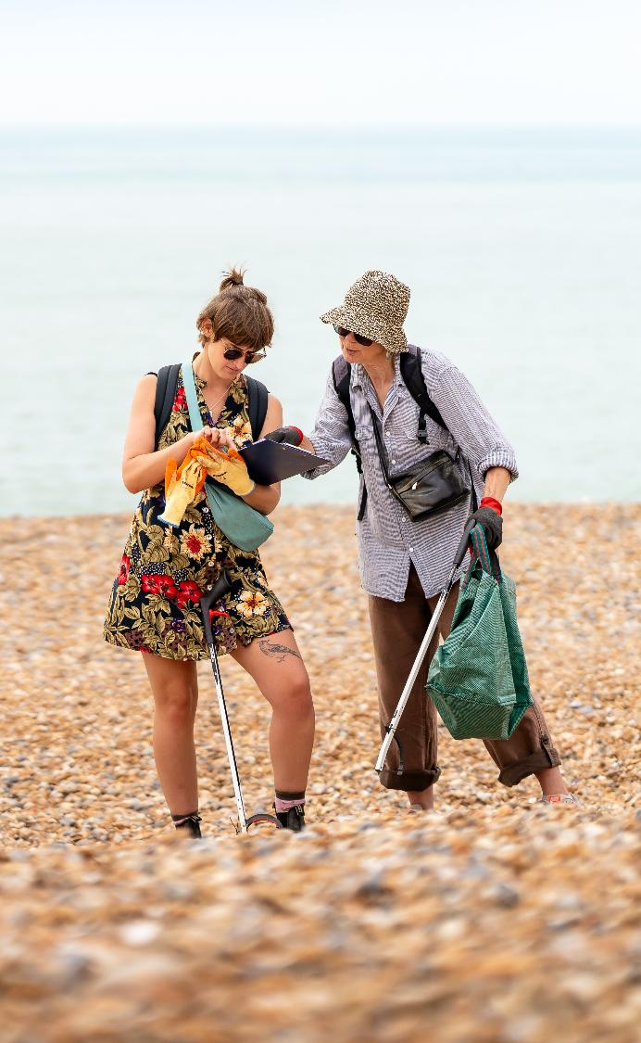
Beachwatch
deep-dive
Beach clean and litter survey
30+ years old
Volunteer-led
State of our beaches report
Credit: Rose Bainbridge
Notes:
Add these slides if the group or company you are presenting too have asked for more information about Beachwatch
The following few slides, I’m going to talk a little more about Beachwatch, as this is something your organisation/group has expressed an interest in
Beachwatch is our longest standing volunteering activity, it's been running for over 30 years!
We have about 15,000 volunteers cleaning our beaches each year
A lot of this falls within the Great British Beach Clean week, which happens in September every year
Beachwatch volunteers don’t just clean the beaches, they collect important litter data that feeds into our policy work and campaigns
Every year, we release a big report called “the state of our beaches” – if you're interested in learning more this is available on our website and it contains all the years facts and figures

Slide 2
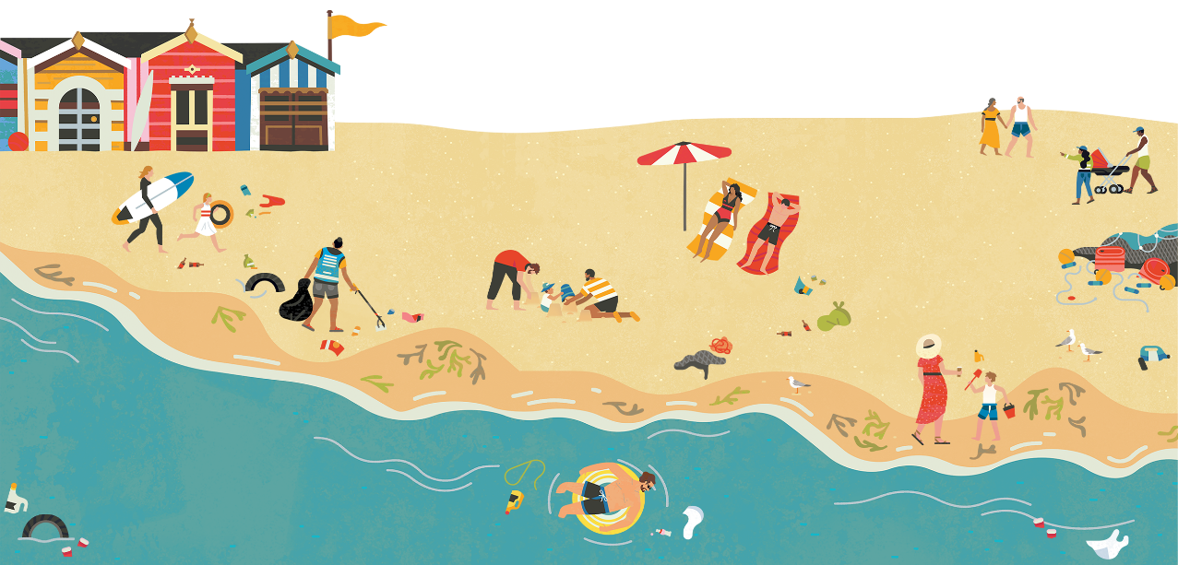
Policy impacts
2015 – plastic bag charge
2019 – straws and cotton buds
2022 – cutlery and food containers
2025 – disposable vapes
Notes:
One of the most important aspects to the Beachwatch programme is that it provides evidence for our campaigns
Here’s a timeline outlining some of our key wins, backed up by beachwatch data
2015 – a 5p charge introduced across whole of UK in 2015, updated to 10p in 2021.​ Using our Beachwatch data, we have seen an 80% decrease in the average number of bags found on beaches across the UK since 2015.
2019 - Over the years our Beachwatch data found thousands of plastic straws and plastic cotton bud sticks on our beaches. We were delighted to see the ban on supplying these items in 2019
2022 – again using Beachwatch data, we showed evidence of plastic cutlery plates, trays, cups and containers found on beaches. So, it was great to see that since October 2022, people can no longer buy these products from any business.
2025 – Using Beachwatch data, and working with environmental activist Laura Young’s (who campaigns against disposable vapes), we’ve contributed towards disposable vapes being banned this year!

Slide 3
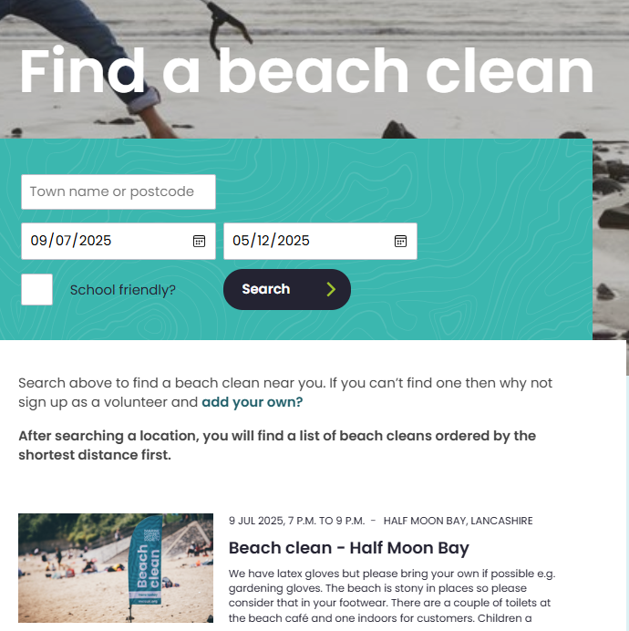
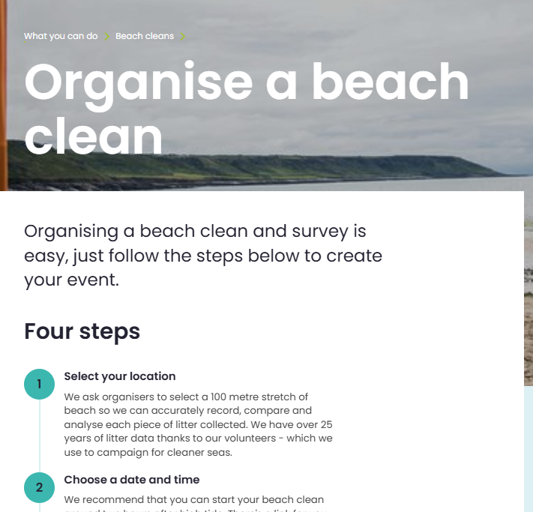
Notes:
We hope by now you want to get involved!
To get involved in Beachwatch, you can attend beach cleans that other volunteers and MCS staff have organised, or you can organise your own! Go to the “ways to volunteer” page on our website for full details
Organise a beach clean | What you can do | Marine Conservation Society
Find a beach clean | What you can do | Marine Conservation Society

Slide 4
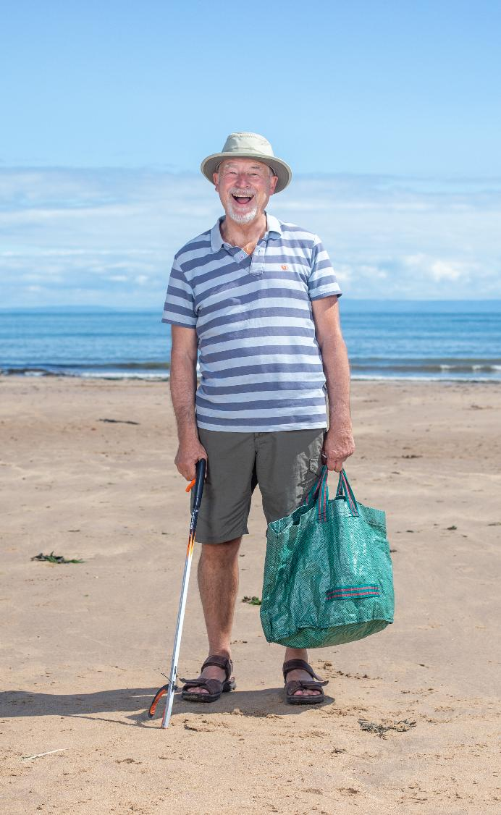
The Great British Beach Clean
Every September
Hundreds of cleans across the UK, Northern Ireland and channel islands
International Coastal Cleanup
Credit: Shane Woodford
Notes:
A great time to get involved is during the week-long Great British Beach Clean which we run every September (2025 dates, 19-28th Sept)
The Great British Beach Clean is a week-long citizen science event, where hundreds of beach cleans take place up and down the UK, Northern Ireland and channel islands
Litter data collected on beach cleans drives our conservation work, helps us to campaign for change, and also feeds into the International Coastal Clean-up
Use the search function on our website to sign up for a clean, or of there's nothing in your area, you could organise your own!
After a summer of enjoying our beaches, there's no better time to help clean our beaches than during the GBBC

Slide 5
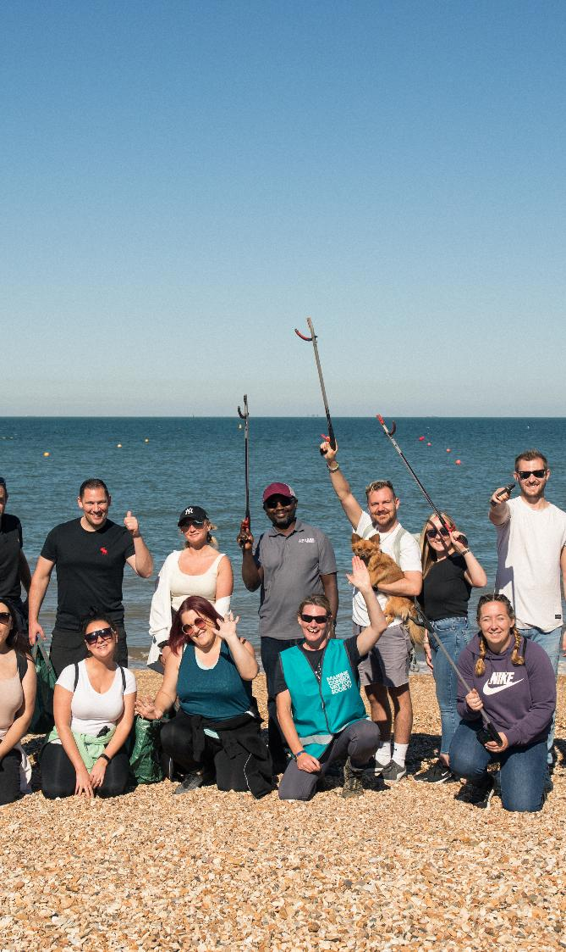
Company Team Beach Cleans
Perfect for volunteer days!
Team building
Bookable throughout the summer
Head to our website for prices and information
Credit: Billy Barraclough
Notes:
Only use this slide if you are talking to a company or business
For organisations like yours, we offer Company Team beach cleans
These can be a fantastic way to use your volunteer days, get outside and do something meaningful for our ocean!
The days normally run from 10:30-3:30pm and include team building exercises and other activities, as well as the beach clean and litter survey
Head to our website for more information and to book your spot: Company Team Beach Clean Events | Business Volunteering | CSR Days | Marine Conservation Society

Slide 6
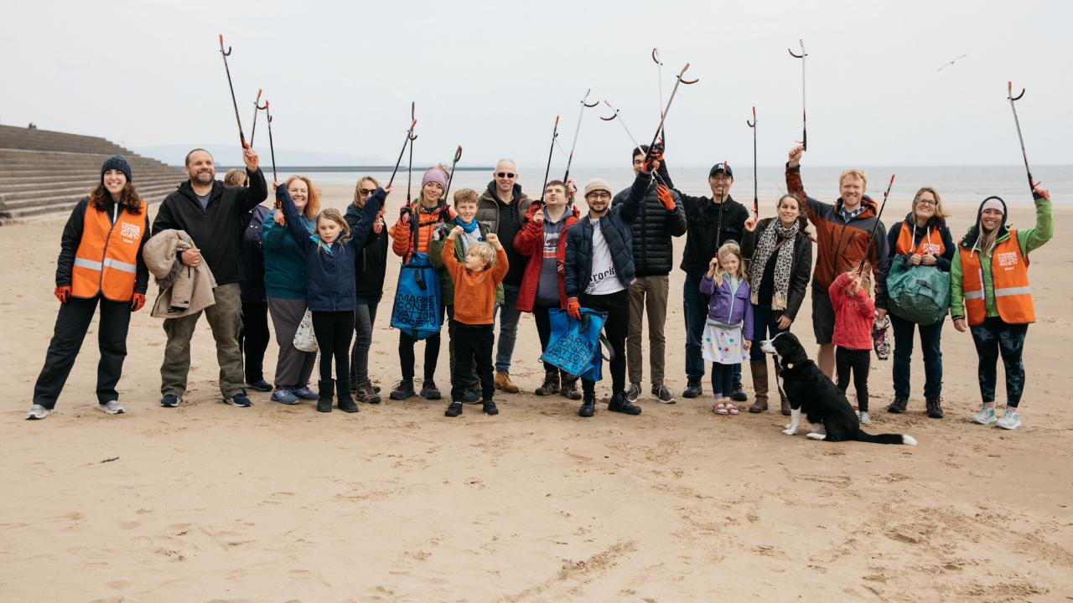

Since 1994, Beachwatch has…
Conducted >19,400 surveys
Surveyed >3,900 miles of coastline
Removed >540 tonnes of litter
Recorded >11.5 million litter items from UK beaches
>257,500 volunteers have dedicated >450,000 hours
Notes:
Before we wrap up, I wanted to share some impressive numbers from the Beachwatch programme. Since 1994 volunteers have :
Conducted over 19 400 surveys
Surveyed almost 4000 miles of coastline
Removed 540 tonnes of litter, which is equivalent of almost 6 blue whales!
Recorded 11.5 million litter items.
257 500 volunteers have dedicated 450 000 hours which is 51 years of continuous time surveying.
This is an incredible effort, none of which would have been possible without the dedication of our volunteers, who have truly helped us drive change.

