Slide 1

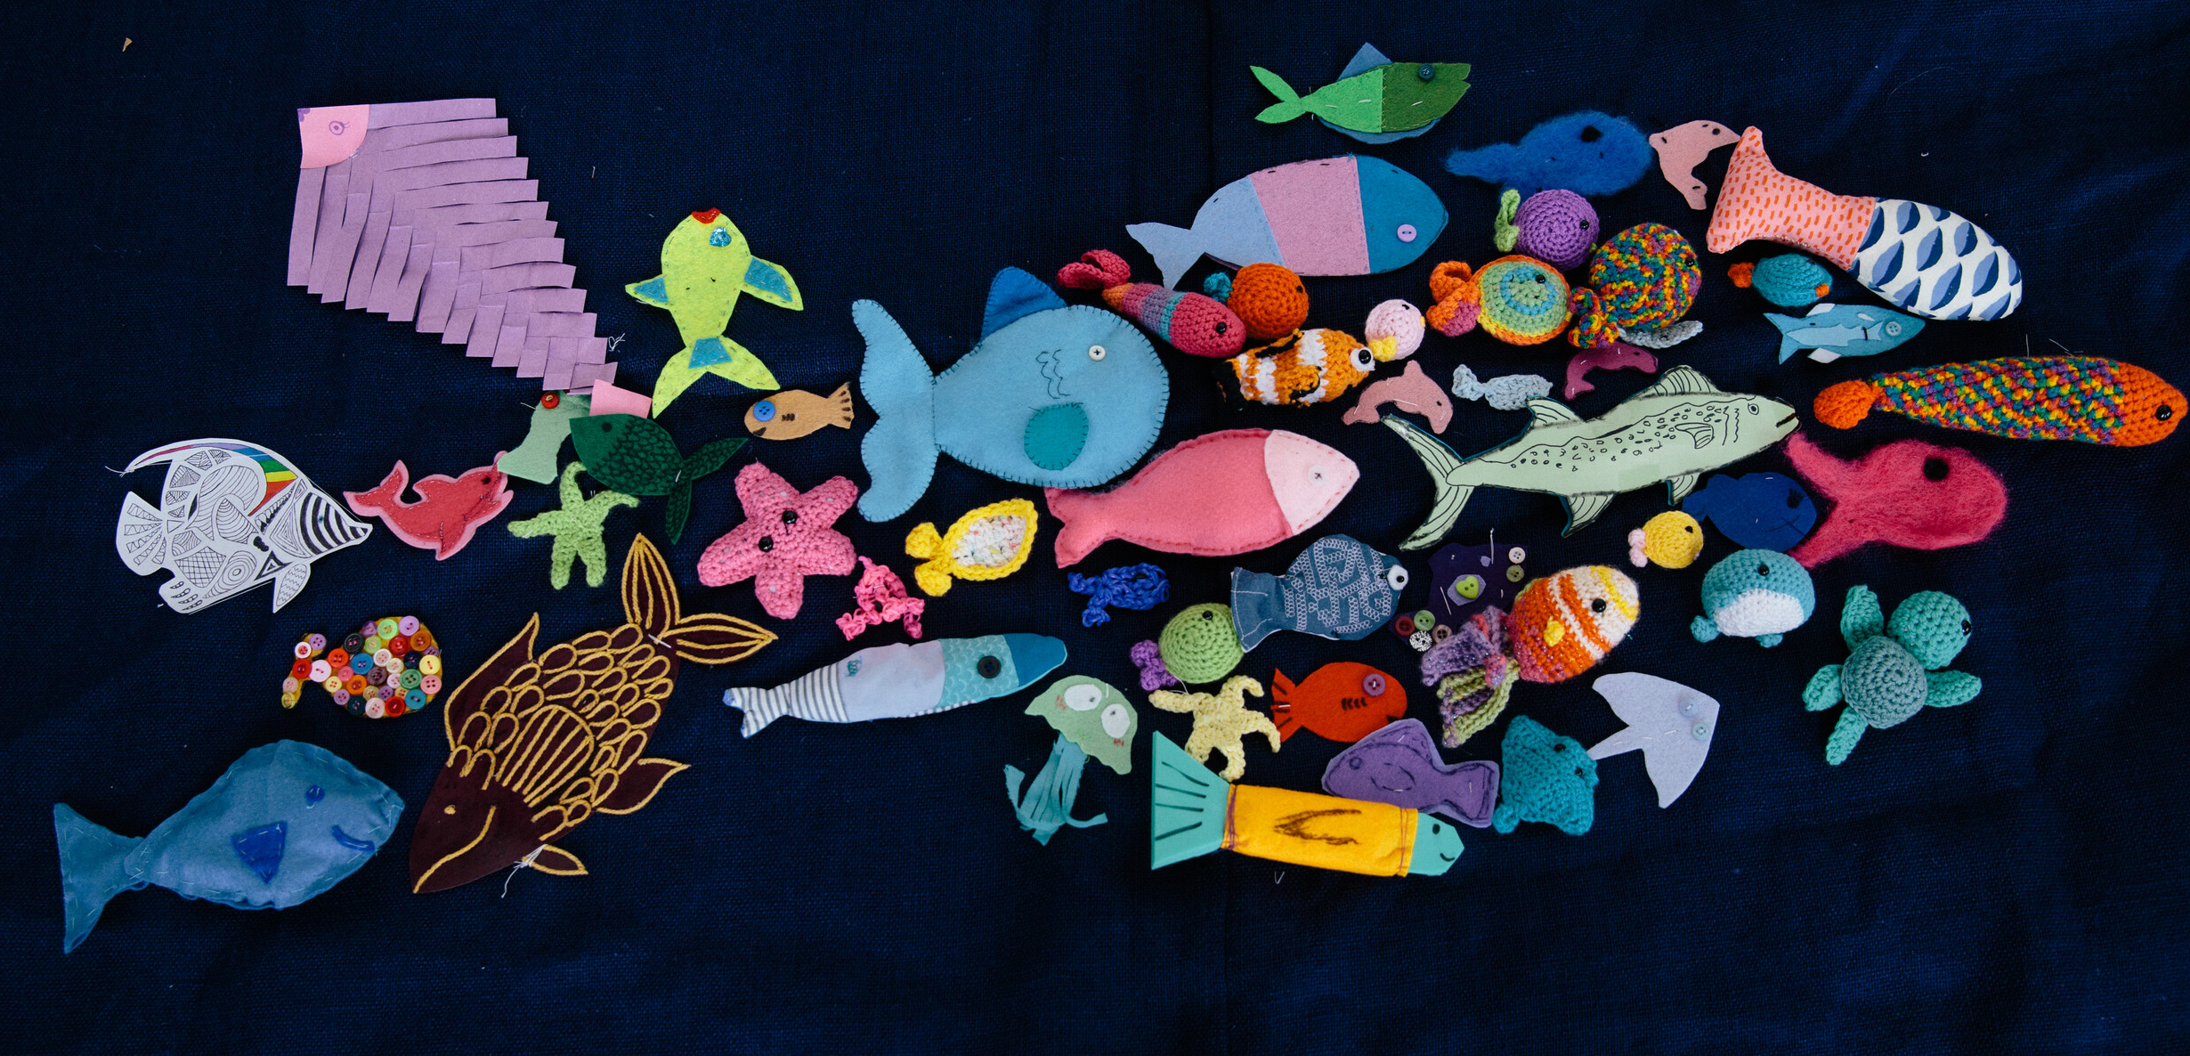
Artivism
Sudheha Amerasinghe

Slide 2
What is artivism?
Simply put, artivism is the combination of art and activism.
It’s all about creating art to tell a story and inspire social, political or environmental change.
Explore some examples of how art and design have been used to raise awareness and get inspired to create your own art piece!

Slide 3
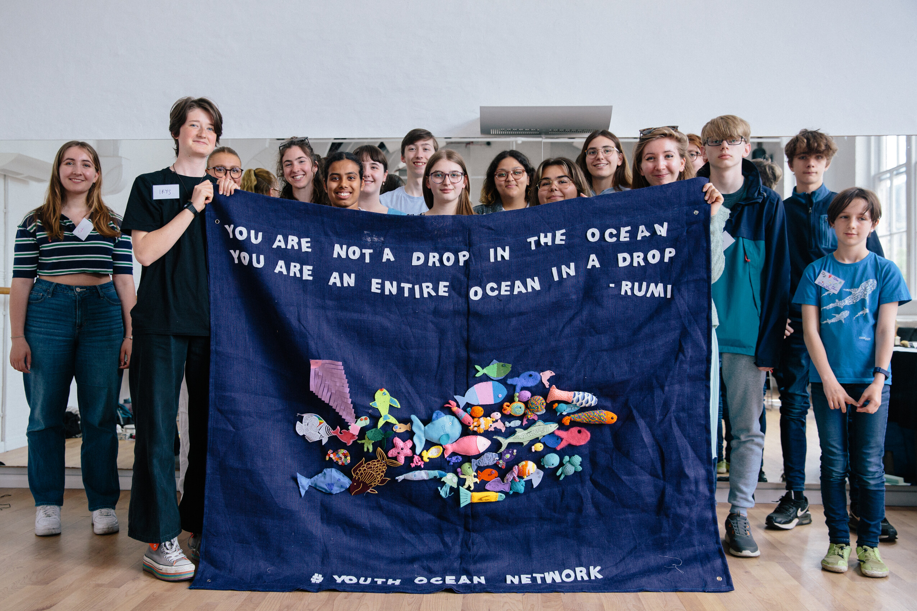
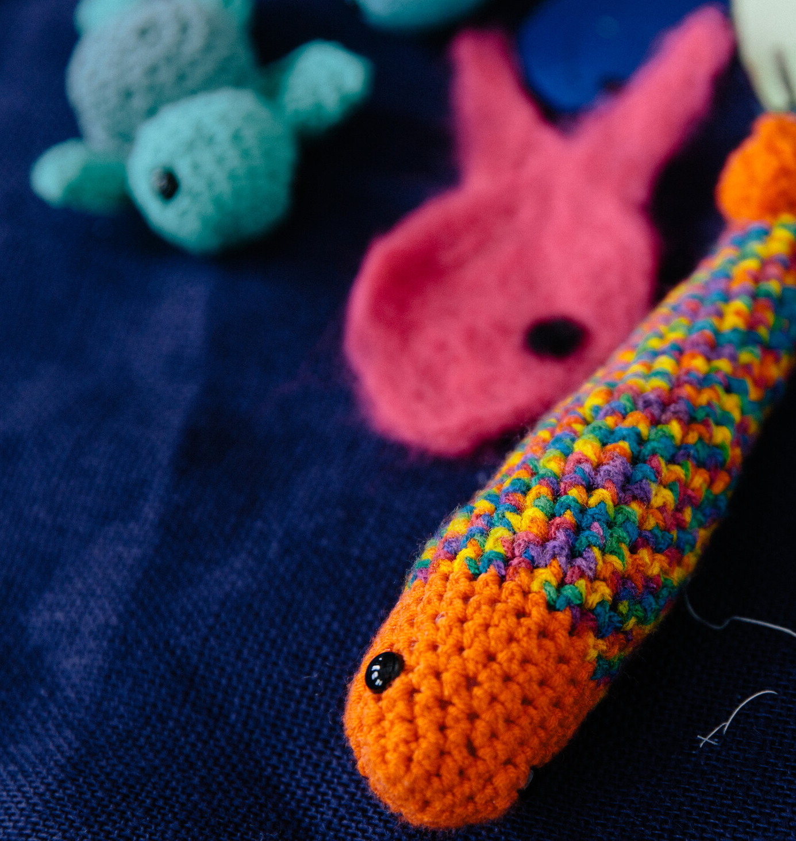
This artwork was designed and planned by members of the Youth Ocean Network and crafted on World Ocean Day 2024. One of the creators, Elle, said that the vision for the piece was a visual reminder of the Rumi quote, ‘you are not a drop in the ocean. You are an entire ocean in a drop.’ Elle said that by bringing together lots of fish crafted by the Youth Ocean Network, they wanted to highlight that we can use individual action to make a big difference.
Youth Ocean Network (2024)
Sudheha Amerasinghe

Slide 4
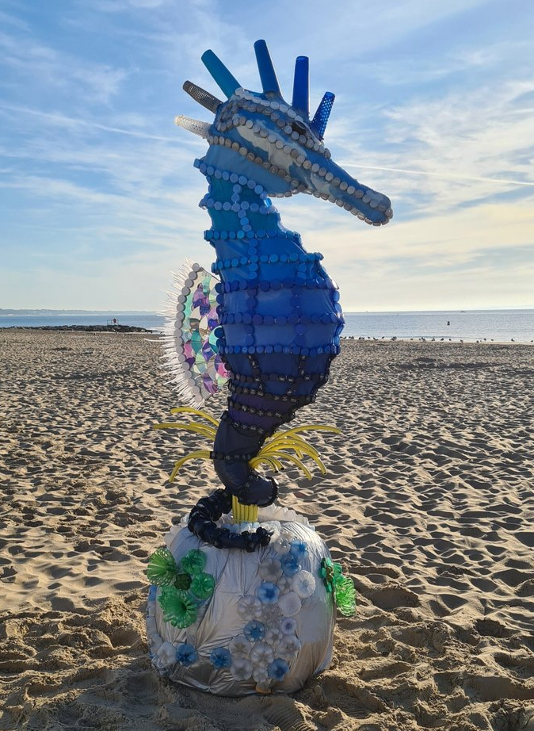
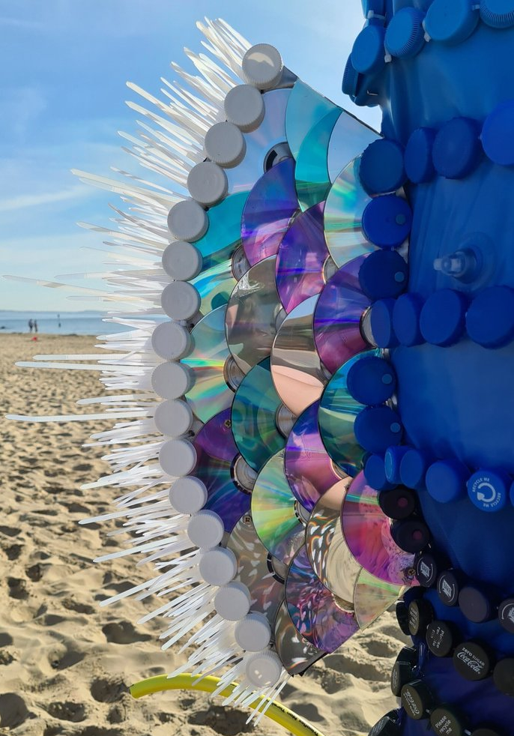
To raise awareness of the Great British Beach Clean and plastic pollution in 2021, Sarah Turner created a giant seahorse out of waste plastics and displayed it at a Marine Conservation Society beach clean in Poole.
The waste plastics included popped paddling pools, bottle caps, CDs and a hose pipe. Reclaimed wood was used to create the structure and any cable tie ends trimmed off were then used to form the edge of the fin.
Seacil the seahorse (2021)
Sarah Turner Eco Art & Design

Slide 5
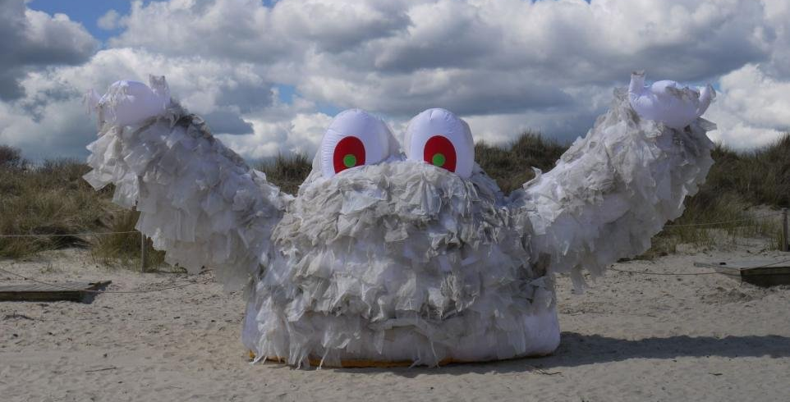
In 2016, the Marine Conservation Society joined forces with South West Water to highlight the huge problems that can be caused by flushing the wrong things down the loo, with the help of a giant monster made of wet wipes! Wallace was over 3 metres tall and 8 metres wide. Volunteers found sewage-related items like wet wipes on 72% of UK beaches in 2023, but in a good news update, all UK governments finally announced a ban on single-use wet wipes in April 2024.
Wallace the wet wipe monster (2016)
Marine Conservation Society

Slide 6
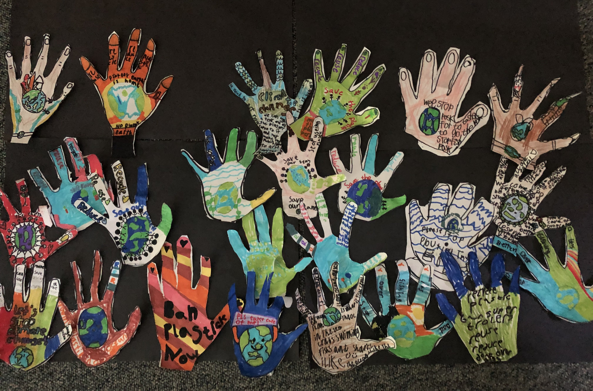
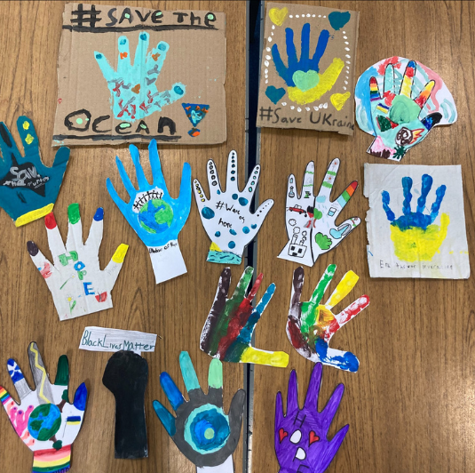
In 2021, the UK hosted two important international events: the G7 Summit and the United Nations Climate Change Conference (COP26). Ahead of these events, the Wave of Hope campaign called for people across the UK to create and display homemade hands decorated with messages of hope for the future. Photos of the hands were featured in newspapers, shop fronts and shared online to show that we stand united. The waving hands symbolised our connection to each other and a growing momentum (or 'wave') of change.
Wave of Hope (2021)
Kirsty Crawford

Slide 7
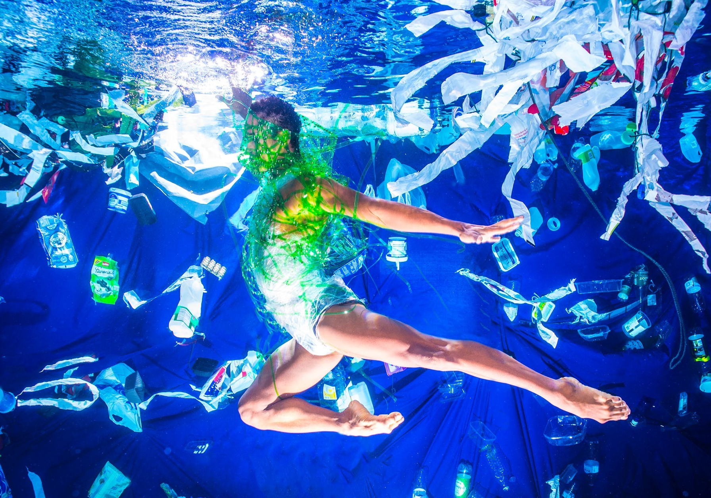
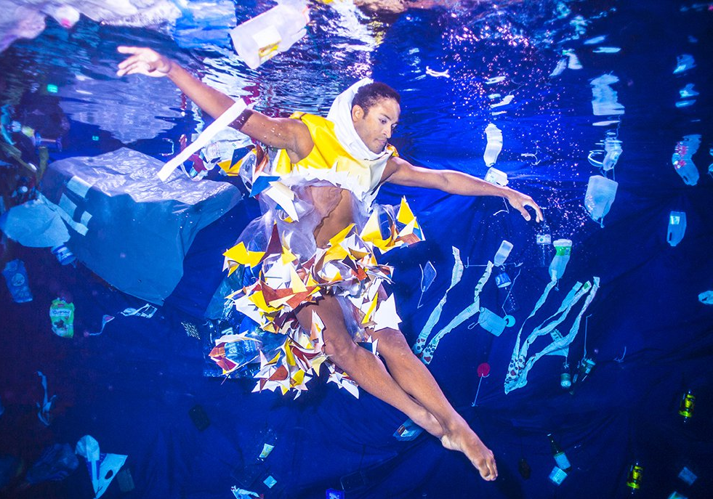
Fernando is a former solo dancer with the Royal Ballet, performing all over the world. As part of World Ocean Day in 2019, Fernando and an underwater photographer, Robin Conway, created Dance for the Sea to highlight the plastic pollution problem in our ocean. The project involved Fernando dancing underwater surrounded by plastic and sculptures made from recycled plastic by schools in London.
Dance for the Sea (2019)
Robin Conway

Slide 8
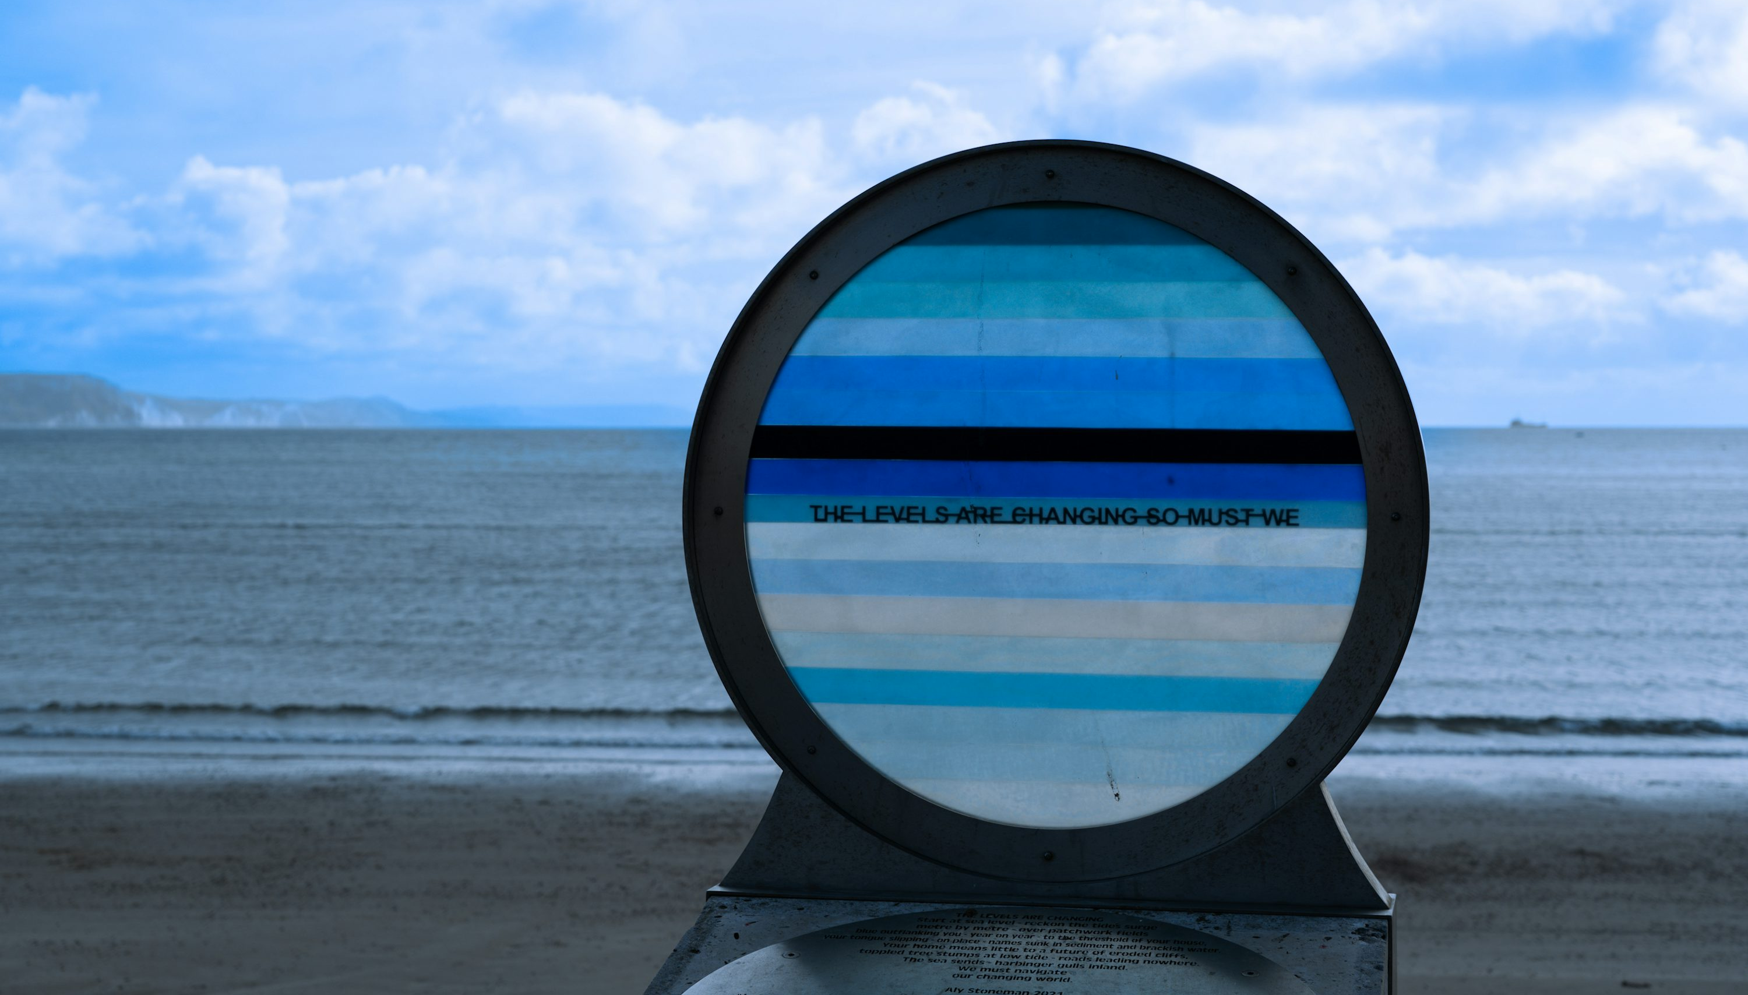
Aly Stoneman is a poet, creator and researcher who explores the relationship between humans and the natural world through her work. In 2021, she worked with artist Raphael Daden on an art piece called ‘The Levels’ as part of Weymouth Art Trail. The theme of the sculpture was rising sea levels and the impact of this on our planet. It was made with stainless steel and resin and was installed on the seafront. Daden wanted the viewer to ‘stand back and think about the ways we can make changes.’
The Levels (2021)
Start at sea level –
reckon the tide’s surge
metre by metre
over Domesday fields
blue outflanking you
year on year
to the threshold of your house,
your tongue slipping
on place names sunk
in sediment and brackish water.
Your home means little to a future
of eroded cliffs, toppled
tree stumps at low tide;
roads leading nowhere.
The sea sends
harbinger gulls
inland.
We must navigate
our changing world.
Aly Stoneman (2021)
Nick Fewings

Slide 9

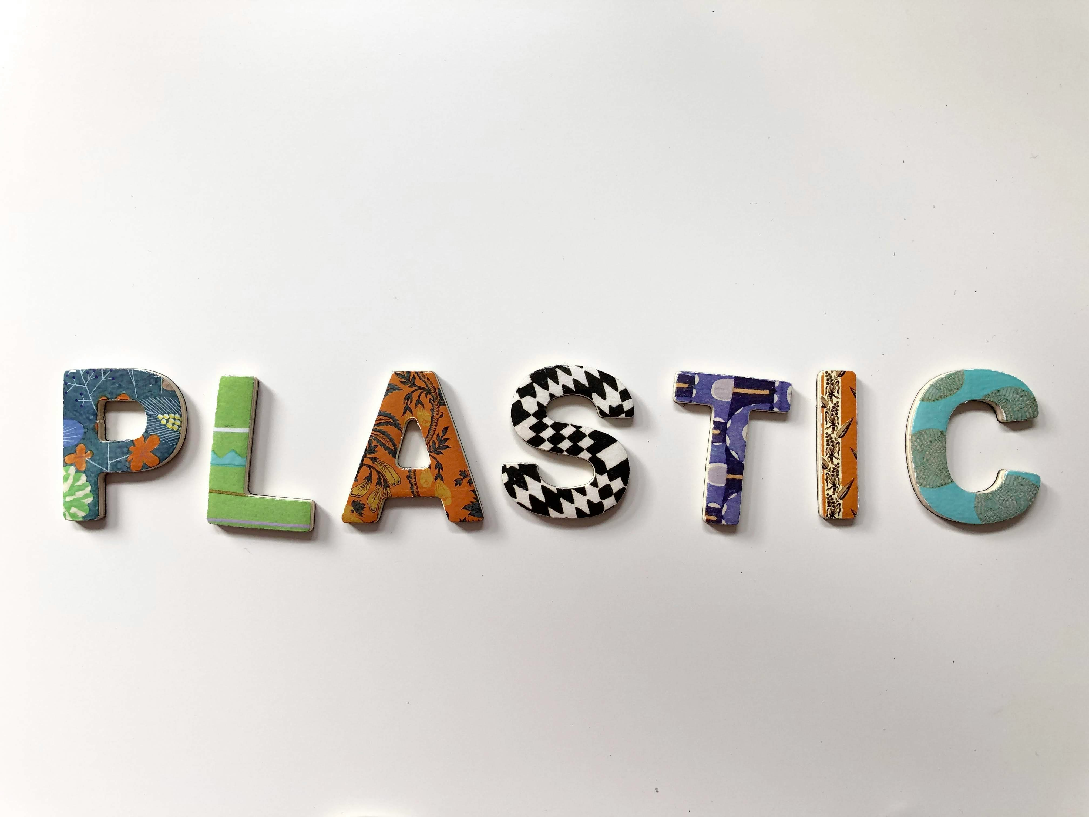
Could you spell out your message to your school or community? What kind of items could you use for your message? What do you want it to say?
Spelling out your message
Volodymyr Hryshchenko
Merakist

Slide 10
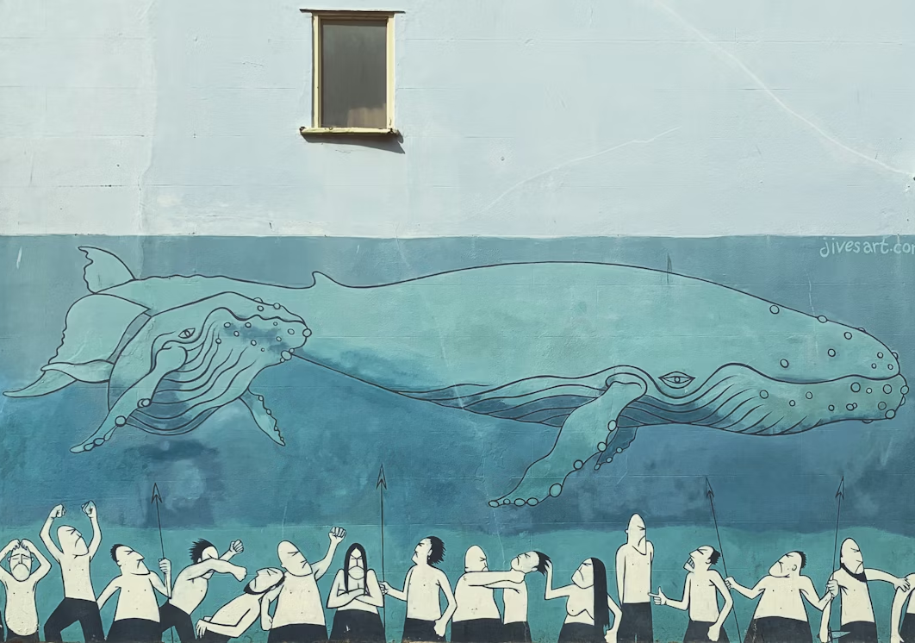
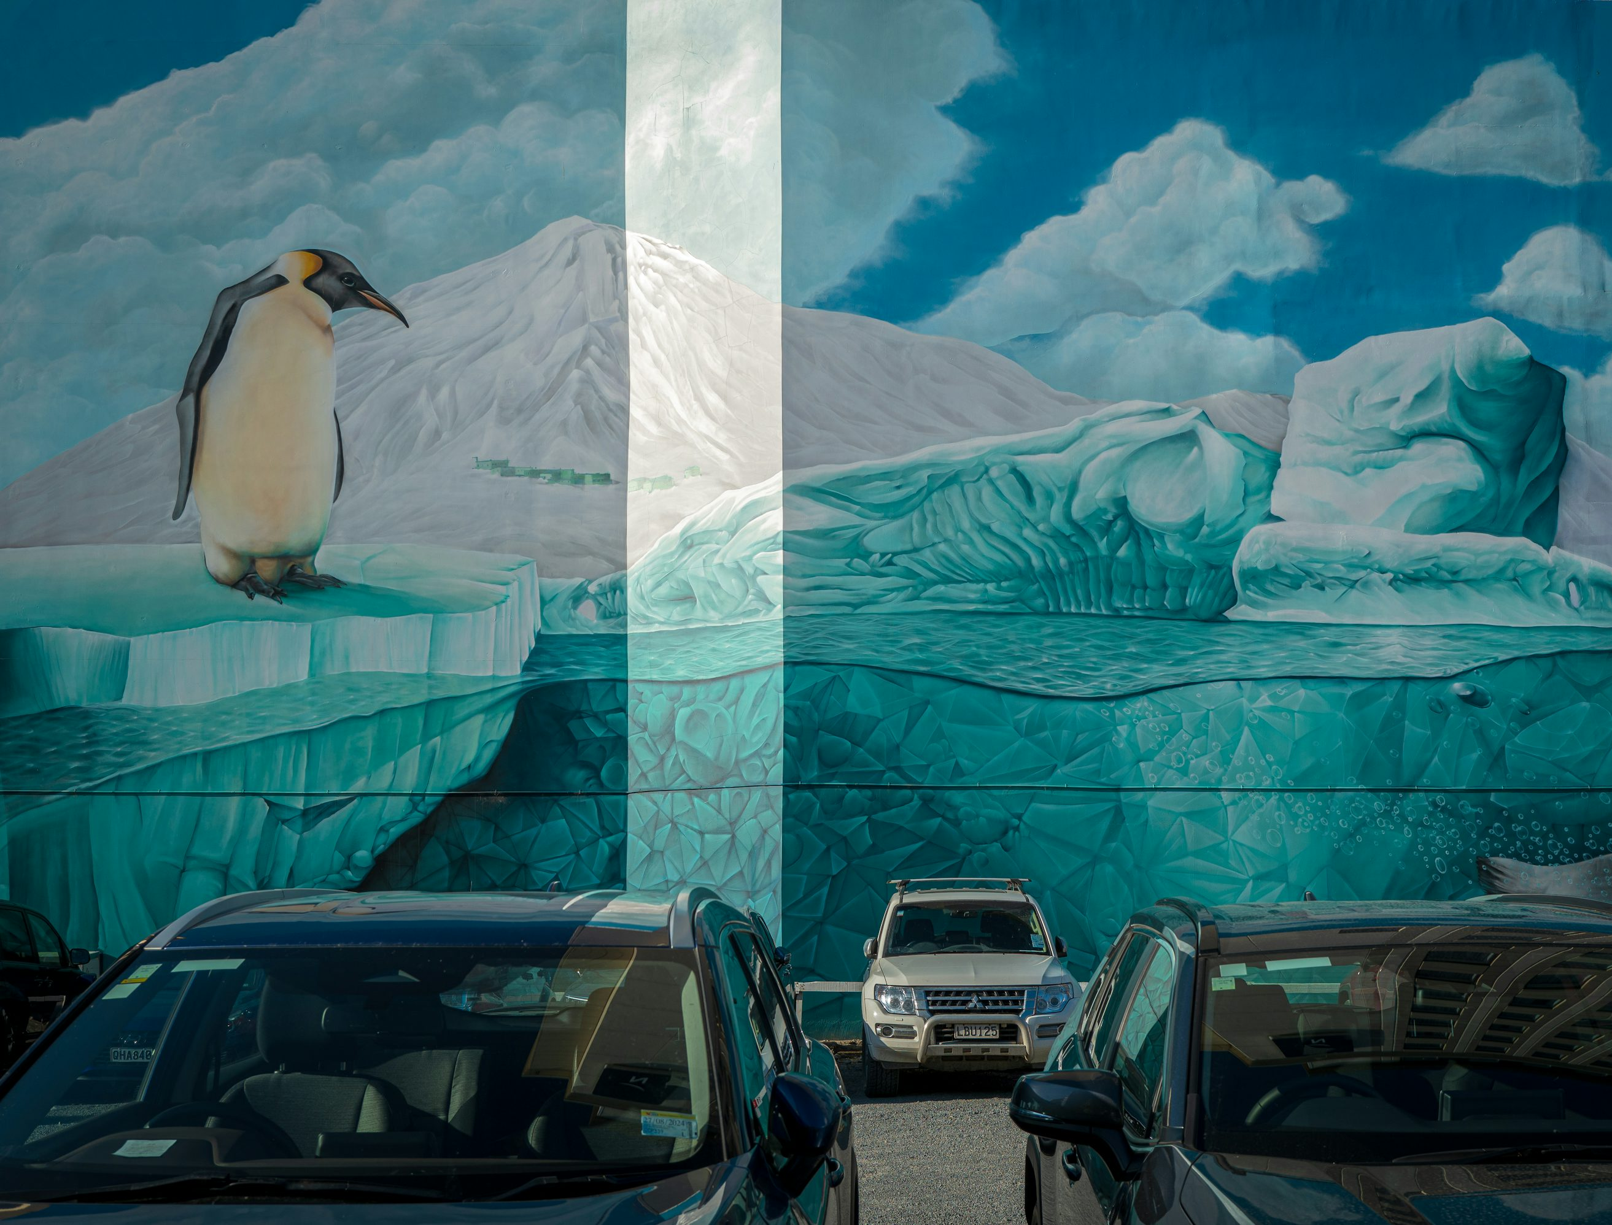
What about drawing your message at your school or in your community? Top tip: you could use pavement chalk for less permanent artwork!
Drawing or painting your message
Nitin Tulswani
Sung Jin Cho

Slide 11
Over to you!
Now it’s your turn! Think about the kind of art piece you want to create and start planning.
What did you think of the different artivism pieces?
Which was your favourite?
How do you want your art to inspire people?

