Slide 1
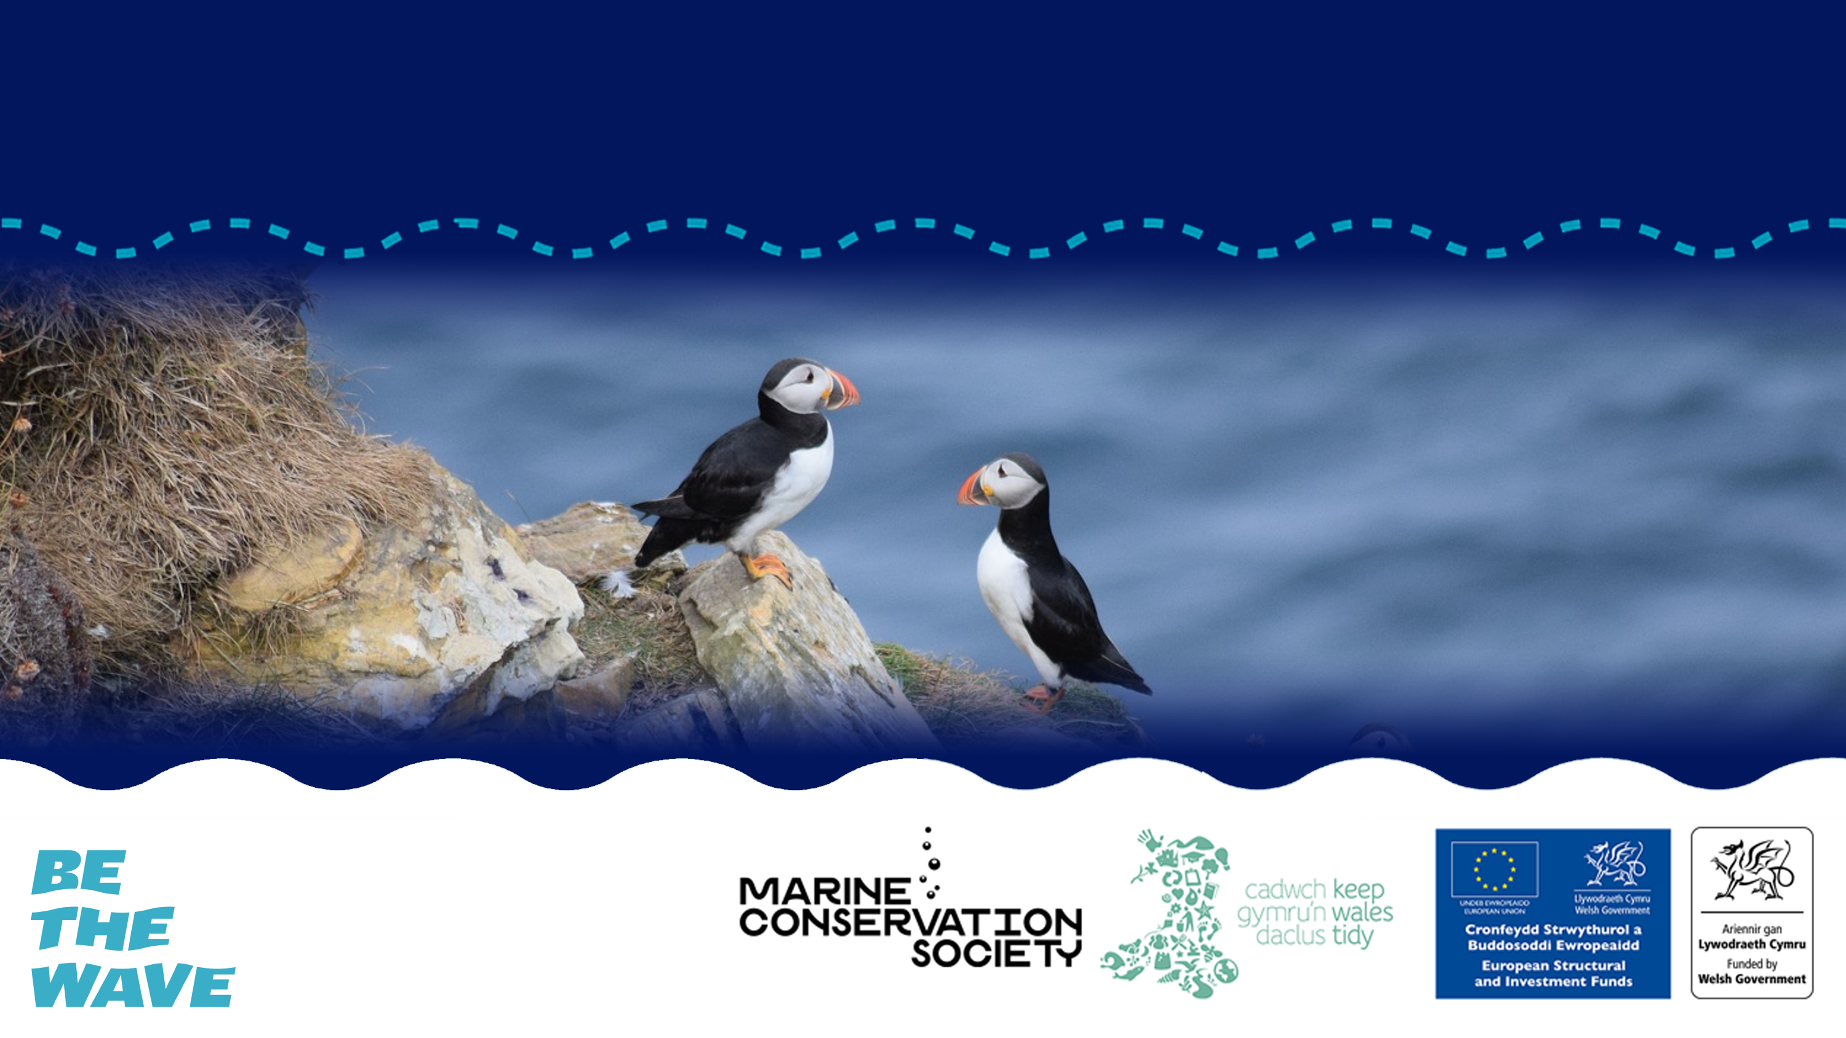
BIODIVERSITY IN WALES
Key habitats and species found across Wales

Slide 2
OBJECTIVES
  Define the terms biome, ecosystem, biodiversity and species.
  Identify key marine habitats found in Wales.
  Name at least two marine species found in Wales and be able to explain how they are adapted to their habitat.
  Understand how species are connected to form an ecosystem.
© Mark Kirkland via MCS

Slide 3

KEY BIODIVERSITY TERMS

Slide 4
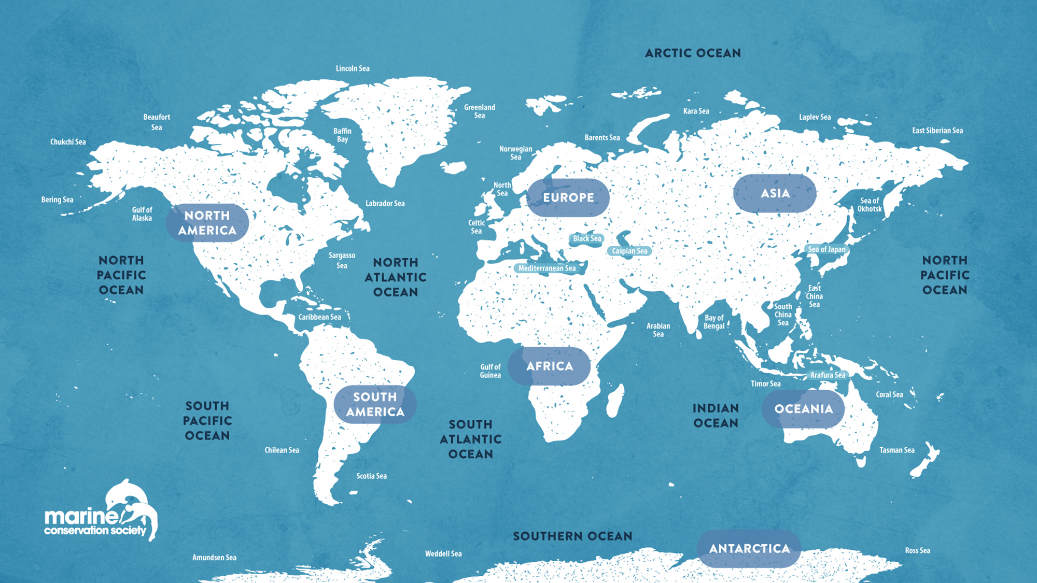

© Mark Kirkland via MCS
Notes:
A biome refers to an area of our planet with similar climates, landscapes, animals and plants. Within the ocean we have five main biomes - Atlantic Ocean, Pacific Ocean, Indian Ocean, Southern Ocean and the Arctic Ocean.
Question to students - What is the nearest ocean Biome to Wales?

Slide 5
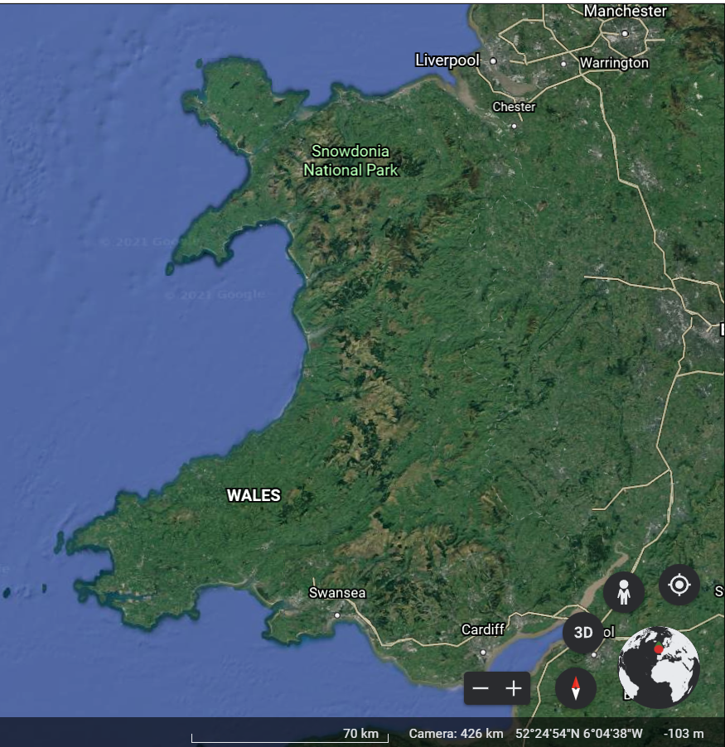
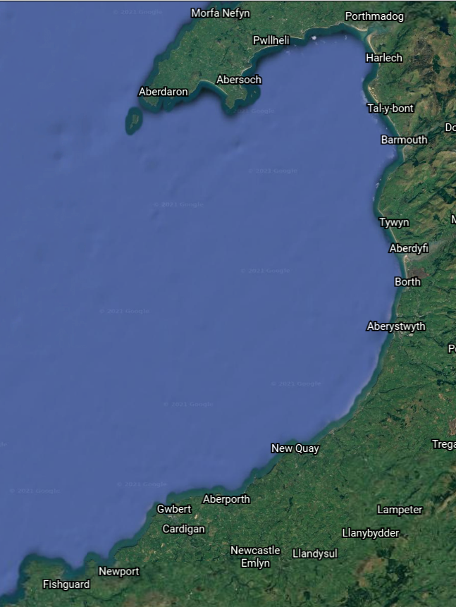
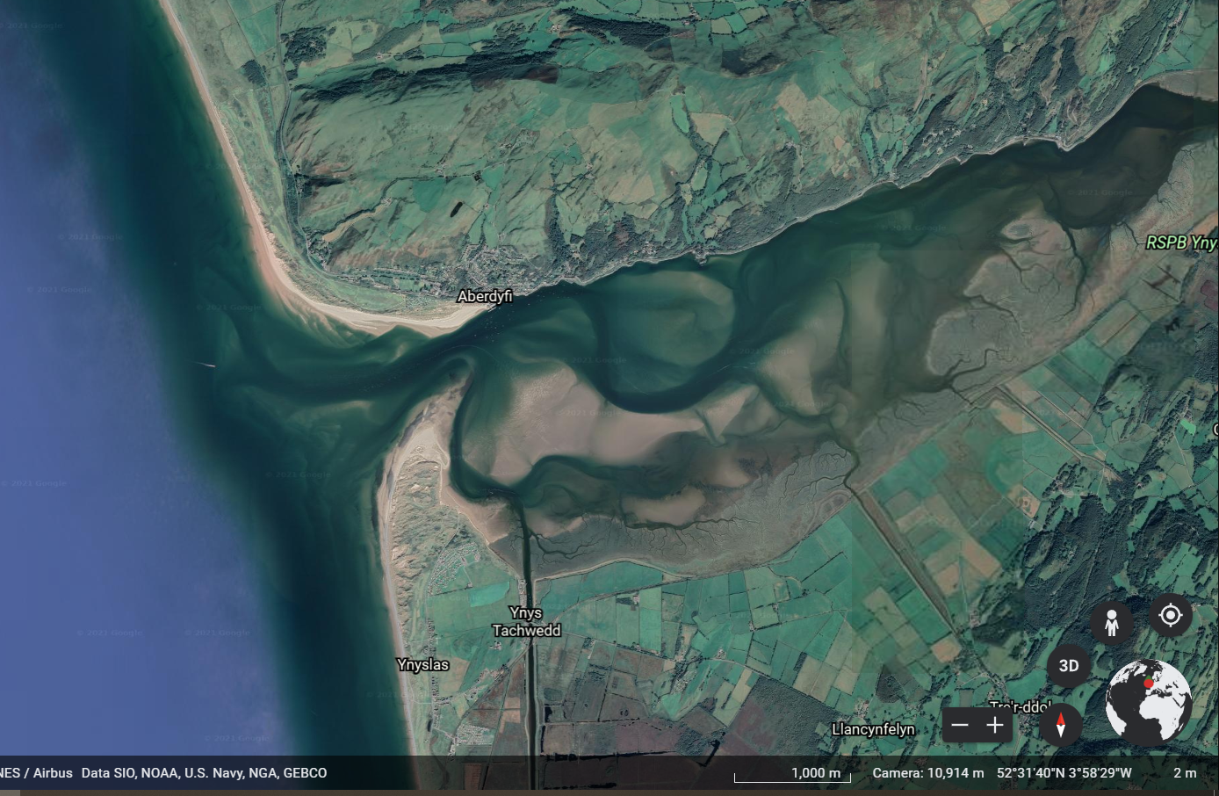
WHAT IS AN ECOSYSTEM?
© Google Earth
© Mark Kirkland via MCS
Notes:
Within that biome, is our stunning Welsh coastline. Lets focus in further and explore Cardigan Bay. Within Cardigan Bay there are a diverse range of ecosystems. The Dyfi Estuary is an example of one of these ecosystems.
Question to students - Does anyone know what an ecosystem is?
An ecosystem is a natural environment in which plants and animals interact and interconnect. It refers to a habitat and its community of plants and animals. Ecosystems are influenced by biotic factors, for example the plants and animals living there, and by abiotic factors including climate, sediment and water. The term ecosystem is used broadly to describe the interactions between biotic and abiotic factors in an environment. An ecosystem could refer to a small pond for example or the ocean.

Slide 6
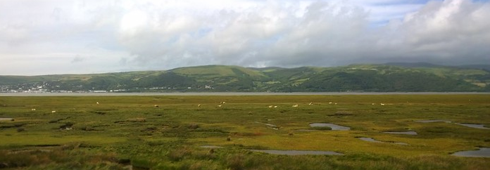
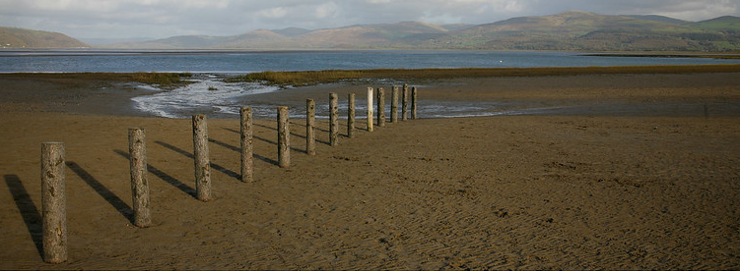
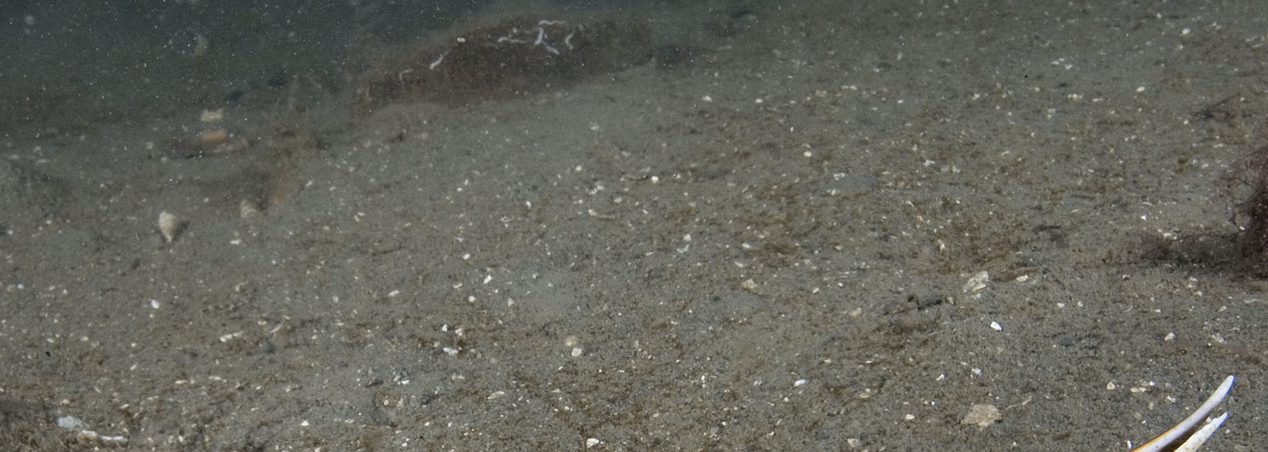
WHAT IS A HABITAT?
© Ruth Hartnup via Flickr
© Umbrrllahead56 via Flickr
© Mark Kirkland via MCS
Notes:
Within the estuary there are several habitats.
Question to students – What is a habitat?
A habitat is the natural home or environment in which an animal, plant or organism lives. A habitat contains everything an organism needs to survive such as food and shelter.
In the Dyfi estuary there are many habitats, including saltmarsh, intertidal mud flats and underwater mud.
A microhabitat is a small area within a larger habitat, which is home to a species. In a saltmarsh for example, the microhabitat for a marine worm would be its burrow. Whereas the microhabitat for a coastal bird would be its nest at the top of the saltmarsh.

Slide 7
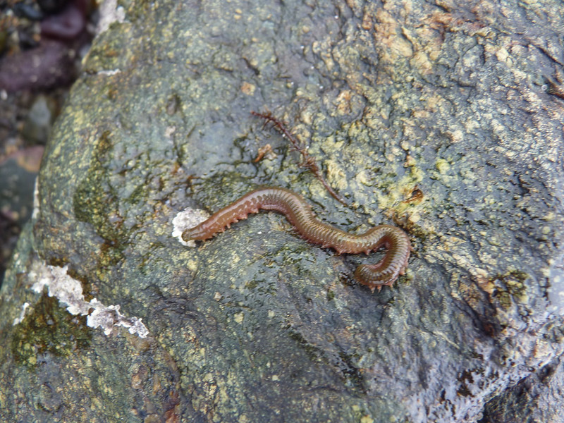
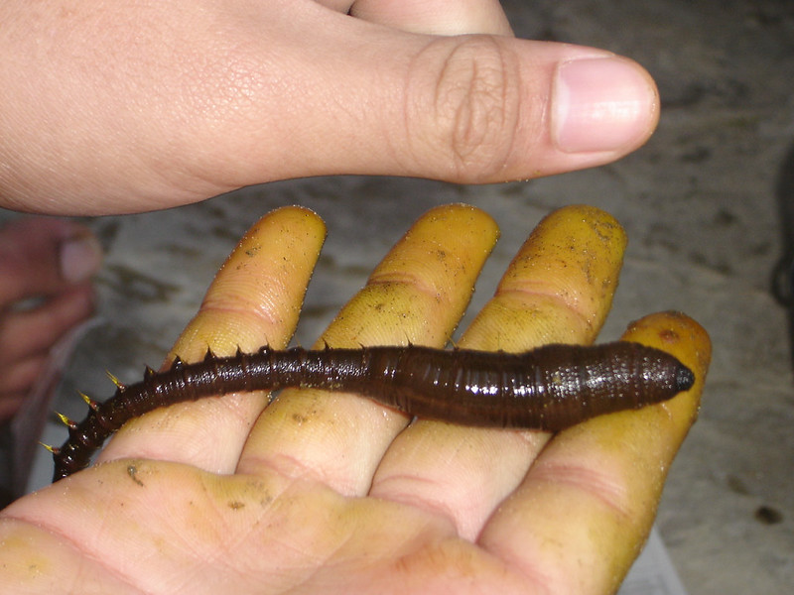
WHAT IS A SPECIES?
© Mark Kirkland via MCS
© Images via Flickr
Notes:
Within a habitat are a diverse range of species.
Question to students – Can anyone try to define the term species?
Species - a group of living organisms consisting of similar individuals that share common characteristics and are capable of interbreeding.
This is an image of a rag worm. In Wales there are several species of worms that live in saltmarsh mud, including sand mason worms and species of lug worms and rag worms.

Slide 8
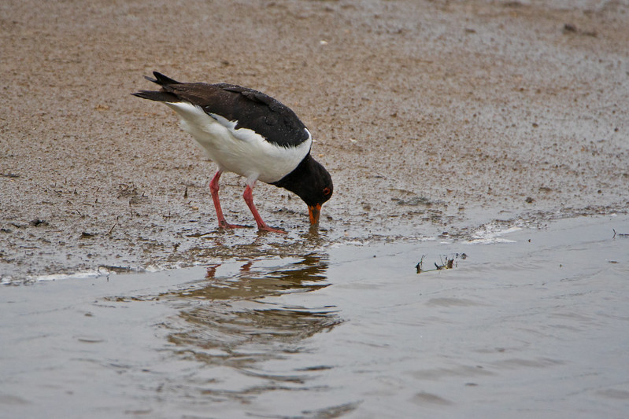
ADAPTATION
© Odd wellies via Flickr
© Mark Kirkland via MCS
© Stephen Gidley via Flickr
Notes:
The rag worm Hediste diversicolor is well adapted to estuaries and can tolerate ranging salinities. It has adapted to this muddy environment by living in a burrow to hide from predators like crabs and birds.
In winter it digs deeper into the mud to escape cooling temperatures. Deeper is also safer to avoid long bird beaks.
Rag worms have adapted to feed without having to leave their burrow and risk being spotted by predators. The rag worm spins a mucus web that sits at the entrance to their burrow and traps small plants and animals. The rag worm then consumes the whole web.

Slide 9
HABITATS
Notes:
There are many important marine habitats along the Welsh coastline. Here is a selection of some key marine habitats.

Slide 10
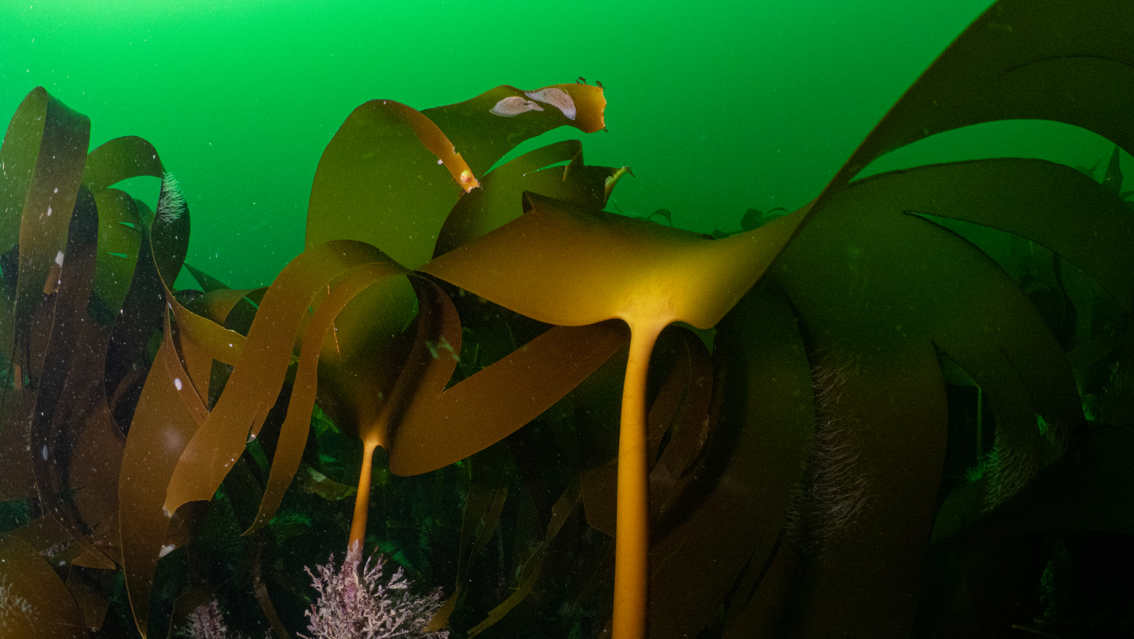
KELP BEDS
© Mark Kirkland via MCS
Notes:
Kelp is a type of large brown seaweed that grows in cool shallower waters. Seaweeds are often mistaken for plants but are actually algae. Kelp are often found together forming an underwater forest known as a kelp bed. The structure of the kelp beds provide a great habitat for many species to shelter and find food. This diverse habitat is home to fish, crabs, sponges, sea stars and provide a hunting ground for seals and sea­birds. The leafy canopy acts as a nursery for juvenile fish, including cod, pollock, haddock and wrasse.

Slide 11
SEAGRASS
Notes:
Seagrass is the only flowering plant in the ocean. It is found in calm, shallow, sunlit coastal waters around the world, including Wales. When seagrass grows in large areas, the habitat it creates is described as a ‘seagrass meadow’. Globally, seagrass meadows are known for their value as fish nurseries for many important species, including flatfish and cuttlefish. Seagrass meadows are also home to many bivalves (a large class of molluscs such as clams, mussels, scallops and oysters), worms, starfish and to rare stalked jellyfish

Slide 12
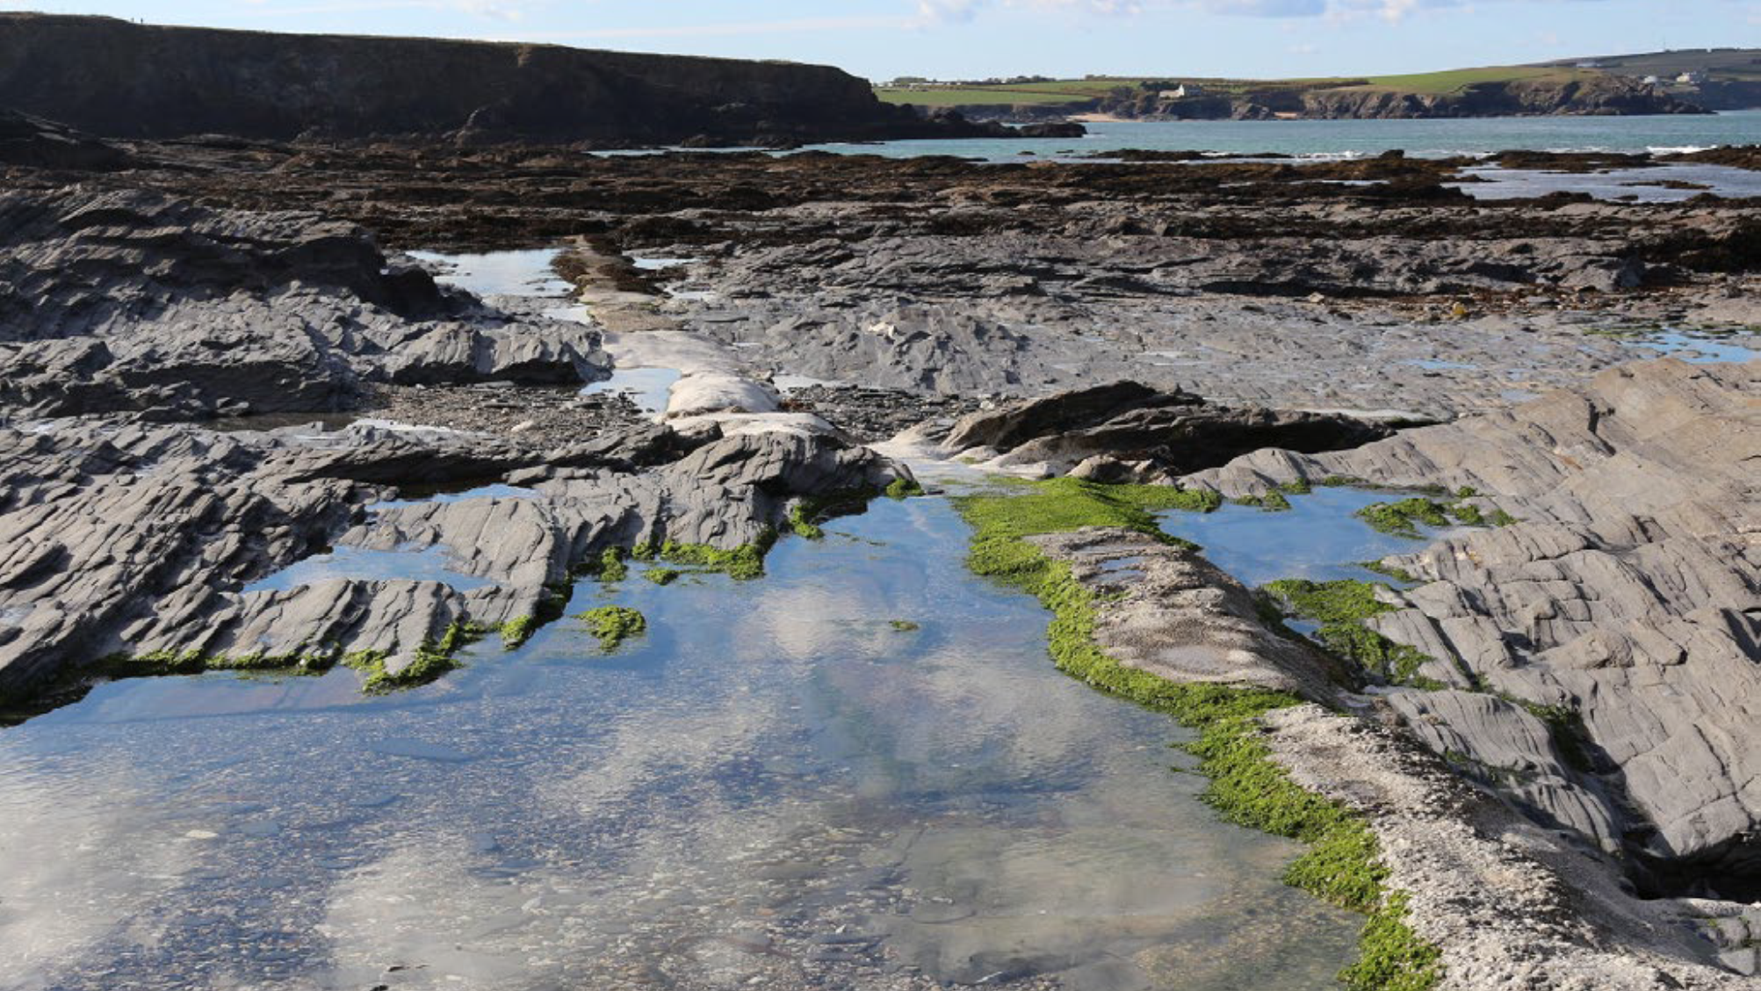
ROCKPOOLS
Notes:
Rockpools are home to a diverse range of plants and animals that have adapted to live in this harsh, forever-changing environment. There are many places for animals to find shelter in the cracks and crevices of the rocks and under boulders. Many seaweeds also live here, as they need the hard rock to attach to. These seaweeds provide shelter and food for other species including many species of fish, starfish, and crabs. Rockpools are also home to many species of animals that need to live on the rock, including anemones, sea snails, limpets, and barnacles.

Slide 13
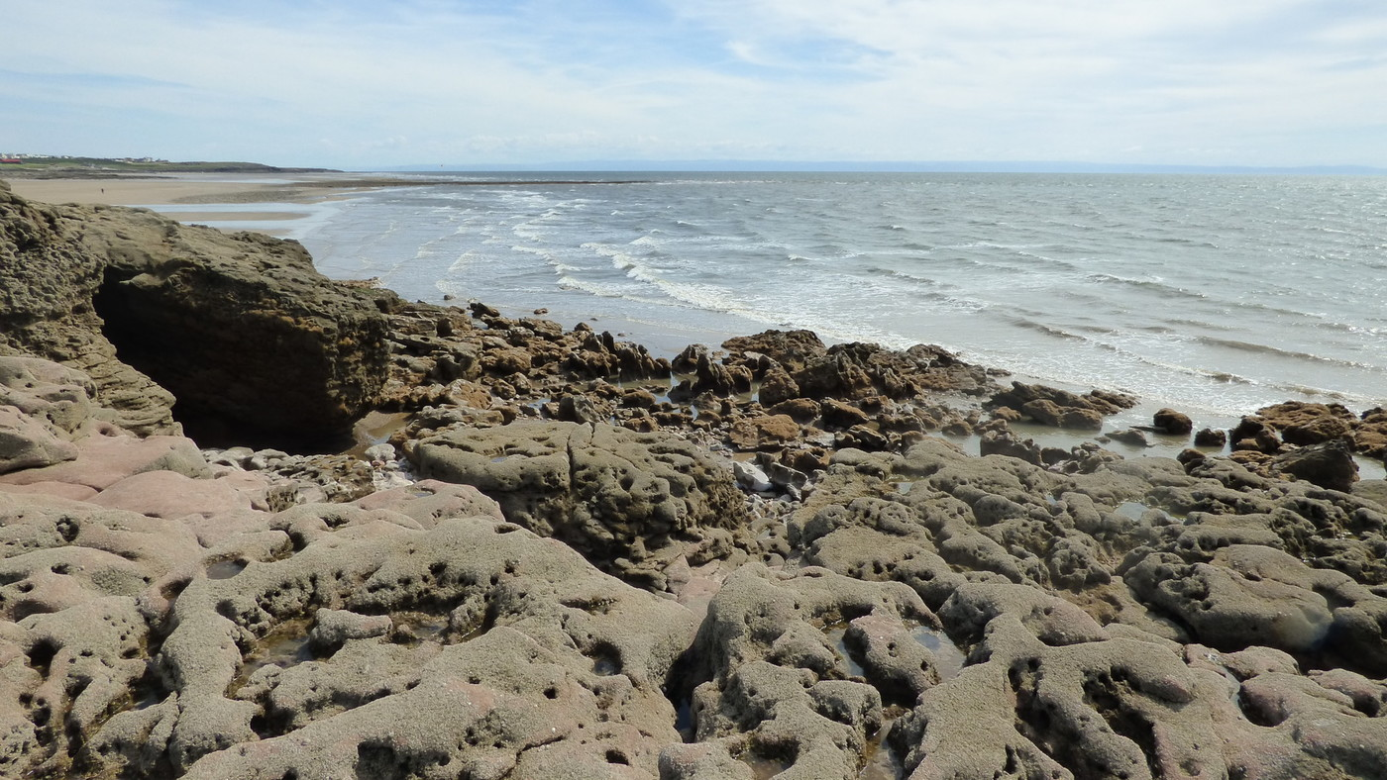
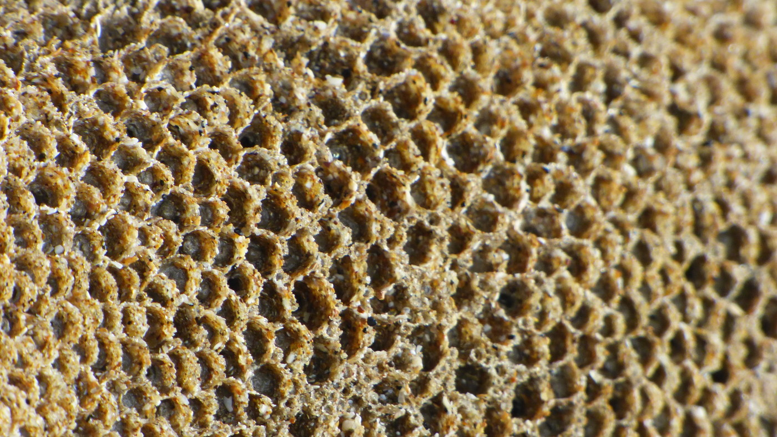
HONEYCOMB WORM REEFS
© Richard Harrington via MCS
Notes:
Honeycomb worm reefs (Sabellaria alveolata) can be found across the UK, but most commonly in Wales. The worm uses sand and shell fragments to form tubes. Numerous tubes together form boulder like structures. Several of these structures together form reefs. These are found on hard rock on open coast with nearby sand. The diversity of other species is low compared to habitats like rockpools but the structures the worms create do provide shelter for some species. Honeycomb worm reefs often form together with mussel beds, and can be home to barnacles and sea snails.

Slide 14

UNDERWATER MUD
© Paul Naylor via MCS
Notes:
Underwater mud might not sound like a very glamourous habitat, but a huge diversity of animals live in muddy areas. Species of bristle worms, shrimps, lobsters and bivalves burrow in the mud. On the seafloor are beautiful sea pens, common skates, flatfish and spider crabs.

Slide 15
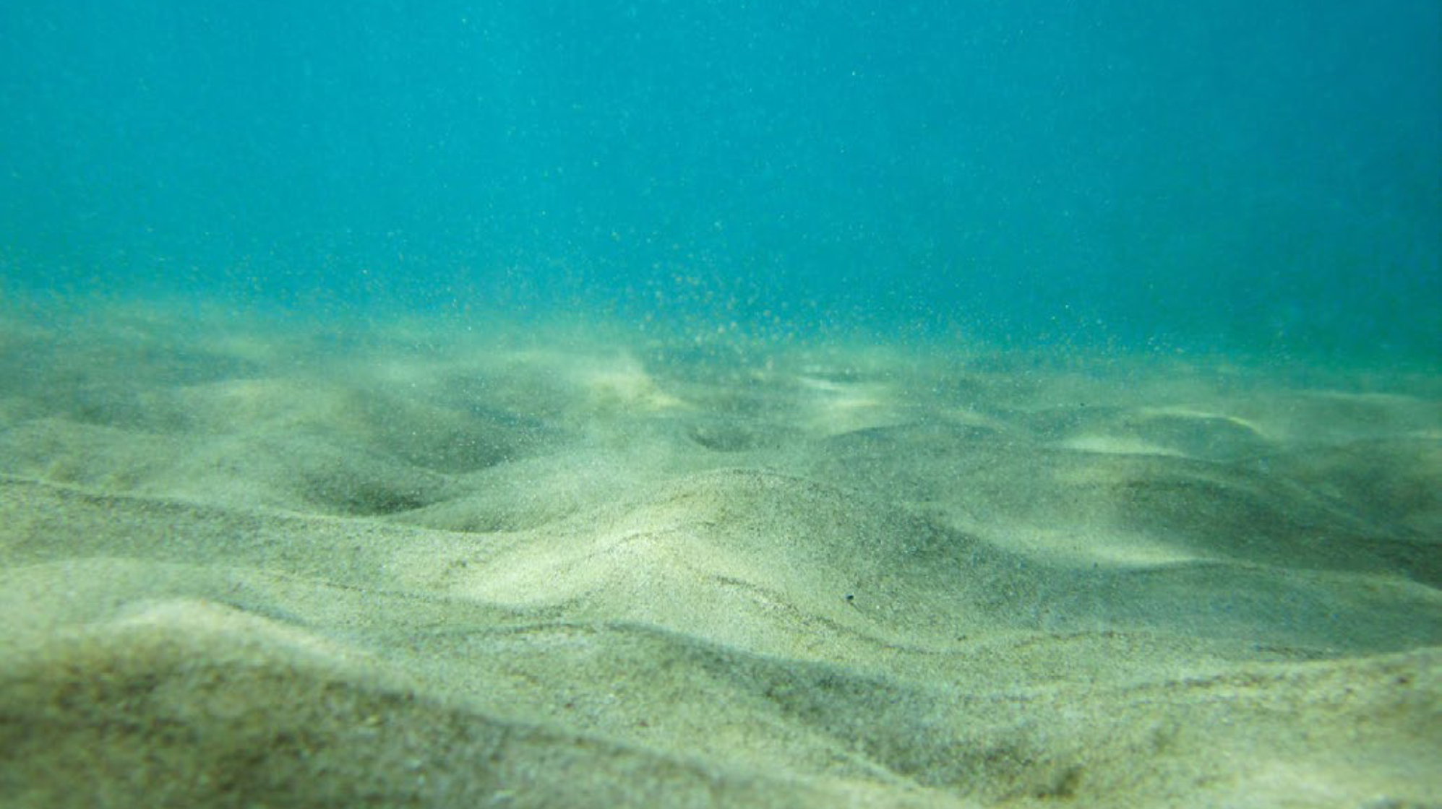
UNDERWATER SAND & GRAVEL
Notes:
Underwater sand and gravel is the most common marine habitat. It may on first glance look barren, but these areas are home to a large variety of animals including sand eels, rays, sea cucumbers, burrowing urchins, starfish, bivalves and many species of fish and crustaceans like shrimp, prawns and crabs. Many fish use these areas to hide their eggs in burrows in the seabed.

Slide 16
SPECIES

Slide 17
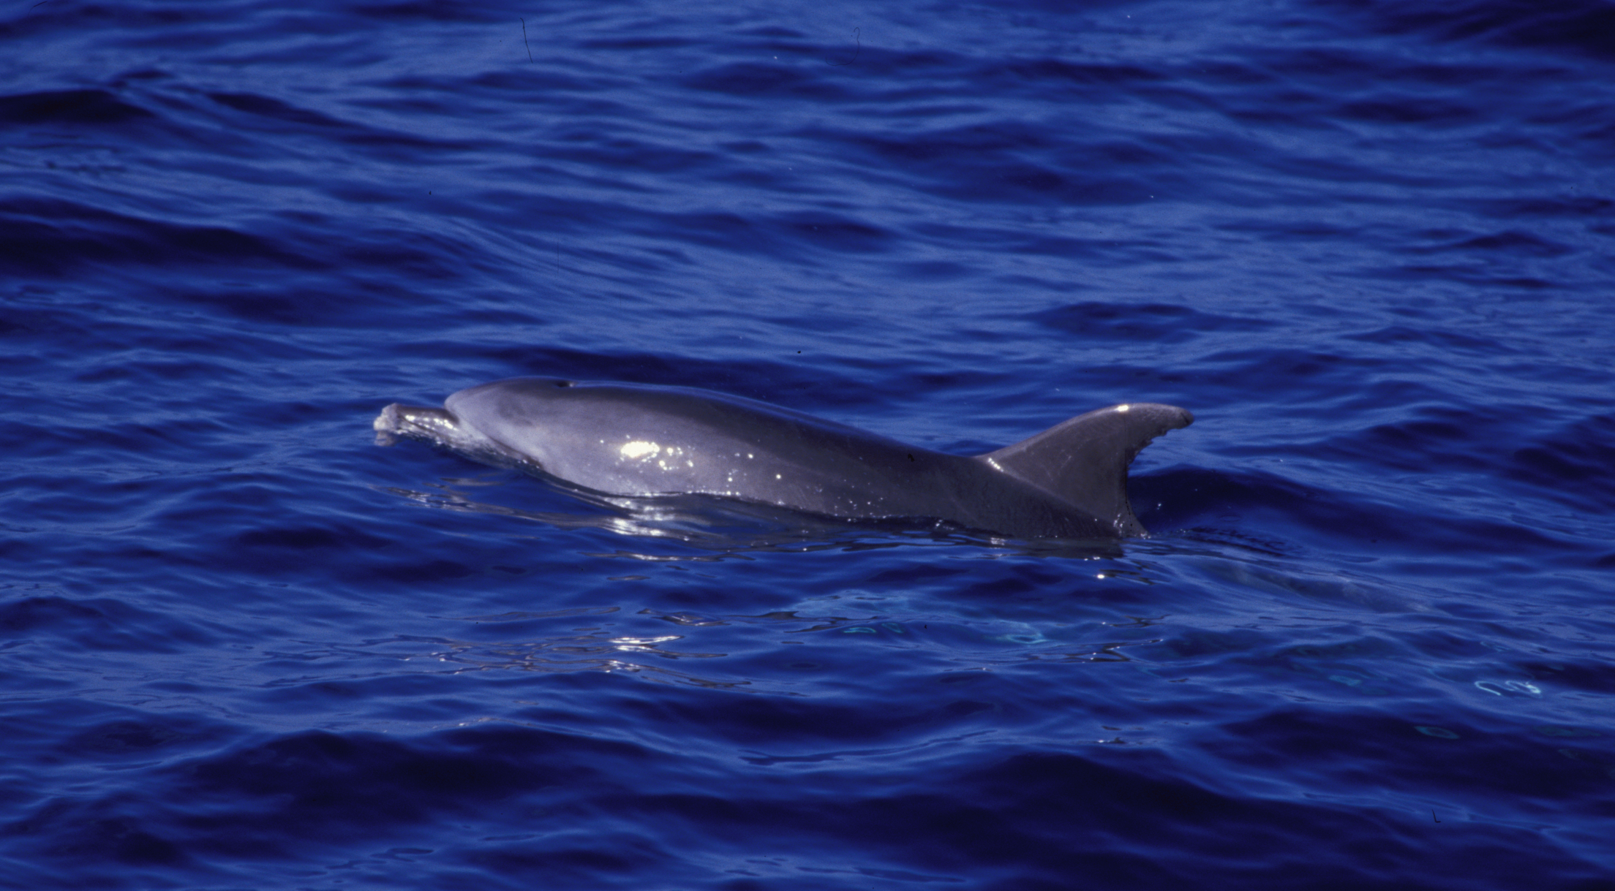
BOTTLENOSE DOLPHINS
© Graeme Cresswell via MCS
Notes:
Bottlenose Dolphins can grow up to 4 meters long. They are sociable creatures, generally in groups of 3-10 individuals and are often seen leaping out of the water. There are approximately 200 bottlenose dolphins in Cardigan Bay, which is one of only two semi-resident bottlenose dolphin populations in the UK.

Slide 18
HARBOUR PORPOISE
© Graeme Cresswell via MCS
Notes:
Harbour Porpoise are often mistaken for bottlenose dolphins, but are much smaller, with a smaller stubbier dorsal fin. They exist along the majority of the Welsh coastline and are most commonly seen in August to November.

Slide 19
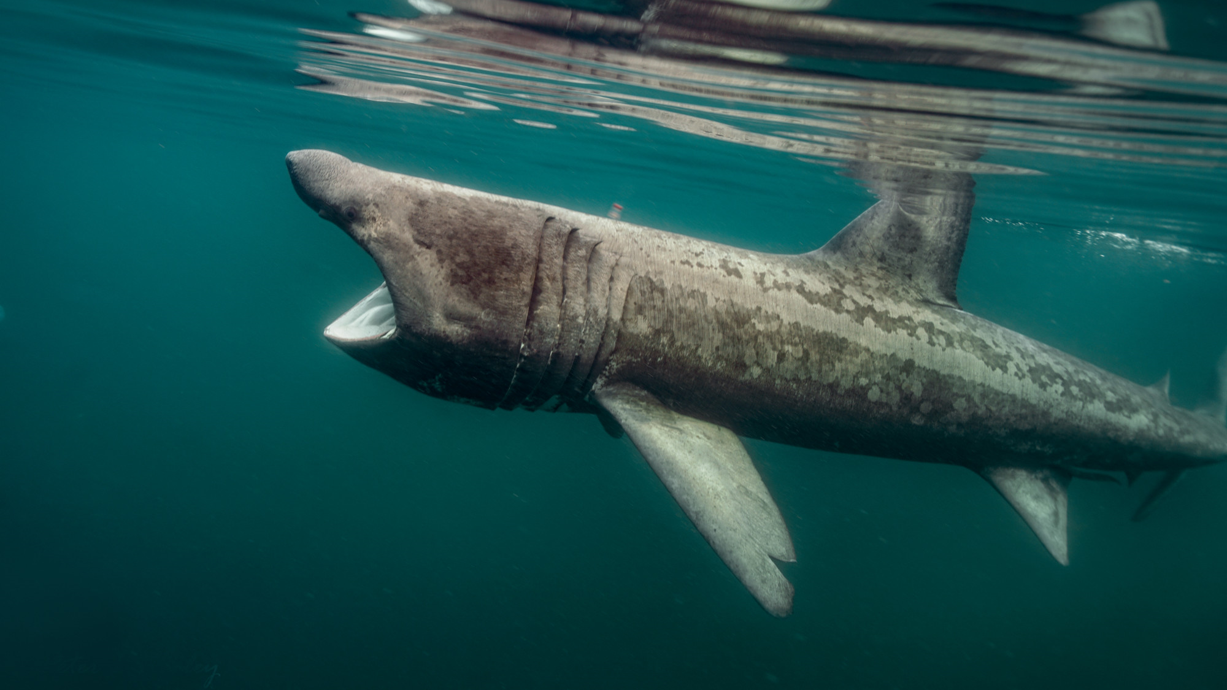
BASKING SHARK
© Peter Bardsley via MCS
Notes:
Basking Sharks are 8-10 meters in length, making them the second largest fish in the world.
Question to students – Does anyone know what basking sharks eat?
They are filter feeders, feeding on tiny plankton species. In the summer basking sharks migrate through the waters around Wales.

Slide 20
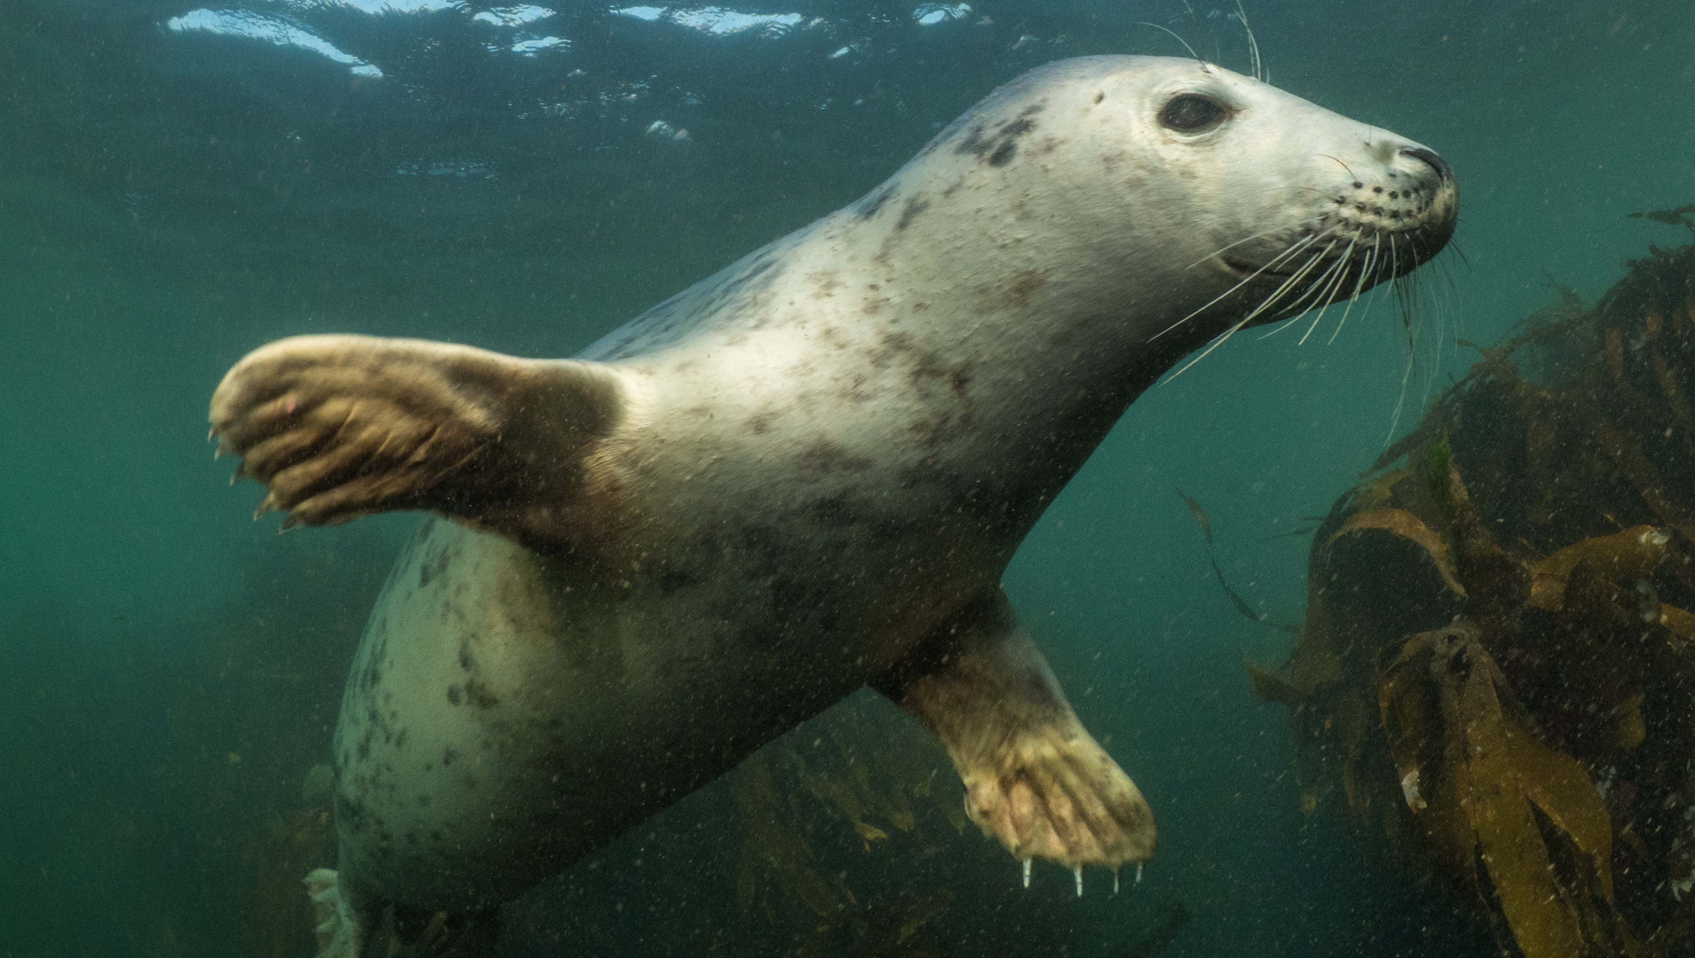
ATLANTIC GREY SEALS
© Mark Kirkland via MCS
Notes:
Atlantic Grey Seals are common in the UK, with 40% of the world’s population found here. The largest colonies are found around the Welsh coastline, particularly on Skomer and Ramsey Islands.

Slide 21
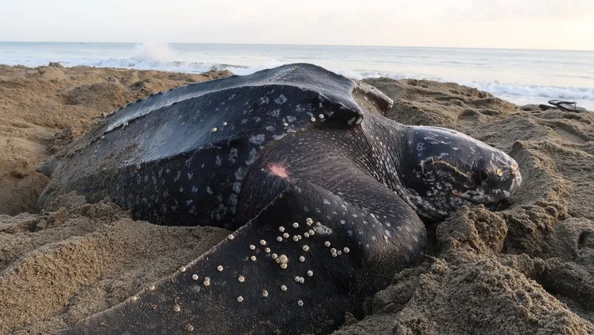
LEATHERBACK TURTLES
© William Farah via Shutterstock
Notes:
Leatherback Turtles travel from tropical seas to visit cooler waters, including Wales.
Question to students – Why do you think Leatherbacks migrate all the way to the UK?
Leatherbacks travel to feed on jellyfish during the summer months. They are the largest sea turtle in the world and can grow to around 1.8 meters. One of the largest turtles ever recorded was found washed up at Harlech beach, North Wales in 1988, and weighed over 2,000 lbs. Unfortunately leatherback turtles are an endangered species.

Slide 22
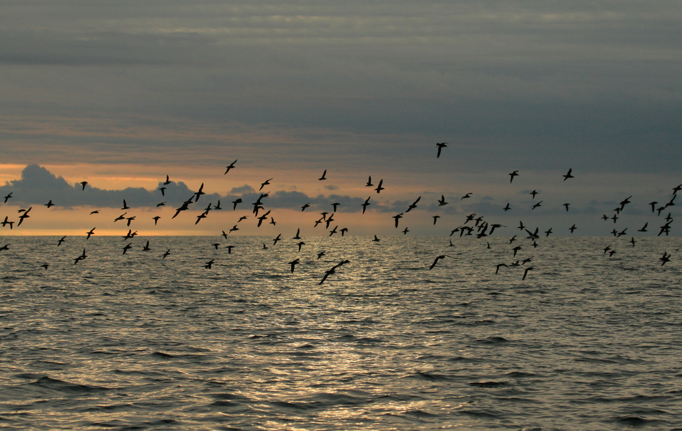
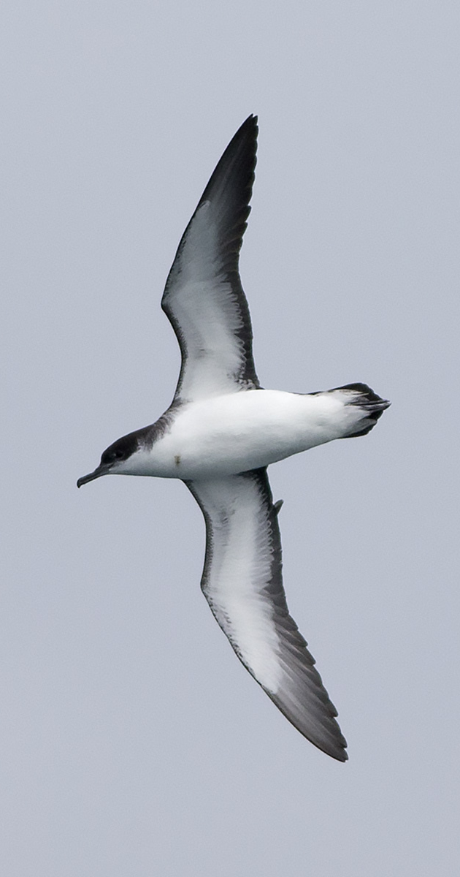
MANX SHEARWATER
© Dave Boyle via MCS
© Joe Pender via MCS
Notes:
Manx Shearwater are a species of seabird that spend most of their life at sea. In summer, hundreds of thousands of these birds return to a few islands off the west coast of Wales to breed. During the winter they travel around 7,000 miles to the coast of South America.

Slide 23
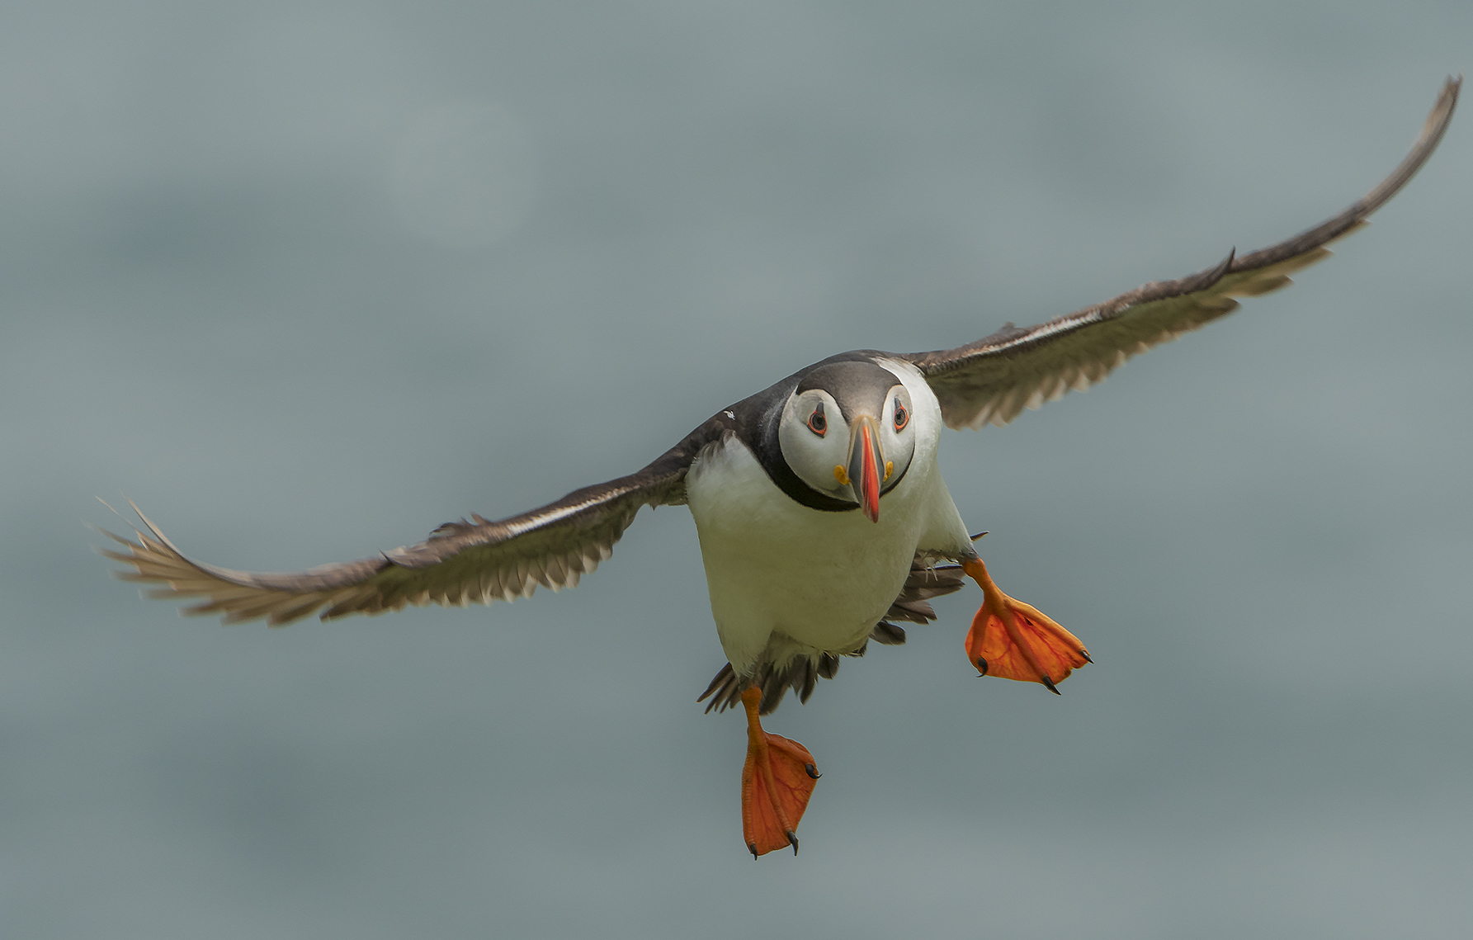
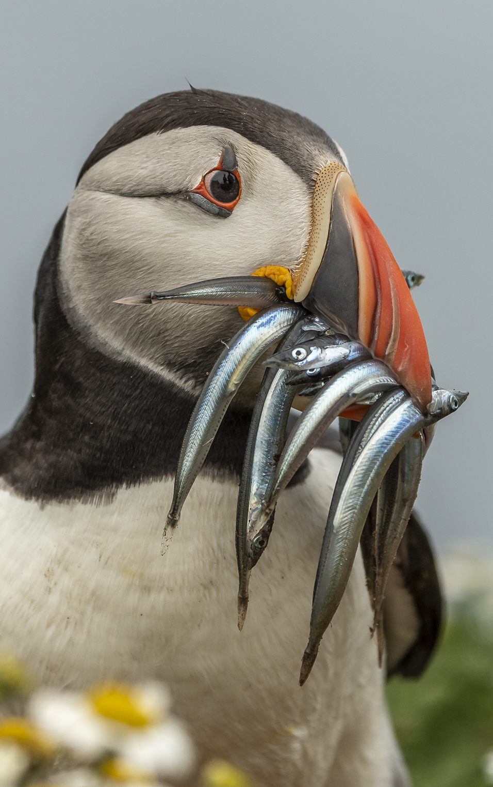
PUFFINS
© JHS Archer-Thomson via MCS
Notes:
Puffins are members of the auk family, along with razorbills and guillemots. These seabirds spend most of their lives at sea and only come to land to have their young.
They breed on coastal islands including Skomer and cliffs like South Stack in Anglesey, where they can be seen fishing in coastal waters between May and July.
Puffins love to feed on sand eels.
Question to students - Can anyone guess how many sand eels puffins can fit in their mouth in one go?
On average its around 10 fish per trip. But the most a puffin has been spotted with was 62 at once! The puffin’s beak is adapted to hold several fish at once. Puffins have spines in their mouths to hold fish and keep them in place while they open their beak to catch more. This way Puffins can bring loads of fish back to shore in one go to share with their family.

Slide 24
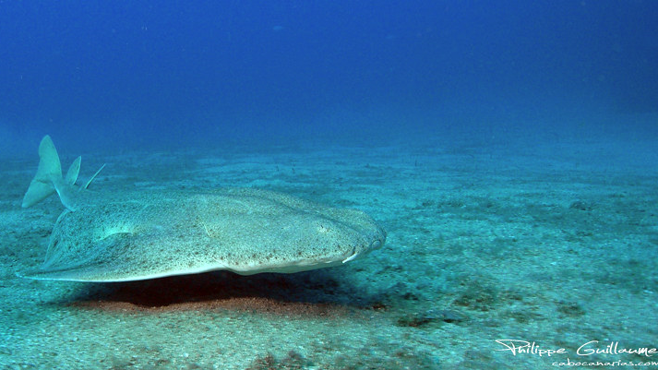
ANGEL SHARKS
Notes:
Angel sharks are one of the most endangered and rarest species of shark in the world. They grow to around 2.4 meters, have very flat bodies, glide above the seabed and live in sandy coastal waters. They are found in the Eastern Atlantic and Mediterranean Sea. Wales appears to be one of the few areas with increasing sightings of this species.

Slide 25
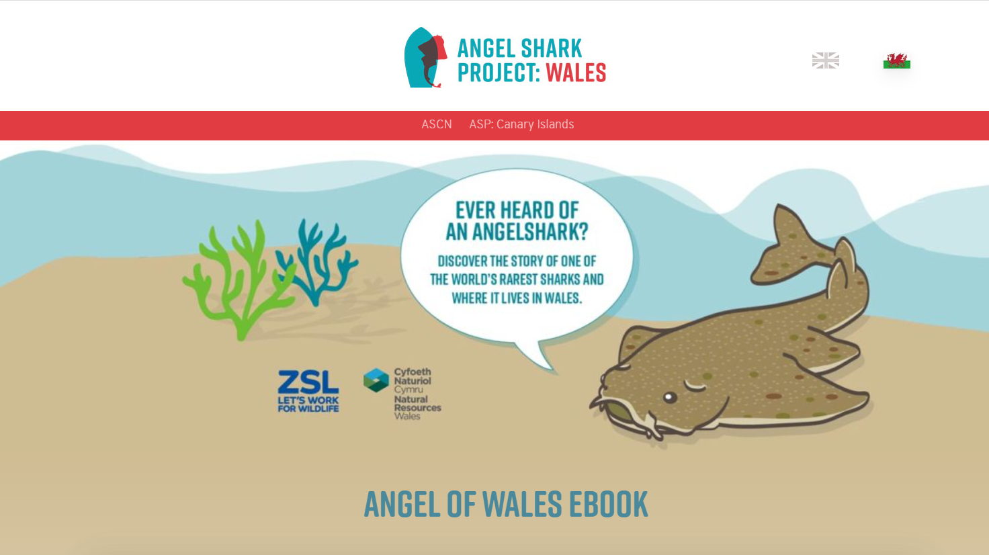
ANGEL SHARKS
Notes:
The Angel Shark Project researches this endangered species in Wales to improve scientific knowledge and understanding, with the aim to better protect angel sharks.

Slide 26
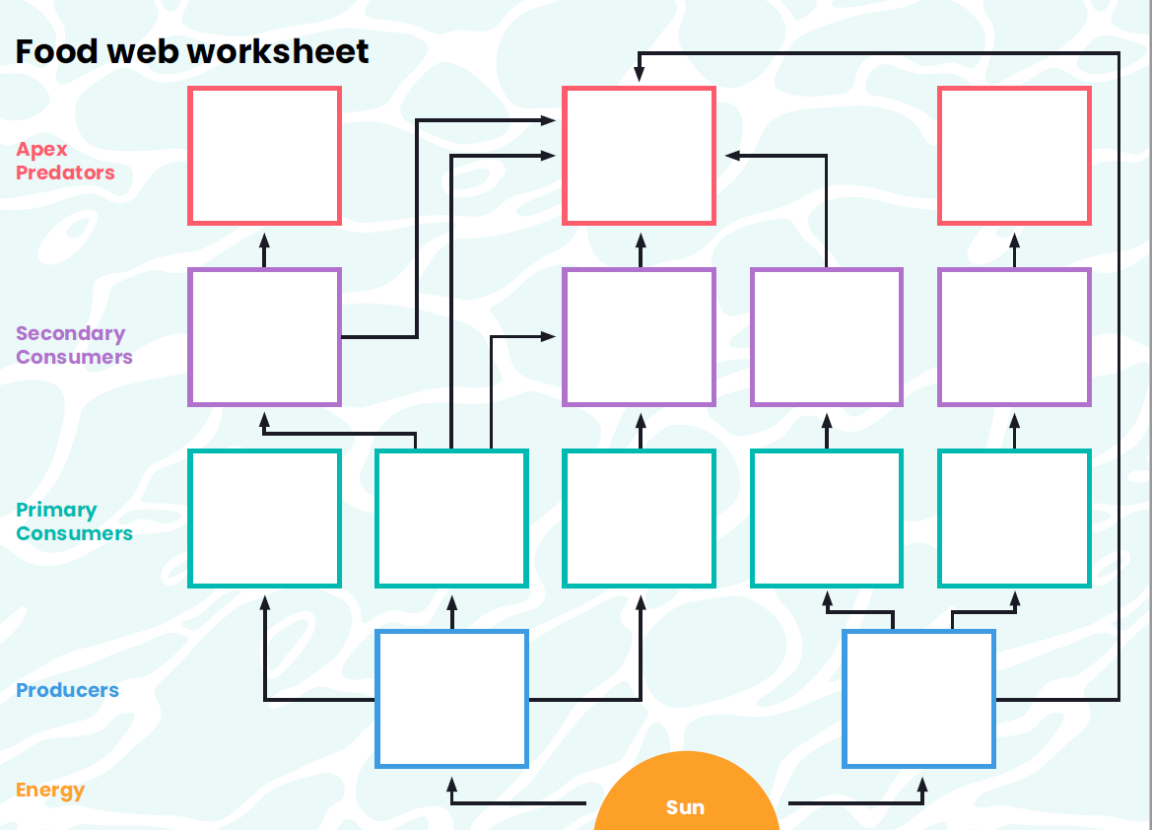
FOOD WEBS
Notes:
Question to students - Whats the difference between food chains and food webs?
Food chains –the transfer of energy from one species to another (who eats who)
Food webs – all the food chains within an ecosystem.
Understanding food webs helps use to realise why species diversity is so important and how species are interconnected with each other.

Slide 27
#BeTheWave

Slide 28

#BeTheWave
SCHOOL
Improve ocean literacy within your school by introducing ocean topics into PSHE, geography, science, history, art, design technology, English and drama.
Does your school have a green/eco club? It is a great way to help students learn more about our incredible natural environment including diversity within your school grounds and further afield. Your group could dedicate a term to explore the underwater world in Wales.
If your school is near the coast why not take your students out for a day trip to the beach. This could be linked to the curriculum or as part of an experience day. If you want a helping hand the Marine Conservation Society offer free seashore safaris for school groups.

Slide 29
#BeTheWave
INDIVIDUAL
Inspire your friends and family by sharing with them what you’ve learnt about the incredible diversity of habitats and species in coastal waters around Wales.
The sea and coastline around Wales is fantastic. The best way to learn more about it and to stay inspired is to get out there and enjoy it.
If you live near the coast there are several citizen science projects you can get involved with to help record the diversity on the coast and increase our scientific knowledge.
  Record seaweed diversity on the shore to help us understand how this is changing overtime:
https://www.mcsuk.org/what-you-can-do/volunteering/big-seaweed-search/
  Report any sightings of jellyfish and turtles: https://www.mcsuk.org/sightings/
  Record quantity and variety of shark egg cases: https://www.sharktrust.org/great-eggcase-hunt

