Slide 1
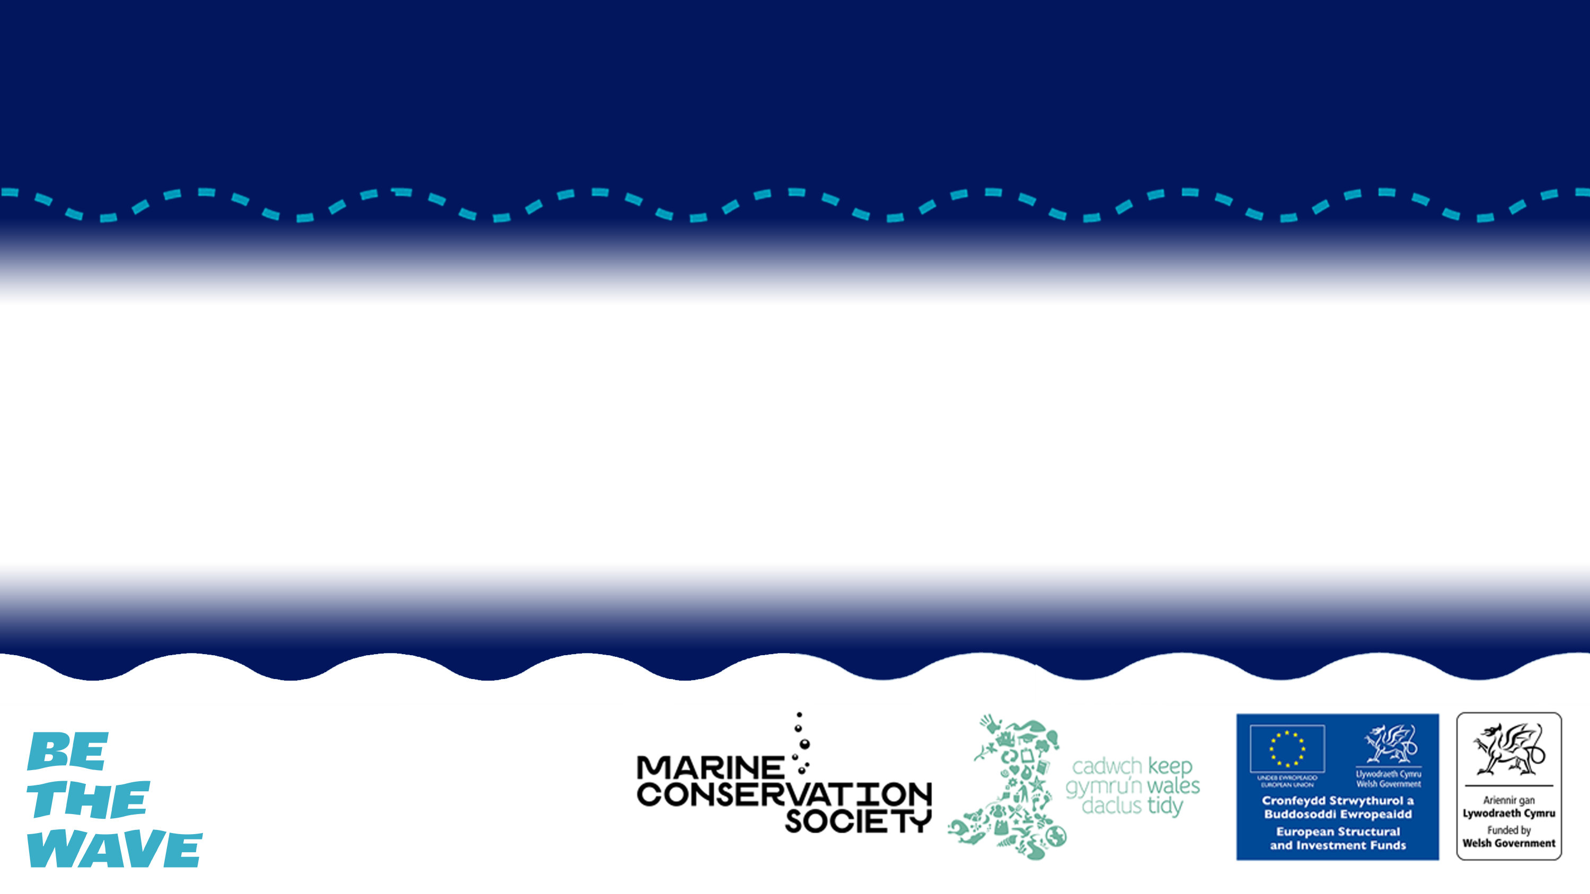
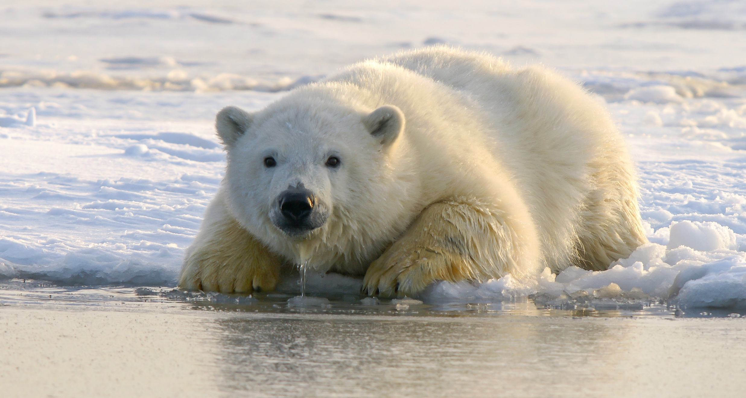
CLIMATE CHANGE
What is climate change, how does it effect the ocean and how can we help reduce it.

Slide 2
Lesson Objectives
Identify how the ocean helps to reduce the effects of climate change
Explain how climate change is affecting the ocean
Discuss ideas to help reduce the effects of climate change on the ocean

Slide 3
HOW DOES CLIMATE CHANGE EFFECT THE OCEAN

Slide 4
Do you know of any ways that climate change is affecting the ocean?
© Odd wellies via Flickr
© Mark Kirkland via MCS
© Stephen Gidley via Flickr
Notes:
Start by asking students if they know how climate change is affecting the ocean. Have a group discussion before using the following slides to go through each impact in more detail.

Slide 5
SEA LEVEL RISE
© Jean-Christophe André via Pexels
© Odd wellies via Flickr
© Mark Kirkland via MCS
© Stephen Gidley via Flickr
Notes:
Global warming is causing a rise in both atmospheric and sea temperatures. In-fact the ocean has absorbed more than 90% of the excess heat in the climate system.
High temperatures are causing ice to melt and sea levels to rise. The rise in sea level will affect a lot of coastal communities and coastal habitat due to flooding, some low lying islands could be completely submerged.

Slide 6
CHANGING HABITATS
© Hans-Jurgen Mager via Unsplash
© Odd wellies via Flickr
© Mark Kirkland via MCS
© Stephen Gidley via Flickr
Notes:
Ice melting in the Artic is also changing the natural habitat there. This is causing lots of problems for wildlife including animals like polar bears who need to use the sea ice as a platform to hunt seals from.

Slide 7
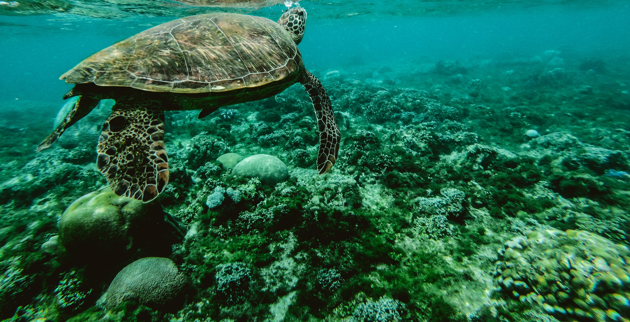
CORAL BLEACHING
© Belle Co via Pexels
© Odd wellies via Flickr
© Mark Kirkland via MCS
© Stephen Gidley via Flickr
Notes:
Increasing temperatures in the ocean is also causing coral bleaching. Simply put this means beautifully vibrant corals are turning white due to stress from increased temperatures, if stress continues they could die.

Slide 8
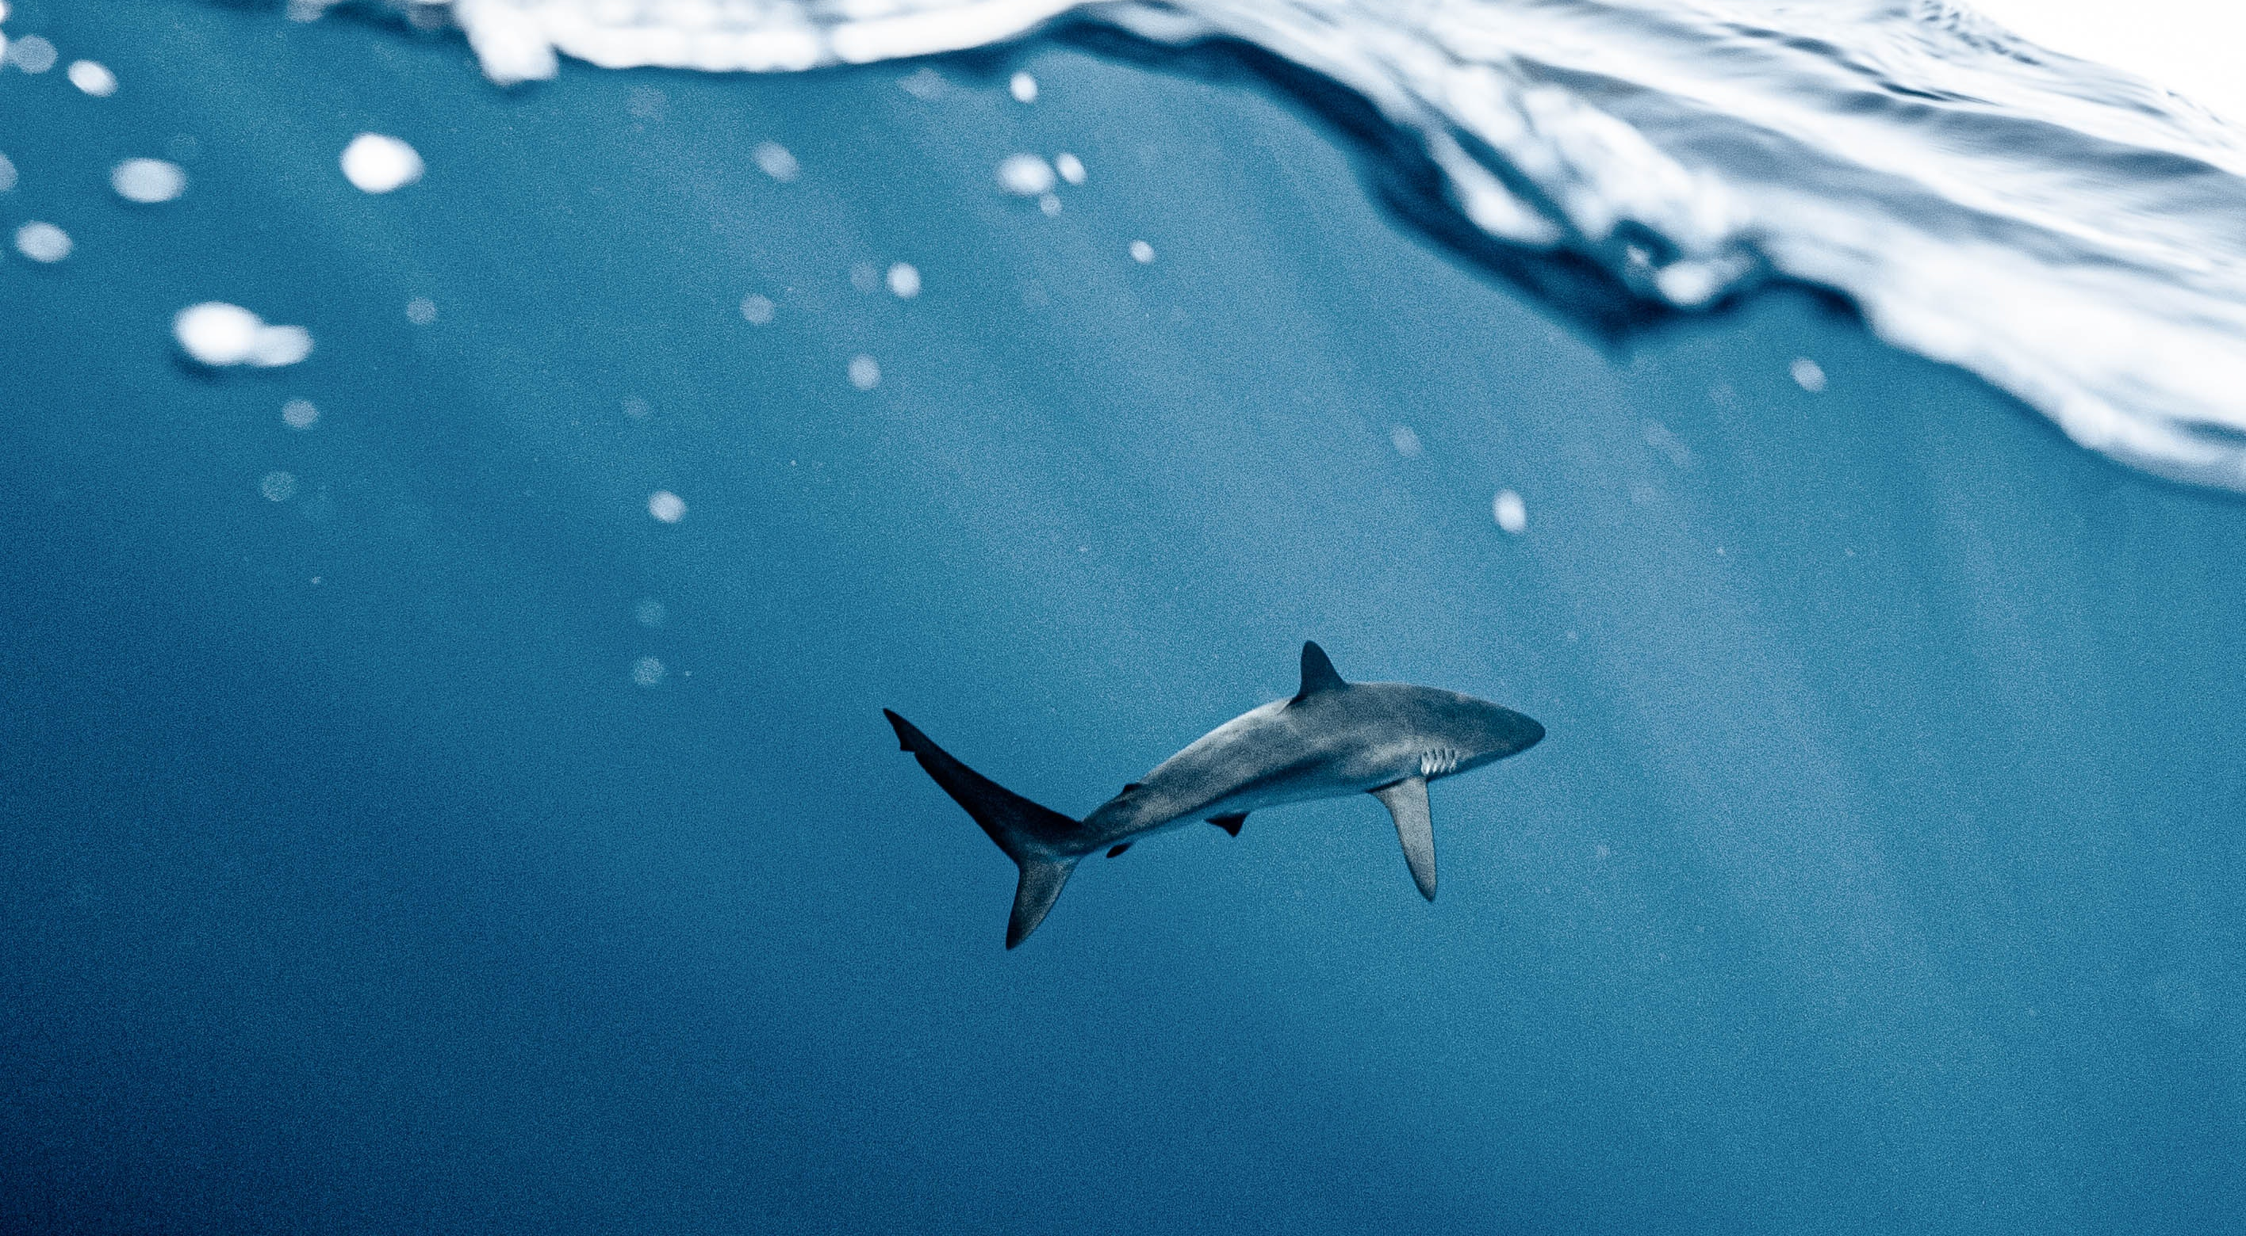
SPECIES DISTRIBUTION
© Elianne Dipp Via Pexels
© Odd wellies via Flickr
© Mark Kirkland via MCS
© Stephen Gidley via Flickr
Notes:
Plants & animals like fish are moving from their normal locations to find cooler waters. In the UK species are moving either north or moving deeper to find cooler waters. Some animals might not be adapted to these new areas, they might not be able find enough food or reproduce effectively in a new habitat. We may see some animals and plants start to die out as a result.

Slide 9
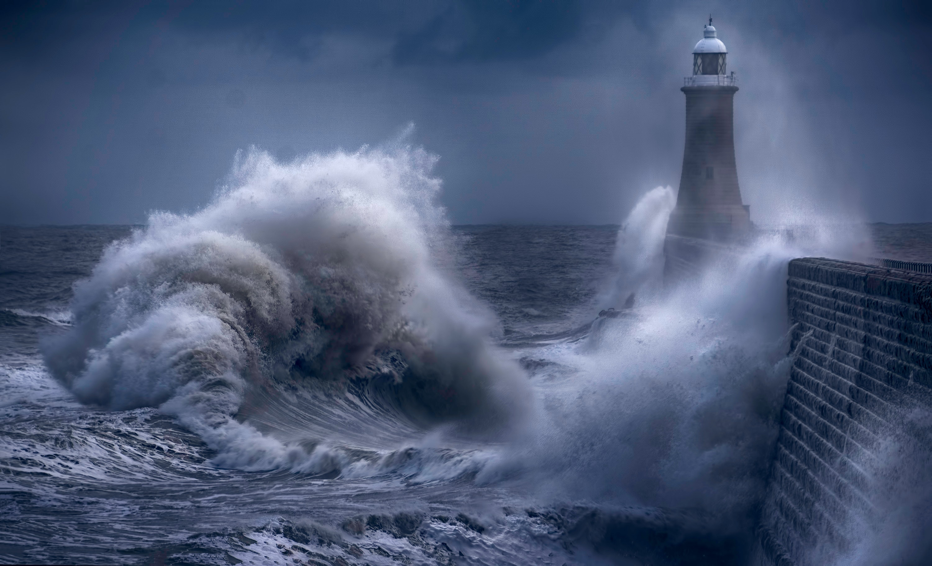
INCREASED STORMS
© Ray Bilcliff via Pexels
© Odd wellies via Flickr
© Mark Kirkland via MCS
© Stephen Gidley via Flickr
Notes:
Increased storms can damage fragile marine habitats like seagrass beds, salt marshes and mangroves.

Slide 10
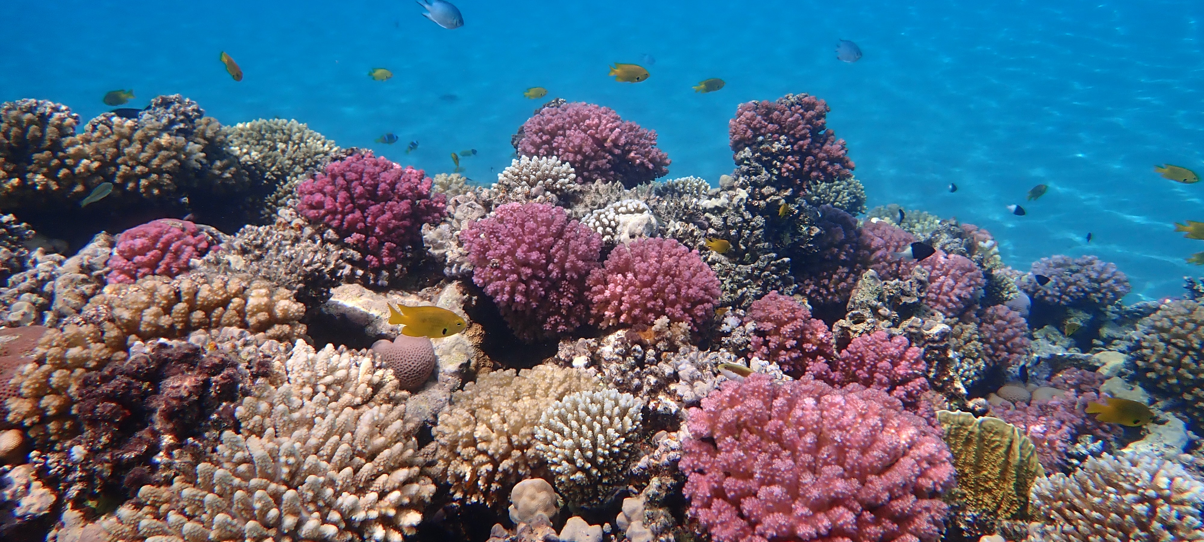
OCEAN ACIDIFICATION
© Ralf Schlegel via Unsplash
© Odd wellies via Flickr
© Mark Kirkland via MCS
© Stephen Gidley via Flickr
Notes:
Increased carbon dioxide is making the ocean more acidic, known as ocean acidification. This affects animals with calcium carbonate skeletons such as corals, some phytoplankton and some seafood such as mussels, lobsters, crabs

Slide 11
OCEAN ACIDIFICATION

Slide 12
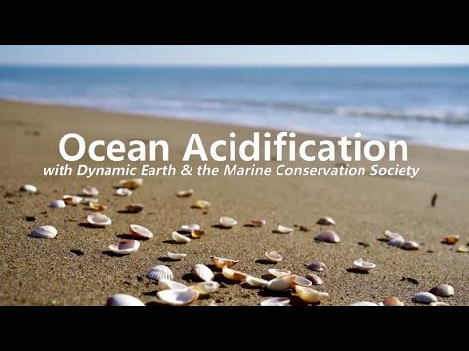
© Odd wellies via Flickr
© Mark Kirkland via MCS
© Stephen Gidley via Flickr
Notes:
This video explains ocean acidification in more detail

Slide 13
BLUE CARBON HABITATS

Slide 14
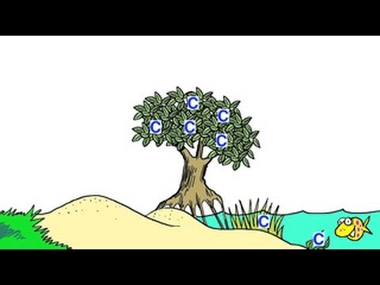
© Odd wellies via Flickr
© Mark Kirkland via MCS
© Stephen Gidley via Flickr
Notes:
https://www.youtube.com/watch?v=4fNW8spFS_o

Slide 15
Blue Carbon Variation between ecosystems
© Odd wellies via Flickr
© Mark Kirkland via MCS
© Stephen Gidley via Flickr
Notes:
Supporting resource - Blue Carbon Variation worksheet.

Slide 16
HOW CAN WE REDUCE CLIMATE CHANGE

Slide 17
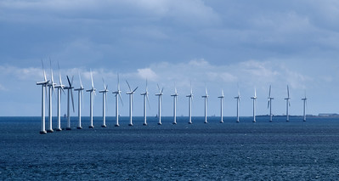
RENEWABLE ENERGY
© Lars Ploughmann via Flickr
© Odd wellies via Flickr
© Mark Kirkland via MCS
© Stephen Gidley via Flickr
Notes:
We need to increase the amount of renewable energy sources such as wind, wave and tidal, and decrease the extraction of fossil fuels.

Slide 18
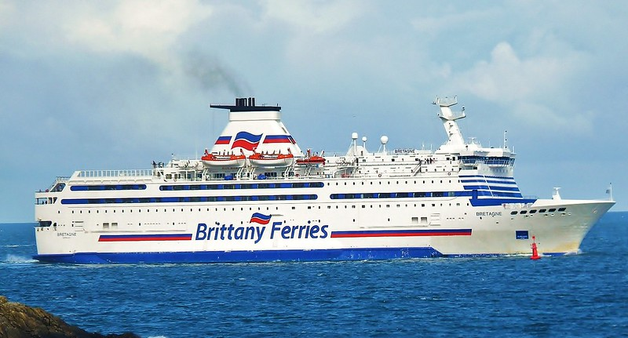
REDUCE EMISSION FROM OCEAN TRANSPORT
© Mike Cattell via Flickr
© Odd wellies via Flickr
© Mark Kirkland via MCS
© Stephen Gidley via Flickr
Notes:
Marine industries like shipping, ferries and fishing need to improve their environmental efficiency to reduce carbon emissions.

Slide 19
REDUCE UNSUSTAINABLE FISHING
C0₂
© Odd wellies via Flickr
© Mark Kirkland via MCS
© Stephen Gidley via Flickr
Notes:
Dredging and trawling are two types of fishing practices that involved dragging fishing gear on the seafloor. This realises carbon dioxide stored in the sediment.

Slide 20
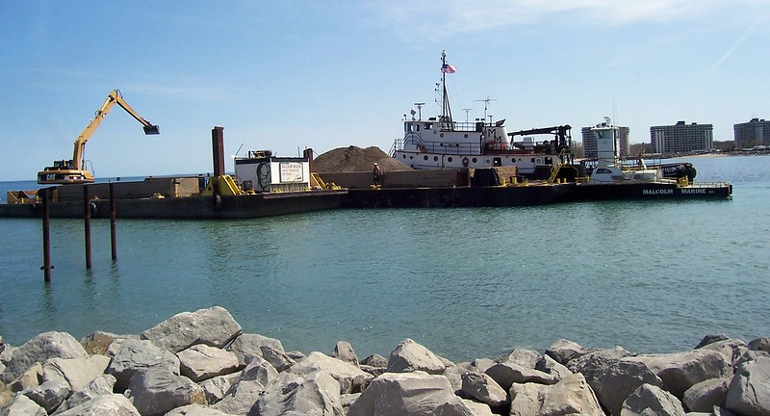
REDUCE DEVELOPMENT
© Kristy via Flickr
© Odd wellies via Flickr
© Mark Kirkland via MCS
© Stephen Gidley via Flickr
Notes:
Damaging activities like dredging & coastal development can release carbon dioxide from sediments and destroy important blue carbon habitats. These activities need to be managed in a climate-smart way.

Slide 21
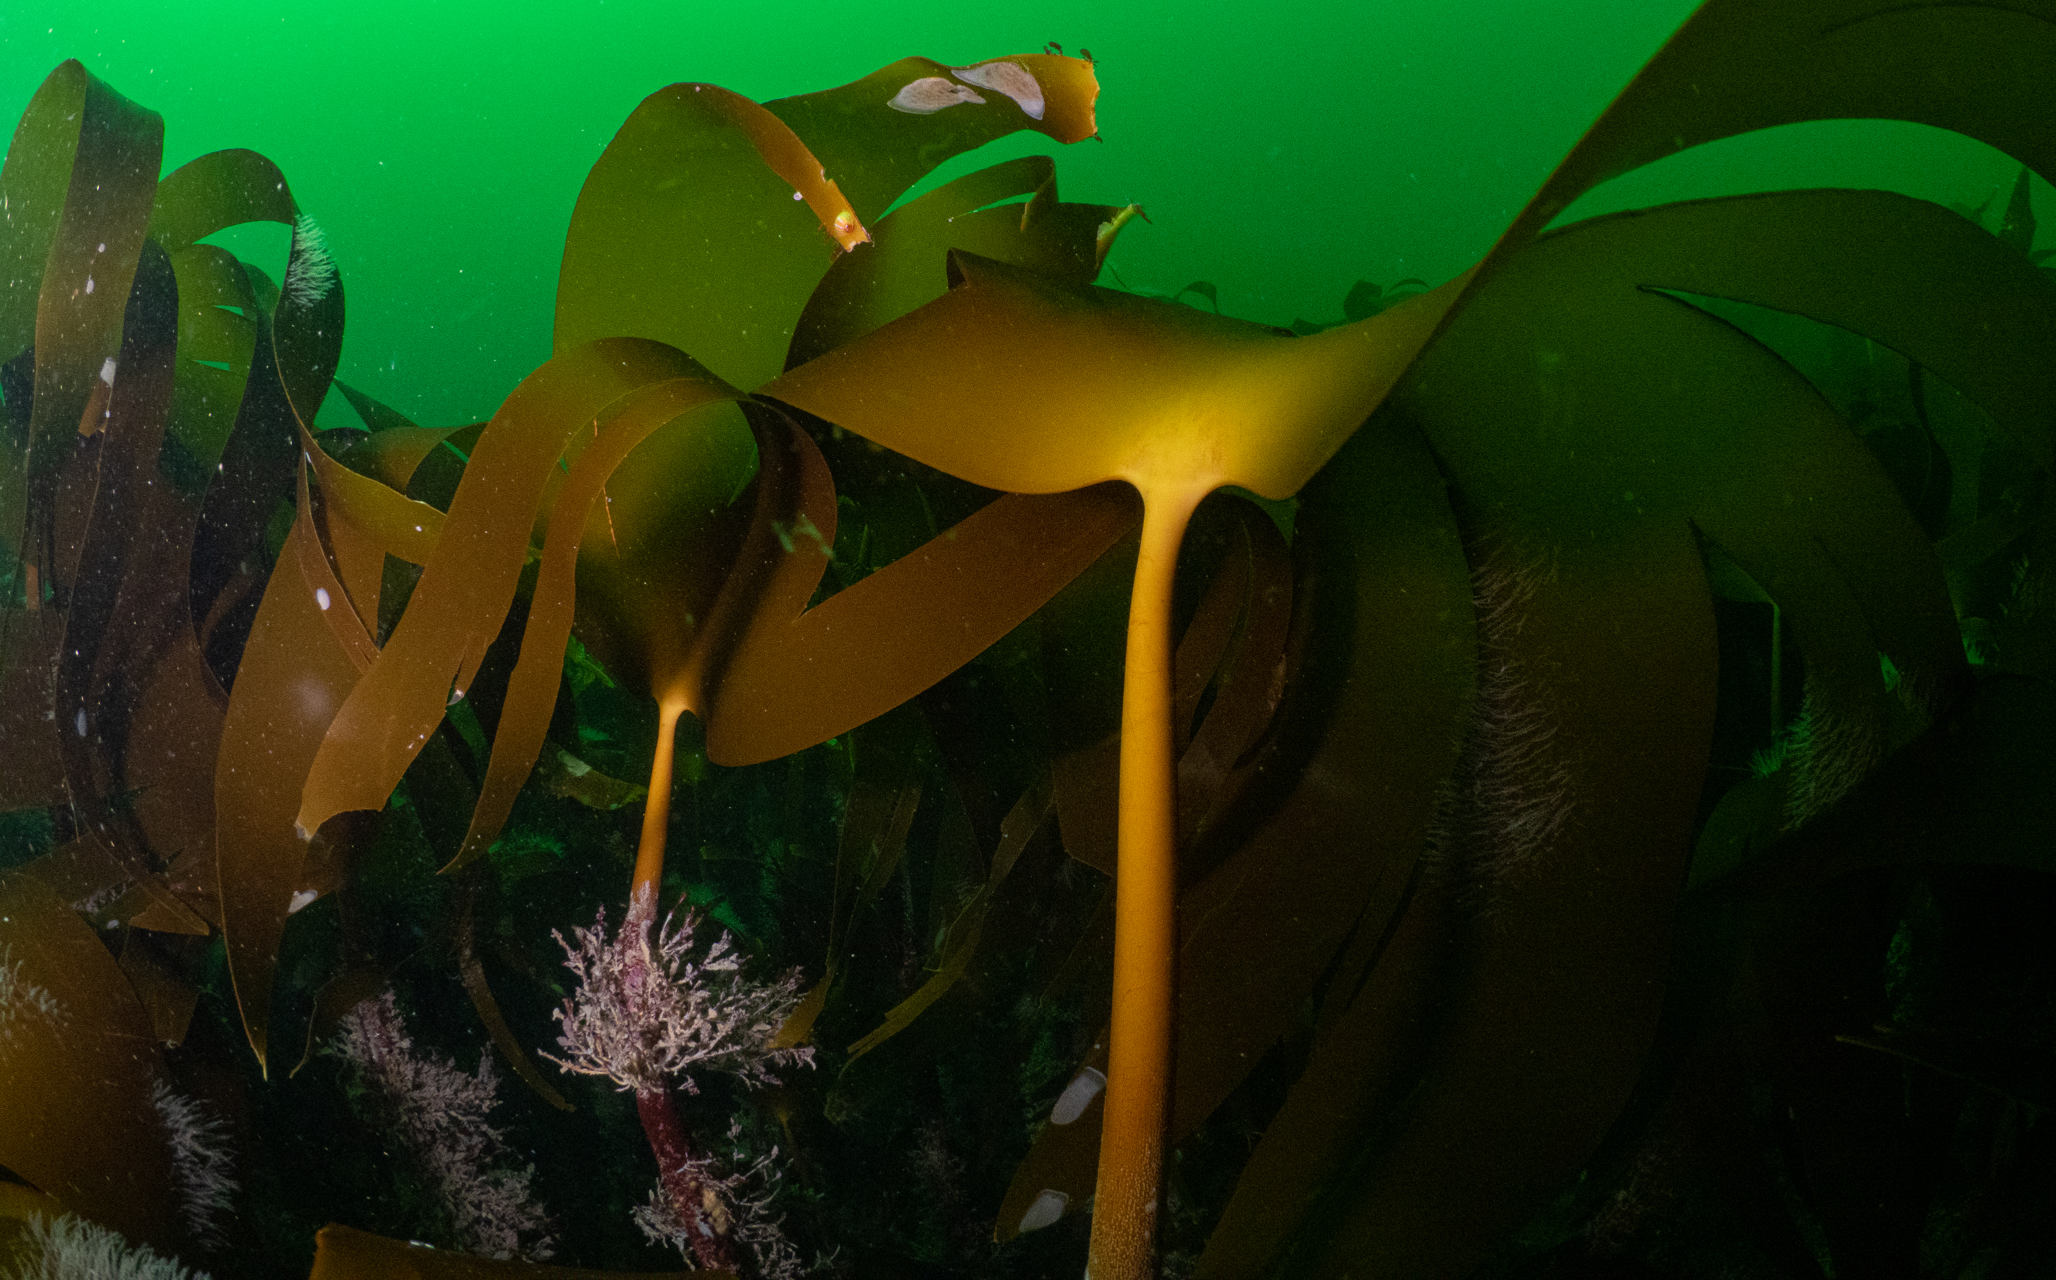
PROTECT BLUE CARBON HABITATS
© Mark Kirkland via MCS
© Odd wellies via Flickr
© Mark Kirkland via MCS
© Stephen Gidley via Flickr
Notes:
Highly Protected Marine Areas are essentially like nature reserves where no destructive activity at all is allowed. We need to make sure we set up Highly Protected Marine Areas to protect and recover blue carbon storing habitats, like seagrass, kelp and saltmarshes.

Slide 22
#BeTheWave

Slide 23

#BeTheWave
SCHOOL
Improve ocean literacy within your school by introducing ocean topics into PSHE, geography, science, history, art, design technology, English and drama.
Does your school have a green/eco club? It is a great way to help students learn more about our incredible natural environment including diversity within your school grounds and further afield. Your group could dedicate a term to explore the underwater world in Wales.
If your school is near the coast why not take your students out for a day trip to the beach. It could be linked to the curriculum or as part of an experience day. If you want a helping hand the Marine Conservation Society offer free seashore safaris for school groups.

Slide 24
#BeTheWave
INDIVIDUAL
Inspire your friends and family by sharing with them what you’ve learnt about the incredible diversity of habitats and species in coastal waters around Wales.
The sea and coastline around Wales is fantastic. The best way to learn more about it and to stay inspired is to get out there and enjoy it.
If you live near the coast there’s several citizen science projects you can get involved with, to help record the diversity on the coast contributing to important science.
  Record seaweed diversity on the shore to help us understand how this is changing overtime:
hwww.mcsuk.org/what-you-can-do/volunteering/big-seaweed-search/
  Report any sightings of jellyfish and turtles: www.mcsuk.org/sightings/
  Record quantity and variety of shark egg cases: www.sharktrust.org/great-eggcase-hunt

