Slide 1
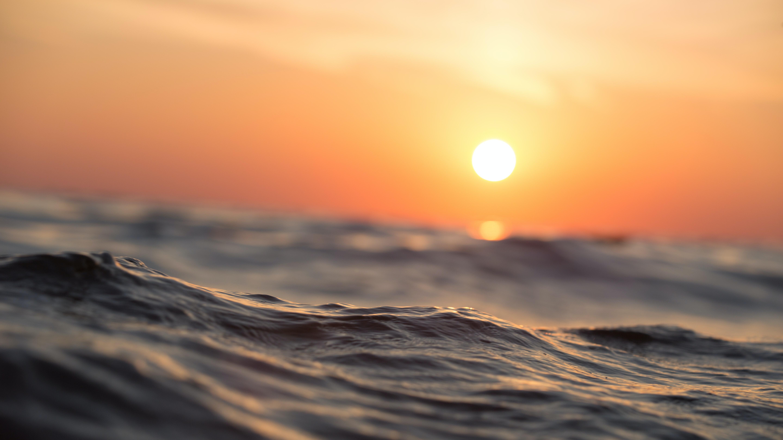
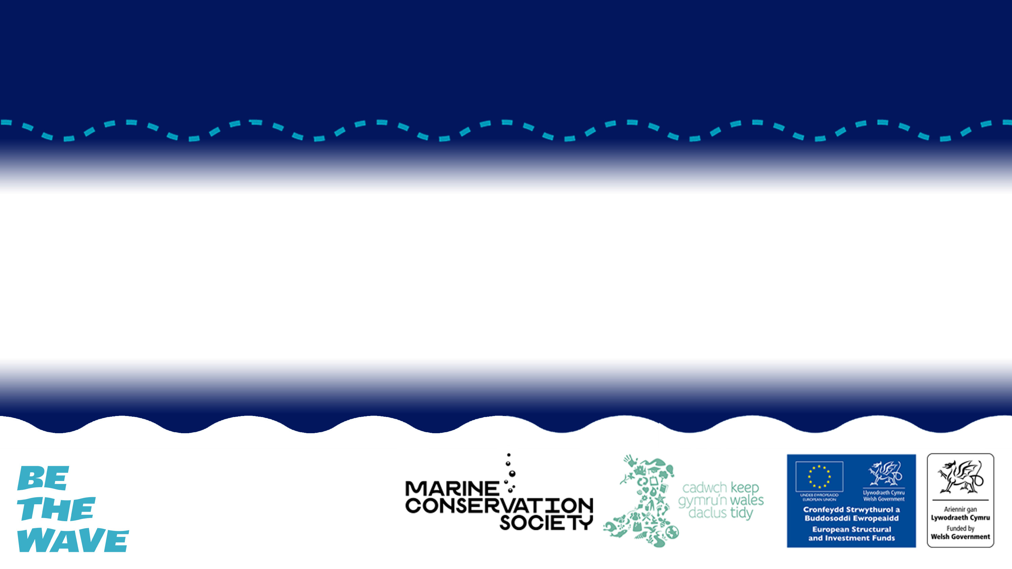
THREATS TO THE OCEAN
What are the key threats to ocean health and how can we help to reduce these threats.

Slide 2
Lesson Objectives
Explain the key threats to the ocean and how these have environmental, economic and social consequences.
Identify how stakeholders can work collaboratively to achieve ecosystem based management.
Construct arguments for and against marine protected areas in the ocean through the views of a key stakeholder.

Slide 3
WHY IS THE OCEAN IMPORTANT?
Notes:
Use the Sustainable Fishing PowerPoint to introduce students to the topic.
Activity 1 focuses on ecosystem impacts of unsustainable fishing and is split into four mini activities looking at overfishing, habitat destruction, food web dynamics and bycatch.

Slide 4
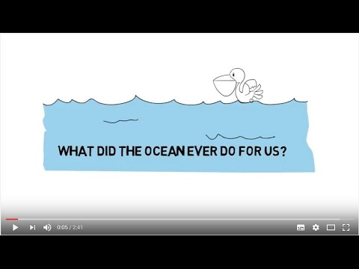
WHAT DID THE OCEAN EVER DO FOR US?
© Odd wellies via Flickr
© Mark Kirkland via MCS
© Stephen Gidley via Flickr

Slide 5
WHAT ARE THE KEY THREATS
TO THE OCEAN?
Notes:
Use the Sustainable Fishing PowerPoint to introduce students to the topic.
Activity 1 focuses on ecosystem impacts of unsustainable fishing and is split into four mini activities looking at overfishing, habitat destruction, food web dynamics and bycatch.

Slide 6
MARINE LITTER
© Rich Carey, Shutterstock via MCS
© Mark Kirkland via MCS
© Stephen Gidley via Flickr
Notes:
60-90% of marine litter is made of plastic items, which can take hundreds of years to break up.
Litter items can cause harm to all sorts of marine life.
Animals can become entangled in litter, causing injury, reduced mobility and even death.
Ingestion of litter, particularly plastic, is very problematic for marine life as they are unable to digest it.

Slide 7
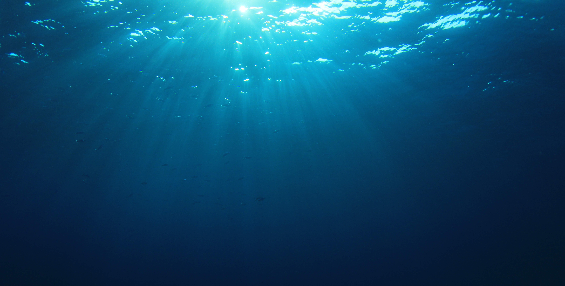
CHEMICAL POLLUTION
Shutterstock via MCS
© Odd wellies via Flickr
© Mark Kirkland via MCS
© Stephen Gidley via Flickr
Notes:
Chemical pollution is invisible, but that doesn’t mean that its not harmful. There are many forms of chemical pollution:
Sewage enters the ocean either treated from water treatment plants or untreated from drains.
Harmful chemicals from factories, industries and even household products are discharged into rivers finding their way eventually to the ocean.
Agriculture runoff entering the ocean contains pesticides and other chemicals, which can cause algal blooms, reducing oxygen and harming marine life.
Toxic chemicals can build up in food chains causing harm to a variety of marine life.

Slide 8
CLIMATE CHANGE – Extreme weather
© Tiniteqilaaq, Greenland © Jean-Christophe Andrévia Pexels
© Odd wellies via Flickr
© Mark Kirkland via MCS
© Stephen Gidley via Flickr
Notes:
High temperatures are causing ice to melt and sea levels to rise.
Increasing temperatures in the ocean is also causing corals to bleach and changing migration routes of many species.
Increased storms affect fragile marine habitats like seagrass beds, salt marshes and mangroves.

Slide 9
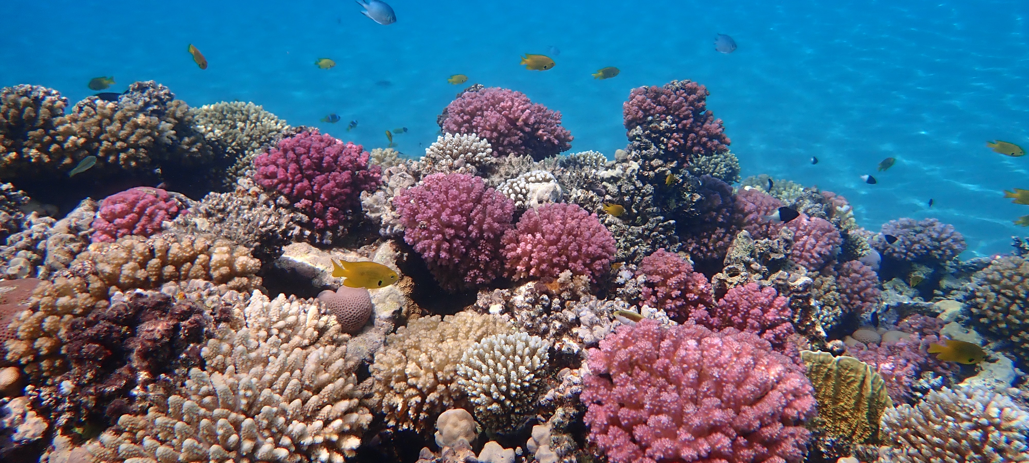
CLIMATE CHANGE – Extreme weather
© Ralf Schlegel via Unsplash
© Odd wellies via Flickr
© Mark Kirkland via MCS
© Stephen Gidley via Flickr
Notes:
Increased carbon dioxide is making the ocean more acidic. This is known as ocean acidification.
This affects animals with a calcium carbonate skeleton such as corals, some phytoplankton and some seafood such as mussels, lobsters and crabs.

Slide 10
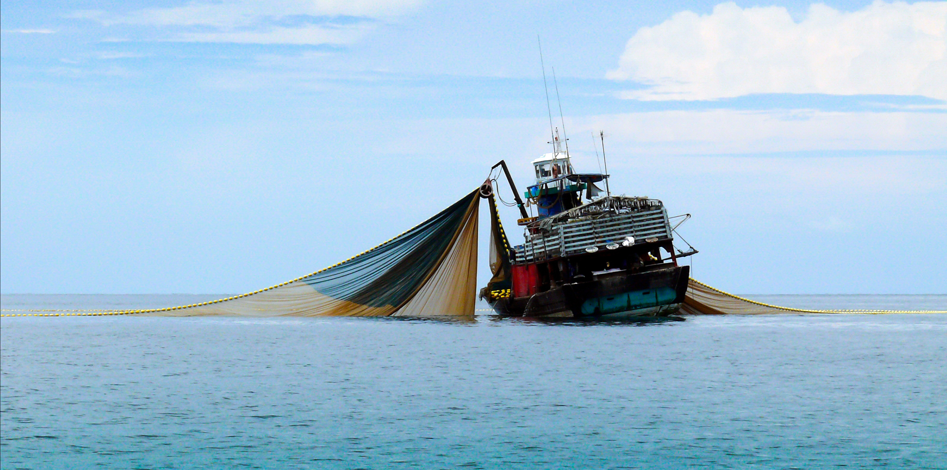
OVERFISHING
© NarisaFotoSS via Shutterstock
© Odd wellies via Flickr
© Mark Kirkland via MCS
© Stephen Gidley via Flickr
Notes:
Unsustainable fishing poses a huge threat to marine biodiversity, affecting food chains and causing depleting fish stocks.
During fishing, animals can be accidentally caught along with the ‘target species’. These are known as bycatch.
Bottom trawling, or dredging, are fishing methods that involve scraping heavy machinery along the seafloor, which can be very destructive to marine habitats.
Illegal and unregulated fishing has disastrous effects on marine environments and harms the livelihood of honest fishers.

Slide 11
TRAFFICKING OF SPECIES
© Sergiu Lacob via Pexel
© Odd wellies via Flickr
© Mark Kirkland via MCS
© Stephen Gidley via Flickr
Notes:
Every year, an estimated 150 million seahorses are caught for the souvenir and medicine trades. As a species, seahorses could be extinct by 2050.
The critically endangered European eel is the centre of the largest wildlife crime in Europe, with illegal trafficking to Asia to be eaten as a delicacy becoming a multibillion-euro industry.
Sharks are caught and traded illegally. They are used as an ingredient in traditional medicine and as delicacy in shark fin soup.

Slide 12
OIL & GAS
© Elise Aldramvia Pixabay
© Odd wellies via Flickr
© Mark Kirkland via MCS
© Stephen Gidley via Flickr
Notes:
Drilling for oil and gas can pose serious threats, from construction of platforms, transportation of goods, creation of pipelines and destructive oil spills.

Slide 13
CONSTRUCTION & DREDGING
© Simon Annablevia Shutterstock
© Odd wellies via Flickr
© Stephen Gidley via Flickr
Notes:
Construction occurs for many activities such as oil and gas rigs, wind turbines, pipelines & coastal development. All cause harm to the marine environment through destruction of habitats and through noise pollution.
Dredging - Sand and gravel is dredged from the seafloor to provide materials for construction, coastal defences, and to increase the depth of shipping channels. Dredging physically damages seafloor communities of plants and animals where the material is removed and where it is deposited.

Slide 14
RECREATION
© Andre Mouton via Pixabay
© Odd wellies via Flickr
© Mark Kirkland via MCS
© Stephen Gidley via Flickr
Notes:
Pressure from recreational development and activities can cause harm to sensitive coastal habitats.
Activities such as boating can cause harm through oil discharge and damage to the seabed habitats through anchoring.
Natural coastal habitats are being destroyed to make room for development. This not only directly reduces biodiversity, but also reduces vital functions these habitats provide such as helping to protect land from erosion and helping to filter nutrient runoff from land.

Slide 15
SHIPPING
© Ian Taylor via Unsplash
© Odd wellies via Flickr
© Mark Kirkland via MCS
© Stephen Gidley via Flickr
Notes:
Shipping can be associated with different kinds of pollution: noise pollution, emissions, oil spills, container spills, dumping of rubbish at sea, and chemical pollution.
It can also directly damage the environment through anchoring, shipwrecks, and contact with large marine mammals.

Slide 16
ECOSYSTEM BASED MANAGEMENT
Notes:
Use the Sustainable Fishing PowerPoint to introduce students to the topic.
Activity 1 focuses on ecosystem impacts of unsustainable fishing and is split into four mini activities looking at overfishing, habitat destruction, food web dynamics and bycatch.

Slide 17

© Odd wellies via Flickr
© Mark Kirkland via MCS
© Stephen Gidley via Flickr

Slide 18
What is a stakeholder?
© Odd wellies via Flickr
© Mark Kirkland via MCS
© Stephen Gidley via Flickr
Notes:
Ecosystem management requires stakeholders to work together.
But what is a stakeholder?
A stakeholder is anybody who can affect or is affected by an organization, or a strategy or a project. Stakeholders can be individuals, groups or organisations.
Stakeholder groups interested in the activity at sea could include those whose actions affect the marine environment or whose livelihoods depend on a healthy ocean.

Slide 19
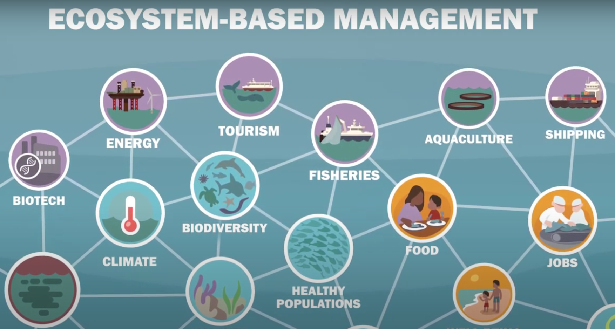
© Odd wellies via Flickr
© Mark Kirkland via MCS
© Stephen Gidley via Flickr
Notes:
In the marine environment there are many different stakeholder groups, such as the fishing industry, shipping, green energy, tourism, oil and gas, Ministry of Defence, environmental charities, coastal community.

Slide 20
Who can you collaboratively work with to reduce risk?
How could you reduce this risk?
What is the affect on the marine environment?
Stakeholder
© Odd wellies via Flickr
© Mark Kirkland via MCS
© Stephen Gidley via Flickr

Slide 21
MARINE PROTECTED AREAS
Notes:
Use the Sustainable Fishing PowerPoint to introduce students to the topic.
Activity 1 focuses on ecosystem impacts of unsustainable fishing and is split into four mini activities looking at overfishing, habitat destruction, food web dynamics and bycatch.

Slide 22
© Odd wellies via Flickr
© Mark Kirkland via MCS
© Stephen Gidley via Flickr
Notes:
MPA VIDEO

Slide 23

#BeTheWave

Slide 24

#BeTheWave
SCHOOL
Improve ocean literacy within your school by introducing ocean topics into PSHE, geography, science, history, art, design technology, English and drama.
Does your school have a green/eco club? It is a great way to help students learn more about our incredible natural environment including diversity within your school grounds and further afield. Your group could dedicate a term to explore the underwater world in Wales.
If your school is near the coast why not take your students out for a day trip to the beach. It could be linked to the curriculum or as part of an experience day. If you want a helping hand the Marine Conservation Society offer free seashore safaris for school groups.

Slide 25
#BeTheWave
INDIVIDUAL
Inspire your friends and family by sharing with them what you’ve learnt about the incredible diversity of habitats and species in coastal waters around Wales.
The sea and coastline around Wales is fantastic. The best way to learn more about it and to stay inspired is to get out there and enjoy it.
If you live near the coast there’s several citizen science projects you can get involved with, to help record the diversity on the coast contributing to important science.
  Record seaweed diversity on the shore to help us understand how this is changing over time:
https://www.mcsuk.org/what-you-can-do/volunteering/big-seaweed-search/
  Report any sightings of jellyfish and turtles: - https://www.mcsuk.org/sightings/
  Record quantity and variety of shark egg cases: - https://www.sharktrust.org/great-eggcase-hunt

