Slide 1
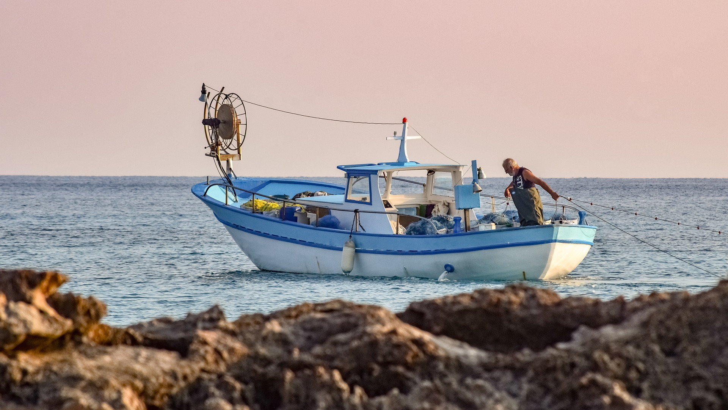
SUSTAINABLE FISHING
Environmental impacts of wild capture fishing and aquaculture

Slide 2
Lesson Objectives
Describe several ecosystem impacts of unsustainable fishing.
Analyse data to determine change over time.
Analyse infographics to determine ecosystem impacts of aquaculture.
Generate creative solutions to reduce the negative impacts of fishing practices.

Slide 3
ECOSYSTEM IMPACTS
Notes:
Use the Sustainable Fishing PowerPoint to introduce students to the topic.
Activity 1 focuses on ecosystem impacts of unsustainable fishing and is split into four mini activities looking at overfishing, habitat destruction, food web dynamics and bycatch.

Slide 4
Overfishing
Habitat destruction
ECOSYSTEM IMPACTS OF UNSUSTAINABLE FISHING
Food web dynamics
Bycatch
© Mark Kirkland via MCS
Notes:
Question to students – Does anyone know what an ecosystem is?
An ecosystem refers to a habitat and its community of plants and animals and how they interact and interconnect.
We are going to have a look at the ecosystem impacts of unsustainable fishing practices. The impacts we are going to look at are overfishing, habitat destruction, food web dynamics and bycatch.

Slide 5
OVERFISHING
Source: Marine Stewardship Council
© Mark Kirkland via MCS
Notes:
Read through the diagram on this slide to introduce students to overfishing and the concept of maximum sustainable yield.

Slide 6
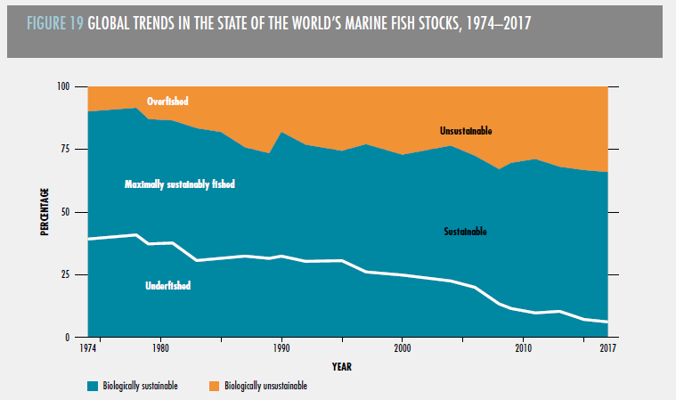
OVERFISHING
© Mark Kirkland via MCS
Source: FAO
Notes:
Use the ecosystems impacts worksheet to analyse and interpret the graph showing global trends of fish stocks from 1974-12017

Slide 7
HABITAT DESTRUCTION
© Mark Kirkland via MCS
Notes:
Watch the video and answer the questions on the ecosystem impacts worksheet.

Slide 8
FOOD WEB DYNAMICS
© Mark Kirkland via MCS
Notes:
Play the wood web game which looks at how overfishing alters food web dynamics (all instructions and cards provided in separate document) and then complete associated questions on the ecosystem impacts worksheet.

Slide 9
BYCATCH
© Mark Kirkland via MCS
Notes:
Watch the video and answer the questions on the ecosystem impacts worksheet.
Answer for question 3 ‘Why is bycatch bad for wildlife and unsustainable?’
1. Even when bycatch is thrown back most of the creatures are dead or dying
2. A lot of juvenile fish get taken as bycatch which means they can’t grow up and reproduce. This can change food web dynamics and the balance of ecosystems
3. Threatened and endangered species are often landed as bycatch

Slide 10
AQUACULTURE
Notes:
Introduce aquaculture as a fishing practice. Students should analyse the infographics and draw out key points to create a table of positives and negatives using the aquaculture worksheet.
Students should think about ecosystem impacts, food supply, climate impact and overall sustainability. They should not be restricted to the information on the infographics alone but also add their own knowledge and thoughts to their table.
To introduce positive solutions for sustainable aquaculture show students the video which looks at multi trophic 3D aquaculture.

Slide 11
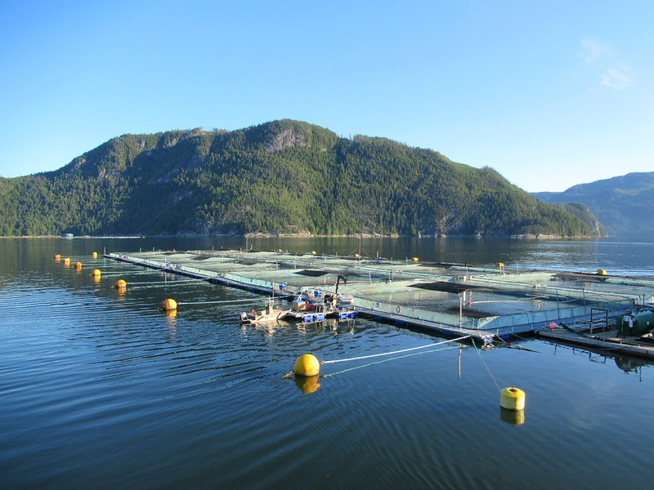
Aqua-culture
Water
Agriculture/ cultivation
Many species of seafood can be farmed such as salmon, trout, prawns, shrimp, mussels, oysters and seaweed.
© David Stanley via Flickr
© Mark Kirkland via MCS
Notes:
The term aquaculture derives from aqua meaning water and culture agriculture / cultivation. Aquaculture basically means farming of freshwater or saltwater species. Many species of seafood can be farmed such as salmon, trout, prawns, shrimp, mussels, oysters and seaweed.

Slide 12
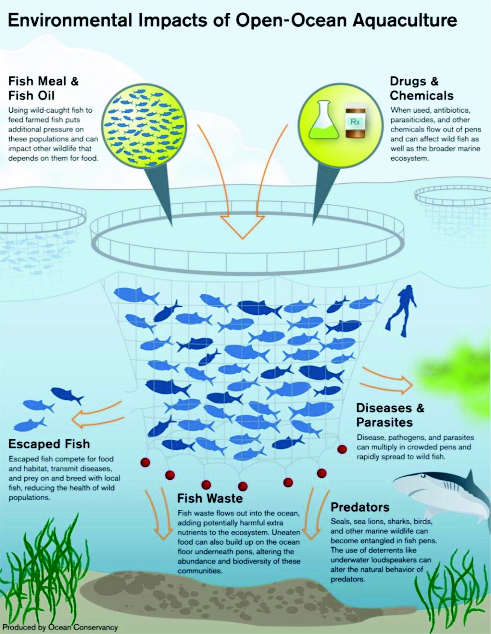
© Mark Kirkland via MCS

Slide 13
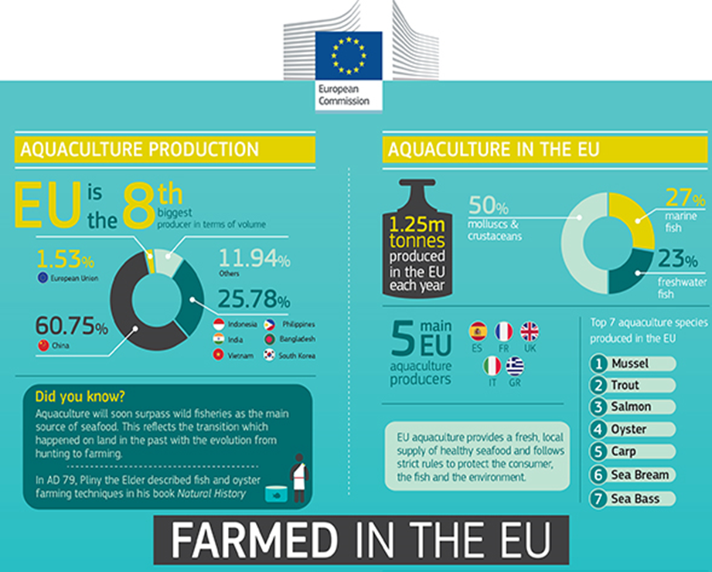
© Mark Kirkland via MCS

Slide 14
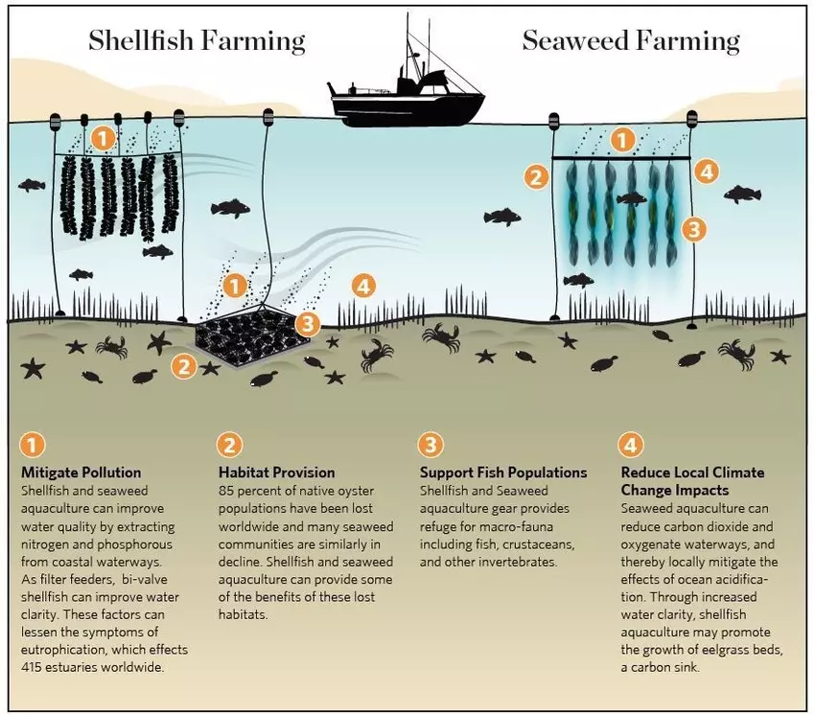
© Mark Kirkland via MCS
Source: The Nature Conservancy

Slide 15
© Mark Kirkland via MCS
Notes:
This video shows a positive example of sustainable farming. Ask students to watch the video carefully as you will discuss the content afterwards.
QUESTION - What seafood was being farmed in the video? ANSWER- Seaweed, scallops, mussels, oysters.
QUESTION – What makes this type of farming sustainable? ANSWER (featured in video) - No fresh water, no fertiliser, no feed, no arable land
QUESTION – What other benefits to this type of farming were discussed in the video. ANSWER - Shellfish and kelp soak up carbon. They also filter nitrogen out of the water column. 3D farms create storm protectors.

Slide 16
#BeTheWave

Slide 17
#BeTheWave
SCHOOL
Use the Marine Conservation Society’s Good Fish Guide when buying fish for school meals to ensure you are providing sustainable fish in your school’s canteen.
https://www.mcsuk.org/goodfishguide/search
Promote your agreement to buy sustainable fish on your website and through your social media channels to help raise awareness of the issue and inspire other schools to do the same.
Incorporate learning about sustainable seafood into your food technology curriculum.

Slide 18
#BeTheWave
INDIVIDUAL
Use the Marine Conservation Society’s Good Fish Guide when buying fish with your family, at home, at your local chip shop or in a restaurant to ensure that your are buying sustainable, responsibly sourced fish.
https://www.mcsuk.org/goodfishguide/search
Tell your friends and family about the Good Fish Guide, and why buying sustainable seafood is important.
Show the government that you care about sustainable seafood by signing the Marine Conservation Society’s red rated campaign online.
https://www.mcsuk.org/campaigns/red-rated-seafood-home

