Slide 1
Source to Sea

Slide 2
Lesson Objectives
To discover the routes litter can take to enter the ocean
To explore the common types of litter that end up in the ocean.
To develop an understanding of the impact litter has on the marine environment.
To apply knowledge of marine litter sources to everyday life through #BeTheWave actions and the Eco-Schools programme

Slide 3
How does litter get into the oceans?
Think of as many ideas as you can and make a class list.
Then watch this video - TRASH TALK
3. Can you add any more to your list?

Slide 4
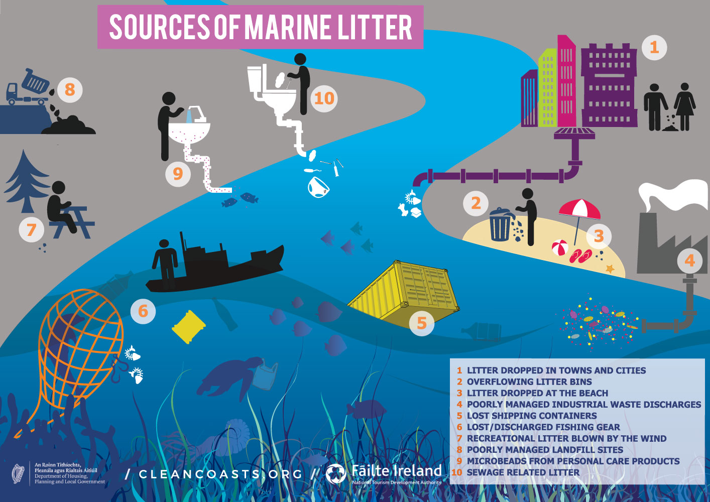
Notes:
Resource from Clean Coasts Ireland, who are support by Irish Government and Failte Ireland.
http://cleancoasts.org/marine-litter/#sources

Slide 6
Source to Sea – Local and Global
Watch the following videos and consider how they make you feel?
Flooding after Storm Dennis: Trail of river litter left behind - BBC News

Slide 7
Source to Sea – Local and Global

Slide 8
The Canal and River Trust have estimated nearly 60% of the litter found in canals are plastic, such as bags, bottles, disposable cups, and food wrappers.
How can we reduce these items from the environment?
Create an action or a rule for your school to follow
Share these with the school and the Eco-Committee

Slide 9
#BeTheWave

Slide 10
#BeTheWave
School
Use the Eco-Schools Litter Environmental Review to investigate litter issues in your school and community. Link with a local business to create a litter action and raise awareness on social media.
Through your school communication channels make sure everybody is educated about the pathways litter can take to get to the ocean. Make sure your school has a litter policy and the content known by the school community.
Create a whole school Litter Challenge, involve the opinion of your site manager or school cleaners. What do they think about the litter in and around the school? What could pupils do to help them?
Spread your litter message outside the school gates. Create a campaign such as “Only Rain Down the Drain” and raise awareness in your local area.
Join in with official litter picking events such as Spring/Autumn Clean Cymru with Keep WalesTidy or investigate local litter picking groups and support them! If you can't find a group, create one!

Slide 11
#BeTheWave
Individual
Never drop litter! Make sure any litter you throw away is safe and secure and can’t escape or be blown away.
Refuse to use at least one item you have discovered that causes a problem in our oceans. Tell your friends and family what you are doing and why. Ask them to join you. Raise awareness of your actions on social media. Feel good about what you are doing and celebrate!
Pledge your support to an established campaign. Check out the City to Sea campaigns or take a look at the Marine Conservation Society "Don't Let Go" . Balloon campaign.
Join in with official litter picking events such as Spring/Autumn Clean Cymru with Keep WalesTidy or investigate local litter picking groups and support them! If you can't find a group, create one!

