Slide 1
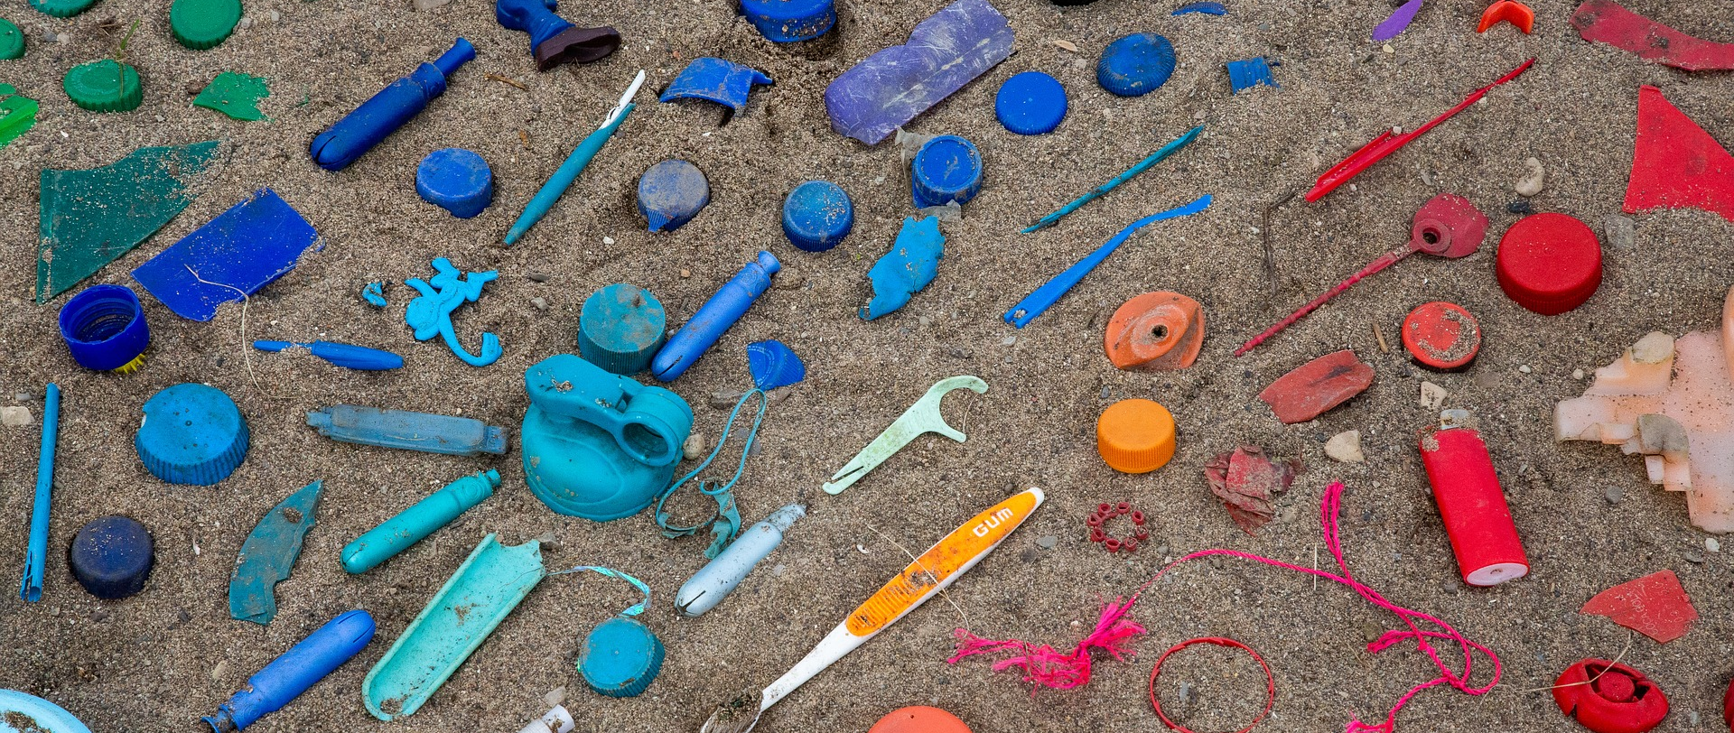
Plastic Pollution

Slide 2
Lesson Objectives
To develop an understanding of plastic, its durability and extensive global use. To explain the impacts of plastic pollution on the marine environment To apply knowledge of plastic pollution to everyday life through action #BeTheWave and Eco-Schools programme

Slide 5
Plastic Diary – Discussion Points
Things to consider:
Which items surprised you?
What proportion of your list is made up of single use plastic items?
Is single use or multi use plastic better/worse for the environment? Why?
What is the best way to present the class data for the plastic diaries? Why?
Do you need to change the data in any way to make it more useable? Why?

Slide 6
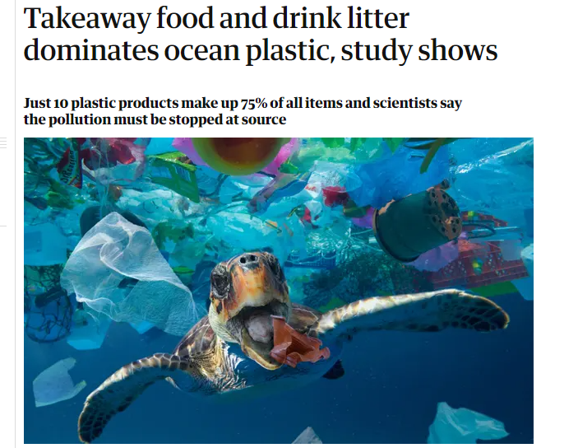
Activity 2
Guardian Report June 2021
Main Points
Half of all plastics are single use applications, used just once and then disposed of
Single use bags, plastic bottles and food wrappers are the four most widespread items polluting the seas, making up almost half of the human made waste
Research identifying the sources of ocean plastic made it clear where action was needed to stop the stream of litter from its creation
Producers should be made to take more responsibility for their products

Slide 7
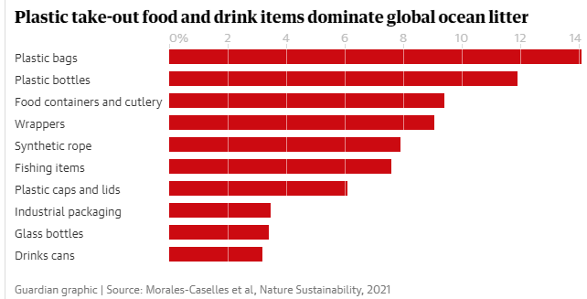

Slide 8
Researchers stated you have to stop the litter at the source, so the plastic doesn’t even enter the environment in the first place.
Extra information to expand activity:
Marine Conservation Society states - We must ditch our single use addiction. We cannot recycle our way out of the current plastics' crisis. Plastic bags, cutlery and food wrappers have a lifespan of a few minutes......
The Welsh Government is looking to ban a range of single use plastic items, many of which are hard to recycle and unfortunately are often found around the Welsh coast.
The items include plastic stemmed cotton buds, plastic cutlery, drink stirrers, straws, single use cups made of polystyrene, take away food containers made of polystyrene, plastic plates and balloon sticks.
They are also looking at certain products that break down into micro fragments including carrier bags and certain plastic bottles.

Slide 9
Extra Plastic Facts
​350 million tonnes of plastic are being produced each year​ - this weighs the same as the entire human population
More than ​8 million tonnes of plastic enter the ocean every year. If waste management practices don't improve, scientists predict this amount could increase tenfold by 2025​
Plastics make up to around 75% of marine litter, although this can be more in some areas​
We don't know how long it takes for some plastics to break down. It's estimated it could take up to thousands of years to degrade​
Birds are highly susceptible to plastic ingestion. It is estimated that over 90% of all seabirds have ingested plastic​
Notes:
Extra information to expand discussion

Slide 10
Plastic News – Wales
The Welsh Youth Parliament recently launched their report Reduce, Reuse, Recycle which aimed to reflect the views and practices of young people in Wales in respect of litter and plastic waste, what they feel about the issues and why and what practical challenges they face.
Notes:
Extra information to expand discussion

Slide 11
Activity 3
Watch the Video - The Waiting Room

Slide 12
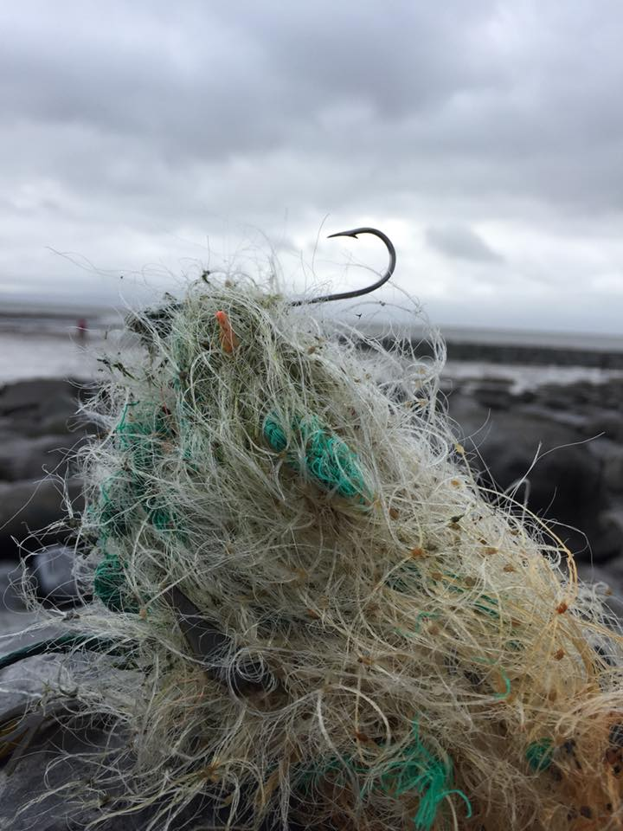
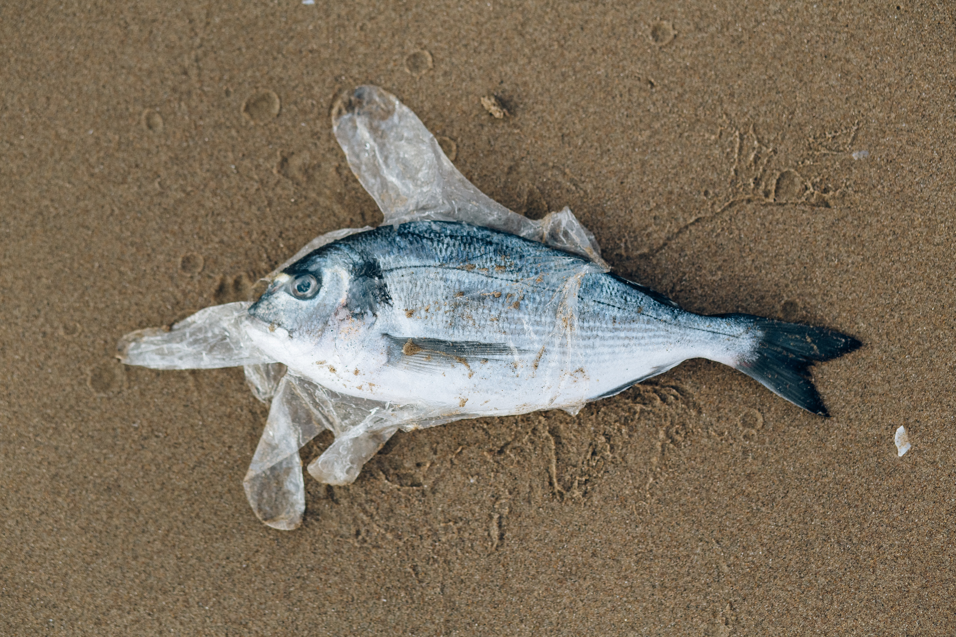
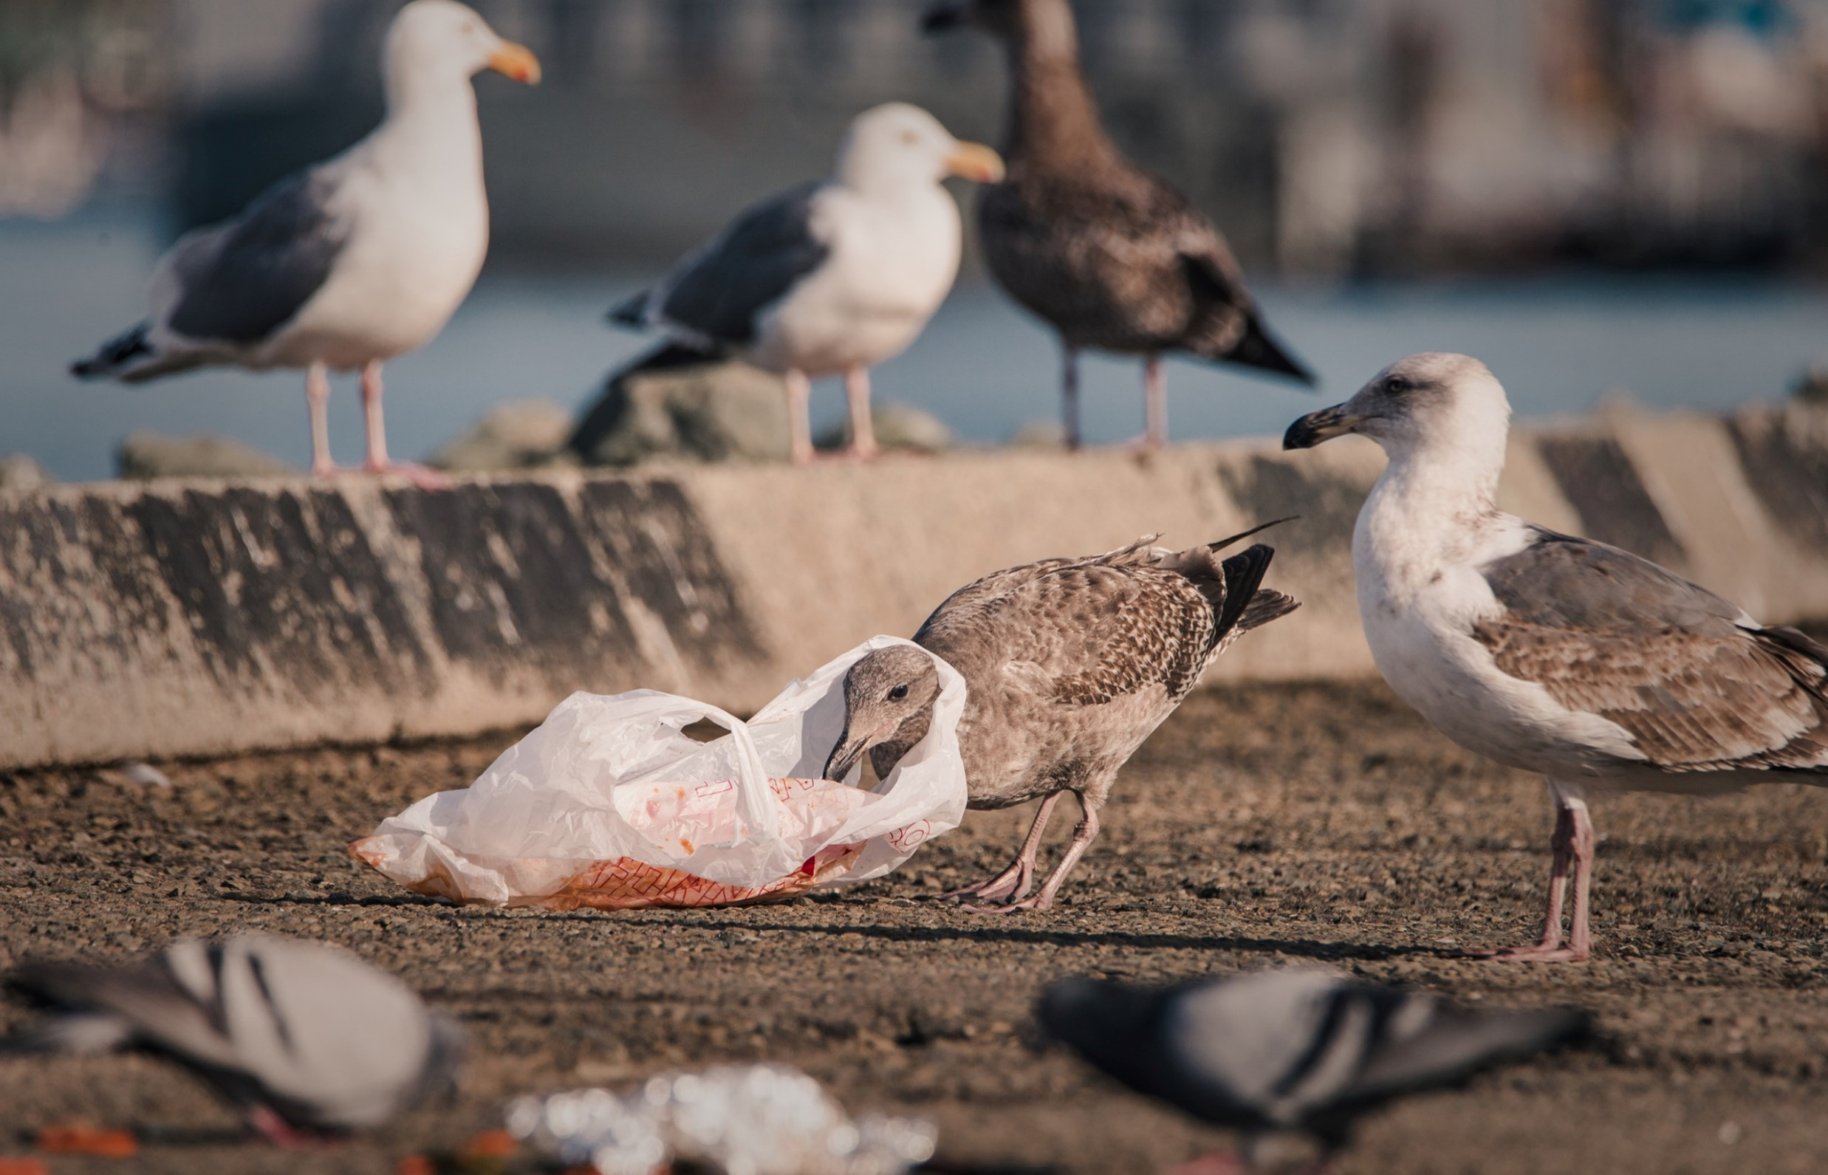
Search the internet ( through Google, Ecosia or Ocean Hero) to discover images of the impact of plastic pollution on marine wildlife.
Notes:
pexels-nataliya-vaitkevich-4813971 Fish and glove
Twitter@ValeCoastalCleanup Hook and Line

Slide 13
#BeTheWave
School
Use your pupil voice and become a Plastic Free School run by Surfers Against Sewage
Take part in the Young Reporters for the Environment and highlight the dangers of marine plastic for our wildlife.
Highlight the Litter and Wildlife facts from the RSPCA. In an assembly, school newsletter or school Twitter feed.
Individual
Live with less plastic - Take a look at Refill Wales and become a Refill Champion
Support local Wildlife Trust for Wales or WWF Cymru and find out about the nature on your doorstep
Investigate Living Seas Wales - help with citizen science work or join an event.

Slide 14
#BeTheWave

