Slide 1
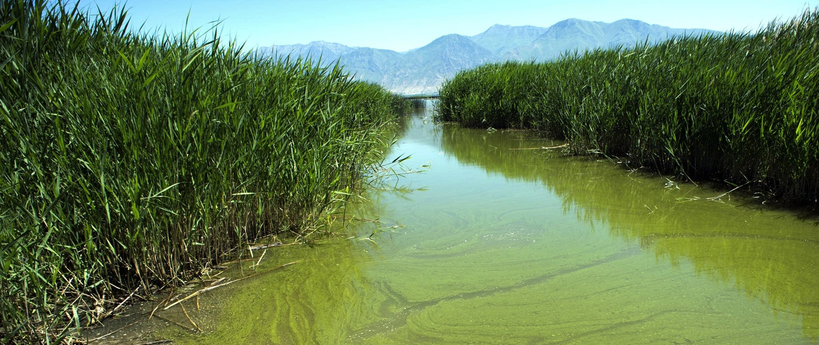
Invisible Pollution
Research Pack

Slide 2
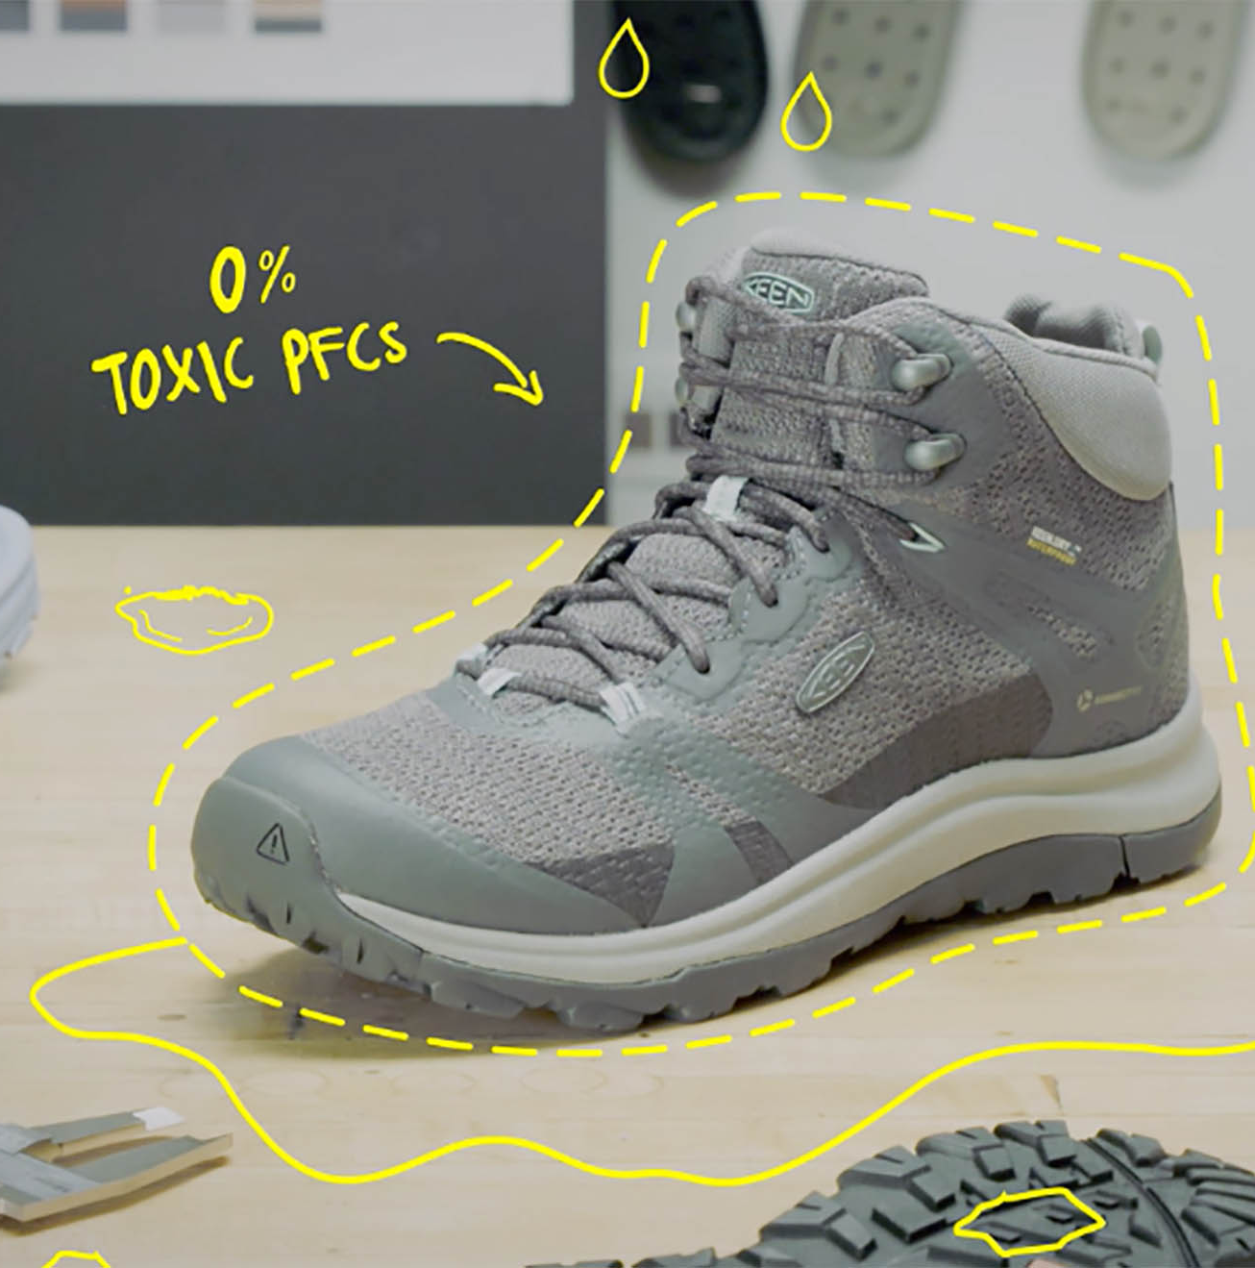
Keen - A Case Study on removing PFCs from their products
SOURCING IT EVERYWHERE (EASIER SAID THAN DONE)
With safe alternatives in hand, it might sound easy to make the transition to a PFC-free DWR. But we quickly realized that getting to 100% PFC Free was not going to be as quick and simple as flipping a switch.
To begin with, PFCs were being embedded in core components throughout the shoe (not just the upper). For a waterproof or water-resistant style, it meant specifying the face fabric, the thread, the foam inside the tongue, and over a hundred other individual pieces, including the KEEN logo. PFCs really are everywhere. It gets pretty complex, because we needed to work with many different suppliers and they in turn needed to work in their supply chain to source the chemistries that we wanted.
Plus, many factories were using it as a coating on their molding machinery — kind of like spraying muffin tins with non-stick cooking spray. So even parts of the shoe that wouldn’t normally have a DWR treatment specified had traces of PFCs in them. It was even in the packaging. So we hired a full-time restricted substances expert who could be on the ground in the factories to ensure that PFCs weren’t inadvertently ending up in our products.
Reference:
PFC Free: Getting ‘Forever Chemicals’ Out of Footwear | KEEN Footwear

Slide 3
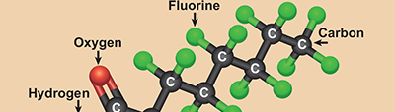
Forever Chemicals (PFAS)
About 5,000 fluorinated compounds known as PFAS (per- and polyfluoroalkyl substances)
Forever chemicals earned their nickname because of how persistent they are. These toxic chemicals never break down, remain in the environment, and enter the food chain.
Headlines continue to pop up about forever chemicals being found in everything from clothing to drinking water.

Slide 4
Some places PFAS are found
PFAS take a long time to breakdown the half life is approximately 25-35 years. The half-life is how long it takes for half of the chemical to breakdown.
This means they can build up in the food chain (bioaccumulation). Each level of the food chain having more toxicity than the last.
In animals it can case changes to the liver, hormone levels (reprotoxic) and adaptive immunity.
In humans in can increase the risk of cancers such as kidney cancer, high cholesterol, ulcerative colitis (inflammation of the colon) and complications in pregnancy.
Reference:
Centre of Disease Control (USA) (cdc.gov)

Slide 5
PFAS affects on Environmental and Human Health
PFAS take a long time to breakdown the half life is approximately 25-35 years. The half-life is how long it takes for half of the chemical to breakdown.
This means they can build up in the food chain (bioaccumulation). Each level of the food chain having more toxicity than the last.
In animals it can case changes to the liver, hormone levels (reprotoxic) and adaptive immunity.
In humans in can increase the risk of cancers such as kidney cancer, high cholesterol, ulcerative colitis (inflammation of the colon) and complications in pregnancy.
Reference:
Centre of Disease Control (USA) (cdc.gov)

Slide 6
Reference:
Greenpeace Dirty Laundry report

Slide 7
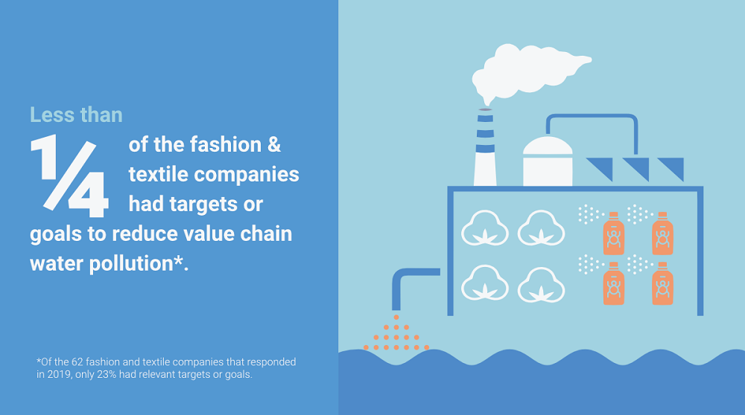
How does this make you feel?

Slide 8
How invisible pollution ends up in the water
Chemical Pollution : Ocean Health Index

Slide 9
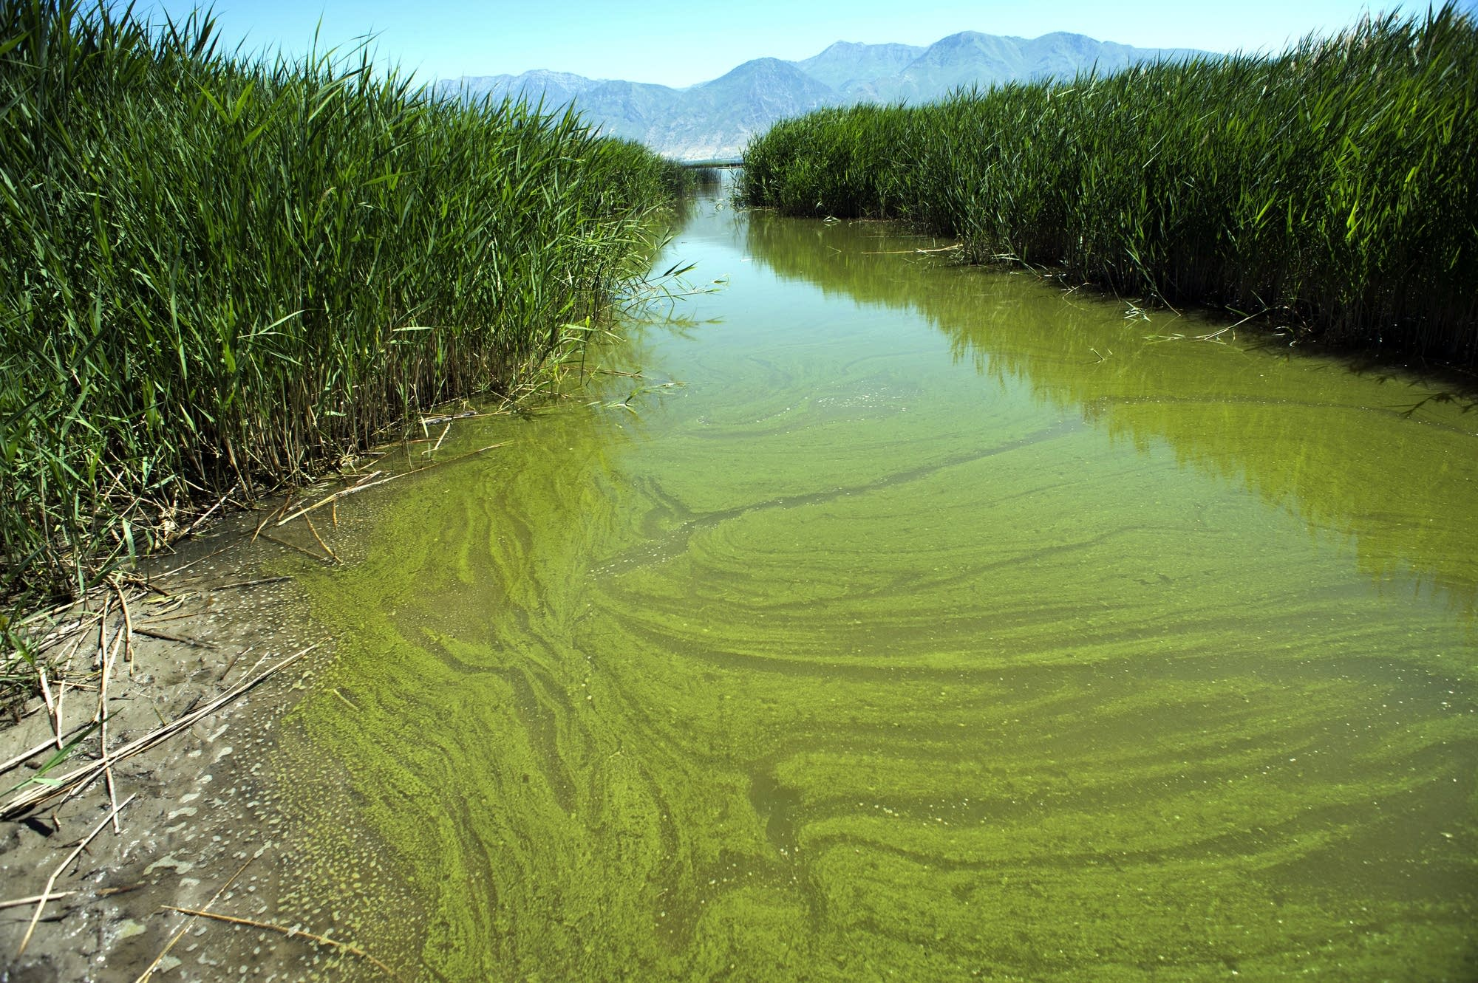
Nitrate and other nutrient pollution from agriculture runoff (fertilisers) and sewage have the most obvious and visible effect on waterways, as they lead to the growth of algal blooms, which deplete oxygen supplies in the water.
What do you think will happen in the river if there is no oxygen?
Reference:
Greenpeace Dirty Laundry report

Slide 10
Pesticides have been linked to birth defects and changes in our hormone systems. Nonetheless we spray it on our food. 4.1 million tons of pesticides are used globally every year.
Reference:
Effects Of Pesticides On Humans (theworldcounts.com)

Slide 11
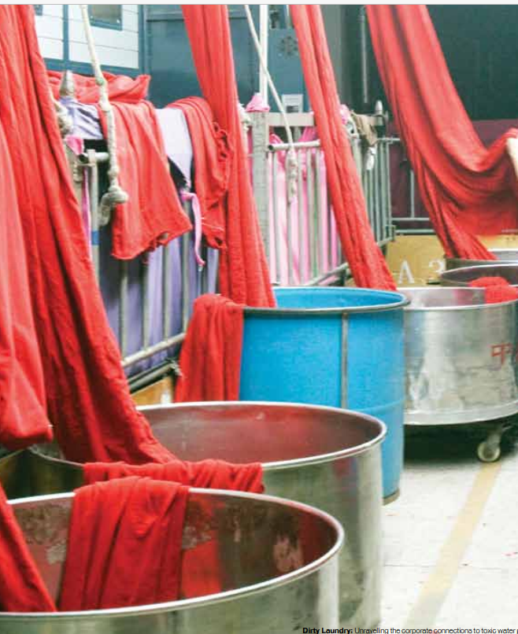
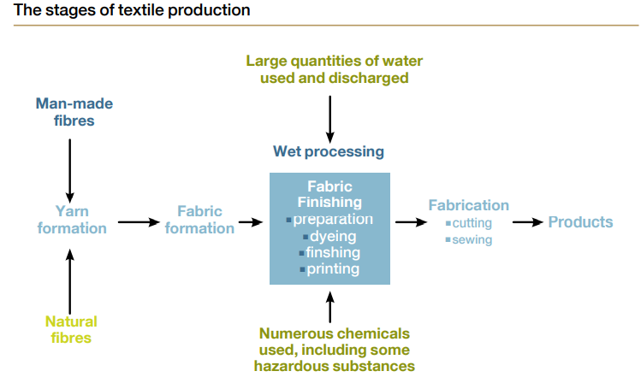
Textile – Wet Production
As much as 200 tonnes of water is used for every tonne of textile produced
10,000 substances are useable in the dyeing and printing process. Of these 3,000 are commonly used

Slide 12
The growth of persistent hazardous chemicals in the textile industry began after the second world war
Chlorinated flame retardants were first used on a large scale during the second world war for military clothing
Perfuorinated chemicals were first manufactured in the 1940s and commercialised in 1950s

Slide 13
Oil
‘Oil’ is the general term for any thick, viscous, typically flammable liquid that is insoluble in water but soluble in organic solvents. Plants and animals produce a variety of natural oils, but the Clean Waters goal is primarily concerned with oil derived from geological deposits of petroleum (crude oil) for use as a fuel or lubricant.
Oil comes from anthropogenic sources, including boats, land-based runoff and, to a lesser degree, oil spills. These sources pose a greater threat to marine environments as the oil enters the ocean in concentrated areas at a high rate of flow.

Slide 14
After 20 years, oil pollution from the 1989 Exxon Valdez spill in Alaska persists, in some areas, is nearly as toxic as initial levels (Exxon Valdez Trustee Council 2009; Raloff 2009).
Events such as the Exxon Valdez spill and the large spill resulting from the explosion of BP's Deepwater Horizon offshore drilling platform in the Gulf of Mexico have substantial effects that should be visible in regional assessments, but are probably not large enough to be seen in global-scale studies.

Slide 15
ECOLOGICAL IMPACT
Oil pollution can degrade or destroy marine ecosystems. Oil pollution can elevate concentrations of toxic elements (e.g. arsenic). Oil pollution can kill marine life through ingestion, inhalation and absorption. Oil pollution can kill marine life through ingestion, inhalation or absorption. Because oil sticks to fur and feathers, seals, sealions and birds lose the insulation that those structures normally provide. Oiled birds are also unable to fly. Oil pollution can have long-term effects on spawning grounds and recovery of fish stocks and populations of most other marine animals. .
HUMAN HEALTH IMPACT
Oil pollution can harm those who consume contaminated water or seafood or have contact with polluted waters through recreation and clean-up activities. Symptoms can include chest pain, coughing, dizziness, headaches, respiratory distress and vomiting.
ECONOMIC IMPACT
Responding to the ecological impacts of oil pollution can result in significant economic costs. Response to the Deepwater Horizon oil spill cost BP US $13 billion dollars. Litigation and compensation for claims cost BP an additional US $15 billion (Telegraph 2011). The company recently agreed to a claims settlement totalling $18.7 billion. (New York Times 2015) Local economies have to deal with costs resulting from contaminated or diminished fish stocks. The BP Deepwater Horizon oil spill caused Louisiana to lose 50 percent of its seafood production, a US $2.4 billion dollar industry in Louisiana that supplied as much as 30 percent of the domestic seafood for the continental U.S. (Nawaguna-Clemente 2011).

Slide 16
Metals are chemical elements that are typically hard, shiny, malleable, fusible, and ductile, with good electrical and thermal conductivity. Metals are toxic if they change the structure and function of proteins and enzymes (GESAMP 2001). Metals found in the ocean that are highly toxic on their own include mercury, cadmium, lead, arsenic, tin, copper, nickel, selenium, and zinc. Mercury, cadmium, and lead can become even more highly toxic in combination with organic compounds. For example, mercury can form neurotoxic compounds such as methylmercury (CH3Hg), when combined with carbon. Arsenic, copper, nickel, selenium, tin, and zinc are not highly toxic by themselves but are able to react with organic materials, creating very toxic compounds (UNEP 2006). Many metals occur naturally in the environment, but anthropogenic emissions from industrial and mining activities can increase concentrations of many to toxic levels. 96% of mercury enters the ocean via atmospheric input (GESAMP 2001). While some metals are deliberately dumped in the ocean, most are found downstream from their sources, including waste dumps, industrial areas, mining operations and metal processing areas. Although global databases describing the concentration of toxic metals throughout the ocean do not yet exist, such data are available in some countries and can be used in regional assessments. For example, Halpern et al.'s (2015) Ocean Health Index assessment for the U.S. west coast used data from NOAA's collaborative Mussel Watch Contaminant Monitoring Program as an indicator of toxic metals along the coasts of California, Oregon and Washington. By filter feeding on plant plankton and small organic particles, mussels bioaccumulate toxic metals and other pollutants very effectively. The Mussel Watch program analyzes those contaminant loads and provides data for various regions in the U.S.

Slide 17
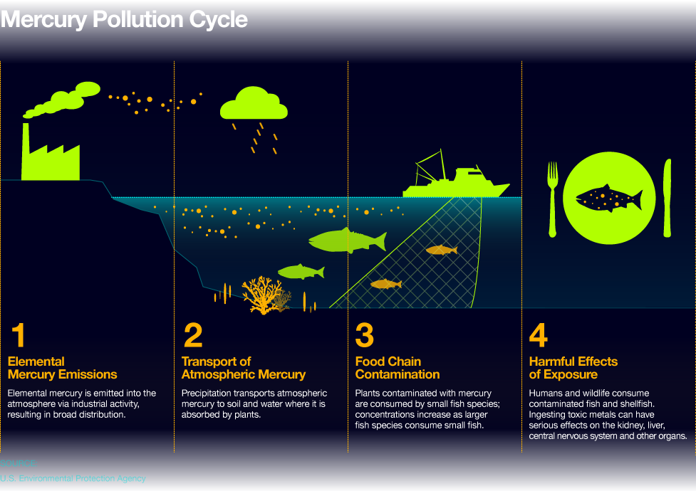
Chemical Pollution : Ocean Health Index

Slide 18
ECOLOGICAL IMPACT
Results of laboratory studies can demonstrate the effects of one or several pollutants on growth, reproduction or other physiological processes in test organisms. Chemical analyses can also reveal the concentrations of pollutants in the tissues of marine organisms collected in the wild. However, limited information is available on how wild marine plants, animals, microorganisms and ecosystems respond to sub-lethal exposure to the many pollutants they encounter, and how other factors such as temperature or pH affect those responses.
HUMAN HEALTH IMPACT
Certain metals, such as zinc, are essential to life in very small amounts, but are toxic in higher concentrations. Others, such as mercury or cadmium, are not used in normal metabolism and are harmful when taken into the body. Ingesting toxic metals can have serious effects on the kidney, liver, immune system, central nervous system and other organs. Over 90% of methylmercury exposure occurs through the ingestion of contaminated fish and shellfish (USGS 2 2009). In the past 20 years, mercury concentrations in the Pacific Ocean have increased 30 percent due to increases in human atmospheric emissions from industries and coal-burning power plants and are estimated to rise 50 percent by the year 2050 (Sunderland 2009).
ECONOMIC IMPACT
In 2004, the U.S. Environmental Protection Agency (EPA) released recommendations for weekly fish consumption so that high levels of mercury ingestion could be avoided (EPA 2010). Expenses can be incurred from health problems attributed to mercury ingestion. An estimated 637,233 children in the United States are born each year with cord blood mercury levels greater than 5.8 mg/L, a level linked to decreased IQ and other birth defects (Trasande et al. 2005).

Slide 19
PERSISTENT ORGANIC POLLUTANTS [POPS]
Persistent Organic Pollutants (POPs) are chemical compounds that are toxic to humans and wildlife. POPs include pesticides such as DDT, herbicides, PCBs (a component found in many coolants, flame-retardants, adhesives), and BPA (a compound found in plastics – primarily in plastic bottles). Though many measurements of the concentrations of various POPs in tissues of various marine organisms are available, they have not been combined into a comprehensive database suitable for use as a global indicator(s). Therefore, the Ocean Health Index developed the proxy described above based on the amount of pesticides used in each country as an estimate of chemical contamination in its coastal waters.

Slide 20
ECOLOGICAL IMPACT
The beluga whale population in Canada’s St. Lawrence estuary has declined from about 5,000 at the beginning of the 1900s to about 650 animals today. They have one of the highest rates of cancer known in any wild population, as well as some of the highest levels of POPs and toxic metals. (Lyons, 2008; Martineau et al. 2002). POP concentrations increasingly accumulate at each stage in the food web. The highest concentrations are found in ‘apex’ predators that feed at the top of the food web (at a high trophic level). Low temperatures cause POPs to break down more slowly and accumulate in higher concentrations than in more temperate zones.
HUMAN HEALTH IMPACT
POPs can cause birth defects, increase cancer risks, disrupt hormone functions and cause reproductive, behavioral, immune system, and neurological problems in humans. Inuit populations that consume large amounts of whale and seal fat have health-threatening, heightened blood levels of POPs, including industrial chemicals such as PCBs and pesticides such as DDT, even though such products were made and used thousands of miles away (Kirby, 2008).
ECONOMIC IMPACT
Because POPs are versatile and inexpensive to manufacture, many countries continue to allow their use. However, the economic costs to deal with the resultant pollution can be high. An estimated 2.8 billion dollars has been spent on dredging and processing POP contaminants from PCB manufacture in the Rhine Delta since 1997. In the United States, the General Electric company (GE), which dumped polychlorinated biphenyl (PCB) used in manufacturing capacitors, will have to pay an estimated total of 1.4 billion dollars to remove PCB-contaminated sediments from the Hudson River (Greenpeace, 2011).

Slide 21
What can be done?
Greenpeace are asking for:
Governments to adopt a political commitment to zero discharge
Individuals to champion post toxic clothing

Slide 22
What can be done?
Join/support/set up an Eco-Committee and work with Eco-Schools to drive environmental change within your school and local community
Eco-Schools | Keep Wales Tidy

Slide 23
#BeTheWave

