Slide 1
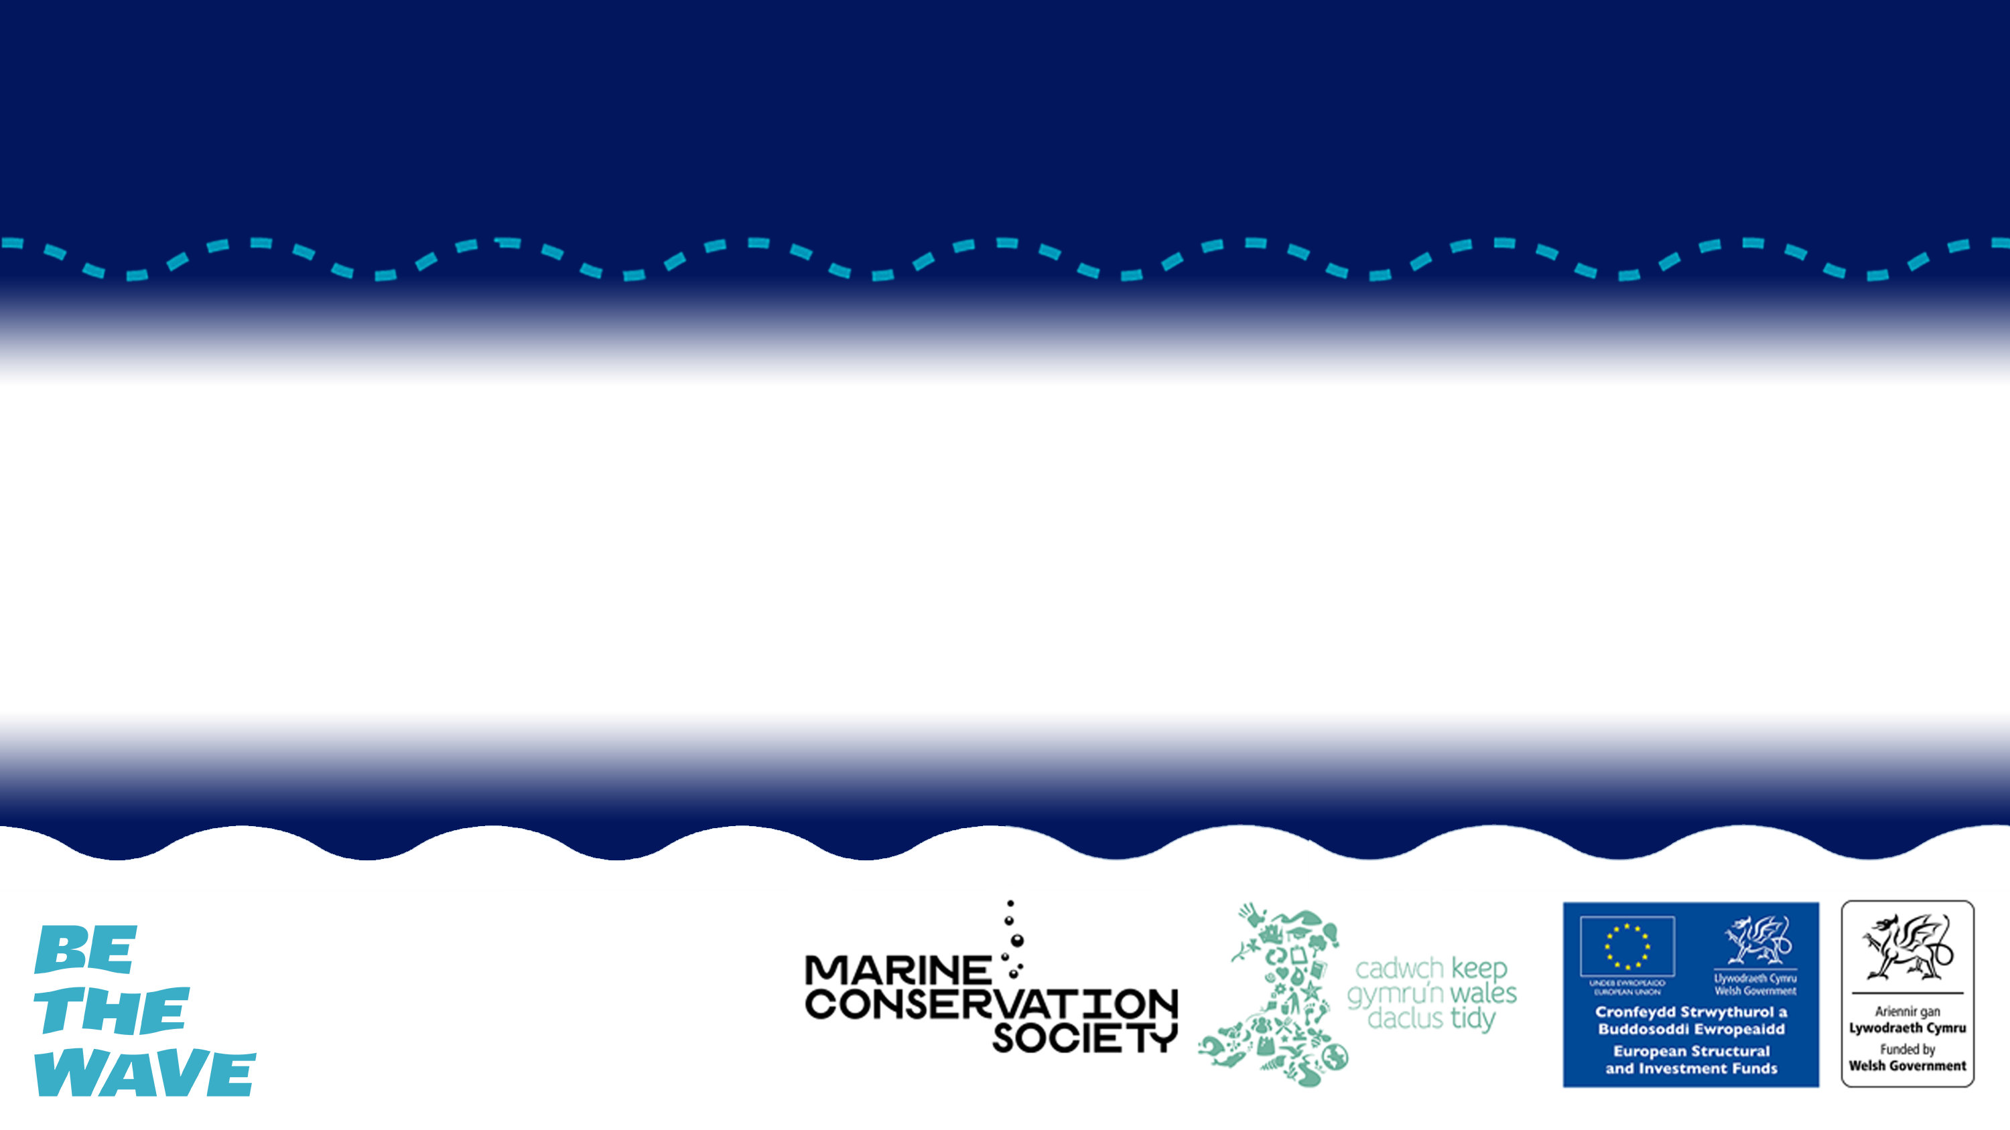
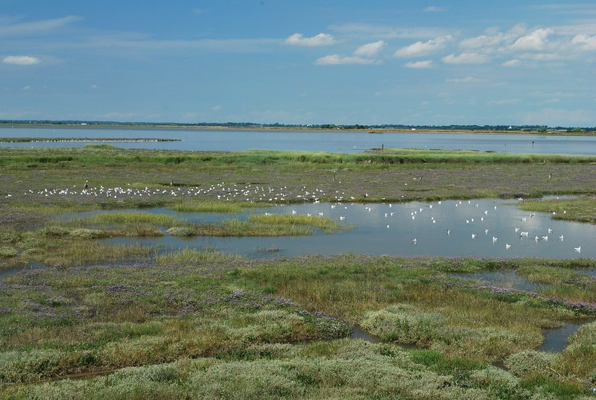
ECOSYSTEM SERVICES
Direct, indirect and aesthetic/ ethical services of ecosystems found across Wales

Slide 2
Lesson Objectives
Describe what the term ecosystem services means.
Give examples of services provided by the ocean and categorise them.
Create an infographic to educate and inform others about the value of ecosystem services.

Slide 3
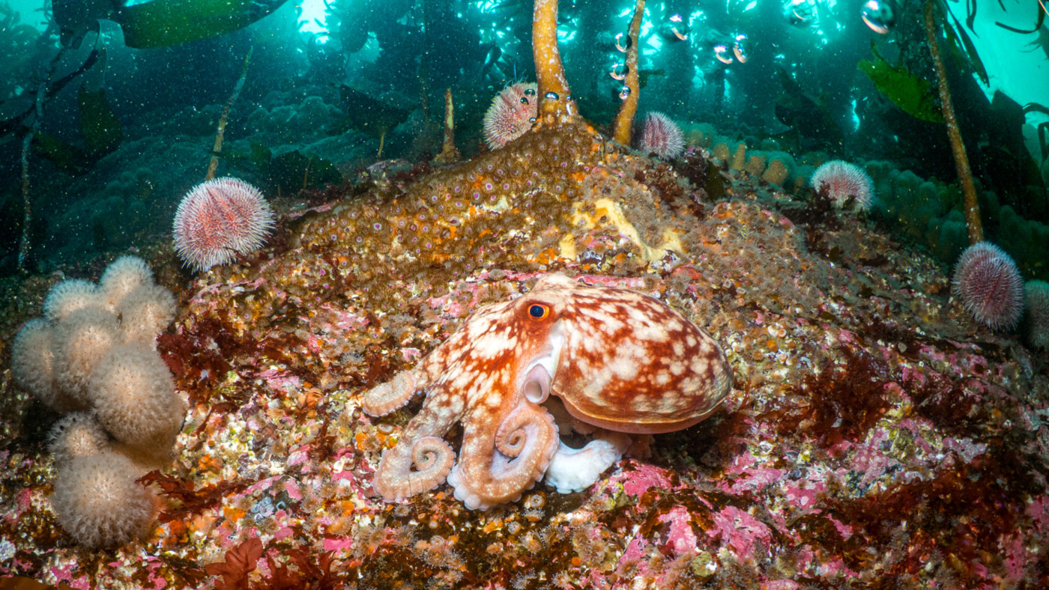
WHAT IS AN ECOSYSTEM?
© Mark Kirkland via MCS
© Mark Kirkland via MCS
Notes:
Question to students – Does anyone know what an ecosystem is?
An ecosystem is a natural environment in which plants and animals interact and interconnect. Ecosystems are influenced by biotic factors, for example the plants and animals living there, and by abiotic factors including climate, sediment and water. The term ecosystem is used broadly to describe these interactions between biotic and abiotic factors in an environment. An ecosystem could refer to a small pond for example or the ocean. An ecosystem refers to a habitat and its community of plants and animals.

Slide 4
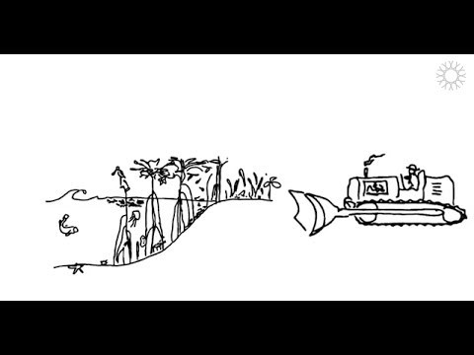
WHAT ARE ECOSYSTEM SERVICES?
© Mark Kirkland via MCS
Notes:
Watch this video which introduces ecosystem services. While watching students should complete the associated worksheet.

Slide 5
ECOSYSTEM CARDS
Notes:
Split the class into small groups of 2 /3 and hand out ecosystem cards to each group. Students should read through the cards and then create a mind map of the indirect services, direct services, aesthetic and ethical services all these ecosystems provide. They could also add knowledge gained from watching the video in activity 1 and any of their own ideas. For example for direct services they could say seagrass beds are nurse habitats for commercial fish. For ethical services they could say beaches provide recreational activities.

Slide 6
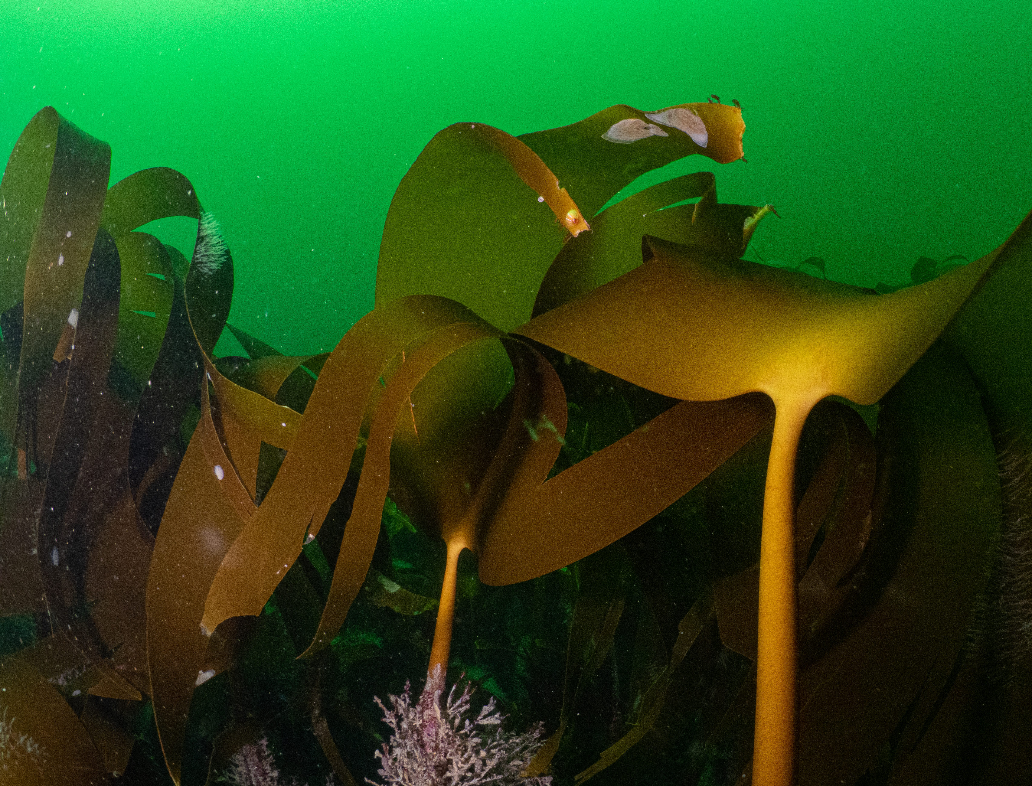
KELP
Kelp are a type of brown seaweed which are often mistaken for plants but are actually algae.
As algae they photosynthesise, and through this they produce oxygen.
Through photosynthesis they also take up carbon dioxide.
The structure of the kelp creates an underwater forest, creating a great habitat for many species to shelter.
This shelter provides a nursery for juvenile fish, including commercially important species such as cod, pollock and haddock.
Kelp beds can help to reduce wave energy along the coast.
ECOSYSTEM CARDS
© Mark Kirkland via MCS

Slide 7
SEAGRASS
Found in calm, shallow, sunlit coastal waters around the world, including Wales.
Seagrass is the only flowering plant in the ocean. Seagrass therefore produces oxygen through photosynthesis.
Seagrass also takes up and stores carbon dioxide. Seagrass captures carbon up to 35 times faster than tropical rainforests.
Globally, seagrass meadows are known for their value as fish nurseries for many important species, including flatfish and cuttlefish.
Seagrass meadows are also home to many bivalves, worms, starfish and to rare stalked jellyfish.
ECOSYSTEM CARDS
© Mark Kirkland via MCS

Slide 8
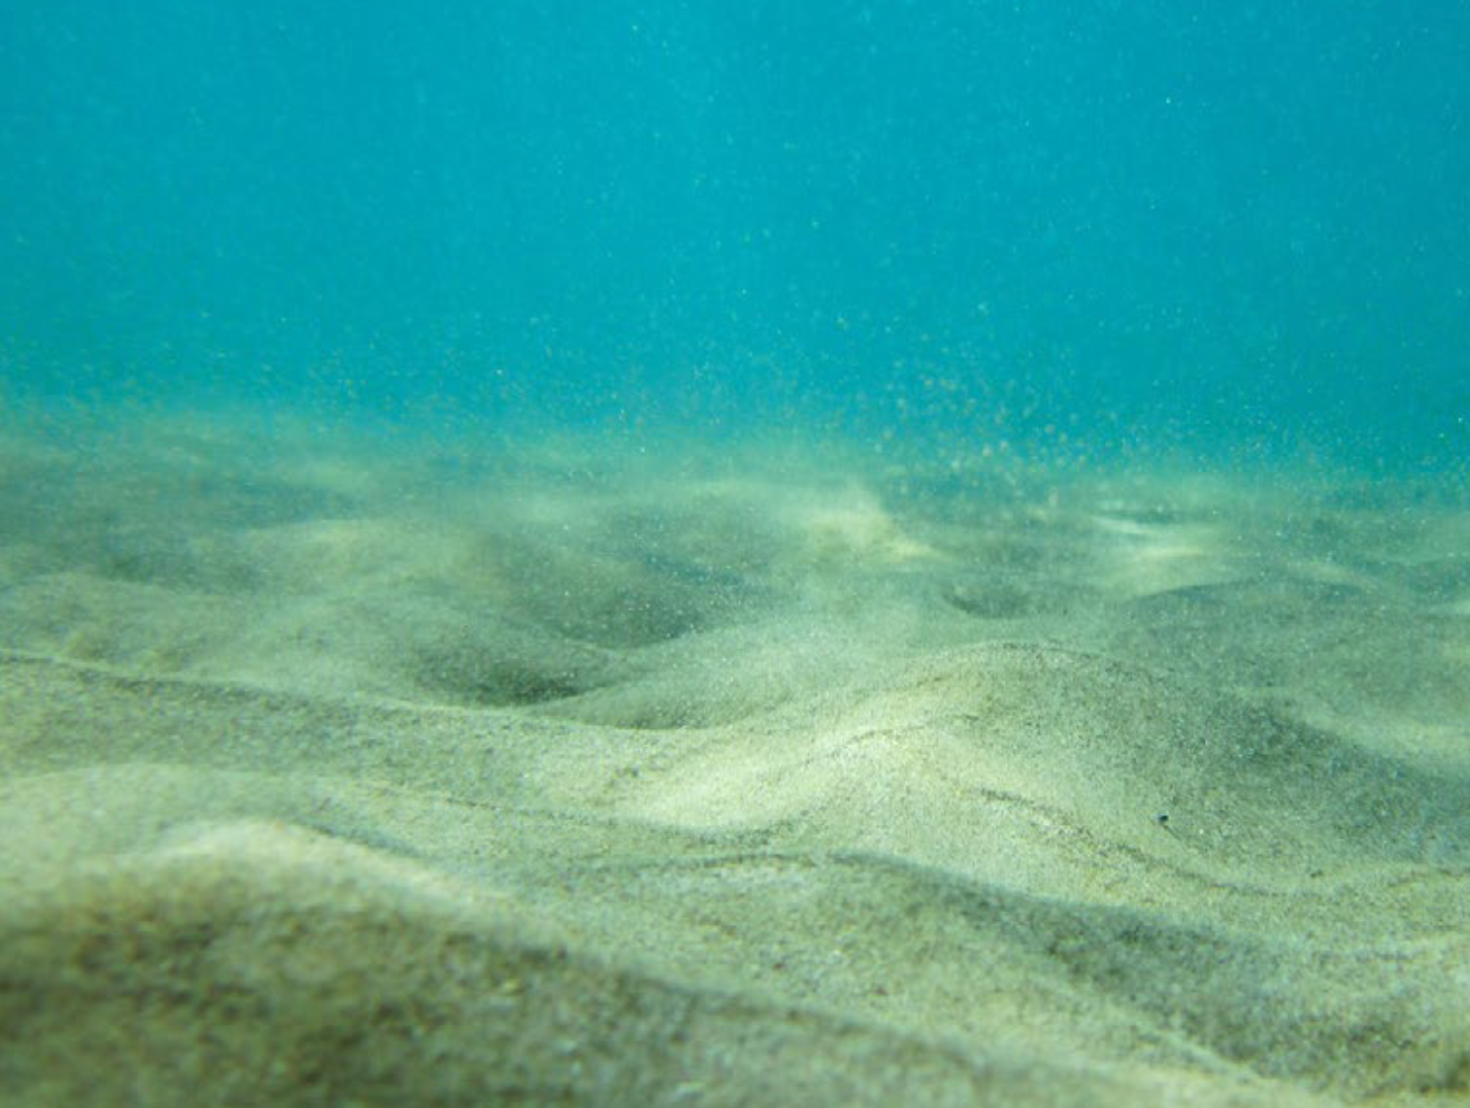
SEABED
It may on first glance look barren but these areas are home to a large variety of animals including sand eels, rays, sea cucumbers, burrowing urchins, starfish, bivalves and many species of fish and crustaceans like shrimp, prawns and crabs.
Many fish use these areas to hide their eggs in burrows in the seabed.
Gravel is extracted for use in construction. Each year in the UK around 20 million tonnes of marine sediments are removed.
The ocean provides us with many valuable resources including oil, gas and minerals.
ECOSYSTEM CARDS
© Mark Kirkland via MCS

Slide 9
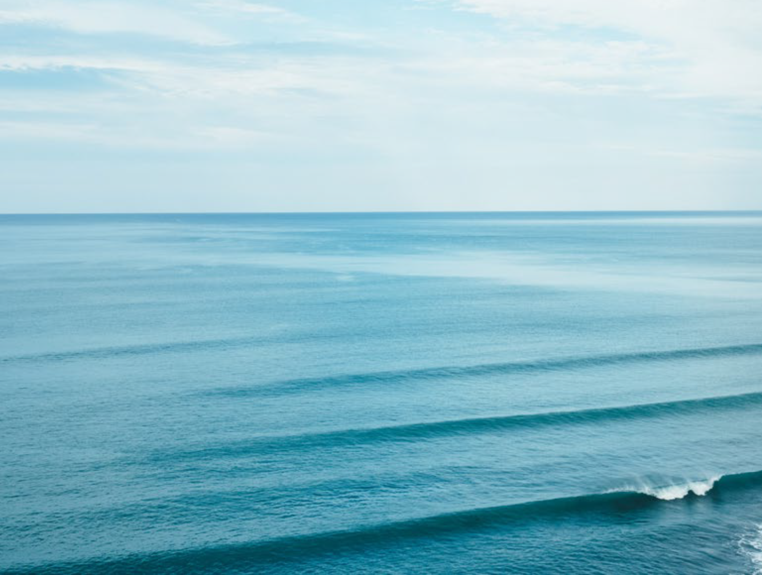
COASTAL SEAS
The ocean is home to huge variety of animals from tiny microscopic plankton to huge whales.
Ours seas provide seafood to millions of people and fishing is an important economic industry.
We use the power of the sea to harvest wave and tidal energy. The large expanse creates wind and a great place for turbines.
Ocean currents transport currents around the world, cold water from the poles and warm water from the tropics. This mixing of sea temperatures helps to regulate the climate.
The ocean hols 97% of the world’s water and plays a major role in the water cycle.
People enjoy spending time on or near the ocean and coastal tourism contributes more than £700 million to the Welsh economy.
ECOSYSTEM CARDS
© Mark Kirkland via MCS

Slide 10
SALTMARSH
The mud in saltmarshes makes them a great habitat for worms and burrowing shellfish. This is why saltmarshes are a great place for birds to feed.
The plants within saltmarsh habitats produce oxygen and store carbon dioxide through photosynthesis.
Saltmarshes protect our coast from floods and waves. The structure helps reduce wave energy and the roots of the plants help to stabilise the sediment.
Healthy saltmarshes have the ability to reduce pollution entering the ocean by filtering nutrients and chemicals coming off land. But too much pollution will damage these habitats.
ECOSYSTEM CARDS
© Mark Kirkland via MCS

Slide 11
DIRECT SERVICES
Notes:
As a class go through the direct services mind map created in activity 2. Students should share their ideas and you can add anything extra by using information provided in background notes.

Slide 12
INDIRECT SERVICES
Notes:
As a class go through the indirect services mind map created in activity 2. Students should share their ideas and you can add anything extra by using information provided in background notes.

Slide 13
AESTHETIC AND ETHICAL SERVICES
Notes:
As a class go through the aesthetic and ethical services mind map created in activity 2. Students should share their ideas and you can add anything extra by using information provided in background notes.

Slide 14
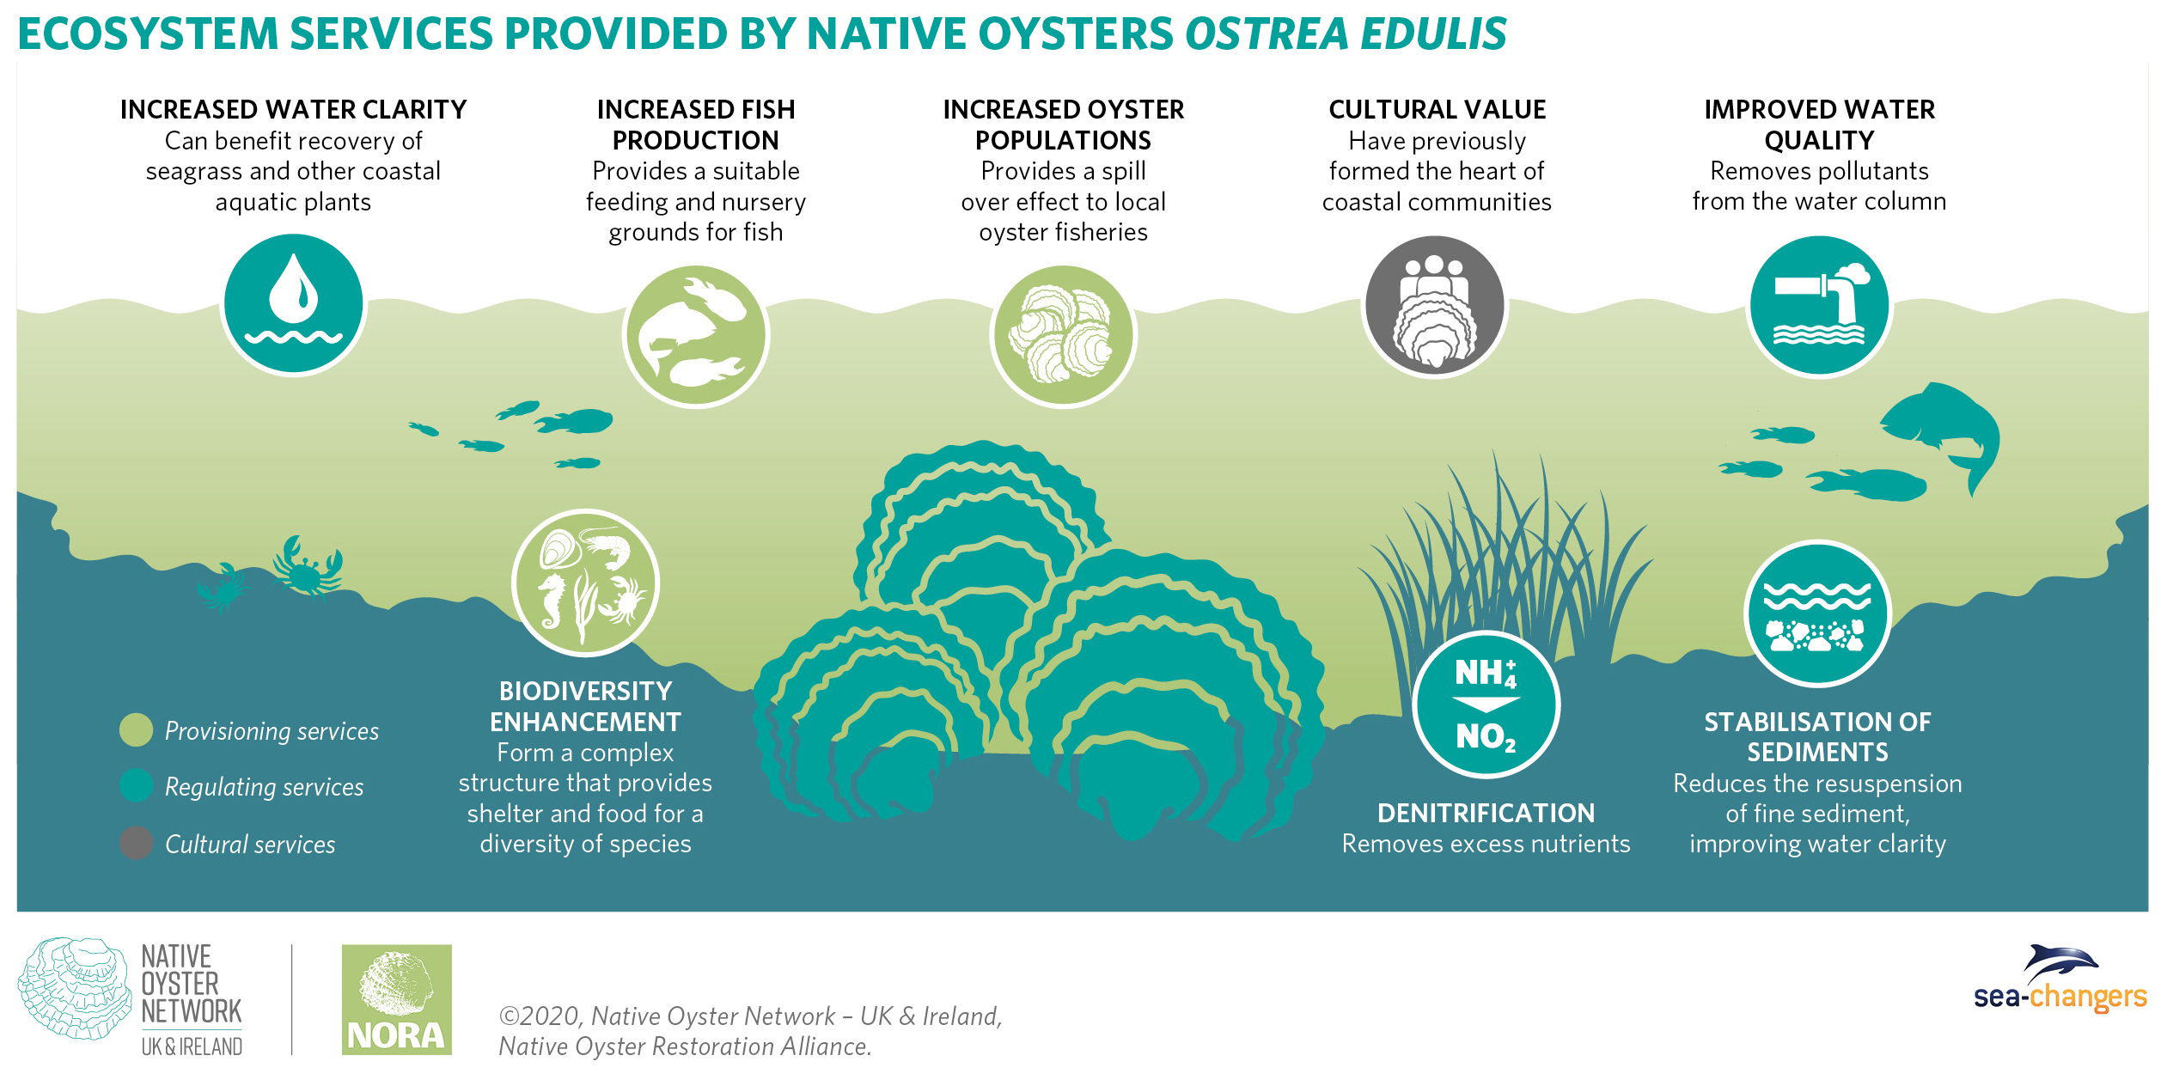

Slide 15
#BeTheWave

Slide 16

#BeTheWave
School
Is your school an eco school? Consider joining the national network of eco schools to help improve environmental awareness in your school and empower students.
https://www.eco-schools.org.uk/about/benefits-of-joining/
Does your school have a biodiversity area? Having a small area in your school grounds where nature can thrive is not only a great way to improve your school grounds for the benefit of nature but also a great teaching aid. Biodiversity areas could include a pond, woodland, small meadow or hedgerows. These make great study sites for students to study biodiversity and ecosystems services and help students to connect with, and ultimately care for nature. You can seek advice on how to improve your school grounds for nature through your local Wildlife Trust.
https://www.wildlifetrusts.org/schools

Slide 17
#BeTheWave
Individual
Stay inspired and learn more by getting out and exploring your local natural space, whether it’s a park, a nature reserve or the coastline.
Help to transform the way people view nature by sharing with friends and family what you have learnt about the incredible services natural ecosystems provide, and how we simply can’t survive without healthy ecosystems.
Think about how you can reduce your footprint to lessen the strain on nature. For example, eat sustainable fish, reduce, reuse, recycle, and be conscious of your energy usage.

Slide 18
EXTENSION ACTIVITES

Slide 19
ACTIVITY 1

Slide 20
Notes:
The following series of Maps are taken from the Welsh National Marine Plan 2015 – 2020.
If you have access to a laptop students could explore the interactive vamping tool on the Welsh Marine Planning Portal http://lle.gov.wales/apps/marineportal/#lat=52.5145&lon=-3.9111&z=8&tgt=false

Slide 22
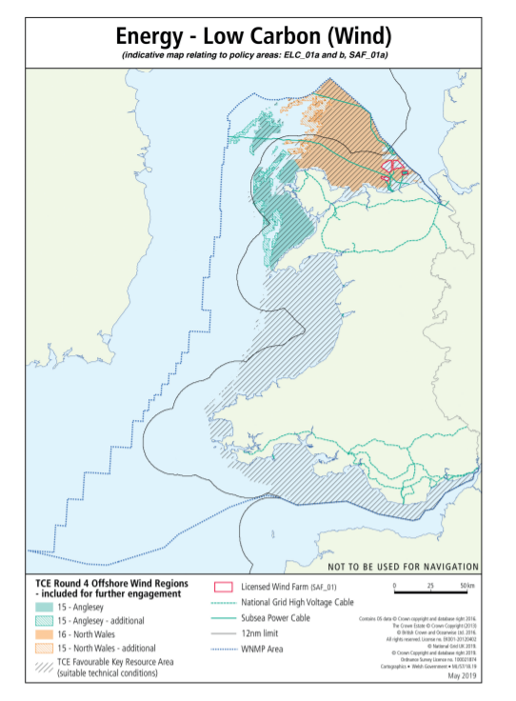

Slide 23
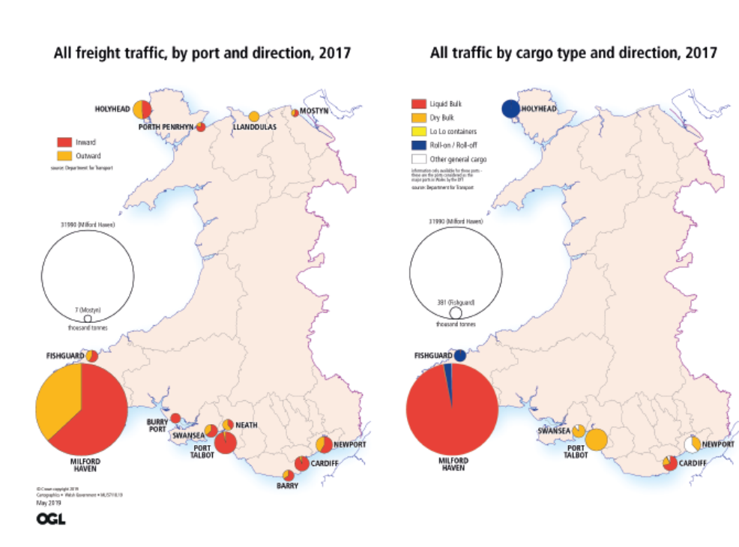
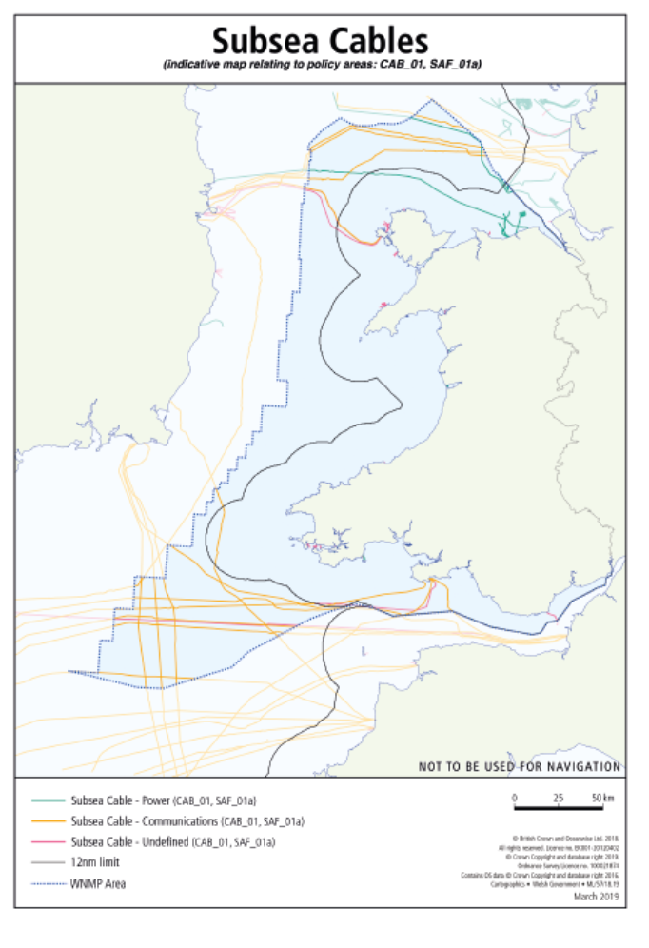

Slide 24
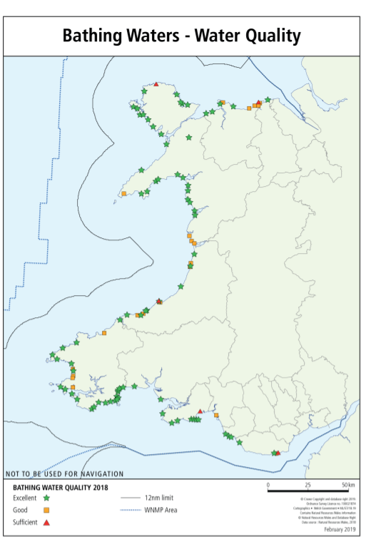

Slide 27
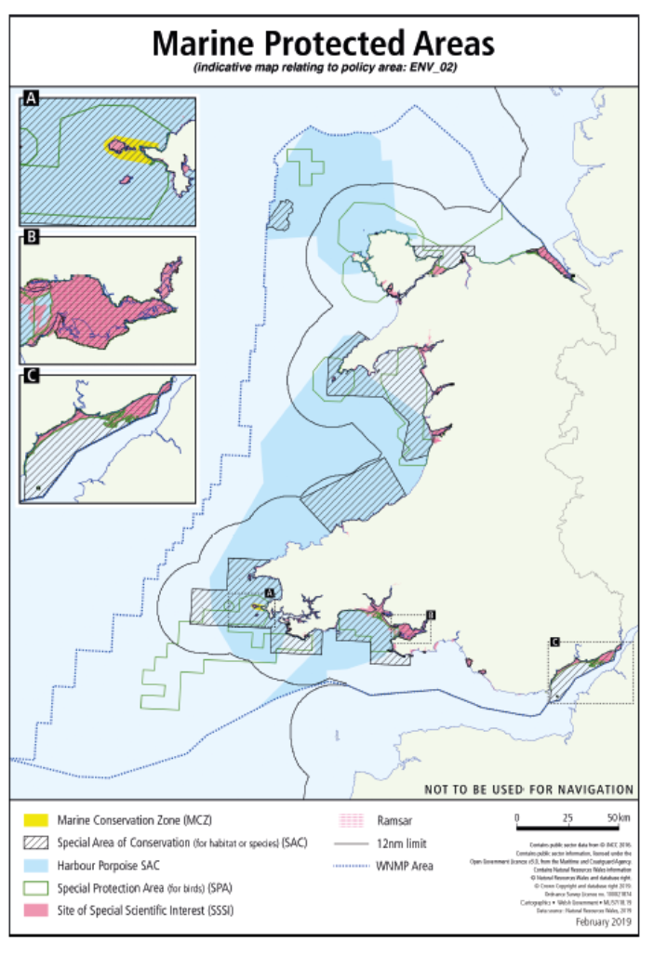

Slide 28
ACTIVITY 2

Slide 30
Conservation status of habitats per biogeographical area in coastal ecosystems
Created 15 Nov 2010 Published 15 Nov 2010 Last modified 23 Jan 2015

