Slide 1
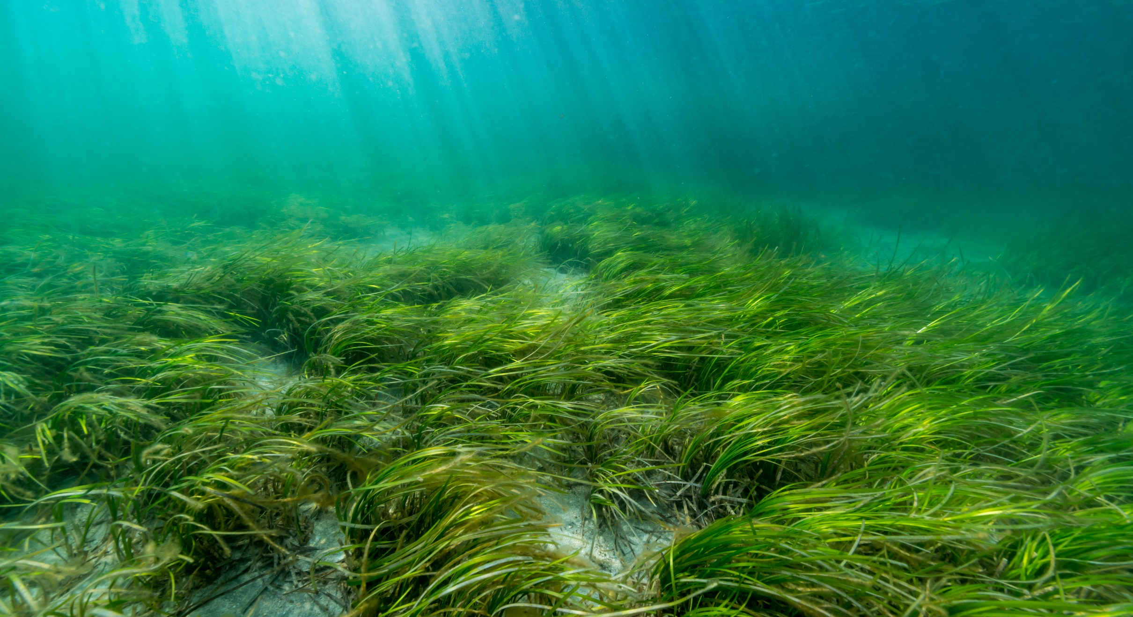
Seagrass
Image Reel
Eelgrass bed © divedog

Slide 3
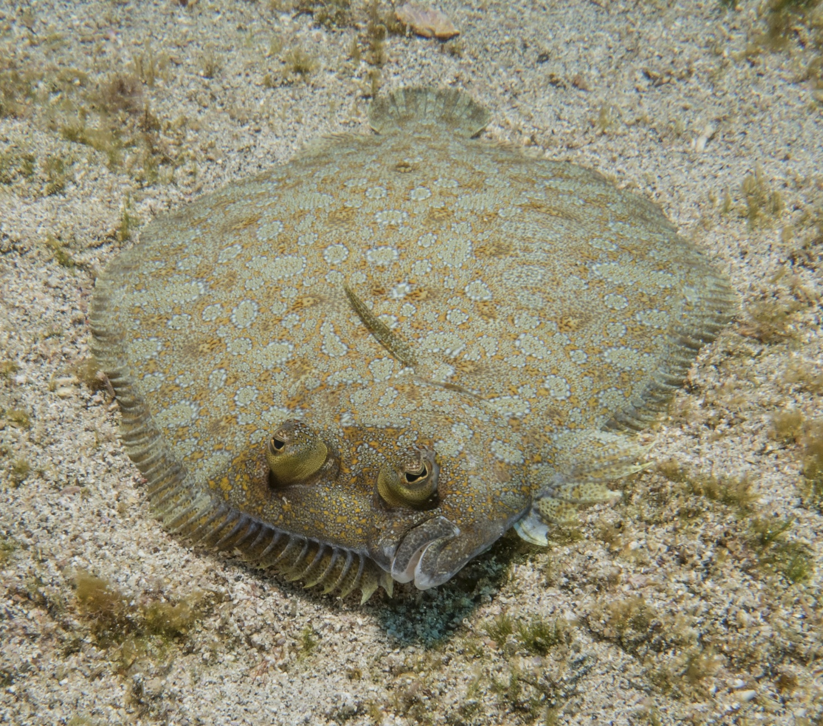
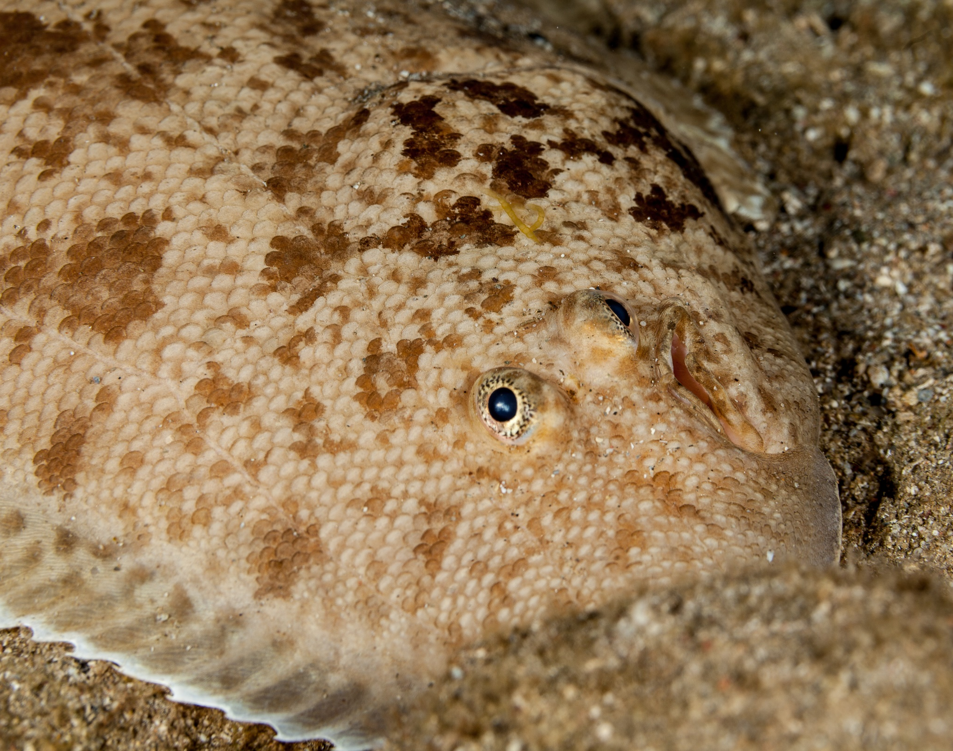
Flatfish
Flounder
Sole
© Becky Gill
© Gerald Robert Fischer
Flatfish such as flounder, sole and plaice are an important fish for the fishing industry. Flatfish use seagrass beds as a nursery for their young because of the shelter that seagrass provides.
Notes:
Flatfish, such as plaice and flounder are an important fish for the fishing industry. These flatfish use the seagrass beds as a nursery for their young due to the shelter the seagrass provides.

Slide 4
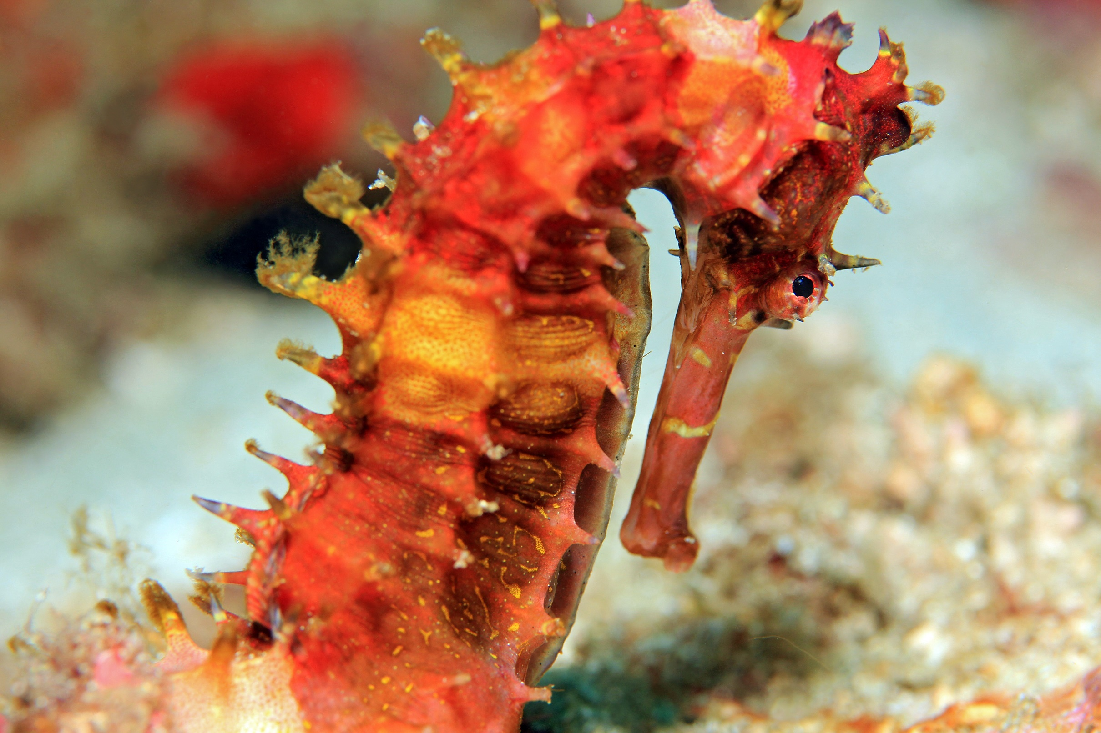
Seahorses
Sole
Spiny seahorse
© Daniel Lamborn
In the UK, seahorses can be found hiding amongst the seagrass. Unlike flatfish that swim around to different ocean habitats, seahorses spend their whole life in the seagrass beds.
Notes:
In the UK, seahorses can be found hiding amongst the seagrass. Unlike flatfish that swim around to different ocean habitats, seahorses spend their whole life in the seagrass beds.

Slide 5
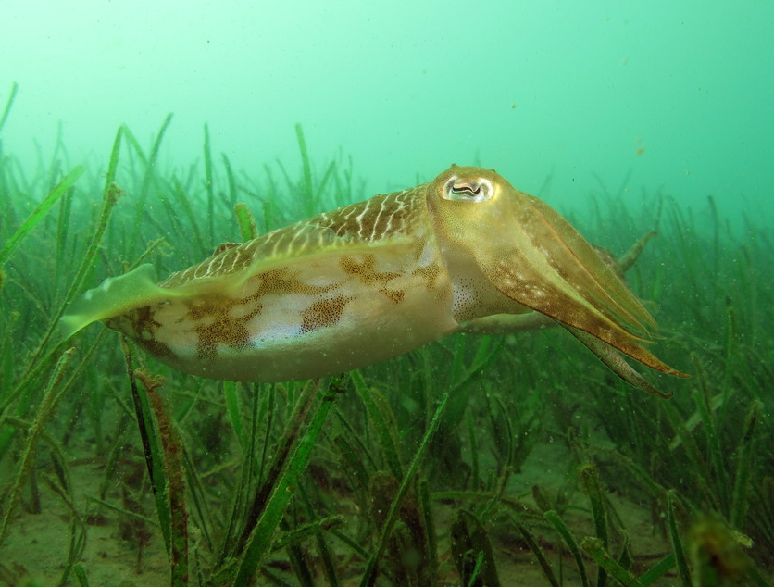
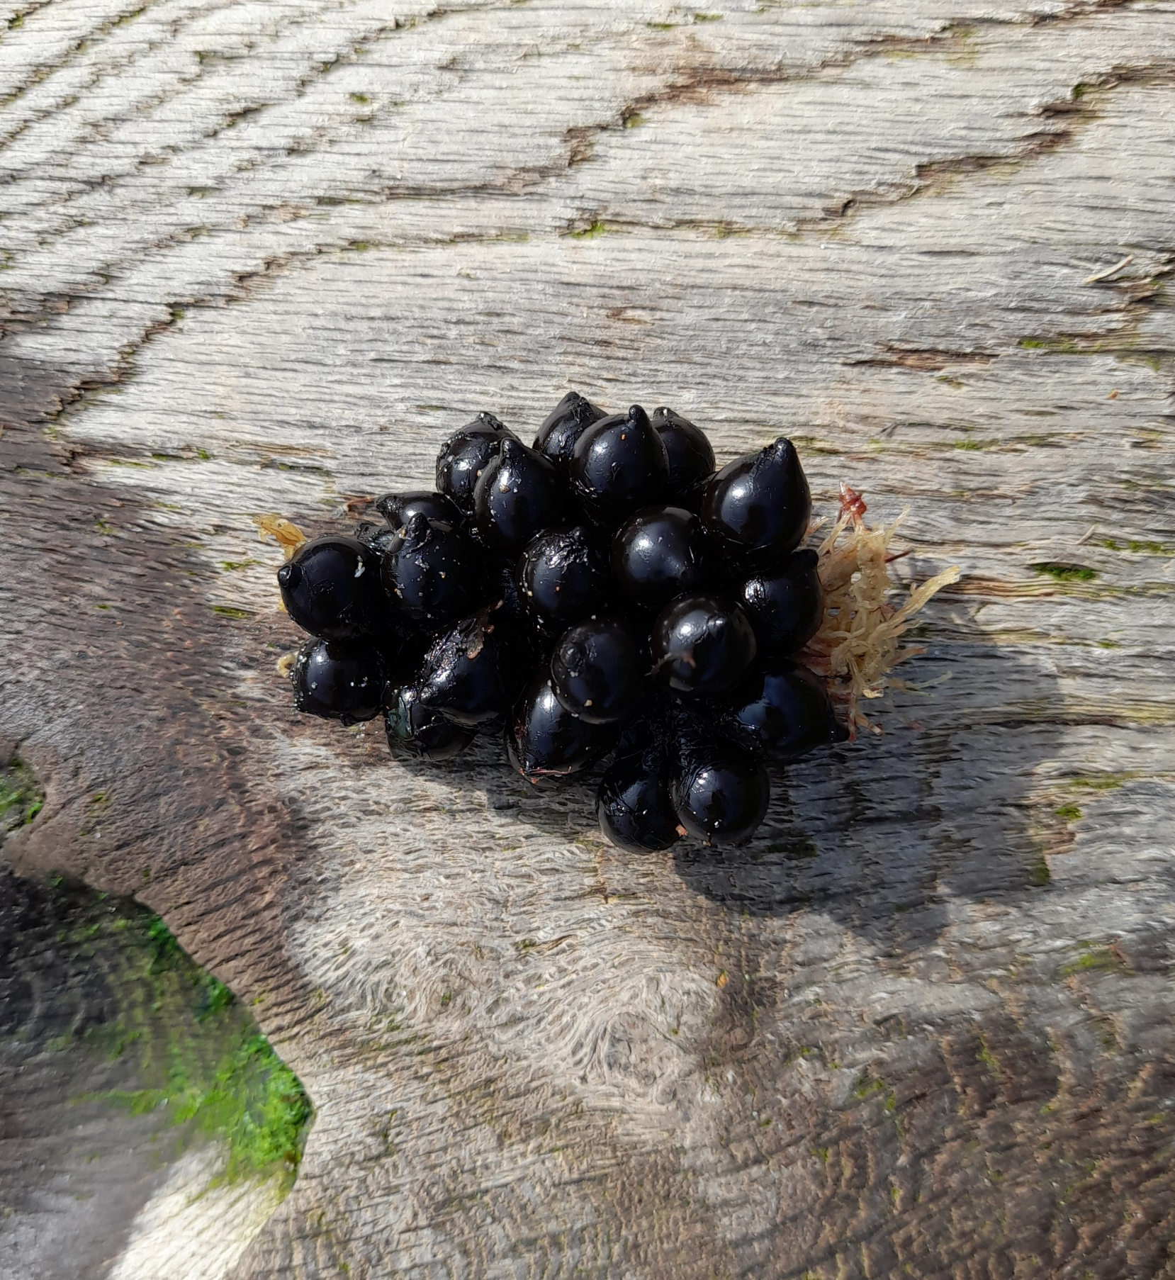
Cuttlefish
Cuttlefish
Cuttlefish
eggs
© Daniel Lamborn
Cuttlefish lay their eggs onto seagrass. They do this to stop their eggs floating away in ocean currents and because the seagrass helps to hide their eggs from predators. Cuttlefish can lay 100s of eggs at one time. Their eggs take 1-2 months to hatch.
Notes:
Cuttlefish lay their eggs onto seagrass. They do this to stop their eggs floating away in ocean currents and because the seagrass helps to hide their eggs from predators. Cuttlefish can lay 100s of eggs at one time. Their eggs take 1-2 months to hatch.

