Slide 1
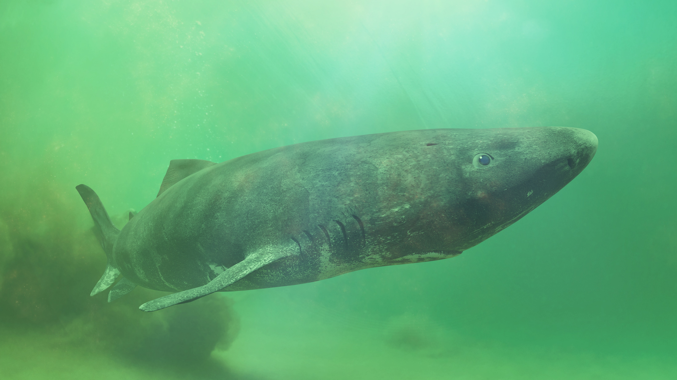
Sharks Image Reel
Greenland shark © Dotted Yeti via Shutterstock

Slide 2
Sharks in the UK

Slide 3
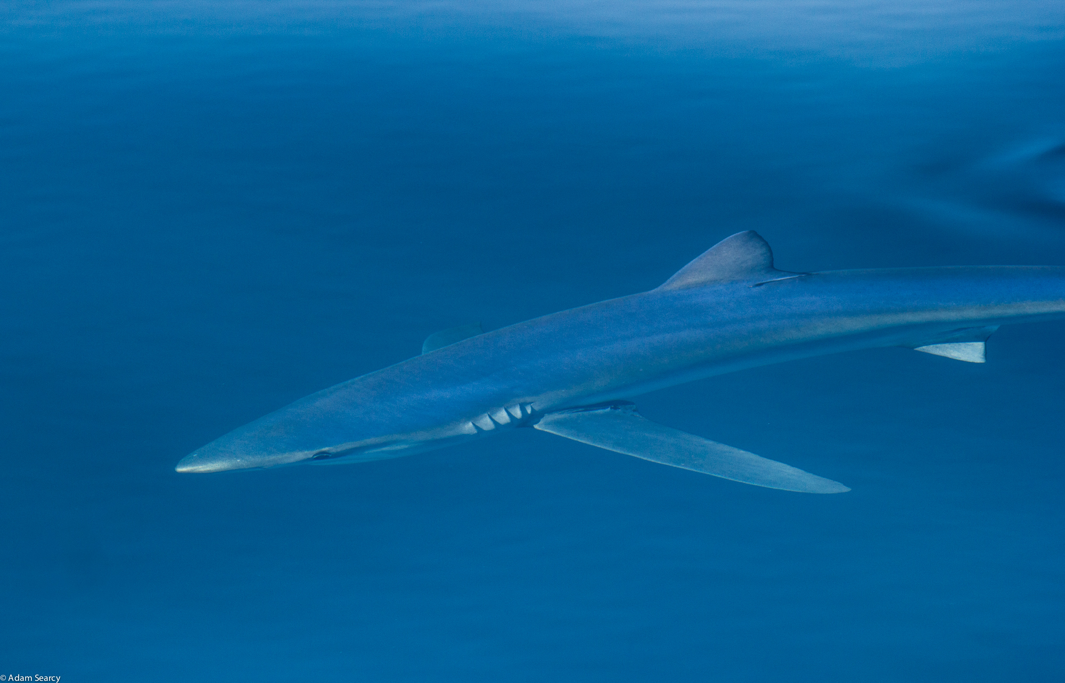
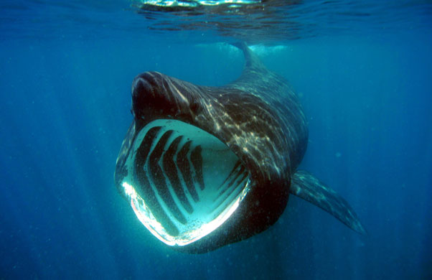
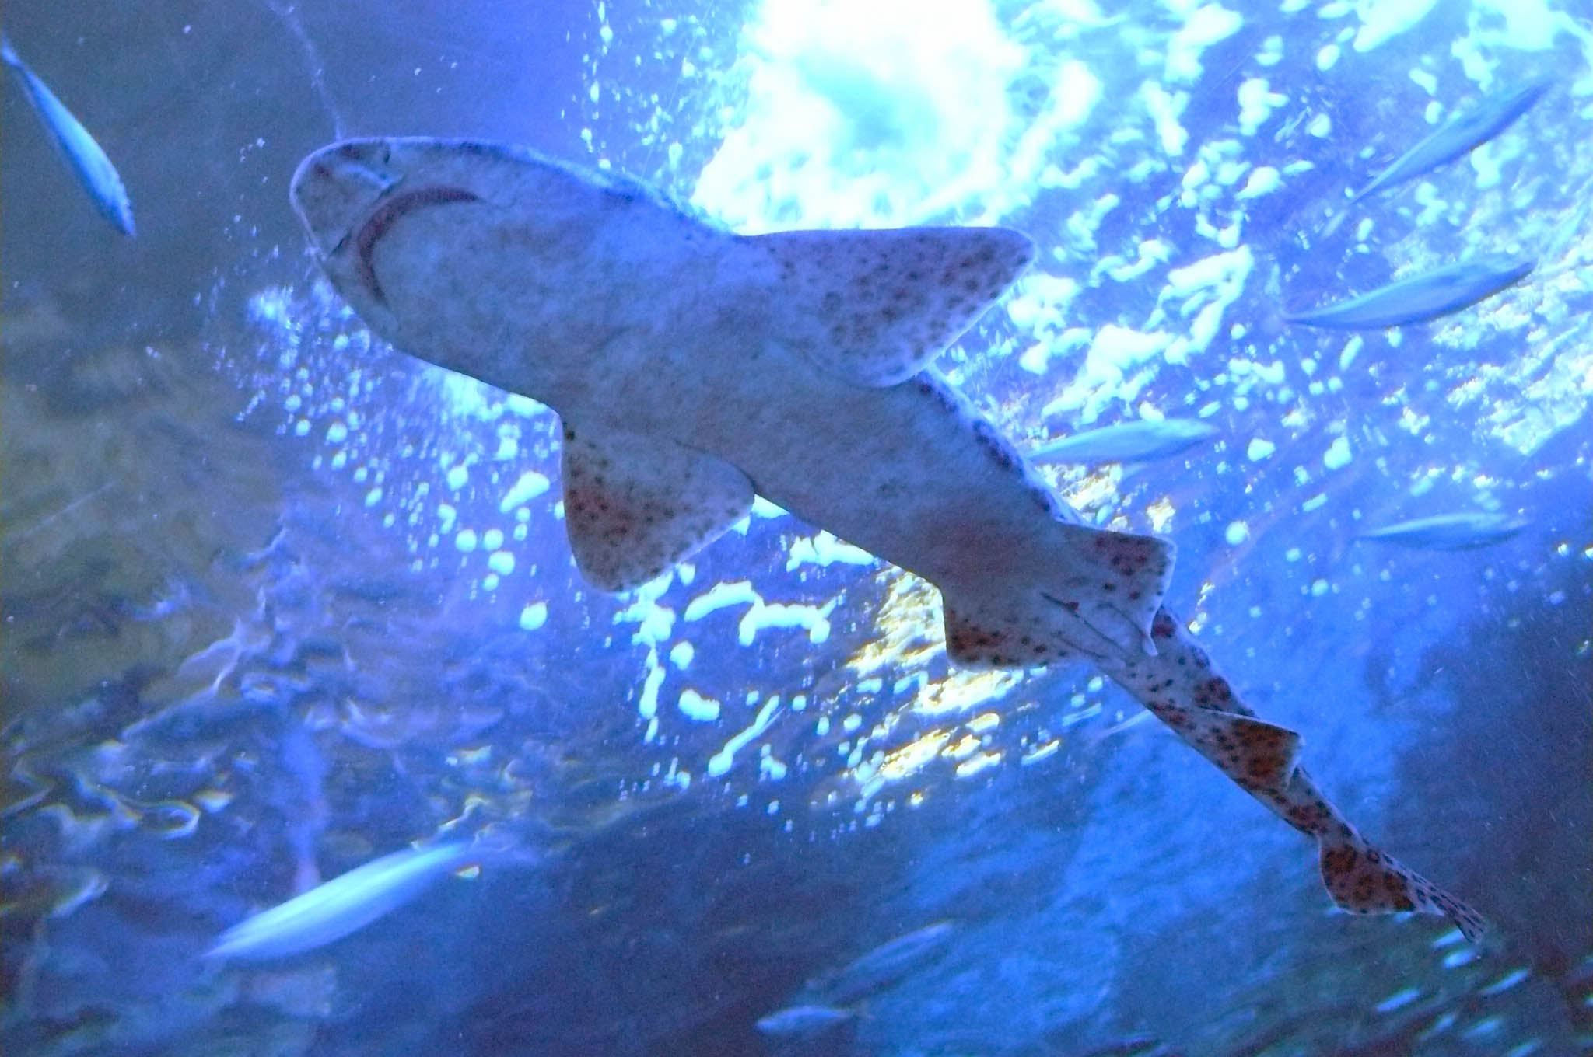
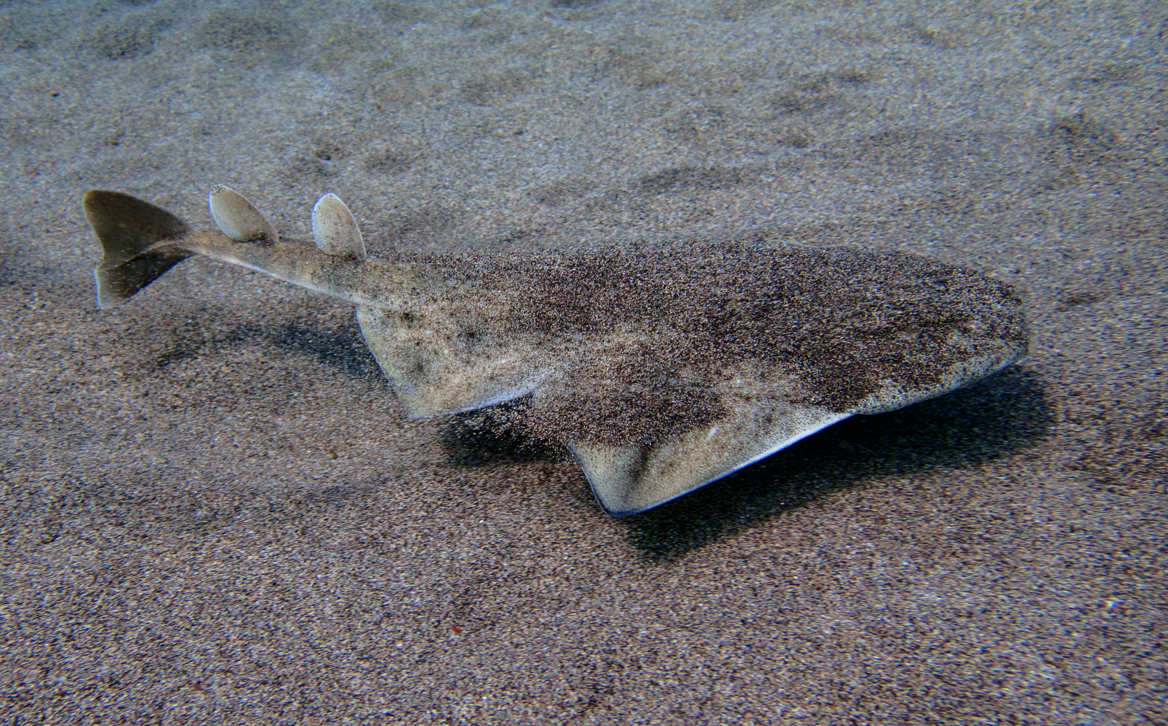
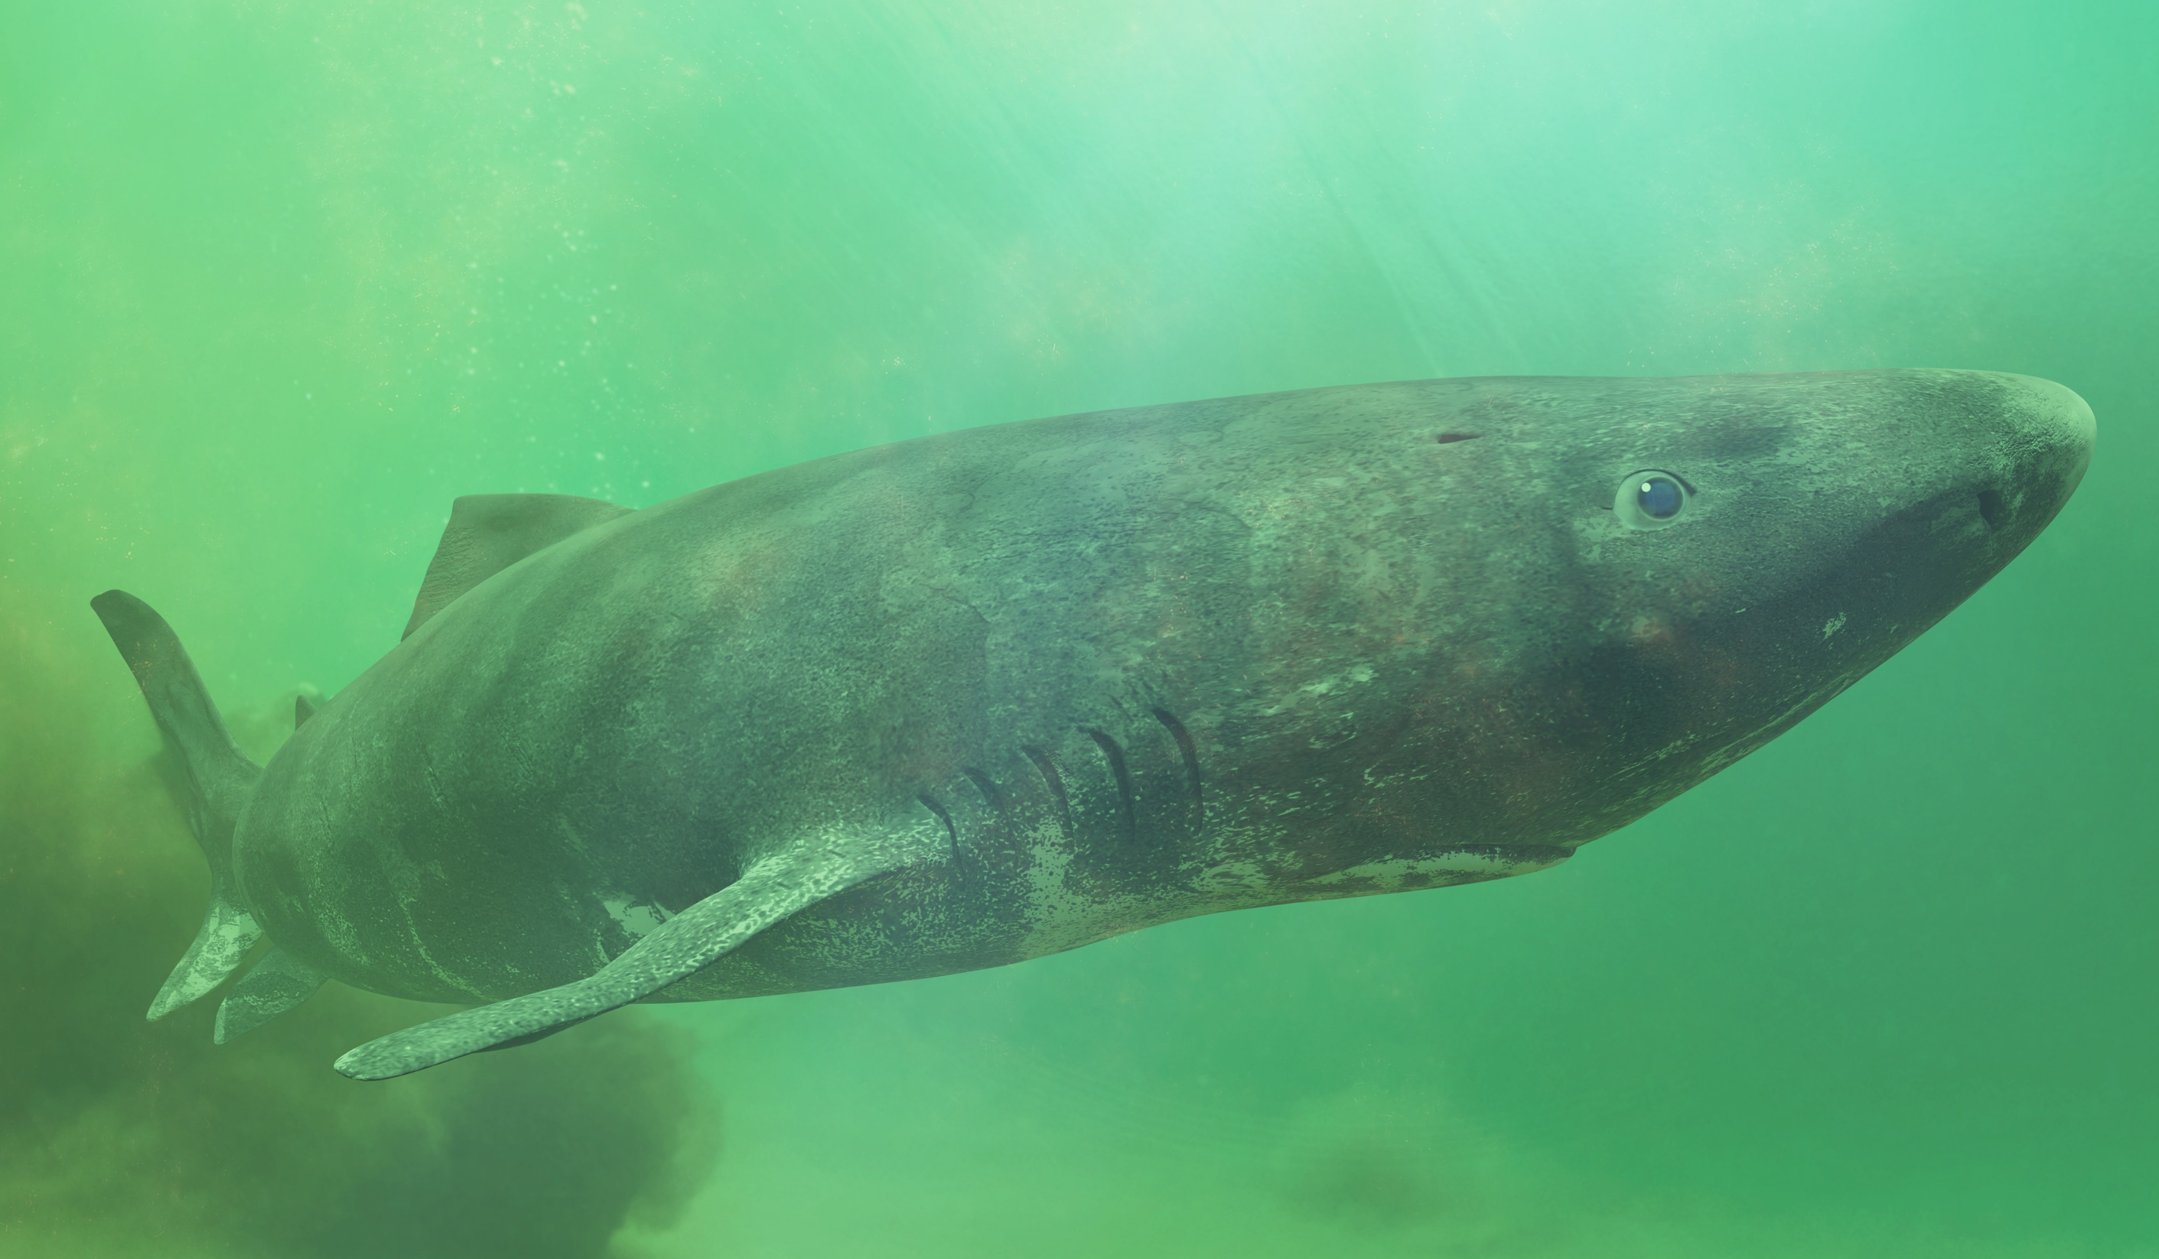
Sharks in the UK
© Adam Searcy
© jidanchaomian
© David Ceballos
Blue shark
Basking shark
Catshark
© Luis Miguel Estevez
© Dotted Yeti
Angel shark
Greenland shark

Slide 4
Blue shark
© Adam Searcy via Flickr
Blue sharks are migratory; each year they make huge trans-Atlantic migrations and can travel 5000 miles in one trip. They visit the UK in the summer. They migrate in a “school”, or larger group.

Slide 5
Basking shark
© jidanchaomian via Flickr
Basking sharks can reach lengths of up to 12 metres, making them the second largest shark. These gentle giants are filter feeders, mostly dining on plankton. Their huge mouths can open up to one metre wide! The basking shark is a seasonal visitor to the UK, so the best time to spot one is between May and October.

Slide 6
Angel shark
© Luis Miguel Estevez via Shutterstock
Angel sharks are nocturnal. They inhabit sandy or muddy areas of the seabed, and bury themselves during the daytime. They are critically endangered. Their numbers have declined dramatically during the last 50 years, to the point of being declared extinct in the North Sea.

Slide 7
Catshark
Small-spotted catshark © David Ceballos via Flickr
Small spotted catsharks are also known as lesser-spotted dogfish. This is the most common shark in the UK. They live in shallow waters spending their time close to the seabed. They are small sharks approx. 75cm in length. Their egg cases, commonly known as mermaid purses, can often be found washed up on beaches.

Slide 8
Greenland shark
© Dotted Yeti via Shutterstock
Greenland sharks are the second largest species of carnivorous shark after the great white. They are found in very deep waters and sometimes referred to as the world’s most mysterious shark. Footage of Greenland sharks swimming in their natural environment was not captured until 2003. Many Greenland sharks have a small parasite attached to their eyes, which slowly causes the shark to go blind.
Research has shown that these fascinating creatures could live to around 400 years old, making them the longest-lived vertebrates on the planet!

Slide 9
Feeding

Slide 10
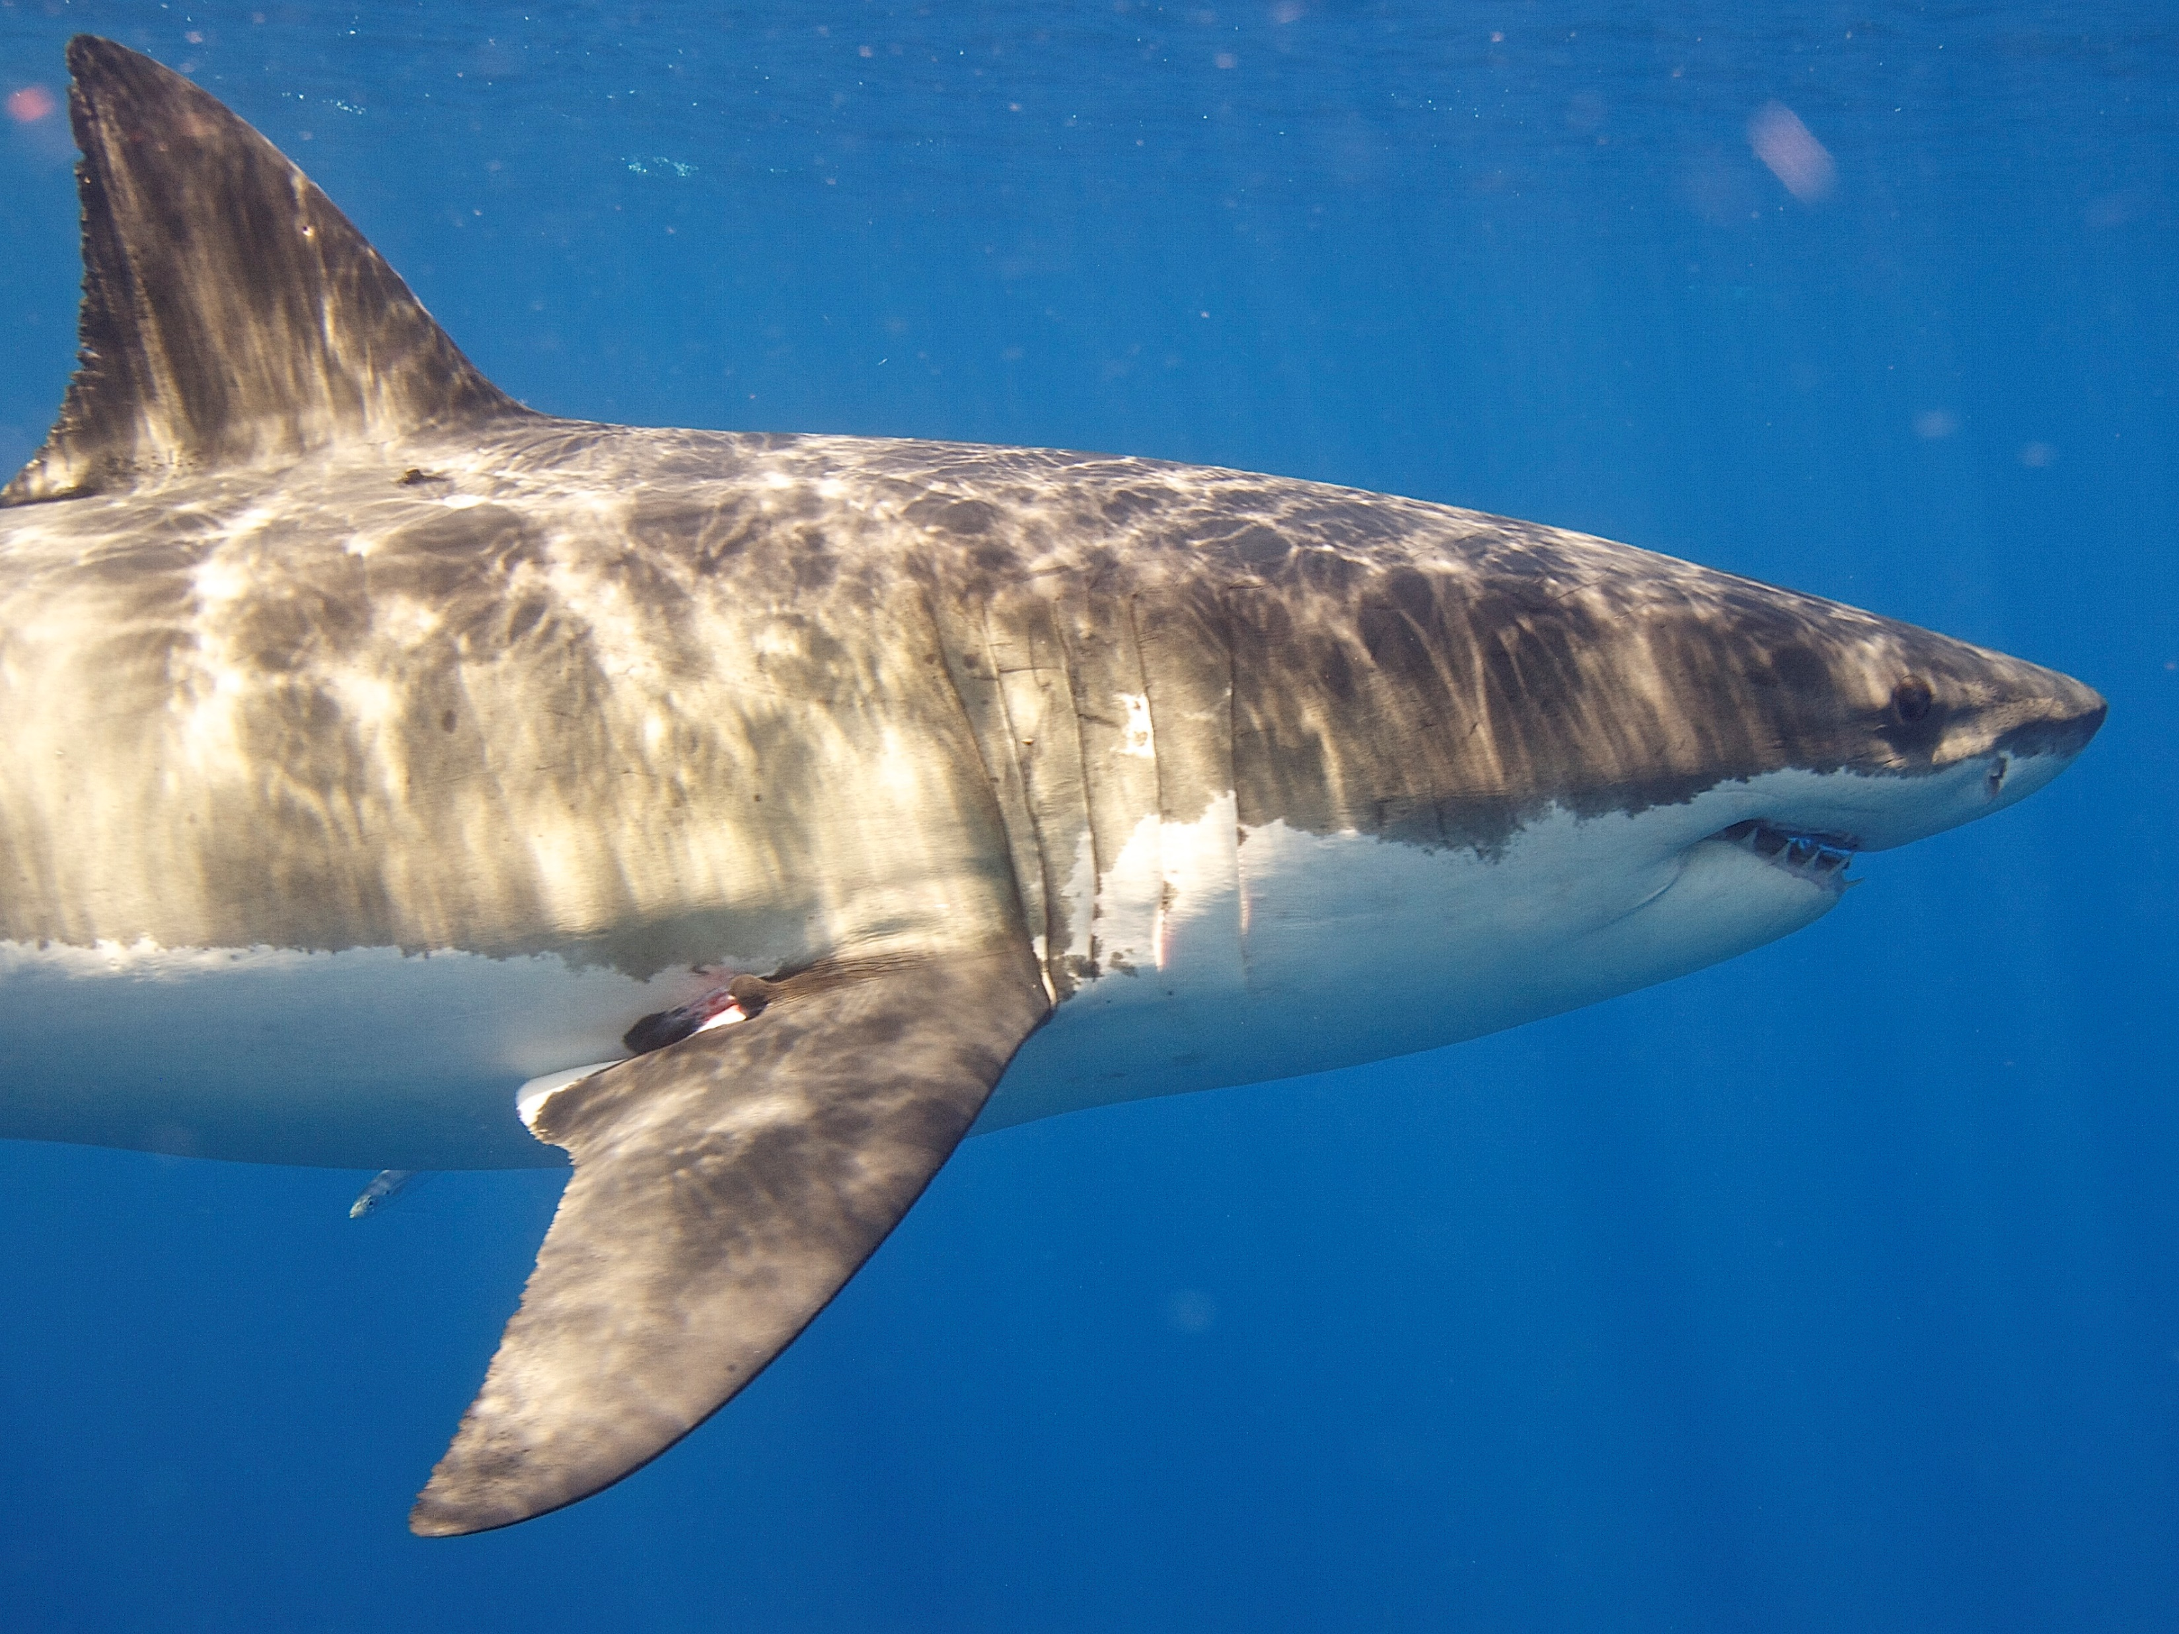
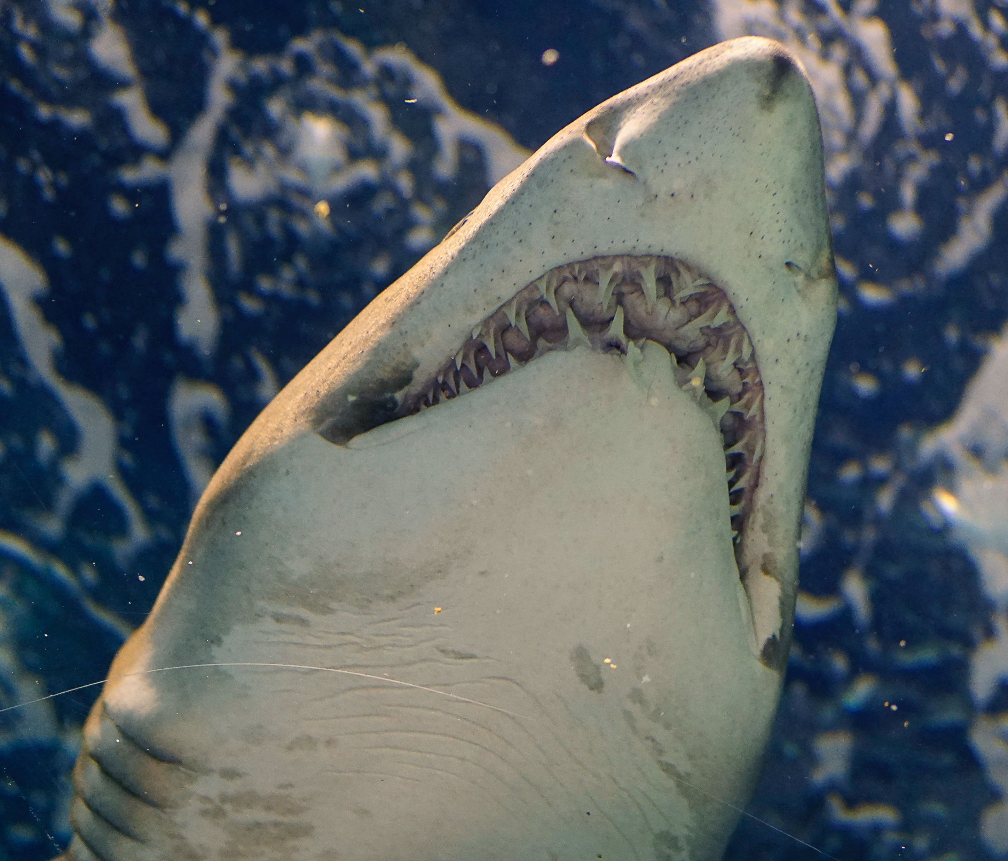
Feeding
Great white shark
© Elias Levy via Flickr
© Karen Zhang via Unsplash
White sharks (commonly known as Great White Sharks) eat large prey like seals, dolphins and large fish like tuna, rays and even other sharks. Their jaws can move forward as well as down to help capture prey. Their teeth are serrated like a knife. The teeth on the bottom jaw are pointed for piercing and holding onto their prey, while their serrated upper teeth act like a saw.

Slide 11
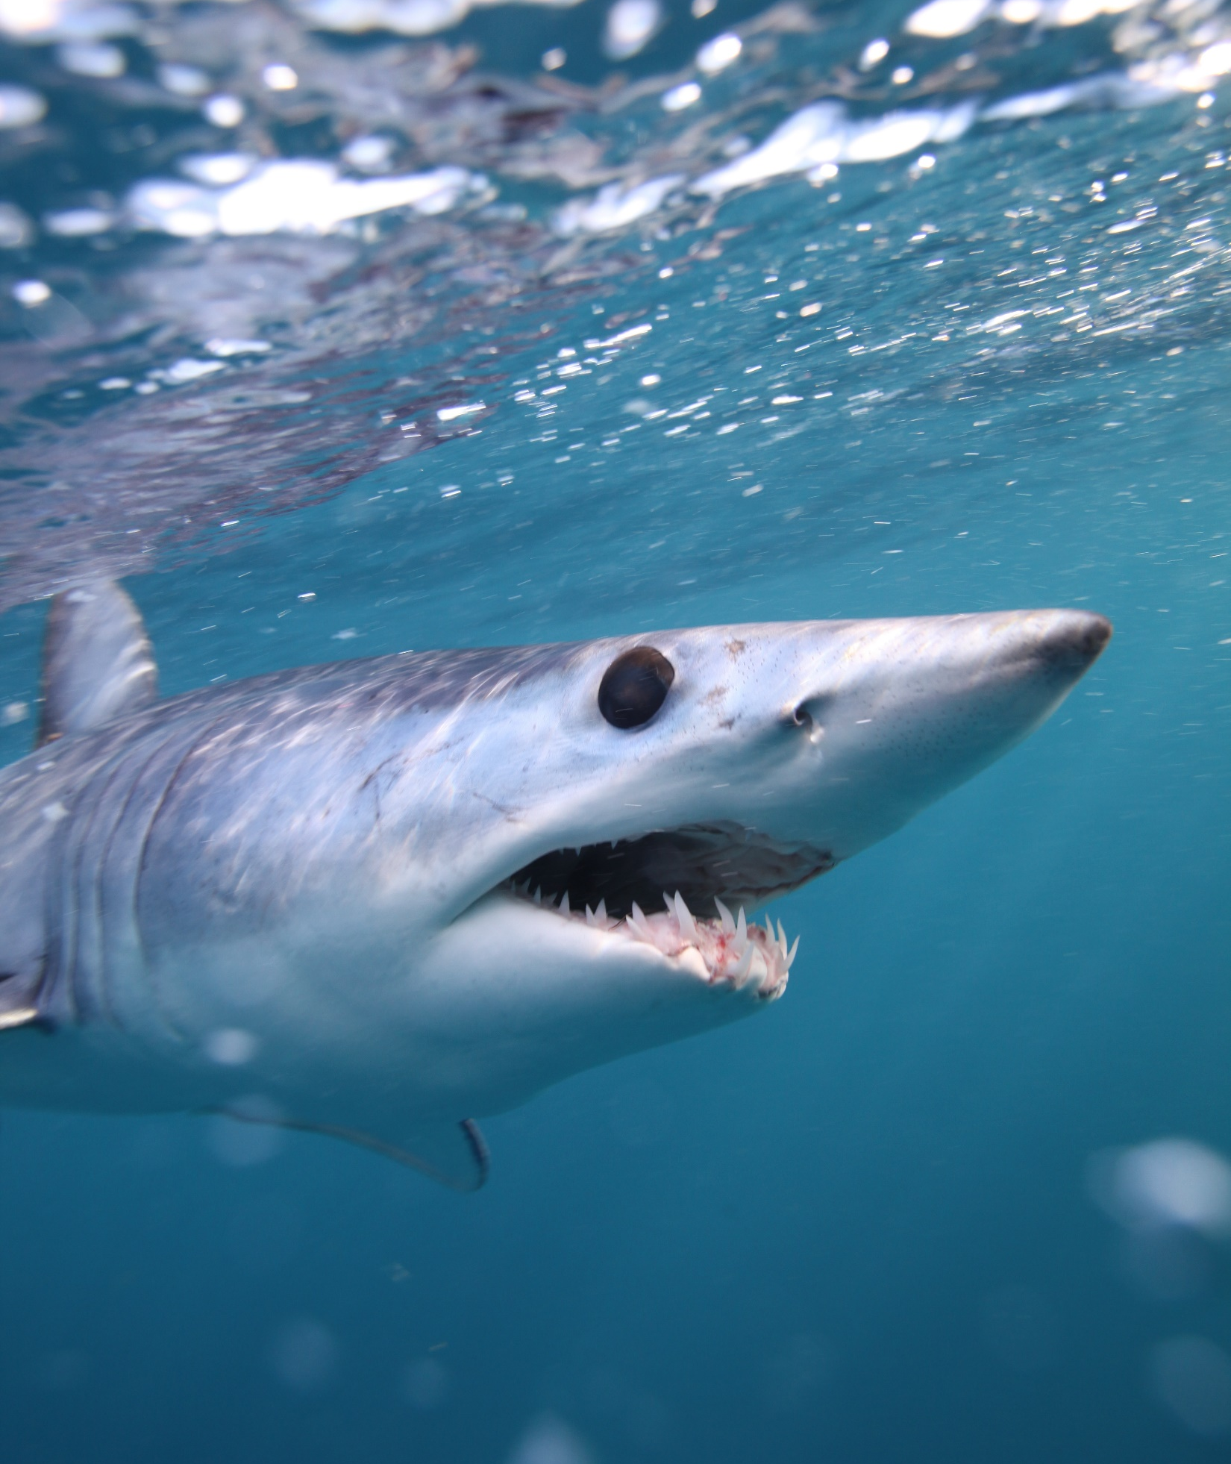
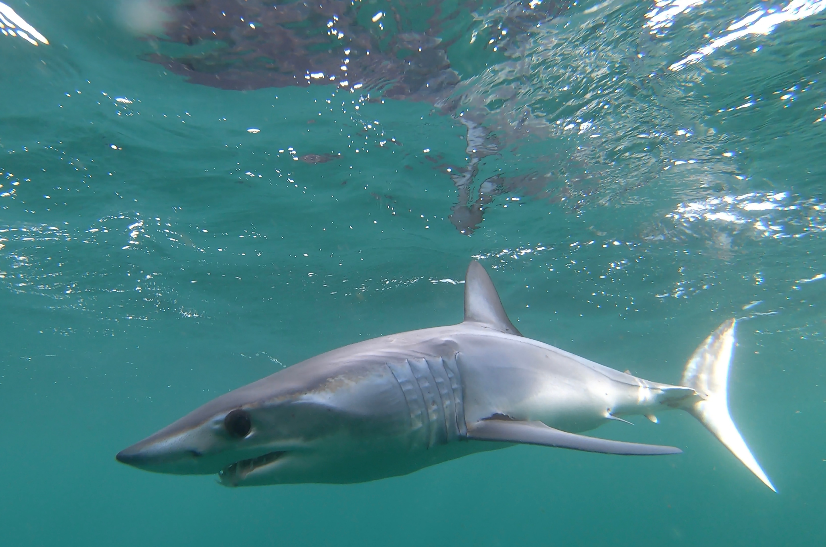
Feeding
Mako shark
© Alessandro De Maddalena via Shutterstock
© Elaine Brewer via Unsplash
Mako eat small slippery fish. They have very sharp, pointy, non-serrated teeth to grasp onto small fish. A mako’s teeth are so large they can’t fully close their mouth. They are also the fastest shark in the ocean - reaching up to 45mph - making them fierce predators.

Slide 12
Feeding
Basking shark
© jidanchaomian via Flickr
Basking sharks eat plankton, which are tiny animals and algae in the water column. They filter the water through their gills to capture plankton, and can filter 2000 tons of seawater per hour. Though they don’t use teeth for feeding, they do have hundreds of tiny hooked teeth.

Slide 13
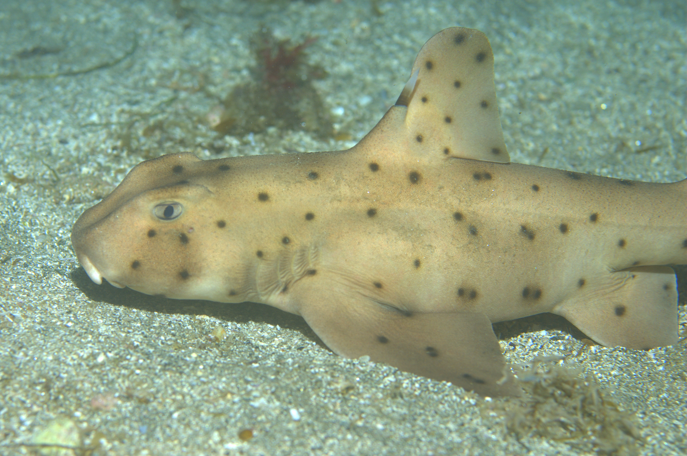
Feeding
Horn shark
Horn shark © Ed Bierman via Flickr
Horn sharks are bottom feeders, feeding on crabs and shellfish that have sharp outer shells. Their front teeth are pointed to pierce with and their back teeth are flat and molar-like for crushing their prey.

Slide 14
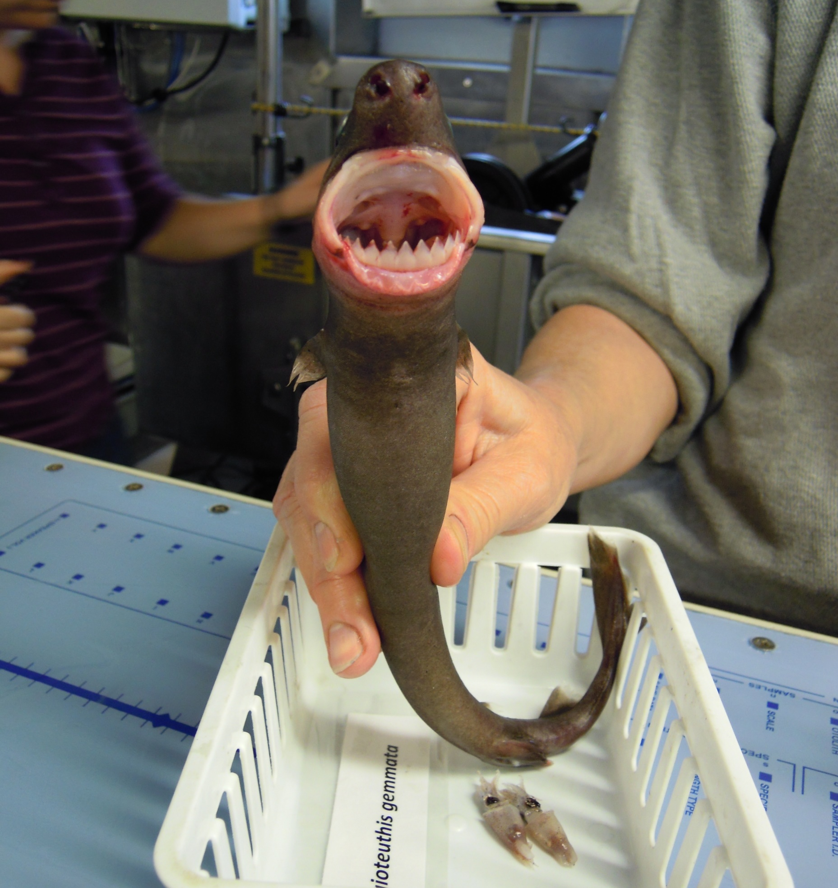
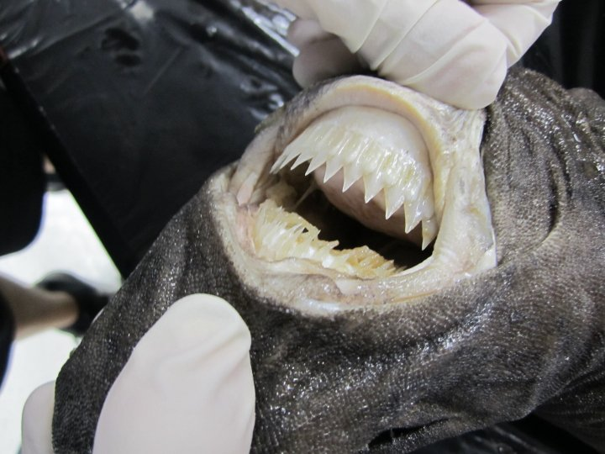
Feeding
Cookie cutter shark
© NOAA Photo Library via Flickr
© JSUBiology via Flickr
Cookie cutter sharks eat squid and small fish but also feed on large prey such as tuna, dolphins and other sharks. They bite small chunks out of their prey without killing it. Cookie cutter sharks use their top teeth to attach on to prey, and then use their razor sharp bottom teeth to slice, twisting their body to create a circular cut. This round mark left on their prey is why they are referred to as the cookie cutter.

Slide 15
Threats to sharks

Slide 16
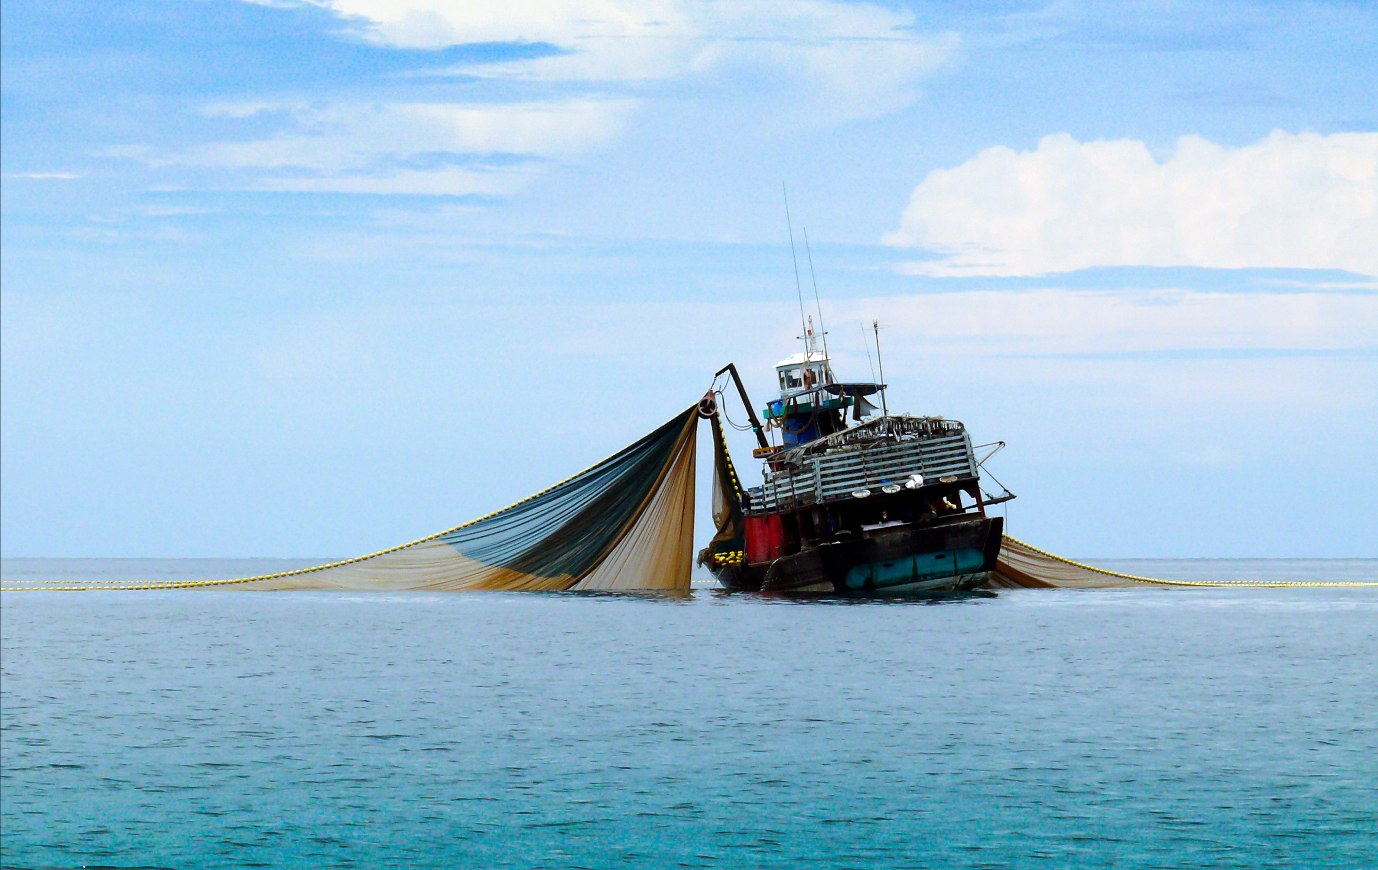
Overfishing
Fishing trawler © NarisaFotoSS via Shutterstock
Overfishing means catching fish faster than they can reproduce. Overfishing pushes fish populations into smaller and smaller numbers until they find it harder to grow again. Approximately 90% of large predatory fish such as tuna, swordfish & sharks have been lost.

Slide 17
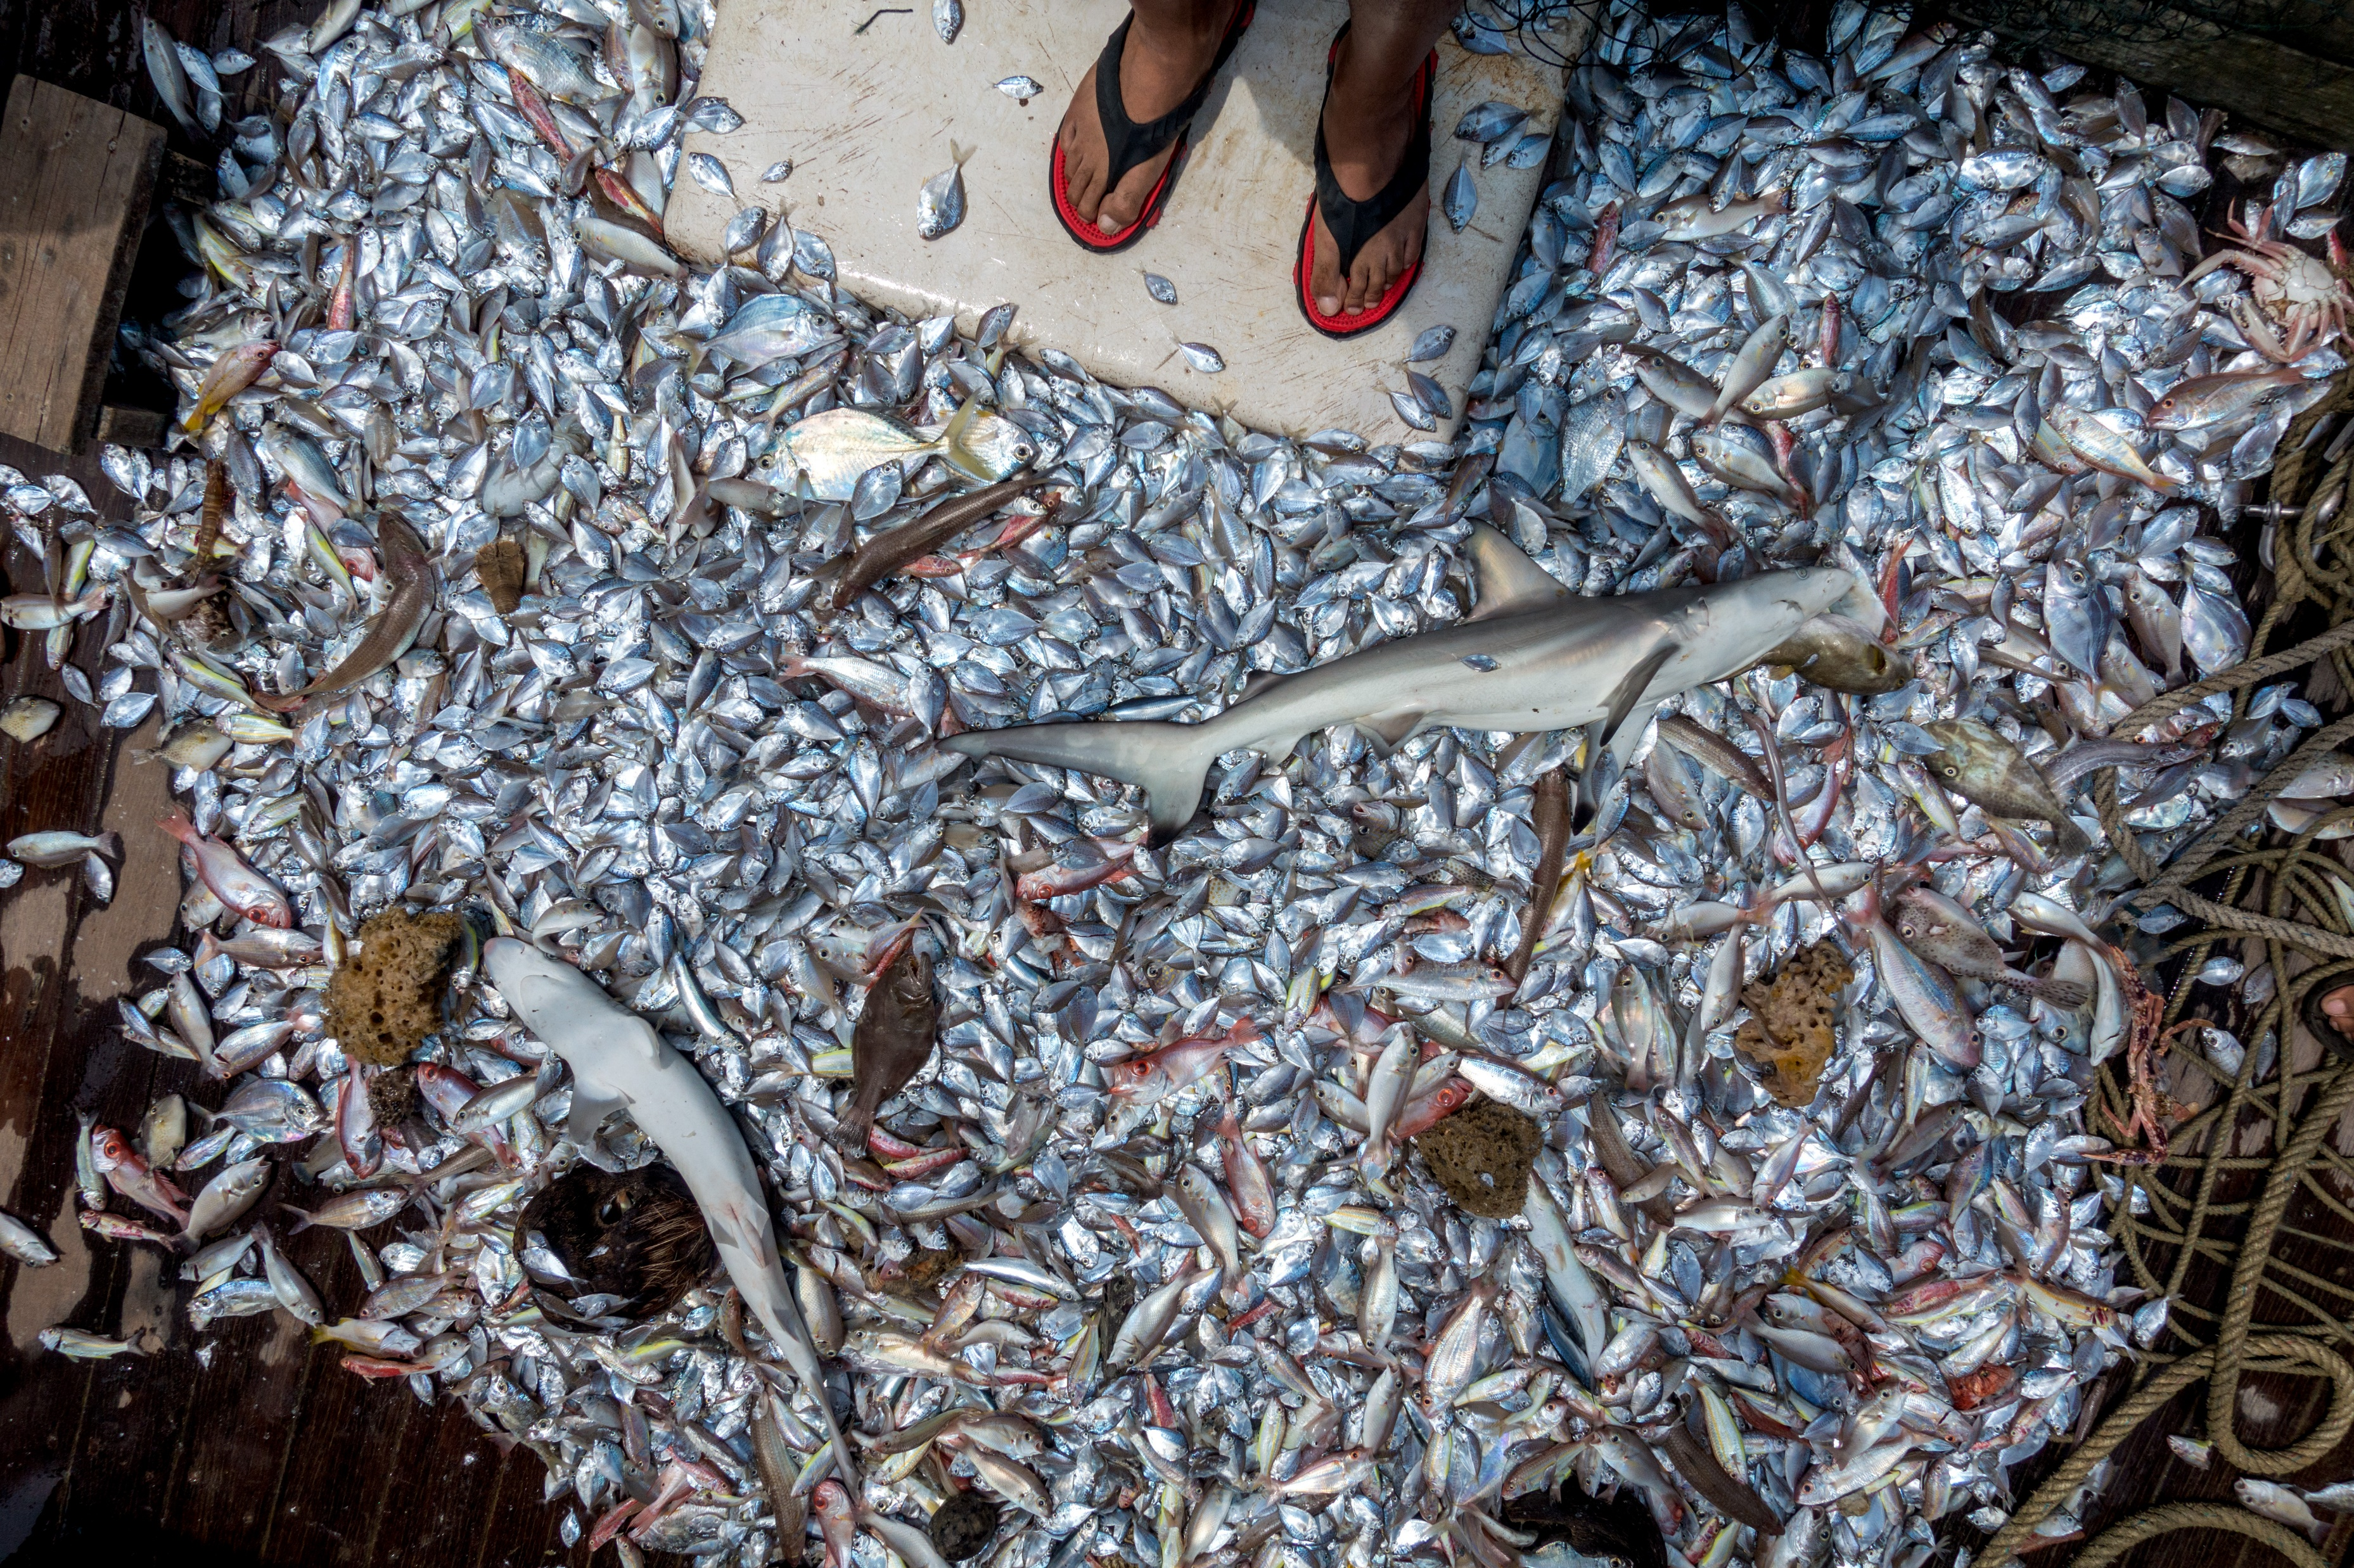
Bycatch
Bycatch © Ivan Sarenas via Shutterstock
During fishing, animals accidentally caught along with the ‘target species’ are known as bycatch. These animals can include dolphins, turtles, sharks and whales. In many parts of the world, bycatch are usually thrown back into the sea either dead or dying.

Slide 18
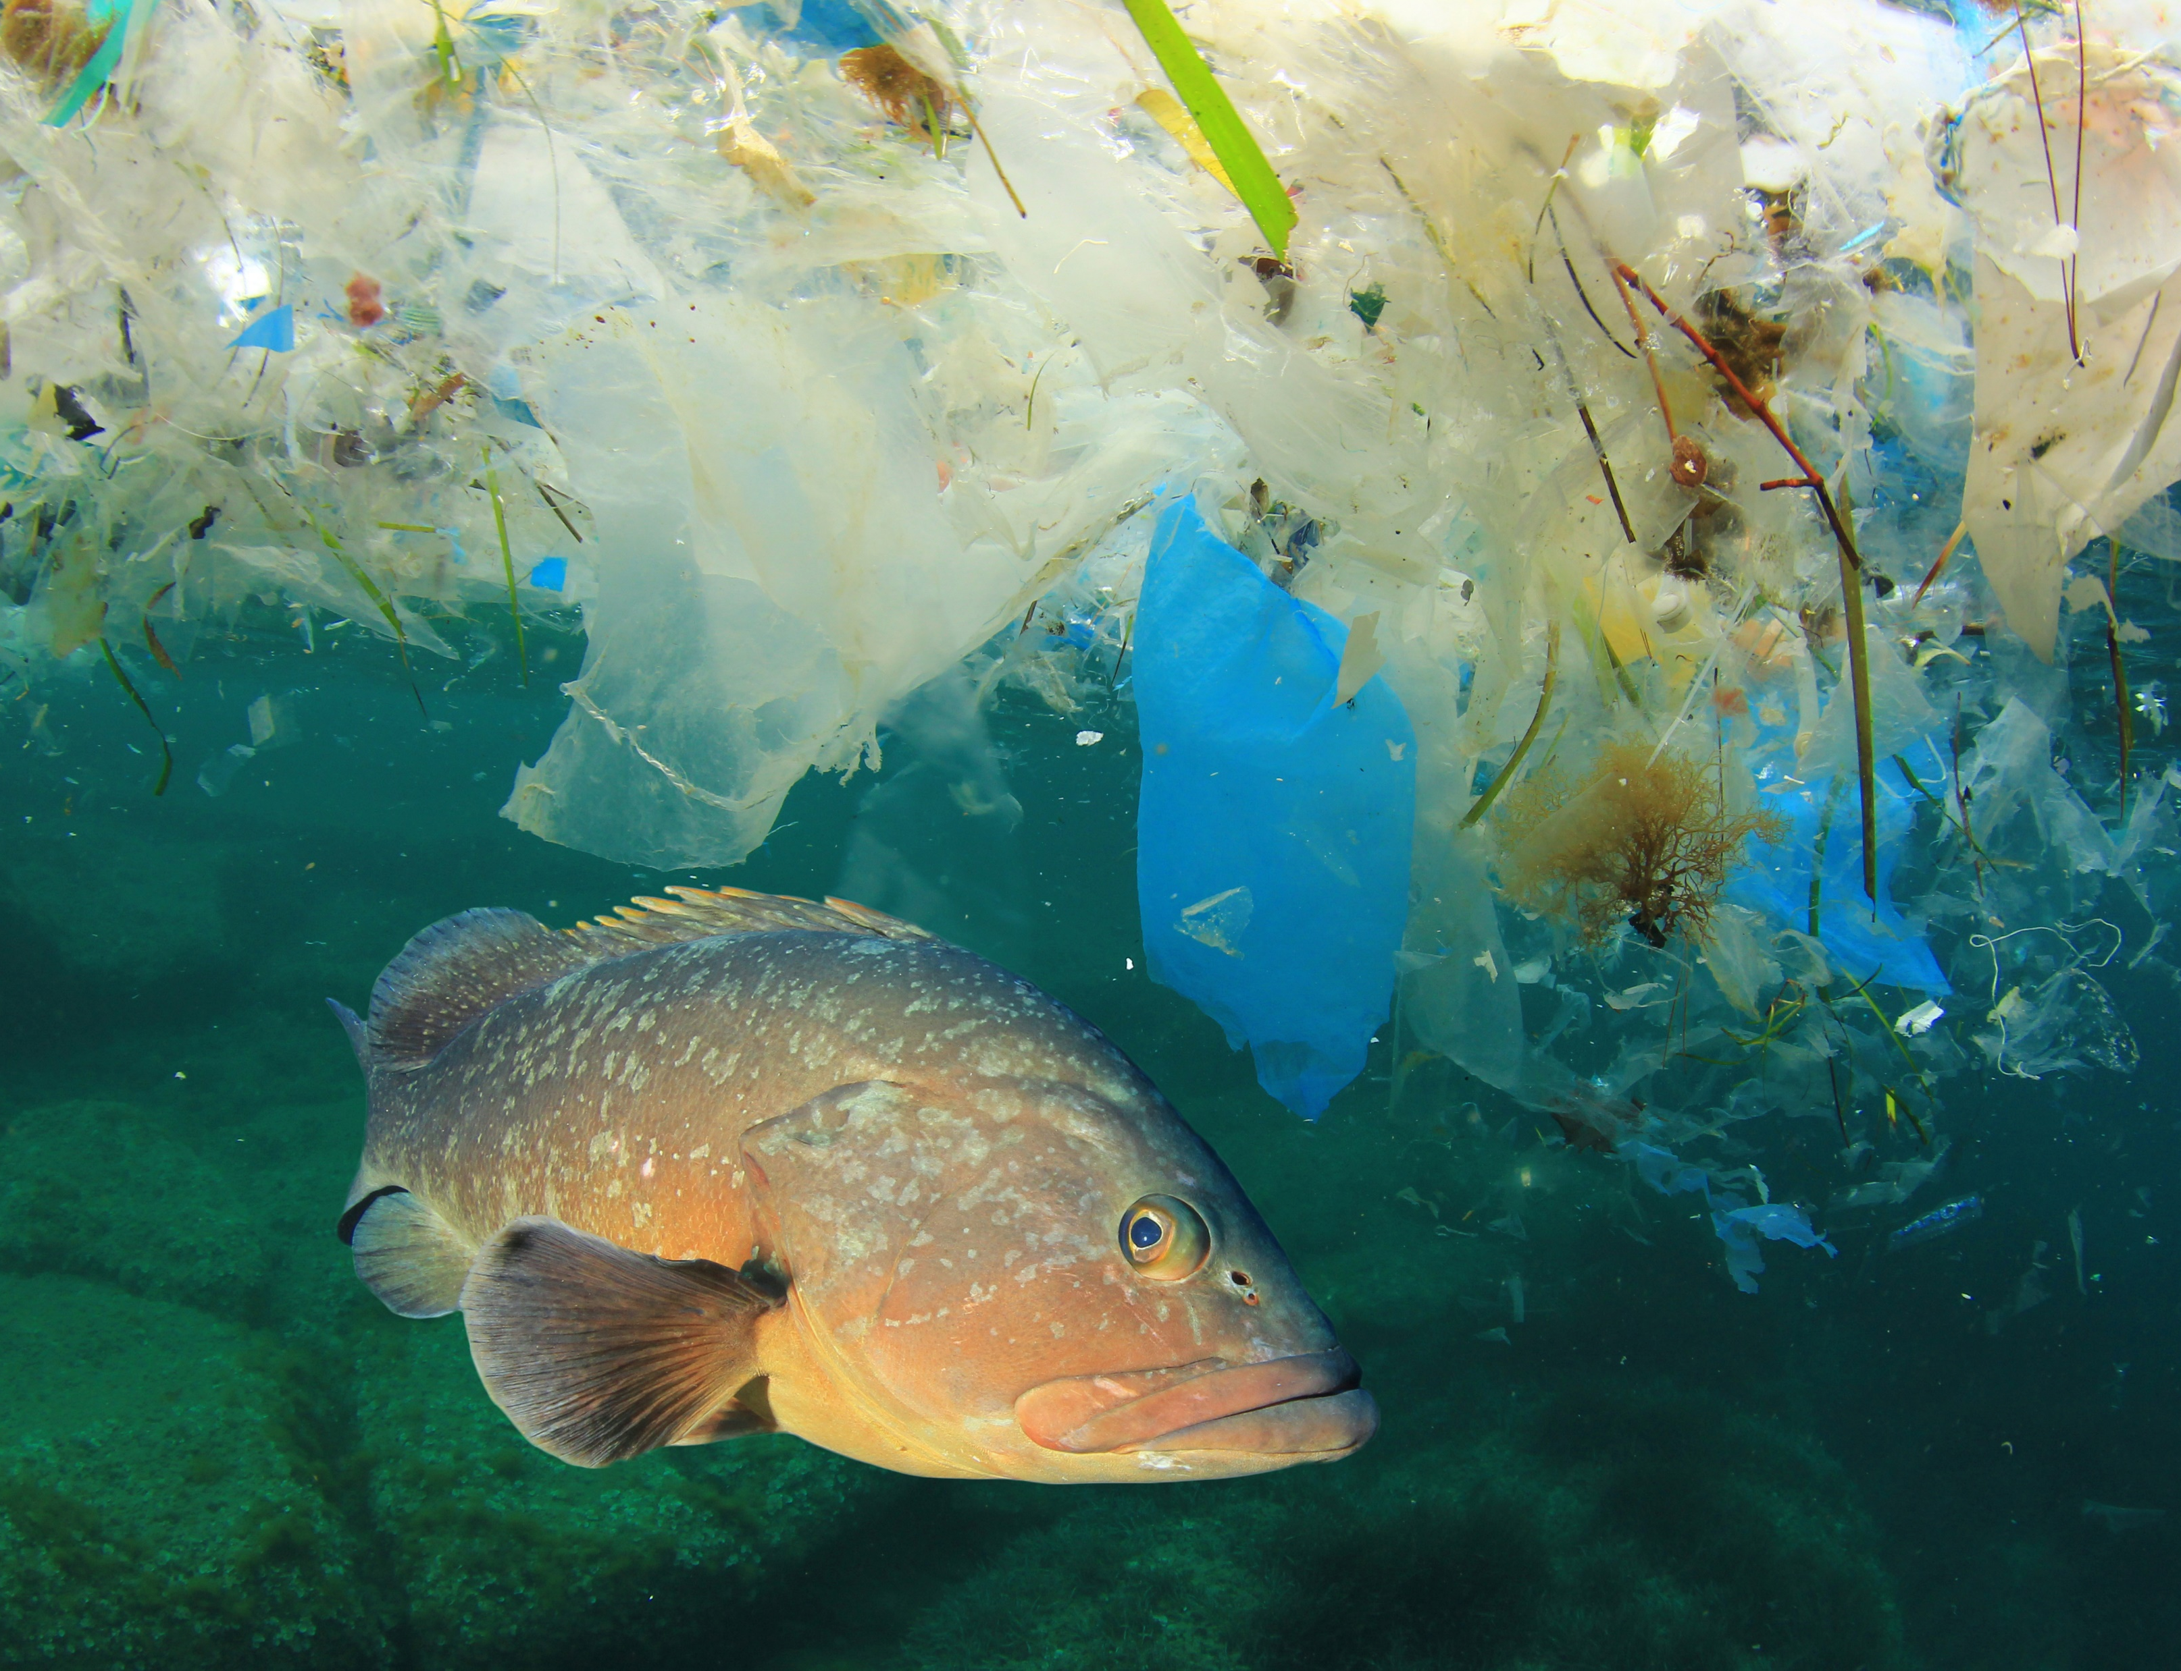
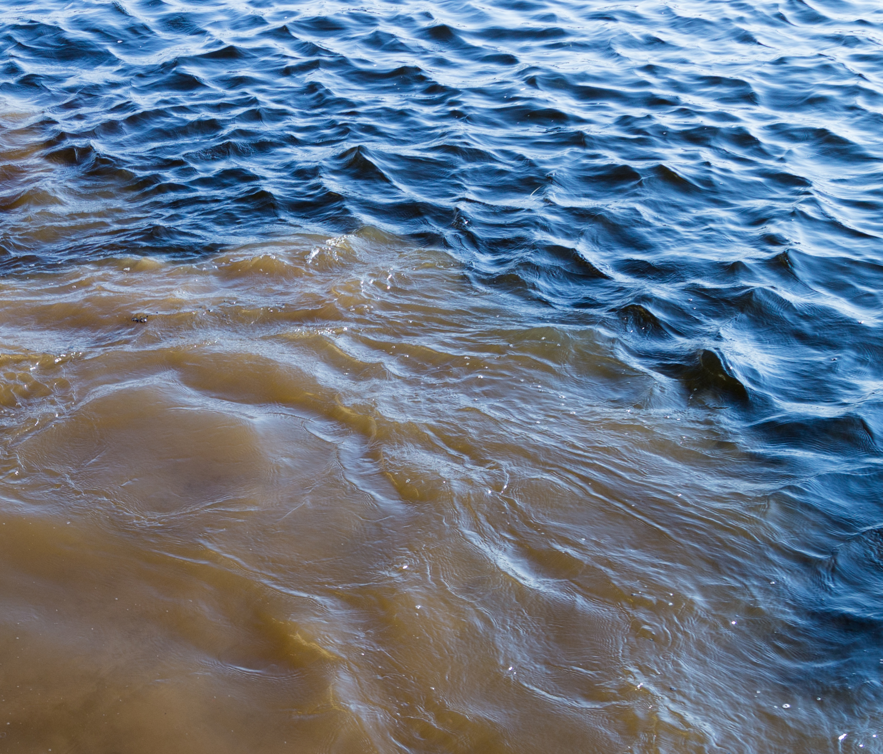
Pollution
Marine litter © Rich Carey via Shutterstock
Polluted water © andreev-studio.ru via Shutterstock
It’s estimated that a staggering 100 million sharks are killed every year worldwide because of unsustainable fishing practices, shark finning, overfishing, pollution and habitat destruction.

