Slide 1
Teach on the Beach
Notes:
Teacher directions are in italics
Script is in normal text
Photo credits in small underlined italic text
See Teacher Document for what you will need and what to prepare for Lesson 1

Slide 2
Before the beach
Lesson 1
Notes:
Today we are going to talk about seaweed!
What it looks, feels like, what it is useful for, where we find it.
Then we are going to visit the seashore!
We’ll do a Big Seaweed Search activity there, looking for and counting different types of seaweed and creatures that live in it.
The Big Seaweed Search is a project that asks people to visit the sea shore to look closely at the seaweed growing there and record what they find.
A lot of people just ignore seaweed, or maybe even avoid it, but it has a lot of uses and is important for our planet.
The Natural History Museum in London and The Marine Conservation Society across the UK are running The Big Seaweed Search to learn more about the seaweed on our shores.
In our lessons you will find out more about seaweed, why it is important and how you can get involved.

Slide 3
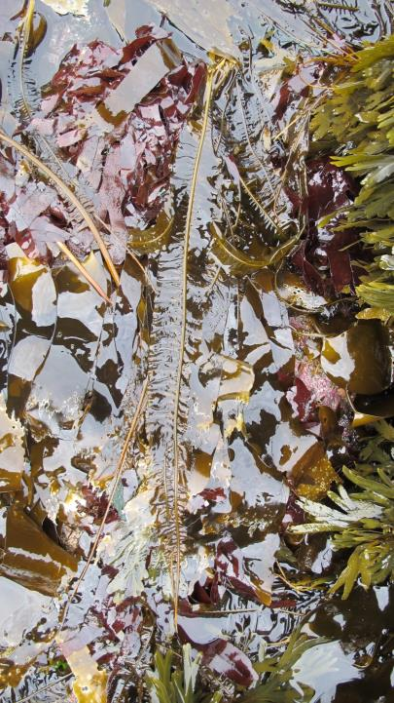
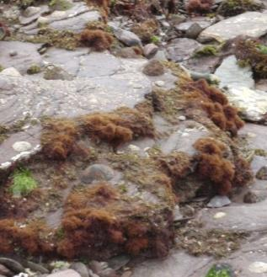
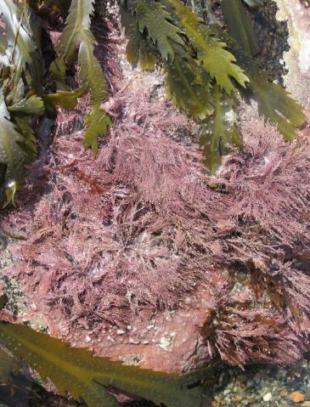
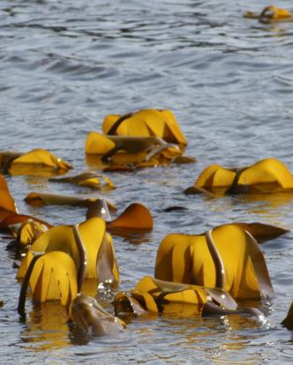
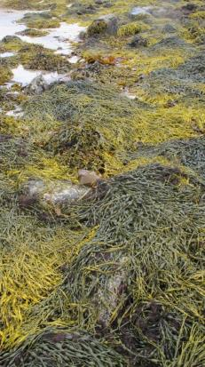
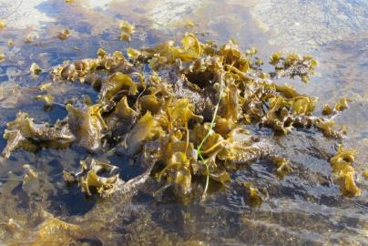
Notes:
Here are some seaweeds of different sizes, colours, shapes and surfaces
Photos from Juliet Brodie at The Natural History Museum

Slide 4
What do you think or feel about seaweed?
Notes:
Use whiteboard or flipchart to record pupils’ feelings and thoughts about seaweed. You could list or make a word cloud/mind map – your map could have a seaweed shape. You could use some emojis with children's help! (see ‘Teachers Evaluation Mind Map Outline’ for examples)
What do you think about seaweed? How does seaweed make you feel?
Add words to flip chart under thoughts and feelings
Emojis by Spaynton used under creative commons license CC BY-SA 4.0

Slide 5
What facts do you know about seaweed?
Fact: A piece of information that is known, or proved, to be true
Notes:
Use a different map shape and/or colour to record facts already known about seaweed before the sessions.
What do you already know about seaweed? What seaweed facts do you know?
What is a fact? How is it different from what you feel or think?
A FACT is piece of information that is known or proved to be true. How can you know or prove facts?
You could look them up in a book/online (but care needed), go and look for yourself, ask somebody who knows (a teacher/expert)
Tell me some seaweed facts you already know
Help by prompting if needed e.g. what colours are seaweeds, is it an animal, where does it grow, what does it need to grow?
Be careful not to teach new facts here.
Add ‘SEAWEED FACTS’ to flipchart/board in a different colour or on a different sheet. If you think facts are wrong see if anyone else in group agrees!
Keep the charts/board or take photos of the lists to use as evaluation of learning in Lesson 2 after the shore.

Slide 6
See the weed
Activity 1
Notes:
Purpose: Examining and separating what we feel and what we know about seaweed. This activity is aimed at challenging any negative feelings children have about seaweed in general by getting them to look closely at real seaweeds. Timing 10-15 minutes
Props
samples (of any seaweed types) ideally fresh, or frozen, dried or pressed
magnifying glasses & torches
OR low mag stereo microscopes if available/phone microscope attachment and phone/USB microscope
Pencil and paper
Handouts
Activity 1/ Seaweed Snap Handout (if you don’t have real seaweed)
Instructions (also see next slide and ‘Teachers Instructions for Activity 1’):
Give out some seaweed samples in trays for each group. Ask children to look at samples under magnifying glasses/low mag stereo microscopes (use torches/lamps to illuminate if you have them).
If you can’t source seaweed use printouts of the species found on the handout for Activity 1/ Seaweed Snap
or you can buy some dried seaweeds online (search for dried carrageen/Irish Moss/sea spaghetti/bladder wrack rather than laver, nori or wakame; be careful not to order flakes, powder or chopped seaweed!)
See next slide for script…..

Slide 7
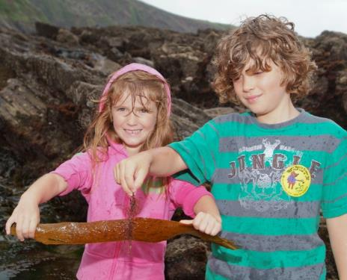
See the weed: look at each seaweed
What shapes
can you see?
What colours
can you see?
Can you see lines
or patterns?
Is it hairy
or smooth?
Does it have
bubbles?
Can you see
through it?
What do seaweeds feel like?
What do seaweeds smell like?
Notes:
In this exercise called Sea The Weed you’ll look at some seaweeds more closely.
Select a seaweed from those on your table.
Have a very good look at it; hold it up to a light/a microscope
Examine each seaweed in turn:
What shapes can you see?
What colours can you see?
Is it hairy or smooth?
Does it have bubbles?
Look with a light behind at the seaweed – can you see patterns? Can you see through it?
Also have a feel of, and smell, each sample.
Write down what you can see/feel/smell or draw a picture.
Photo from The Natural History Museum

Slide 8
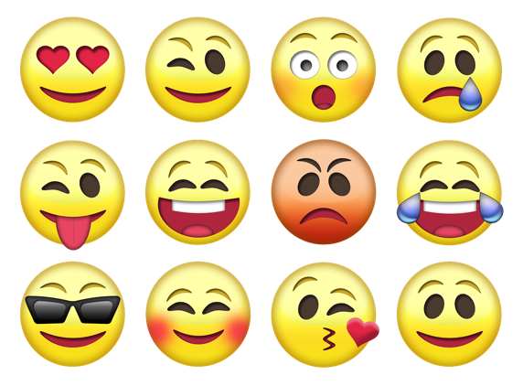
What do you think or feel about seaweed?
Notes:
What do you think/feel about seaweed now after that activity?
Have we got any new feelings to add to the list?
Add any new words to flip chart – but
use a different colour
or put them in boxes,
or list them below the original feelings to differentiate the before and after exercise
Emojis by Spaynton used under creative commons license CC BY-SA 4.0

Slide 9
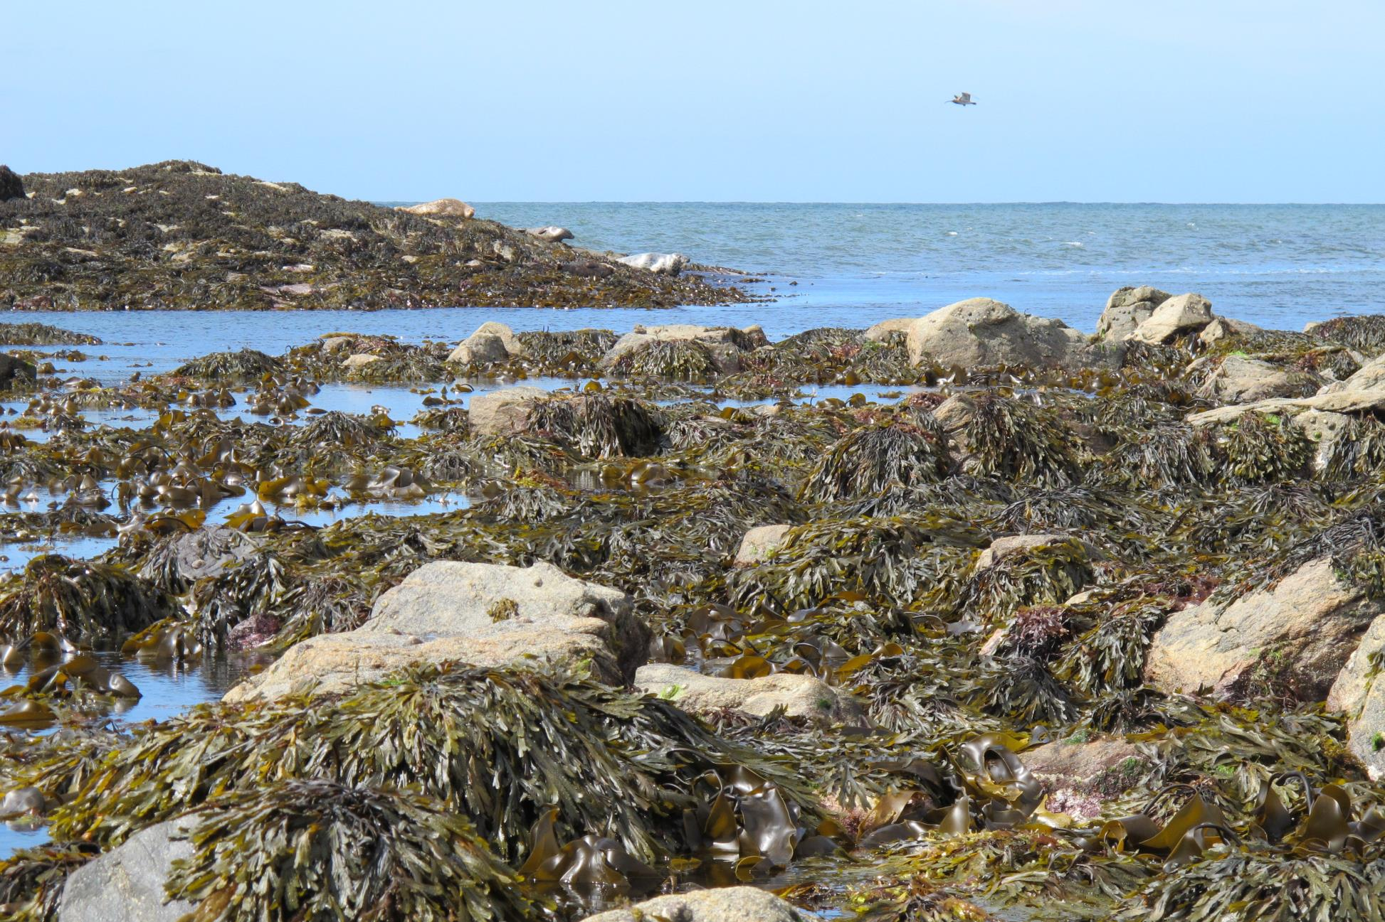
Notes:
The team of seaweed scientists (phycologists) at the Natural History Museum in London have been studying seaweeds for a long time. They often collect them to study very carefully.
They are being helped by the Marine Conservation Society and the public (people like you) to find out more about seaweed.
Together they have been looking at seaweeds on the shore all around the UK through the Big Seaweed Search. This is a project that has both scientists and everyday people working together to understand more about seaweed and you’re going to help!
So, we’ve talked about what we feel and we’ve looked at some seaweed samples more closely.
Let’s talk again about what we already know
So at the start what we knew about seaweed was this….
(read out the facts on the facts chart/whiteboard).
Photo from The Natural History Museum

Slide 10
Seaweed facts
Notes:
Next I will share some more seaweed facts from the Natural History Museum and the Marine Conservation Society – some of them may surprise you!
We will also discuss why seaweed is important for us, and for the planet as a whole.

Slide 11
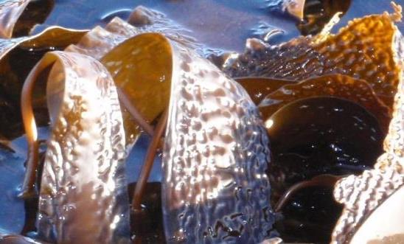
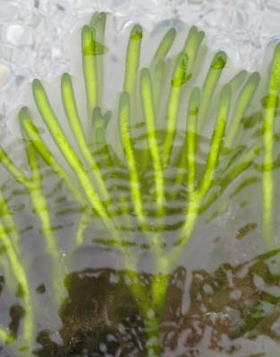
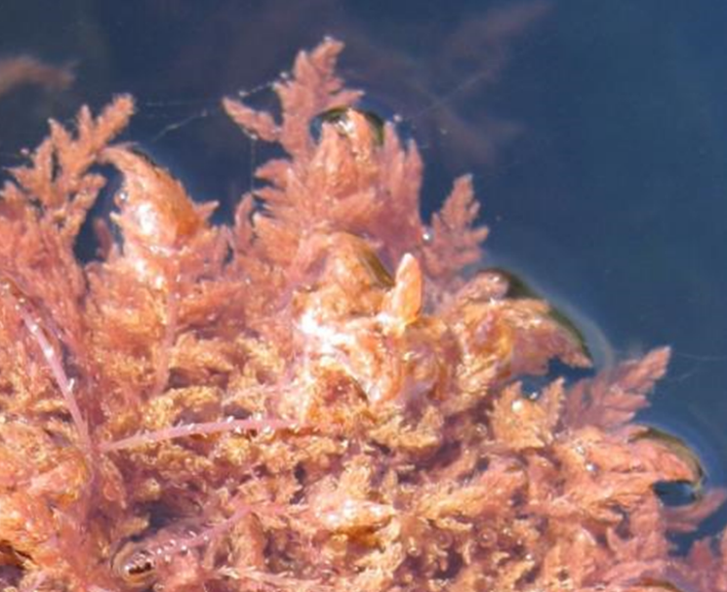
brown
red
green
Notes:
There are around 12,000 different types of seaweed that grow in the world's seas. In the UK we have about 650, so it’s a very rich area for them.
There are three main types of three different colours: brown, green, and red.
All three contain chlorophyll which is a pigment inside plants that gives land plants their green colour . Brown and red seaweeds contain other pigments that are stronger than the green so they cover it up and you can’t see it. A pigment is a substance that gives things colour.
Brown seaweeds are much bigger than the others and can live at greater depths – the huge, flat brown seaweeds are also called kelp and they can form thick underwater forests.
Green seaweeds prefer shallower and warm water.
Red seaweeds can be anything from purple to bright red to a pinky colour and there are more different red kinds than brown or green kinds.
All seaweeds need sunlight to survive and grow, so more tend to grow at the edges of the oceans where it is shallow and lots of light can reach them.
At the bottom of the sea there are no seaweeds – why do you think?
It is dark so seaweeds cannot grow there.
Do you know how fast your hair grows? Its about 1.25cm/month or 15cm per year.
The biggest seaweeds (giant kelp) can grow 60cm per day! That’s the same as 2 regular sized rulers!
Photos from Juliet Brodie and The Natural History Museum

Slide 12
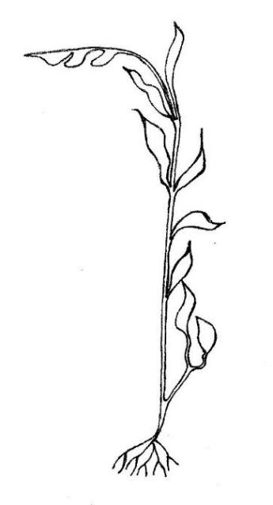
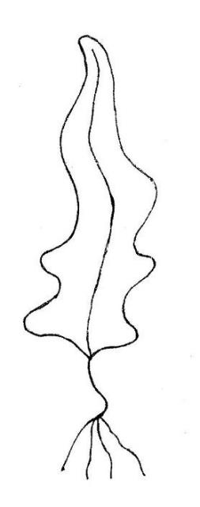
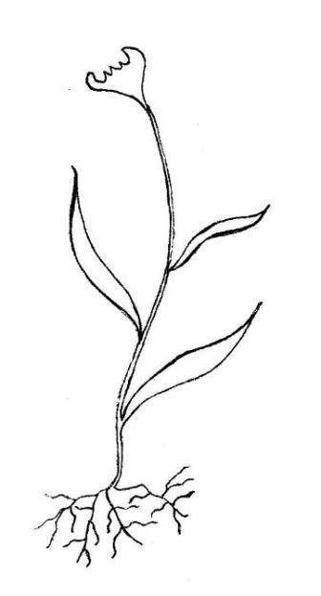
Plant vs seaweed (marine macro-algae)
se
land plant
seaweed (marine algae)
frond
leaf
blade
stem
stipe
root
holdfast
Notes:
Seaweeds look a lot like land plants don’t they?
They have a stem called a stipe and kind of leaves, that are called blades. The blade and stipe can also be called a frond.
They aren’t quite the same as land plants though, they are marine algae. They are plant-like but more simple; they don’t have water moving around inside them to transport nutrients like plants do. Each seaweed is a collection of simple algal cells living together. Each cell has to get its own nutrients from the sea water.
They make carbon dioxide into oxygen using energy from sunlight, just as plants do. Marine animals depend on this oxygen, which is present in sea water as in air, to keep them alive. Oxygen also escapes into the air for us to breathe too.
Marine algae are really important for the whole planet for the oxygen they give out. We think that 70-80% of oxygen comes from algae in the sea, which is almost all of it!
Only a few types of marine algae live free-floating in the ocean and most of those are tiny. Most seaweed has to be attached to something. They don’t have roots like plants do. Large seaweeds, or macro-algae, have holdfasts that allow them to hold on tight in the waves.
Unlike roots of a plant, the holdfast doesn’t lie beneath the sand or sea bed, but grows grabbing onto something on the surface like a rock, a shell or even another seaweed. It cannot transport nutrients or water like plant roots can, it acts as an anchor. Other creatures can often live within the shelter of the holdfast.
Extra info: One of the primary differences between algae and plants is that plants have connective tissues that transport nutrients and water throughout. In algae, each individual cell is responsible for absorbing its own water. This makes the algae non-vascular compared to the highly vascular plants. Although marine macro-algae can still possess a multitude if cells, typical algae do not have chloroplasts and the cells do not have cellulose walls. Seaweed can be unicellular, colonial or multicellular but land plants are always multi-cellular. Seaweed or marine macro-algae lack key structures that are normally present in ordinary plants like the leaves, roots and stem. This is the reason why seaweeds are today no longer described as plants. They are grouped in their own loose groups or phyla; they are different from each other – there is no single one for all seaweed; the red green and brown seaweed have no common ancestor and seaweed is a colloquial collective term rather than a taxonomic classification.
Picture drawn by Jules Agate, MCS

Slide 13
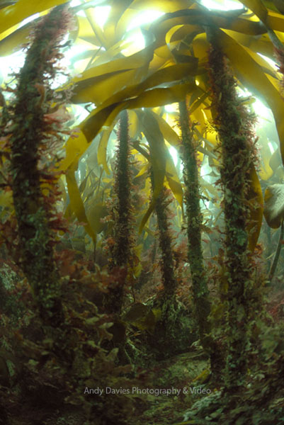
Seaweed forests
Notes:
Seaweeds are important for lots of sea creatures and for us too
They grow to form underwater forests, which provide shelter for a lot of animals like fish, lobsters, crabs, seahorses and shellfish.
The babies of sea creatures often hang around and hide under the seaweed as protection from being eaten by bigger animals.
They help to protect the shore from storms and trap sand to create soft sea beds.
Some of them are hard and can form reefs. Having both soft and hard places on the sea bed, as well as structures like holdfasts, makes homes for lots of different kinds of creatures
Video you could use to show how seaweeds and animals interact:
BBC Big Blue Live 360 degree exploration of a kelp forest (in a US aquarium) https://youtu.be/kJv0eYQp1lo?si=7bHG004fVjC3TLKt
Photo by Juliet Brodie, Natural History Museum

Slide 14
Odd one out?
Notes:
Can you guess the odd one out of these creatures and why?
It’s the sperm whales as they don’t eat seaweed - they eat squid, octopus and crabs mainly.
(It could also be turtles as they are reptiles and people and whales are mammals so acknowledge that’s another correct answer)
Some turtles eat seaweed – the green turtle shown here eats mainly seaweed and sea grass as an adult. Other turtles eat jellyfish, squid and octopus.
People can also eat seaweed. Sushi is a kind of Japanese rice roll that people eat, often wrapped in seaweed.
There are lots of products we eat like jelly, cakes and sweets that often use ingredients taken from seaweed to make them stick together or bind. Even beer can contain seaweed – it is used to make the frothy top on it.
What do you think seaweed tastes like? Would you eat seaweed flavoured ice cream? A lot of ice cream has seaweed in it, but you can’t taste it.
Photos: Sperm whale from MCS
Green Turtle by Tom Shelley for MCS
Eating ice cream by Jules Agate, MCS

Slide 15
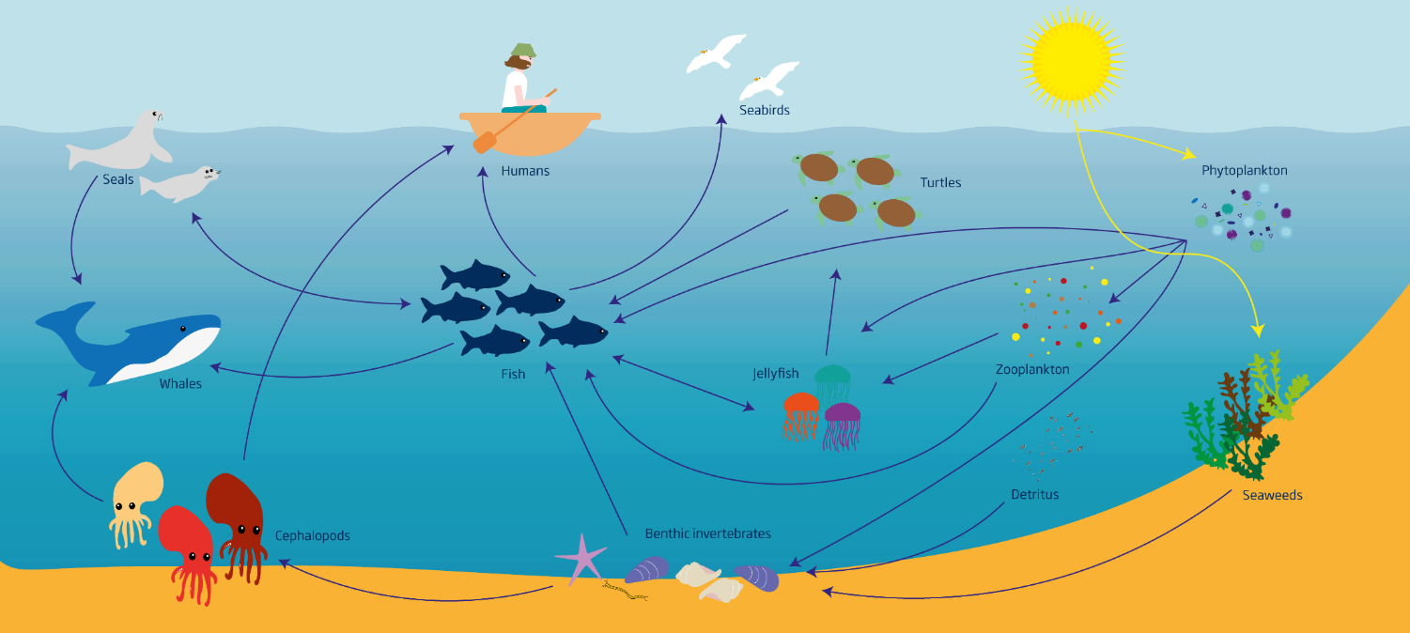
Food in the sea
Image: Alejandra Bize, JNCC
seabird
tiny algae
human
turtle
seal
jellyfish
fish
plankton
whale
dead stuff
octopus
shellfish
seaweed
Notes:
The seaweeds that live only in salt water that we have been describing are also called macro algae (macro just means big).
But there are also tiny algae in the sea. Some of them are so tiny they can only be seen with a microscope and are made of just one single cell. They’re called phytoplankton.
Tiny algae can live in fresh or salt water and are super-important. All of the animals in the sea depend on them.
Do you remember Dory from the Disney films? She is a regal blue tang and they eat tiny algae in the coral reefs where they live.
Tiny algae are also eaten by small creatures that are called zooplankton – and almost everything in the sea either eats zooplankton or eats something that eats zooplankton, so they are really important sources of energy.
Do you know a big fish that eats plankton? Whale sharks which are the biggest fish in the world eat only plankton as do basking sharks and they are our biggest fish here in the UK.
Everything in the sea depends on the tiny algae or seaweed to produce food from sunlight.
Picture taken from open access page https://water.europa.eu/marine/topics/state-of-marine-ecosystem/marine-food-webs
Copyright Alejandra Bize, JNCC

Slide 16
Why are seaweeds important?
oxygen
shelter
food
protection
anything else?
Notes:
BREAK can be taken here. On return…
Let’s think back over what we said about why seaweeds are important – take a few minutes with the person next to you and see if you can remember reasons that we mentioned before, as to why seaweeds are important?
oxygen for us and for the planet
shelter for sea creatures
food for sea creatures
food for us
protection for our coasts
They are also used in toothpaste, beauty products, and they provide us with medicines.
And they help to keep our climate stable. By growing, then dying and drifting down to the deep sea, seaweeds like kelp lock up carbon into the sea bed. This helps to slow climate change, which we will explore in lesson 2.
Image: Matt Cole via vecteezy.com

Slide 17
Studying seaweed
Notes:
Studying seaweed is easy.
There is a lot of seaweed on our coasts to look at, it is there a lot of the time, it doesn’t swim away and we can see much of it without any special equipment.

Slide 18
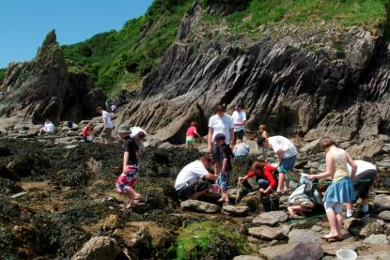
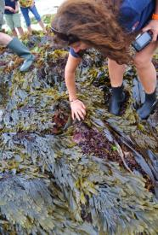
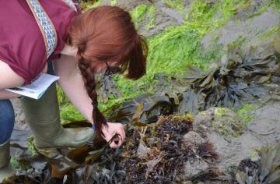
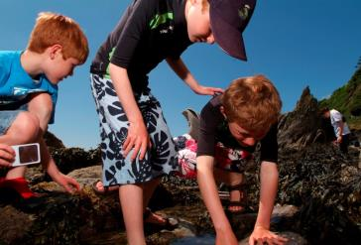
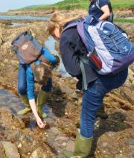
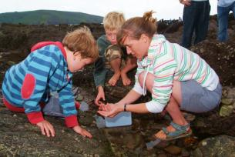
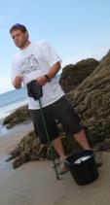
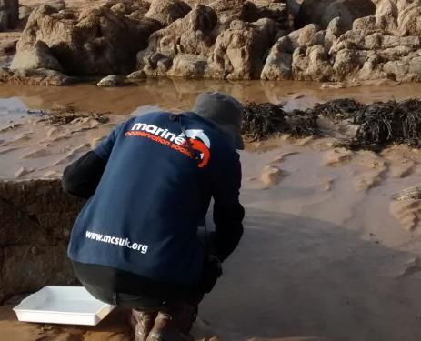
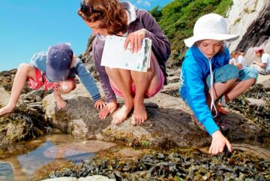
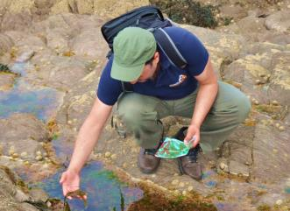
Notes:
Looking at seaweed can also tell us some interesting and useful things about our world and how it is changing
We can look how the warming seas on our planet Earth are affecting seaweeds
We can look at how different seaweed types around the world are being found in new places where they are sometimes called ALIEN species or more correctly, Invasive Non-Native Species, which means they came from somewhere else
We can look at some special seaweeds and see if there are becoming more or less of them in general or in particular places.
These changes can reflect or ‘mirror’ changes in our world as a whole, and the Big Seaweed Search aims to record them.
Pictures by MCS/NHM

Slide 19
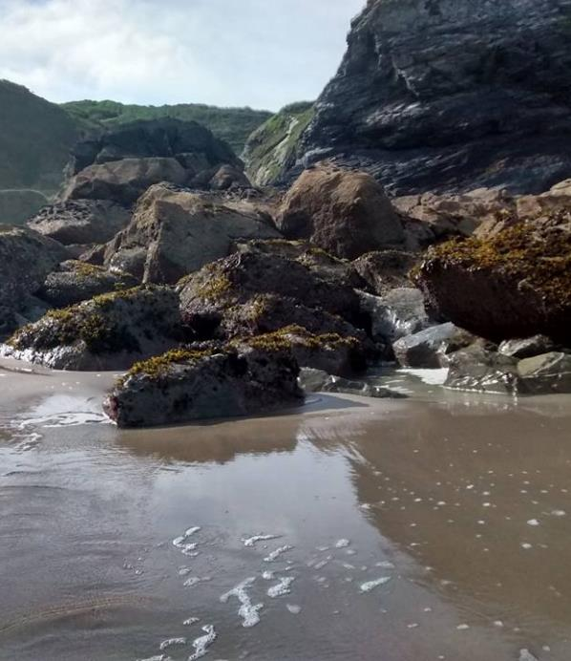
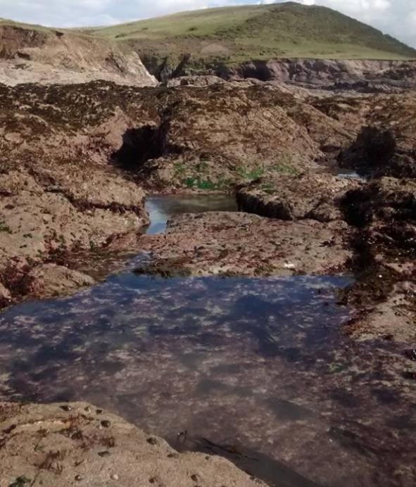
different shores
Notes:
How might we understand how seaweed is changing over time and how it is different from one place to another?
These shores are quite different. The one on the left has big, steep boulders on sand. The other is a rocky shore that is gently sloping with a lot of rock pools. They both have seaweed growing on them.
How could you find out which of these different shores has the most seaweed?
We could look at what kind there is there and MEASURE how much there is of it at the different places – we could COMPARE
This can help us to understand changes in the sea and on the shore that might be affecting seaweed from PLACE to PLACE
Pictures by Jules Agate, MCS

Slide 20
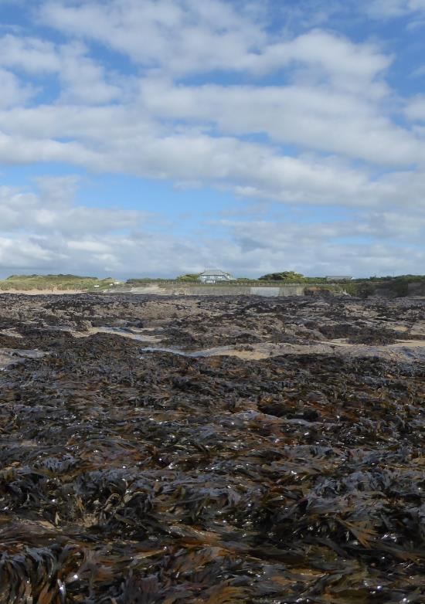
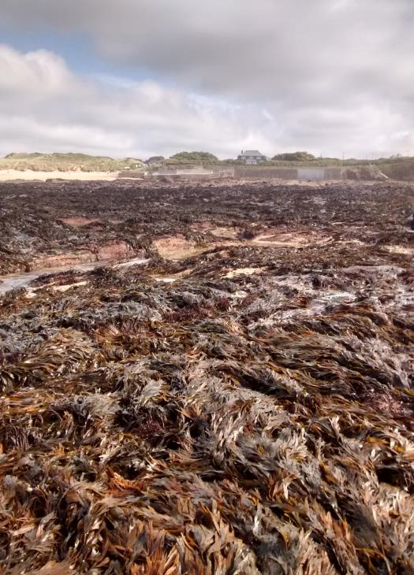
different times on the same shore
2016
2017
Notes:
You can see this is the same rocky shore because the house at the back in the photos is the same
The photo with the blue sky (on the left) was taken in 2016. And the photo with the grey clouds (on the right) in 2017, one year later.
How can we know whether there is more or less seaweed on a shore than the year before?
How do you know how something has changed – like how much you have grown in a year?
You measure it and then measure it again next year – you COMPARE measurements from the same place
This can help us to understand changes in the sea and on the shore that might be affecting seaweed over TIME
Pictures by Jules Agate, MCS

Slide 21
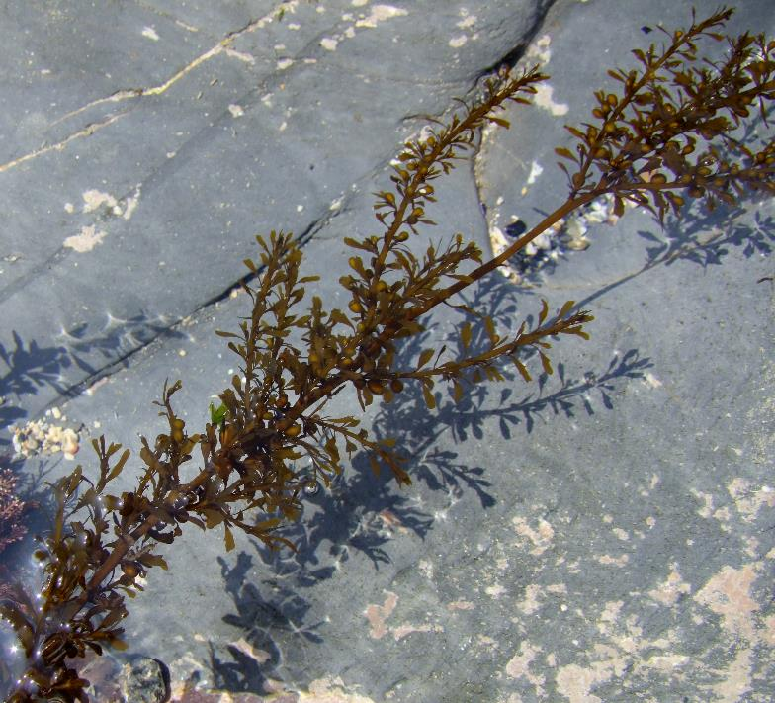
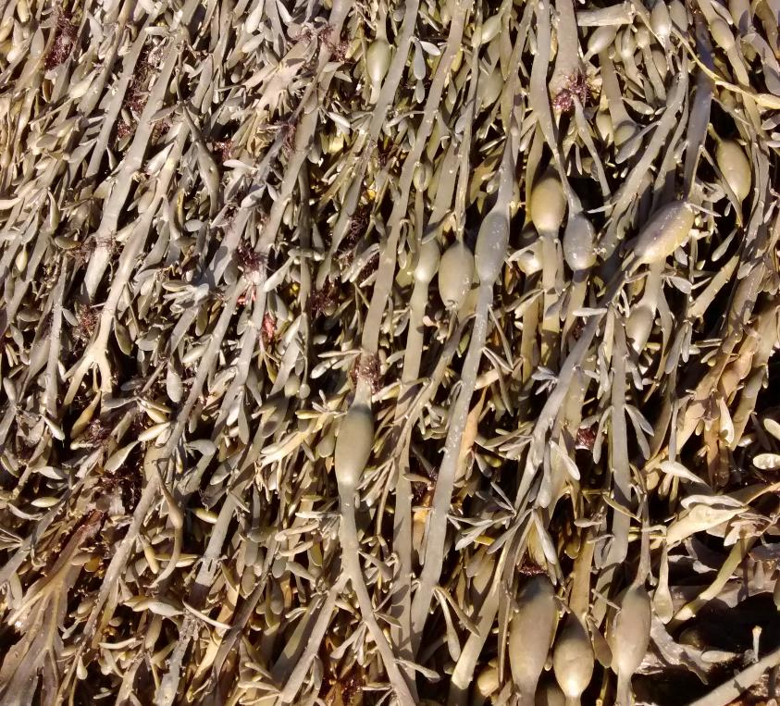
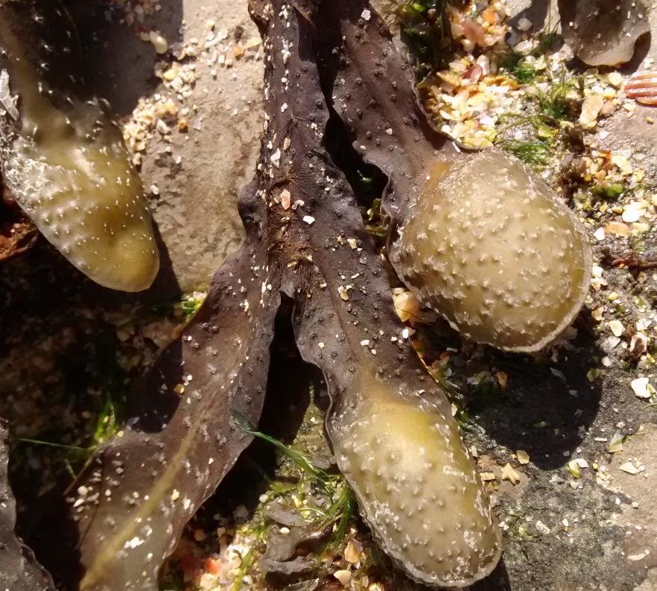
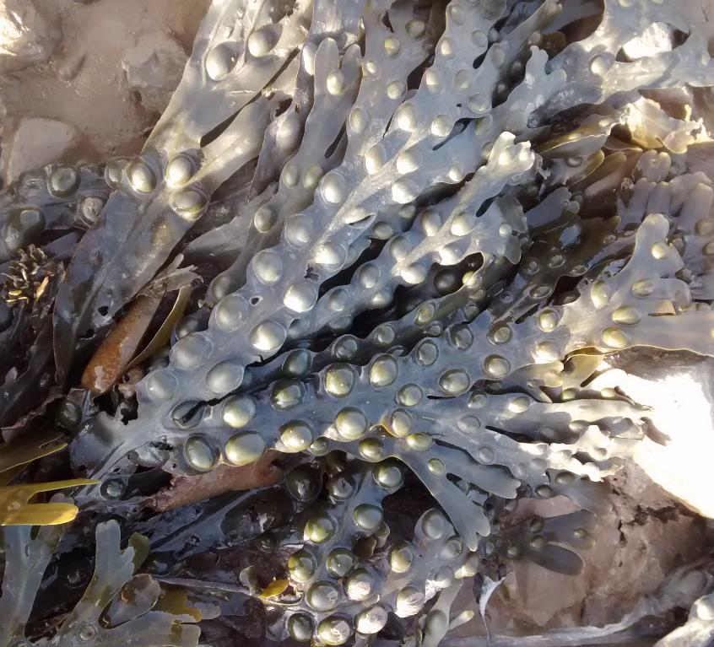
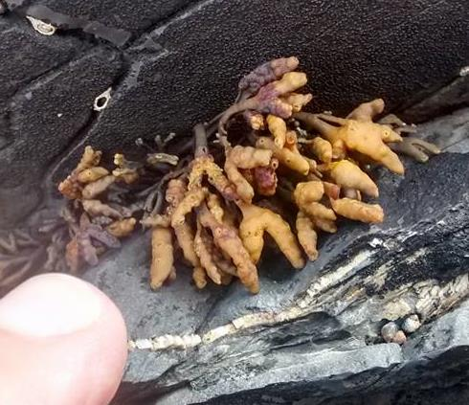
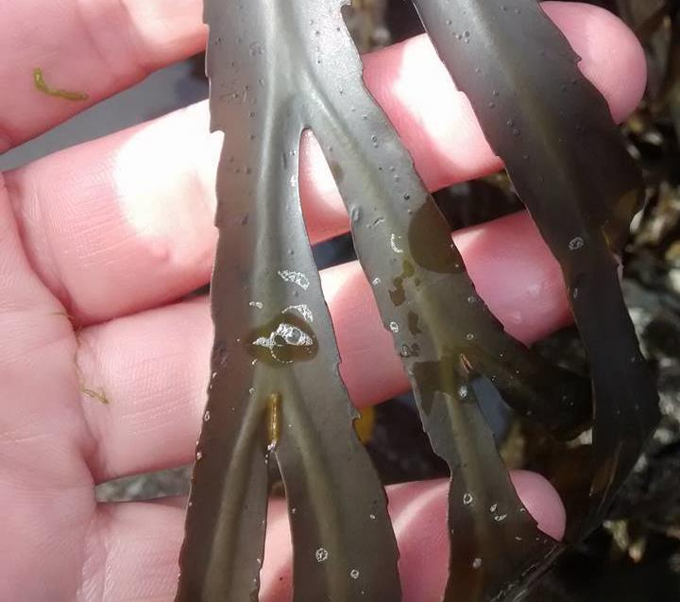
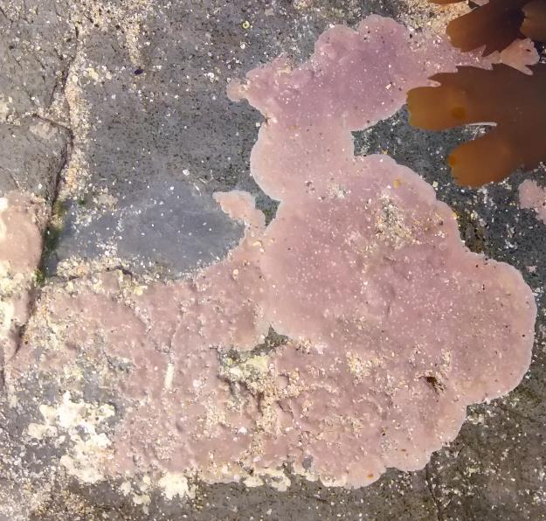
seaweed types
Notes:
As well as measuring how much there is, in the Big Seaweed Search we also look at what kinds of seaweed there are and name them or identify them – just like we might look at different kinds of plants or birds or dinosaurs.
There are lots of different kinds – but how are they different? We’re going to look at some now to find out.
Pictures by Jules Agate, MCS

Slide 22
Guess the seaweed
Activity 2
Notes:
See ‘Teachers Instructions for Lesson 1 Activity 2’. You will need:
Activity 2 pupil instructions handout
Paper and pencils
10 trays or buckets
For 5 groups = you need 30 seaweed samples (drift) of 3 species, 10 bits of each of the 3 species
For each group lay out 2 trays with 3 matching seaweeds in each (seaweed 1, 2, 3 in tray A and seaweed 1, 2 and 3 in tray B
Purpose: getting the children to describe the features of seaweed and recognise the different features that seaweed have that will help them to separate/identify the different types
Now we are going to play a game called guess the seaweed
Split up into groups (5 groups, 6 pupils per group in class of 30)
Then split your group into (roughly) half again so each group has 2 teams
Team 1 = green team – you are describers
Team 2 = red team you are guessers
Teams sit/stand close enough to hear. Both teams have 3 seaweed samples in front of you, but keep your tray/bucket covered and don’t let the other team see it (or sit back to back)
Team 1 green the describers - secretly agree on a seaweed from your bucket/tray (point to it but don’t let the other team know). One of you describes 1 thing about it to the other team (colour, shape, size, smell, feeling). It must be true!
Team 2 red – you get 1 guess after each description at which type of seaweed it is. Hold up the seaweed type you think is right
Make 1 description and 1 guess until the red team guesses right
When you have it right, write down the description that was most helpful
Swap teams. Green team get to guess and red team have to describe do one other seaweed.
Which seaweed was easiest to describe? Which features helped you to describe it/guess it?
Alternative ides – if too difficult to get 30 seaweed bits
use printouts of the species on the handout for Activity 1/Seaweed Snap but direct children not to use the names (knife, bubbly) as a describing feature
Using the cards from Activity 1/seaweed snap play Seaweed Snap or a pairs memory game (see Teachers follow Up Activities for an explanation)
Use the True/False game see Teachers notes for Practical Session)
Make a quiz based on what has been learned so far about the features of seaweed

Slide 23
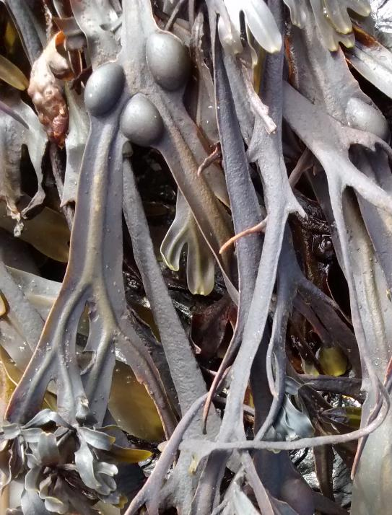
How can we tell seaweeds apart?
shape
feeling
lines (mid rib)
air bubbles
lines
air bubbles
Notes:
What kind of features did you find on the seaweeds that helped you to tell them apart? Read out some of your descriptions you used.
Shape is important – some are flat, some are like little trees with branches like this one
They can be soft and slimy, but some are really hard like rock so how they feel or texture is useful to tell them apart
Some of them had bubbles – which are full of air. This helps the seaweed to float. Why would that be useful? (to get sunlight)
Did you notice that some of them have lines like veins on a leaf? This is called the mid rib
Picture by Jules Agate, MCS

Slide 24
Notes:
Give out the ‘BSS Schools i-d Handout’ that you will be using at the beach so that children can familiarise themselves with it
I’m going to describe to you now (and show you) the seaweed types we are going to search for at the beach on our Big Seaweed Search activity.
We have over 650 different types of seaweeds in the UK. In North Devon, as well as all around much of the UK coasts, seaweeds are a very important part of our natural world. You’ll see them growing on a lot of our rocky shores and also on piers, harbour walls and even ship’s ropes.
The full big seaweed search project has people looking for, and measuring, 14 of them all around our coasts.
We are just going to search for 7 to start with.
Each of the 7 has been given an easy name and also a symbol to help you to remember (they have more complicated scientific names in Latin too, and other common names).
Let’s start with easy to remember names that describe them.

Slide 25
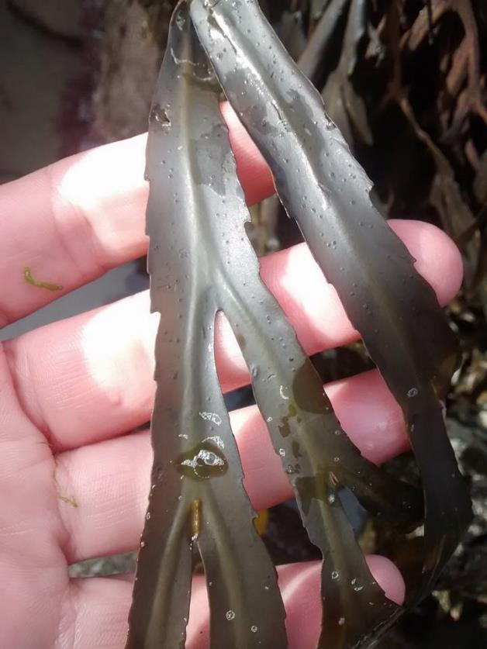
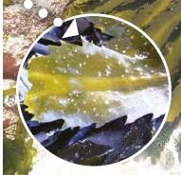
knife
sharp edge
Notes:
Use fresh or frozen seaweed samples if you have them, along with the slides to show the class.
This is the knife-like one. Edge of each blade looks like a cutting knife - it is jagged and has lots of little points.
Also has thick lines (mid rib) but it has no air bubbles
(check they remember a blade is like a leaf on a plant)
Pictures by Natural History Museum and Jules Agate, MCS

Slide 26
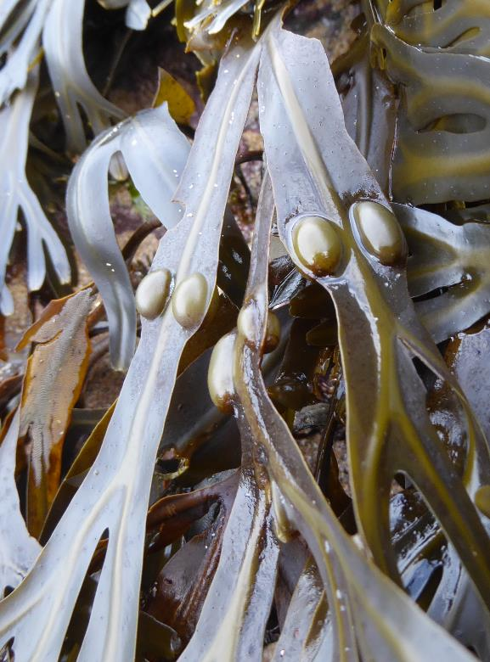
bubbly
air bubbles in 2s
Notes:
This is the bubbly one. It has air bubbles usually in pairs (sometimes 3 together).
Also has thick lines along the centre (midrib)
Pictures by Natural History Museum and Jules Agate, MCS

Slide 27
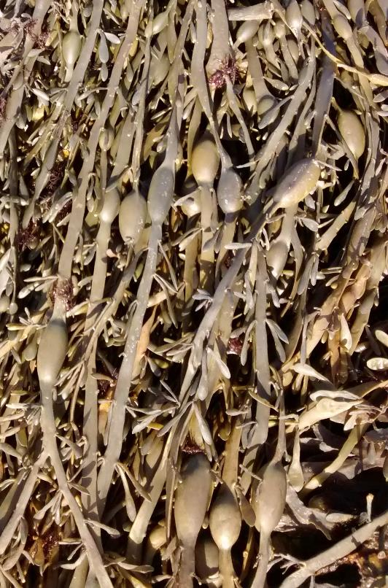
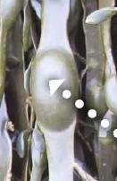
egg
big air bubble
In 1s
Notes:
This is the egg-like one. It has big air bubbles like a single egg, just one at a time along a flat, straight frond like a strap. Each egg equals about 1 year of growth.
No lines or midrib
Pictures by Natural History Museum and Jules Agate, MCS

Slide 28
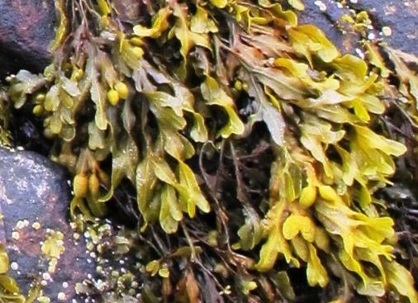
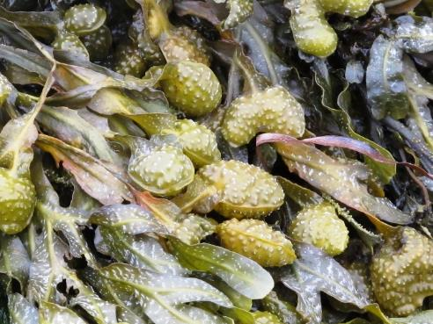
curly
Fronds are not flat
Pockets on ends filled with goo, with rim around
Notes:
The curly one grows like curly hair. The others have flat fronds but this one is crinkly or curly. It has no air bubbles.
Usually most fronds have a pocket on the end filled with gooey stuff. This pocket can often be heart shaped and there is a rim around the edge of it.
It has lines or mid ribs.
Pictures by Natural History Museum and Jules Agate, MCS

Slide 29
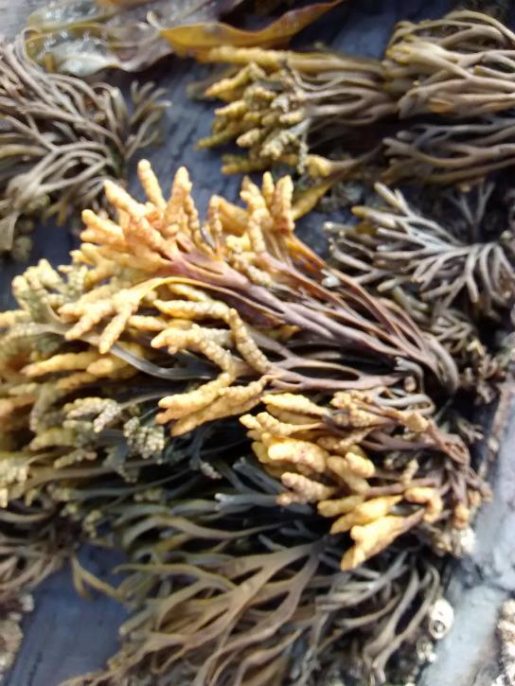
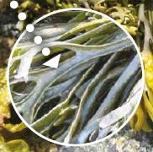
groovy
grooves; very small seaweed
Notes:
Groovy (and small). It has grooves or channels down the middle instead of lines – the edges are rolled inwards.
No air bubbles.
It is quite a lot smaller than the others. Fronds are brown when wet and almost black when dry. Ends are often yellowy
It lives high up on the shore and is often dried out and crispy to touch.
Pictures by Natural History Museum and Jules Agate, MCS

Slide 30
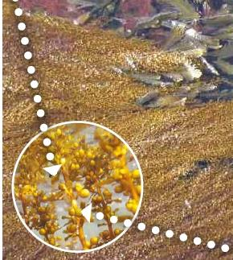
pretty
Pretty little leaves
tiny air bubbles on stems
Notes:
Pretty (or leafy – or pretty and leafy!)
Has tiny little air bubbles on stems. Lots of very small pretty ‘leaves’ (that aren’t really leaves) but that look like a leaf up close.
Has very long fronds. If you hold it up (horizontally) the fronds all hang down from one side, like clothes hanging off of a washing line
Pictures by Natural History Museum and Jules Agate, MCS

Slide 31
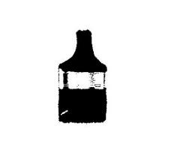
pink paint
Notes:
This type looks like pink paint that someone has painted onto the rock, but it is seaweed!
It is very hard like rock as it has solid material in it to make it strong. Can be covering a whole rock or just dots of it. It can be found growing on shells and stones too. It’s often found underneath other seaweed.
It can be dark pink like in the left picture or very light pink. It can be under the water in pools or out of the water on the shore.
Pictures by Natural History Museum and Jules Agate, MCS

Slide 32
Big Seaweed Search activity
Notes:
Can you remember the seven types of seaweed we are looking for?
Run through them again with the symbols - knife, bubbly, egg, curly, groovy (& small), pretty (& leafy), pink paint. Use samples if you have them and ask children to hold them up

Slide 33
counting seaweed
Notes:
As well as looking for these seven types and recording if they are there we also want to MEASURE and record how much of each type there is on the shore.
Why would it be good to know how much? (Recap on earlier – so that we can compare different places and the same place at different times)
Do you think it would be easy to just count all the seaweeds on a shore? On a shore like this one it would be really difficult!
Pictures by Jules Agate, MCS

Slide 34
sample
Notes:
Instead of counting ALL of them, we can look at how much in a small square. The square has to be the same size on every shore so that we can compare.
This is called looking at a SAMPLE. You measure or count a sample to tell you about a small part of something when it is impossible to measure the whole thing. This scientist is using a grid made of lots of little squares to sample. We will use a 1m square made of rope, just like on the right image.
Pictures by Capturing Our Coast and Jules Agate, MCS

Slide 35
scoring
Score 3 if all of 1m²
Score 1 if just 1 or 2 plants,
Score 2 if more than 1 or 2 but less than 1m²
score = 1
score = 2
score = 3
Notes:
Handout ‘BSS schools scoring sheet HO’
Within the 1m square, for each type of seaweed we will score it based on how much of it there is in that square
If there is only one or two plants then we score 1
If the whole square is covered with that type we score it 3
If it is somewhere in between, we score it 2
It should be GROWING IN the square – you can pull it a little bit to check it is attached. We clear away any drifted seaweed that isn’t attached or plants growing outside from the square
Drawings by Jules Agate MCS

Slide 36
scoring question
What score would we give this this seaweed
if there are 3 plants within 1m²
Score 3 if all of 1m²
Score 1 if just 1 or 2 plants,
Score 2 if more than 1 or 2 but less than 1m²
answer: score = 2
Notes:
What score would we give this seaweed in this square?
We’d check how many plants growing in the square – in this example there are 3
If there is only one or two plants then we score 1
If the whole square is covered with that type we score it 3
If it is somewhere in between, we score it 2
We would score 2 for this seaweed
Drawing by Jules Agate MCS

Slide 37
search area
Notes:
We don’t look at the whole shore just a section of it starting at the top of the beach and working our way towards the sea. This will be the SEARCH AREA
(or survey transect for older children)
We’ll search for the
knife,
bubbly,
egg,
curly,
groovy (& small),
pretty
pink paint seaweed
And use our 1 metre squares to score how much of each type of seaweed in each square is as we go down the shore
We’ll record our results on our ‘Big Seaweed Search for Schools RECORDING FORM’ (show).
We will survey up to 10 squares for each group and then we’ll compare our results back in class.
Pictures by Jules Agate, MCS

Slide 38
limpet count
Notes:
We will also count limpets in our search area.
Limpets are marine animals with shells (a type of shellfish). They EAT seaweed by scraping it off of the rock. They are in the same family as snails (called molluscs) and they eat seaweed like snails eat land plants.
Picture 1 is a limpet on a rock
Picture 2 on the right shows a limpet’s home scar. Limpets live really close to the sea and what could happen to them? They could get knocked off into the sea and smashed. Or pulled off the rock by a person or bird or fish and eaten! Or they could dry out in the sun.
So, they are stuck on the rock very firmly. They make a ‘home scar’ by grinding their shell (or the rock) to make a perfect fit. This stops them drying out when the tide is out.
When the tide is right and water is covering them, the limpet leaves its home scar and moves very, very slowly to eat the seaweed growing nearby. They find their way by leaving a trail of mucus (a bit like snot or a snail trail) which they follow back to their home when the tide goes out.
They have super-strong teeth to scrape seaweed off of the rocks. Limpet teeth are nature’s strongest material, stronger than a shark’s tooth. But the teeth are less than the thickness of one of your hairs.
We’ll use the 1m again to count the limpets in a square AND draw a map or diagram of the limpets and seaweed.
Imagine picture 3 in the middle is your square. How many limpets are in it? There are 3 and there is a line drawn round each of them. Also a line has been drawn around the seaweed at the bottom.
You can see on your recording form that there’s a space for you to make a drawing like this of your own square. This should show the position and amount of limpets and seaweed in your square.
Would there be more or less seaweed if there are a lot of limpets do you think? Would you expect that the limpets have eaten all of the seaweed? Maybe! But limpets need seaweed to live on, so maybe they will be living where there is more of it.
Pictures by Jules Agate, MCS

Slide 39
On the seashore

Slide 40
seashore code
We are studying a seashore creature’s home!
Don’t drop anything into a rock pool or the sea
Don’t pick animals up and move them
Don’t knock animals off of seaweed
Be gentle with any animals living on or under the seaweed – don’t pull or poke
Put creatures back where you found them (they may have a family there!)
Put seaweed and rocks back too
Notes:
There are lots of animals that live on and under seaweed that we might find on the shore. Can you think of any?
Crabs, fish, anemones, limpets.
We need to know and use the SEASHORE CODE for seaweed searches at the shore, because we are studying the seashore creature’s home!
Never throw anything into a rock pool or the sea that shouldn’t be there – litter or even apple cores, as it will change the natural state of the water. You could harm the creatures living there.
Don’t pick animals up you find and move them about or knock animals off of seaweed on purpose. It might be their home base. Put creatures back where you found them (they may have a family there!).
If you are searching under the seaweed or rocks, put the rocks back where you found them, the right way up and replace the seaweed.
Be gentle with any animals you do find living on or under the seaweed; don’t pull or poke them – and the same goes for each other!

Slide 41
Starfish
Dog whelk
Crab
Top shell
Blenny
Periwinkle
Anemones
Notes:
Here are some creatures you might find under, on or near the seaweed
Crab – what do you know about crabs? They walk sideways (not all of them – spider crabs walk forwards). They hide under seaweed.
What about Starfish? Do you know starfish have 5 legs but if they lose a leg or even two legs, they grow back.
A dog whelk is not a dog but it is a shellfish with quite a big shell. They drill a hole in limpets and mussels and eat them.
Blenny is a striped little fish often found in rock pools hanging about at the bottom or hiding in seaweed or under a rock
A topshell is a type of snail that lives on the shore. It grazes on seaweed.
Periwinkles are also sea shore snails. They can be pretty colours like this one, or brown, grey and almost black. Some are very small indeed.
Anemones look like blobs when the tide is out and then the arms or tentacles come out and wave about when the sea is over them.
Pictures by Jenny Griffiths, Paul Naylor, Jules Agate

Slide 42
at the beach
Notes:
Use a photo of the beach you are going to get children thinking about where they are going (or if not just use this one - of Westward Ho! in the North Devon Coast AONB)
What can you see in the photo of the beach we are going to that you might need to think about avoiding to keep yourself safe? What things not in the photo might you come across? You might encounter slippery seaweed, the sea, people (strangers), sticky mud, stormy weather, a road, litter, dogs, jellyfish.
These are all called HAZARDS – things you might need to avoid or do something to lessen their effect – like wearing a waterproof coat in a storm, or wearing gloves to pick up litter. By thinking about and preparing for HAZARDS before go to the beach, we can make them less likely to be dangerous.
Can you think of an example of a hazard
On the sea shore generally?
On the rocks when you are looking at seaweed?
How you might stop the hazard from being dangerous to you?
For example a hazard would be falling in the sea – don’t get too close, slipping off of a rock – wear sensible shoes.
You could run through what the shore you are going to be visiting is like based on your pre-activity visit. Mention any particular hazards there and what children should do to avoid them (see Teachers Practical Instructions).
Picture by Jules Agate, MCS

Slide 43
stay safe
Don’t run/climb/jump over rocks – walk carefully
Stay with your group and listen to instructions
Don’t go near the sea (or in the mud!)
Don’t pick up anything sharp, gooey or that can sting
Watch out for dogs
Be kind to each other and all living things
Notes:
One way to help you to stay safe is to always go with an adult when you go to the seashore.
What else? Can we agree how we’ll all stay safe on our beach visit? These are some ideas on the slide… Any I have missed that you want to add?
Decide here on your 5 groups of 5-6 children for the shore visit. Make sure they know who is in their group and who will be the leader. If you have time you can run through what will happen at the shore– see the Teachers Practical Instructions.
Picture by Jules Agate, MCS

Slide 44
have your say!
Notes:
Evaluation Questions you can use to assess enjoyment and learning
Hands up if you liked activity 1 where we looked at seaweed and you wrote down or drew what you saw.
Hands up if you liked activity 2 where you had to guess the seaweed in teams.
Tell me:
1 thing you didn’t know before today about seaweed (record some of these on flipchart or phone)
1thing you liked about the class today
1 thing you didn’t like
Can you remember any of the 7 types of seaweed we will look for on the beach?
Skip back to slides 25-31 to if needed to recap knife, bubbly, egg, curly, groovy (& small), pretty (& leafy), pink paint

Slide 45
What do you think or feel about seaweed?
Notes:
What do you think/feel about seaweed now?
Add any new thoughts or feelings in a different colour or maybe in capitals to Flipchart 1. Mark it somehow so that you can recognise it as post-Lesson 1 feelings
Emojis by Spaynton used under creative commons license CC BY-SA 4.0

Slide 46
thank you for listening!
Let’s go and see some seaweed!
Notes:
Thank you for listening to this session about seaweeds.
We are going to go to the beach and do our own Big Seaweed Search!
(you could explain when this will happen if appropriate – see optional slide 48 to explain plans for the practical session)

Slide 47
Teach on the Beach
This project has been supported by the North Devon Coast AONB’s Sustainable Development Fund (SDF) which is funded by Defra
Notes:
This project has been supported by the North Devon Coast AONB’s Sustainable Development Fund (SDF) which is funded by Defra.
Many thanks also to Julie McMorine and the children of Appledore Primary School for their help in developing and testing these resources.

Slide 48
practical session
Notes:
Optional additional slide: If time and it is appropriate to do so, you could explain here what will happen at the shore, what children need to bring, how you are getting there, any special instructions for that day (lunch etc). And possibly give out your letters.
See ‘Teachers Instructions for Practical’
Pictures of Appledore Primary School used with kind permission.

Slide 49
Virtual rockpooling
Optional activity
Notes:
Optional additional activity; see Teachers Lesson 1 Follow Up Activities

Slide 50
optional rock pool spotter activity
Notes:
Optional extra activity
Hand out rock pool spotter sheets: https://www.mcsuk.org/documents/239/5._Rockpool_Explorer_-_Outside_AO5_Lesson_plan_and_worksheets.pdf
Bring up rockpooling video on YouTube on a big screen: https://youtu.be/H1pd2jNcDnQ?si=O3jKaq5ziswxG33V
We’re going to watch a video of life in a rockpool. You will be spotting creatures that you can find in rockpools around the UK. Tick off the ones you see in the video and count up how many you saw.
Give out spotter sheet and pencils and read through the names of each to orientate children.

