Slide 1
Tremendous Turtles Image Reel
© David Troeger via Unsplash

Slide 2
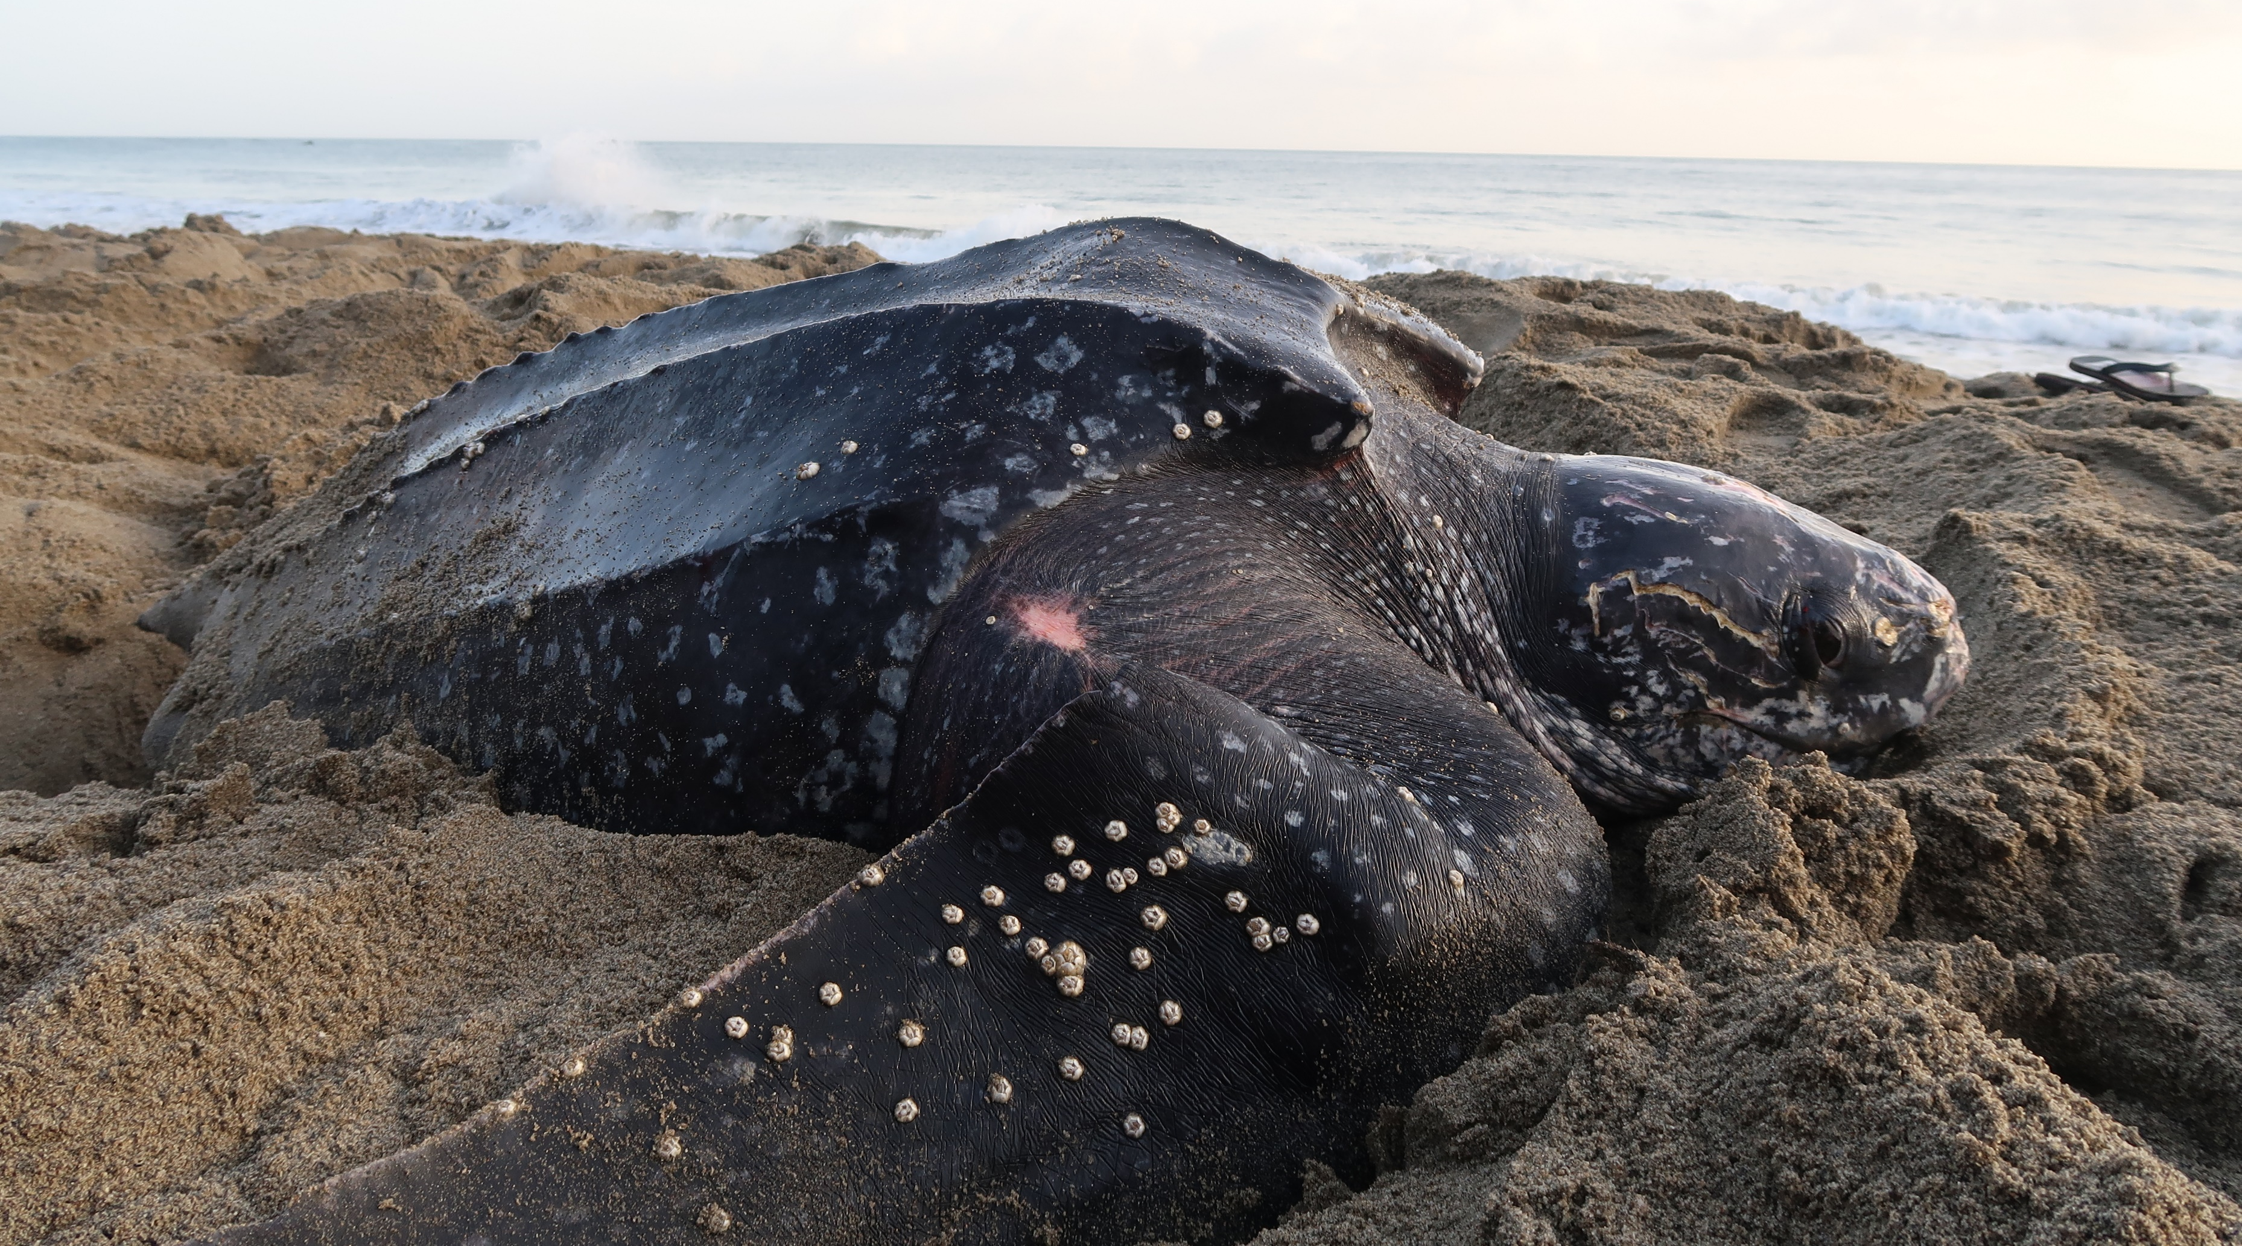
Leatherback turtle
© William Farah via Shutterstock
The leatherback turtle is the largest turtle, usually about 2 metres long. They get their name from the black, leathery skin that covers their carapace. Leatherbacks are the most common turtle species in the UK.

Slide 3
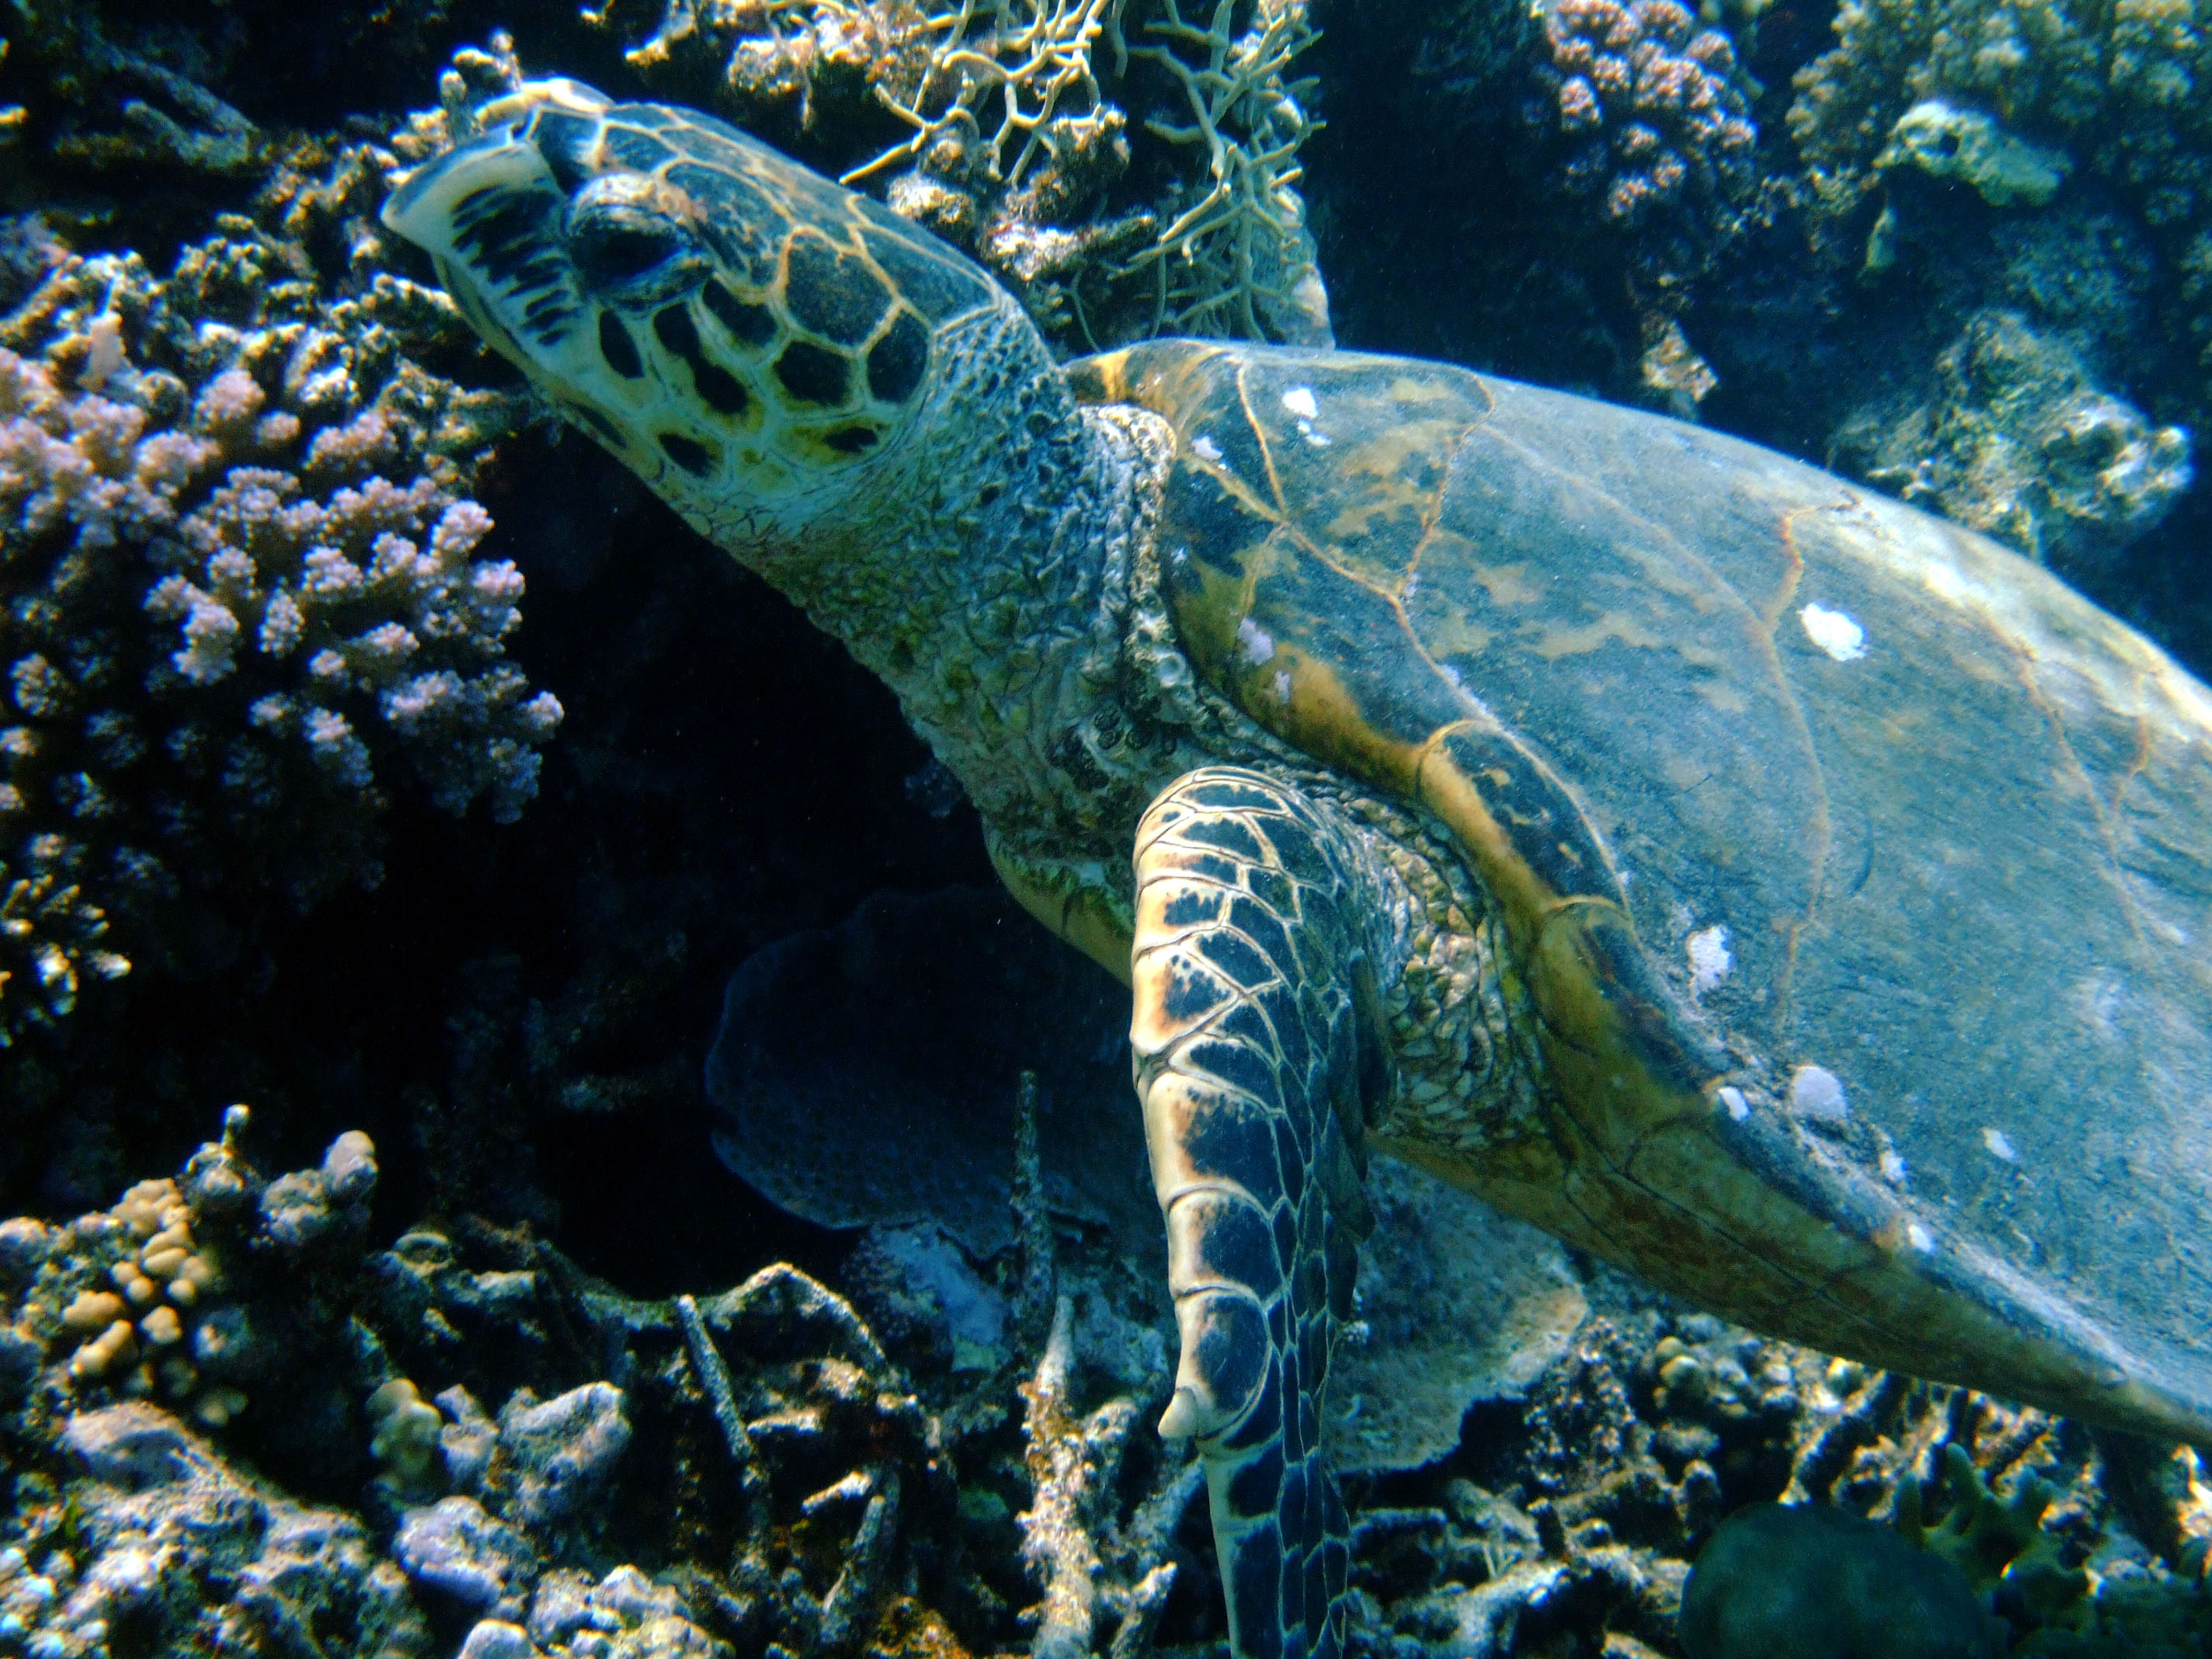
Hawksbill turtle
© MCS/Jonathan Kinnair
Hawksbill turtles have long been hunted for their beautiful shells, and are now critically endangered. They have a narrow head and a long, tapered beak like a bird of prey, hence the name.

Slide 4
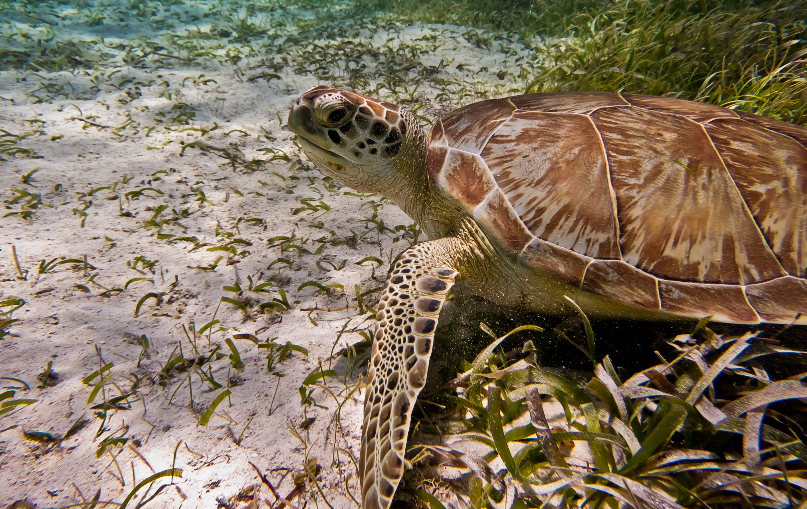
Loggerhead turtle
© MCS/Tim Fanshawe
Loggerhead turtles are named after their very large heads. They have powerful jaw muscles and a large beak for crushing prey such as crabs.

Slide 5
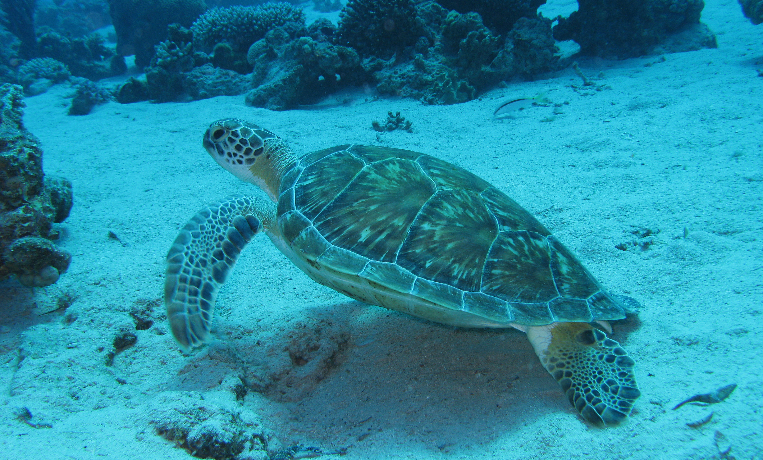
Green turtle
© prilfish via Flickr
Green turtles were once hunted for turtle soup, and their name comes from a green fat which is the main ingredient in the soup. Adult green turtles feed on seagrass and algae.

Slide 6
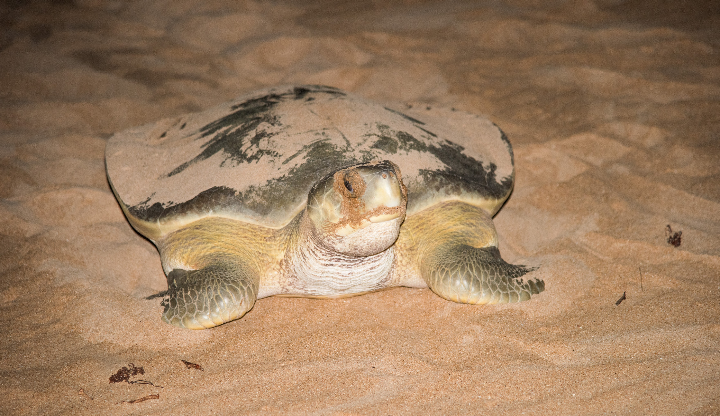
Flatback turtle
© EA Given via Shutterstock
Flatback turtles, as the name suggests, have a flattened carapace. They are only found in Australia and New Guinea.

Slide 7
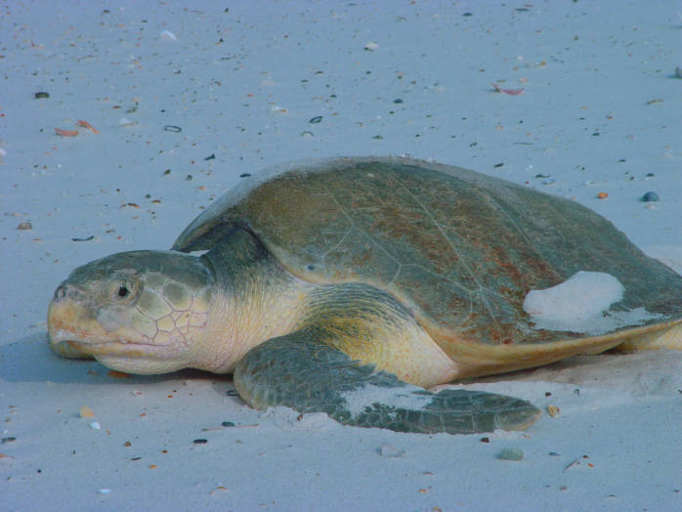
Kemps Ridley turtle
© USFWS Endangered Species via Flickr
The Kemps Ridley turtle is the rarest marine turtle. They were nearly extinct in the 1980s but through conservation efforts, their numbers are increasing.

Slide 8
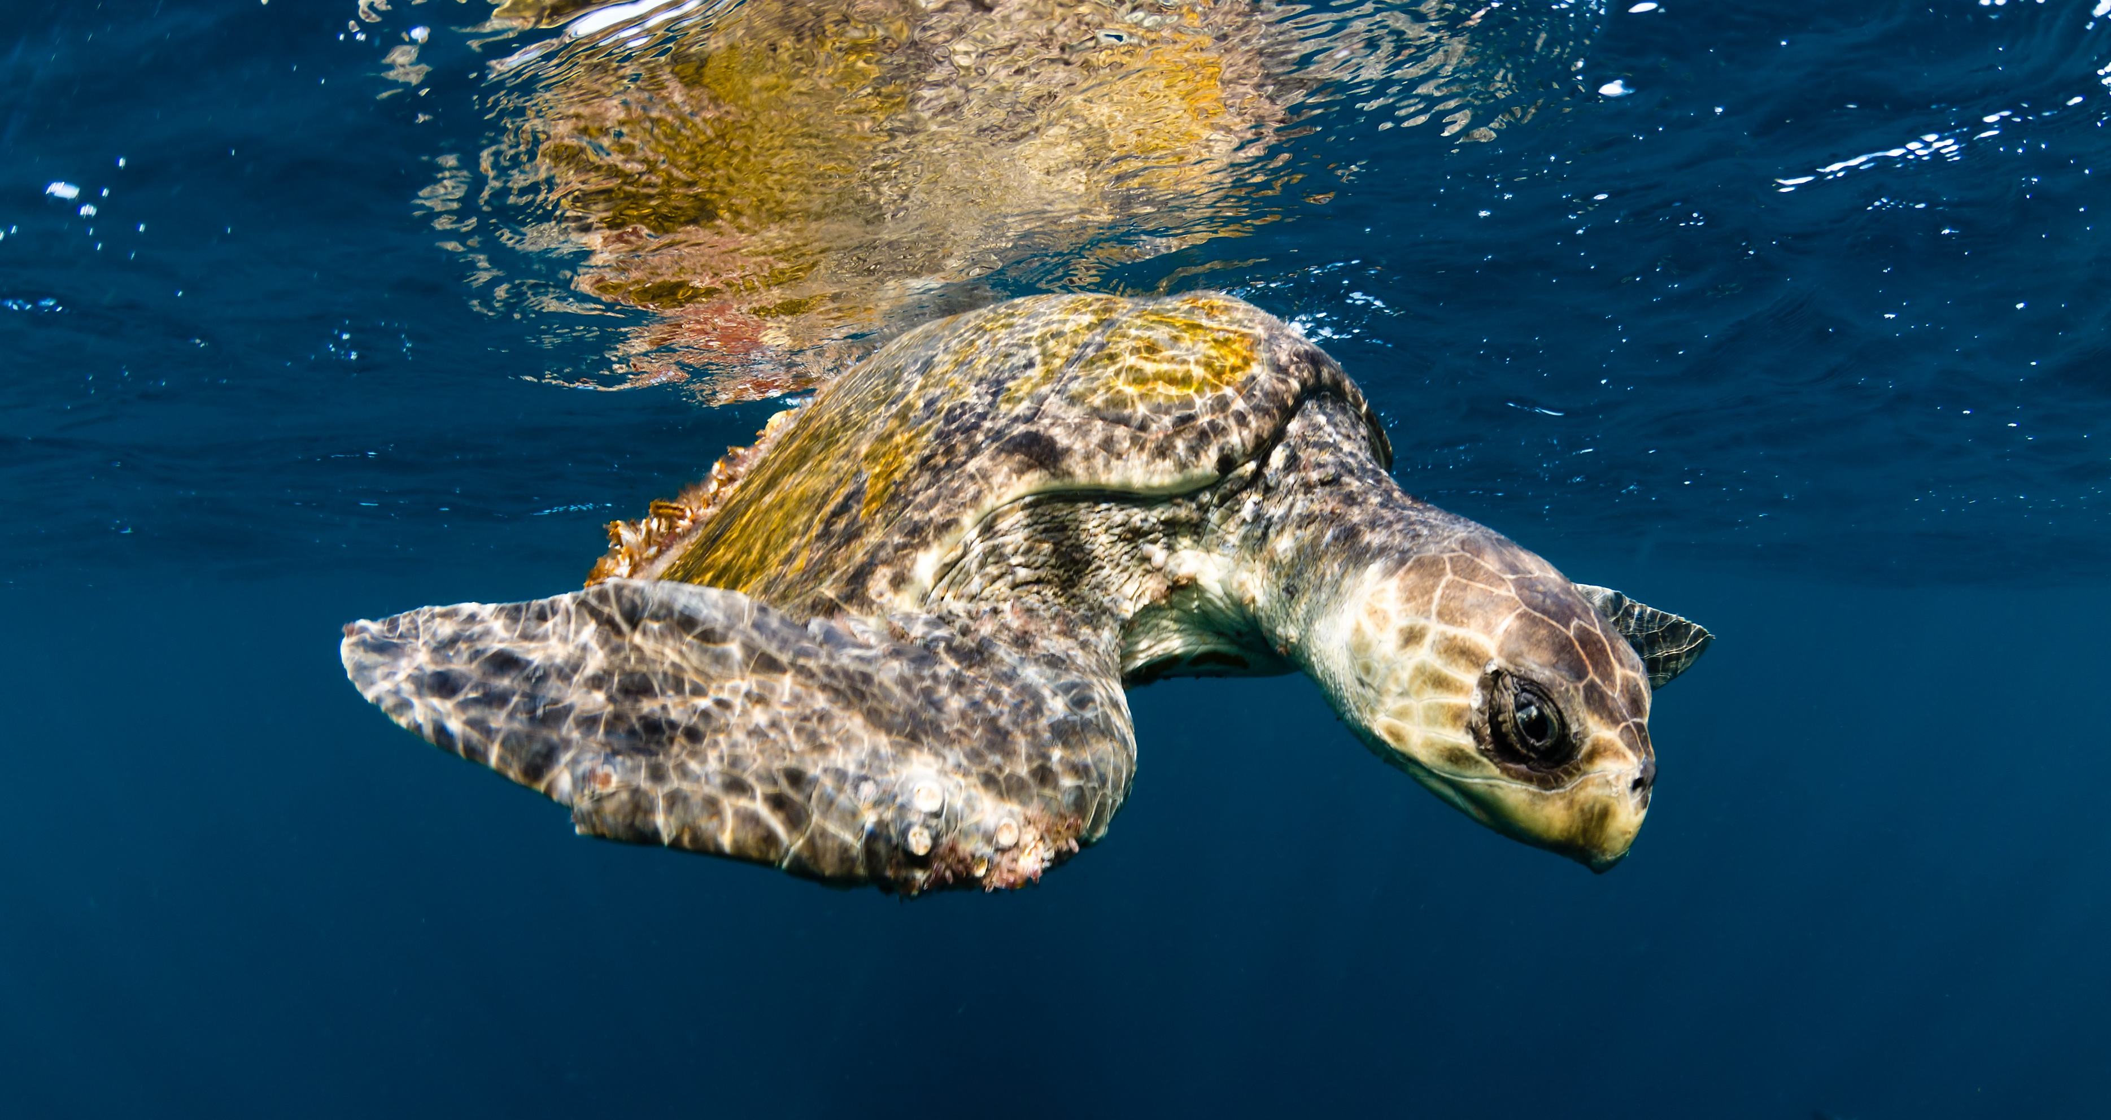
Olive Ridley turtle
© Joost van Uffelen via Shutterstock
The Olive Ridley turtle has an olive green carapace. Thousands of females come to shore at the same time to nest simultaneously.

Slide 9
Threats to turtles

Slide 10
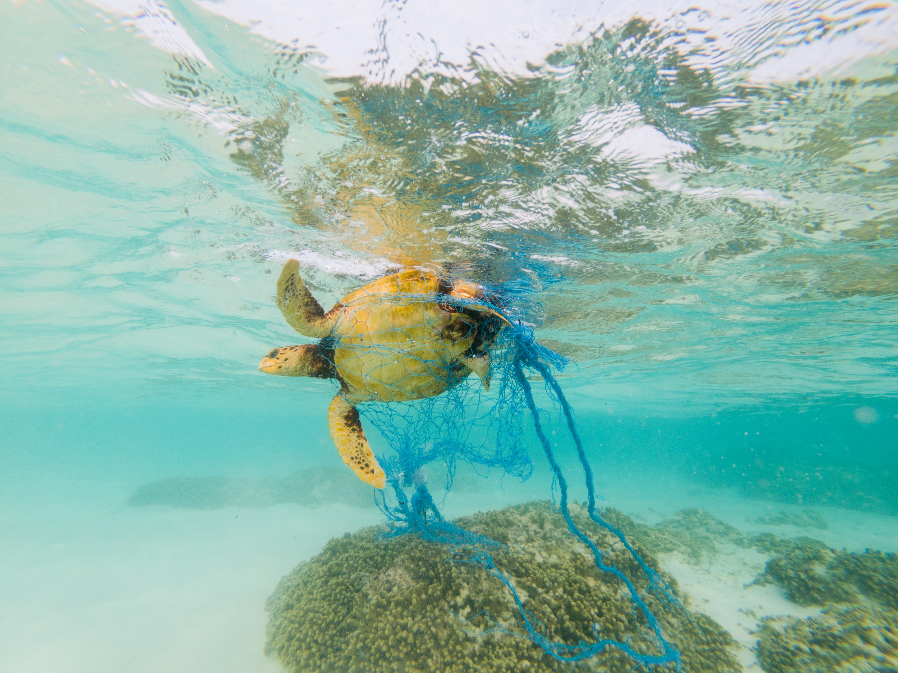
Entanglement
in fishing gear
All species of turtle are susceptible to accidental capture in fishing gear, a phenomenon known as bycatch.
They could be entangled in nets during fishing or in discarded net, for example. Longline fishing methods are particularly impactful, and in the year 2000 alone, over 200,000 loggerhead turtles were caught as longline bycatch. (1)
Green turtle entangled in fishing net © Mohamed Abdulraheem via Shutterstock
1. Lewison et al 2004

Slide 11
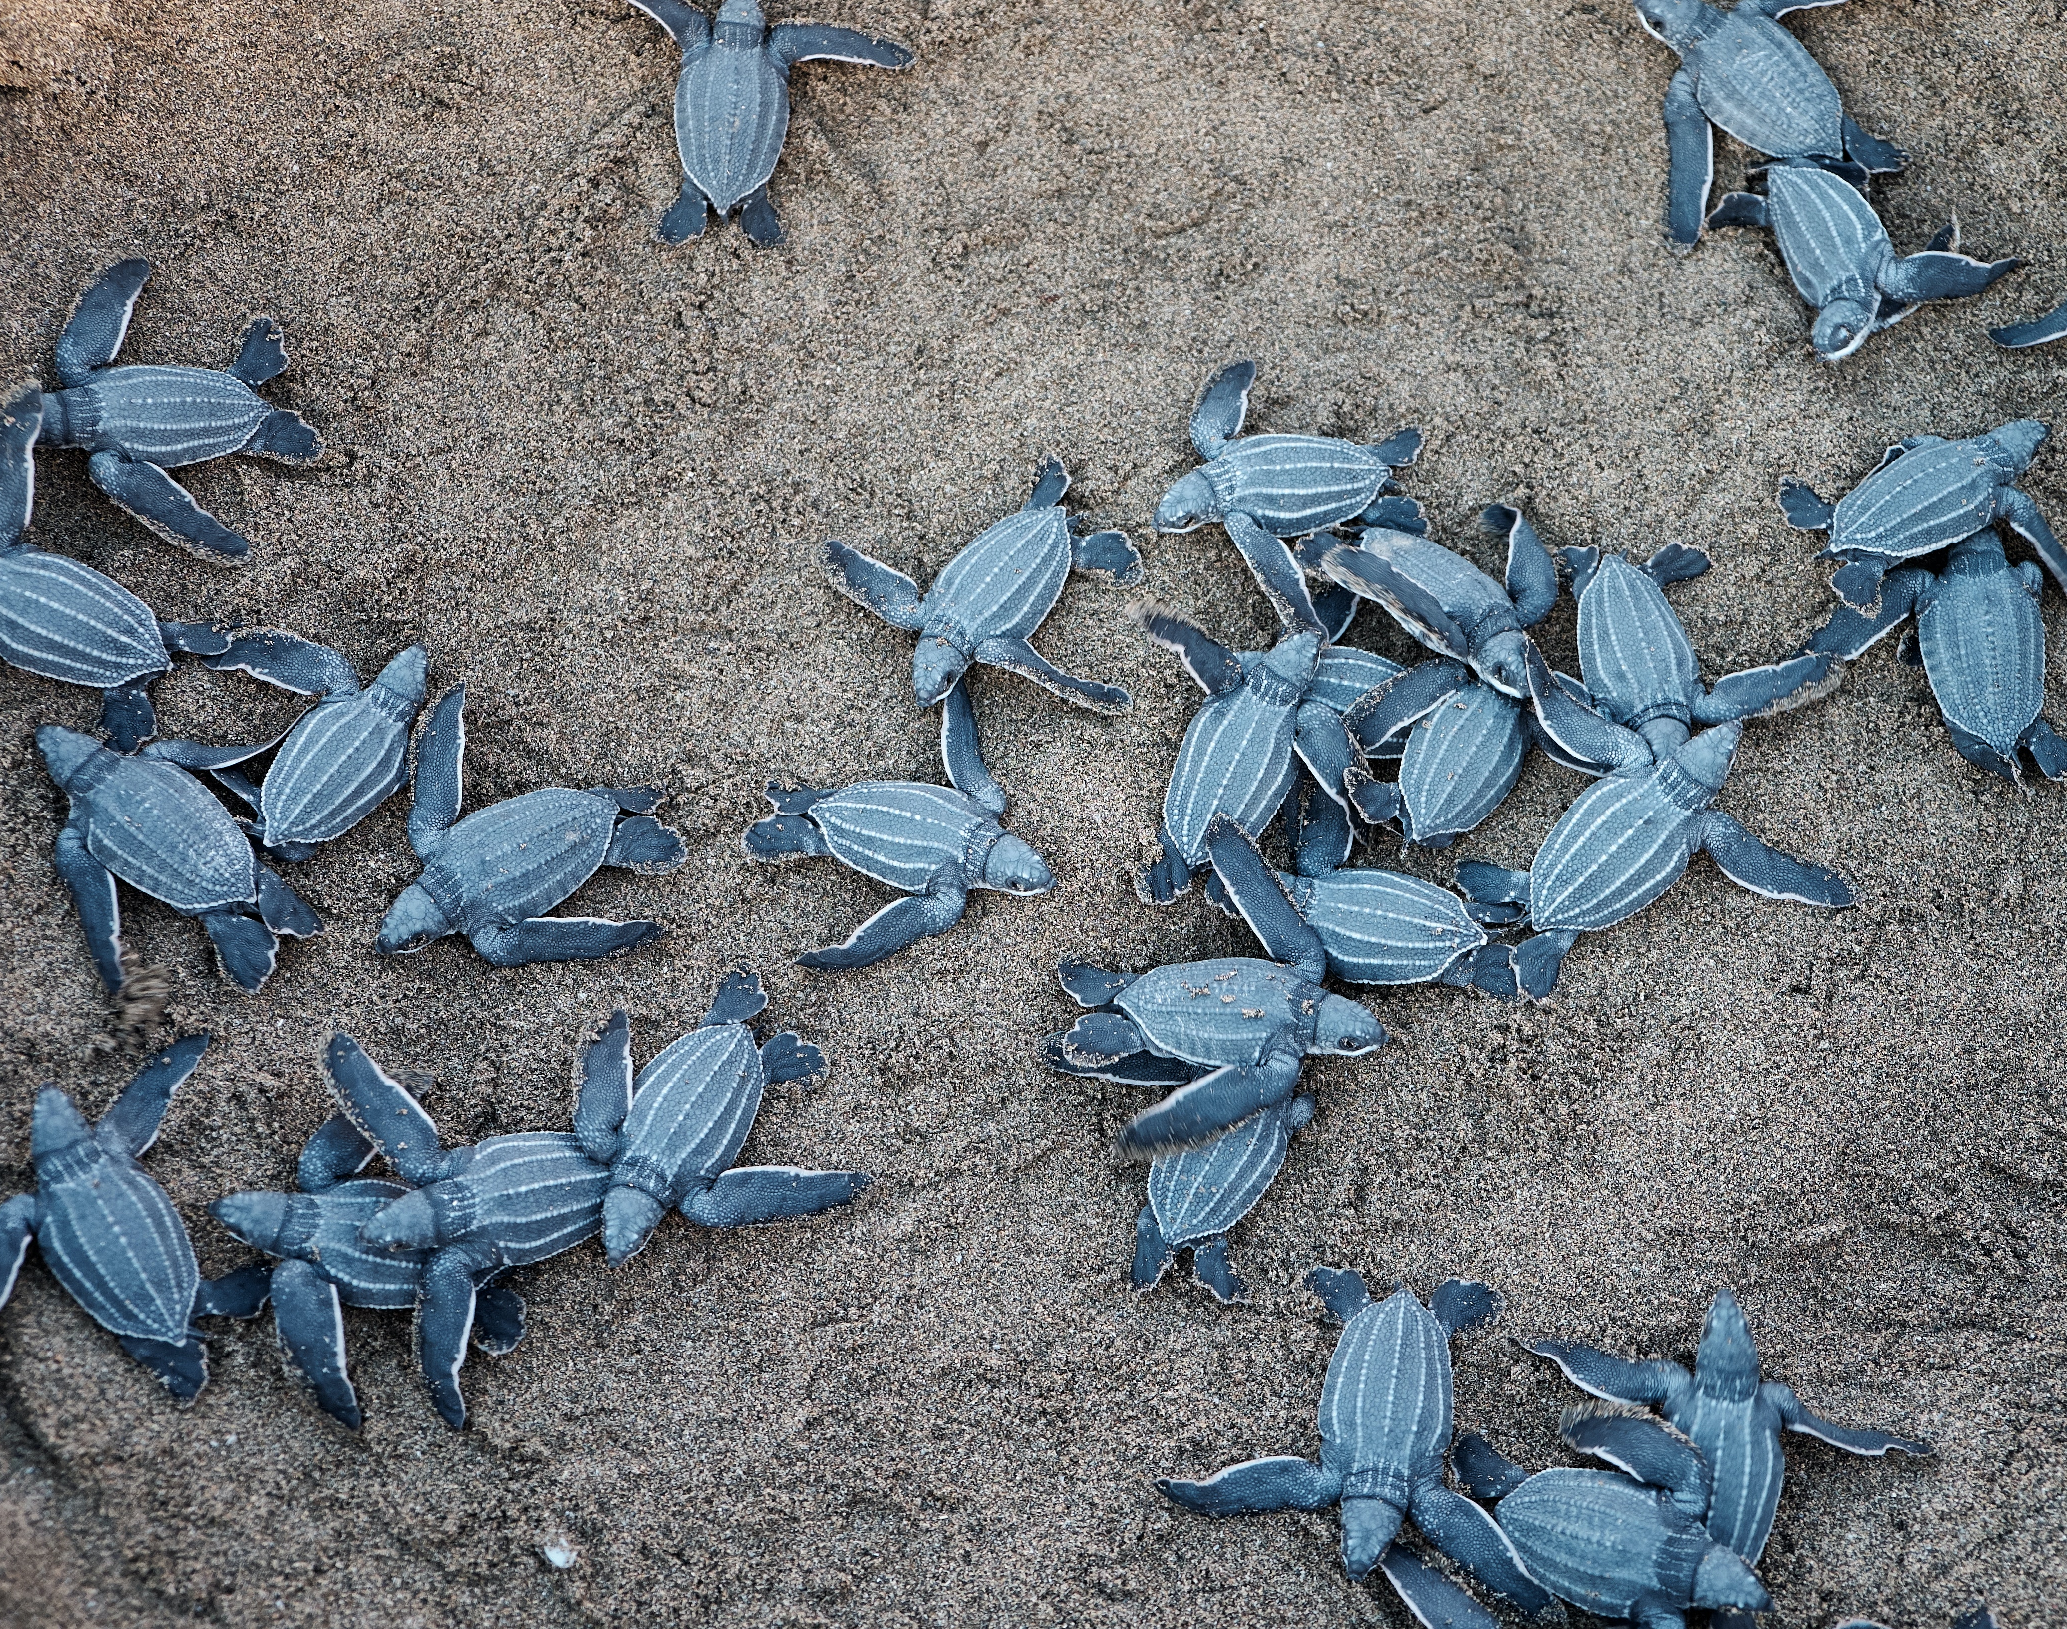
Use of turtle eggs, meat and shells
Turtles are still legally harvested for their meat in four of the five UK Overseas Territories in the Caribbean.
Extensive turtle egg collection is thought to have been a significant factor in the decline of several marine turtle populations around the world. world. We’ve been working with communities in the Caribbean to protect turtles over a certain shell length so that they’re able to mature and reproduce.
In many parts of the world, hawksbill turtles are targeted for the scales on their shells, which are used to make ‘tortoisehell’ decorations and jewellery.
Turtle hatchlings © Jolo Diaz via Pexels

Slide 12
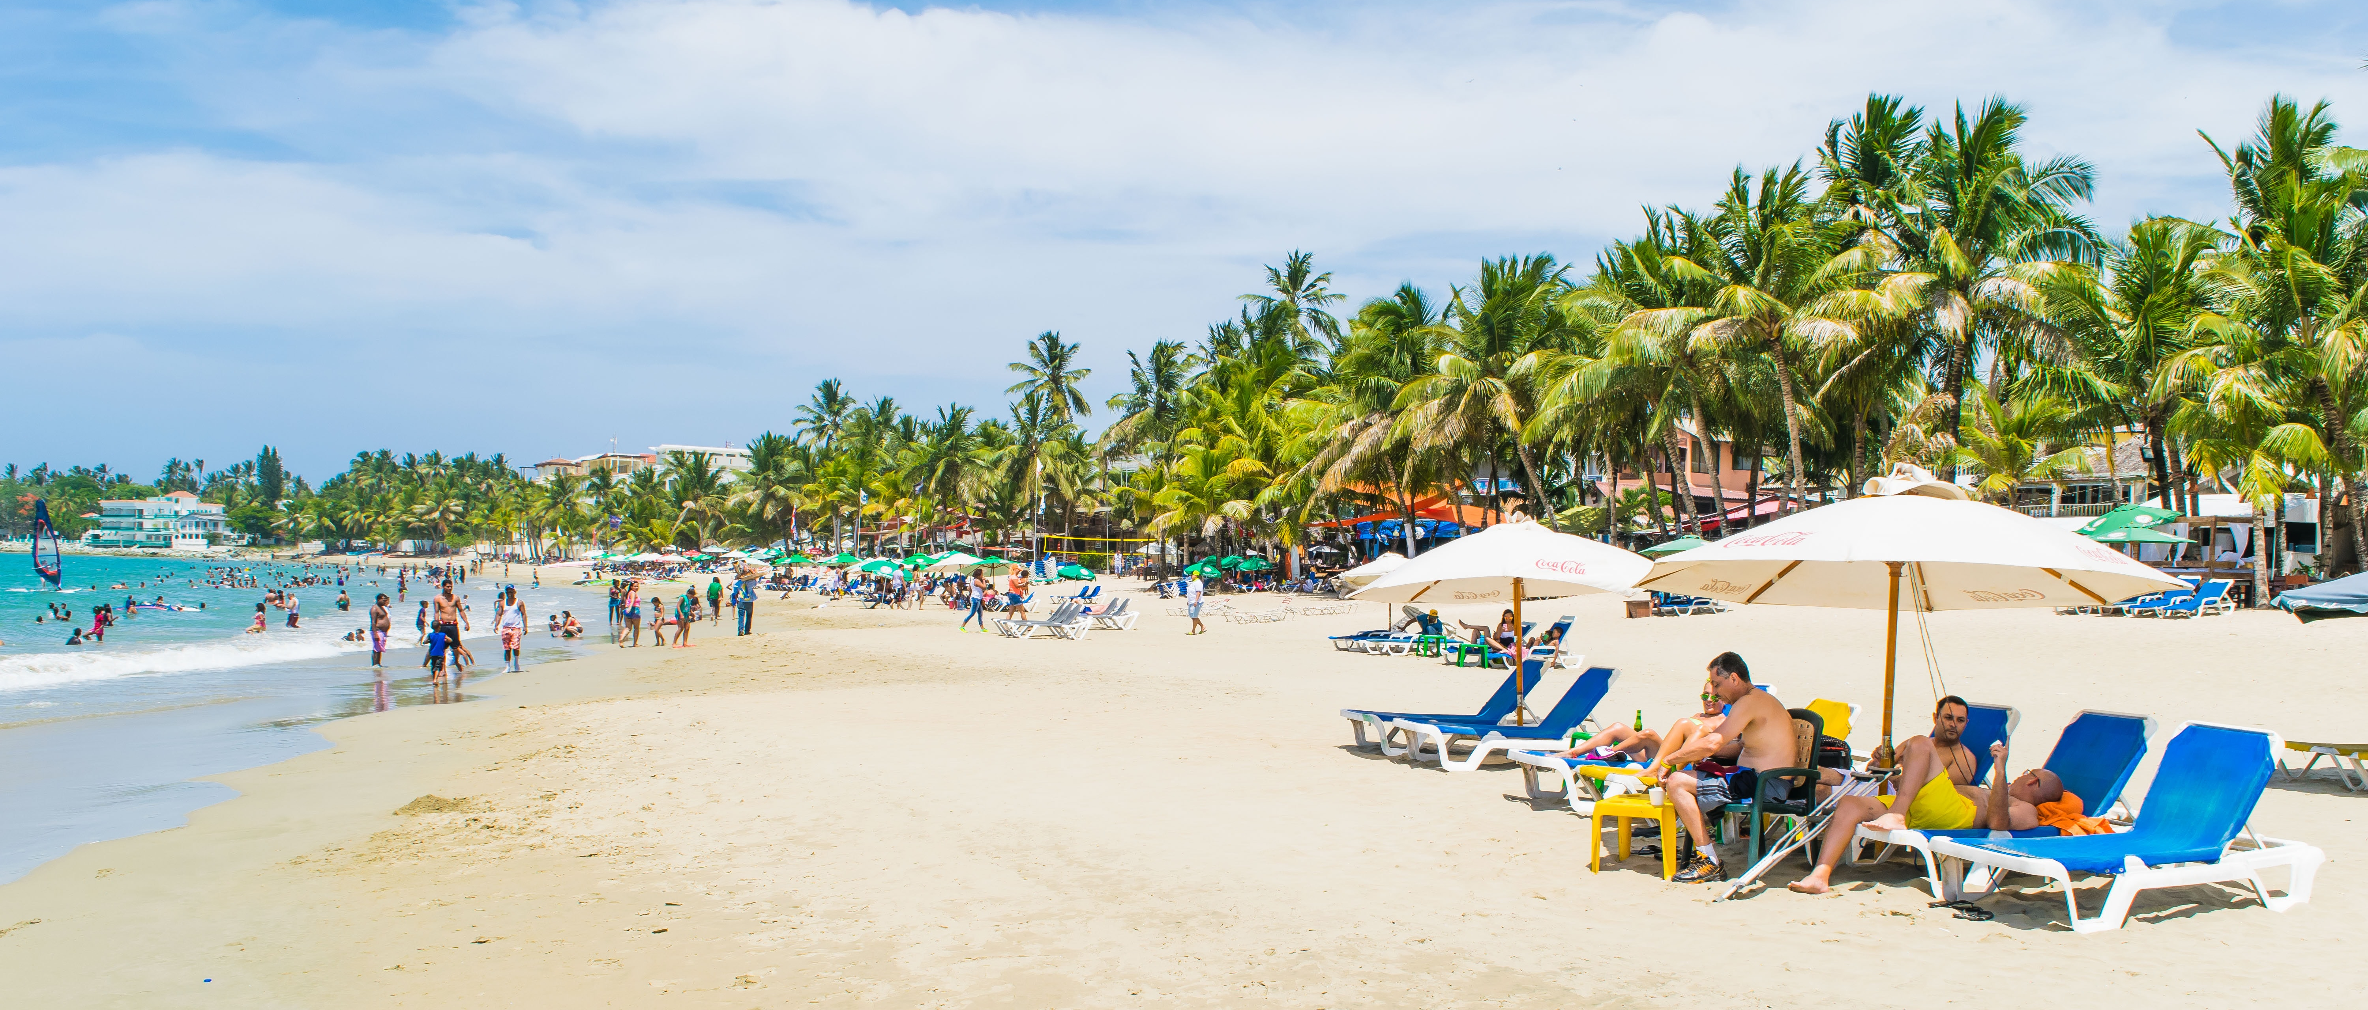
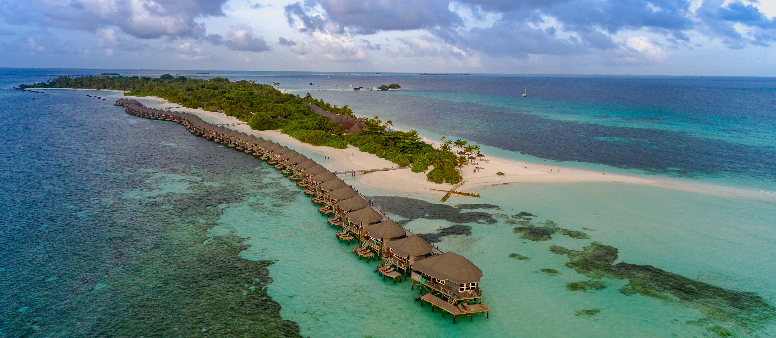
Habitat disturbance
Turtle nesting beaches are under pressure from development, especially from the tourism industry.
Light pollution also disorientates emerging hatchlings, making them head inland to artificial light sources rather than out to sea.
Boat traffic can also damage seagrass beds and coral reefs, which are important turtle feeding habitats.
© Joel Casilla via Unsplash
© dronepicr via Flickr

Slide 13
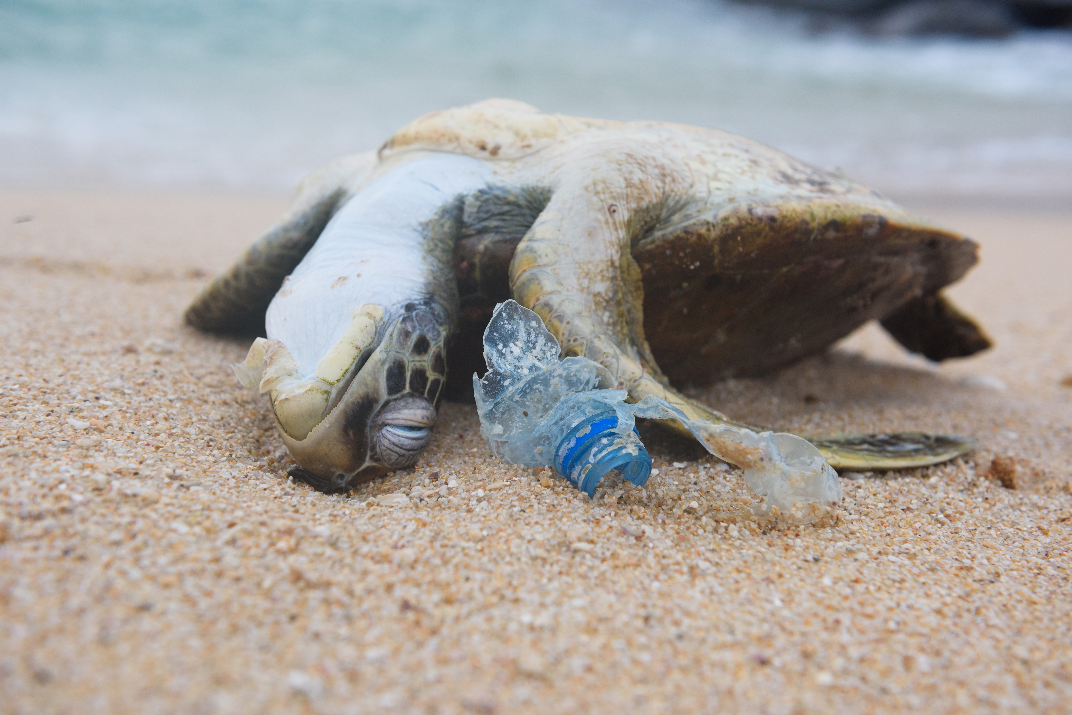
Pollution
Chemical pollution like oil spills and sewage can directly affect marine turtles if they’re exposed to high levels.
It can also lead to contamination of their feeding habitats and nesting beaches.
Turtles are also killed by entanglement in, and ingestion of, marine litter, like discarded fishing gear, plastic bags and balloons.
Turtle and plastic bottle © nevodka via Shutterstock

Slide 14
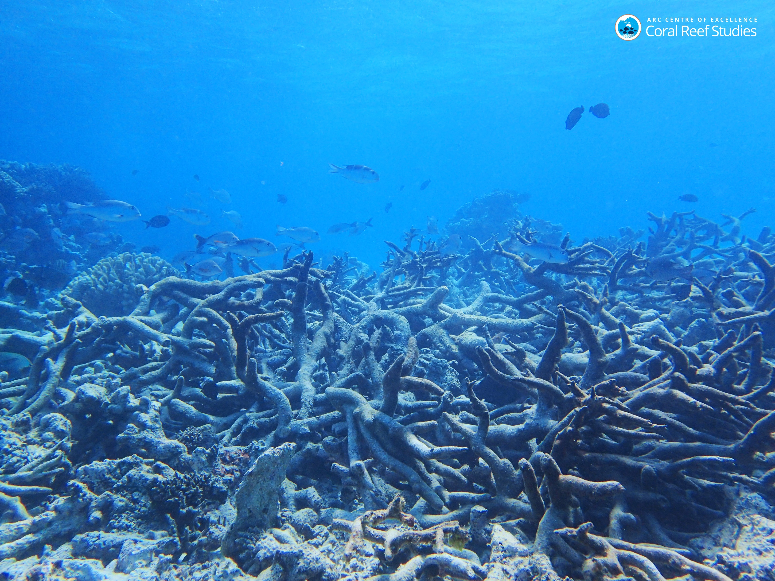
Climate change
Dead coral reef © ARC Centre of Excellence for Coral Reef Studies via Flickr
Turtle nesting beaches could be inundated with water due to sea level rise if they’re prevented from moving inland as a result of coastal development.
Foraging habitats like tropical coral reefs and seagrass beds are likely to be affected by rising sea temperatures, rising sea levels, ocean acidification and the effects of increased storms and rainfall.
Rising temperatures will also affect the sex ratios of turtles. Higher nest temperatures produce female turtles and lower temperatures produce male turtles. Due to warming temperatures, some beaches are now producing 99% female hatchlings. (2)
2. Jensen et al 2017

