Slide 1
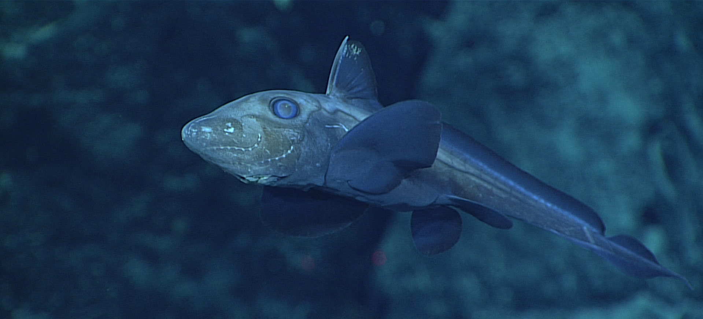
Life in the Deep Image Reel
Ghost fish at around 1850m. Image: NOAA Ocean Exploration & Research

Slide 2
Deep Sea Zones
Sunlight Zone – This is the top layer of the ocean. In this zone there is enough sunlight for plants to grow.
Twilight zone - A small amount of light can reach this zone but not enough for plants to grow.
Midnight zone – There is no natural light at all below 1000 meters and this zone is complete dark.

Slide 3
Dark waters
Some animals have adapted to have huge eyes or produce their own light.
At extreme depths some animals have adapted to have tiny eyes, and even no eyes, as there’s no need to use them. Instead they use tactile and sensory clues to find food.

Slide 4
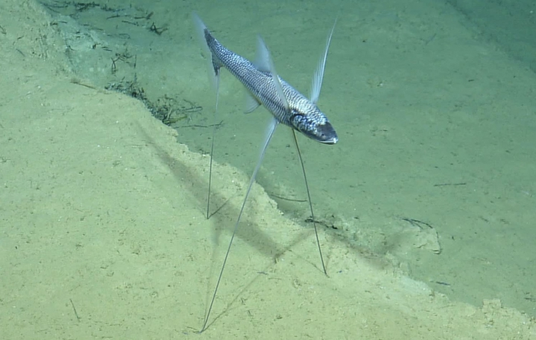
Dark - Tripod fish
Image: Ocean Exploration Trust
Tripod fish use their long front fins to feel for food. They then use these fins like hands to guide the food to their mouth.

Slide 5
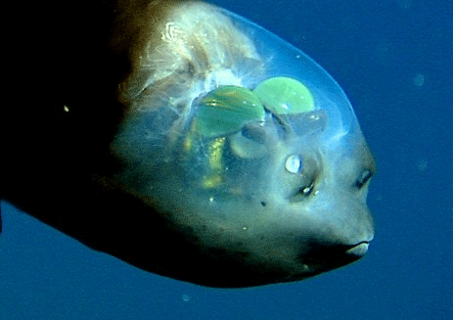
Dark - Spookfish
Image: GreenAnswers.com via Flickr
Spookfish have highly sensitive, cylindrical eyes to help them look up as well as forward.

Slide 6
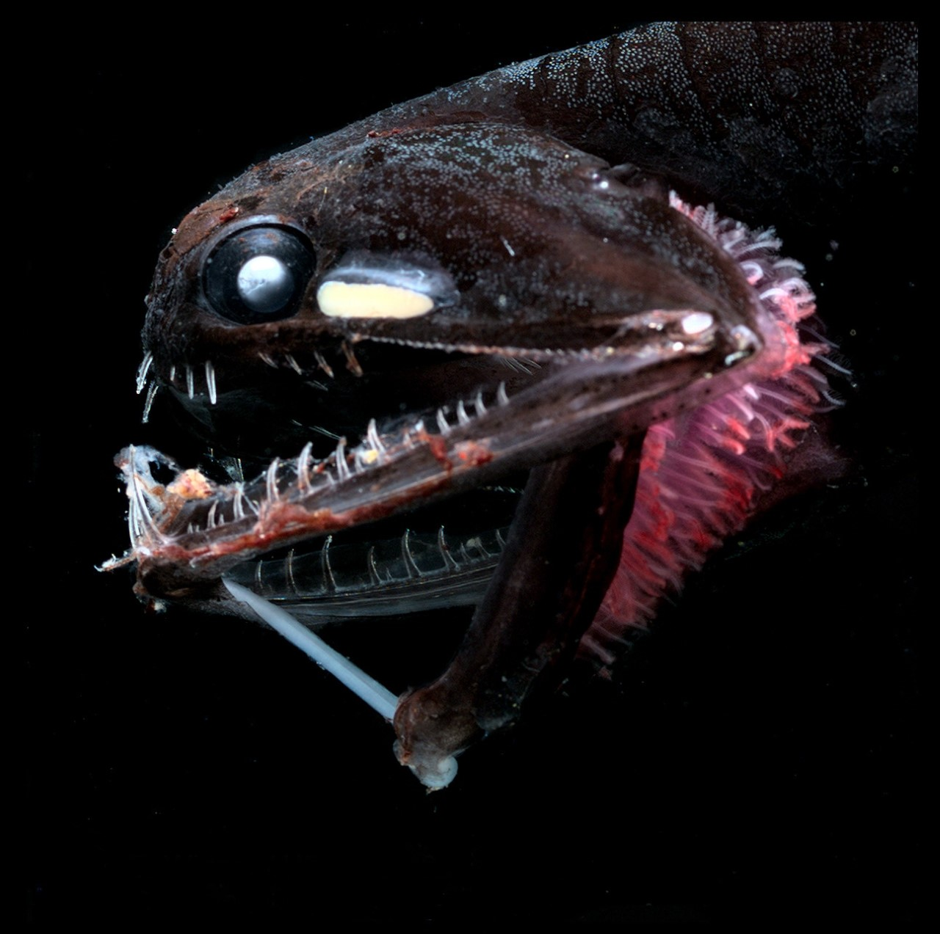
Dark - Bioluminescence
Image: Edith Widder
Photostomias species are named after the Greek for photo, meaning light, and stoma meaning mouth, because they have a light organ behind their mouths. They are able to emit red light which makes them invisible to predators, but aids their vision.

Slide 7
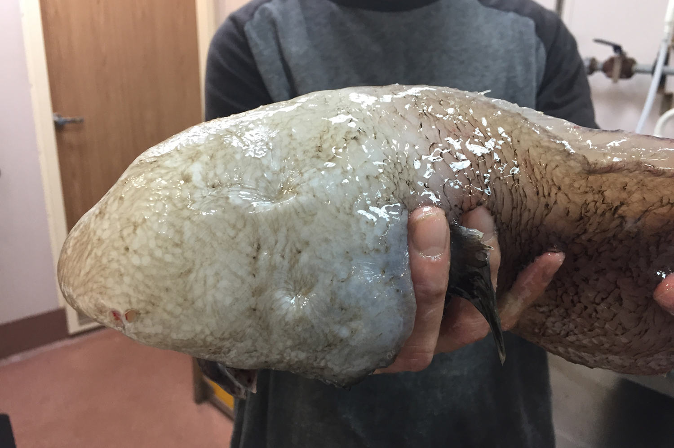
Dark - Faceless Cusk Eel
Image: Dianne Bray, Museums Victoria
At extreme depths, some animals have adapted to have tiny eyes and even no visible eyes at all like the faceless cusk eel. Their latin name Typhlonus nasus comes from the Greek, Typhlos (blind) onous (hake), and nasus (nose) due to their large nostrils.

Slide 8
High pressure
The deeper in the ocean you travel, the greater the pressure becomes, because of the weight of the water above.
In the Mariana Trench the pressure is approximately 1000 times greater than at sea level.

Slide 9
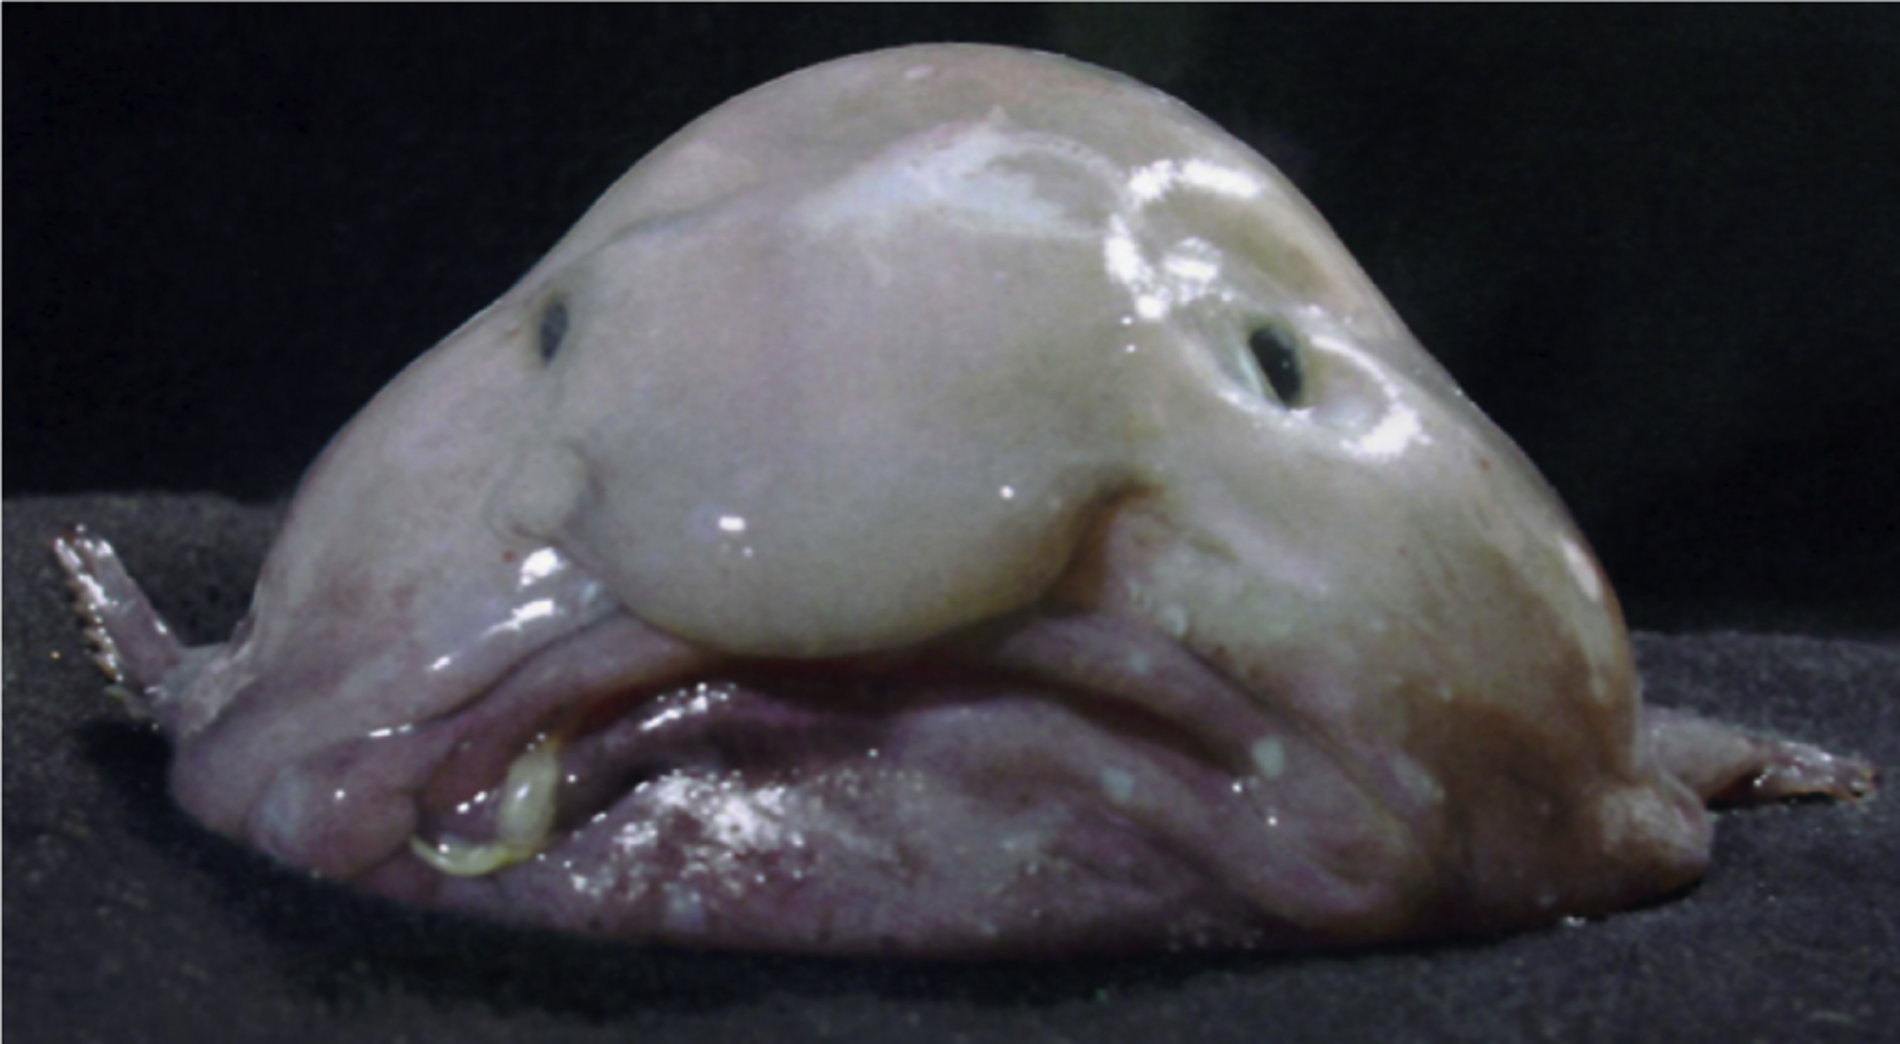
Pressure – Blobfish
Image: James Joel via Flickr
The Blobfish has been voted the world’s ugliest fish! Their bodies are gelatinous to withstand high pressure. When the pressure compresses their bodies in the deep, they appear quite fish-like in shape. But if brought to the surface for study purposes, their bodies relax without that pressure, and turn into a gelatinous blob.

Slide 10
Cold waters
The lack of sunlight in the deep means the water temperature is very cold.
One adaptation to cold temperatures seen in animals all over the world is to grow larger, which is referred to as the Bergmann's rule.
Large animals have greater fat reserves to keep them warm and they have a lower surface to volume ratio to reduce heat loss.

Slide 11
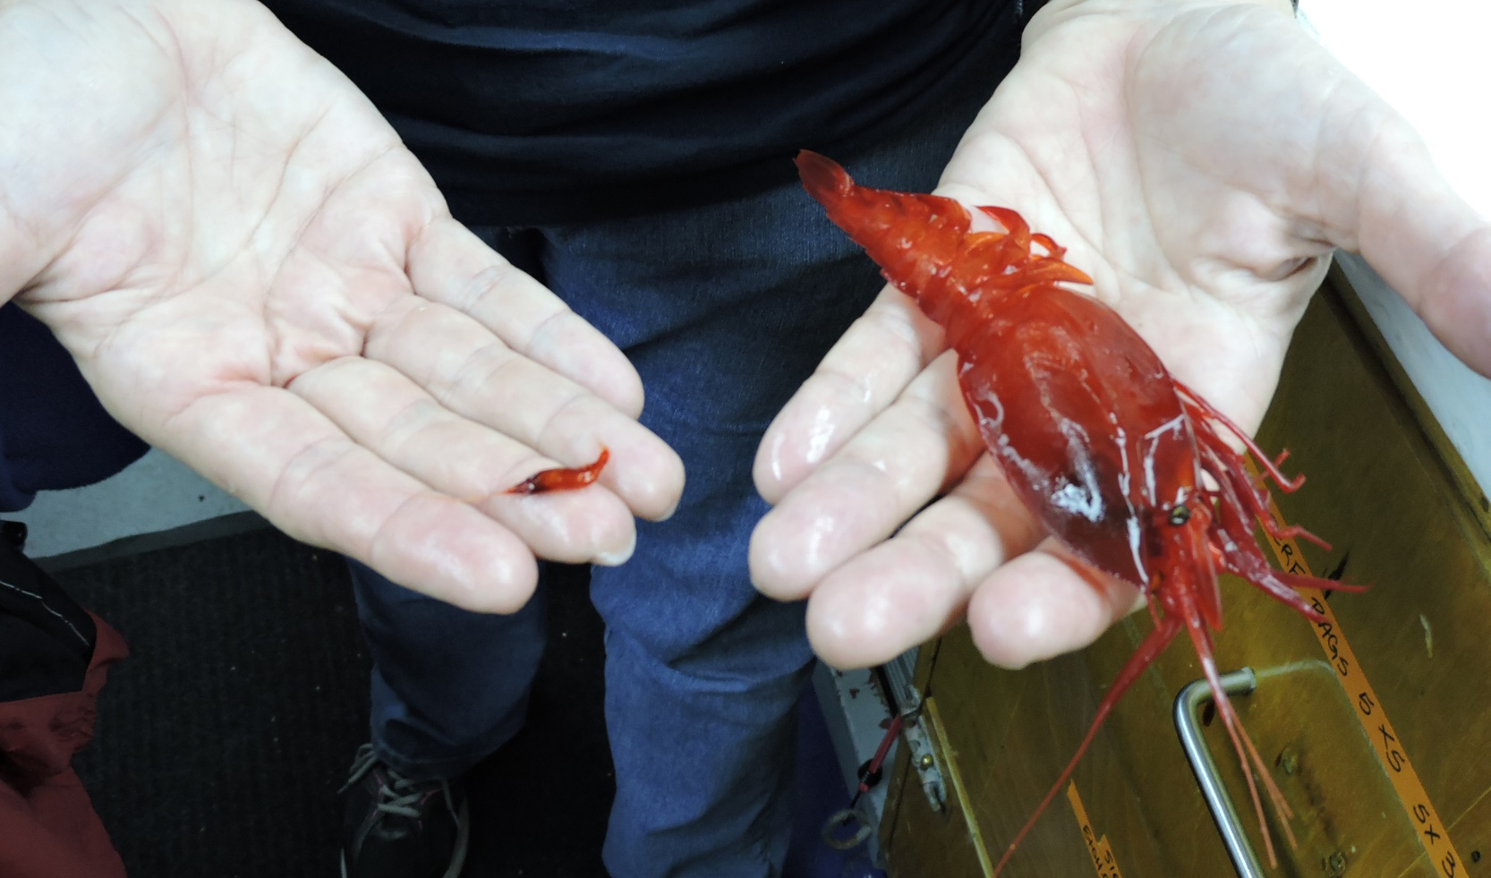
Cold – Deep sea shrimp
© NOAA Photo Library via Flickr
Image: NOAA Photo Library Journey into Midnight: Light and Life Below the Twilight Zone
This image shows the size comparison of a ‘normal’ shrimp from the twilight zone (up 1000 meters below sea level) and ‘giant’ shrimp from the midnight zone (1000–4000 meters below sea level).

Slide 12
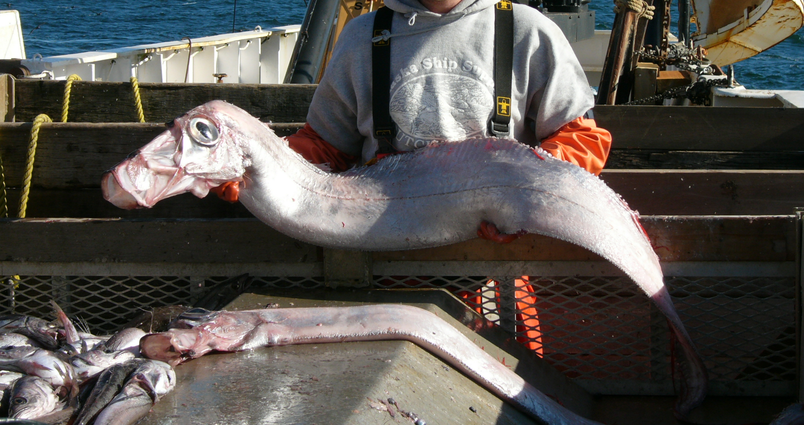
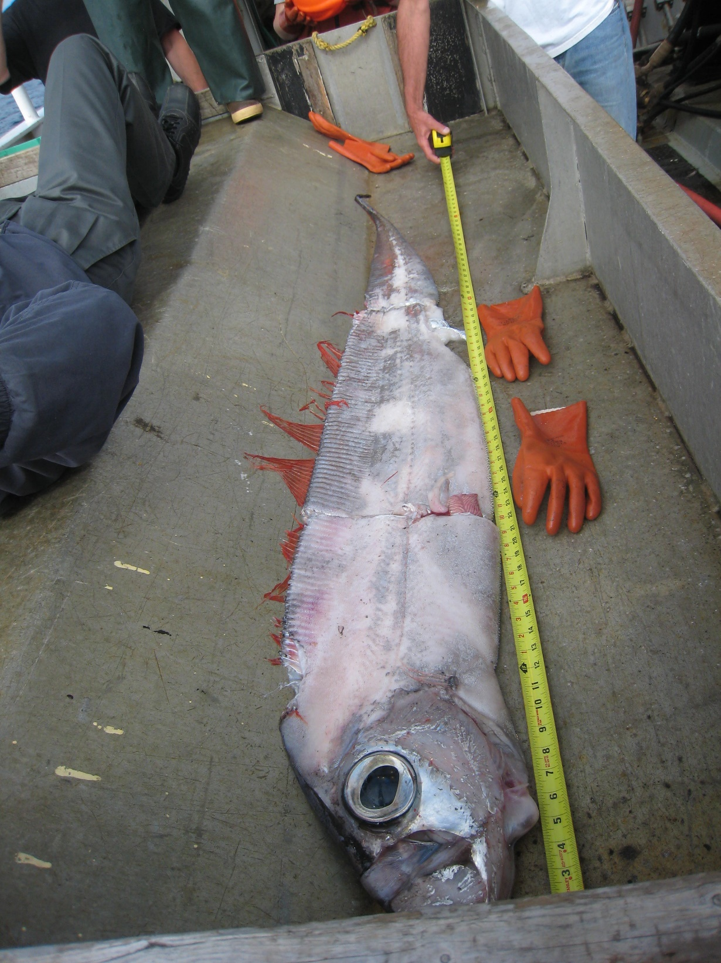
Cold - Giant oarfish
Image: NOAA Photo Library via Flickr
Image: NOAA Photo Library via Flickr
Giant oarfish are the longest bony fish in the world. They don’t have teeth because they are filter feeders. Their pectoral fins look like oars. They don’t have scales like most fish, but instead they have a slimy material called guanine.

Slide 13
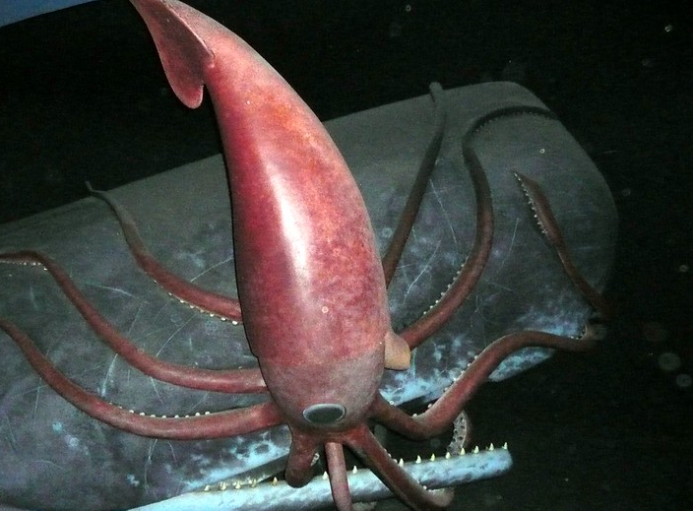
Cold - Colossal squid
Image: Shih-Pei Chang via Flickr
Colossal squid live in the deep ocean around Antarctica. They are the largest invertebrate on Earth with the largest eyes in the world. Even though they’re huge, they still have predators and are the favourite food of sperm whales.

Slide 14
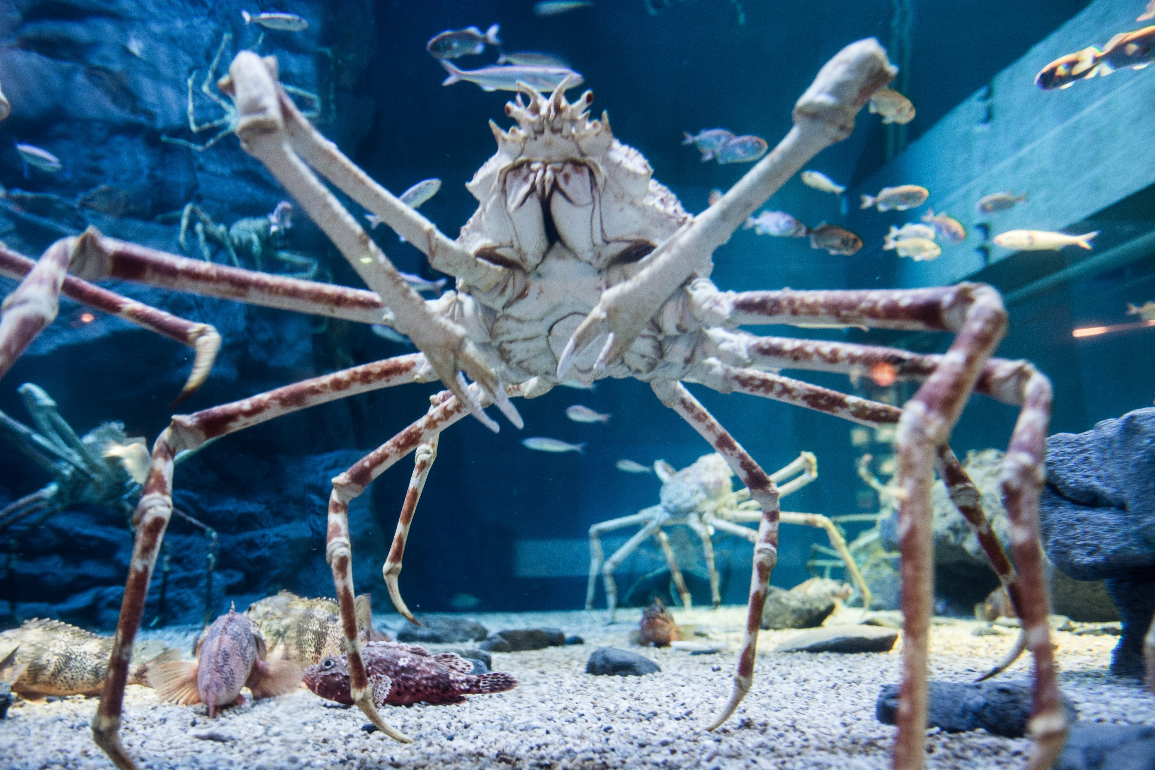
Cold - Japanese spider crab
Image: Takashi Hososhima via Flickr
Japanese spider crabs live in the Pacific Ocean near Japan. They live in waters up to 200 metres deep, but move to shallower water (around 50 meters deep) to breed.

Slide 15
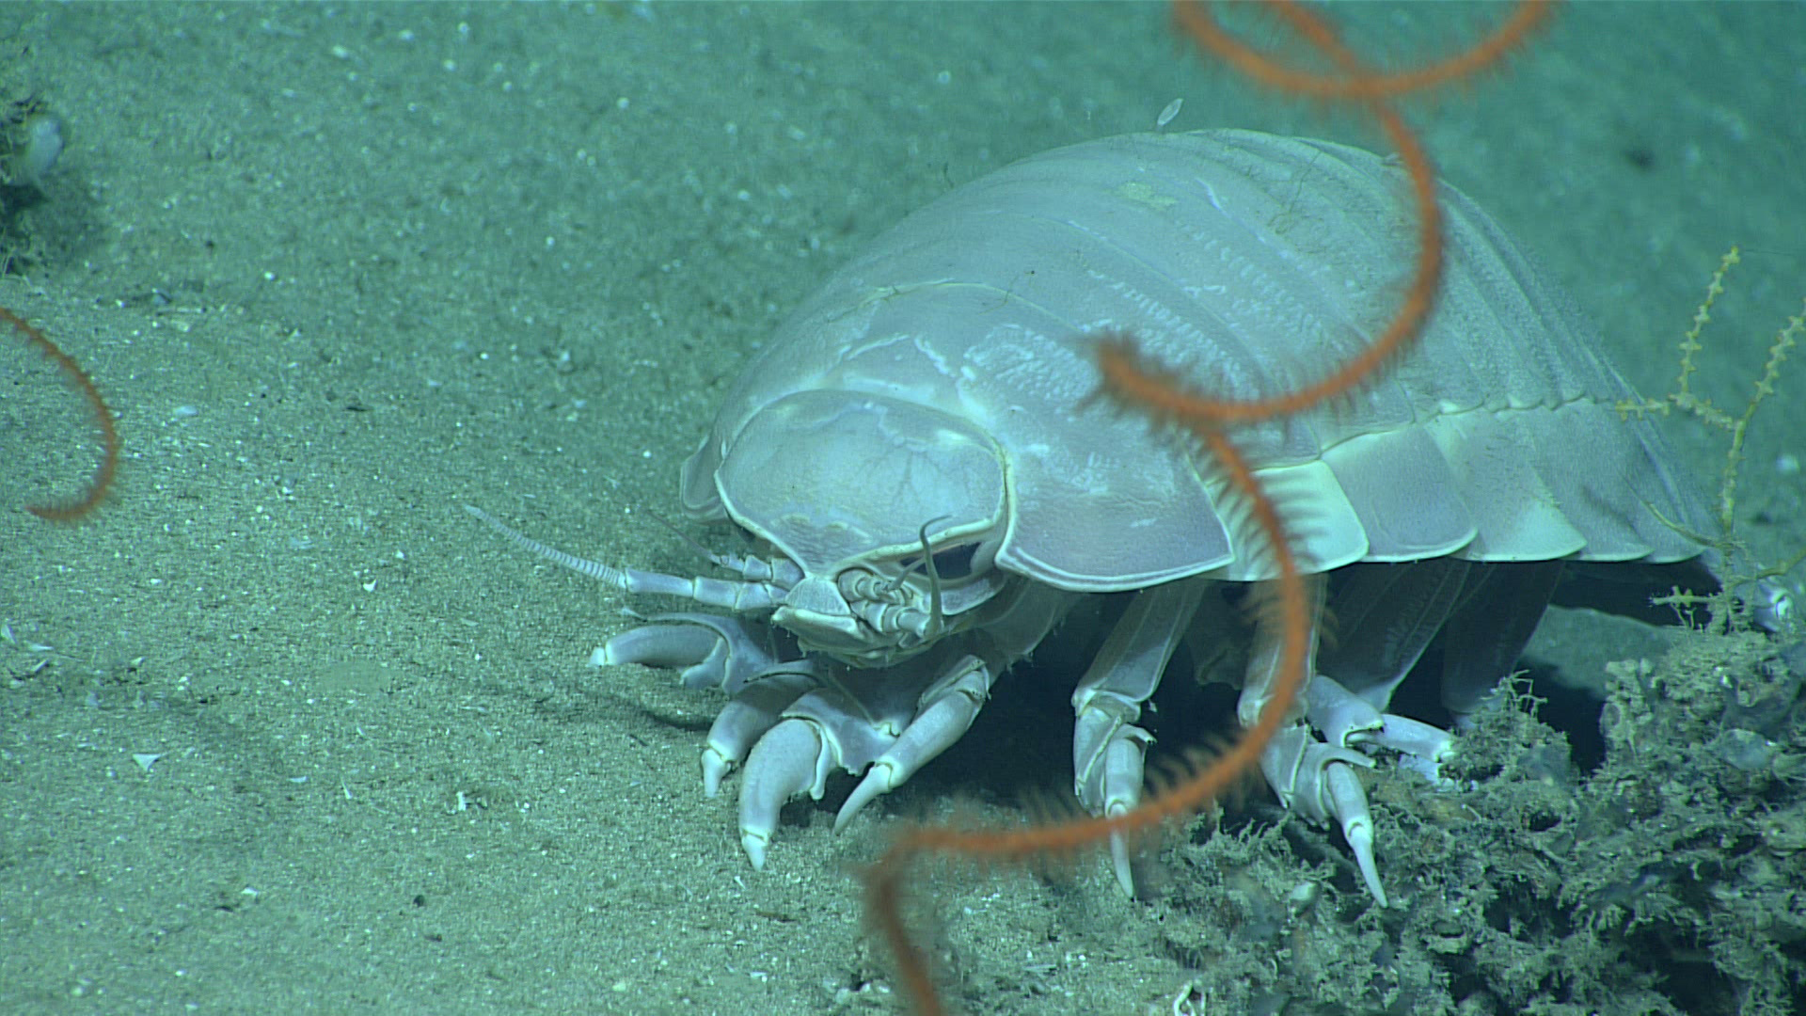
Cold - Deep sea isopod
Giant isopod. Image: NOAA Ocean Exploration & Research via Flickr
Deep sea isopods are crustaceans that look similar to a woodlouse. A typical isopod in shallower waters can measure up to 5cm, whereas a giant deep sea isopod can measure up to 15cm and a supergiant species up to 50cm. Though this might still sound small, it is a huge size difference between shallow and deep water species.

Slide 16
Searching for food
The deep is a huge vast space and therefore it can be hard to find food.
Animals have adapted in many ways, like eating a variety of food, and eating as much as they can when they have the ability to do so.

Slide 17
Food - Gulper eel
Double click the image to play video
The Gulper eel (also known as pelican eel) has a mouth that can open to 10 times bigger than its own body, which is the biggest mouth to body ratio of any vertebrate.​ Along with an expandable stomach, this means the gulper eel is able to feed on a range of species and not be restricted by size. Watch this video to see it in action.

Slide 18
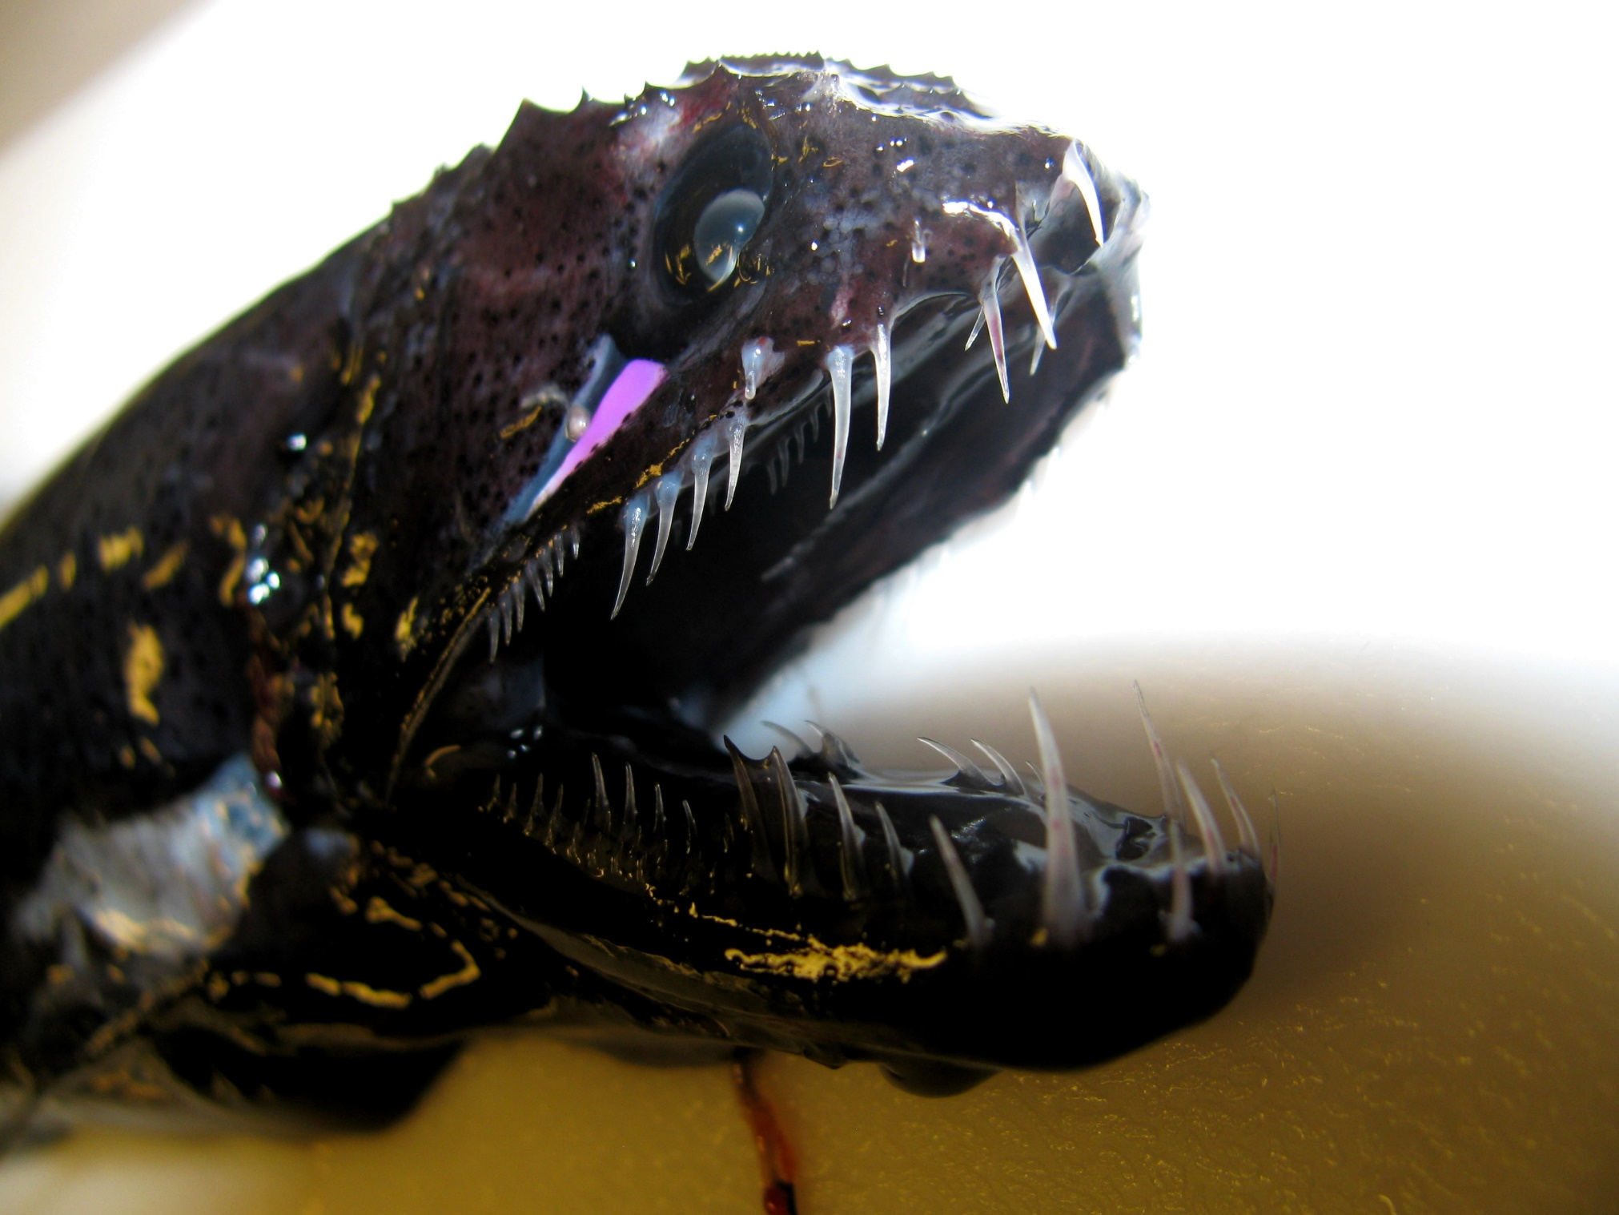
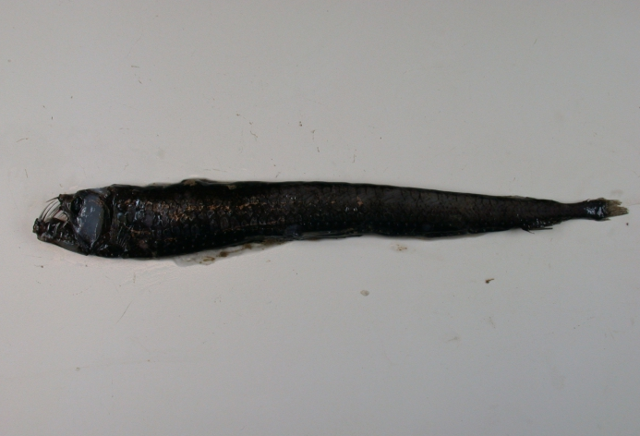
Food - Viperfish
Viperfish (Chauliodus shoani). Image: NOAA Photo Library via Flickr
Chauliodus sloani. Image: Alexei Orlov (orlov@vniro.ru)
Viperfish are best known for having teeth so large they don’t fit inside their mouths. To catch food they first use bioluminescent to lure prey and then swim at high speeds and use their large sharp teeth to grab hold of their prey.
Notes:
​

Slide 19
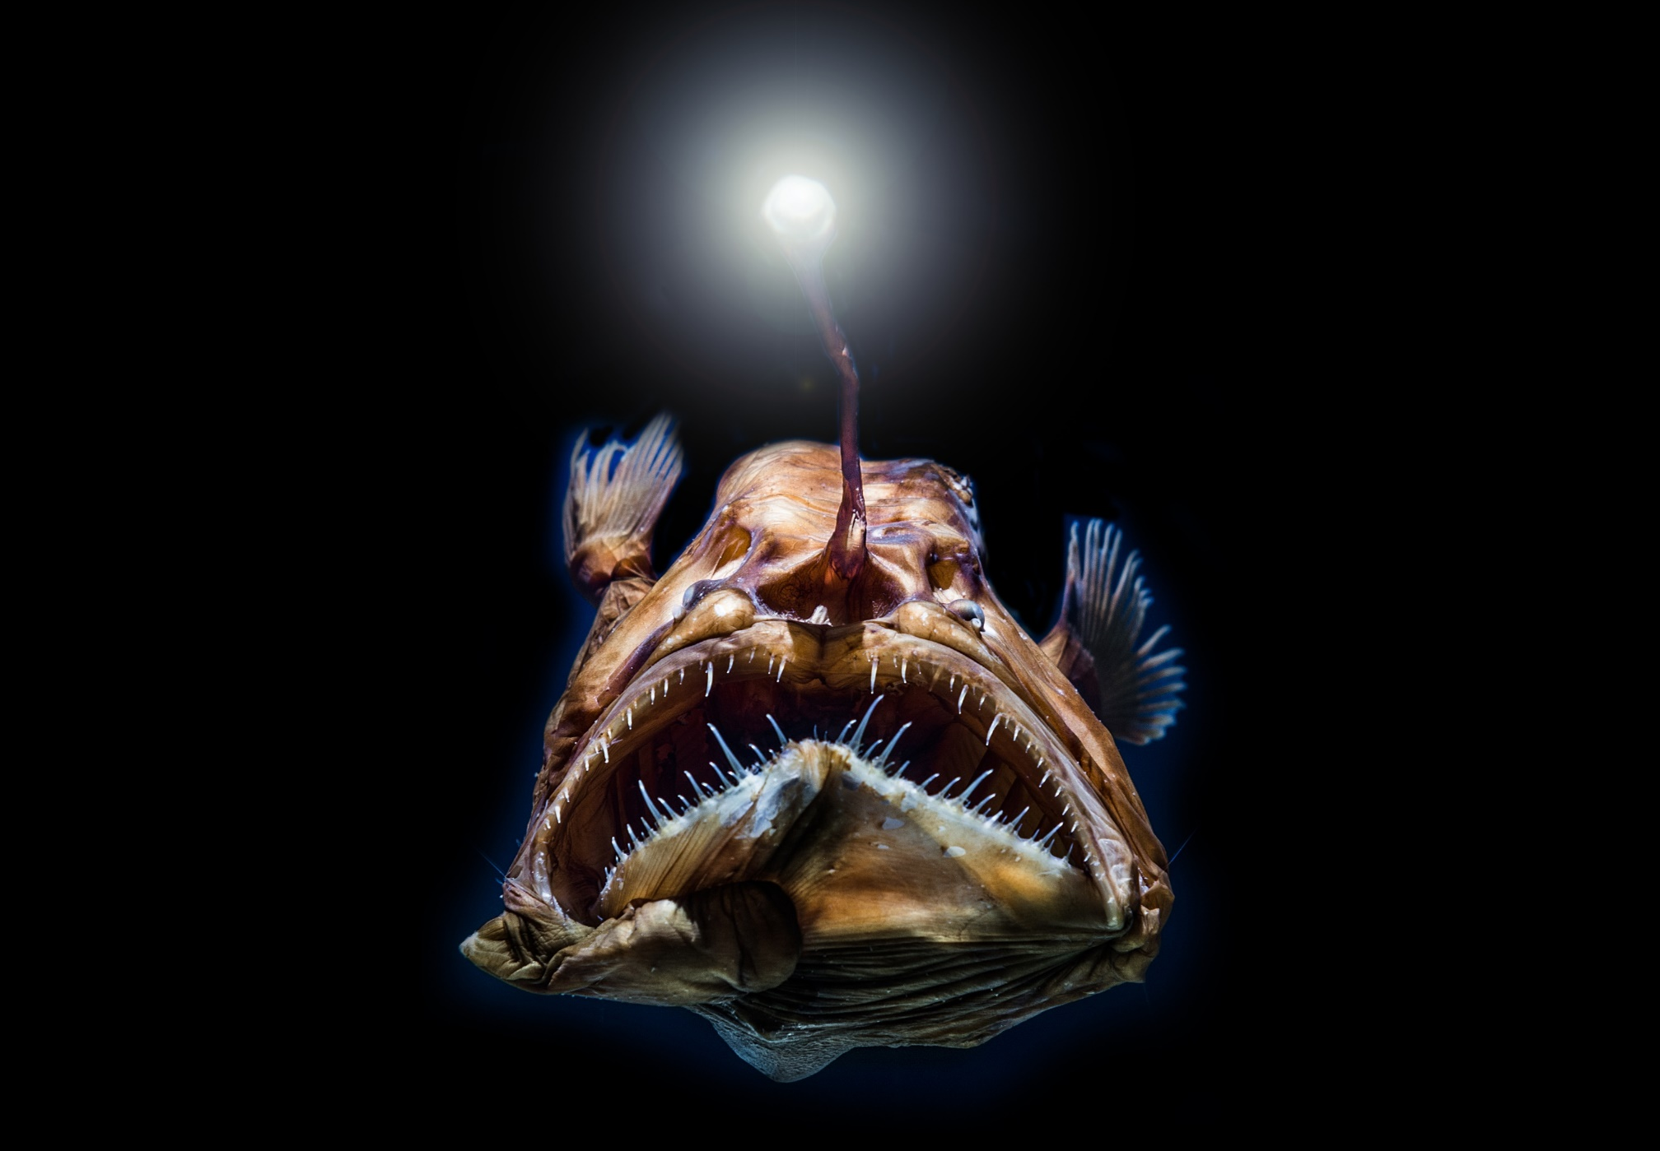
Food - Anglerfish
Anglerfish. Image: Superjoseph via Shutterstock
Anglerfish have bioluminescence on the end of their dorsal spine. This is positioned near their mouth and used to attract prey.

Slide 20
Life in the Deep
Double click the image to play video

