Slide 1

Climate change and the ocean

Slide 2

Learning Objectives
Describe how the ocean helps to reduce the
effects of climate change.
Describe how the ocean is affected by climate change.
Discuss ideas for helping to directly and indirectly reduce the effects of climate change on the ocean.

Slide 3
Set the scene
How does climate change affect the ocean?
Notes:
Start by asking students if they know how climate change is affecting the ocean. Have a group discussion before using the following slides to go through each impact in more detail.
Using the slides and notes sections in this PowerPoint, lead a group discussion on how climate change affects the ocean.

Slide 4
Sea level rise
© Jean-Christophe André via Pexels
Notes:
Global warming is causing a rise in both atmospheric and sea temperatures. In fact, the ocean has absorbed more than 90% of the excess heat in the climate system.
High temperatures are causing ice to melt and sea levels to rise. The rise in sea level will affect a lot of coastal communities and coastal habitat due to flooding, and some low-lying islands could be completely submerged.

Slide 5
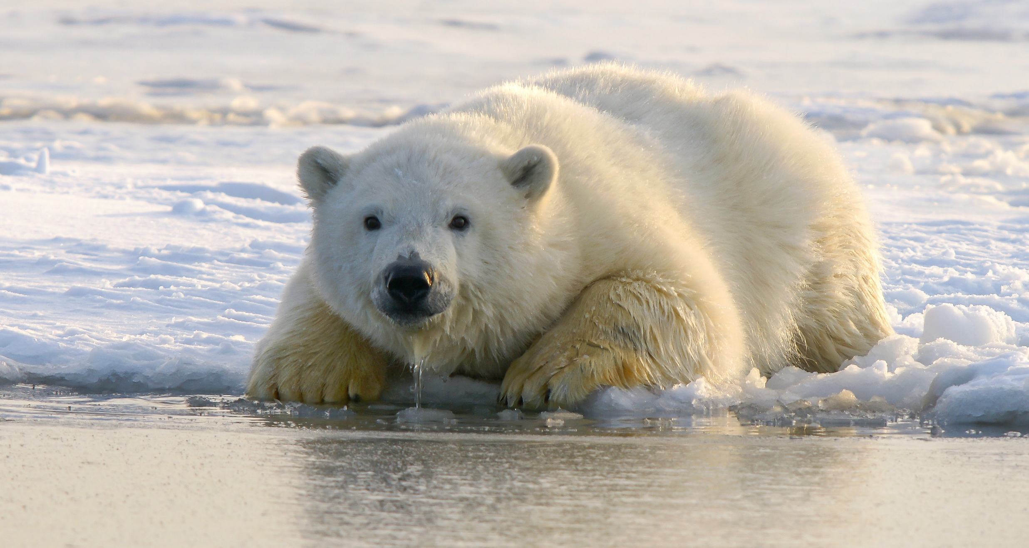
Changing habitats
© Hans-Jurgen Mager via Unsplash
Notes:
Ice melting in the Artic is also changing the natural habitat there. This is causing lots of problems for wildlife including animals like polar bears who need to use the sea ice as a platform to hunt for seals.

Slide 6
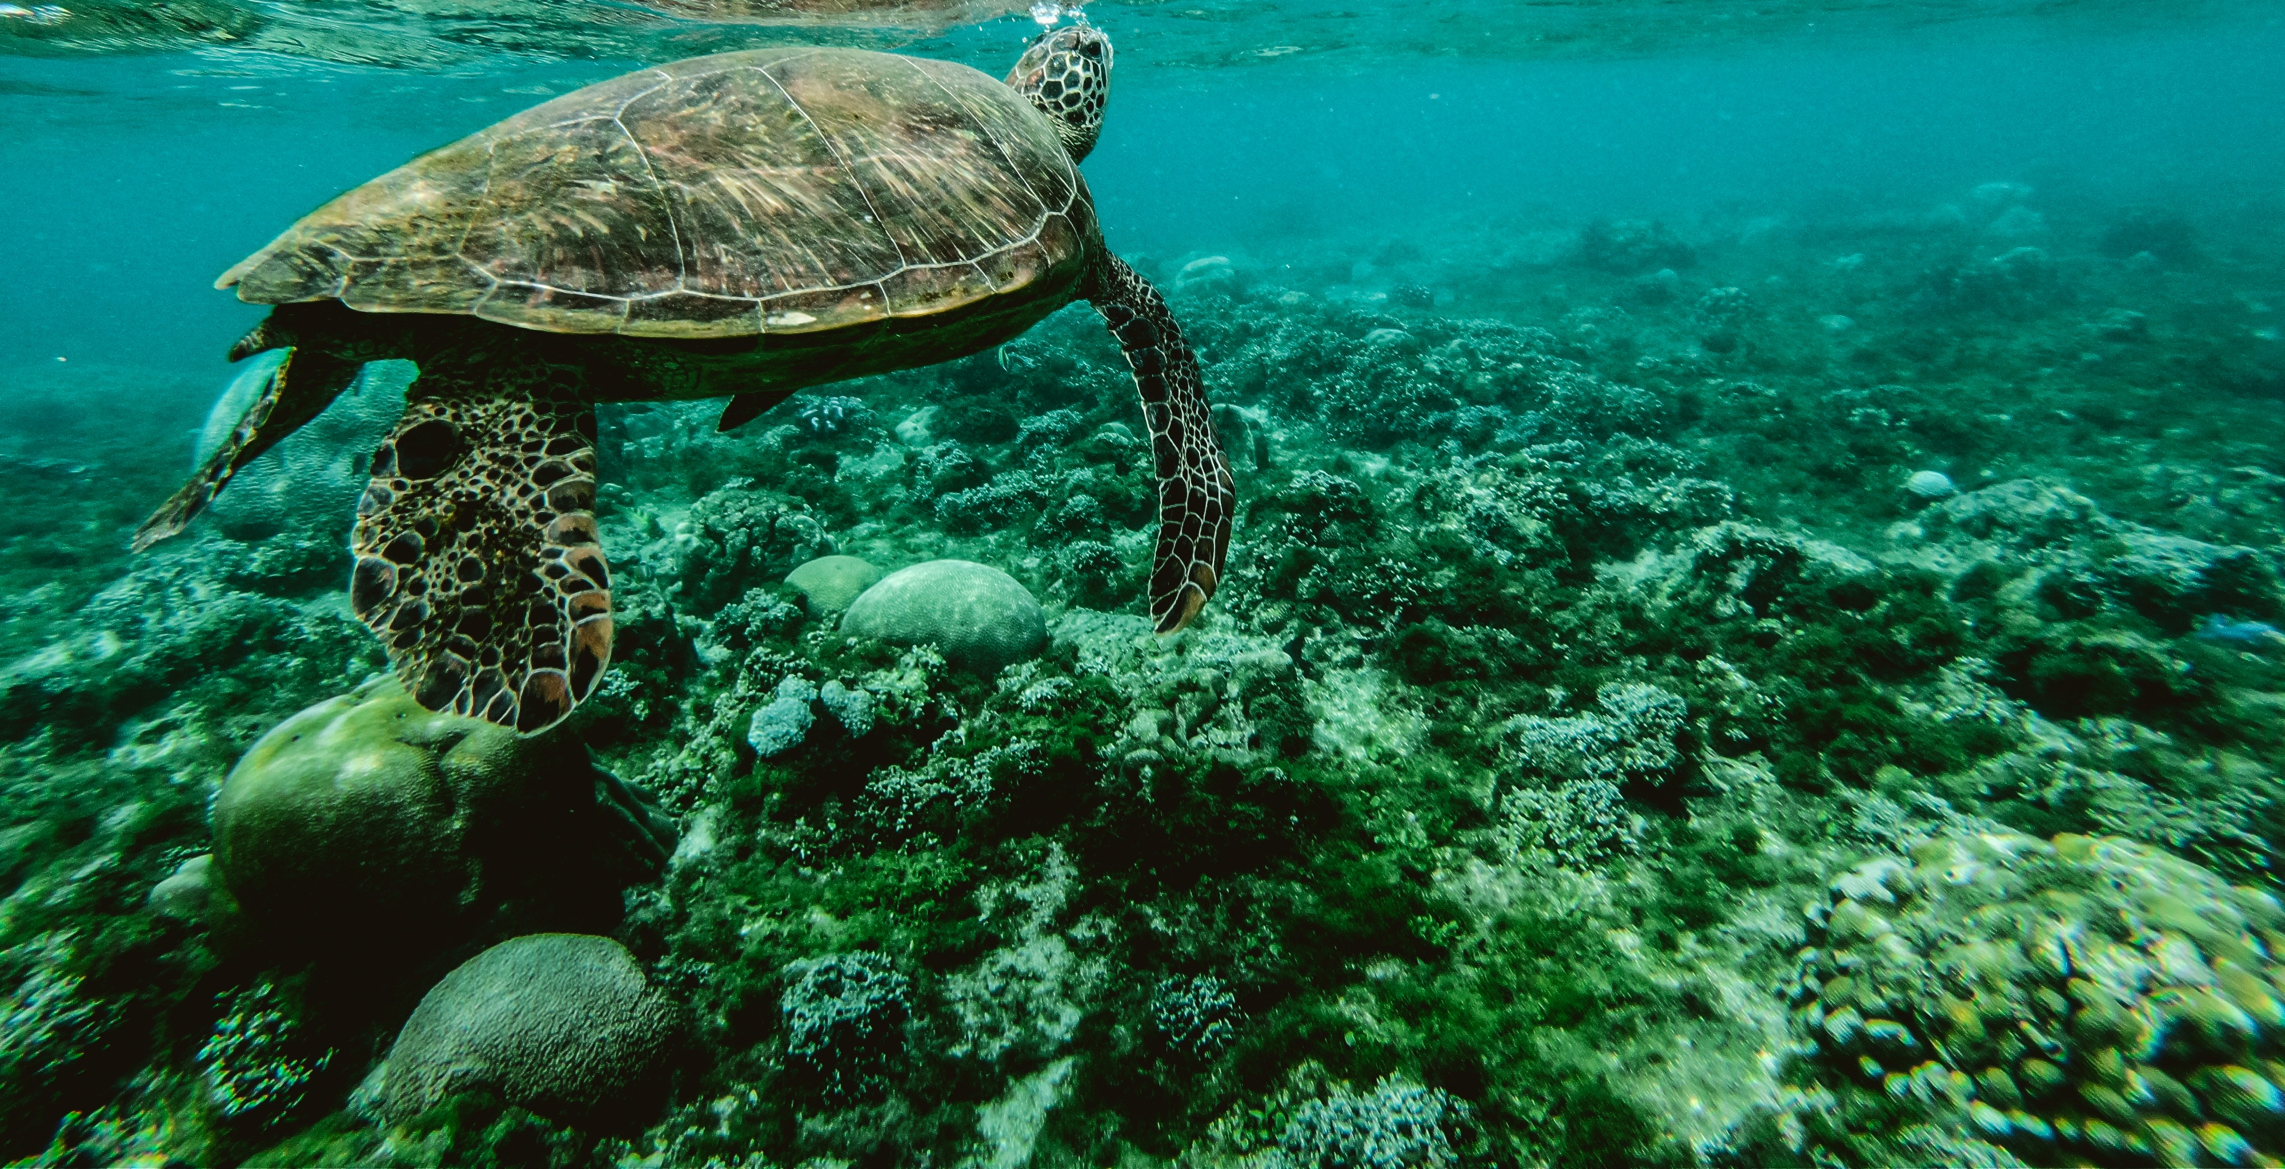
Coral bleaching
© Belle Co via Pexels
Notes:
Increasing temperatures in the ocean are also causing coral bleaching. Simply put, this means beautifully vibrant corals are turning white due to stress from increased temperatures. If this stress continues, they could die.

Slide 7
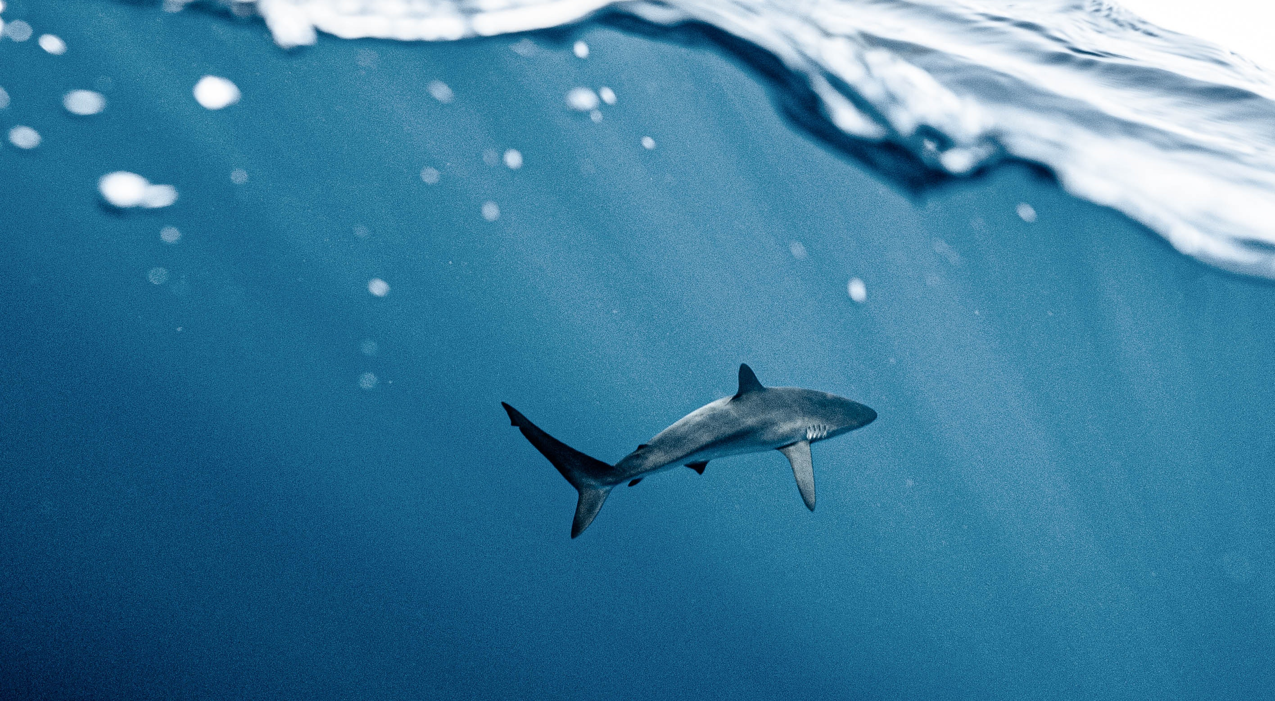
Species distribution
© Elianne Dipp Via Pexels
Notes:
Plants and animals, like fish, are moving from their normal locations to find cooler waters. In the UK species are moving either north or moving deeper to find cooler waters. Some animals might not be adapted to these new areas, and they might not be able find enough food or reproduce effectively in a new habitat. We may see some animals and plants start to die out as a result of this.

Slide 8
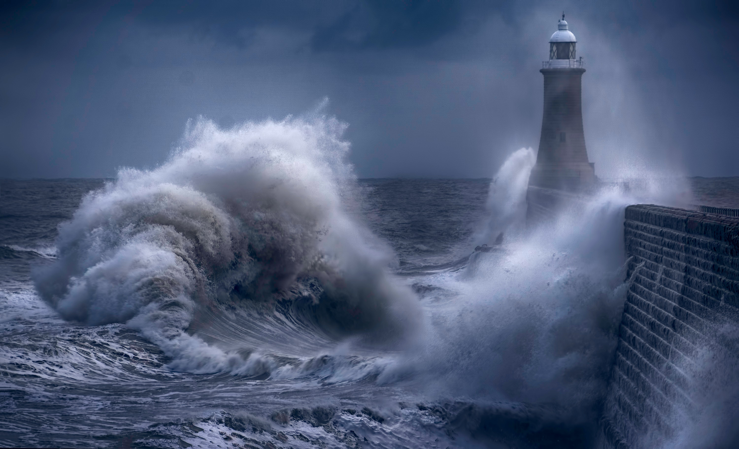
Increased storms
© Ray Bilcliff via Pexels
Notes:
Increased storms can damage fragile marine habitats like seagrass beds, salt marshes and mangroves.

Slide 9
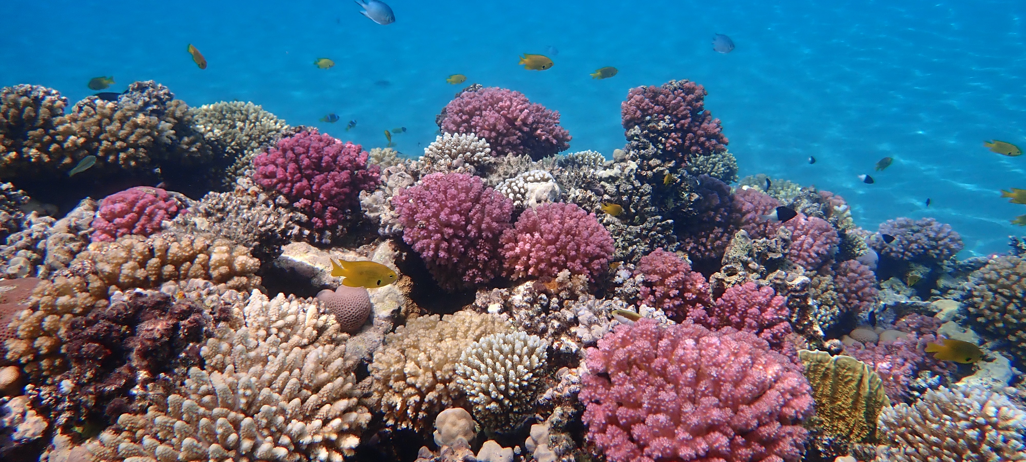
Ocean acidification
© Ralf Schlegel via Unsplash
Notes:
Increased carbon dioxide is making the ocean more acidic – this process is known as ocean acidification. This affects animals with a calcium carbonate skeleton like corals, some phytoplankton and some seafood such as mussels, lobsters, and crabs.

Slide 10
Activity 1
Ocean acidification
Notes:
Activity 1 - Ocean Acidification
To study one of the impacts in more detail, watch the following ocean acidification video. In the video there is a clip showing briefly what happens to calcium carbonate in acidic solutions. To investigate this further, set up an acidification experiment.
In small groups, students should work together to set up the experiment. Each group will need a calcium carbonate item like a shell or chalk, and 2 beakers, one with water/vinegar mix (to mimic an acidic ocean) and the other just water. Ask students to record the pH of each solution on the Ocean acidification worksheet. Students should be guided to create a hypothesis of what will happen to a calcium carbonate object in the two different solutions over time. Refer back to knowledge gained in the video to help with the hypothesis. Before starting the experiment, students should sketch the calcium carbonate object and record its size and weight on the worksheet. If you have access to a microscope or magnifying glass, it’s also
really useful for students to compare the structure of the object pre and post-experiment. This experiment needs time, and you should review and analyse results the following week.
When analysing results, students should repeat measurements of weight, size, and pH. Students should also sketch what the object looks like now and examine using magnifying glass/microscope. Compare results and discuss how this experiment relates to ocean acidification.
Resources required: Ocean acidification worksheet, Shells or chalk, microscopes/magnifying glass, beakers, distilled water, vinegar/water mix, litmus paper

Slide 11
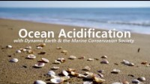
Notes:
In the video there is a clip showing briefly what happens to calcium carbonate in acidic solutions. To investigate this further set up the acidification experiment.

Slide 12
Activity 2
Blue carbon habitats
Notes:
Activity 2 - Blue carbon ecosystems
Introduce students to blue carbon habitats and their role in helping to reduce carbon in the atmosphere, by watching the video on the following slide.
Students should interpret and analyse the three graphs in the PowerPoint that show global carbon variation between ecosystems. Students should use the Blue carbon variation worksheet to explain what is being measured and what is being compared. They should describe patterns, trends and range in the data for each graph by quoting figures and units, and identifying any anomalies. Students should explain the results of each graph and then compare the three graphs and draw a conclusion.
Resources required: Blue Carbon Variation Worksheet

Slide 13
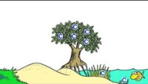
Notes:
Introduce students to blue carbon habitats and their role in helping to reduce carbon in the atmosphere by watching the video.

Slide 14
Blue carbon variation between ecosystems
Notes:
Students should interpret and analyse the three graphs that show global carbon variation between ecosystems. Students should use the Blue carbon variation worksheet to explain what is being measured and what is being compared. They should describe patterns, trends and range in the data for each graph by quoting figures and units, and identifying any anomalies. Students should explain the results of each graph and then compare the three graphs and draw a conclusion.
Resources required: Blue carbon variation worksheet

Slide 15
Activity 3
How can we help reduce climate change?
Notes:
Using the following slides to introduce the various steps we can take to protect our ocean.

Slide 16
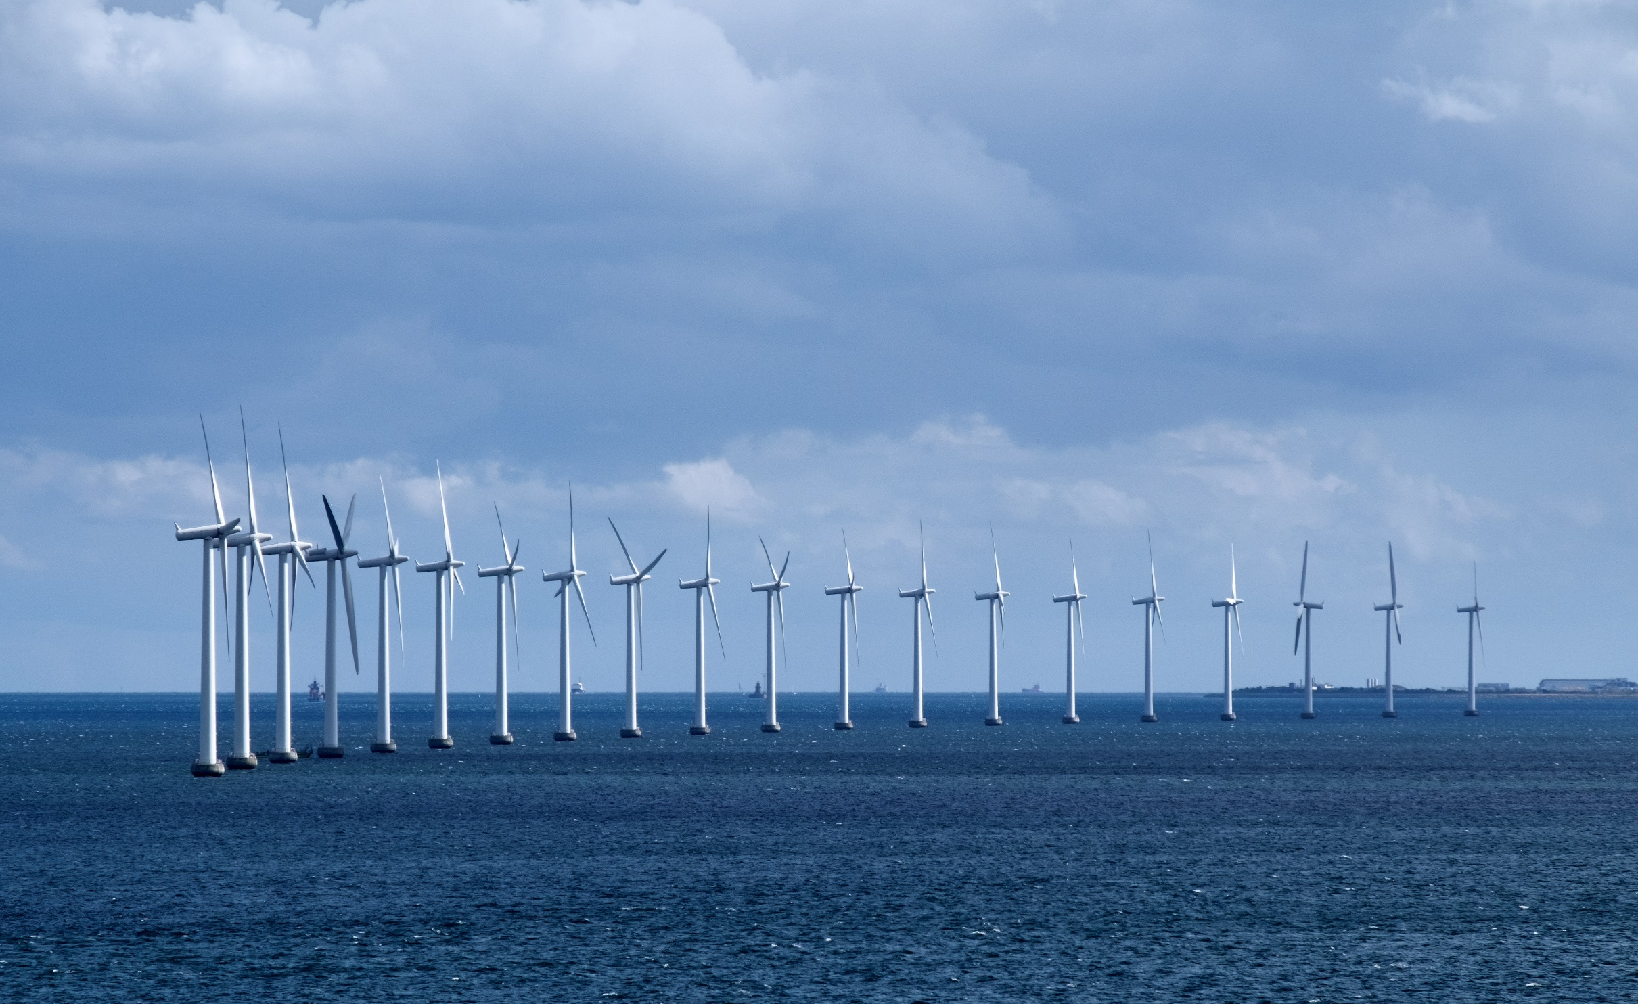
Renewable energy
© Lars Plougmann via Flickr
Notes:
We need to increase the amount of renewable energy sources such as wind, wave and tidal, and decrease the extraction of fossil fuels.

Slide 17
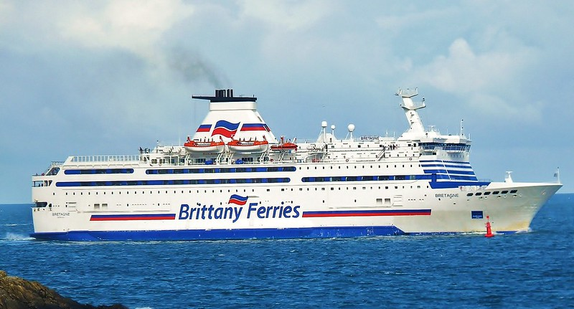
Reduce emissions from ocean transportation
© Mike Cattell via Flickr
Notes:
Marine industries like shipping, tourism and fishing need to improve their environmental efficiency to reduce carbon emissions.

Slide 18
Reduce unsustainable fishing
CO₂
Notes:
Dredging and trawling are two types of fishing practices that involved dragging fishing gear on the seafloor. This releases carbon dioxide stored in the sediment.

Slide 19
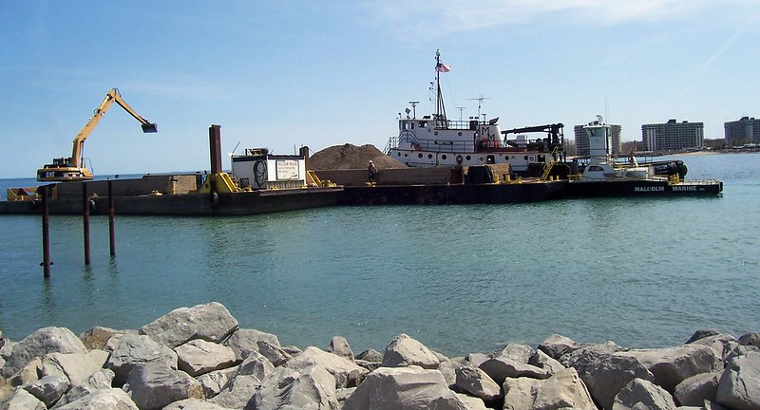
Reduce development
© Kristy via Flickr
Notes:
Damaging activities like coastal dredging and development can release carbon dioxide from sediments and destroy important blue carbon habitats. These activities need to be managed in a climate-smart way.

Slide 20
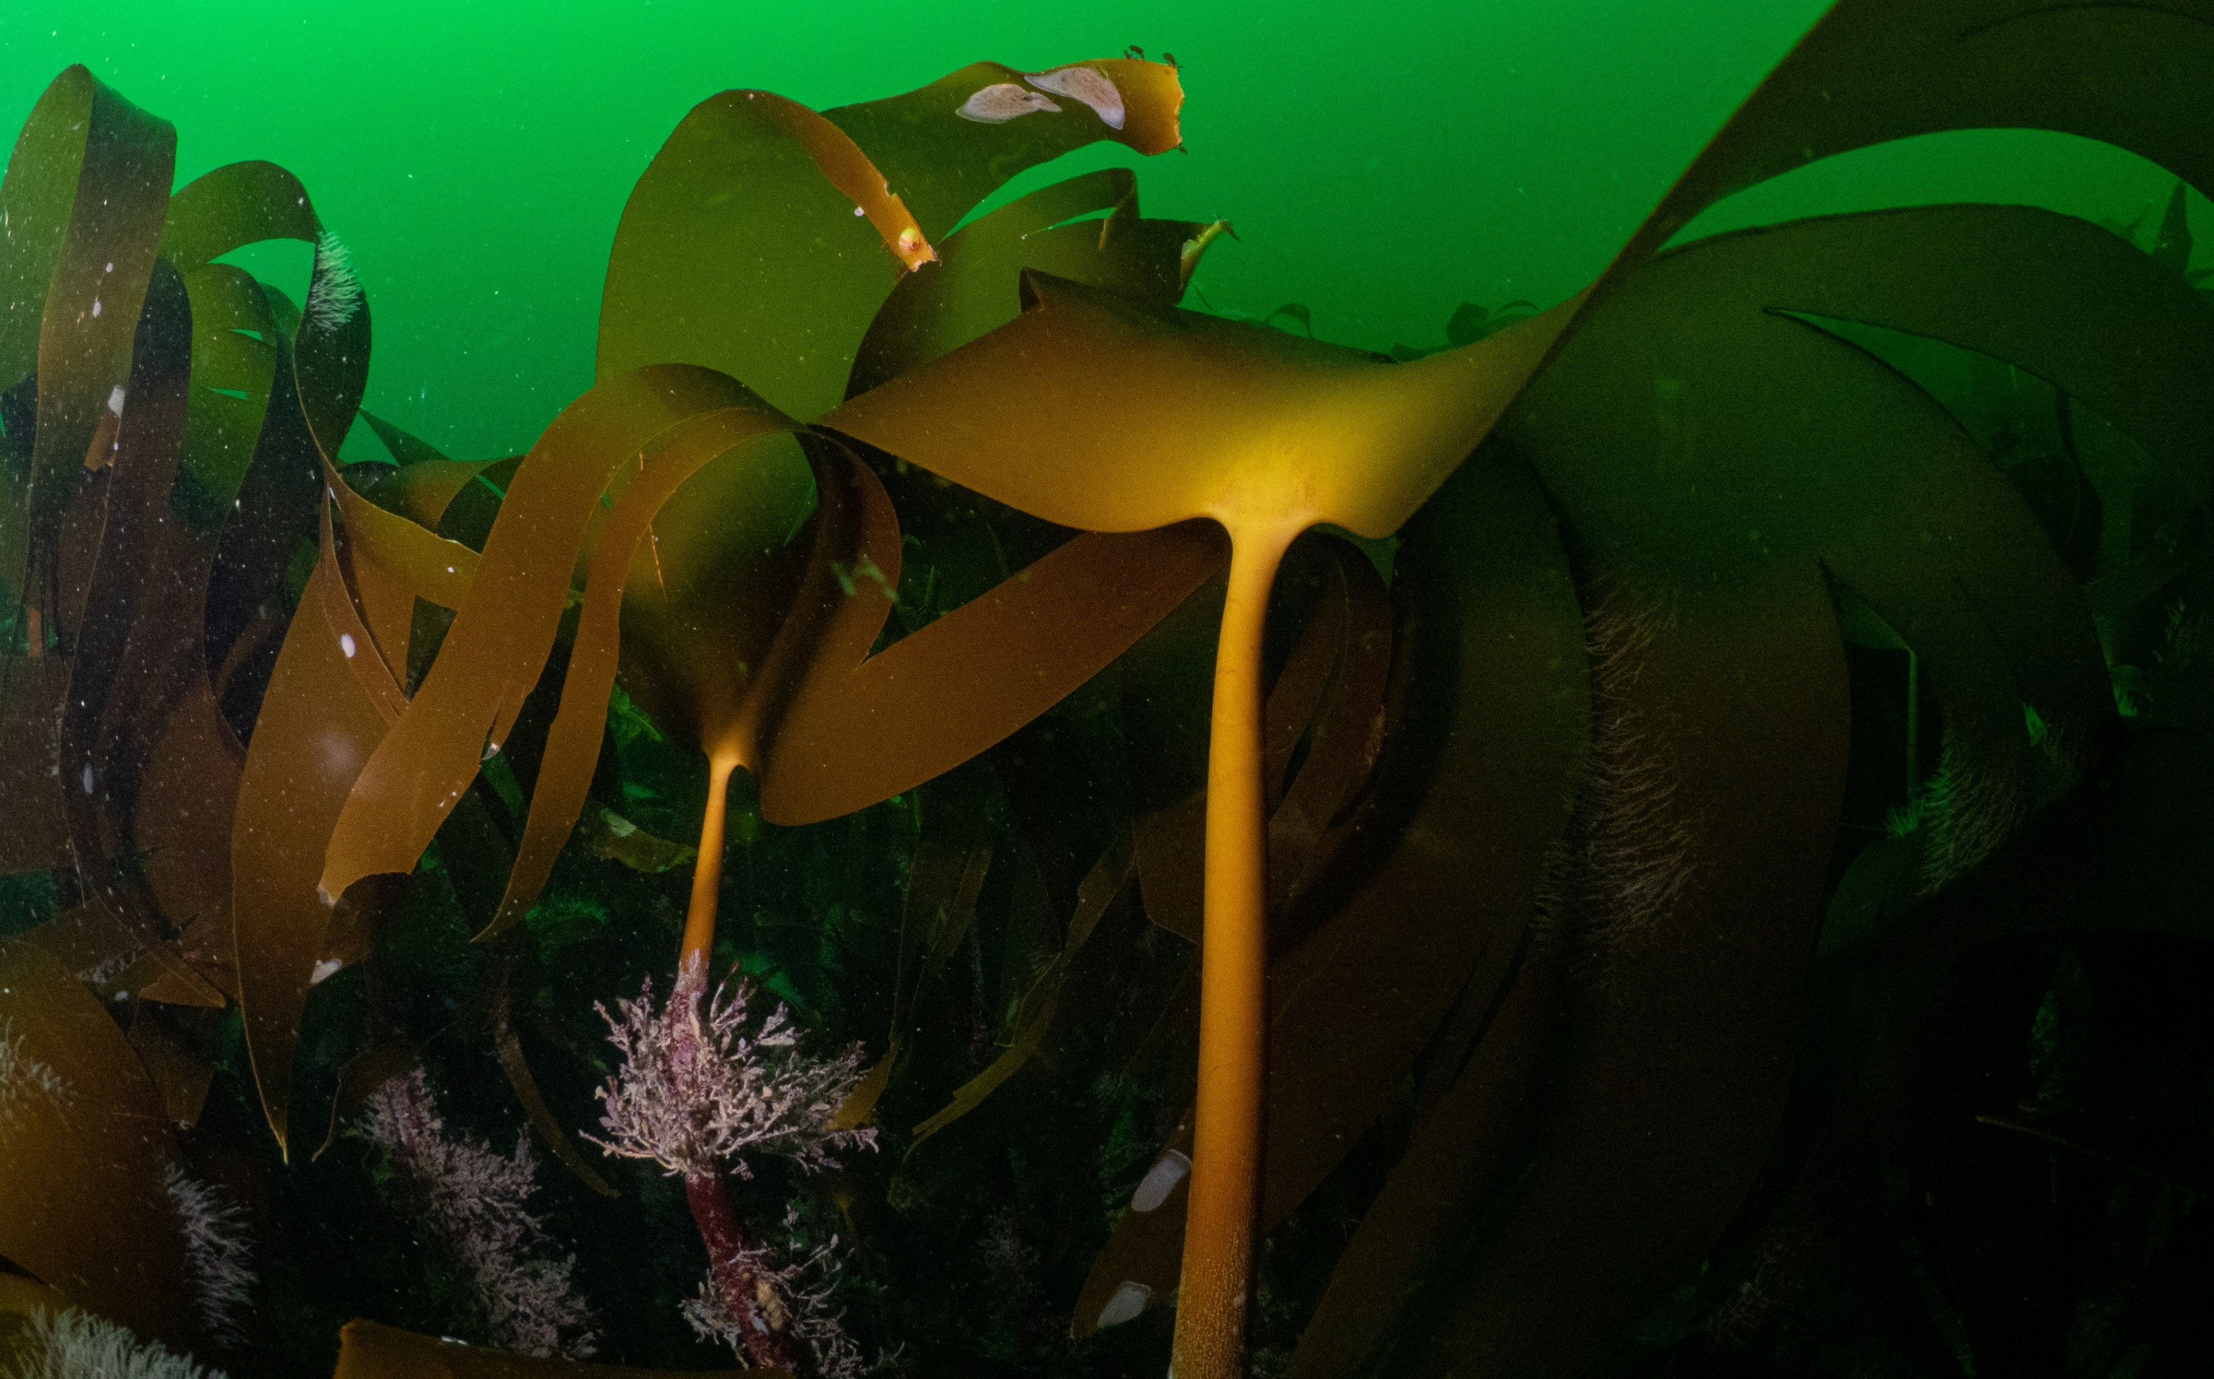
Protect blue carbon habitats
© Mark Kirkland
Notes:
Highly Protected Marine Areas are like nature reserves in the sea, where no destructive activity at all is allowed. We need to make sure we set up more Highly Protected Marine Areas to protect and recover blue carbon storing habitats, like seagrass, kelp and saltmarshes.

Slide 21
How can we help to reduce climate change? Summarise the following:
The effects of climate change on the ocean
How the ocean helps reduce climate change
Threats to the ocean
How we can manage our seas more efficiently
How we can all make changes to benefit the ocean
and reduce climate change.
Notes:
In small groups, students should use the mind map template worksheet to draw together everything they have learnt in Activities 1, 2 and 3. A completed example of a mind map is provided.
Students should summarise:
The effects of climate change on the ocean
How the ocean helps reduce climate change
Threats to the ocean
How we can manage our seas more efficiently
How we can all make changes to benefit the ocean and reduce climate change.
Once students have completed their mind maps, they should make links between the answers they gave for each question. For example:
Extreme weather causes storms which damage fragile habitats and destroys costal properties.
Plants in carbon storing habitats like saltmarsh, mangroves, seagrass absorb and store carbon dioxide through photosynthesis.
Coastal development destroying habitats like saltmarsh and mangroves.
Reduce coastal construction that damages climate-smart habitats like saltmarshes.
Support marine conservation charities.
Students should then use these links to come up a with a campaign idea to help reduce climate change. They should write a persuasive text for why their campaign needs action. They could use the themes of each mini mind map to help structure their text.
Resources required: How can we reduce climate change? template, How can we reduce climate change? completed example

Slide 22
The effects of climate change on the ocean
Extreme weather causes storms which damage fragile habitats and destroys costal properties.
How the ocean helps reduce climate change
Plants in carbon storing habitats like saltmarsh, mangroves, seagrass absorb and store carbon dioxide through photosynthesis.
Threats to the ocean
Coastal development destroying habitats like saltmarsh and mangroves.
How we can manage our seas more efficiently
Reduce coastal construction that damages climate smart habitats like
saltmarshes.
How we can all make changes to benefit the ocean and reduce climate change
Support marine conservation charities.
Notes:
Once students have completed their mind maps, students should make links between the answers they gave for each question. For example
Extreme weather causes storms which damage fragile habitats and destroys costal properties.
Plants in carbon storing habitats like saltmarsh, mangroves, seagrass take up and store carbon dioxide through photosynthesis.
Coastal development destroying habitats like saltmarsh and mangroves.
Reduce coastal construction that damages climate smart habitats like saltmarshes.
Support marine conservation charities.
Students should then use these links to come up a with a campaign idea to help reduce climate change. They should write a persuasive text for why their campaign needs action. They could use the themes of each mini mind map to help structure their text.
Resources required: Climate change and the ocean PowerPoint, How can we reduce climate change template, How can we reduce climate change completed example

Slide 23
Reflect
What have you learnt?

Slide 24
Learning Objectives
Describe one way the ocean helps to reduce the effects of climate change.
Can you describe what ocean acidification is and how it affects marine animals?
How can we help to directly and indirectly reduce the effects of climate change on the ocean?

Slide 25
We will continue to fight for the ocean and protect wildlife

