Slide 1
Marine pollution

Slide 2
Learning Objectives
Be able to explain how litter negatively impacts the marine environment, economy and society, and understand the social responsibility we all have to reduce this impact.
Understand how your school is connected to the local community and wider geography of the UK by studying litter in the environment.
Use creativity and design in a school-based project to reduce waste.
Design a sustainable circular economy product.

Slide 3
Set the scene
What is litter?
Notes:
Ask students to briefly discuss this question and then as a class try to define the word ‘litter’.
Some point for discussion:
What’s the difference between litter and waste? – Waste is a product that’s no longer required and is disposed of. Litter is waste products that have be discarded incorrectly (for example, not in the bin).
What types of products are commonly littered? What are the properties of these products?
Where have you seen litter in your local area?
Why do people litter?

Slide 4
Why is litter bad?
Economic
Social
Environmental
Notes:
Split the class into small groups. Assign a topic (economic, environmental or social) to each group and ask them to brainstorm ideas for how litter affects this area. After 5 minutes, have a class discussion with groups sharing their thoughts.

Slide 5
Activity 1
Why is marine litter such a problem?
Notes:
Start by asking students why they think marine litter is such a topical and important issue, and why marine litter is so problematic. Use the following slides to add information into a group discussion.

Slide 6
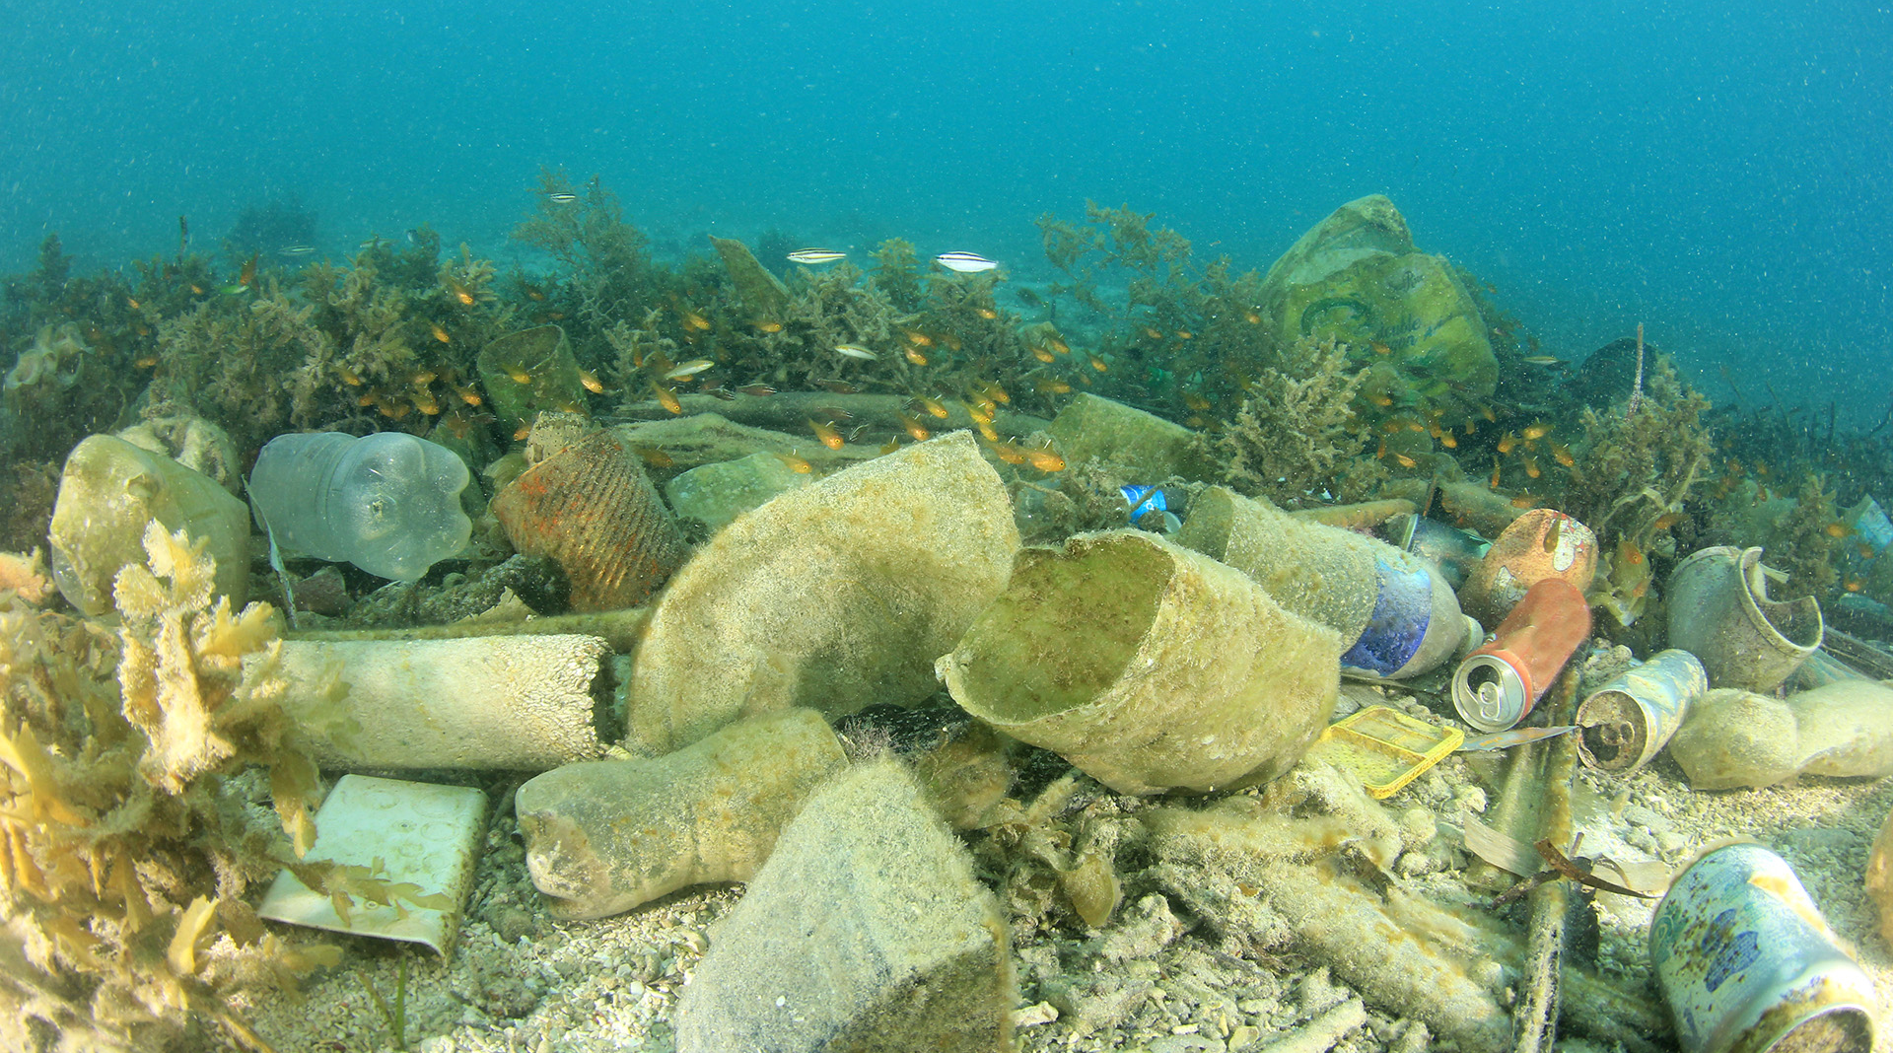
An estimated 11 million tonnes of plastic ends up in the ocean each year.
© Shutterstock
Notes:
Litter can be directly enter the ocean through fishing, sailing, speed boats, commercial ships and container spills, causing litter pollution.
80% of litter found in the sea is from inland sources, including intentional and accidental littering and windblown litter from bins and landfills. All rivers lead the ocean. Litter items flushed down toilets, sinks and drains or litter carried by rain water into drains will enter rivers and eventually the sea.

Slide 7
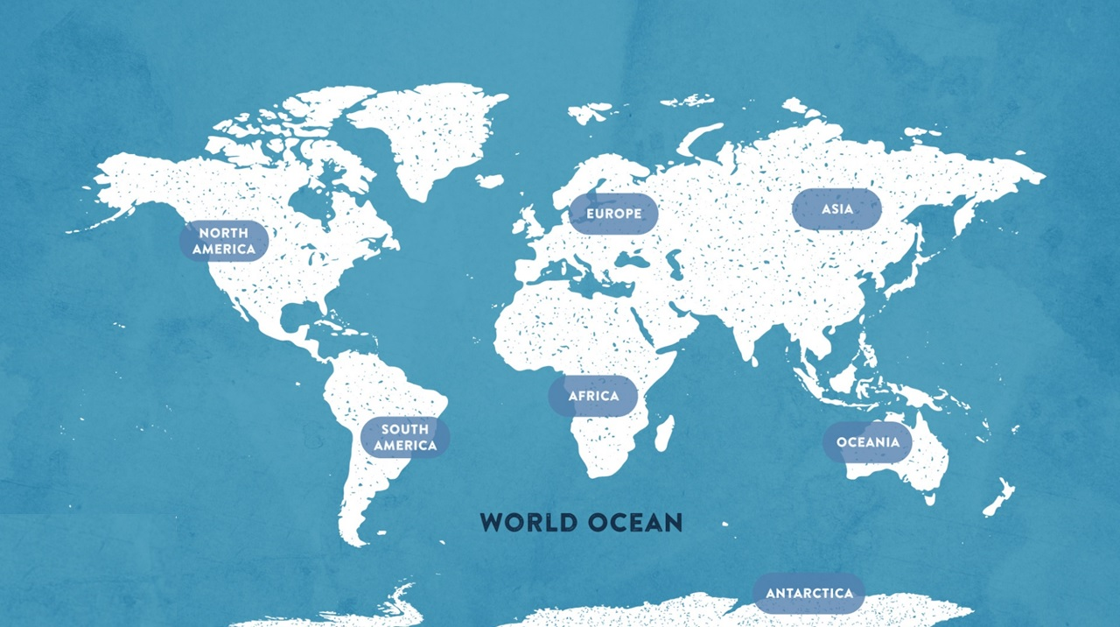
70% of our planet is covered by the ocean
Notes:
The vast majority of our planet is ocean. Once litter enters the ocean, it becomes extremely difficult to access it to remove it.

Slide 8
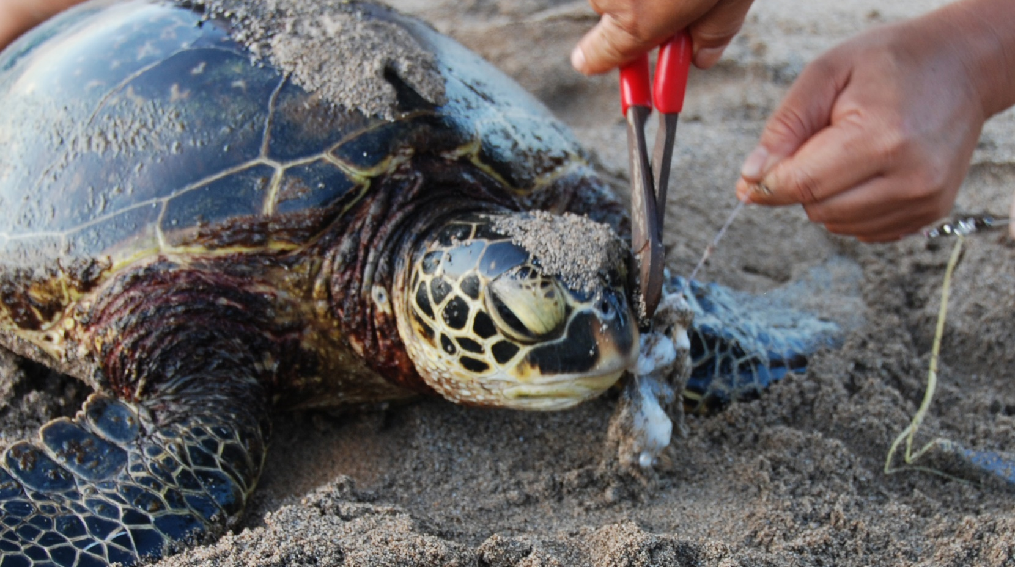
Studies investigating turtles found plastics in the stomachs of 100% turtles tested.
© NOAA
Notes:
Many marine animals are directly affected by marine litter by accidental ingestion. They mistake litter for food, this takes up space in their stomach, and can often lead to starvation and death.

Slide 9
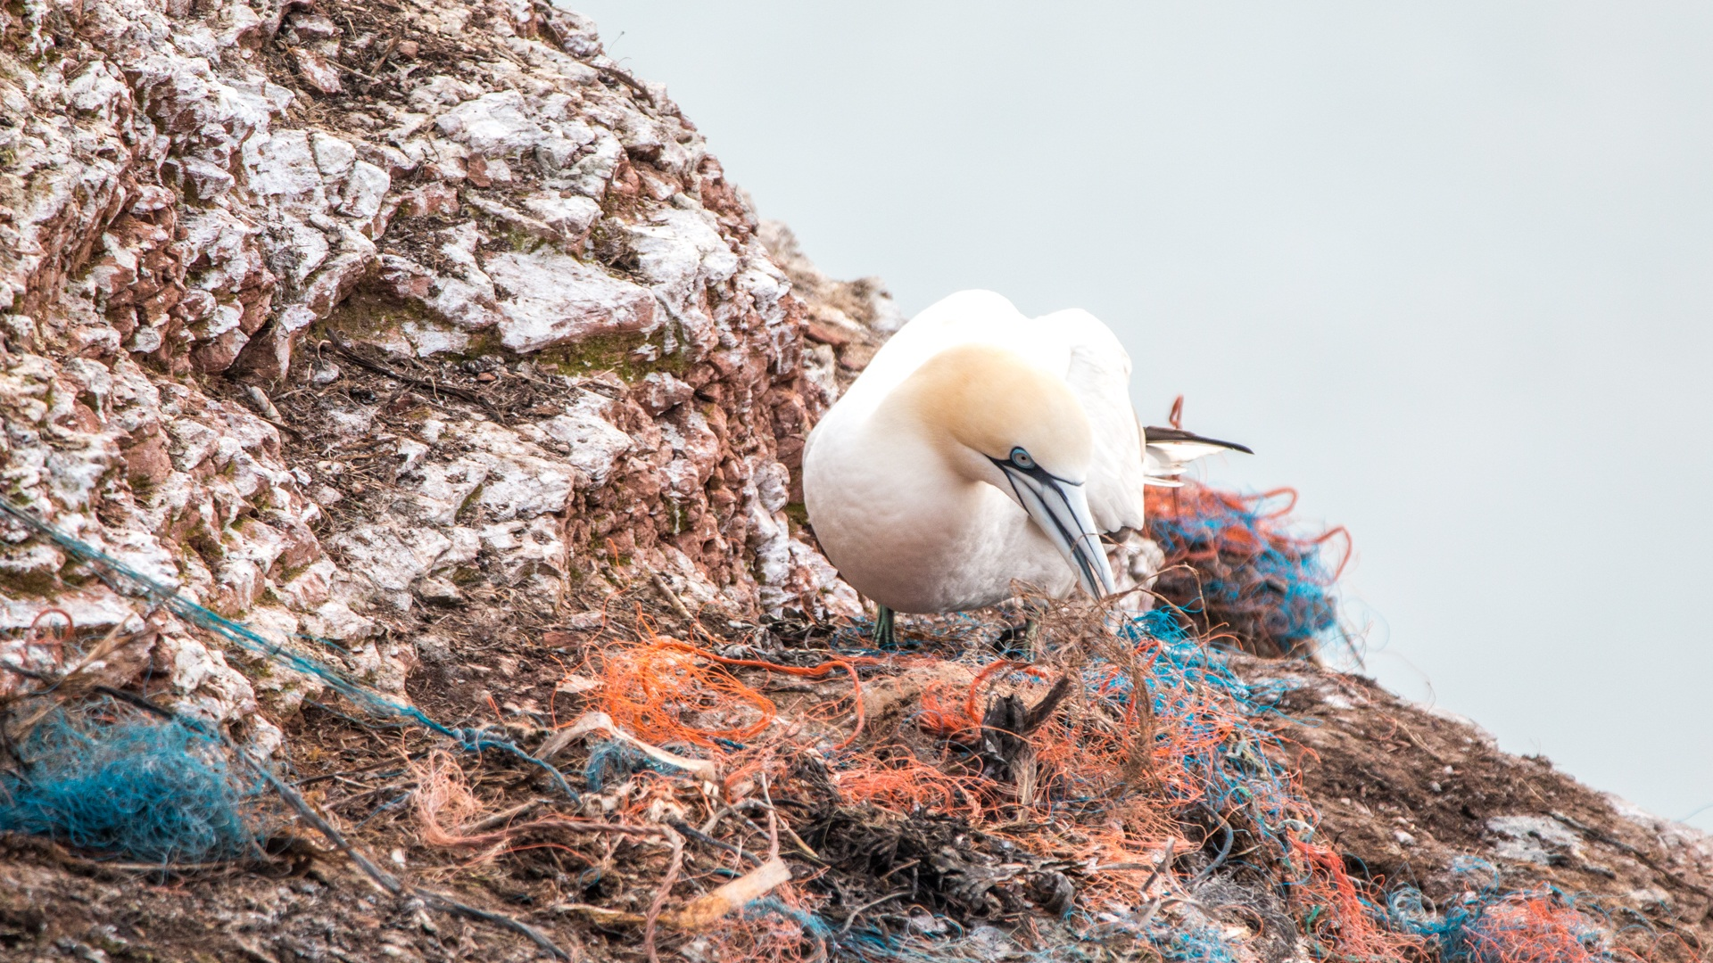
1 million sea birds are killed by marine plastic pollution annually
© Pixabay
Notes:
1 million sea birds are killed by marine plastic pollution every year.

Slide 10
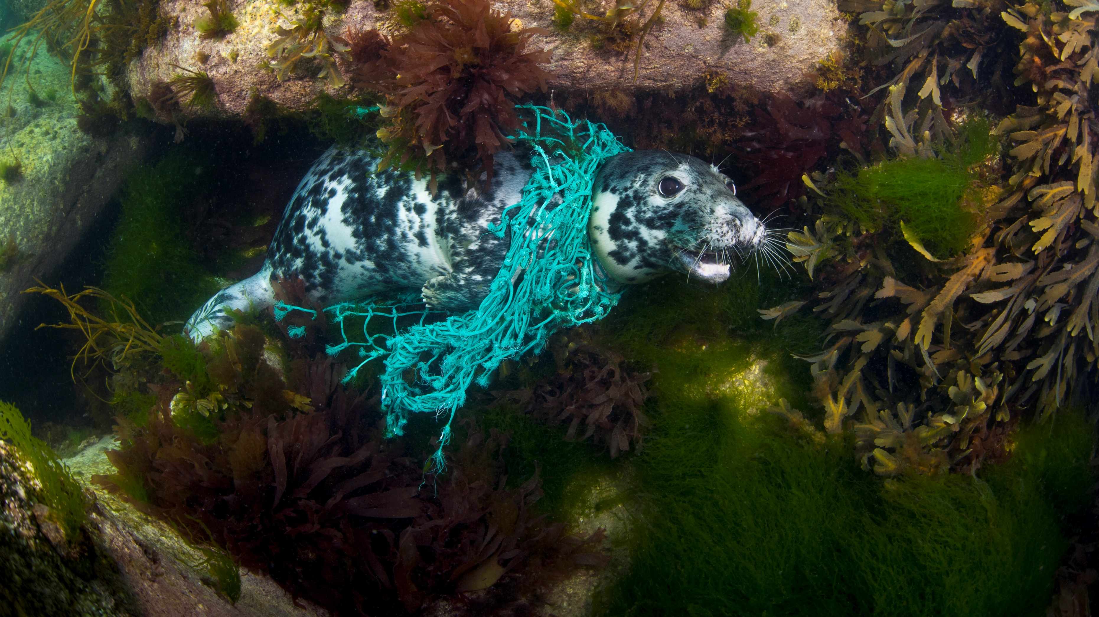
136,000 seals and whales are trapped every year in ghost fishing net.
© Alexander Mustard
Notes:
Animals can also become entangled in marine litter leading to injury, stress, pain and sometimes death.

Slide 11
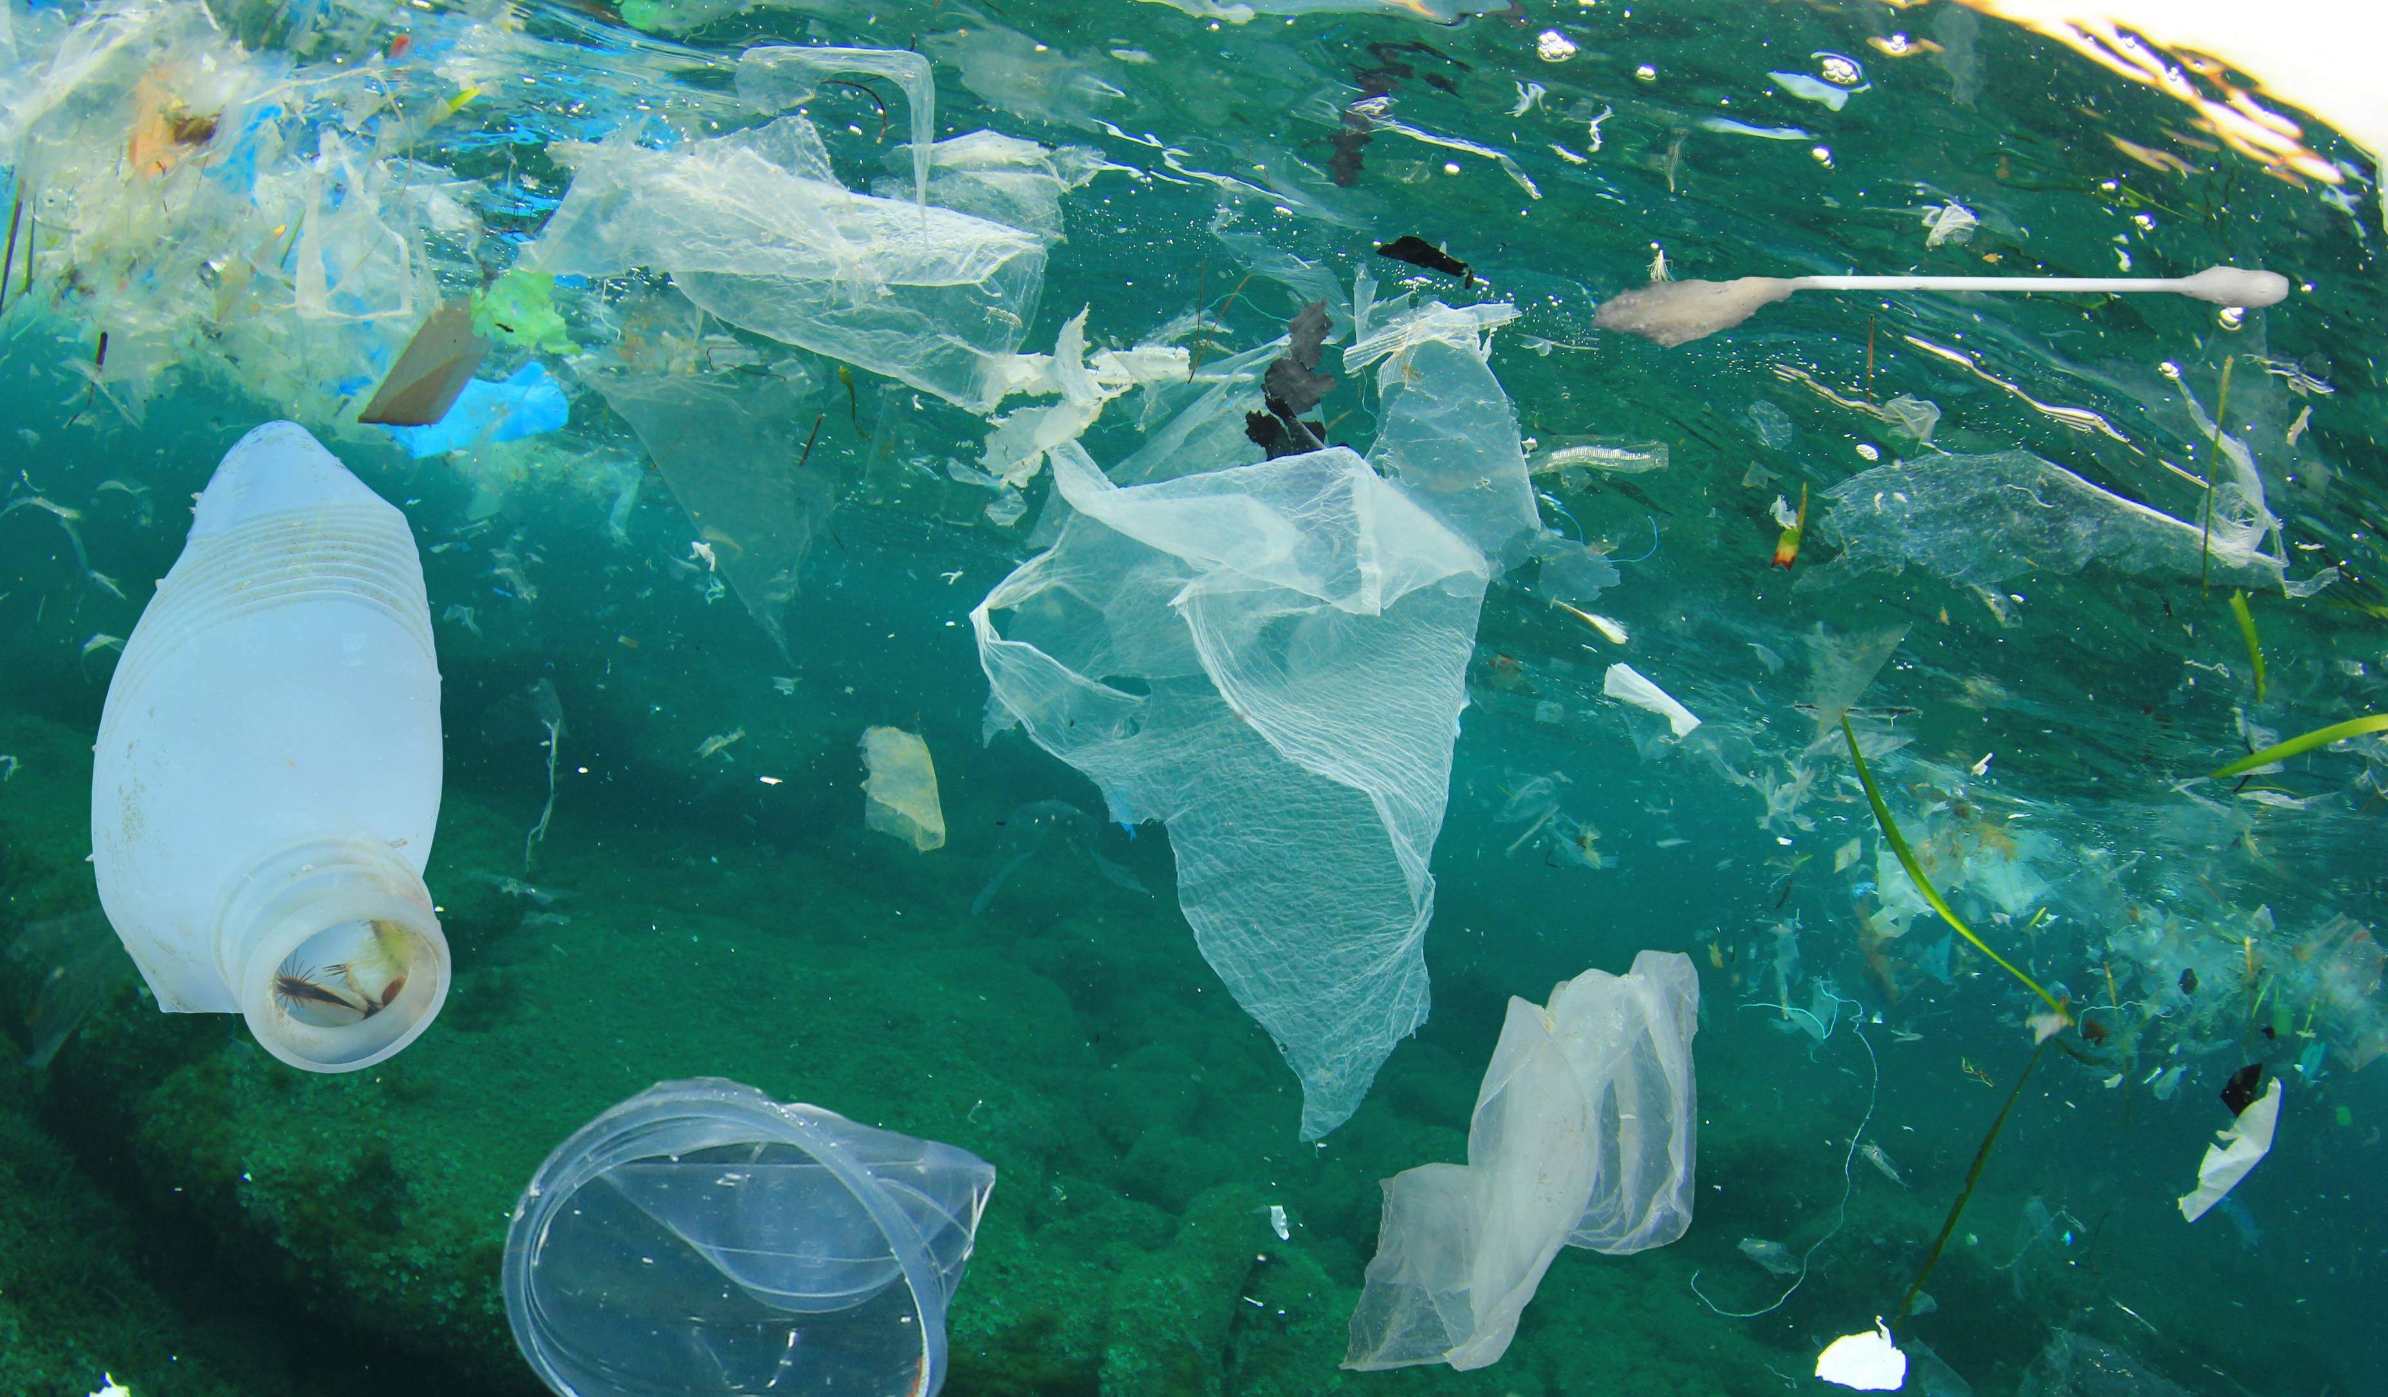
© Rich Carey
Notes:
Litter in the ocean takes longer to degrade than litter on land, but will eventually start to break up due to wave action, currents, saltwater and sunlight. Degradation times vary greatly, from 1–450 years, depending on the properties of the litter. The most important thing to remember is that plastic never truly decomposes, but breaks up into smaller and smaller pieces.

Slide 12
© Shutterstock
Notes:
Microplastics (pieces smaller than 5mm) are a serious environmental issue. Plastics have been found amongst the finest of sand samples, in seawater samples and in the stomachs of microscopic zooplankton.

Slide 13
Activity 2
How is your school connected to marine litter?
Notes:
Activity 3 is split into three mini activities investigating how your school is connected to the ocean and to marine litter.

Slide 14
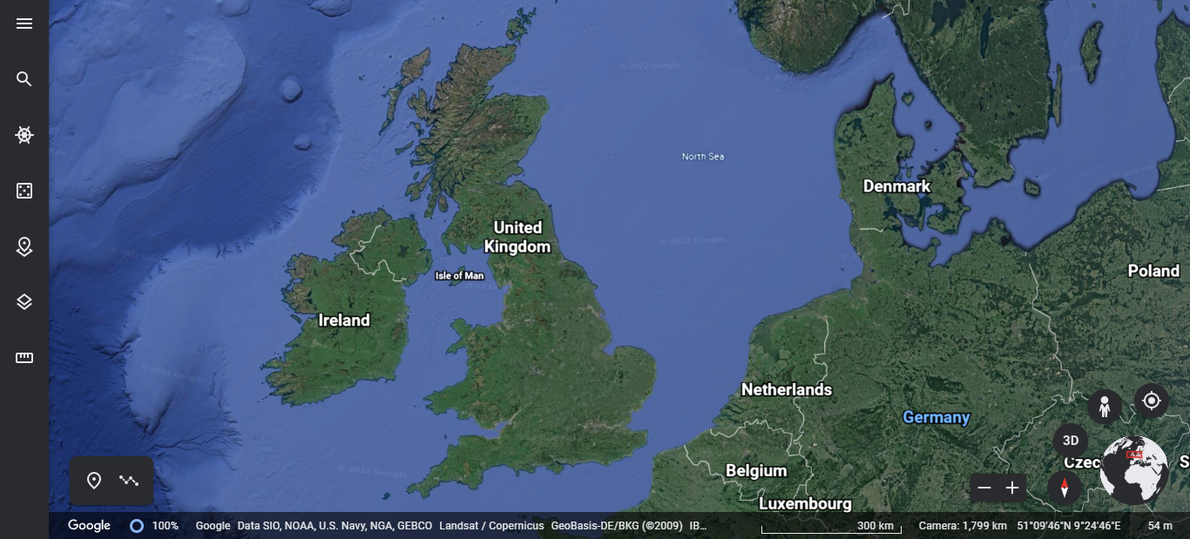
From source to sea
Notes:
Find out how your local area is connected to the ocean by following your local river on its journey to the sea. While doing this, imagine a litter item travelling along the river to the ocean.
Use Google Earth to find your school.
Find your school on Google Earth by typing in your school name in the search function.
Zoom out to find your nearest river or stream
Once you’ve found the river’s name, type this into the search bar. This will bring up information about the river. Click on ‘more info’ to find out where the mouth of the river is.
The river mouth may lead you to the sea or it might flow into another river. If it leads you to another river, you will need repeat step 3 until you reach the sea.
Once at the sea, look for the name of the estuary. Zoom out to find the name of the sea.
Use the measurement tool to find out the distance from the estuary to your school.

Slide 15
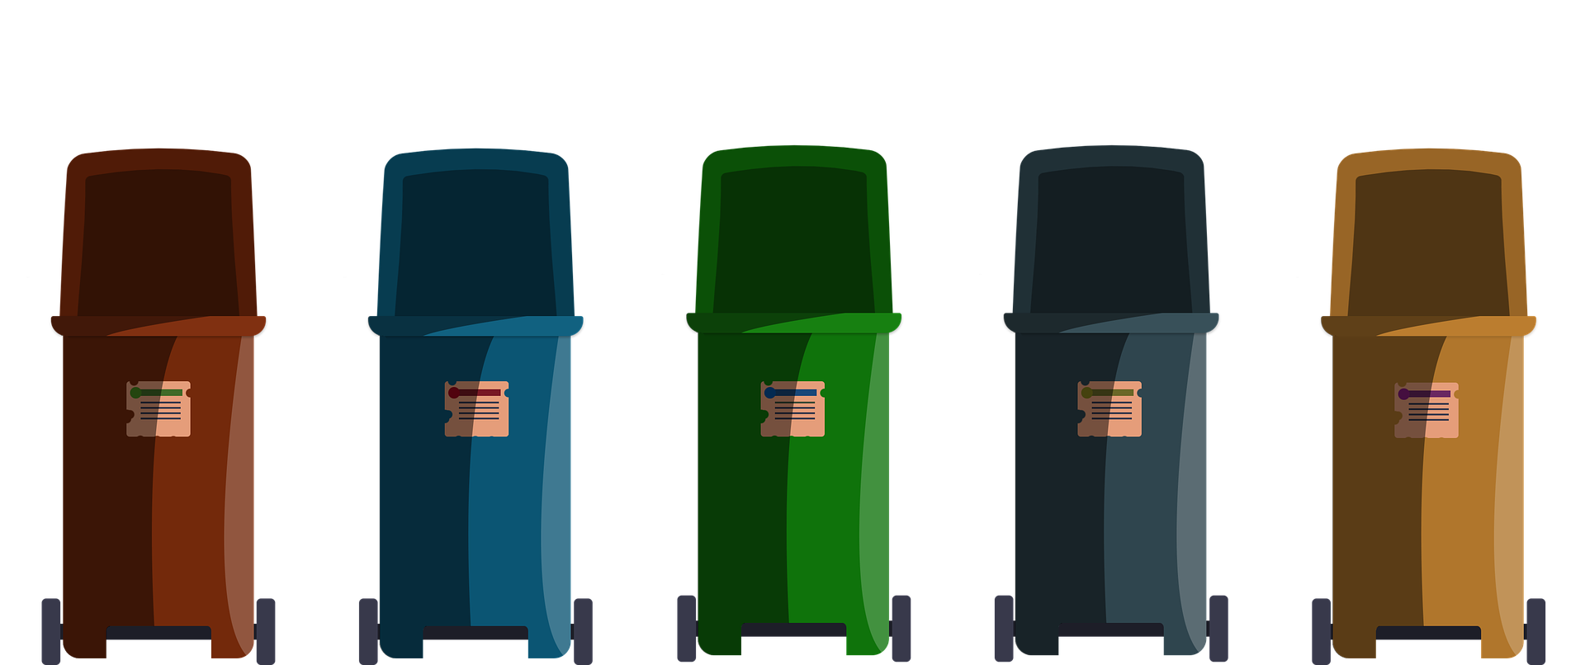
Waste audit
Notes:
Conduct a waste audit at your school to analyse the quantity and variety of waste thrown away.
Encourage students to think about questions they would want to find out by completing the survey, for example: How much waste should be recycled? How much waste is single-use plastic? Is there a certain area of the school that’s generating more waste?
Students should design their own surveys or use Recycle Now's survey template as inspiration. After conducting the waste audit, students should analyse and present the data and see whether their questions have been met by the survey. They could then review their methodology and make suggestion for future waste audits. Students could use their results to generate a school-wide campaign to reduce the amount and/or type of waste being produced.
Tips for running a waste audit:
In a staff meeting, agree the day or days when pupils will record the waste.
You can manage the safety of the activity by either having an adult accompany pupils to each room when they record the waste, or ask the member of staff to stay in their classroom or office and help pupils record it.
For the canteen, position pupils next to the bins at lunchtime to record what is thrown away. Ask catering staff to either save their packaging to be recorded by pupils or work with pupils to log it.
For the playground, before and after school and at breaks, position pupils next to bins to record the plastic thrown away.

Slide 16
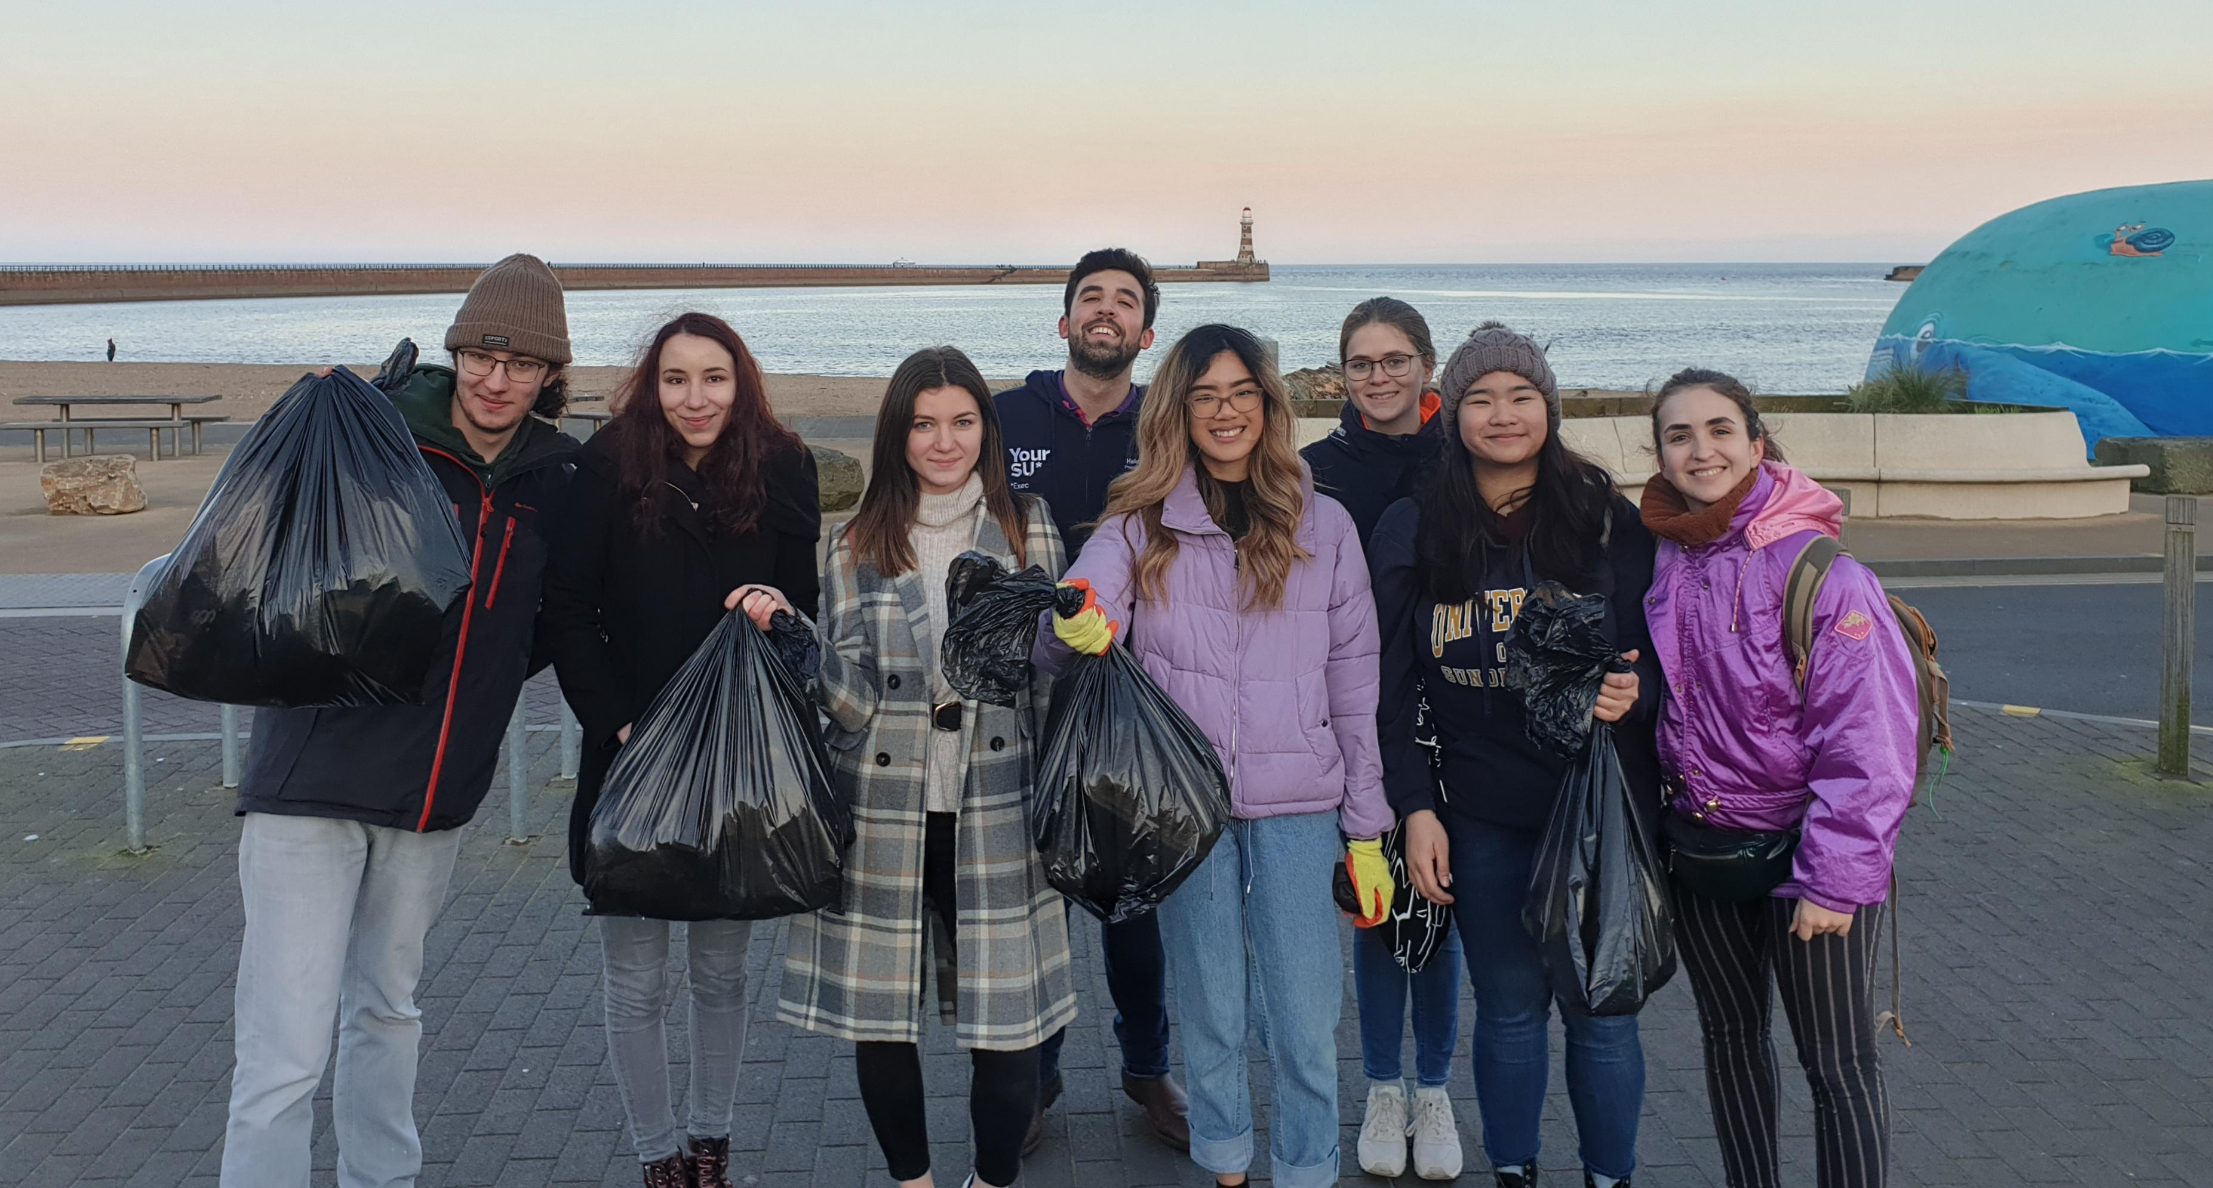
Community responsibility
© MCS
Notes:
To help students realise the environmental responsibility they have as citizens of their local community, conduct a local litter pick. The litter pick will help students see first hand the amount of litter in the environment and provide them with a great fieldwork experience.
If you’re close to a beach you can use our more detailed beach clean survey. If you can’t access a beach, use our national Source to Sea Litter Quest survey form in your local park, street or even school grounds. All information you need regarding, health and safety advice and litter survey forms is provided in the litter survey PDF document. After the survey, students should analyse and present their data to find out what the most common type of litter is in your local area. As a follow-up activity students could design a creative community campaign - please see extension activity for more details.

Slide 17
Activity 3
How can we reduce litter?

Slide 18
Notes:
Watch this video to summarise learning so far and introduce one way we can help to reduce the amount of waste we produce.

Slide 19
Is recycling the best option?
Notes:
After watching the video, pose the question, is recycling the best option? Have a class discussion.

Slide 20
8.3 billion metric tons
of plastic produced
6.3 billion metric tons
of plastic thrown away
Landfill or environment
Incinerated
Recycled
Notes:
A report in 2015 stated that 8.3 billion metric tons of plastics have been created, of which 6.3 billion have already been thrown away. And of that waste, only 9% was recycled.
(More info: 12% incinerated – with 79% accumulated in landfills or the natural environment)

Slide 21
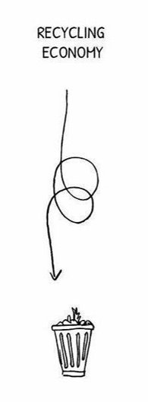
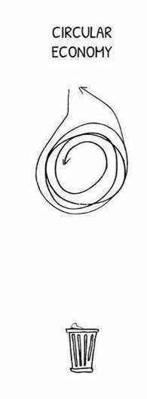
Circular Economy
Notes:
At the moment we have a quite linear economy, meaning products go straight from being made, to being sold, to being used, to thrown away.
In a recycling economy, items are made, sold, used and then recycled before being sold again. This is much better, but depends on what the material is. For example, most plastics can only be recycled up to 5 times before losing their strength.
In a circular economy, products are designed with their whole life cycle considered. Materials used are designed to be repairable, reused or recycled time and time again and therefore very little, or none, of the final product ends up as waste.

Slide 22
A circular economy explained
Notes:
Watch this video to explain the circular economy concept in more detail and then ask the question, how does a circular economy differ from recycling? Ask students to generate ideas in pairs before feeding into a group discussion.

Slide 23
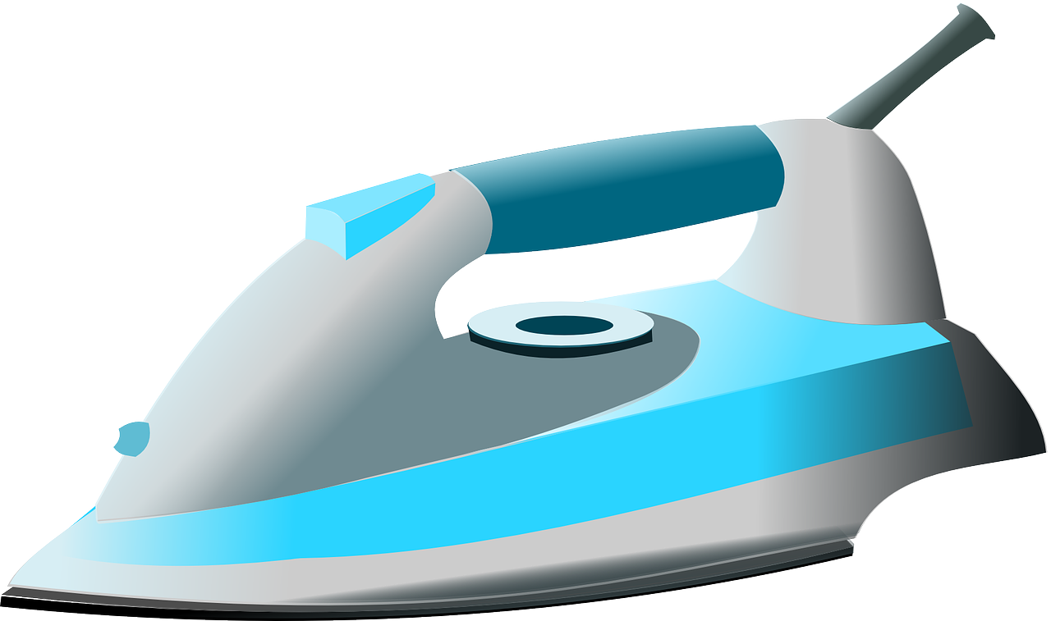
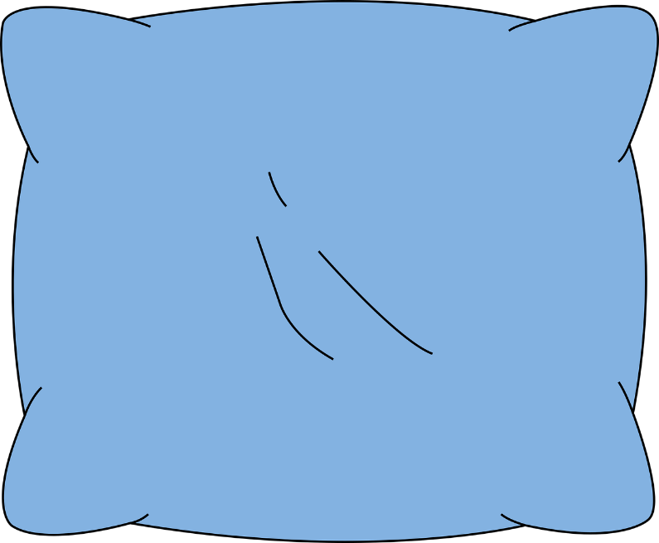
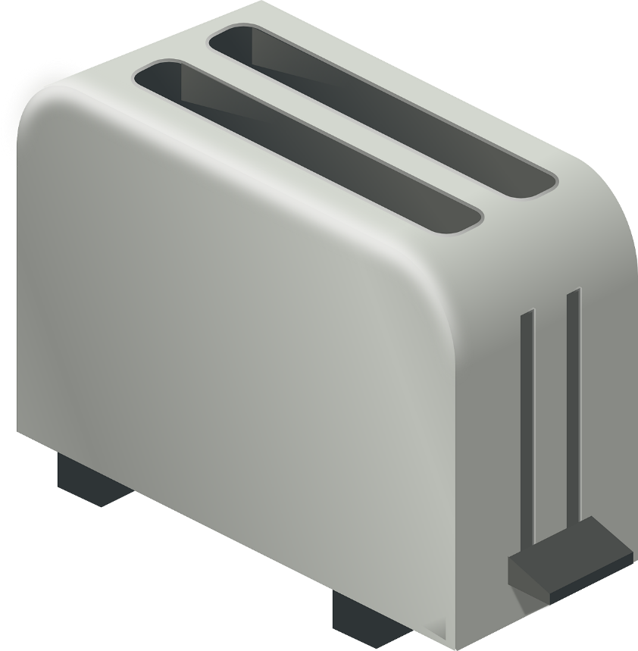
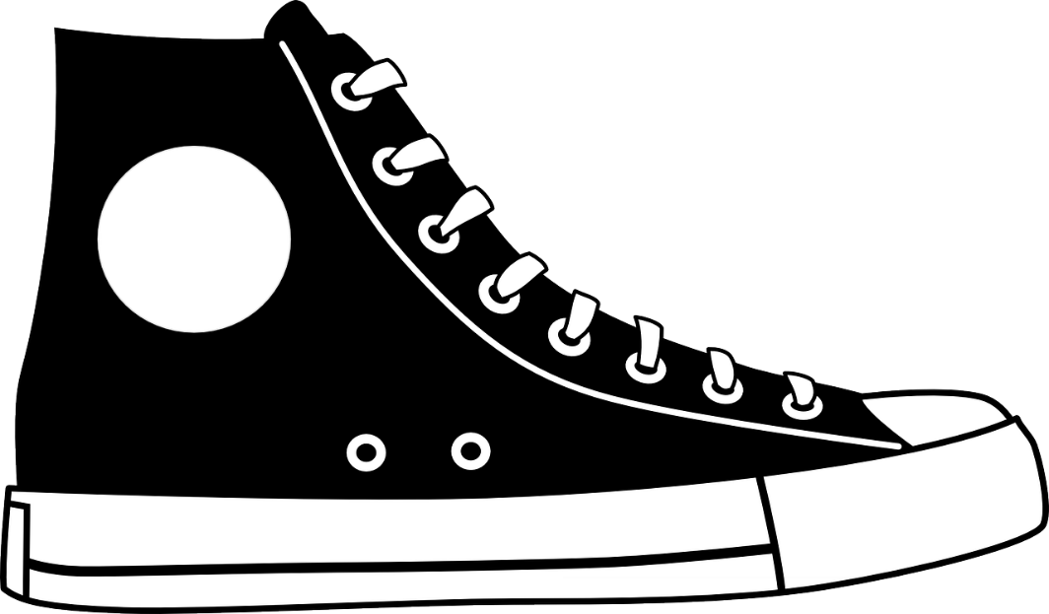
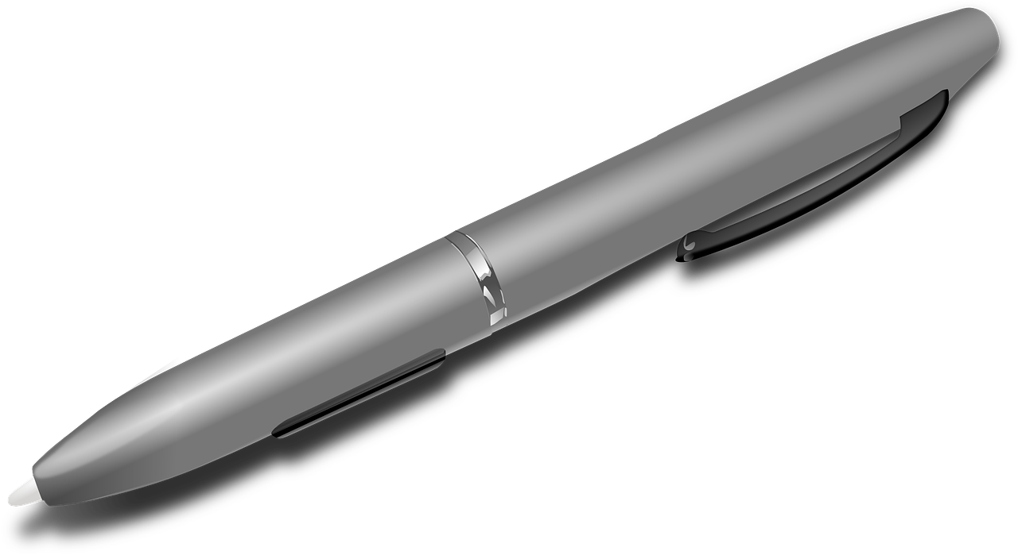
Designing a circular economy product
Notes:
In small groups, students should study a broken or unwanted product and consider what the product is used for, the length of time it’s used for, and all the components the product is made out of. Students should then consider how they could recreate this product using sustainable circular materials. Full activity details can be found in the Circular Classroom activity pack.
Link: https://circularclassroom.com/wp-content/uploads/2018/09/Module_3_Design_and_Creativity_EN.pdf

Slide 24
Extension activities
Data analysis

Slide 25
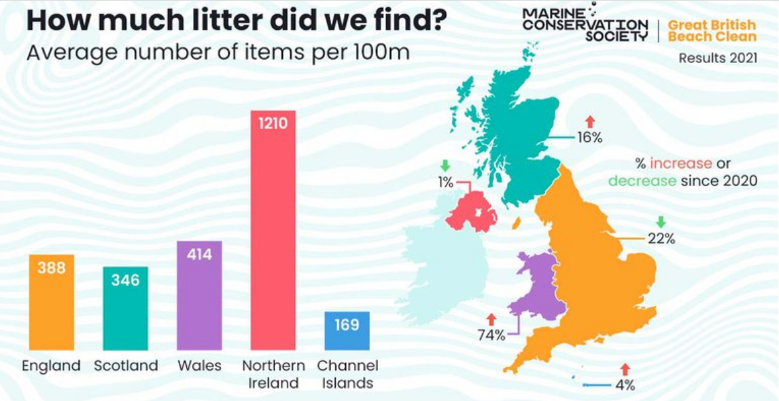
Notes:
We’ve collated 10 years’ worth of Great British Beach Clean data in from around the UK. We’ve organised the data and standardised the results to show an average per 100m of beach. In some cases our surveys are conducted over more than the standard 100m in our survey methodology, so to compare results, they must be standardised to 100m. This should make the data a bit easier to interpret and manipulate, but you could also tailor this further depending on your current curriculum focus and the age of your group.
Data could be used to explore patterns in a particular litter item over time, identify patterns in litter sources or look at frequency of different materials.
Pivot tables are useful to help compare various elements of data and are a key tool we use in our analysis. After a walkthrough of the data and how to sort it, students could then work to interrogate the data in collaborative groups (if possible) to identify a particular issue with an item, source or type of material, and then develop an action plan to reduce the issue. To provide contextual information our survey methodology we’ve provided an annotated dataset.

Slide 26
Extension activities
Forever chemicals

Slide 27
Forever chemicals
Per- and Polyfluoroalkyl Substances (PFAS)
Notes:
Pollution isn’t just about physical items you can see but also includes chemical pollution. One group of chemicals that we are worried about are per and polyfluorinated alkyl substances, or PFAS for short.
There are over 4,000 different chemicals in this family but they all have similar properties. They have an extremely strong bond which requires temperatures above 1000 degrees to break. They don’t break down in the environment and are nicknamed ‘forever chemicals’.
These chemicals can also build up through the food chain. PFAS are extremely mobile and have been found in rivers, seawater and even drinking water. They’ve even been found in polar regions, miles away from any industrial or consumer behaviour.

Slide 28
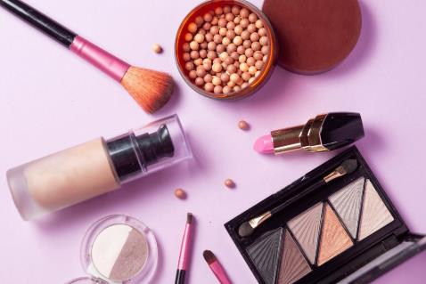
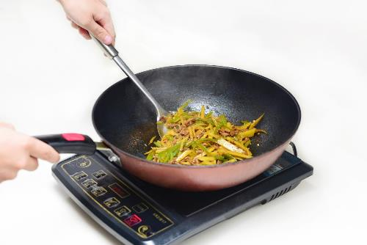
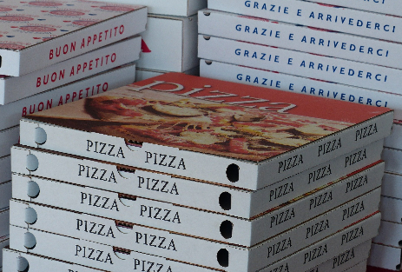
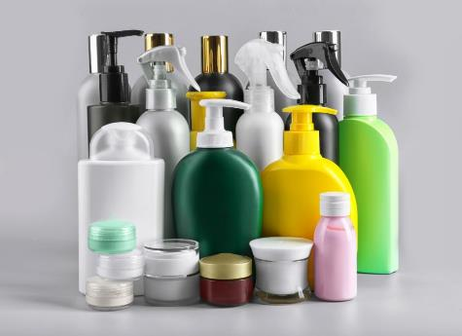
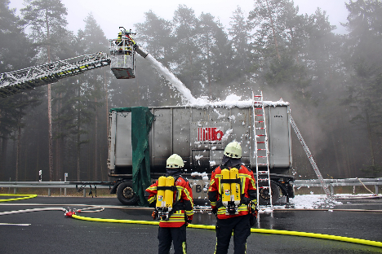
Clean Seas – Forever Chemicals
Notes:
PFAS are used in so many of our products because they have useful properties.
They improve the texture of cosmetics. One study showed around 49% of cosmetics investigated contained PFAS. They’re used in makeup, hair care, shaving products, face masks, and other face care products.
Every time we have a shower using cosmetics that contain PFAS, we are washing these chemicals down the drains, and they’ll eventually be released into the environment.
Due to their waterproof properties, PFAS are also used in many coats, outdoor equipment, food packing, non-stick pans and in firefighting foams.
(Images via Shutterstock & Pixabay)

Slide 29
PFAS Bead test
Notes:
Take part in FIDRA’s citizen science project to find out what food packing contains PFAS chemicals.
Collect paper and cardboard food packaging – this could be from the food stored in your home or from when you have been out to eat.
Carry out the simple ‘bead test’ shown in our helpful video. All you need is some food packaging, a pencil and some olive oil.
Then submit your results! - https://www.pfasfree.org.uk/beadtest#submit
https://www.pfasfree.org.uk/beadtest

Slide 30
Extension activities
Creative campaign

Slide 31
Notes:
Neat Streets campaigns use the latest behaviour change research and thinking from around the world to tackle littering behaviours. From flash mobs to talking bins, and naked bin men to chewing gum art, they have tested many different playful ways to reduce litter and are constantly refining our approach and testing new ideas.
Watch this video as inspiration to design a creative schools initiative to reduce waste and litter in the school grounds and/or in the local community.

Slide 32
Reflect
What have you learnt?

Slide 33
How does litter negatively impact the marine environment, economy and society?
Why do we have a social responsibility to reduce this impact?
How is your school connected to the ocean?
What does ‘circular economy’ mean?
How could we as individuals, a school or community reduce litter in the environment?

Slide 34
We will continue to fight for the ocean and protect wildlife

