Slide 1
Sustainable fishing

Slide 2
Learning Objectives
Describe several ecosystem impacts of unsustainable fishing.
Analyse data to determine change over time.
Analyse infographics to determine ecosystem impacts of aquaculture.
Generate creative solutions to reducing negative impacts of fishing practices.

Slide 3
Set the scene
What is an ecosystem?
Notes:
Question to students - What is an ecosystem?
An ecosystem is a natural environment in which plants and animals interact and interconnect. Ecosystems are influenced by biotic factors, like the plants and animals living there, and by abiotic factors including climate, sediment and water. The term 'ecosystem' is used broadly to describe these interactions between biotic and abiotic factors in an environment. A small pond and the whole ocean are both examples of ecosystems. An ecosystem refers to a habitat and its community of plants and animals.

Slide 4
Set the scene
What does sustainable mean?
Notes:
Question to students - What does the word sustainable mean?
There are lots of different definitions for sustainable, but a simple definition is ‘enough for all forever.’
In the case of sustainable seafood, this would mean making sure there is:
Enough seafood – not being greedy and taking more than we need, but just taking enough to feed us.
For all – would mean to feed all humans across the world and all animals too.
Forever – would mean enough seafood for future generations.

Slide 5
Activity 1
Ecosystem Impacts
Notes:
Activity 1 - Ecosystem impacts of unsustainable fishing
Activity 1 focuses on ecosystem impacts of unsustainable fishing and is split into four mini activities looking at overfishing, habitat destruction, food web dynamics and bycatch:
Overfishing – Using the ecosystem impacts worksheet, students should analyse the graph showing global trends in fish stocks and record their answers on the worksheet.
Habitat destruction – Watch the video on slide 9 and complete the associated questions on the ecosystem impacts worksheet.
Food web dynamics – Play the food web game using the instructions and cards provided in the lesson plan. The game explores how overfishing alters food web dynamics. After completing the game, students should answer the associated questions on the ecosystem impacts worksheet.
Bycatch - Watch the video on slide 11 and complete the associated questions on the ecosystem impacts worksheet.
Resources required: Sustainable Fishing PowerPoint, Ecosystem impacts of fishing worksheet, Food web game

Slide 6
Habitat destruction
Overfishing
Ecosystem impacts of unsustainable fishing
Food web dynamics
Bycatch
Notes:
Activity 1 - Ecosystem impacts of unsustainable fishing
Activity 1 focuses on ecosystem impacts of unsustainable fishing and is split into four mini activities looking at overfishing, habitat destruction, food web dynamics and bycatch:
Overfishing – Using the ecosystem impacts worksheet, students should analyse the graph showing global trends in fish stocks and record their answers on the worksheet.
Habitat destruction – Watch the video on slide 9 and complete the associated questions on the ecosystem impacts worksheet.
Food web dynamics – Play the food web game using the instructions and cards provided in the lesson plan. The game explores how overfishing alters food web dynamics. After completing the game, students should answer the associated questions on the ecosystem impacts worksheet.
Bycatch - Watch the video on slide 11 and complete the associated questions on the ecosystem impacts worksheet.
Resources required: Sustainable Fishing PowerPoint, Ecosystem impacts of fishing worksheet, Food web game

Slide 7
Overfishing
Source: Marine Stewardship Council
Notes:
Read through the diagram on this slide to introduce students to overfishing and the concept of maximum sustainable yield.

Slide 8
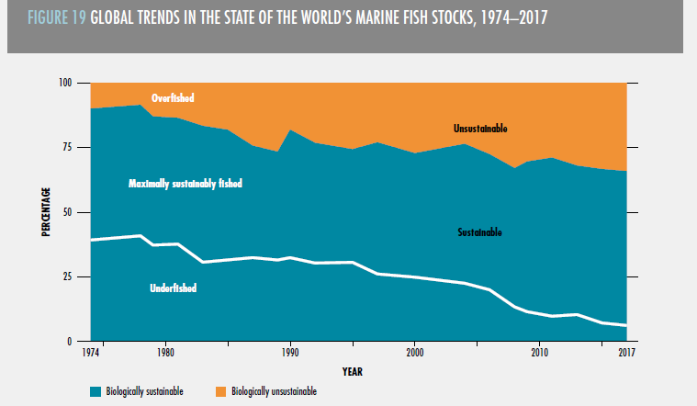
Overfishing
Notes:
Use the ecosystems impacts worksheet to analyse and interpret the graph showing global trends of fish stocks from 1974-2017

Slide 9
Habitat destruction
Notes:
Watch the video and answer the questions of the ecosystem impacts worksheet. You may need to double click on the image to play the video.

Slide 10
Food web dynamics
Notes:
Play the food web game (all instructions and cards provided in the lesson plan) which looks at how overfishing alters food web dynamics and then complete associated questions on the ecosystem impacts worksheet.

Slide 11
Bycatch
Notes:
Watch the video and answer the questions of the ecosystem impacts worksheet. You may need to double click on the image to play the video.
Answers for question 3 - Why is bycatch bad for wildlife and unsustainable?
1. Even when bycatch is thrown back most of the creatures are dead or dying
2. A lot of juvenile fish get taken as bycatch which means they can’t grow up and reproduce which can change food web dynamics and the balance of ecosystems
3. Threatened and endangered species are often landed as bycatch

Slide 12
Activity 2
Managing fishing in a sustainable way
Notes:
Activity 2 - Managing fishing in a sustainable way
Split the class into small groups. Give each group one of the ecosystem impacts covered in Activity 1 (overfishing, habitat destruction, food web dynamics and bycatch). Each group should mind map how we could improve fishing practices and the fishing industry to decrease their allocated ecosystem impact and make fishing more sustainable.
To help the students generate ideas, write some key words on the whiteboard - for example: fishing gear, boats, species, habitats, protection, law.
After 5 minutes, ask students to share their ideas and create a mind map on the board for each ecosystem impact with everyone’s ideas. Many ideas will have crossover between the different ecosystem impacts. Stress to students that in order for fishing to be sustainable we need to consider ways to reduce all the ecosystem impacts. Notes are provided in the fact file to help you with this activity.

Slide 13
Managing fishing sustainably
Key terms:
Boats
Fishing gear
Species
Protection
Habitats
Law
Notes:
To aid the students to generate the ideas, write some key words on the whiteboard, for example; fishing gear, boats, species, habitats, protection, law.

Slide 14
Activity 3
Aquaculture
Notes:
Activity 3 – Aquaculture
Introduce aquaculture as a fishing practice using the following slides.
Using the aquaculture worksheet, students should analyse the infographics and draw out key points to create a table of positives and negatives of aquaculture. Students should think about ecosystem impacts, food supply, climate impact and overall sustainability and should not be restricted to the information on the infographics alone but also add their own knowledge and their own thoughts to their table.
To introduce positive solutions for sustainable aquaculture show students the video on slide 19. After watching use the questions in the notes section of the PowerPoint to discuss 3D farming.
Resources required: Aquaculture infographics, Aquaculture worksheet

Slide 15
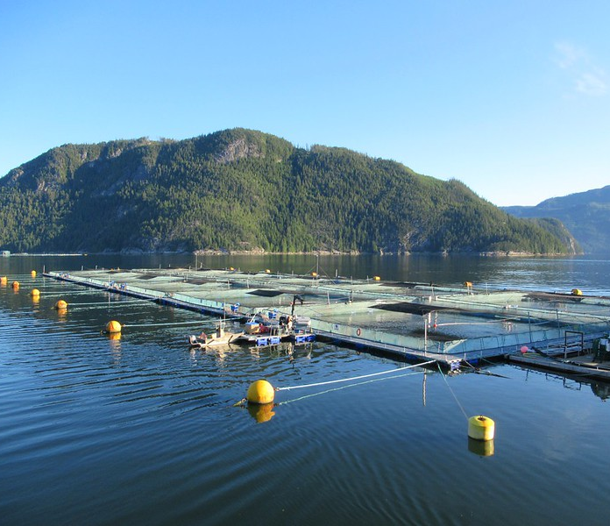
Aqua
= water
Culture
= Agriculture/cultivation
Direct Services
Many species of seafood can be farmed, including salmon, trout, prawns, shrimp, mussels, oysters and seaweed.
© David Stanley via Flickr
© David Stanley via Flickr
© Mark Kirkland
Notes:
The term aquaculture is derived from ‘aqua’ meaning water and ‘culture’ meaning agriculture or cultivation. Aquaculture is a catch-all term for farming of freshwater or saltwater species. Many species of seafood can be farmed such as salmon, trout, prawns, shrimp, mussels, oysters and seaweed.

Slide 16
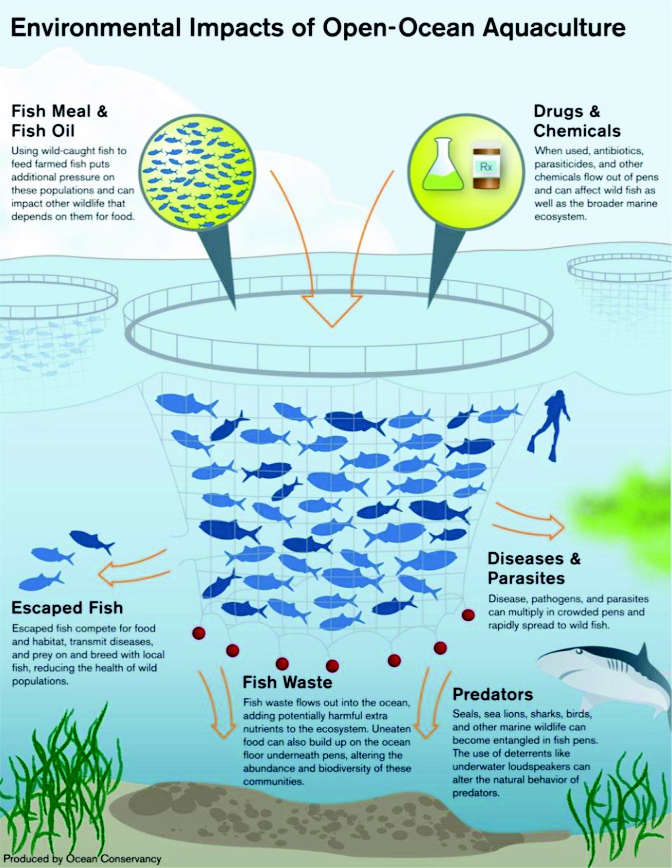
Direct Services
© Mark Kirkland
© Rich Carey, Shutterstock
Notes:
Using the aquaculture worksheet, students should analyse the infographics and draw out key points to create a table of positives and negatives of aquaculture. Students should think about ecosystem impacts, food supply, climate impact and overall sustainability and should not be restricted to the information on the infographics alone but also add their own knowledge and their own thoughts to their table.

Slide 17
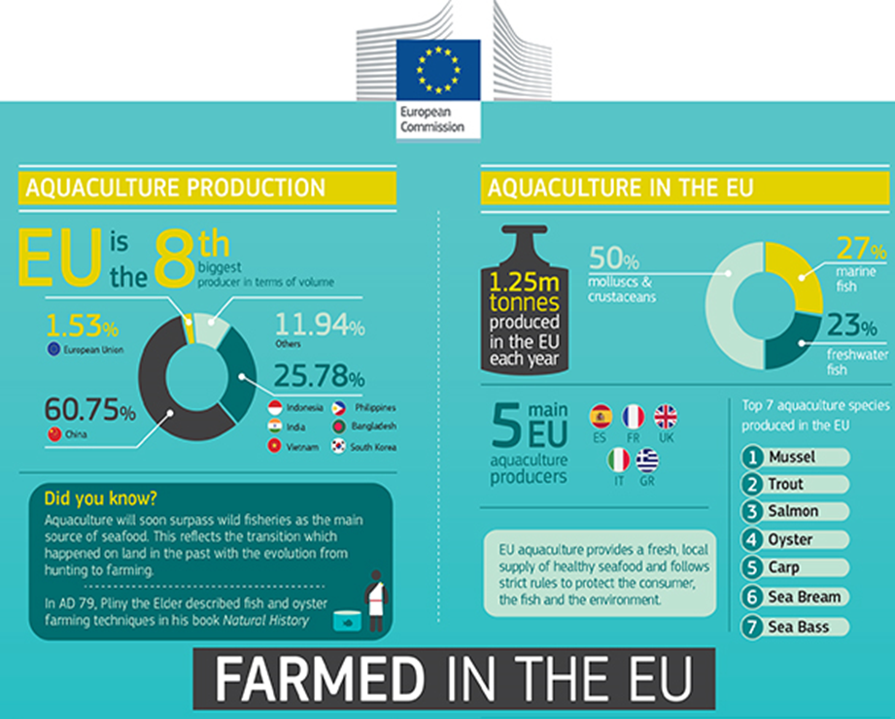
Direct Services
© Mark Kirkland
© Rich Carey, Shutterstock
Notes:
Using the aquaculture worksheet, students should analyse the infographics and draw out key points to create a table of positives and negatives of aquaculture. Students should think about ecosystem impacts, food supply, climate impact and overall sustainability and should not be restricted to the information on the infographics alone but also add their own knowledge and their own thoughts to their table.

Slide 18
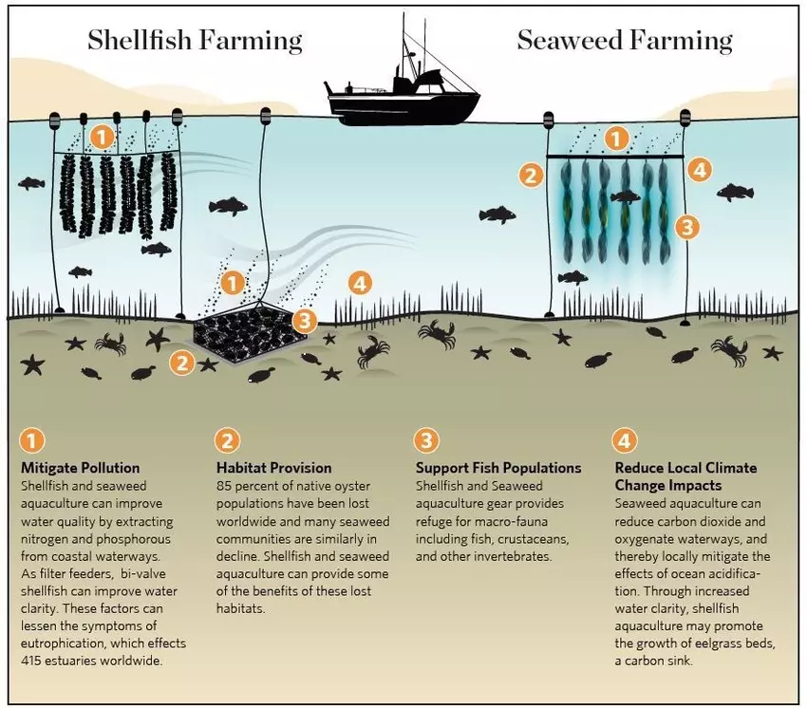
Direct Services
© Mark Kirkland
Source: The Nature Conservancy

Slide 19
Direct Services
© Mark Kirkland
© Rich Carey, Shutterstock
Notes:
To introduce positive solutions for sustainable aquaculture show students this video. After watching, use the questions below to discuss 3D farming.
Question to students - What seafood was being farmed in the video? ANSWER - Seaweed, scallops, mussels, oysters.
Question to students – What makes this type of farming sustainable? ANSWER (featured in video) - No fresh water, no fertiliser, no feed, no arable land
Question to students – What other benefits to this type of farming were discussed in the video. ANSWER - Shellfish and kelp absorb carbon. They also filter nitrogen out of the water column. 3D farms create storm protectors.

Slide 20
Extension activity
Summary videos

Slide 21
This is a sustainable fish
© Mark Kirkland
Notes:
This video sums up the ecosystem impacts of fishing and what sustainable means. (Stop playing at 2:11 as last section is America focused). It could be shown before Activity 3 to sum up what has been learnt and to introduce aquaculture.

Slide 22
Will the ocean ever run out of fish?
© Mark Kirkland
Notes:
This video brings together everything learnt in this lesson from overfishing, habitat destruction and management challenges. You could watch this at the end of your lesson and ask students to write a paragraph to summarise all they have learnt.

Slide 23
Reflect
What have you learnt?

Slide 24
Learning Objectives
How does unsustainable fishing lead to:
overfishing
habitat destruction
a change in food web dynamics
bycatch?
How could we manage fishing practices more efficiently to reduce unsustainable fishing?
What is aquaculture? How can the environmental impacts of aquaculture be reduced?

Slide 25
We will continue to fight for the ocean and protect wildlife

