Slide 1

Biodiversity

Slide 2
Learning Objectives
Define the terms: biome, ecosystems, biodiversity and species.
Identify key marine habitats found in the UK.
Name at least two marine species found in the UK and be able to explain how they are adapted to their habitat.
Understand how species are connected to form an ecosystem.

Slide 3
Set the scene
Key terms

Slide 4

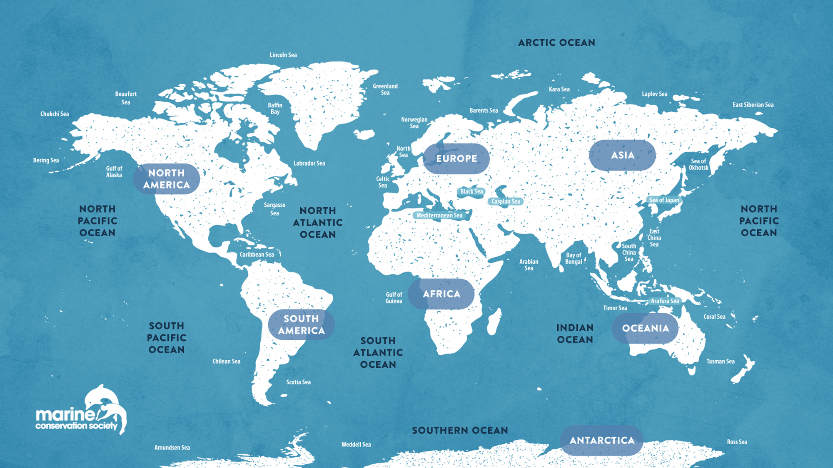

What is a biome?
Notes:
A biome refers to an area of our planet with similar climates, landscapes, animals and plants. Within the ocean we have five main biomes: Atlantic Ocean, Pacific Ocean, Indian Ocean, Southern Ocean, and the Arctic Ocean.
Question to students - What is the nearest ocean biome to you?

Slide 5
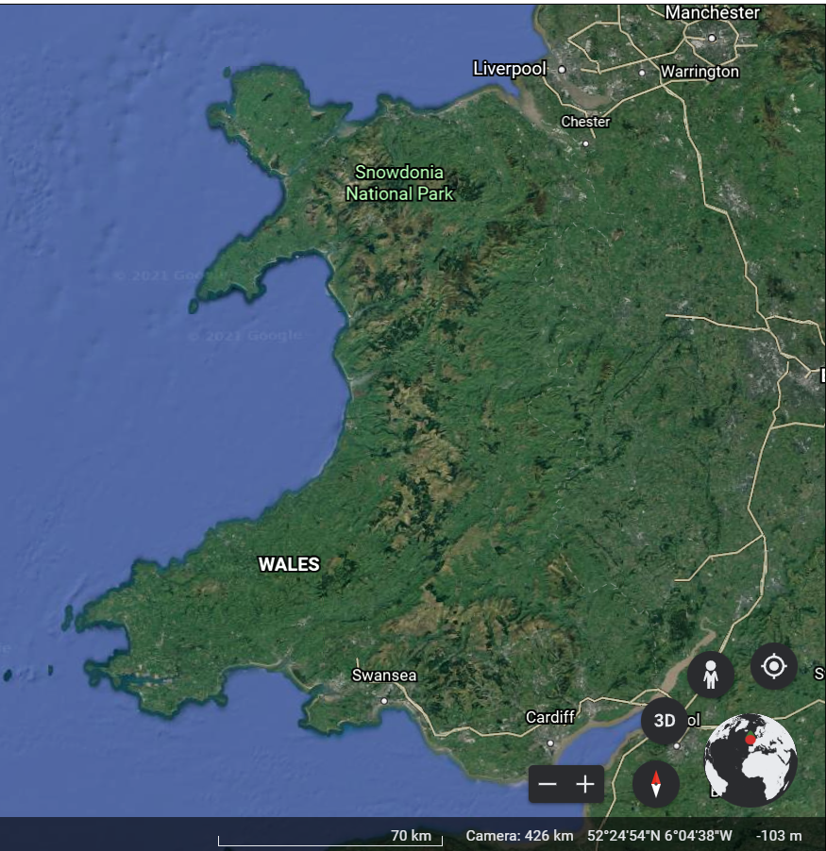
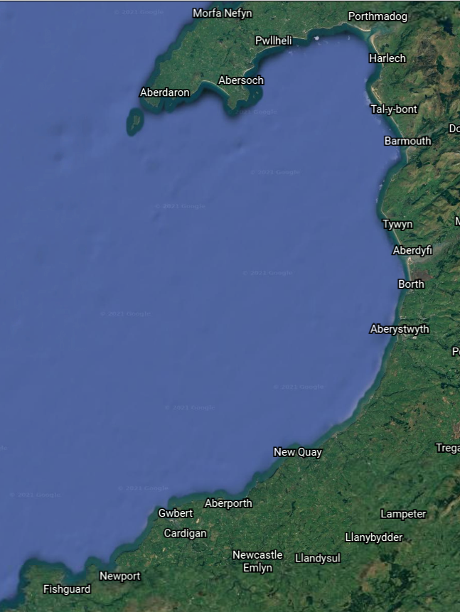
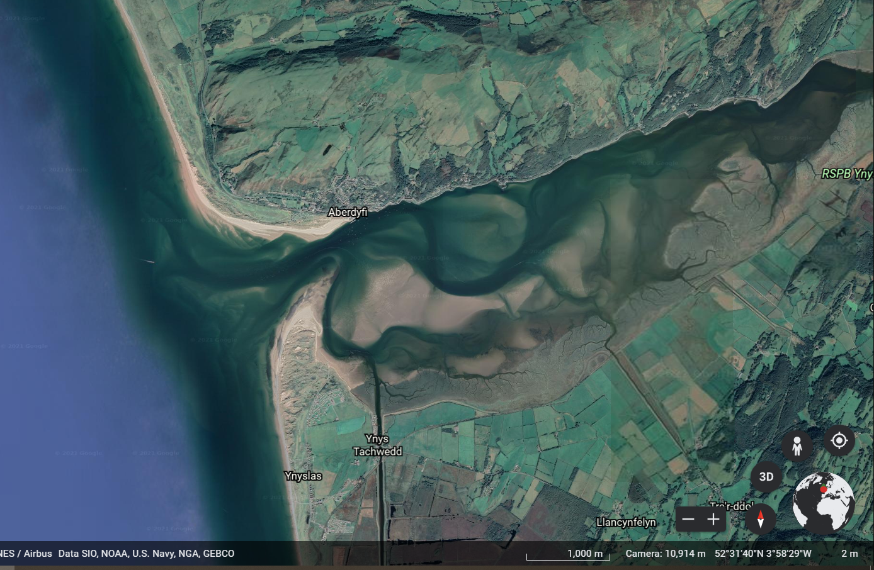
What is an ecosystem?
© Google Earth
Notes:
Question to students - Does anyone know what an ecosystem is?
An ecosystem is a natural environment in which plants and animals interact and interconnect. Ecosystems are influenced by biotic factors, like the plants and animals living there, and by abiotic factors including climate, sediment and water. The term 'ecosystem' is used broadly to describe these interactions between biotic and abiotic factors in an environment. A small pond and the whole ocean are both examples of ecosystems. An ecosystem refers to a habitat and its community of plants and animals.
Within the biome of the North Atlantic Ocean is the Welsh coastline
To use this as an example, let's focus in further and explore the Cardigan Bay area
Within Cardigan Bay there are a diverse range of ecosystems
The Dyfi Estuary is an example of one of these ecosystems.

Slide 6
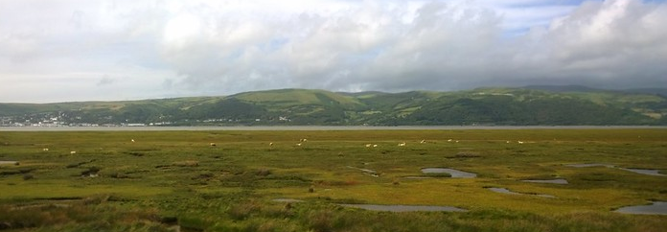
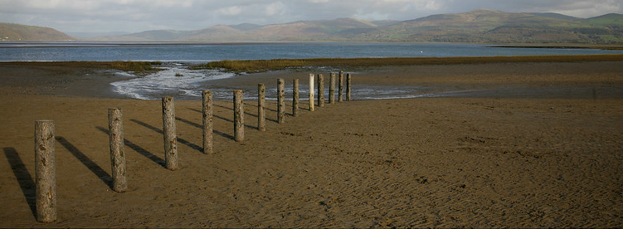
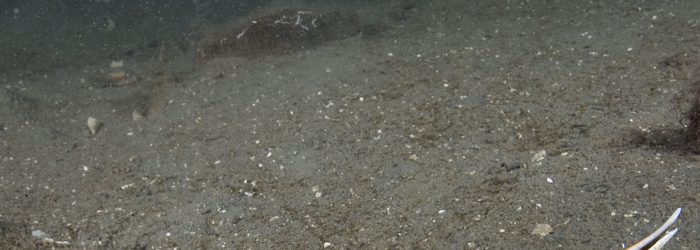
What is a habitat?
© Ruth Hartnup via Flickr
© Umbrrllahead56 via Flickr
© Google Earth
Notes:
Within the estuary there are several habitats.
Question to students – What is a habitat?
Habitat – A habitat is the natural home or environment in which an animal, plant or organism lives. A habitat contains all an organism needs to survive, like food and shelter.
In the Dyfi Estuary there are many habitats, including saltmarsh, intertidal mud flats, and underwater mud.
A microhabitat is a small area within a larger habitat which is home to a species. In a saltmarsh, for example, the microhabitat for a marine worm would be its burrow, whereas the microhabitat for a coastal bird would be its nest at the top of the saltmarsh.

Slide 7
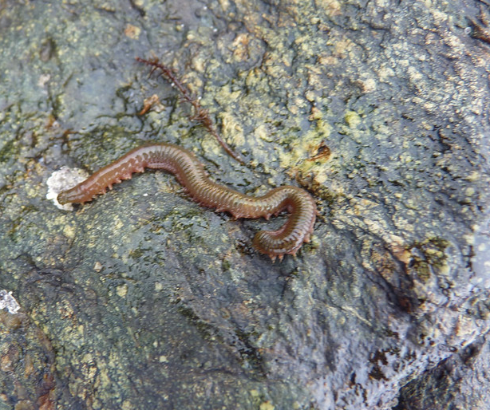
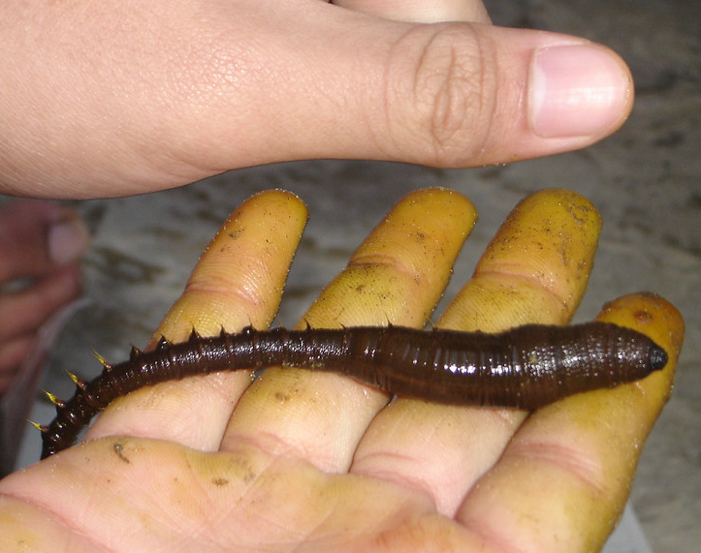
What is a species?
© Images via Flickr
Notes:
Within a habitat is a diverse range of species.
Question to students – Can anyone try to define the term 'species'?
A species is a group of living organisms consisting of similar individuals that share common characteristics and are capable of interbreeding.
This is an image of a rag worm. In Wales there are several species of worms that live in saltmarsh mud, including sand mason worms and species of lug worms and rag worms.

Slide 8
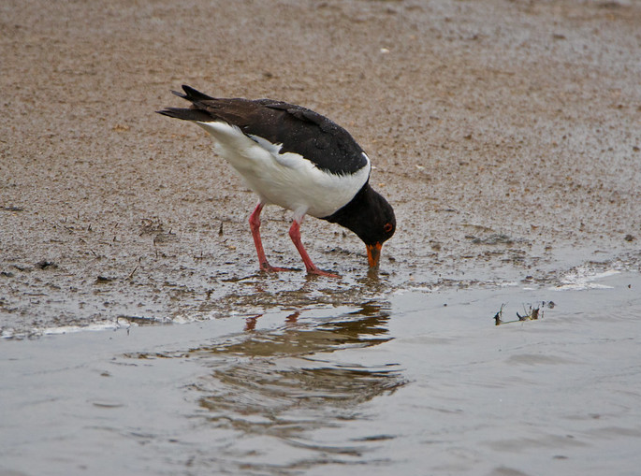
What is adaptation?
© Odd wellies via Flickr
© Stephen Gidley via Flickr
Notes:
Question to students – Can anyone try to define the term 'adaptation'?
The rag worm Hediste diversicolor is well adapted to estuaries and can tolerate ranging salinities. It has adapted to this muddy environment by living in a burrow to hide from predators like crabs and birds. In winter, it digs deeper into the mud to escape cooling temperatures. Deeper is also safer to avoid long bird beaks.
Rag worms have adapted to feed without having to leave their burrow and be spotted by predators. The rag worm spins a mucus web that sits at the entrance to their burrow and traps small plants and animals, and it then consumes the whole web.

Slide 9
Activity 1
Habitats
Notes:
There are many important marine habitats along the Welsh coastline. Here's a selection of some key marine habitats.
Activity 1
Use the images and notes in each slide to explore key marine habitats. After introducing the habitats, split the class into small groups of 3-4 and allocate a habitat to each group. Provide each group with a laptop and complete the habitat worksheet, making notes on habitat location, the physical and biological characteristics of their habitat, and the diversity of animals and plants living there. Students should then present their findings back to the class.

Slide 10
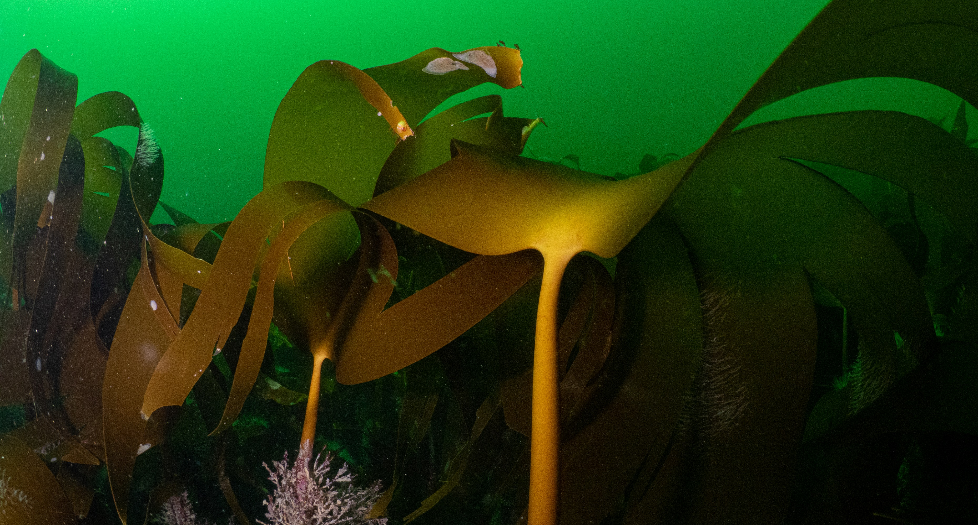
Kelp
© Mark Kirkland
Notes:
Kelp is a type of large brown seaweed that grows in cool shallower waters. Seaweeds are often mistaken for plants, but are actually algae. Kelp are often found together forming an underwater forest known as a kelp bed. The structure of the kelp beds provide a great habitat for many species to shelter and find food. This diverse habitat is home to fish, crabs, sponges, sea stars and is a hunting ground for seals and sea­birds. The leafy canopy acts as a nursery for juvenile fish, including cod, pollock, haddock and wrasse.

Slide 11
Seagrass
Notes:
Seagrass is the only flowering plant in the ocean. It's found in calm, shallow, sunlit coastal waters around the world. When seagrass grows in large areas, the habitat it creates is described as a ‘seagrass meadow’. Globally, seagrass meadows are known for their value as fish nurseries for many important species, including flatfish and cuttlefish. Seagrass meadows are also home to many bivalves, worms, starfish and to rare stalked jellyfish.

Slide 12
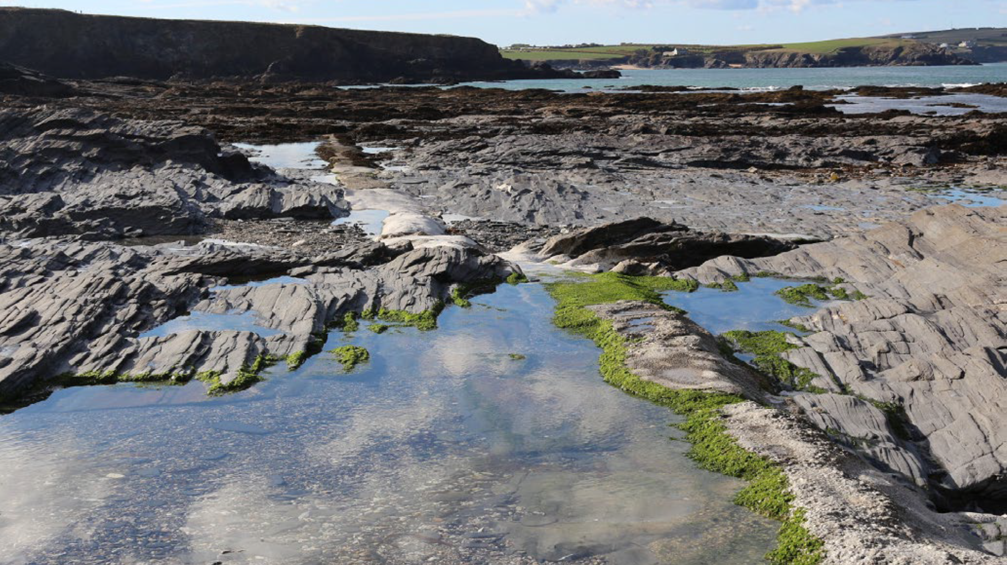
Rockpools
Notes:
Rockpools provide a home to a diverse range of plants and animals that have adapted to live in this harsh, ever-changing environment. There are many places for animals to find shelter, both in the cracks and crevices of the rocks and under boulders. Many seaweeds live here, as they need the hard rock to attach to. These seaweeds provide shelter and food for other species, including many species of fish, starfish, and crabs. Rockpools are also home to many species of animals that need to live on the rocks, including anemones, sea snails, limpets, and barnacles.

Slide 13
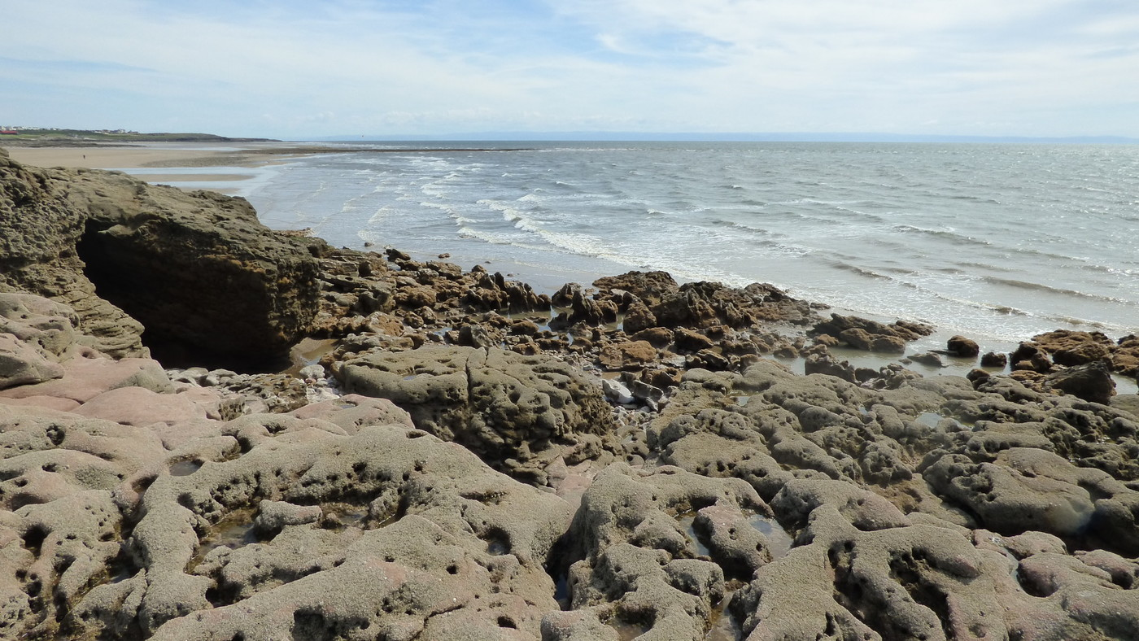
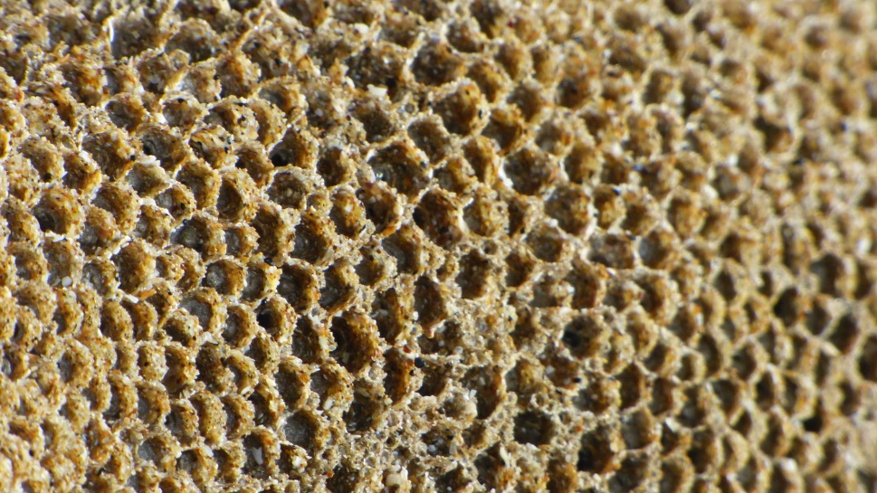
Honeycomb worm reef
© Richard Harrington
Notes:
Honeycomb worm reefs (Sabellaria alveolata) can be found across the UK, but most commonly in Wales. The worm uses sand and shell fragments to form tubes, and numerous tubes together form boulder-like structures. Several of these structures together form reefs. These reefs are found on hard rock on open coast with nearby sand. The diversity of other species is low compared to habitats like rockpools, but the structures the worms create do provide shelter for some species. Honeycomb worm reefs often form together with mussel beds, and can be home to barnacles and sea snails.

Slide 14

Underwater mud
© Paul Naylor
Notes:
Underwater mud might not sound like a very glamourous habitat, but a huge diversity of animals live in muddy areas. Species of bristle worms, shrimps, lobsters and bivalves burrow in the mud. On the seafloor are beautiful seapens, common skates, flatfish and spider crabs.

Slide 15
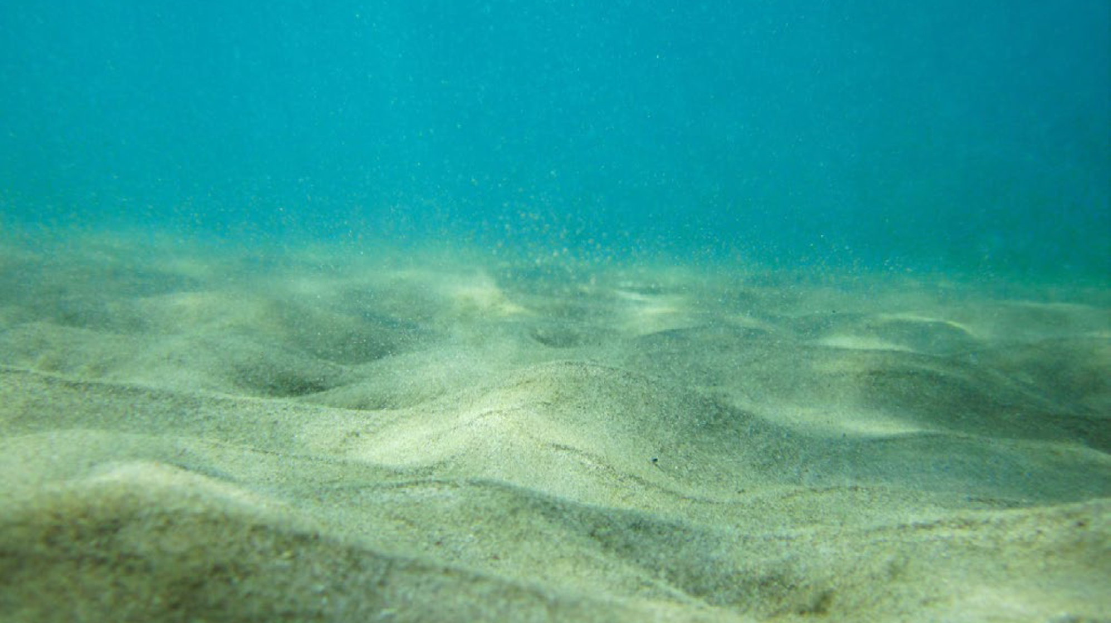
Underwater sand and gravel
Notes:
Underwater sand and gravel is the most common marine habitat. It may at first glance look barren, but these areas are home to a large variety of animals including sand eels, rays, sea cucumbers, burrowing urchins, starfish, bivalves and many species of fish and crustaceans like shrimp, prawns and crabs. Many fish use these areas to hide their eggs in burrows in the seabed.

Slide 16
Activity 2
Species
Notes:
Activity 2 – Part 1
Use the following slides to introduce some key charismatic and important species that are found in UK seas. Share facts provided in the notes section of each slide.

Slide 17
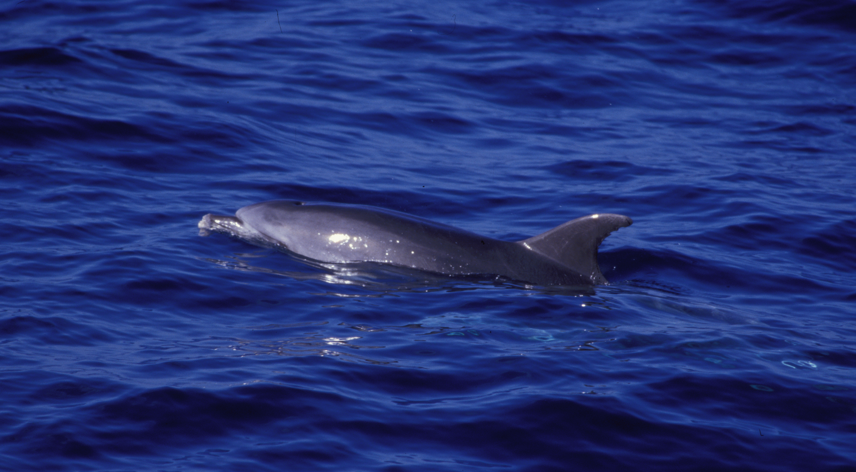
Bottlenose dolphin
© Graeme Cresswell
Notes:
Bottlenose dolphins can grow up to 4 metres long. They are sociable creatures, generally living in groups of 3-10 individuals, and are often seen leaping out of the water. Bottlenose dolphins can be spotted across the UK but there are two main semi-resident populations: one in the Cardigan Bay area of Wales, and one in the Moray Firth in Scotland.

Slide 18
Harbour porpoise
© Graeme Cresswell
Notes:
Harbour porpoises are often mistaken for bottlenose dolphins, but are much smaller with a stubbier dorsal fin. They can be found along the majority of the UK coastline. They mainly eat small fish, and with high metabolism, have to eat about 10% of their body weight every day.

Slide 19
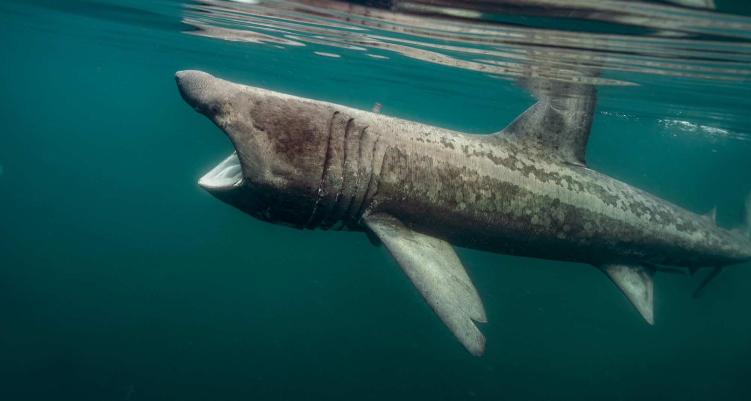
Basking shark
© Peter Bardsley
Notes:
Basking sharks are 8-10 metres in length, making them the second-largest fish in the world.
Question to students – Does anyone know what basking sharks eat?
They are filter feeders, feeding on tiny plankton species.

Slide 20
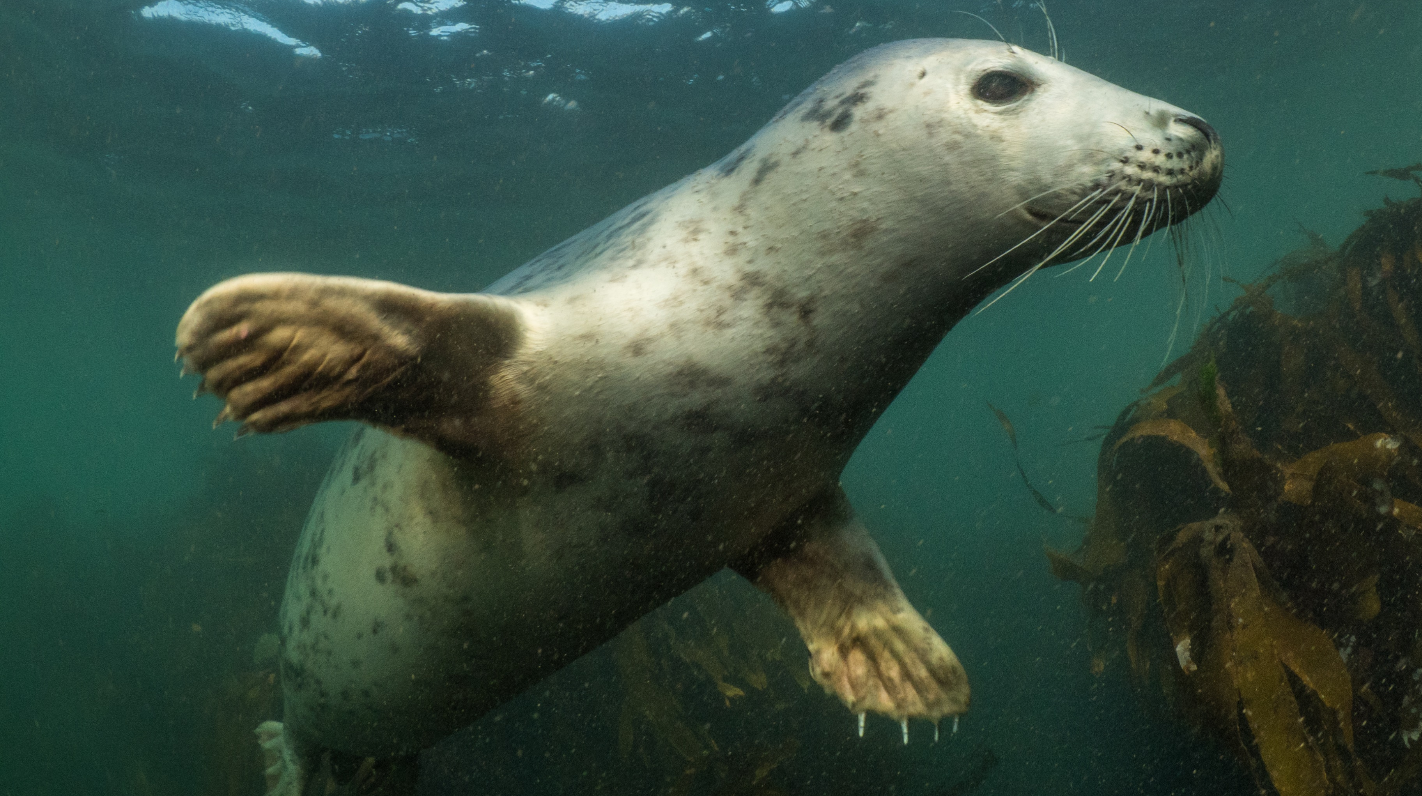
Atlantic grey seal
© Mark Kirkland
Notes:
Atlantic grey seals are common in the UK, with 40% of the world’s population found here. They spend most of their time hunting for fish, but are often spotted when they come to shore to rest and to breed.

Slide 21
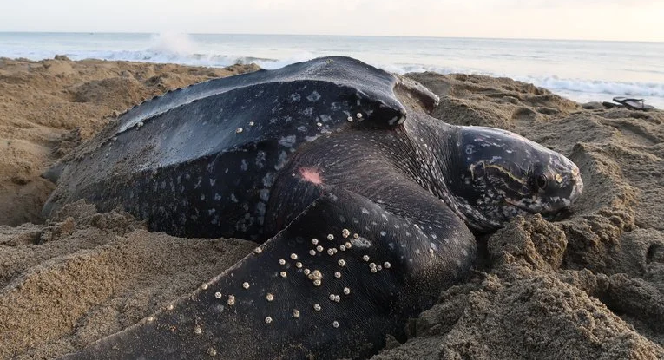
Leatherback turtle
© William Farah via Shutterstock
© Mark Kirkland
Notes:
Leatherback turtles travel from tropical seas to visit cooler waters, including the UK.
Question to students – Why do you think leatherbacks migrate all the way to the UK?
They travel to feed on jellyfish in summer months. They are the largest sea turtle in the world, and can grow to around 1.8 metres. One of the largest turtles ever recorded was found washed up at Harlech beach, North Wales, in 1988 and weighed over 2,000 lbs. Unfortunately leatherback turtles are an endangered species.

Slide 22
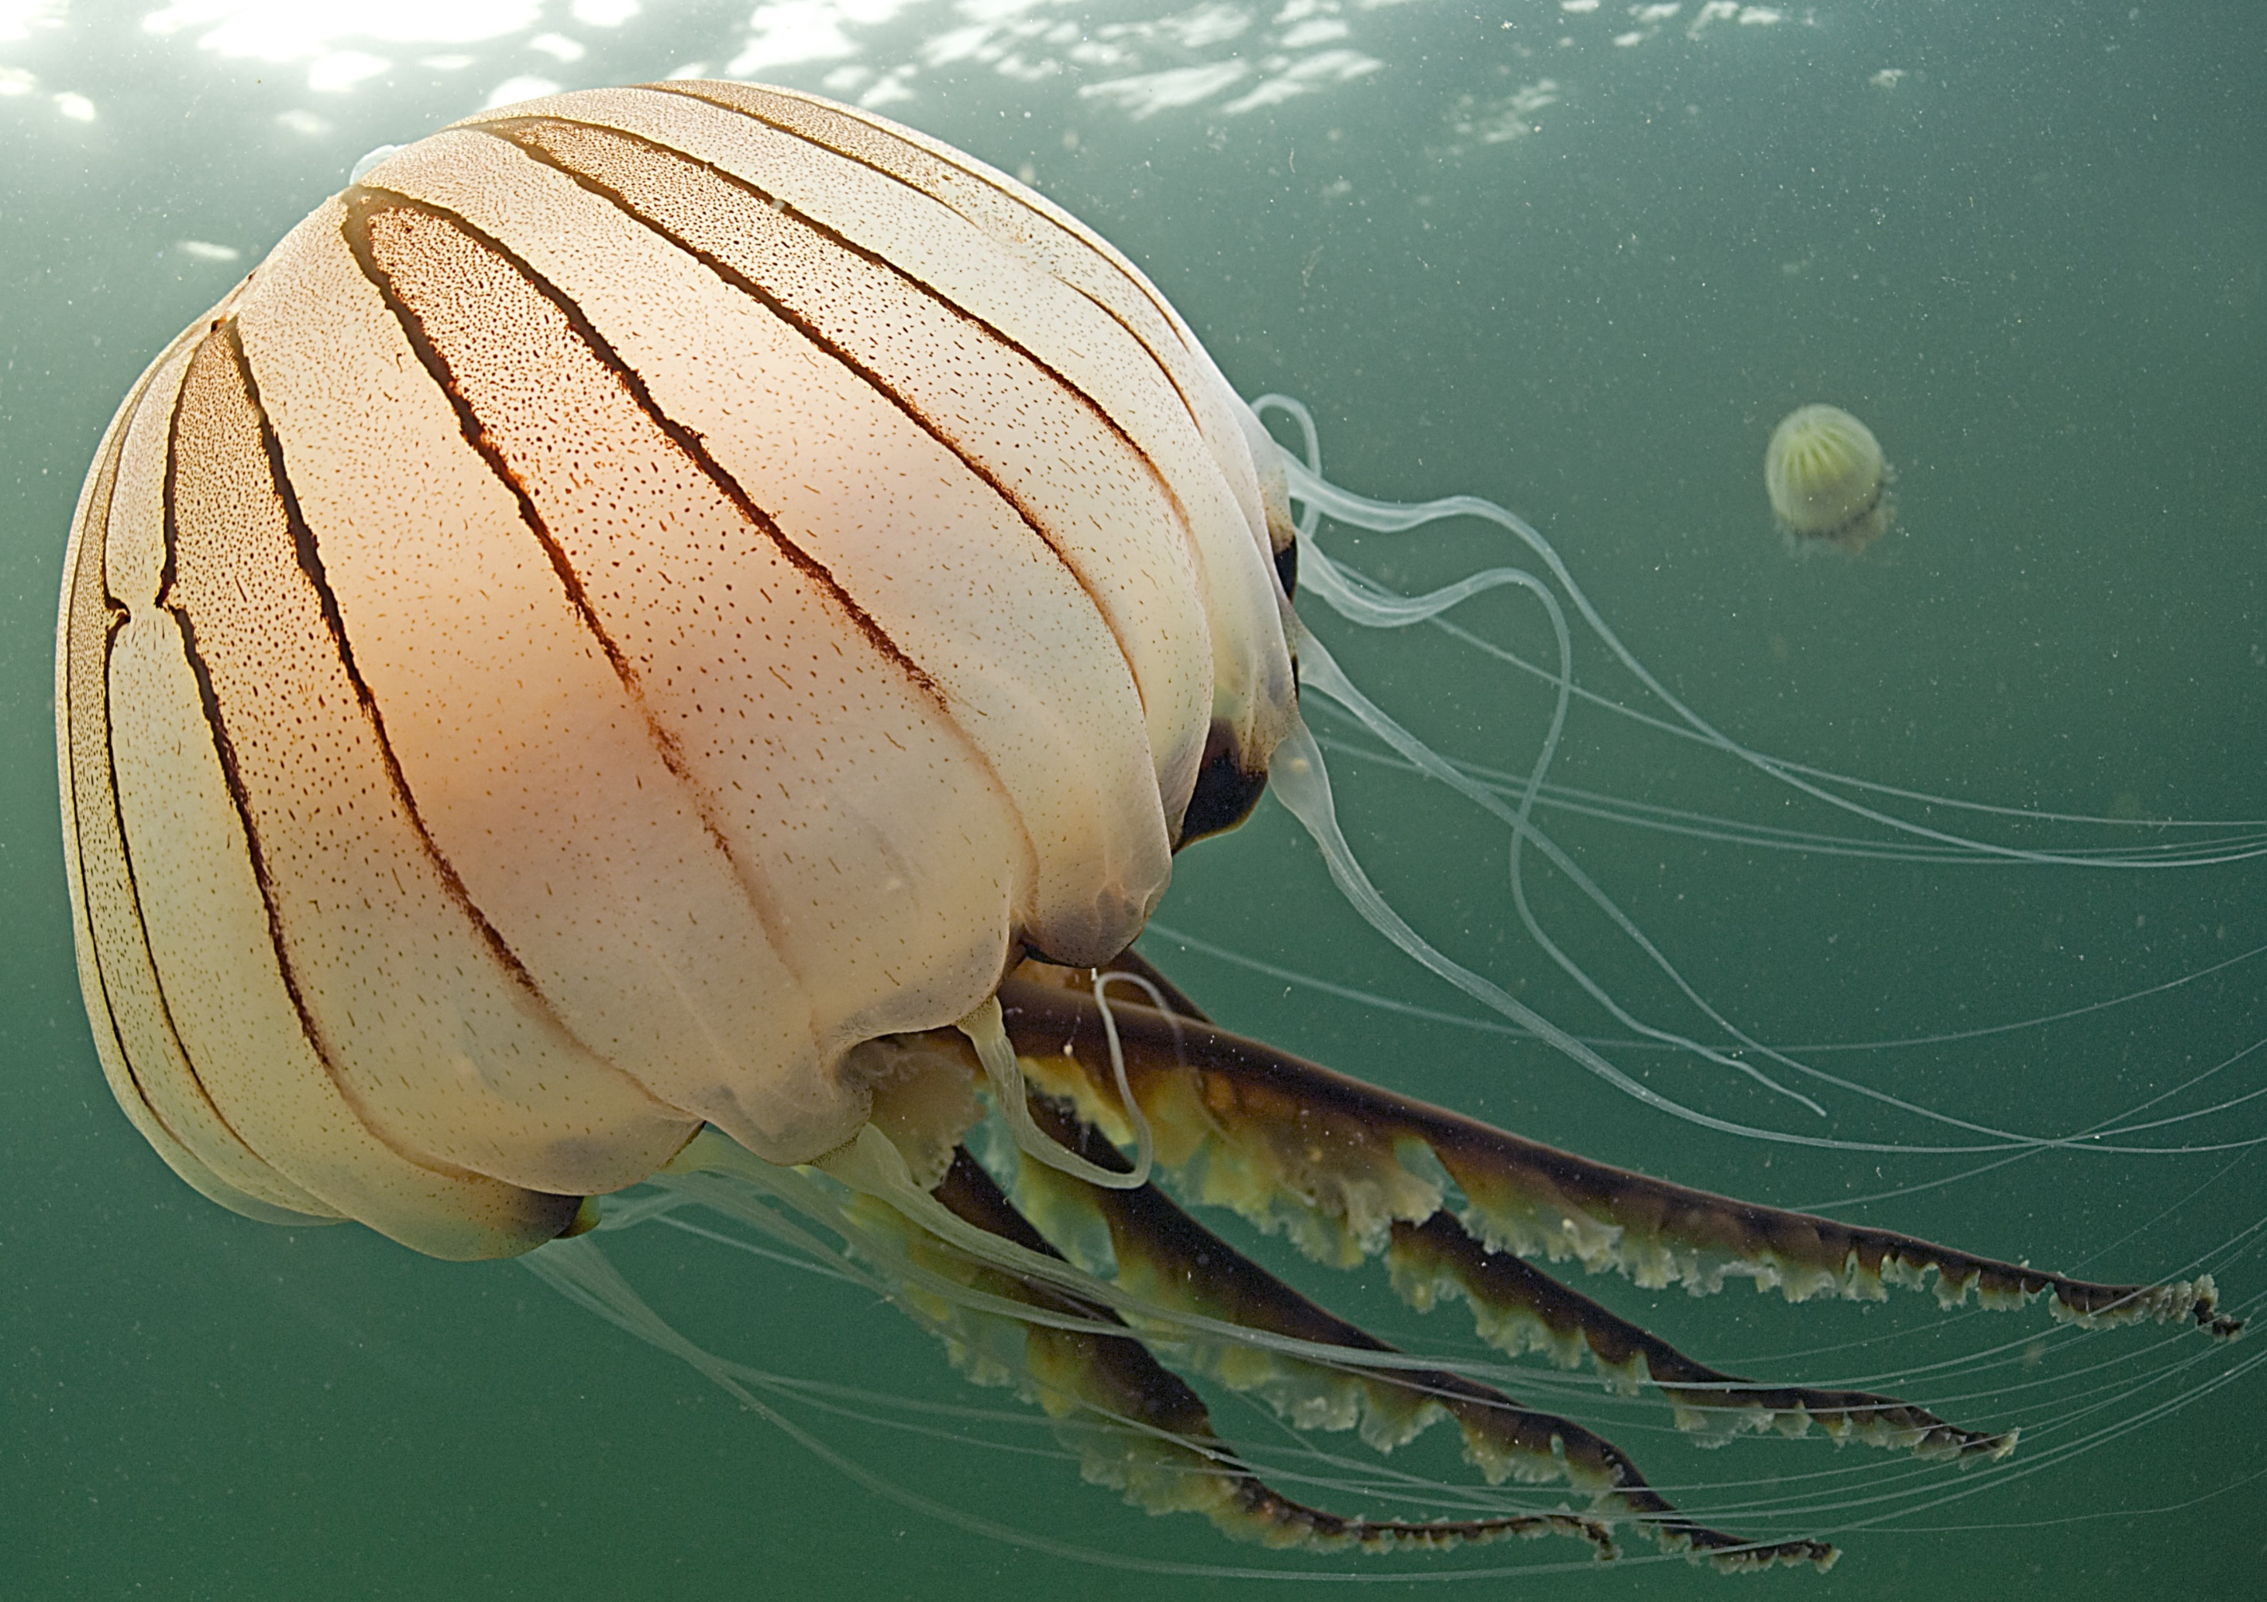
Compass jellyfish
© Mark Thomas
© Mark Kirkland
Notes:
Jellyfish have been on earth since before dinosaurs existed.
Compass jellyfish can be seen across UK shores in the summer months. They use their stinging tentacles to catch and stun their prey, including small fish, crabs and smaller jellyfish.

Slide 23
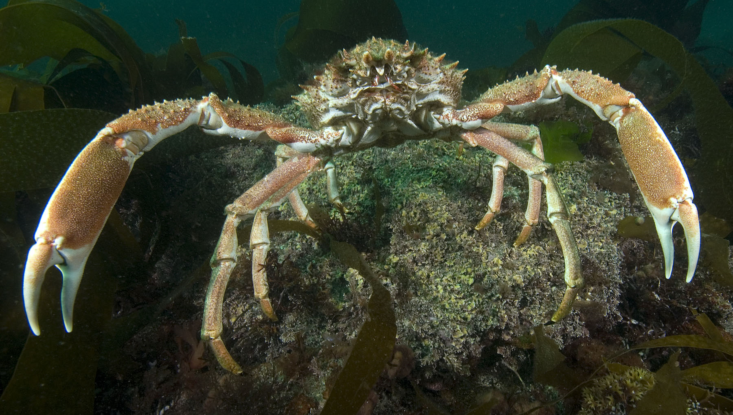
Spider crabs
© Paul Naylor
© Mark Kirkland
Notes:
Crabs grow by moulting; shedding their exoskeleton. The exoskeleton or shell can then often be found washed up on beaches.
In autumn, spider crabs migrate to deeper waters, travelling huge distances and in great numbers.

Slide 24
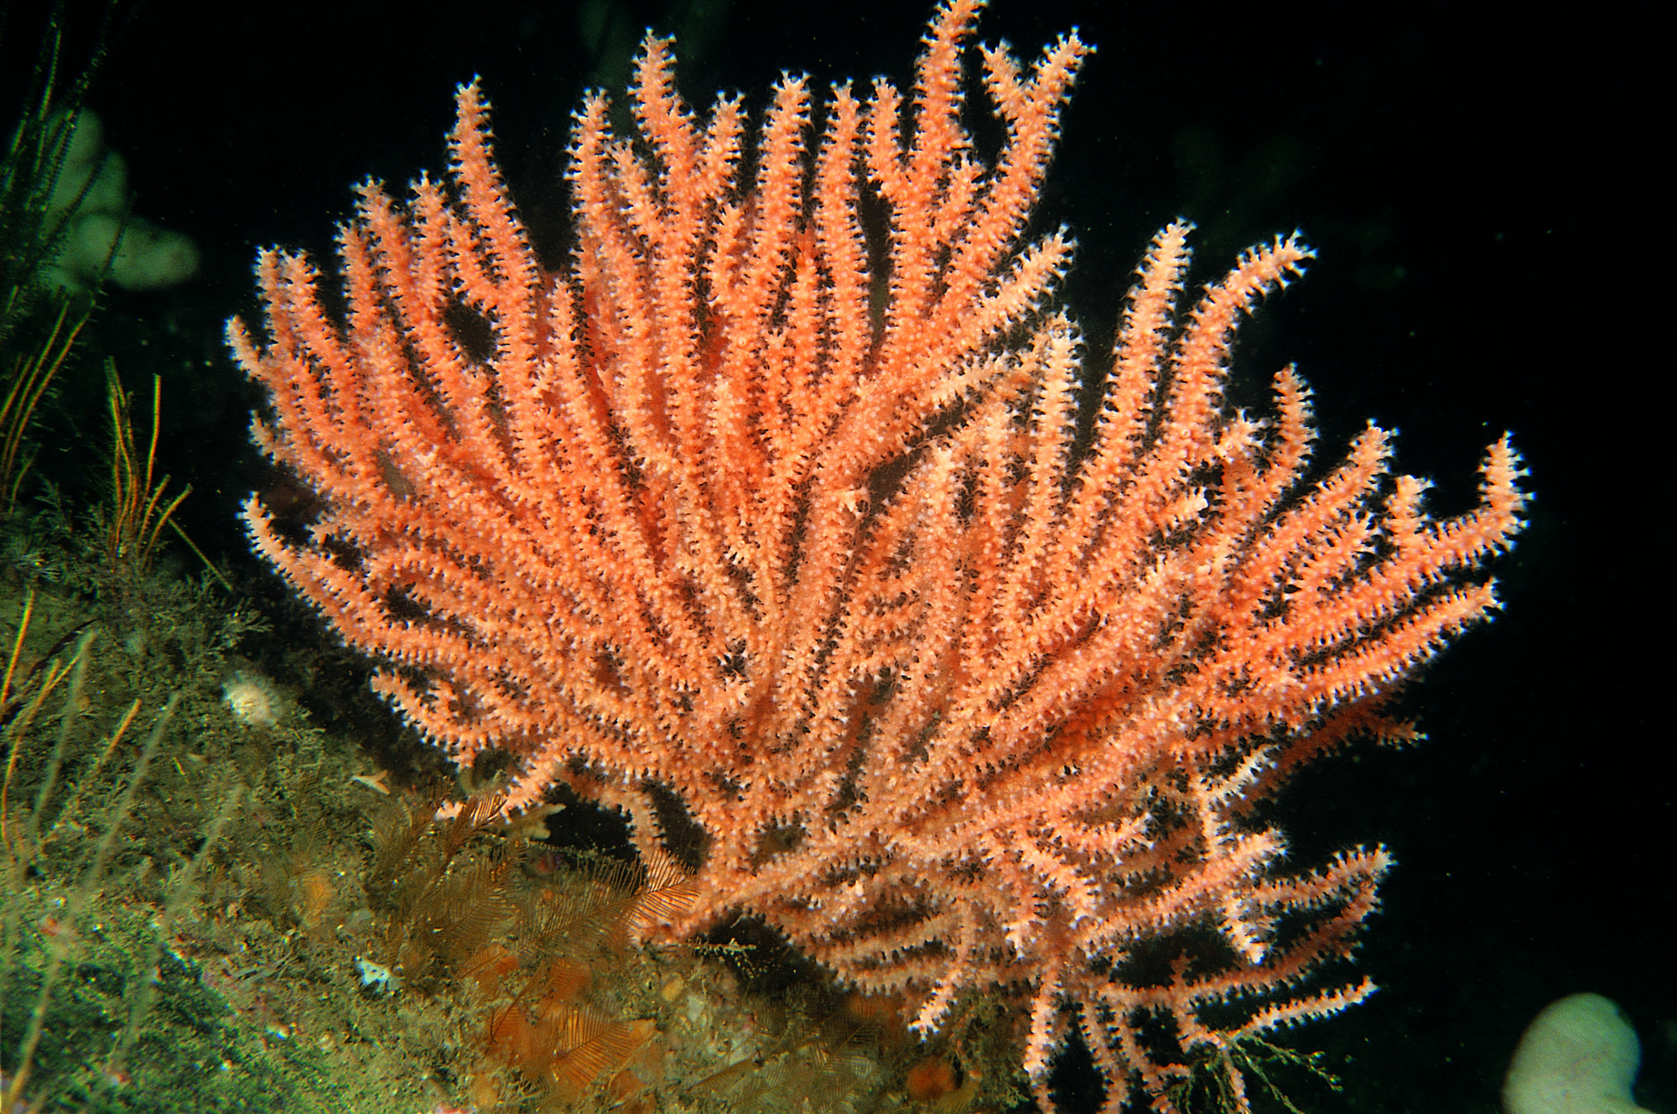
Sea fans
© Paul Naylor
© Mark Kirkland
Notes:
Although sea fans look like plants, they are actually colonies of coral, made up of animals whose hard skeletons run through the fan. Their fan shape helps them to capture food, like plankton, in the water column.

Slide 25
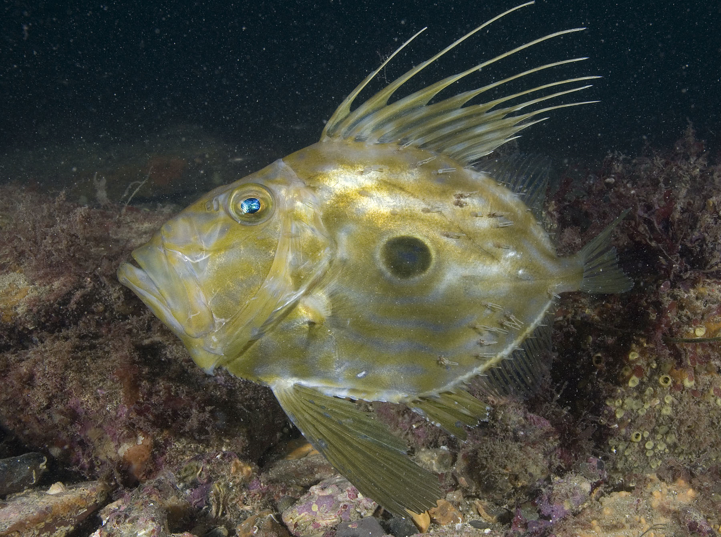
John Dory
© Paul Naylor
© Mark Kirkland
Notes:
John Dory live in mid to deep water and can be found at depths of 400 metres. They have a flat, oval body and 8-10 dorsal fin rays. They don’t shoal and instead live by themselves. The eye marking on the side of their body helps to confuse predators into thinking that they're a larger creature with big eyes.

Slide 26
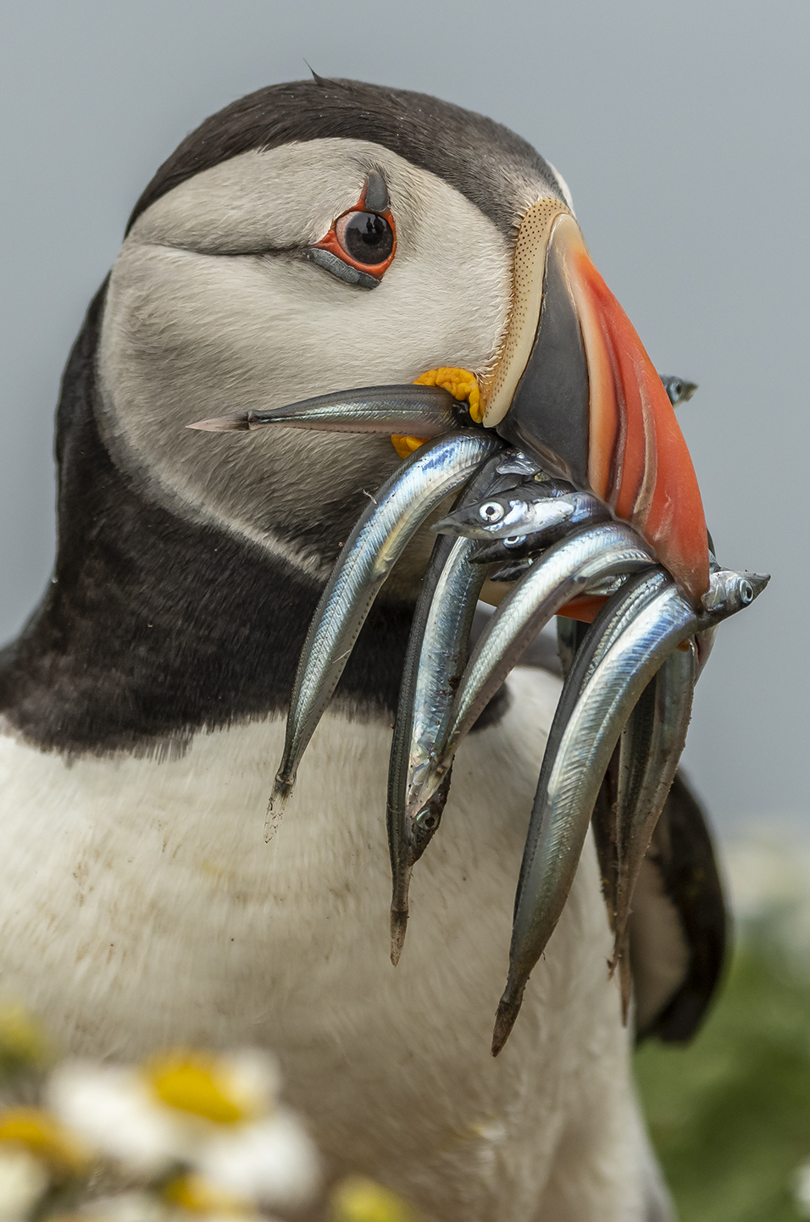
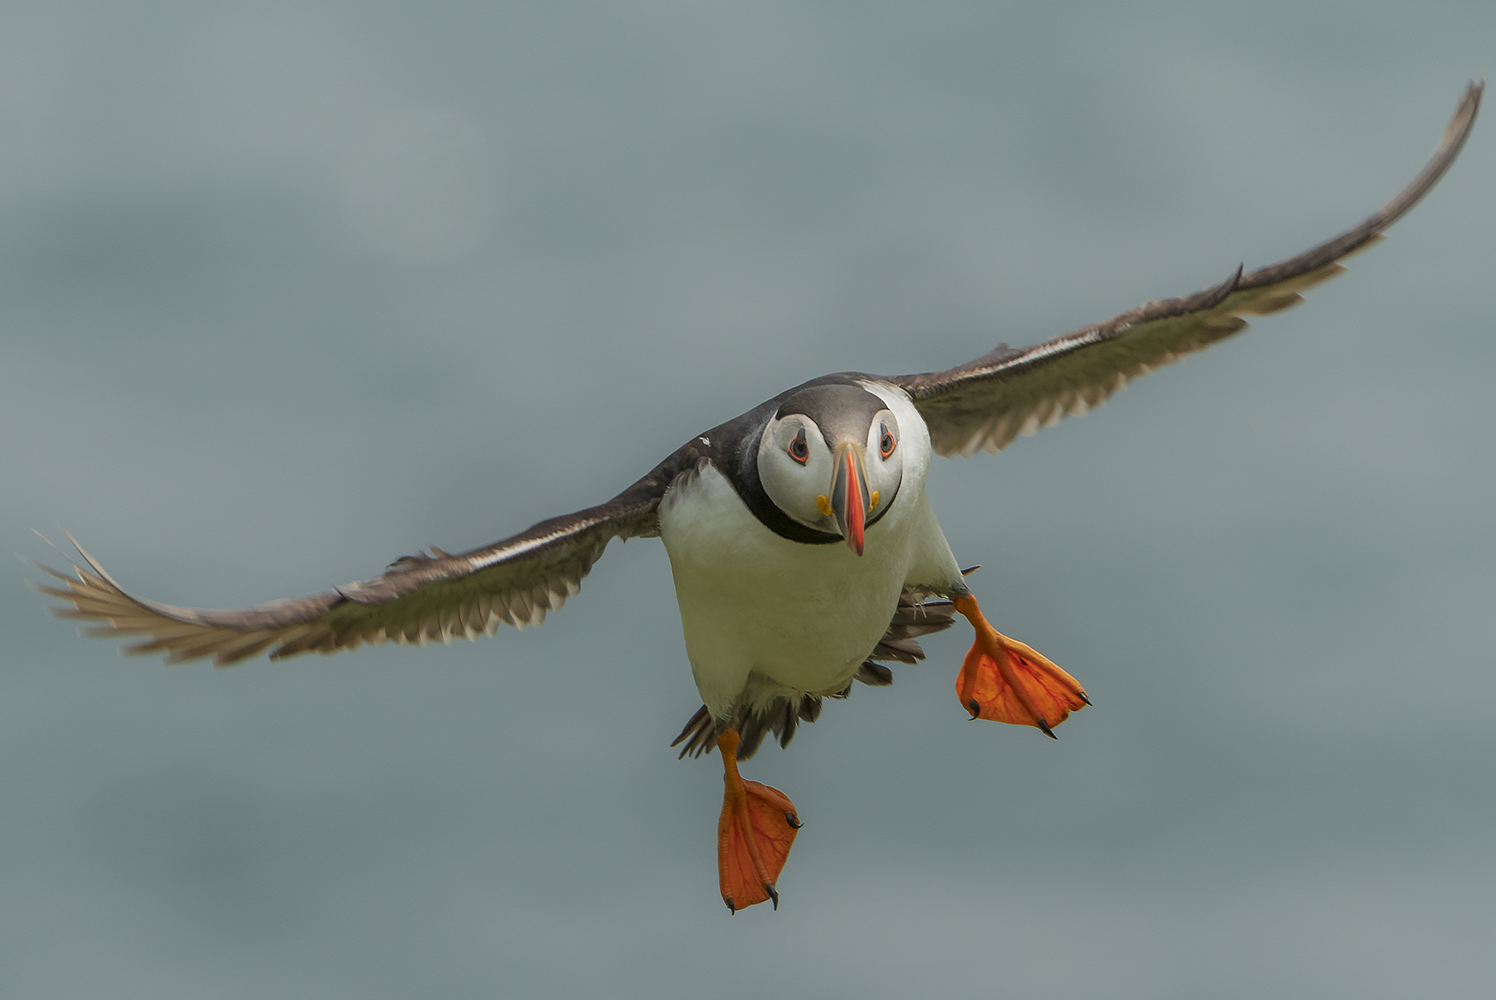
Puffin
© Mark Kirkland
Notes:
Puffins are members of the auk family along with razorbills and guillemots. These seabirds spend most of their lives at sea and only come to land to have their young. They breed on coastal islands and cliffs, where they can be seen fishing in coastal waters between May and July. Puffins love to feed on sand eels.
Question to students - Can anyone guess how many sand eels puffins can fit in their beaks in one go?
On average it's around 10 fish per trip, but the most a puffin has been spotted with at once was 62. The puffin’s beak is adapted to hold several fish at once, and has spines to hold fish in place while they open their beak to catch more. This means that they can bring lots of fish back to shore to share with their family.

Slide 27
Activity 2
A focus on Angel Sharks
Notes:
Activity 2 - Part 2
The last species to be introduced is the angel shark, a critically-endangered species found in Wales. Students should use the electronic book to gain knowledge of angels sharks, their anatomy, their distribution and threats before completing the quiz at the end of the book.
https://angelsharknetwork.com/ebook/

Slide 28
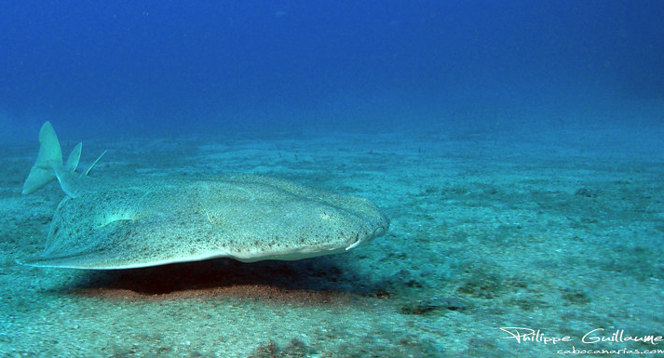
Angel shark
© Mark Kirkland
Notes:
Angel sharks are one of the most endangered and rarest species of shark in the world. They grow to around 2.4 meters, have very flat bodies, glide above the seabed and live in sandy coastal waters. They are found in the Eastern Atlantic and Mediterranean Sea. Wales appears to be one of the few areas with increasing sightings of this species.

Slide 29
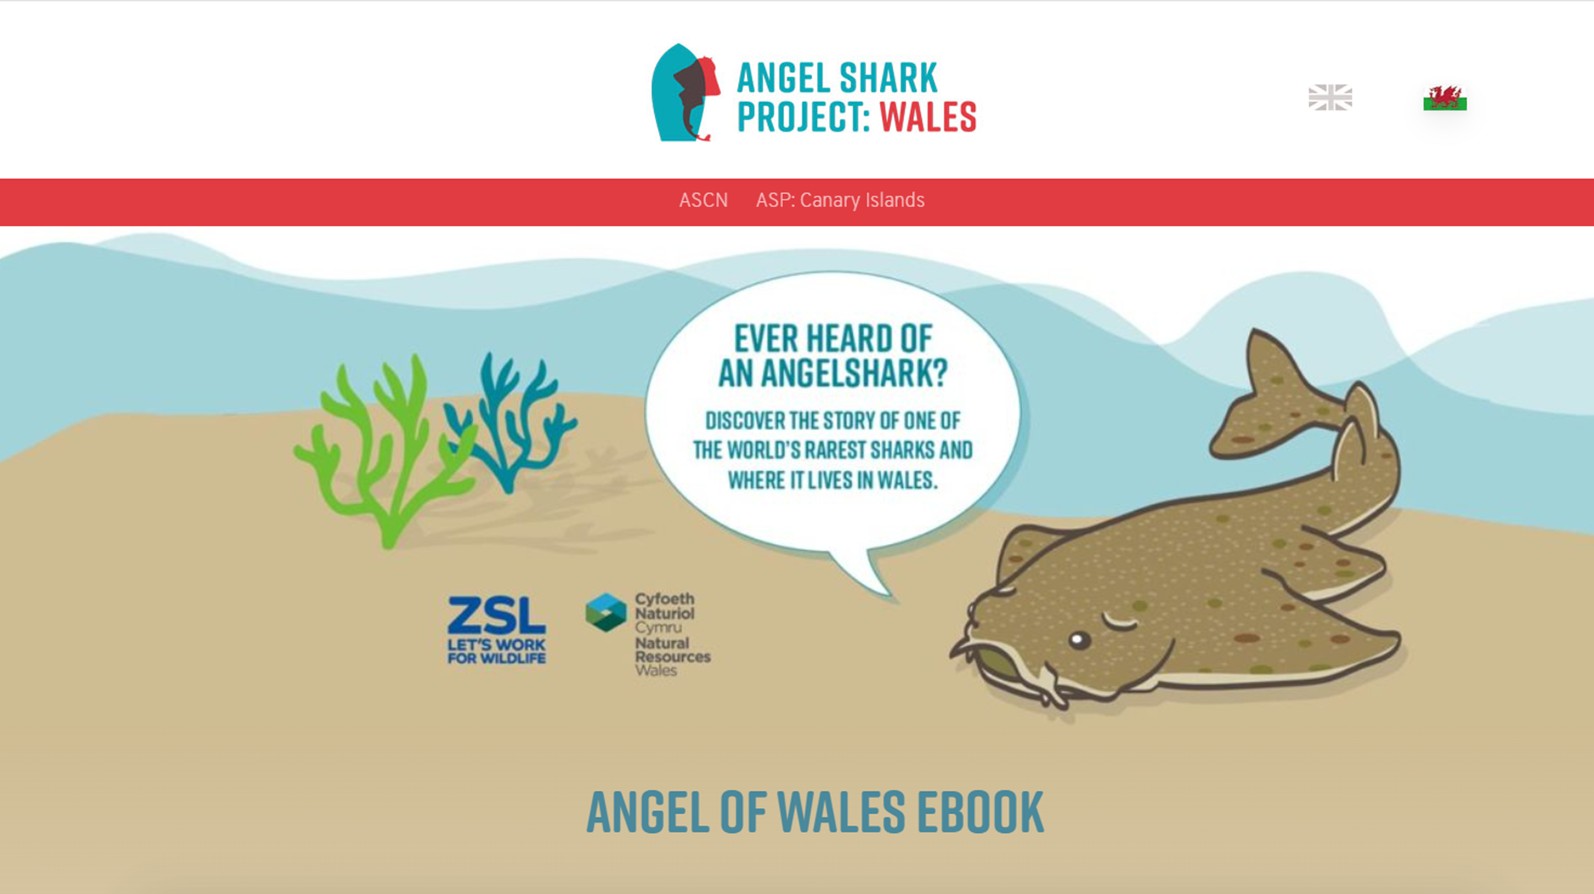
© Mark Kirkland
Notes:
The Angel Shark Project researches this endangered species in Wales to improve scientific knowledge and understanding, with the aim of better-protecting angel sharks.
https://angelsharknetwork.com/Angels%20of%20Wales%20-%20Web%20App%20folder/index.html#/reader/chapter/0?vi=0

Slide 30
Activity 3
Biodiversity
Biodiversity is a broad term meaning the variety of plant and animal life found in the world or a particular habitat.
Biodiversity refers to diversity within species, between species and within
an ecosystem.
Notes:
Biodiversity is a broad term meaning the variety of plant and animal life found in the world or a particular habitat. Biodiversity refers to diversity within species, between species and within an ecosystem.
Activity 3
Use the next few slides to introduce the term 'biodiversity' and why biodiversity is important.
To highlight how species are interdependent, play the food web game. Cards and instructions are provided to highlight to the students how animals in the ocean are all interconnected, and how pressure on one animal can cause pressure on several parts of the food web. Explain to students that the game is just a snapshot of a possible food web and that, in the wild, food webs are more complicated and species' diets often vary depending on their location. After you have completed the game, students should complete the food web worksheet.

Slide 31

Why is biodiversity important?
For marine life:
Different species are dependent on each other for food.
Many species rely on the shelter of plants to hide from predators.
Species like sea snails help to maintain the environment by eating algae that
could smother animals.
Some species have symbiotic relationships. For example a few species of hermit crabs and anemones. The crab gets protection from carrying the anemone, and the anemone benefits from access to food lifted into the water column when the crab feeds.

Slide 32
Why is biodiversity important?
For all life:
Plants and algae provide oxygen that all animals need to survive.
Plants and algae store carbon dioxide, helping to reduce the effects of climate change.
Plants and algae are also a vitally important element of the carbon cycle.

Slide 33
Why is biodiversity important?
To humans:
The ocean provides many species of fish, shellfish and algae that humans eat.
Marine plants and animals provide medicine.
The structure of coastal habitats, like seagrass and kelp, help to reduce wave energy, protecting coastal communities from storms.
Millions of jobs are dependent on diverse and productive seas, including tourism, diving, and fishing.
A healthy ocean is important for our health and wellbeing.

Slide 34

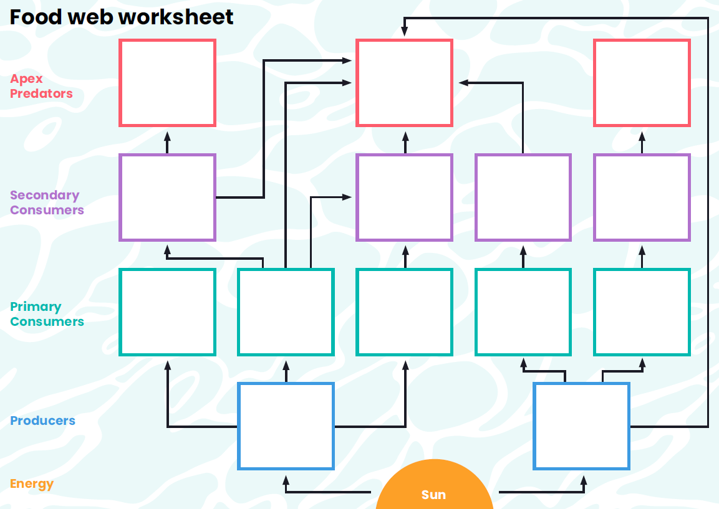
Species interdependence
© Mark Kirkland
Notes:
As discussed, different species depend on each other for variety of things, including, food, shelter and maintaining the physical environment. Understanding food webs helps us to see why species diversity is so important and how species are interdependent.
Question to students - What's the difference between food chains and food webs?
Food chains show the transfer of energy from one species to another (who eats who).
Food webs are all the food chains within an ecosystem.

Slide 35
Reflect
What have you learnt?

Slide 36
Learning Objectives
Can you define the following terms?
  Biome
  Ecosystems
  Habitats
  Species
  Interdependence
  Biodiversity
Can you identify a variety of key marine habitats found in the UK?
Can you describe how a marine species adapts to their habitat?
Can you describe how species are interdependent and how
human interactions can alter ecosystem dynamics?

Slide 37
We will continue to fight for the ocean and protect wildlife

