Slide 1
Fishing in the Cromer Shoal Chalk Beds Marine Conservation Zone
Ages 4-7
Design and Technology

Slide 2
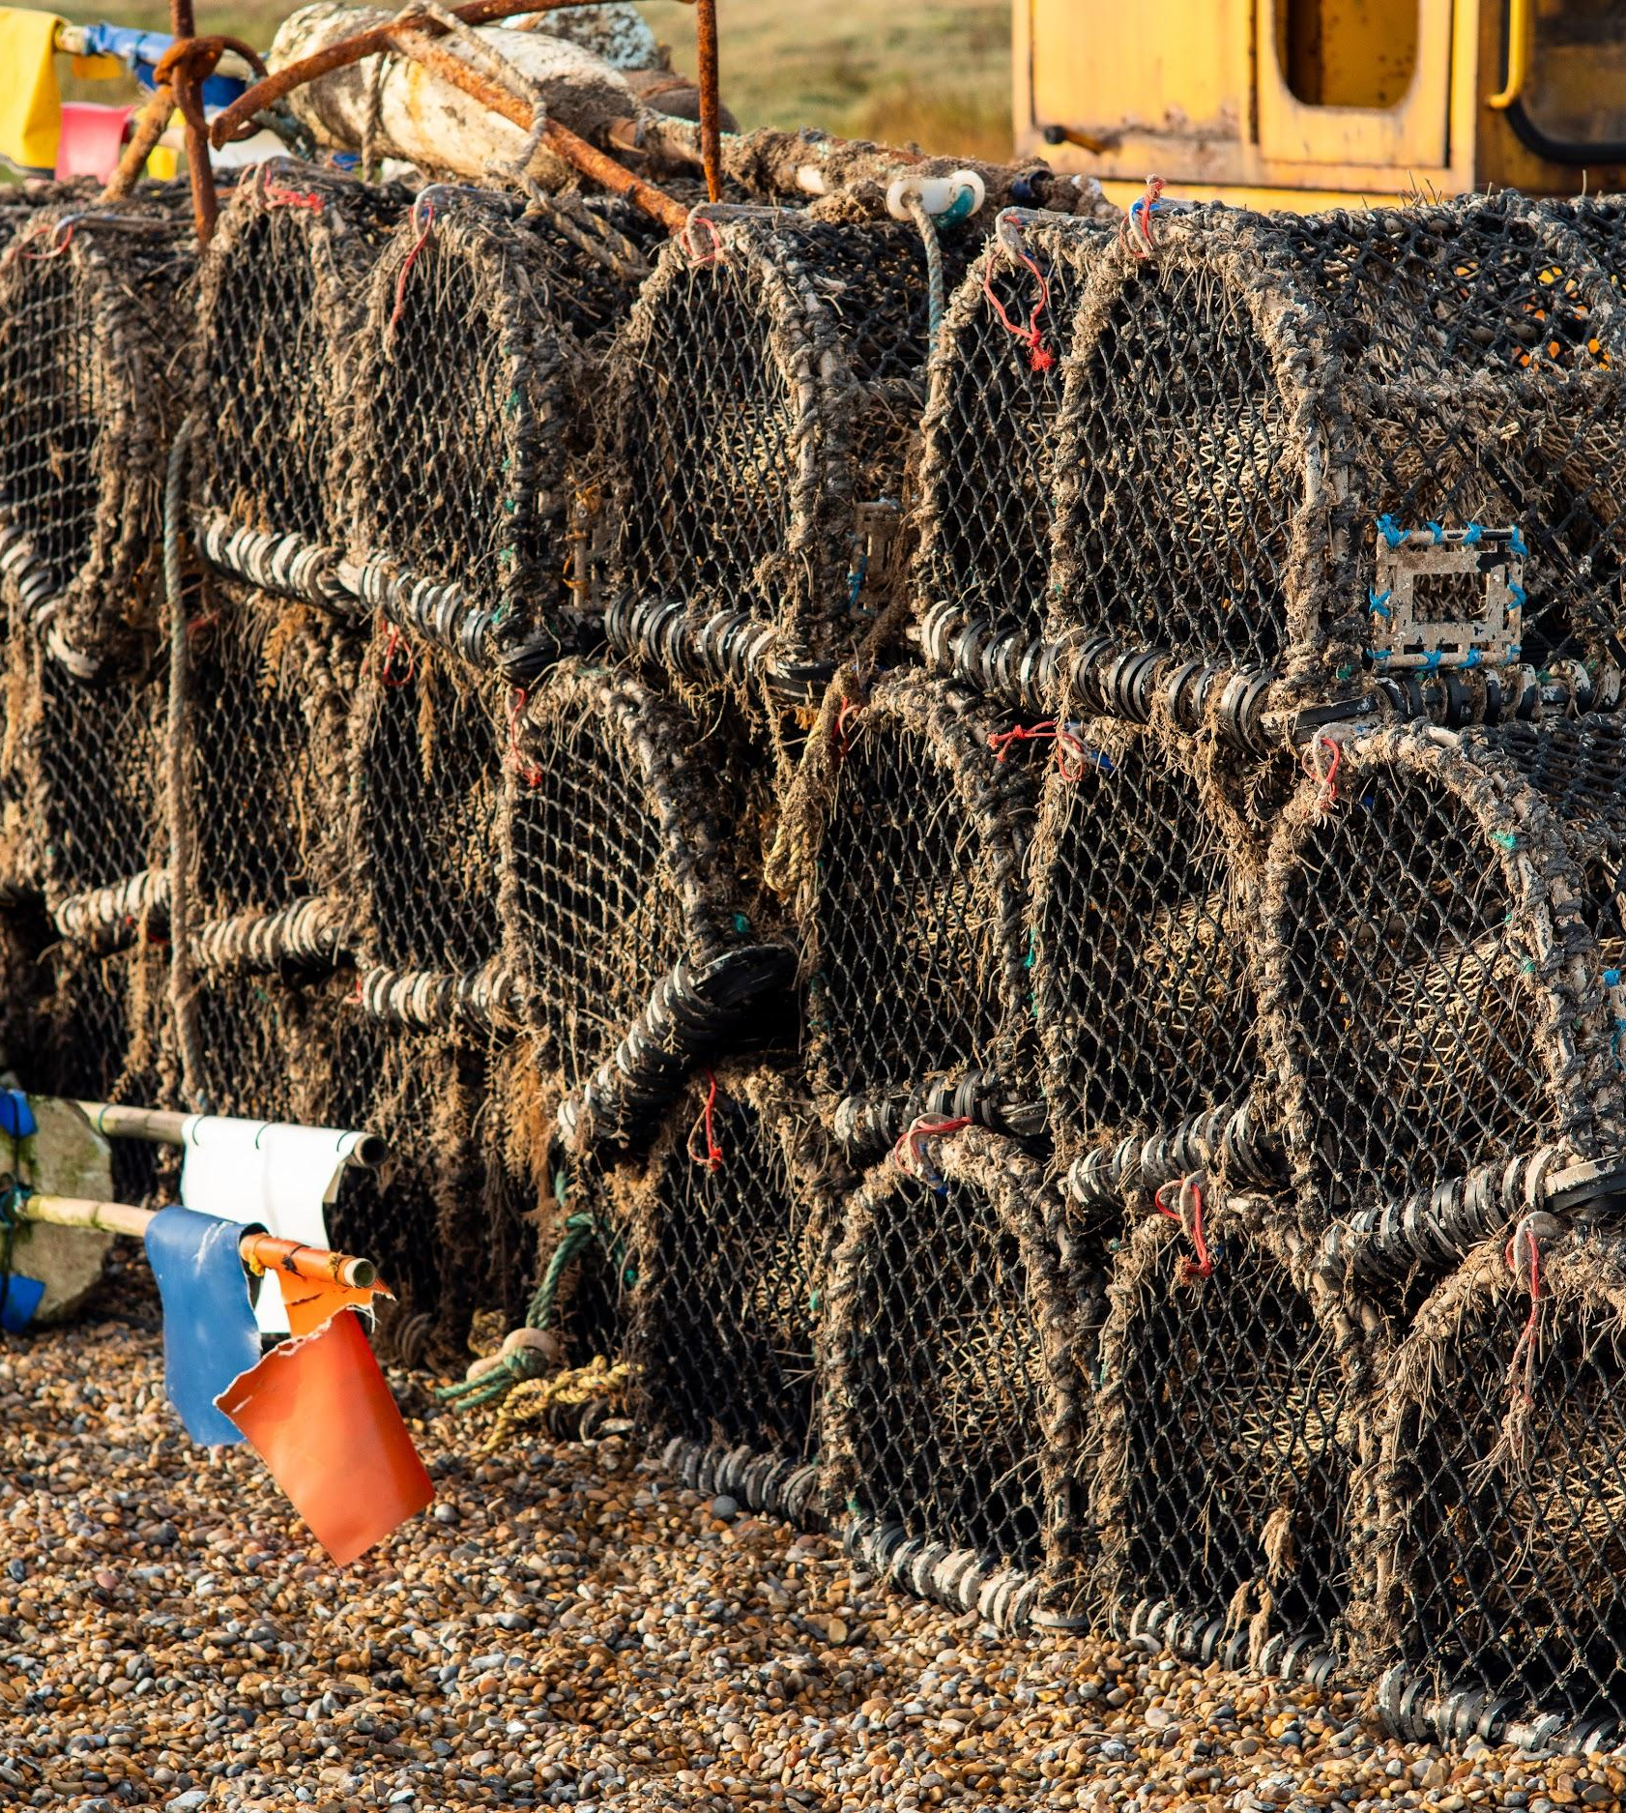
Have you ever seen crab pots stacked up by the sea?

Slide 3
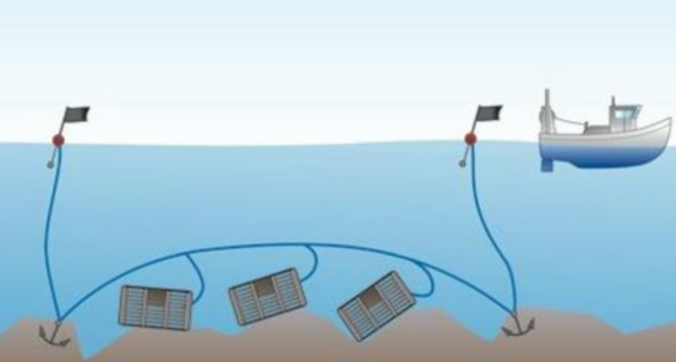
How do crab pots work?
The crab pots are laid in lines called shanks.
There are usually 10 to 25 pots per shank depending on the size of the boat.

Slide 4
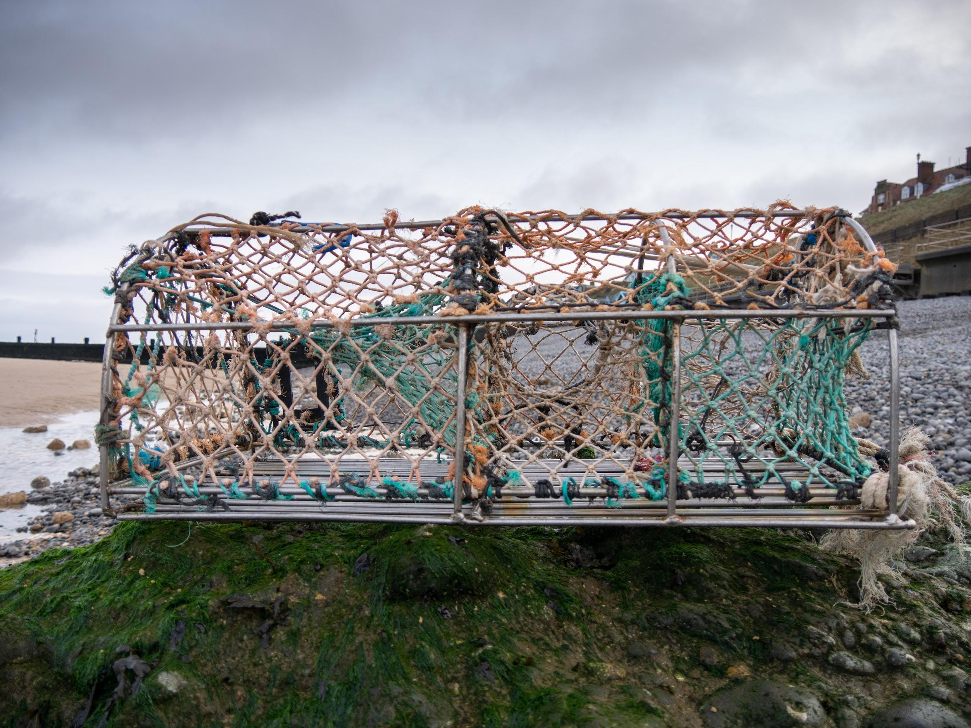
How a parlour (crab) pot works:
6. The slope leads into the ‘parlour’ which they drop into and stay until the pot is emptied by a fisher
1. Bait (dead fish) is secured inside the pot between two pieces of cord
2. Crabs and lobsters want to eat the bait so they move around the pot until they find a way in
5. They find a way to go, but this takes them up the net slope
Photo: Rob Coleman
3. The crabs and lobster find an entrance. It’s easy for them to crawl into the wide opening and drop into the pot
4. When they finish eating, they look for a way out. They can’t get out the way they came in because it’s narrow and high up

Slide 5
Life as a fisher
Crab fishers are out on the water most days, weather permitting, from March to October and less often during the winter.
Depending on tides, there can be early starts in the dark. They go out in varying weather conditions so long as the wind and waves are not too strong.
The cold temperatures in the winter mean there are fewer crabs, so this time of year is used to fix damaged pots and carry out maintenance of boats.
The video on the next slide shows a Cromer fisherman’s day at work out on his boat.

Slide 6
Life as a fisher
Notes:
Video link: https://youtu.be/GxdOyWeSO4w

Slide 7
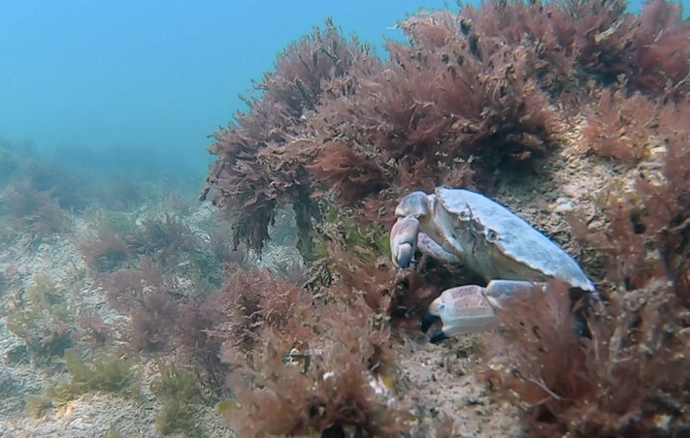
Sea to Sandwich
Edible (brown) crabs live in the sea.
Photo: christaylorphoto.co.uk

Slide 8
Photo: christaylorphoto.co.uk
Being a fisher can mean some early morning
starts depending on the tides.

Slide 9
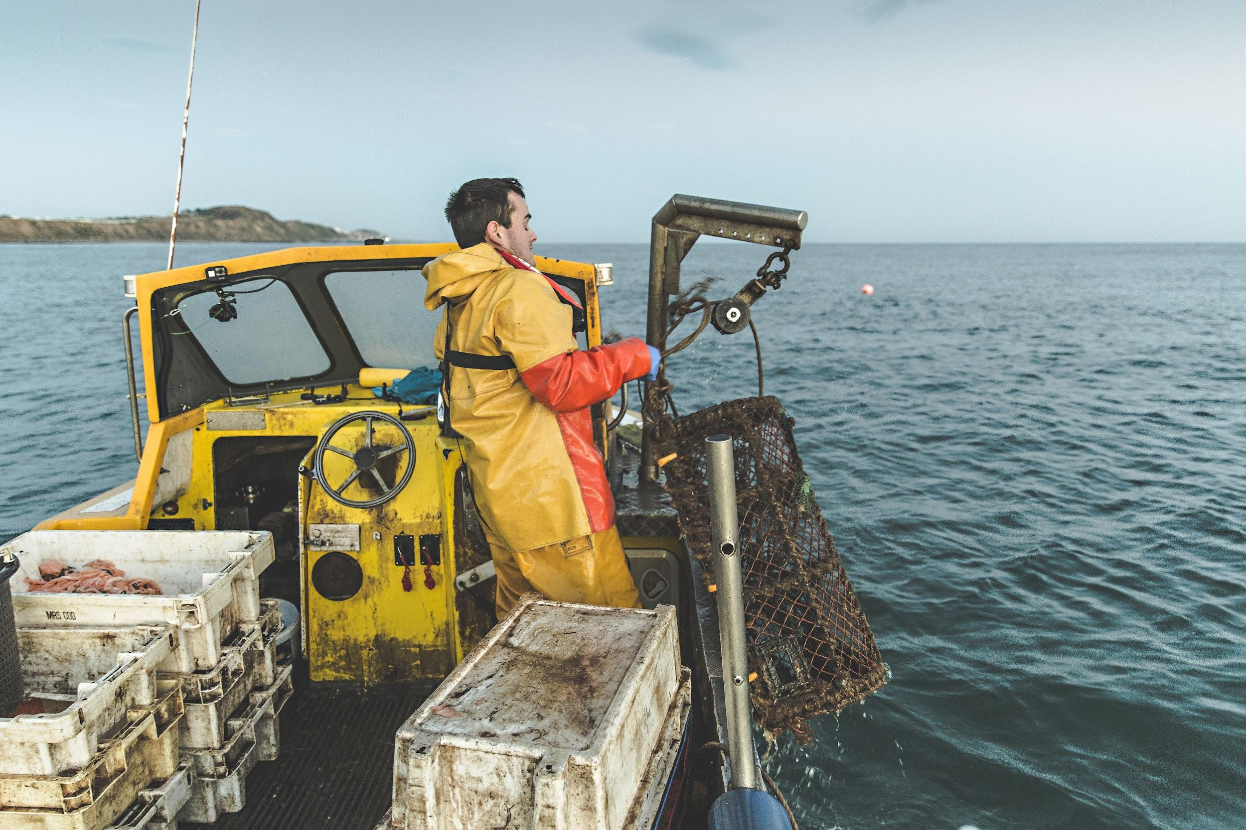
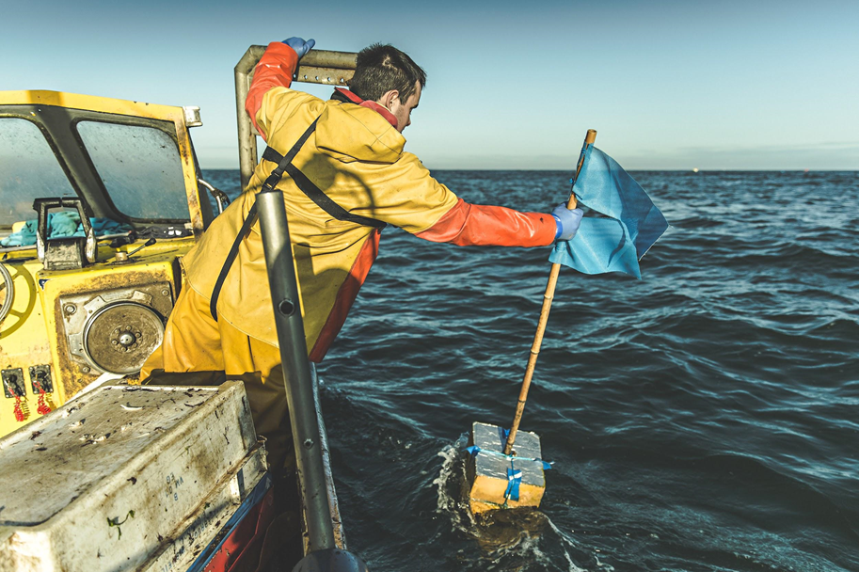
They go to their pots which are marked with flags.
They haul in their pots. The fishers use a winch to help raise the pots.
Photos: christaylorphoto.co.uk

Slide 10
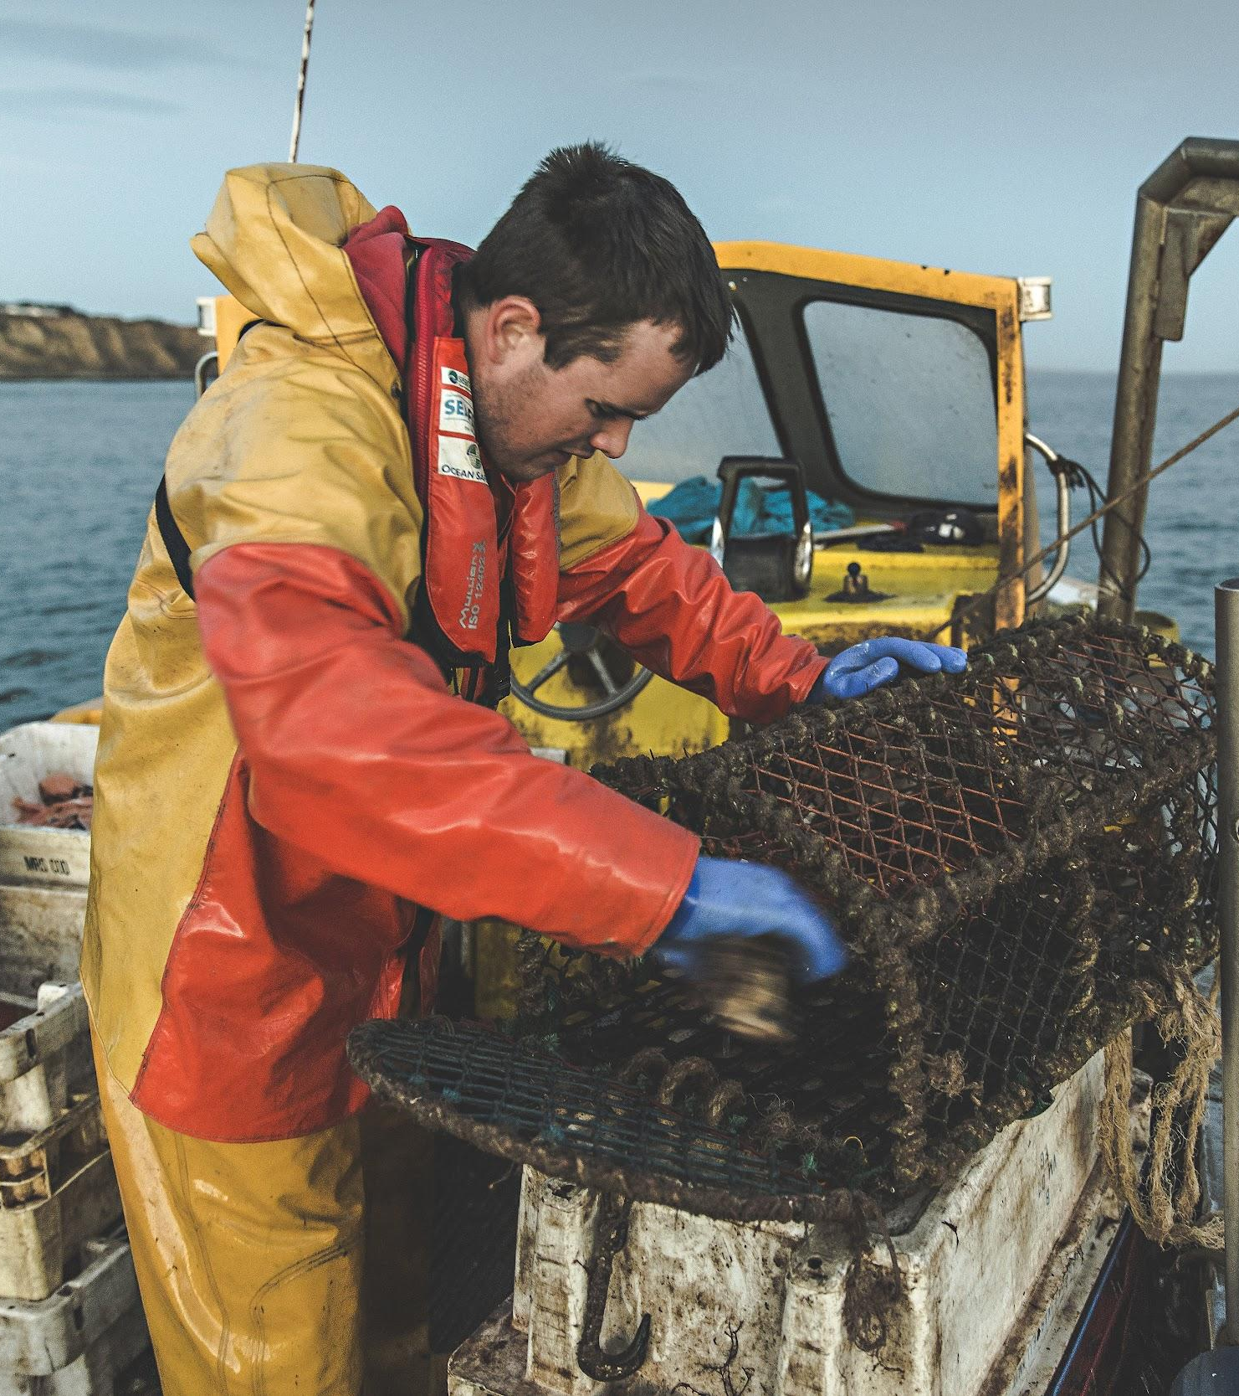
The pots are emptied.
Photo: christaylorphoto.co.uk

Slide 11
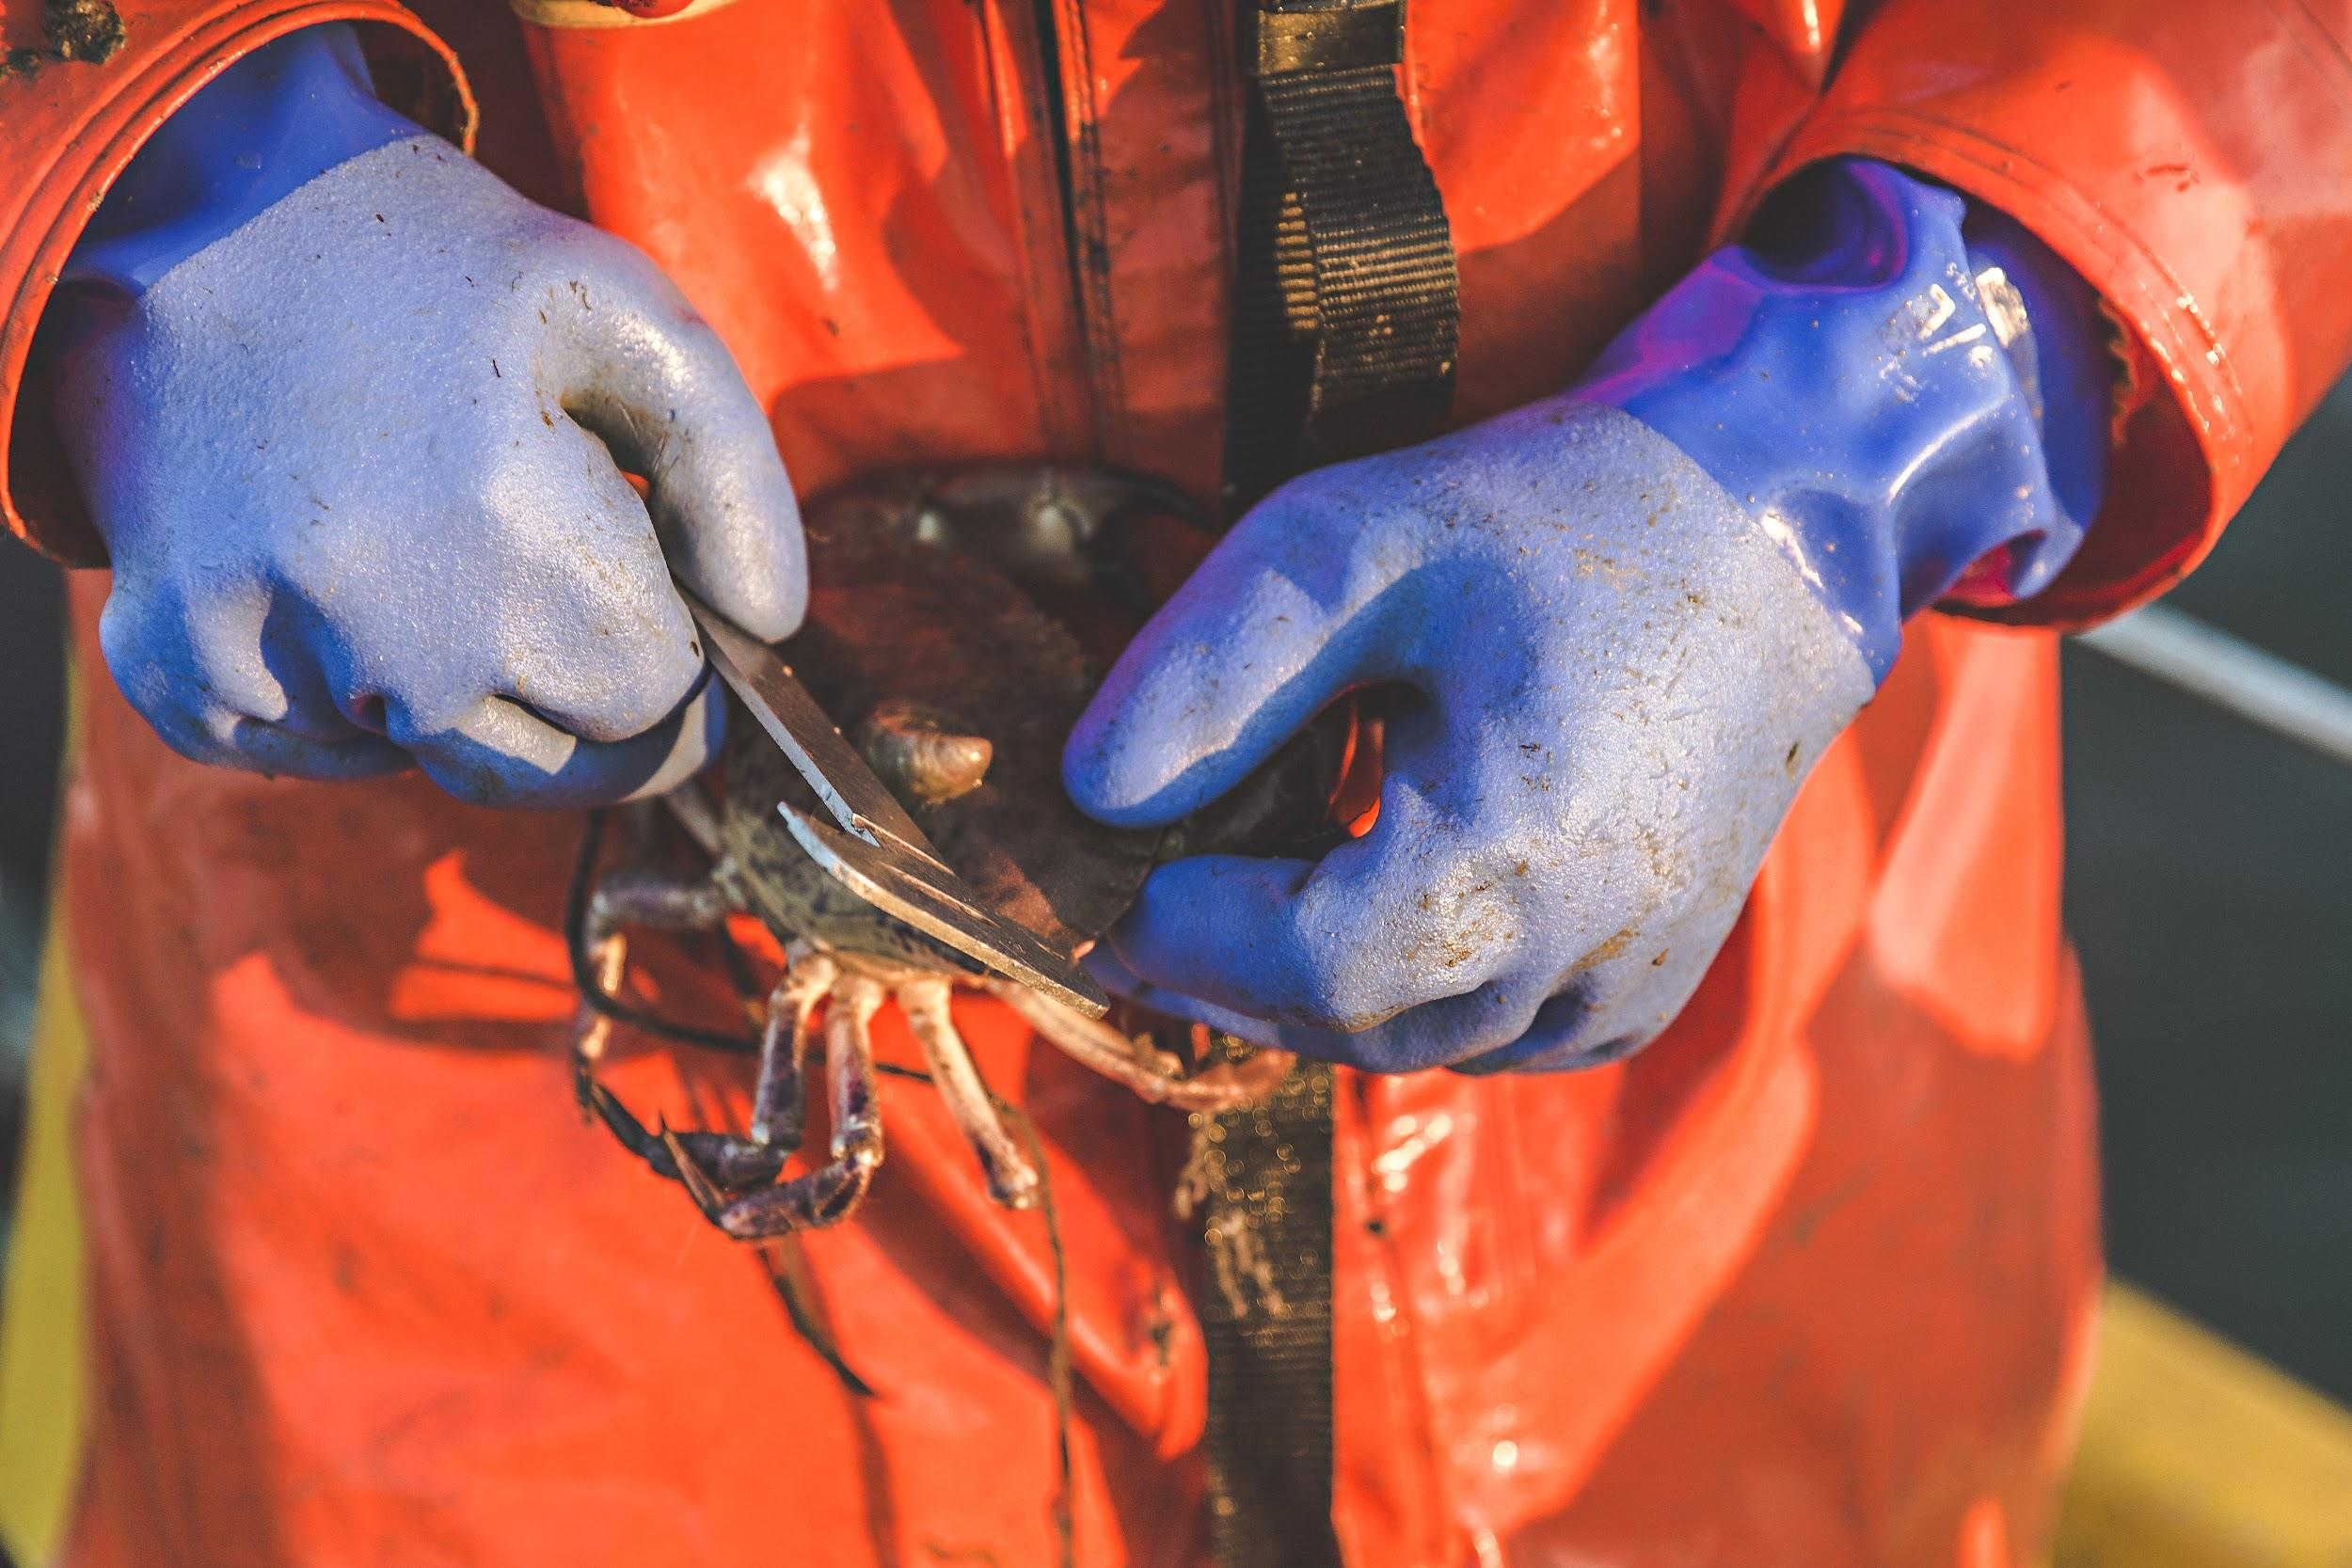
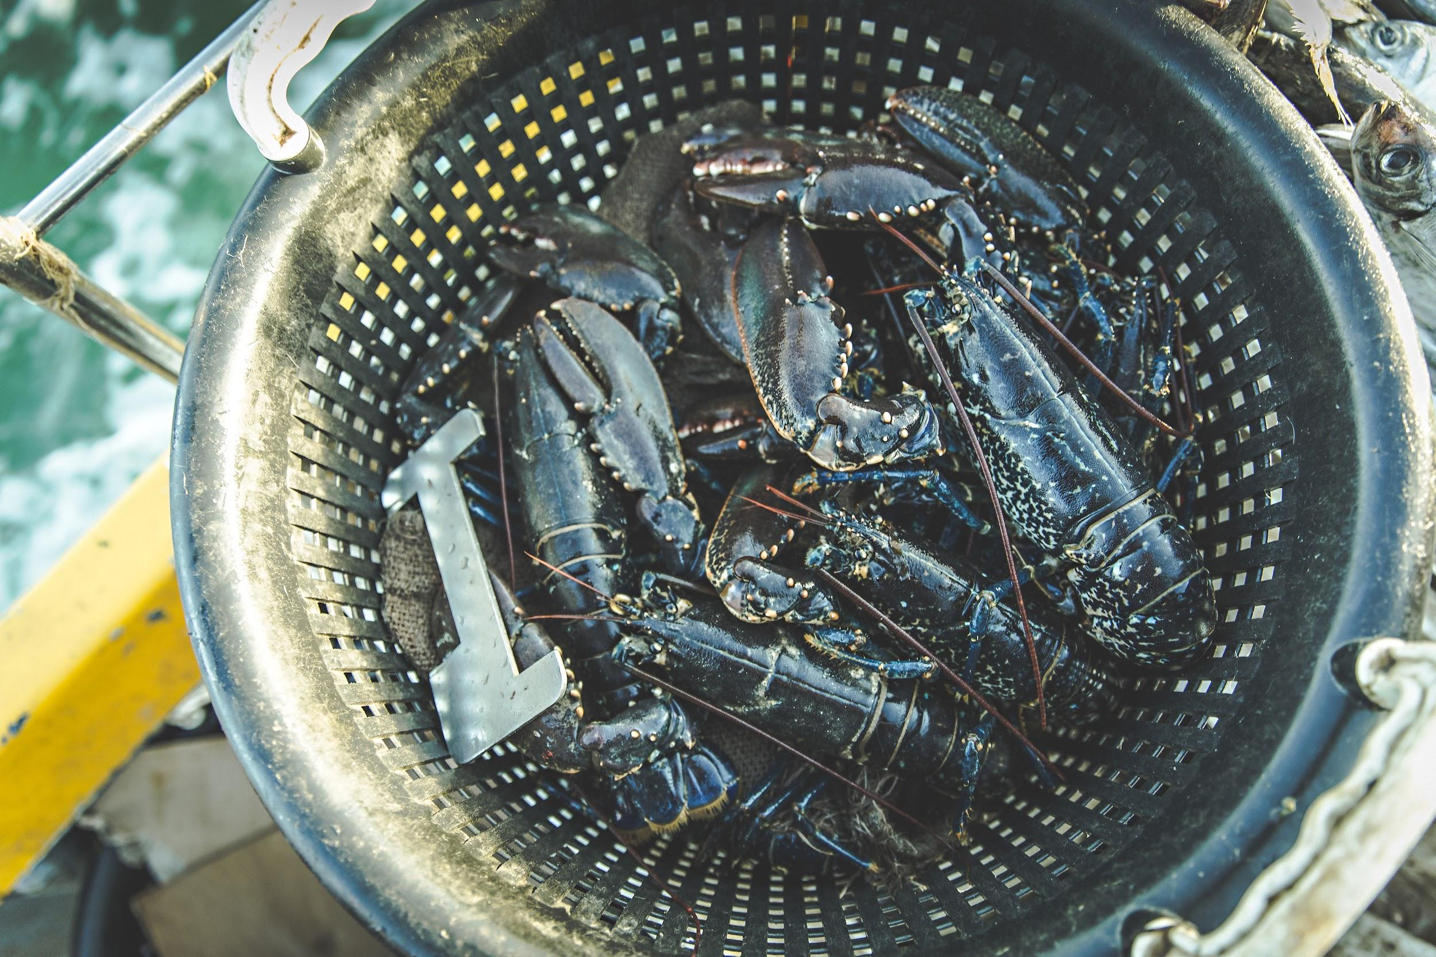
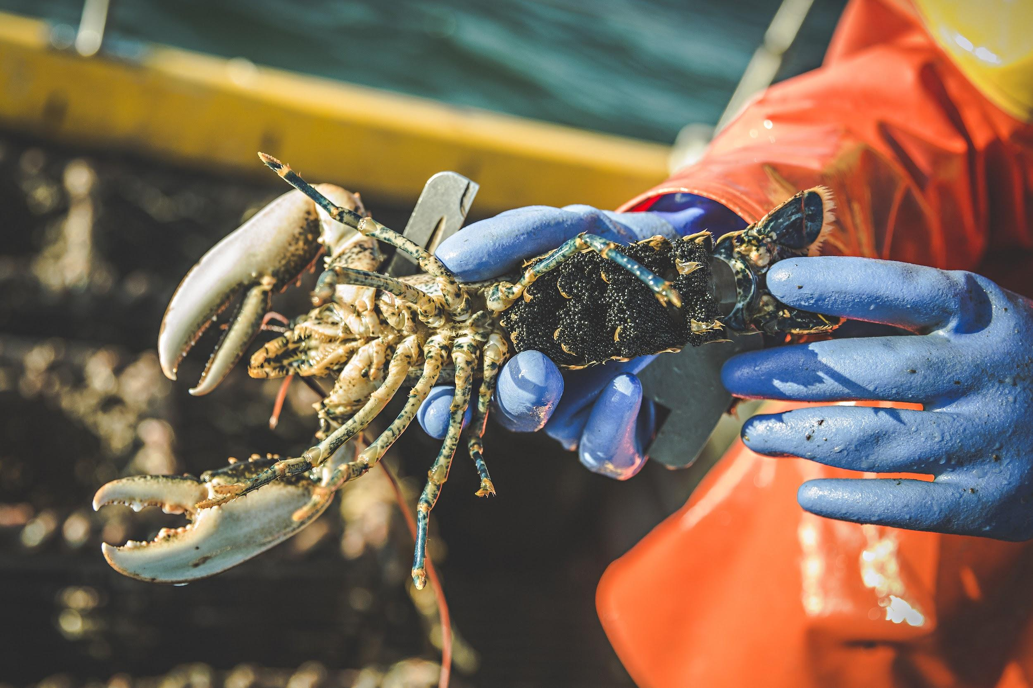
The crabs and lobsters are measured and checked.
Photos: christaylorphoto.co.uk
If they are too small or are berried (have eggs) they are
thrown back.

Slide 12
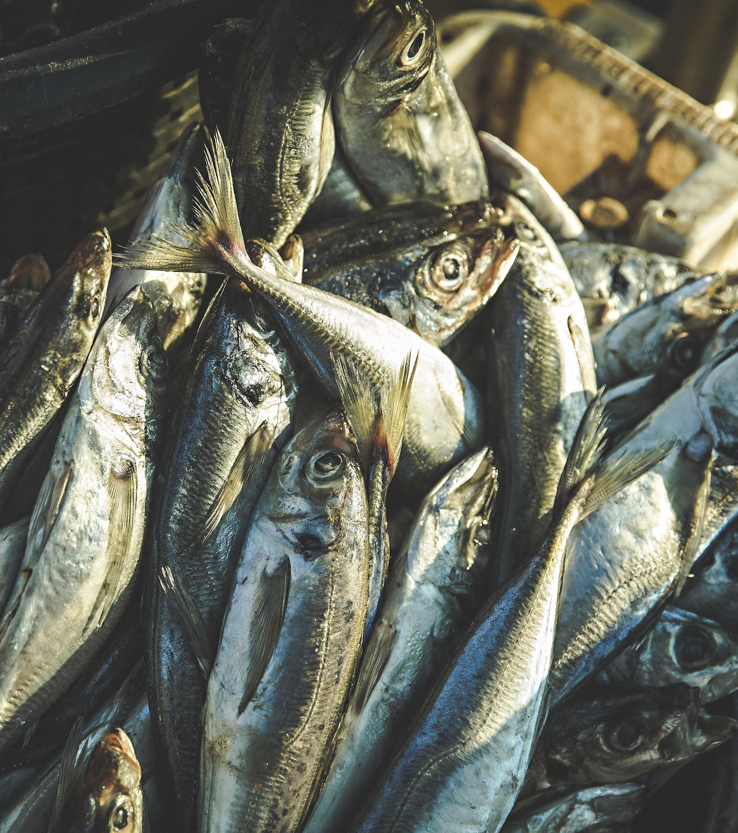
The crab pots are baited.
Fishers use a variety of bait - scad, flounder, gurnard and
salmon heads are commonly used.
Photo: christaylorphoto.co.uk

Slide 13
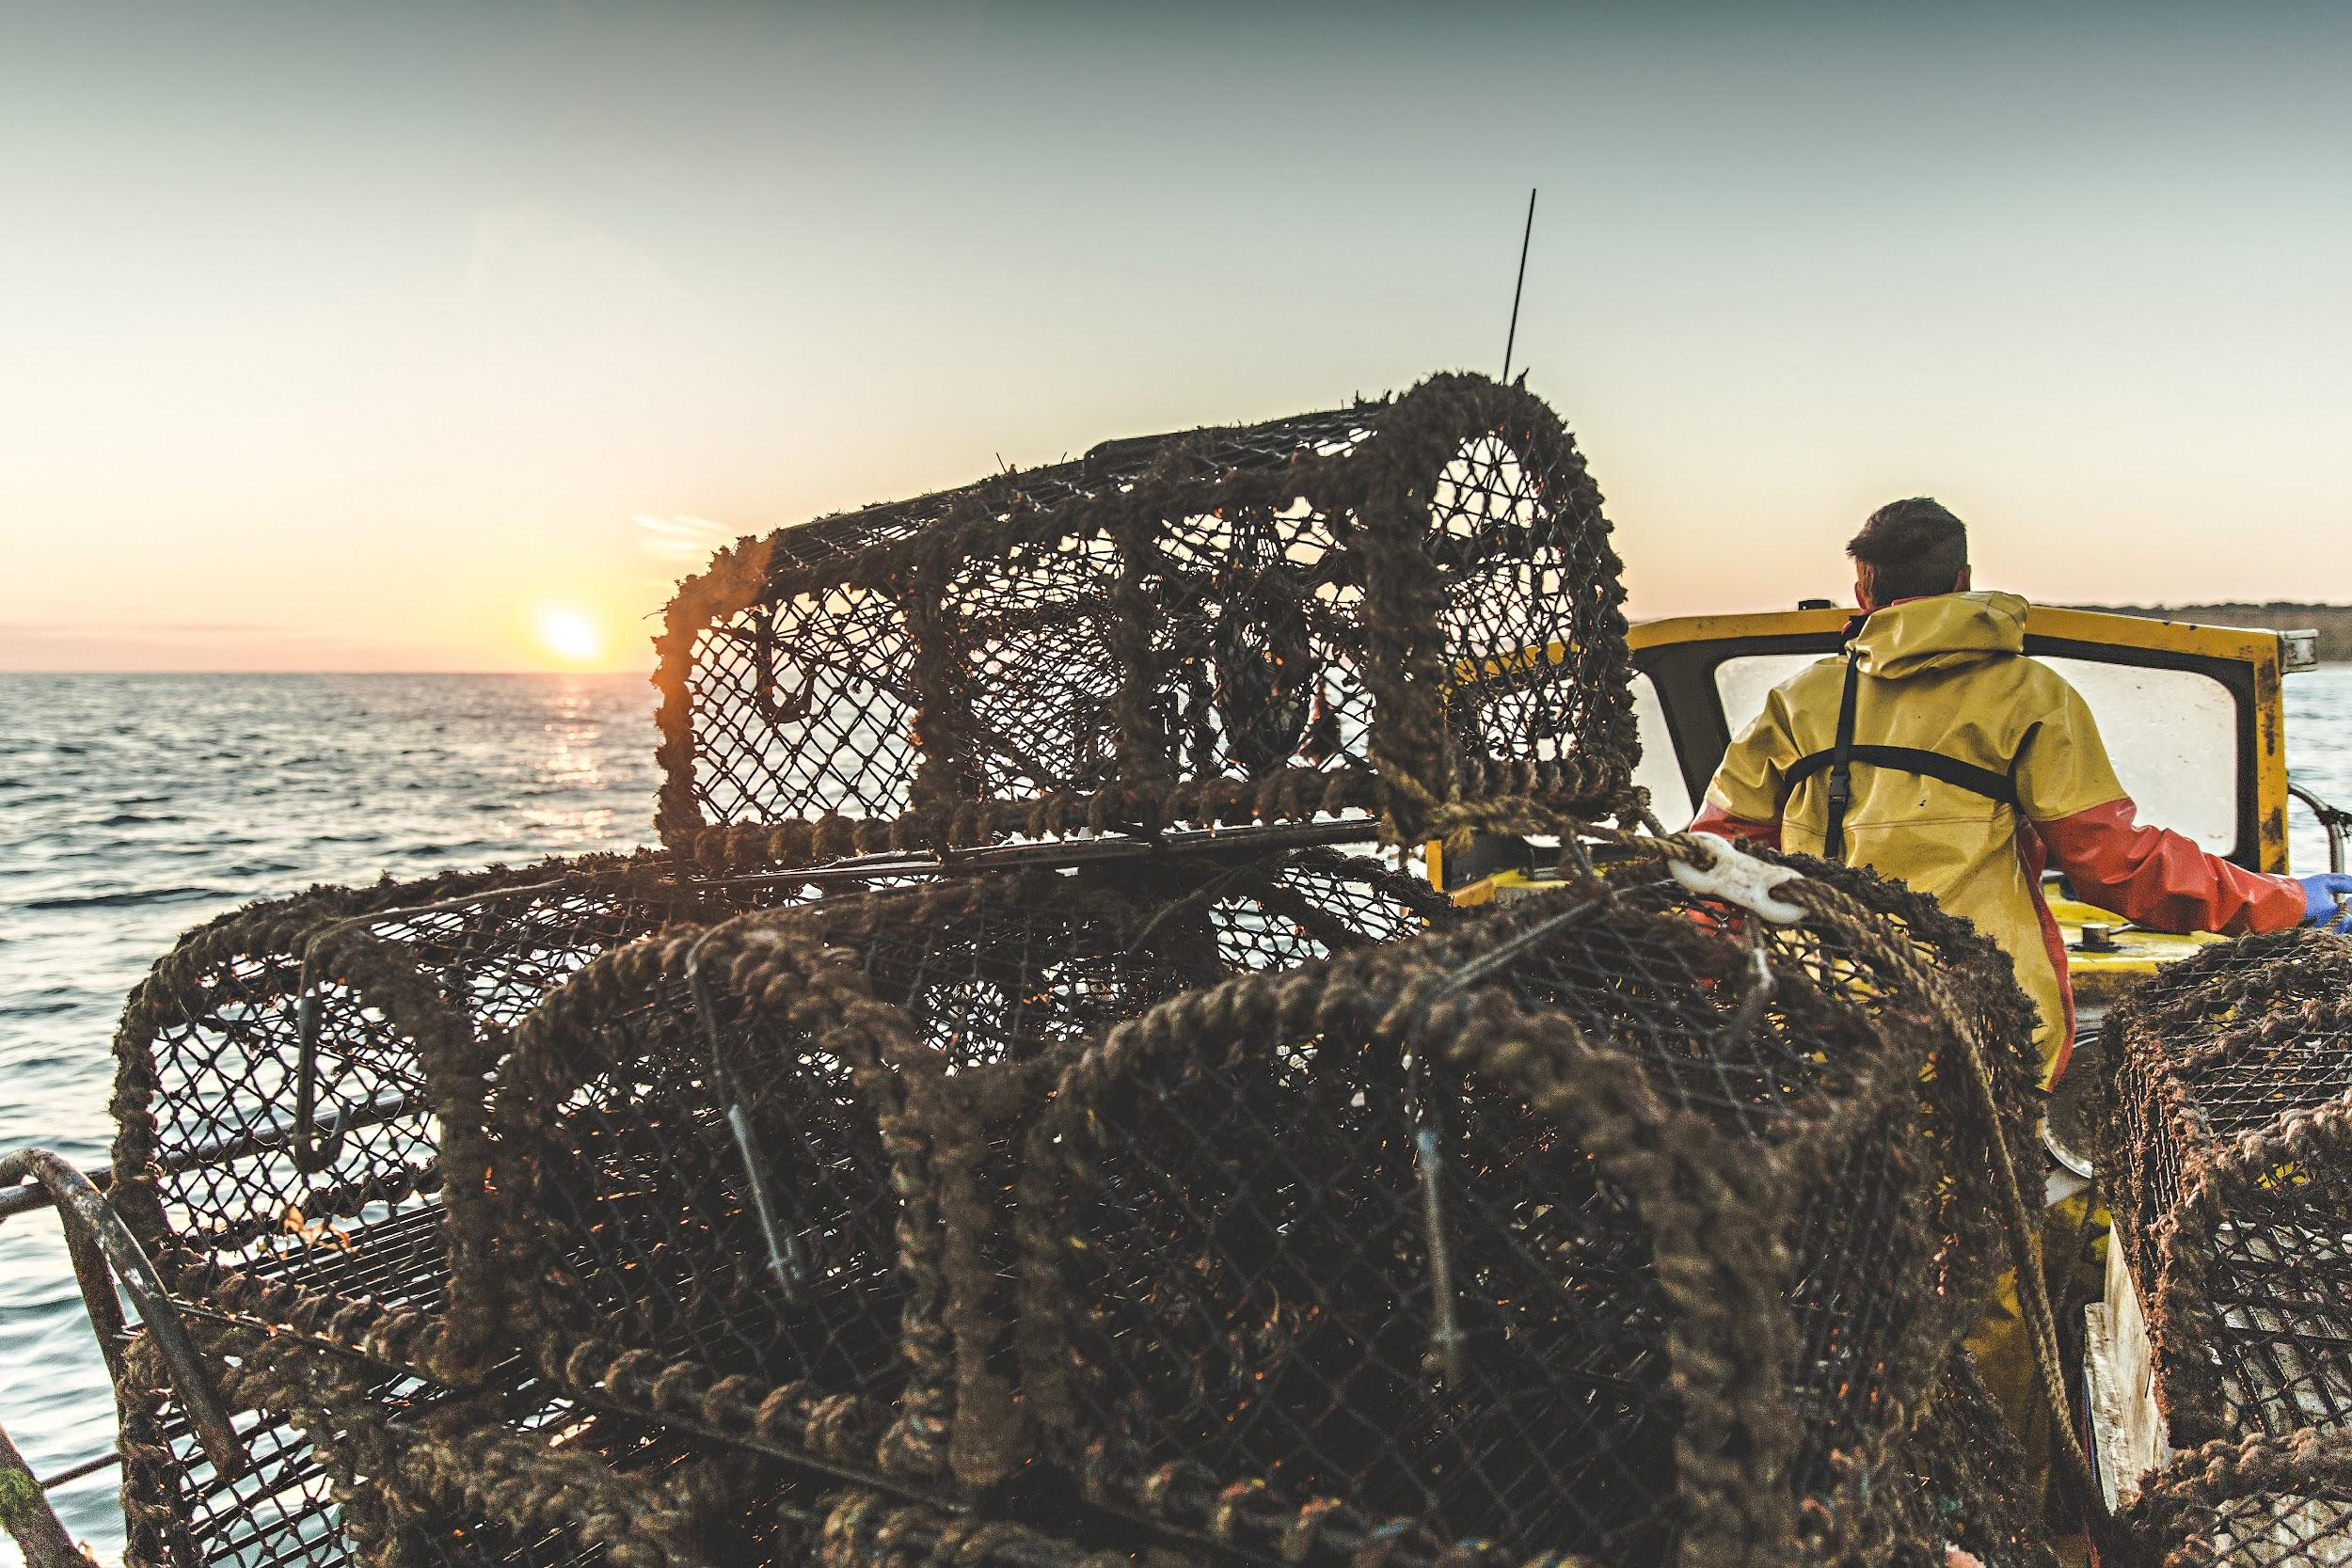
The pots are stacked in the boat then taken to another area.
Photo: christaylorphoto.co.uk

Slide 14
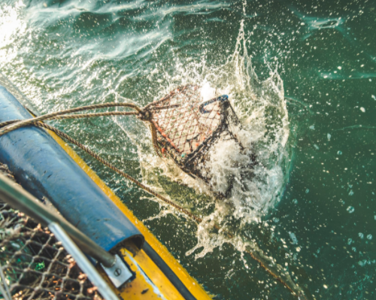
The pots are lowered back into the sea
Photo: christaylorphoto.co.uk
The fishers empty other shanks of pots then head back to shore with their catch.

Slide 15
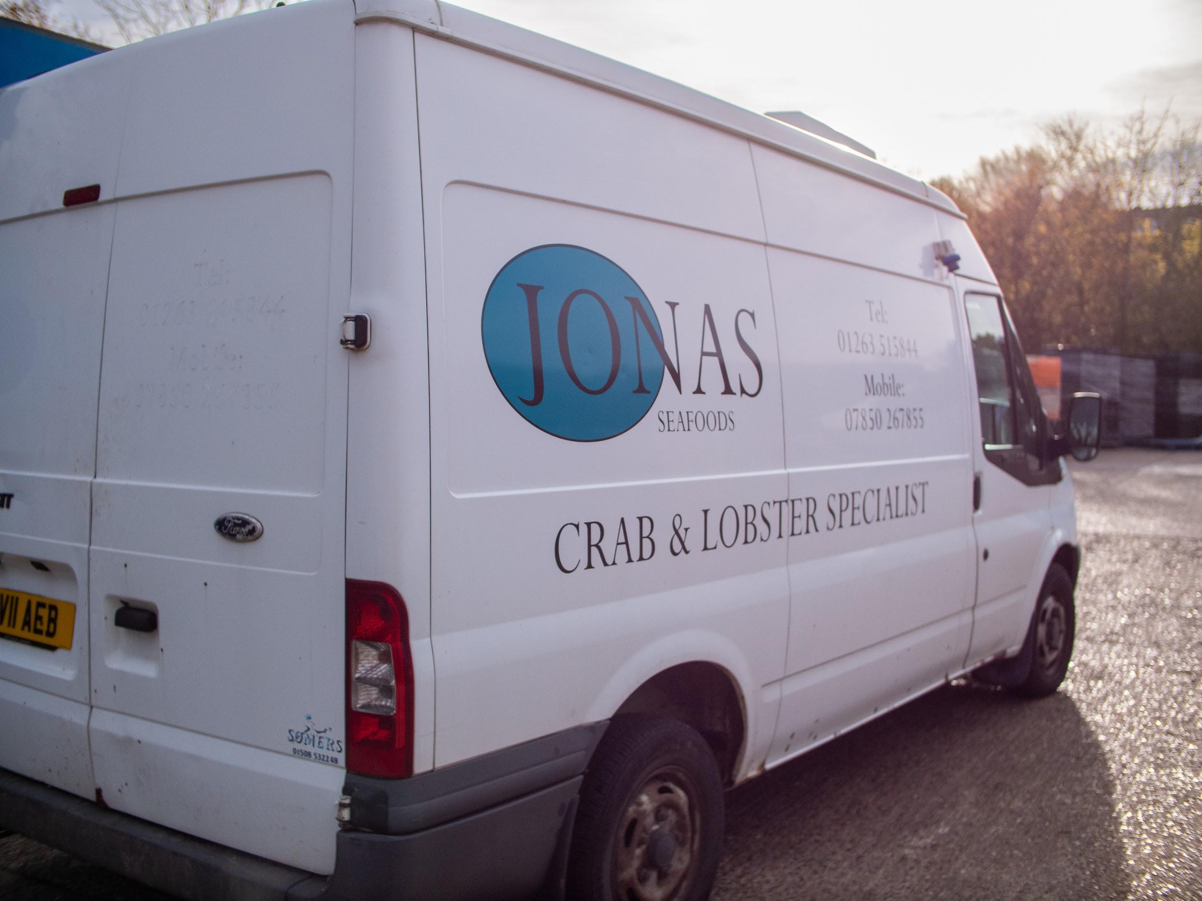
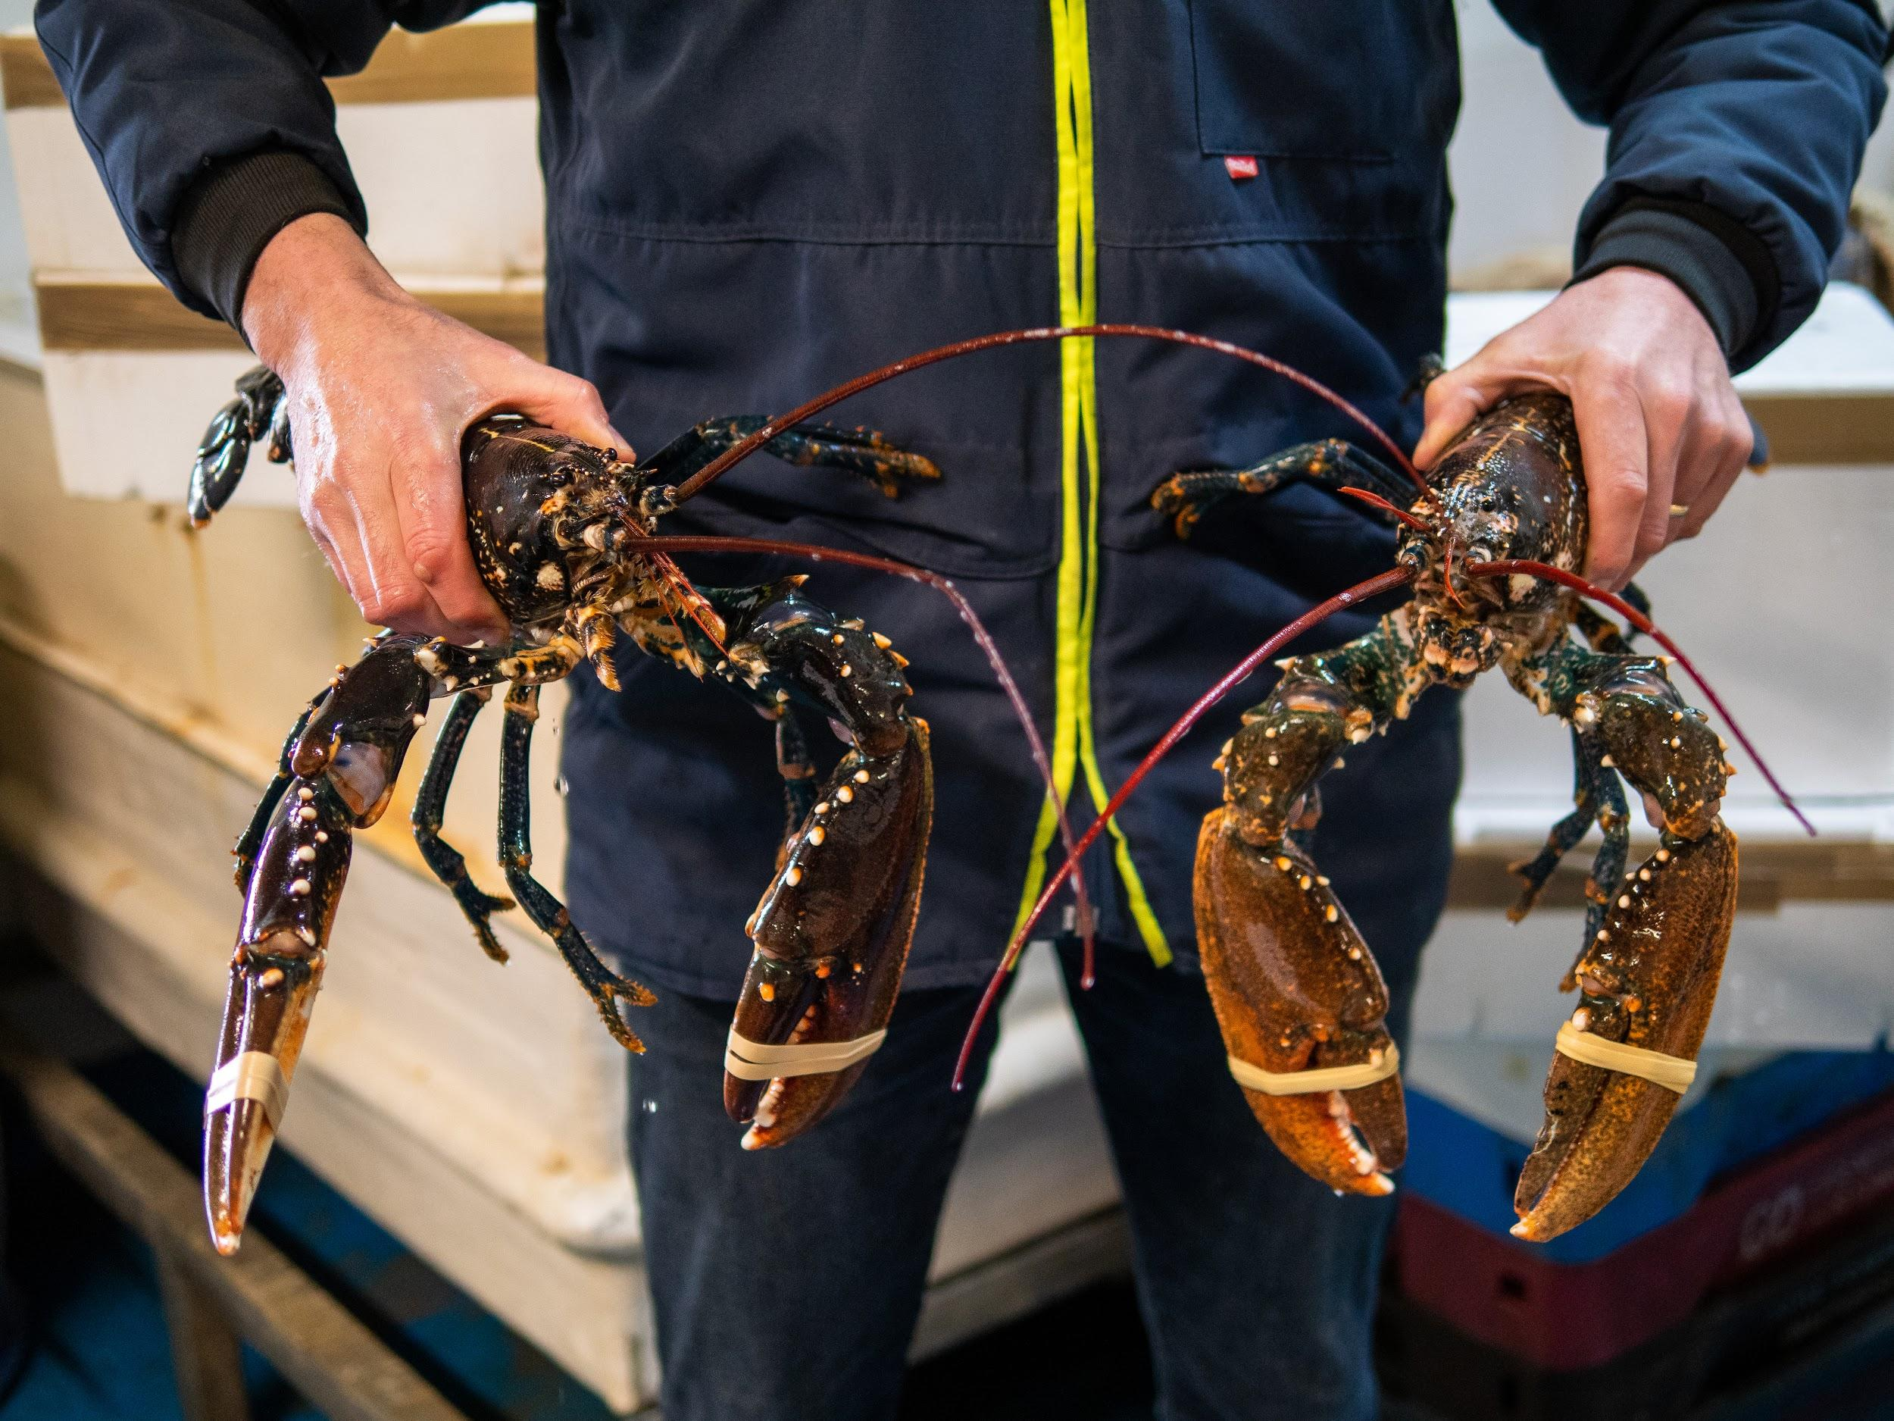
When back on shore, the crabs and lobsters are transported alive to the factory.
Photo: Rob Coleman
Photo: Rob Coleman

Slide 16
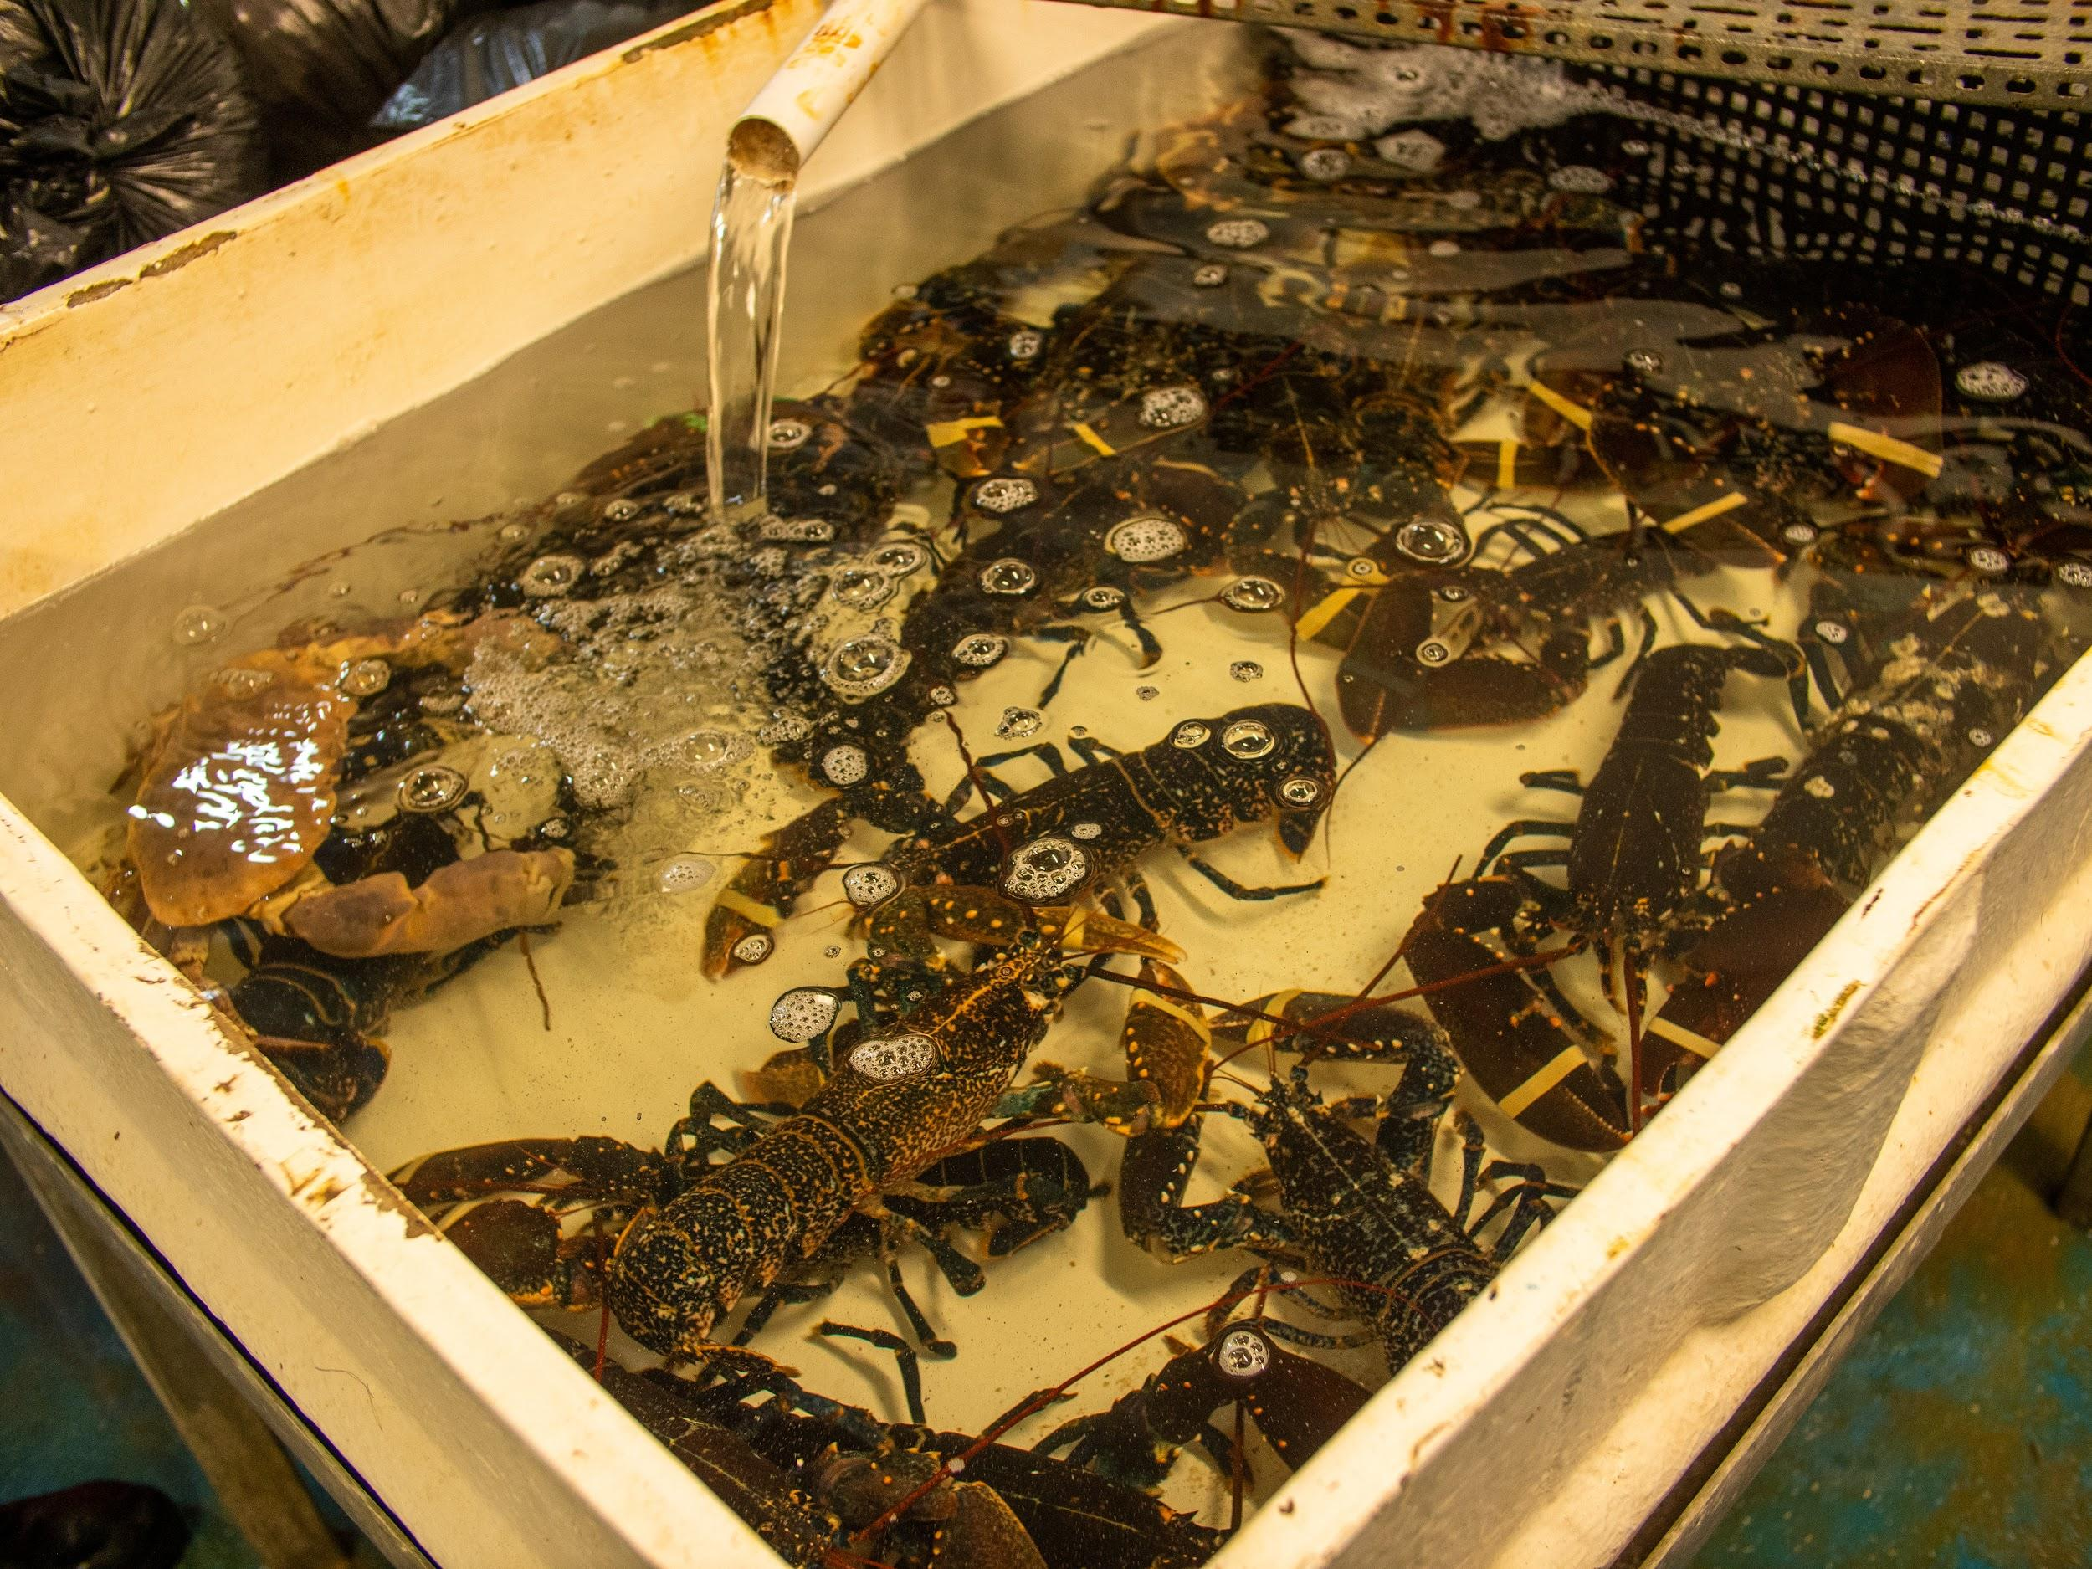
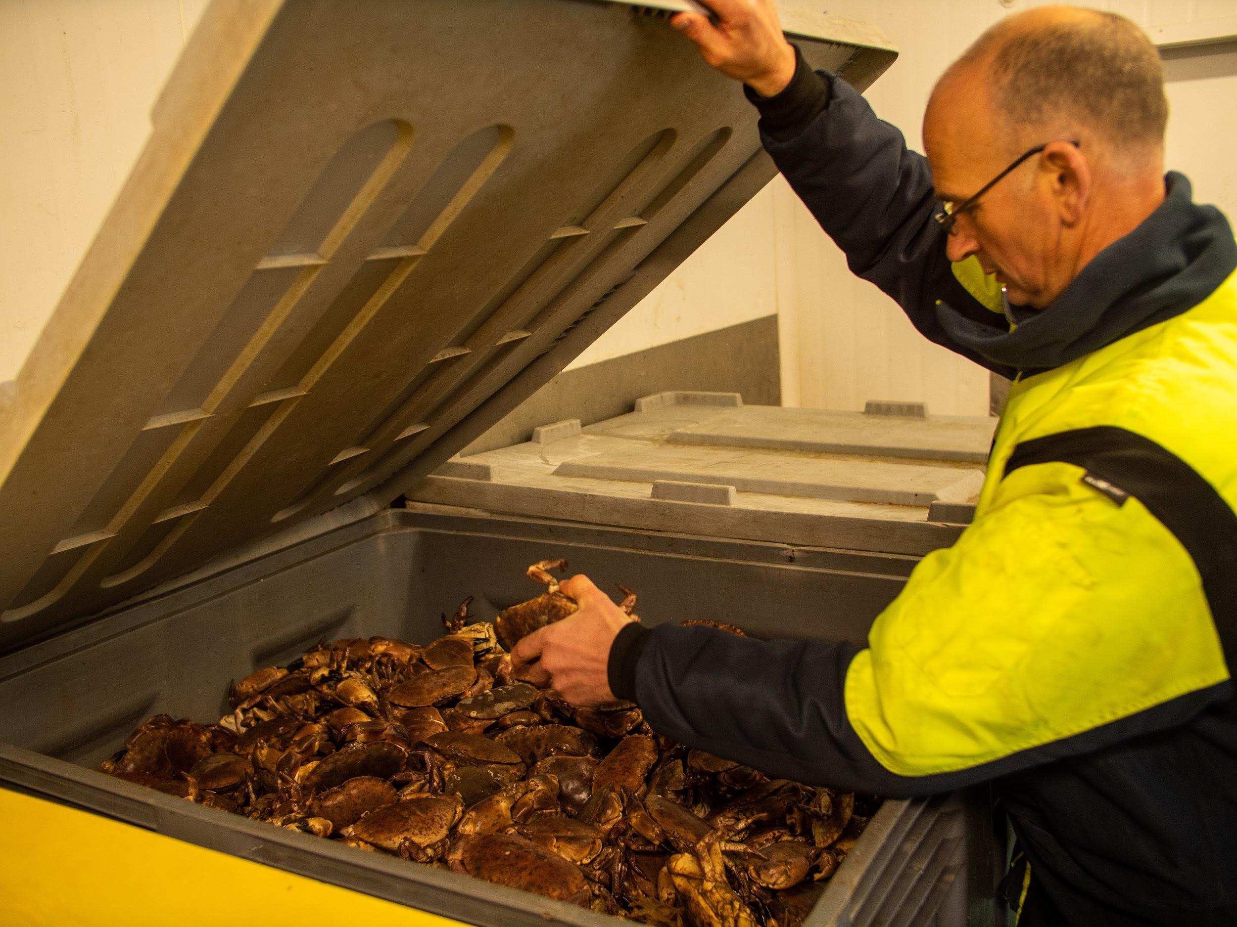
The crabs and lobsters are stored alive at the factory.
Photo: Rob Coleman
Photo: Rob Coleman
Lobsters are stored in tanks of circulating, filtered seawater.
Crabs are stored in large boxes.

Slide 17
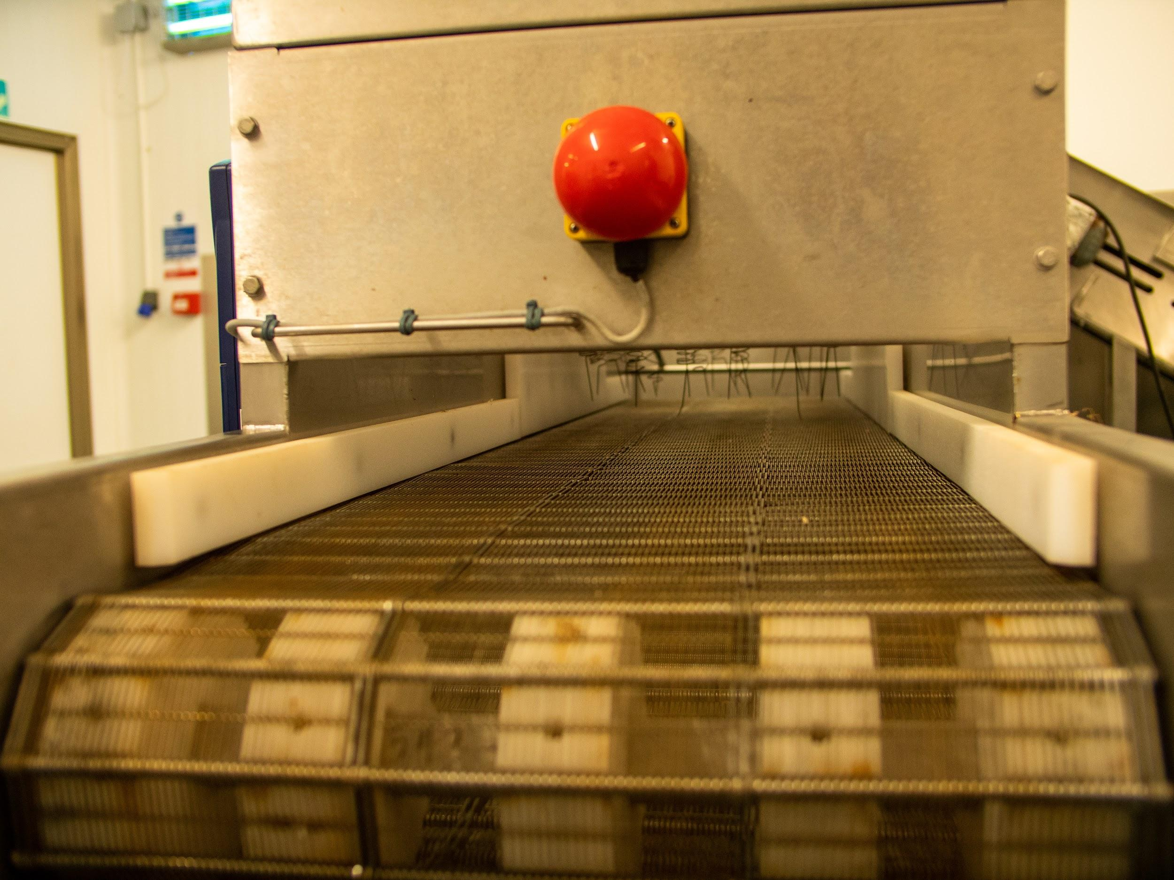
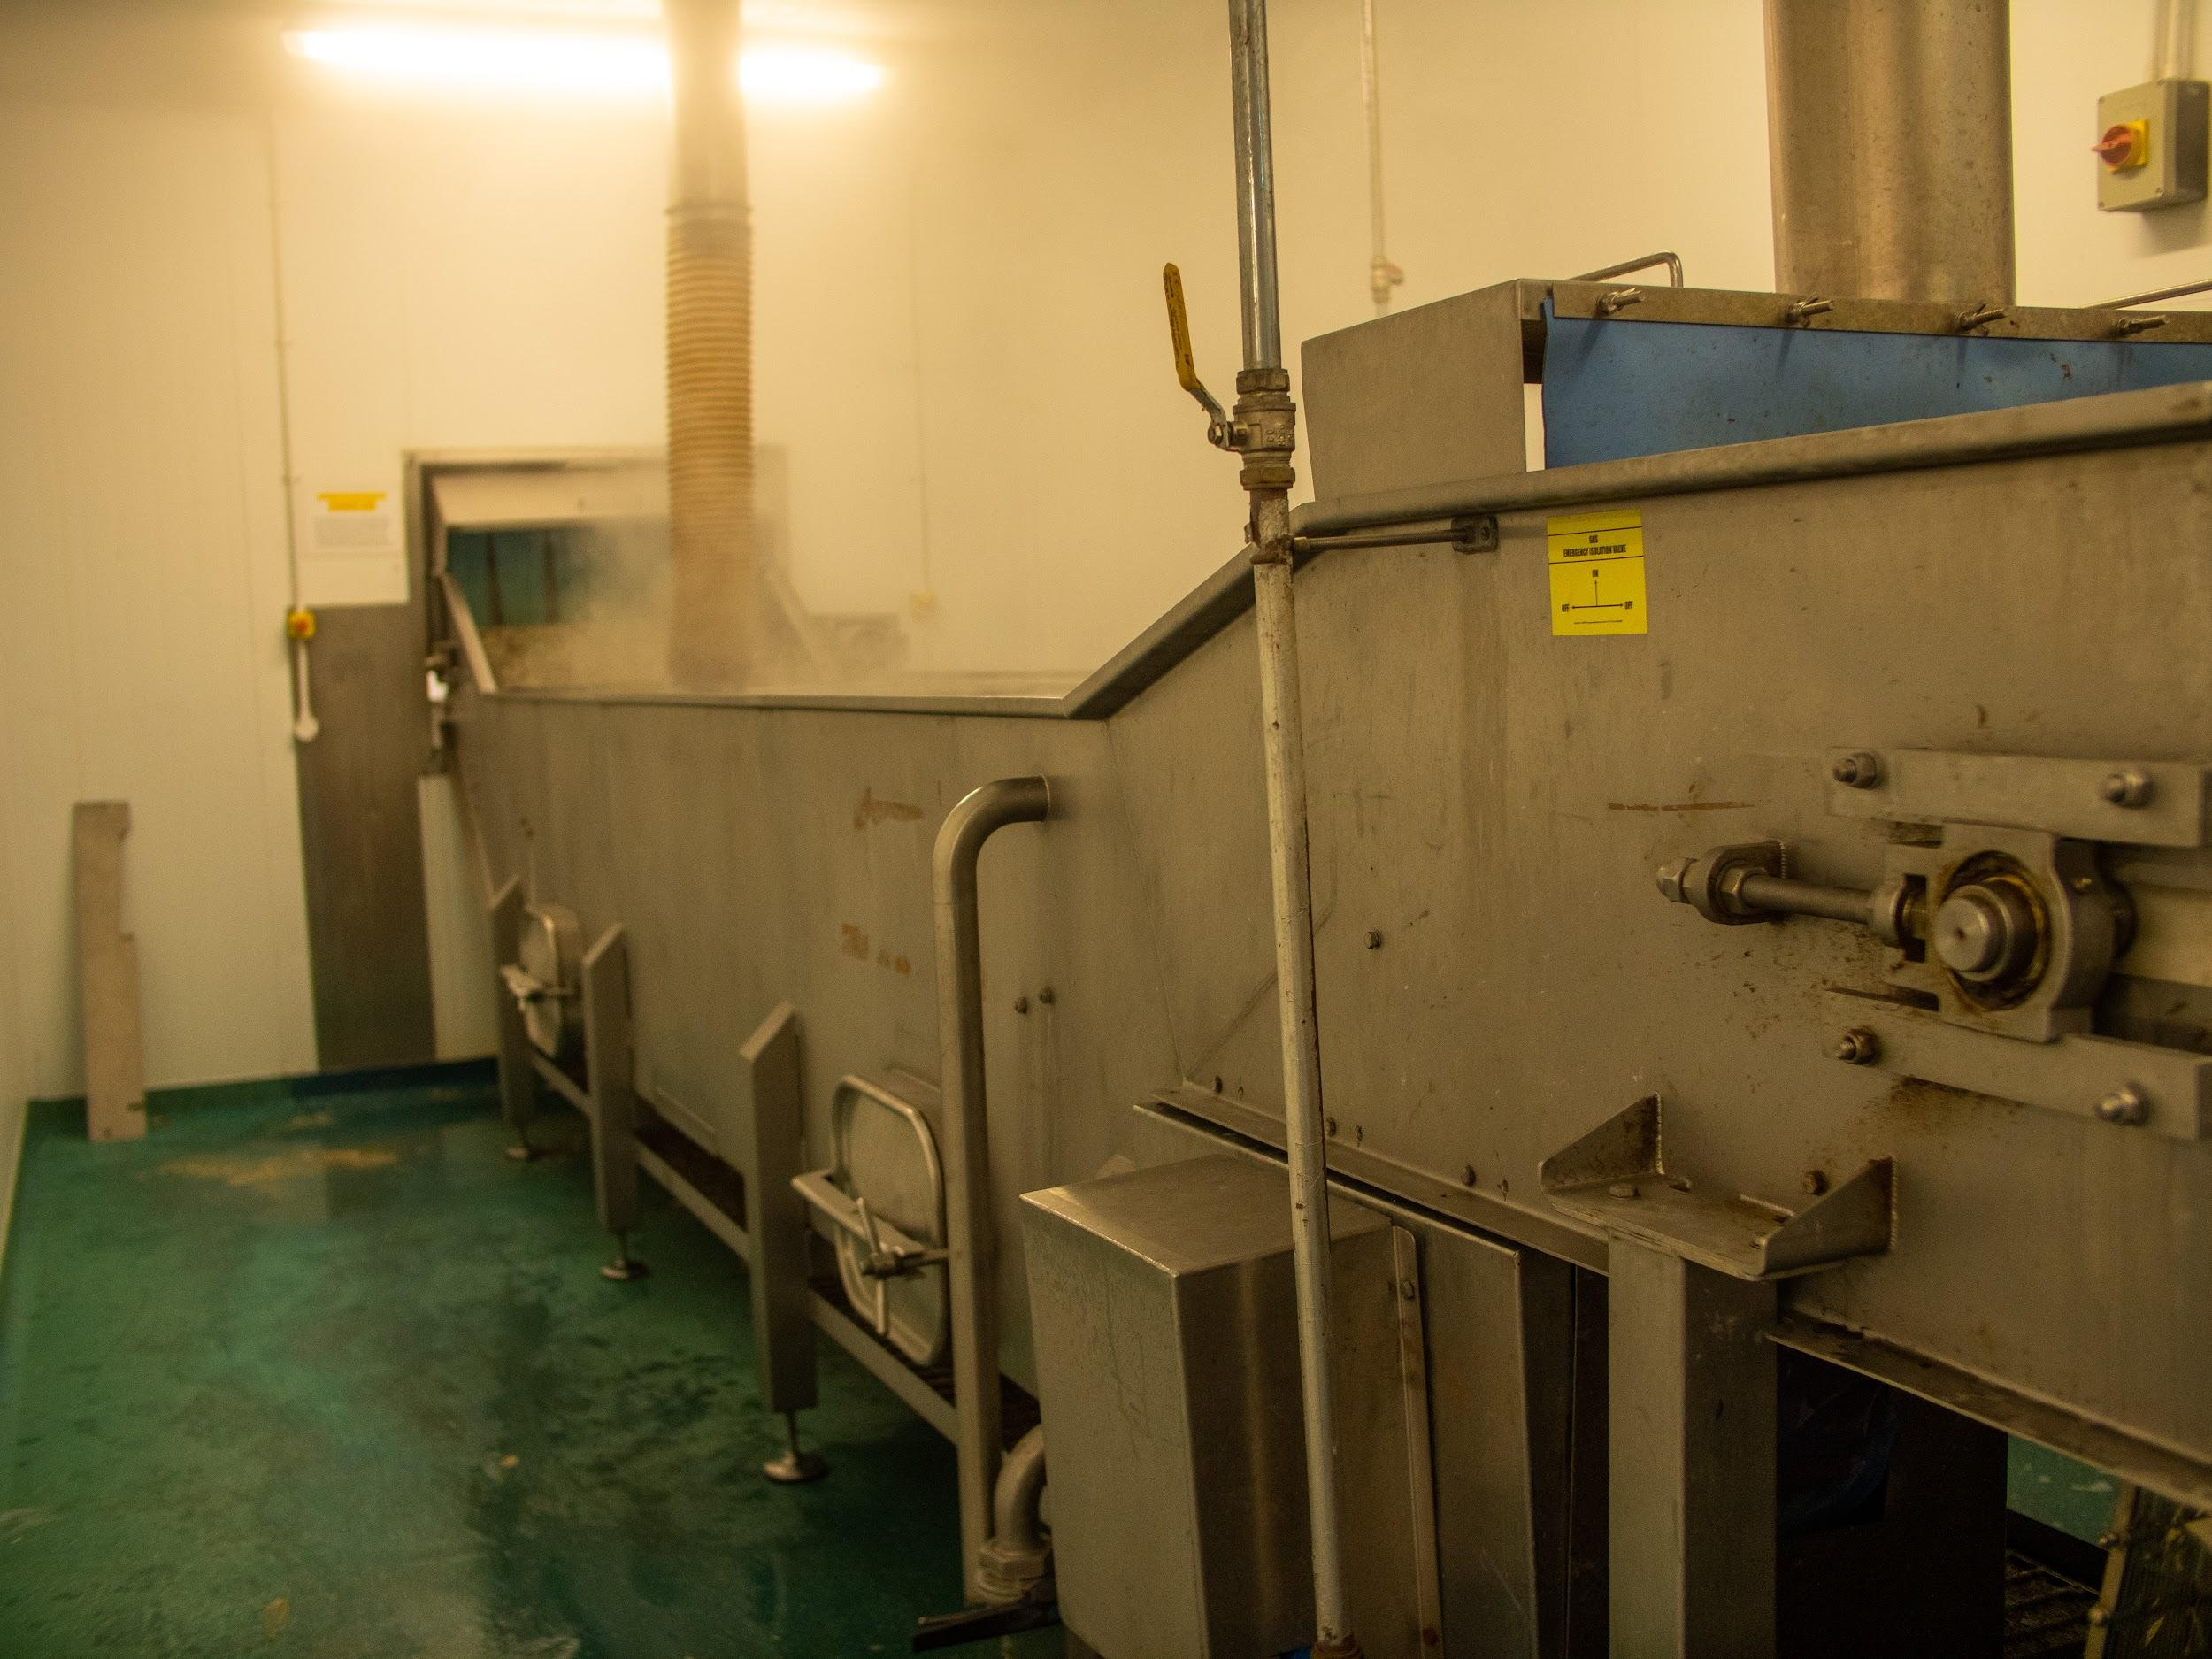
The crabs and lobsters are stunned and then cooked.
Photo: Rob Coleman
Photo: Rob Coleman
This all happens on a conveyor belt through the stunner and into the boiling water.

Slide 18
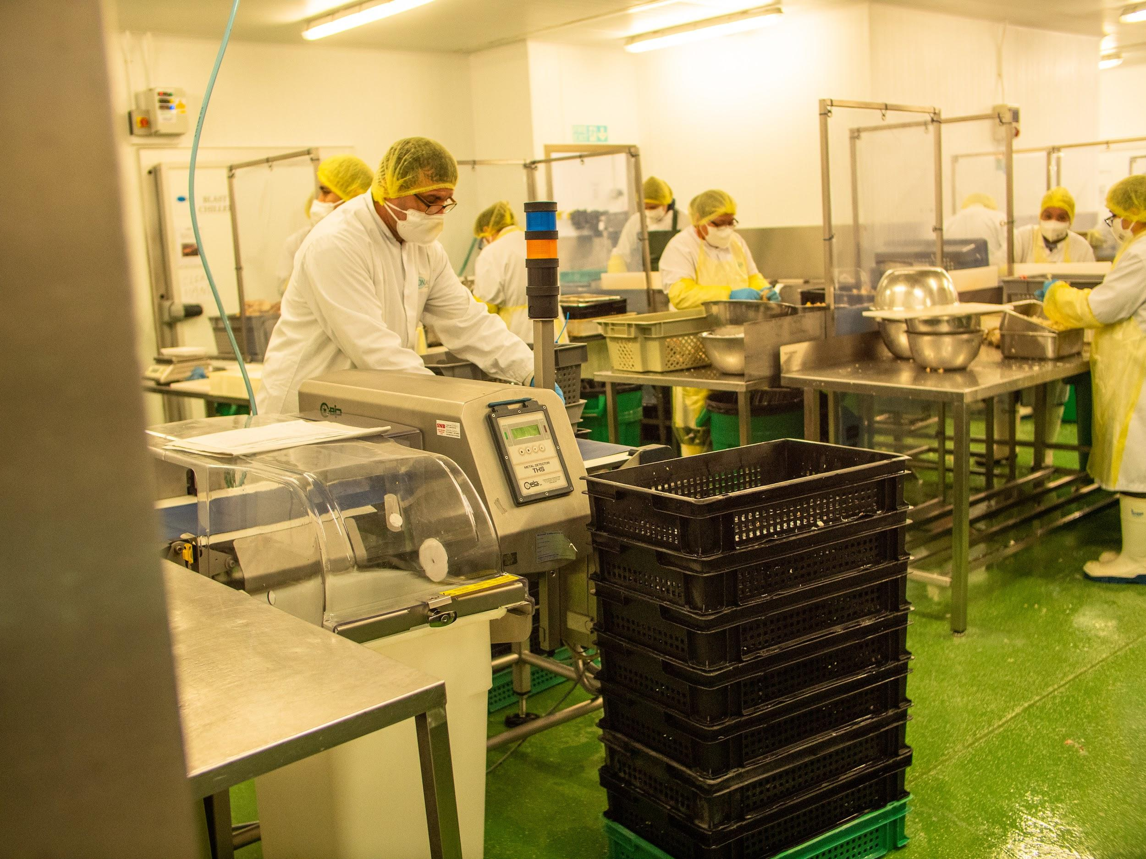
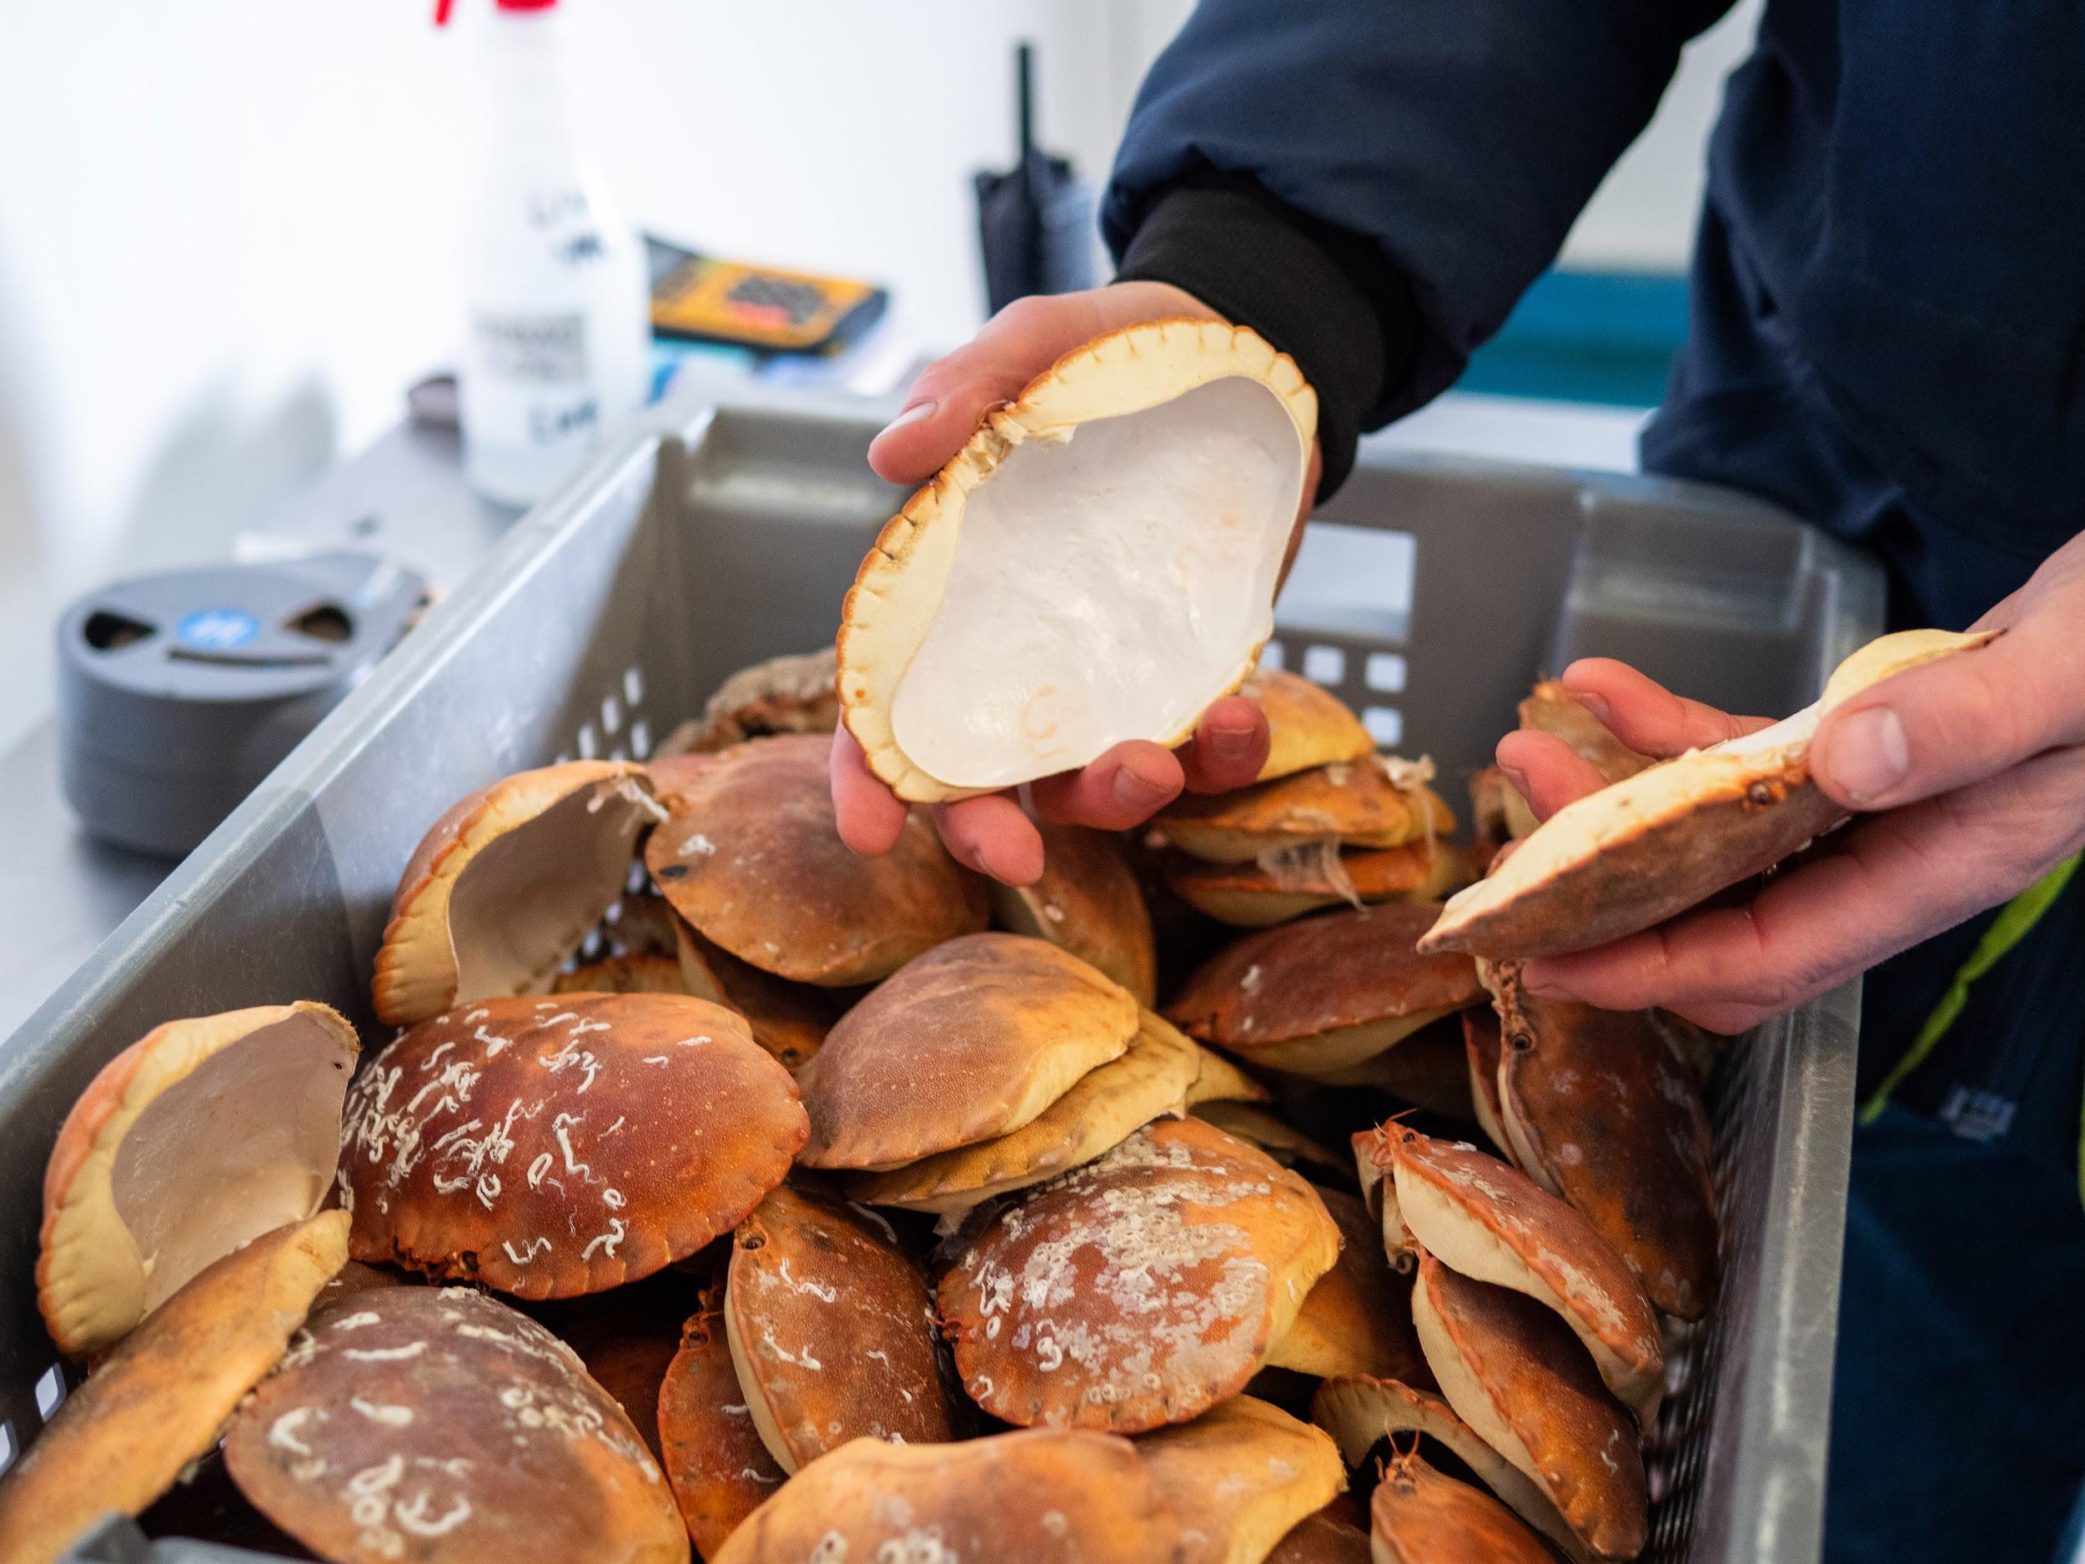
They are then chilled and stored before being ‘dressed.’
Photo: Rob Coleman
Photo: Rob Coleman
Dressing a crab means the meat is removed from the shell.
The meat is put back in shells that have been cleaned and sterilised in boiling water.

Slide 19
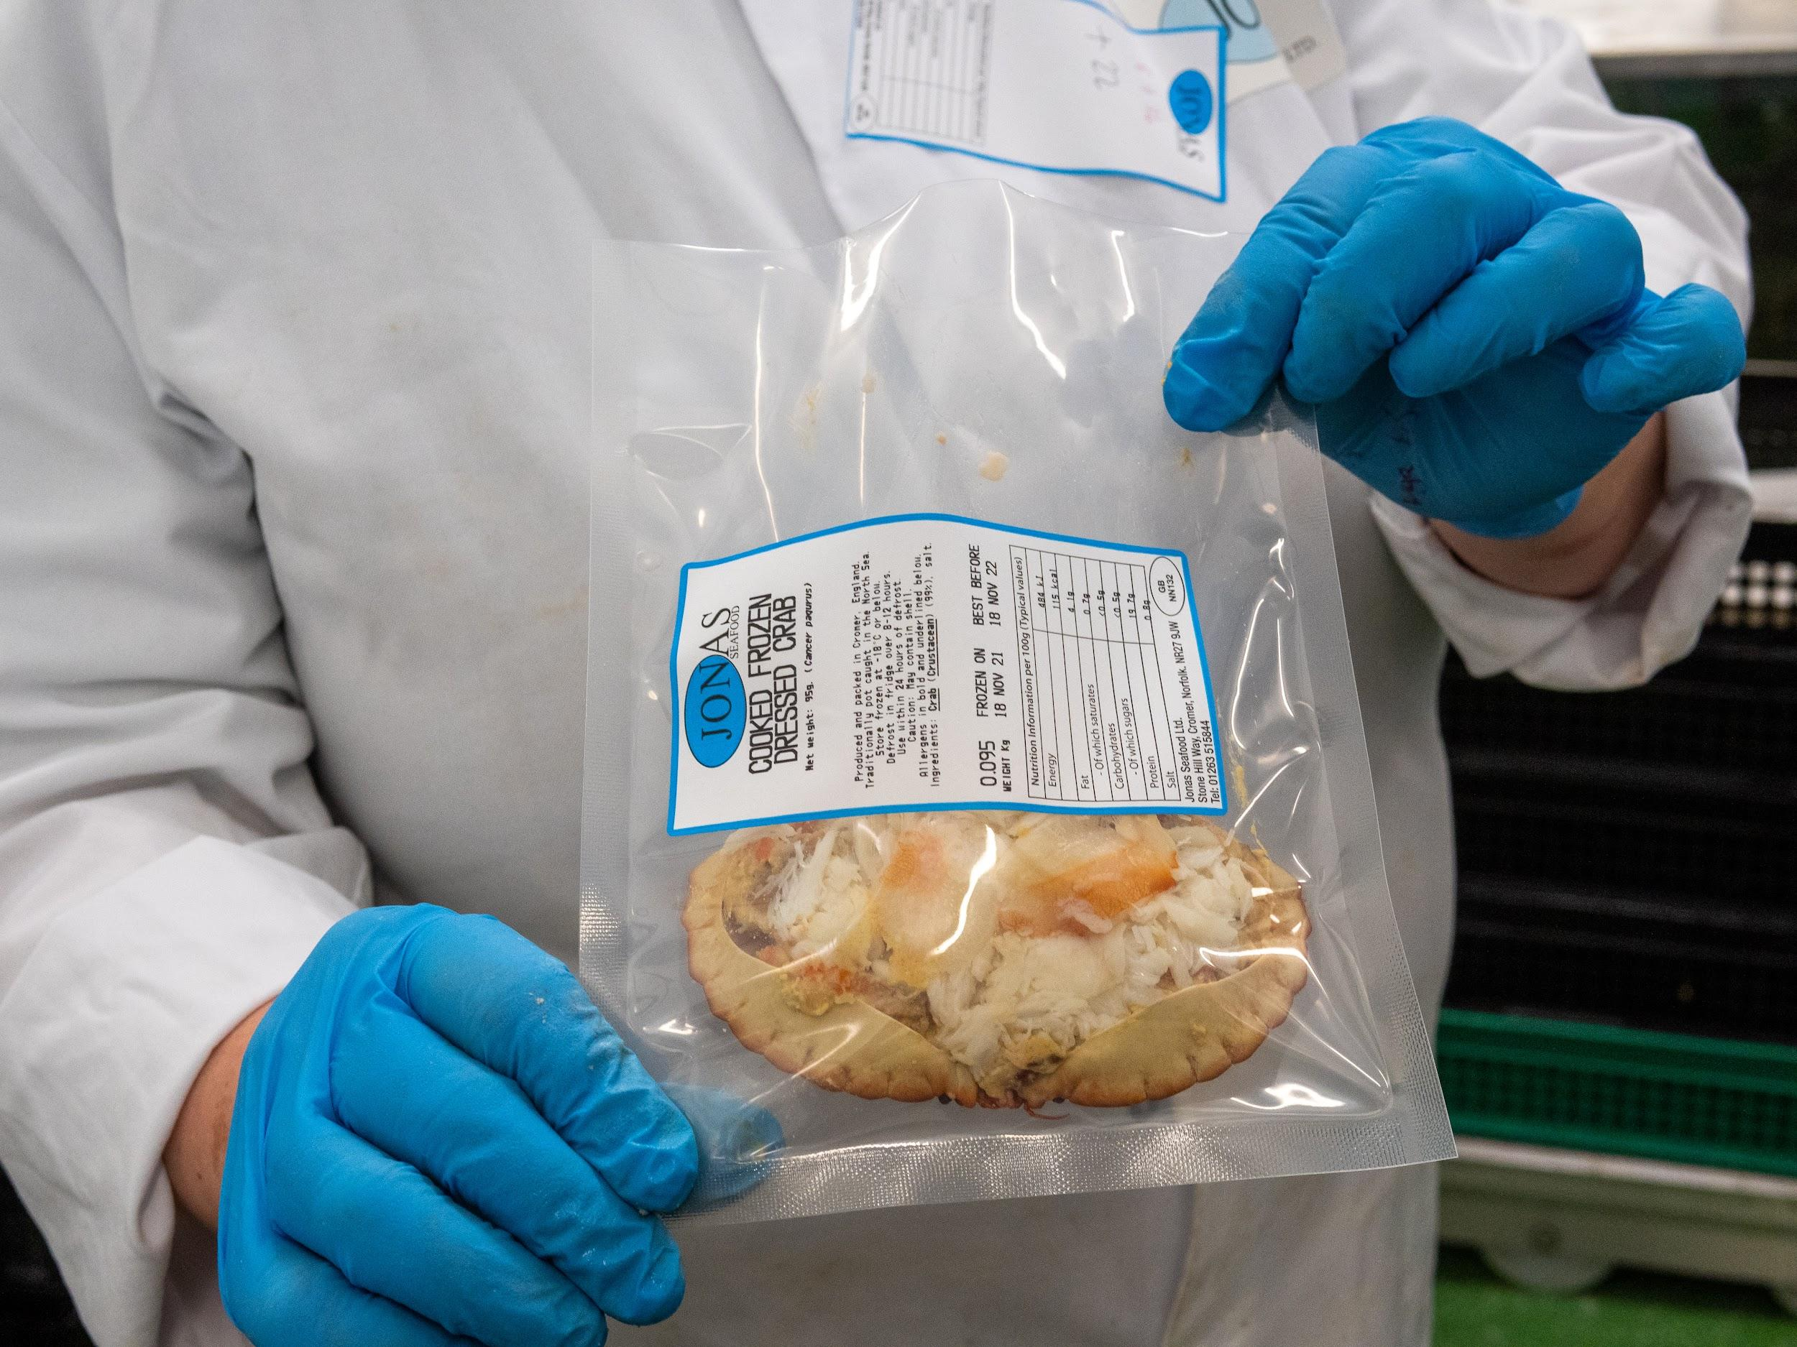
Dressing a crab!
See a crab being dressed at Davies Fish Shop in Cromer:
Photo: Rob Coleman
Notes:
Video link: https://youtu.be/PakFoEbdYMo

Slide 20
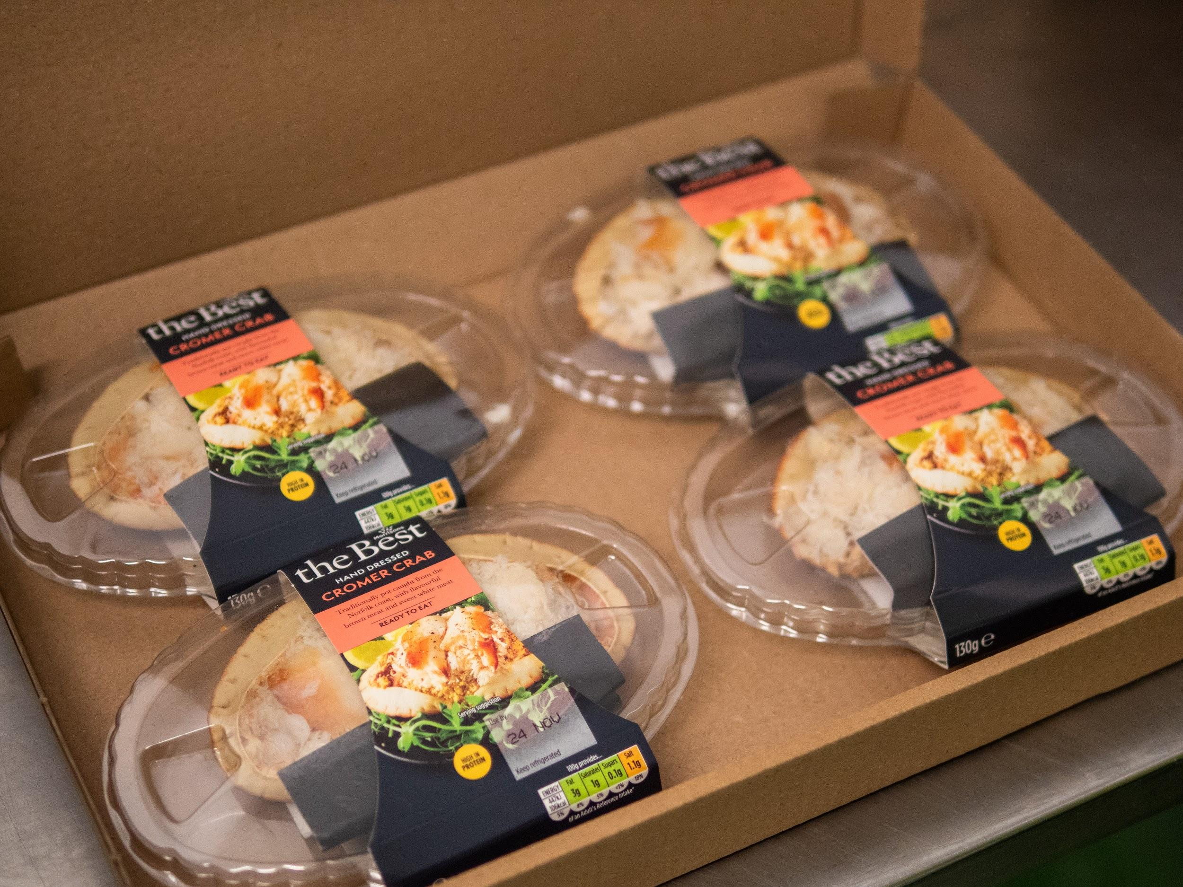
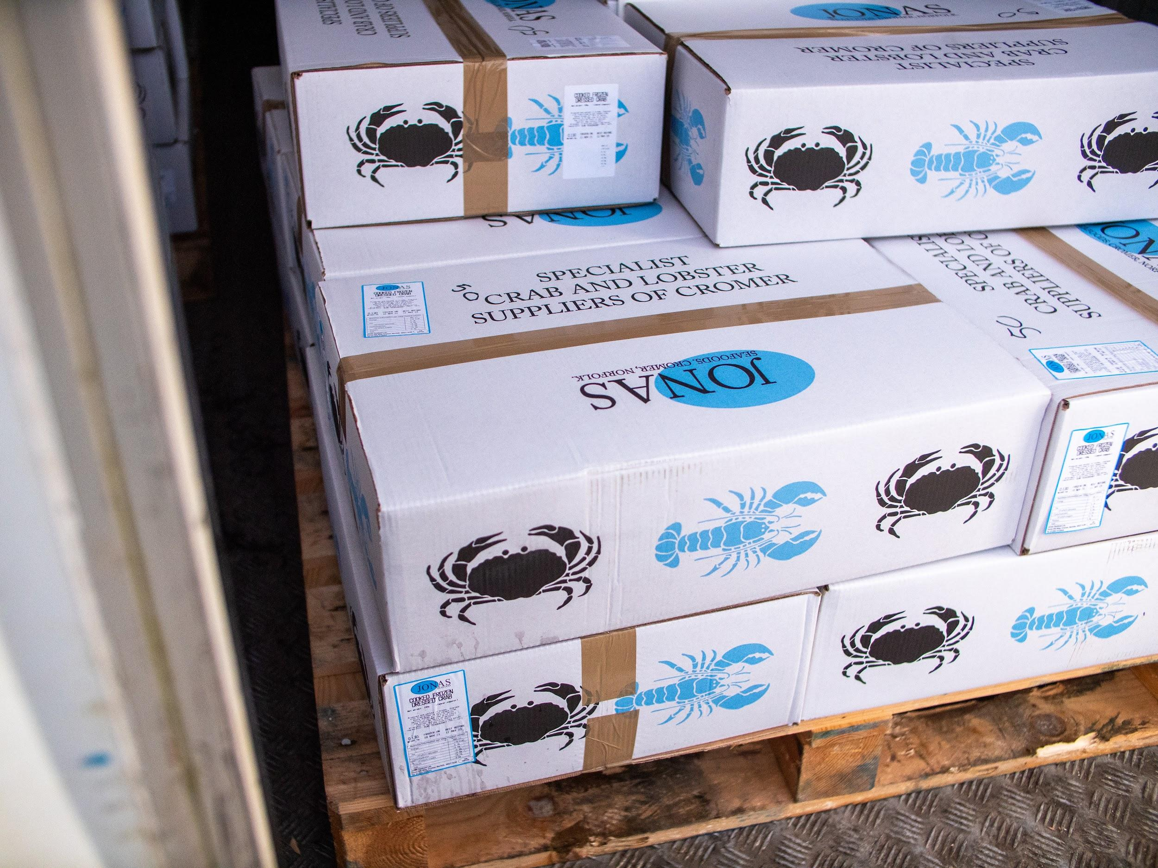
The dressed crabs are then labelled and boxed up ready to transport to the wholesaler, supermarket or restaurant.
Photo: Rob Coleman
Photo: Rob Coleman

Slide 21
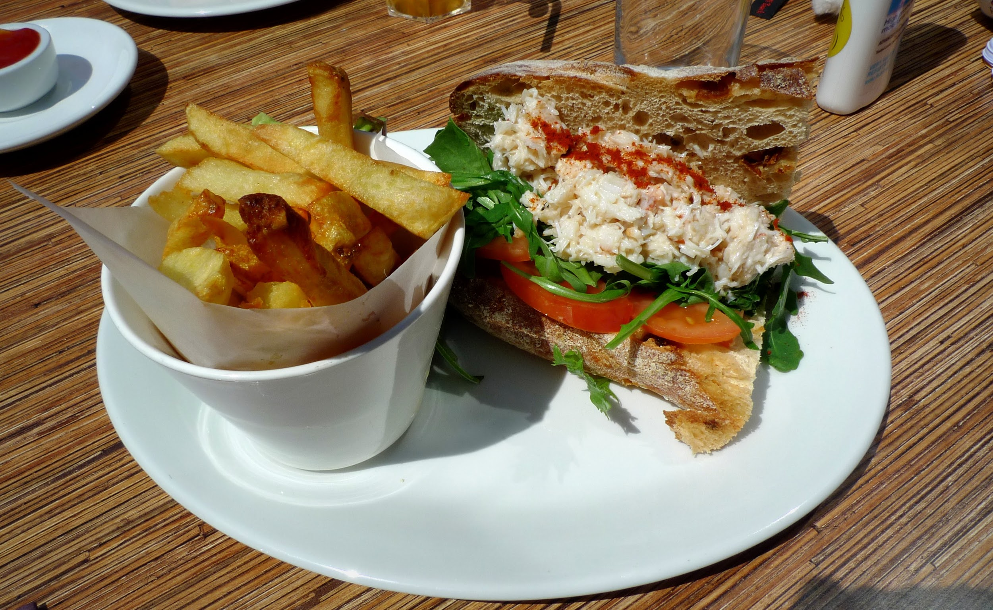
The crabs are ready to be bought and eaten!
Photo: Rob Coleman

Slide 22
Sea to Sandwich
Can you put the pictures in the correct order to show how a crab becomes a crab sandwich?
A crab sandwich ready to eat
The fisher collects the pots in
The crabs are cooked
Crabs are taken to the factory
Packed ready for sale
A crab is living in the sea
The crabs are dressed
Pots laid in shanks in the sea
Transported to supermarket or restaurant
The crabs are taken out of the pots and measured

Slide 23
Sea to Sandwich
Did you get them in the right order?
1.
2.
3.
A crab is living in the sea
The pots are laid in shanks in the sea
The fisher collects the pots in
4.
5.
6.
The crabs are taken out of the pots and measured
The crabs are taken to the factory
The crabs are cooked

Slide 24
Sea to Sandwich
Did you get them in the right order?
7.
8.
The crabs are dressed
Packed ready for sale
9.
10.
Transported to the supermarket or restaurant
A crab sandwich ready to eat!

Slide 25
The North Norfolk crab fishery
This video shows crabs being dressed and served at Rocky Bottoms café:
Notes:
Video one: https://youtu.be/C6z8zArQ9VY?t=158
Video two: https://youtu.be/D3T2T0jM_MY

Slide 26
Crab recipes
Have a go at making some savoury recipes using Cromer Crab!
Recipes include:
Crab sandwich
Crab cakes (like fishcakes!)
Crab and sweetcorn chowder

Slide 27
Crab sandwich
Ingredients
Bread
Butter
Crab meat
Mayonnaise
Salt
Pepper
Lemon juice
Lettuce
Method
Butter the bread.
Mix the crab meat with some mayonnaise, a squeeze of lemon juice and season with salt and pepper.
Spread the mixture onto the bread.
Add some lettuce and top with another slice of bread.
Serve!

Slide 28
Crab cakes Makes 10 x 6cm crab cakes
Ingredients
3 spring onions
½ a bunch of fresh flat-leaf parsley
1 large free-range egg*
750g cooked crabmeat
300g potatoes
1 tsp ground pepper
1 tsp cayenne pepper
Pinch of salt
Plain flour*, for dusting
Olive oil
Method
Peel, boil and mash the potatoes and leave to cool.
Trim and finely chop the spring onions.
Pick and finely chop the parsley.
Beat the egg.
Combine the crab meat, potatoes, spring onion, parsley, pepper, cayenne and egg in a bowl with a little salt.
Shape into 6cm cakes.
Dust with flour.
Shallow-fry in oil over a medium heat for about 5 minutes each side or until golden brown.
*Recipe can be made gluten free by substituting gluten-free flour *The egg can be substituted by egg-free mayonnaise

Slide 29
Crab chowder
Ingredients
1 tbsp olive oil
1 small/medium onion, chopped
2 celery ribs, chopped
2 medium carrots, peeled + chopped
2 leeks, sliced into half-moons
2 large potatoes, peeled and diced into small cubes
1 bay leaf
1 tsp paprika
1 tsp ground pepper
1½ tsp salt
1 litre vegetable stock
2 large tins sweet corn
500g fresh crab meat
100ml milk
100ml single cream
¼ cup finely chopped fresh parsley
Method
In a large hob to oven dish, gently fry onions, celery, carrots, and leeks until soft.
Add potatoes, bay leaf, paprika, pepper, salt and vegetable stock. Cook for about 8-10 minutes until the potatoes are halfway done.
Puree 2 cups of the vegetable mixture in a food processor or blender until smooth. Stir the mixture back into the pot.
Add sweetcorn, crab meat, milk and cream. Cook uncovered for about 8 minutes.
Stir in parsley and serve!

