Slide 1
Wildlife in the MCZ
Ages 7-11

Slide 2
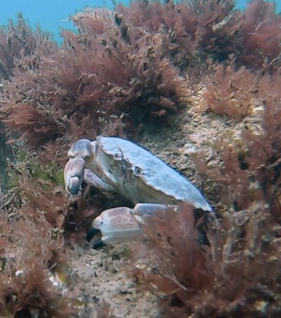
Wildlife in the MCZ
Much of the wildlife in the Cromer Shoal Chalk Beds Marine Conservation Zone is hidden beneath the surface but it is pretty amazing! Over 350 species of marine animals and plants have been recorded in the MCZ.
Watch the videos on the next slides to see some of the amazing creatures that live there.
Photo: christaylorphoto.co.uk

Slide 3
Wildlife in the MCZ
3-minute video:
Notes:
3.5 minutes (no narrative): https://www.youtube.com/watch?v=16tExrrMktA

Slide 4
Wildlife in the MCZ
10-minute video:
Notes:
10.5 minutes (with narrative): https://www.youtube.com/watch?v=rVPooS9iiN8

Slide 5
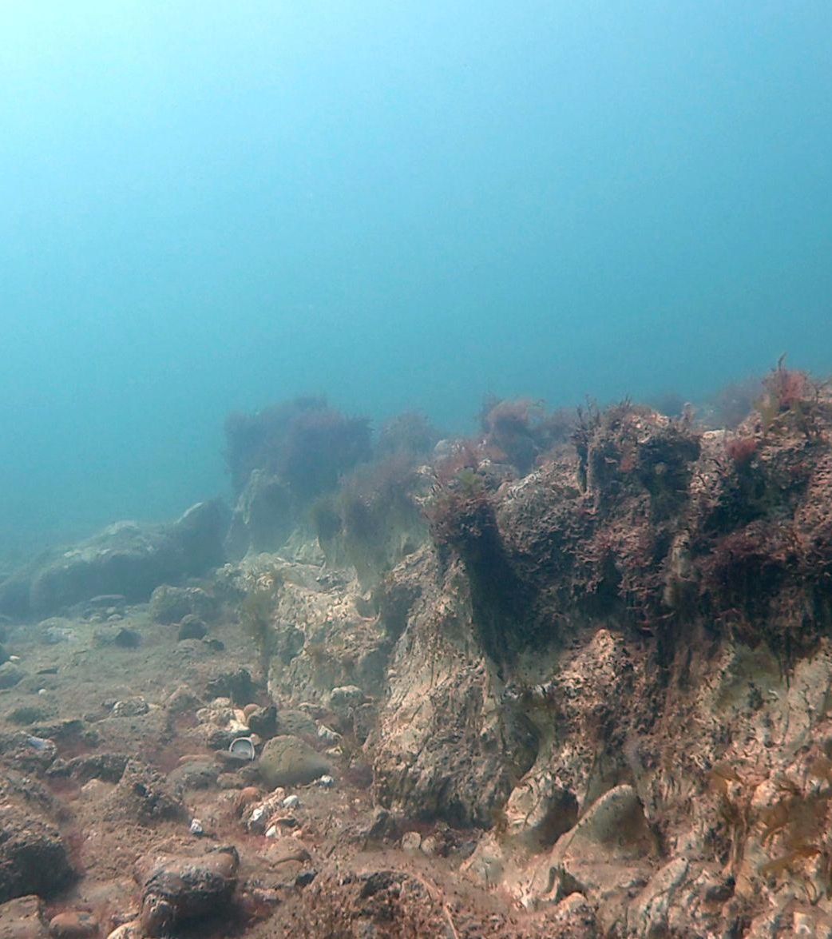
Photo: christaylorphoto.co.uk
Chalk seabed
The chalk beds have holes, arches and ridges up to 3m high. These provide great places for wildlife to live and hide from predators.
The chalk provides a surface for seaweed and creatures to attach to. It is a different habitat to much of the seabed in the North Sea.

Slide 6
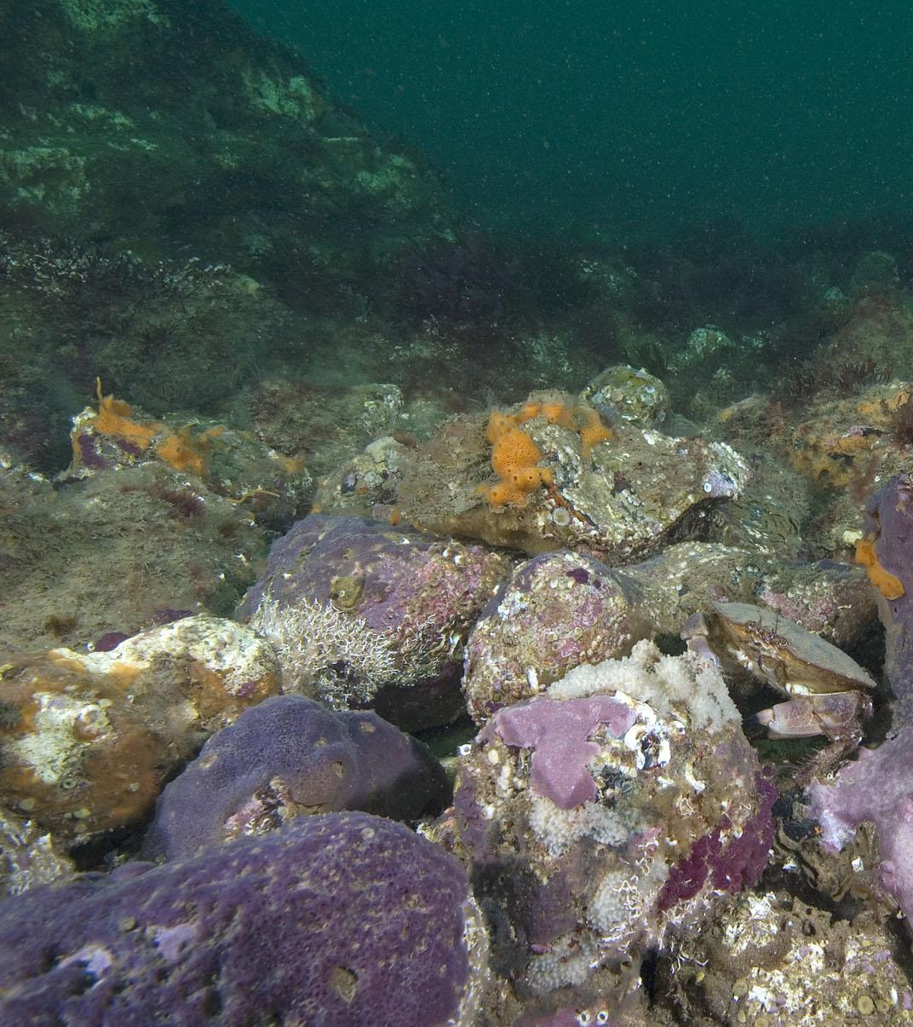
Photo: Paul Naylor
Parpal Dumplin
In 2011 some Seasearch divers noticed a purple sponge and with the help of scientists they realised it was new to science! It is the only place in the world where it is known to live.
In 2021 a competition was organised that a local school girl won. She named it Parpal Dumplin because it’s purple and looks a bit like a dumpling!

Slide 7
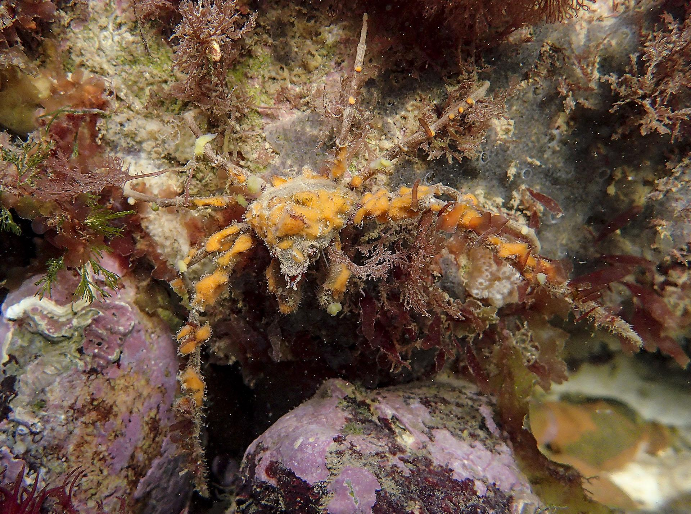
Photo: Paul Naylor
Can you spot the crab?
These amazing spider crabs cut off and attach pieces of sponge to their shell to help them camouflage!

Slide 8
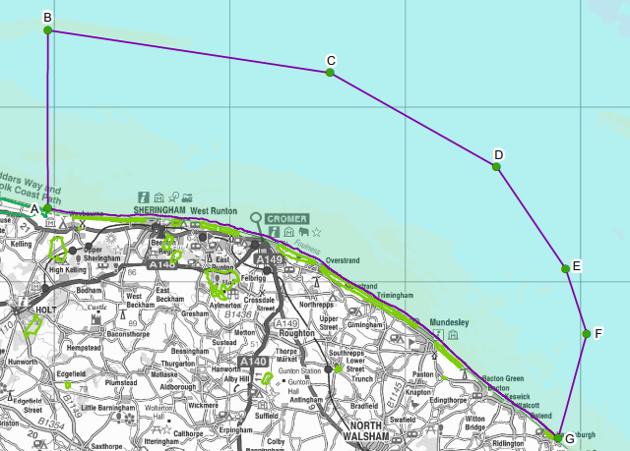
Threats to wildlife in the MCZ
Despite being hidden from view, the wildlife faces some threats.
The Marine Conservation Zone designation means that work is happening to protect the wildlife from these threats.
Potential threats include:
Litter
Wind farm development
Coastal defence works
Fishing

Slide 9
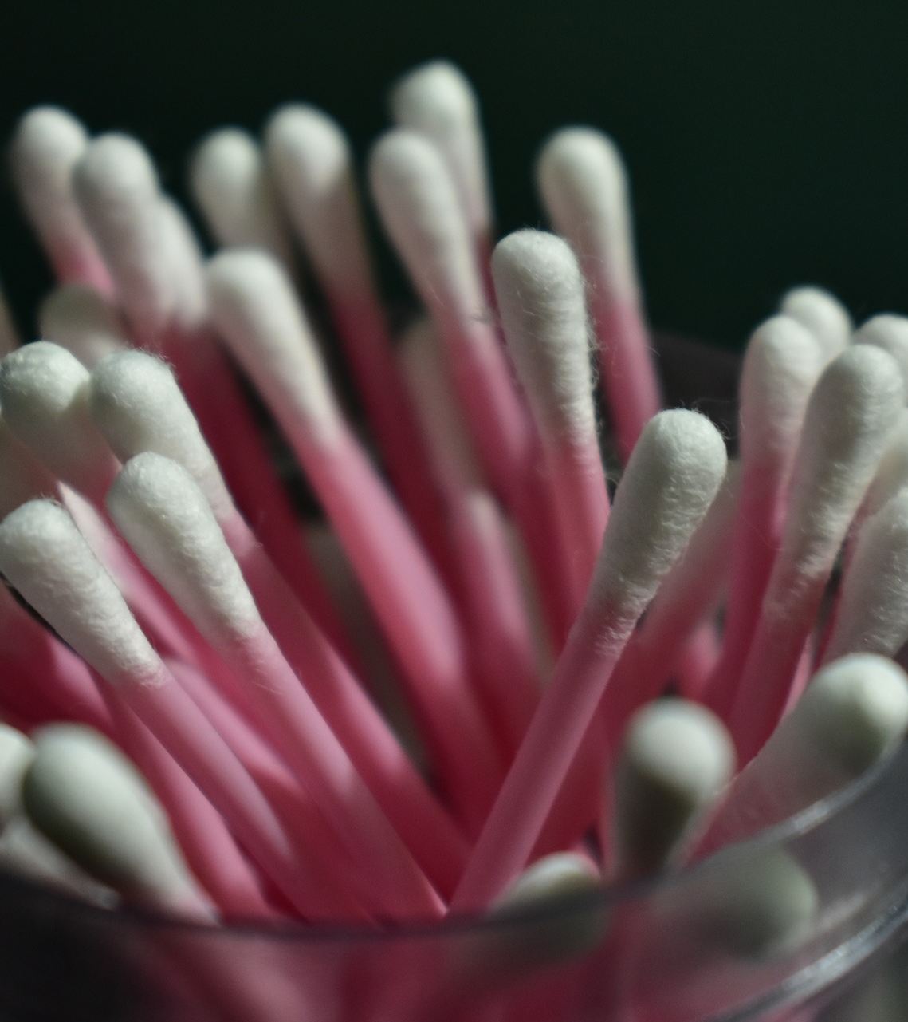
Litter
Beach clean organisers collect data about the litter collected. They can then identify where the litter is coming from and campaign to prevent it. Plastics are the main problem.
Plastic cotton buds were regularly found during beach cleans. Following campaign work, the government banned them from sale from 1st October 2020, along with plastic straws and stirrers. Now they are rarely found.
The sticks are now made from card, wood or bamboo which biodegrades naturally.
PhotoPisauikan

Slide 10
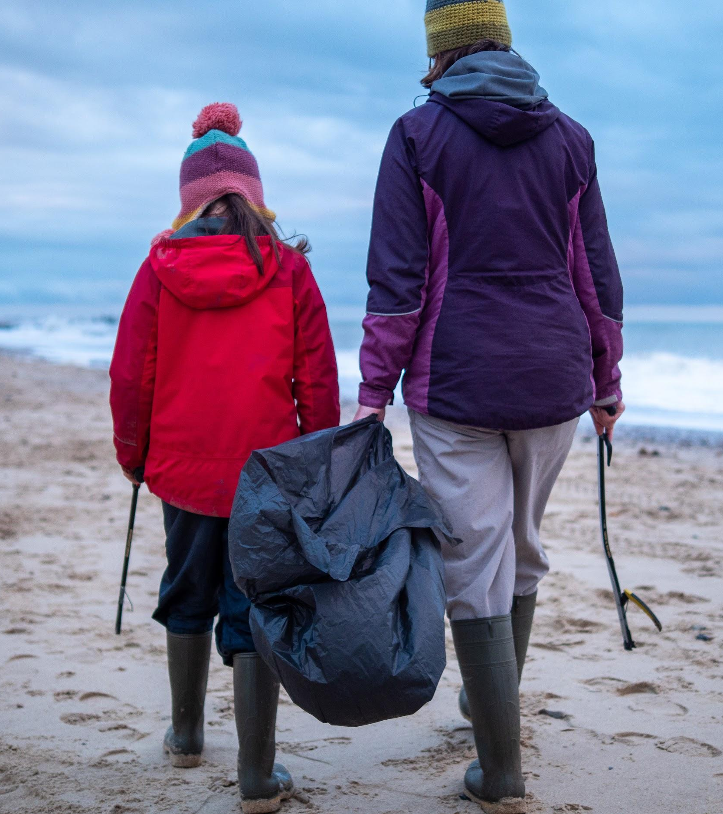
Plastics
Beach cleaners regularly collect litter from the beaches.
They have noticed lots of pieces of plastic edging from crab pots getting washed up on beaches. Use of plastic free, stainless-steel pots has the potential to remove this problem, but they are more expensive.
Photo: Rob Coleman

Slide 11
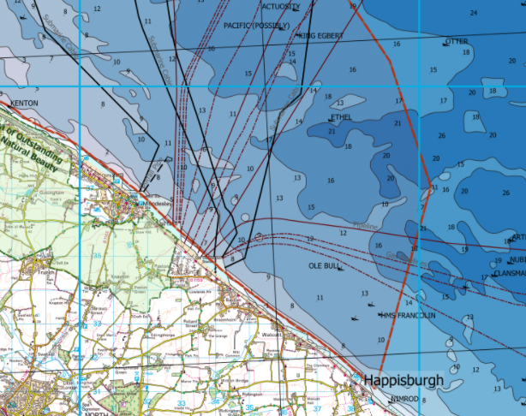
Oil, gas and windfarm development
The MCZ designation means extra considerations need to be made before permission is granted for development within the area.
A new wind farm altered its planned cable route to avoid the MCZ.

Slide 12
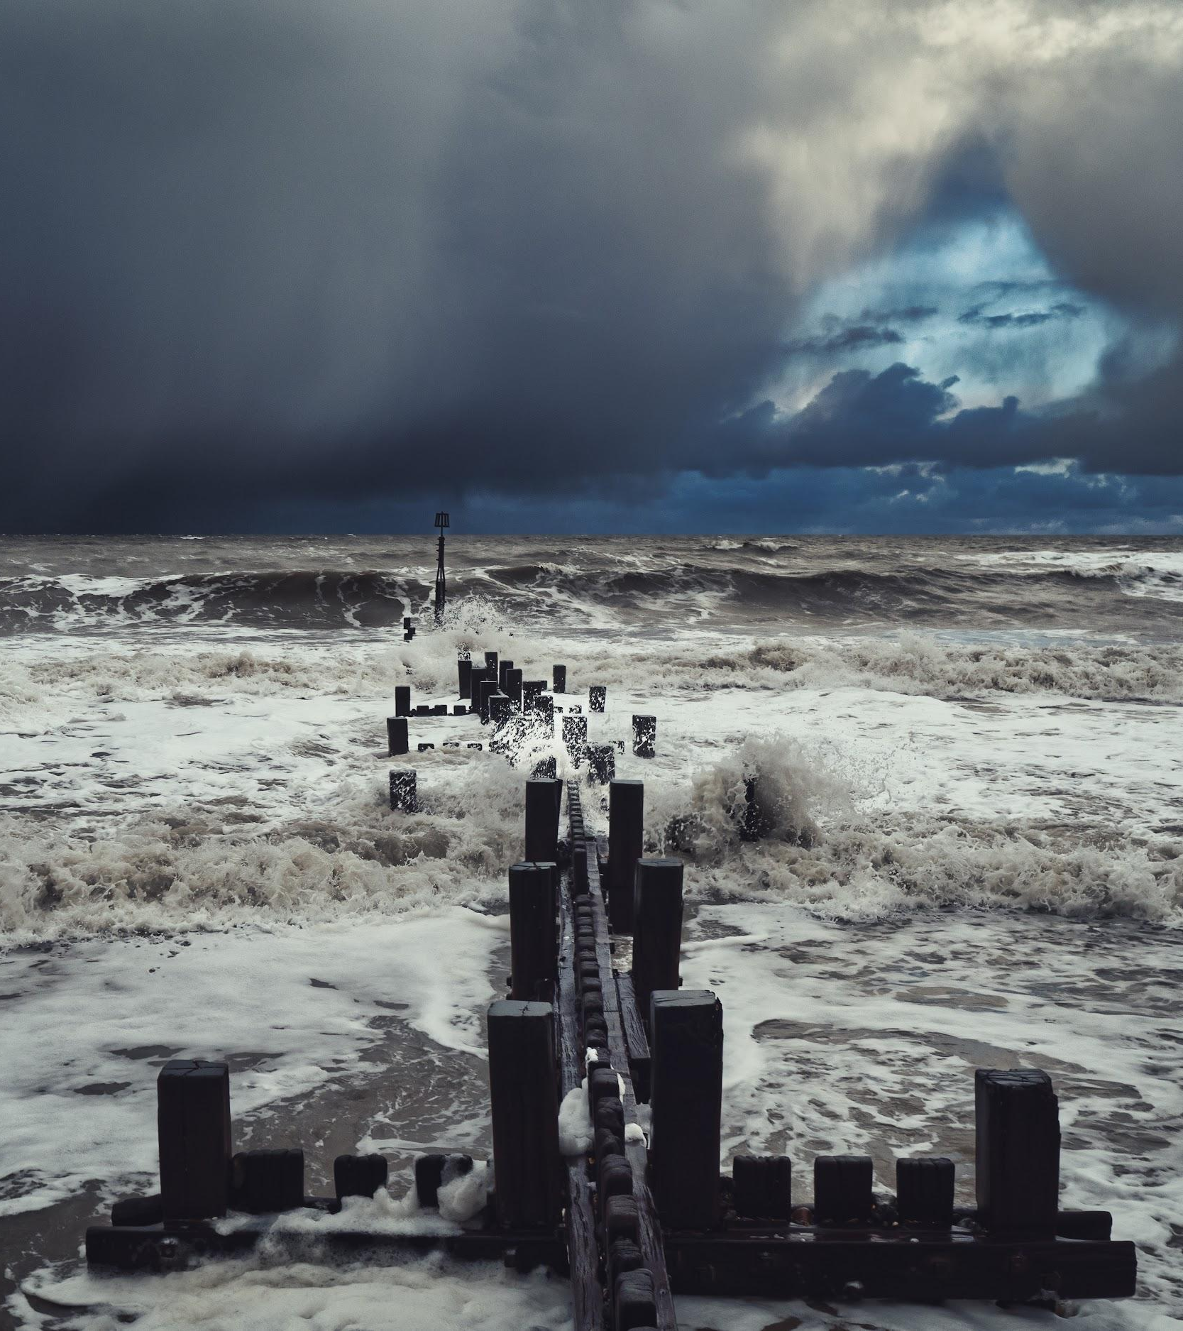
Coastal defence works
The North Norfolk coast is vulnerable to erosion as the cliffs wear away and fall into the sea causing the loss of farmland, housing and industry.
You can see various methods of coastal defence along the coast including:
Groynes
Revetments
Boulder barriers
Sea walls
Sandscaping
There was a big sandscaping project at Bacton in 2019 where 1.8 million cubic metres of sand were added to the beach.
These methods can all affect the seabed and the wildlife in the MCZ.
Photo: Rob Coleman

Slide 13
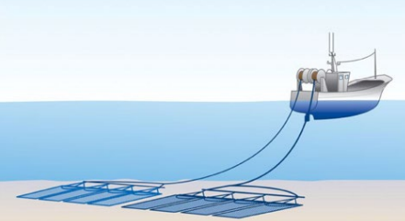
Damage from trawling and dredging
45% of the area was already a no-trawl and no-dredge area. A byelaw has extended this to 93% of the MCZ.

Slide 14
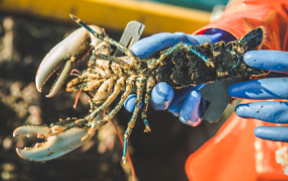
Overfishing
Overfishing is the catching of fish (or crabs!) faster than they can reproduce which causes numbers to decline.
Data about crab numbers and fishing effort is collected to monitor crab populations.
Some laws are in place to help prevent overfishing:
Fishers are not allowed to land crabs that are smaller than 115mm across their shell. This means they have at least one year to reproduce before being caught.
Berried crabs and lobsters (with eggs) are thrown back.
Photo: christaylorphoto.co.uk

Slide 15
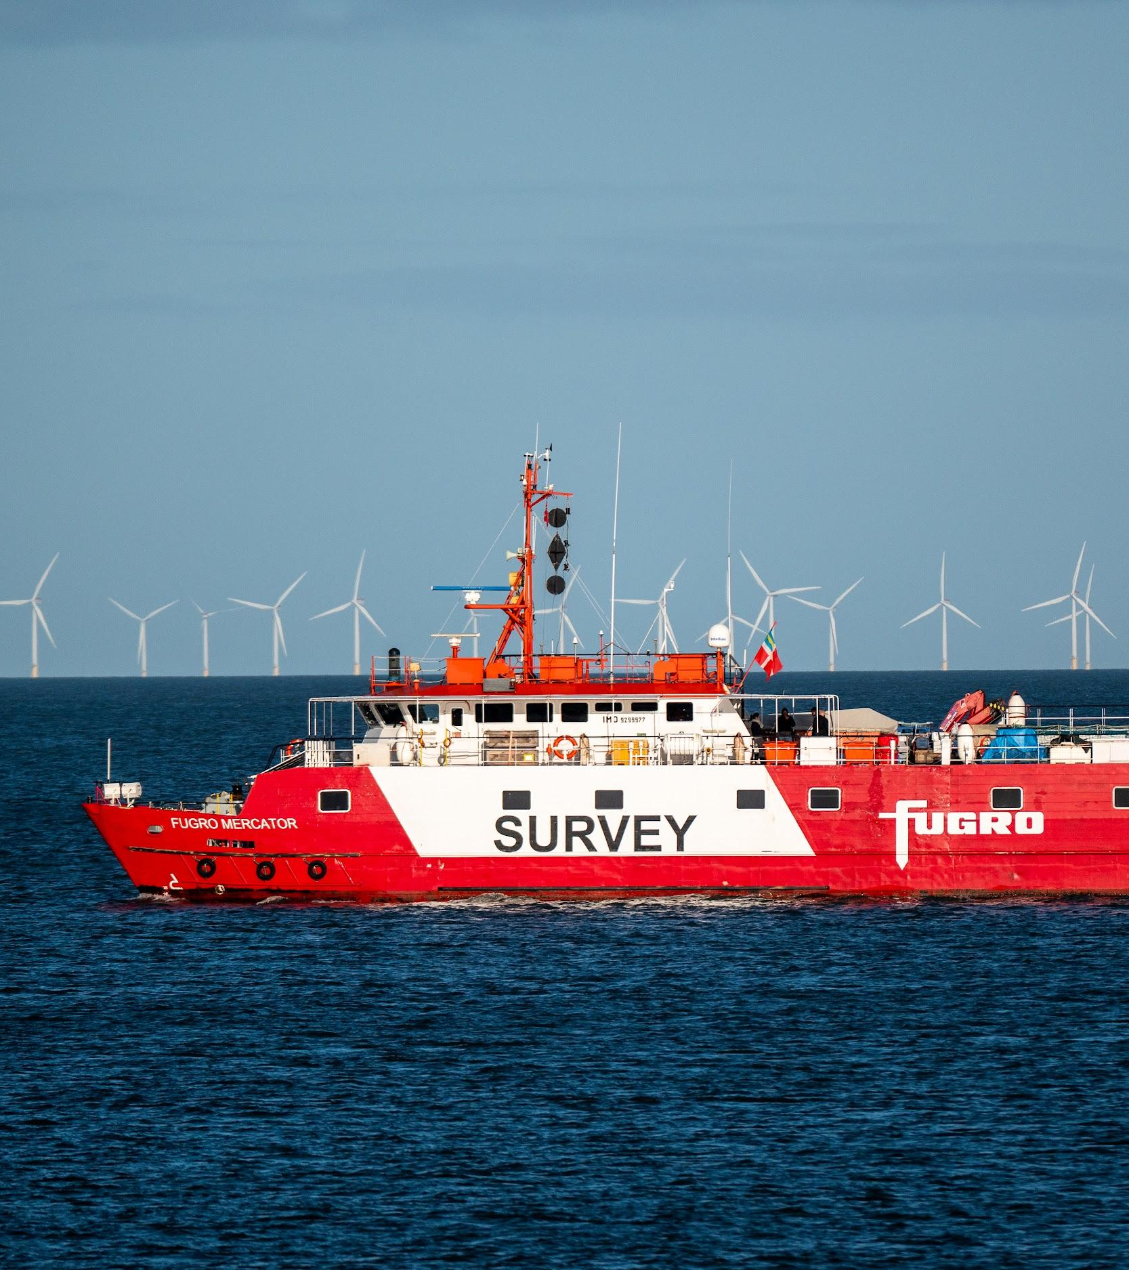
Environmental impact of potting in the MCZ
In 2019, a study found that potting fisheries were linked to physical damage to chalk outcrops.
Pots and ropes can scour the chalk as they move in the currents. This can damage the chalk and the life that is attached to it.
A code of practise has been written so fishermen minimise the impact of lost and stored pots.
Research to map the seabed and fishing activity is ongoing. This will improve understanding of the area and the impact of fishing on the chalk. Depending on findings, laws may be brought in to minimise impact.
Photo: Rob Coleman

Slide 16
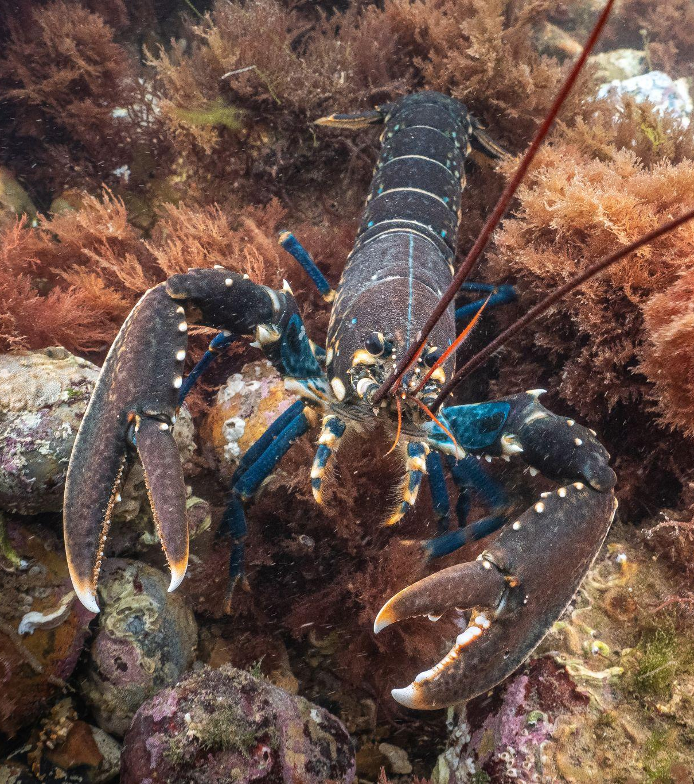
Amazing wildlife
There are lots of amazing creatures living in the Marine Conservation Zone.
Threats to the wildlife that lives there are being monitored and new laws may be brought in to help the wildlife.
Photo: christaylorphoto.co.uk

Slide 17
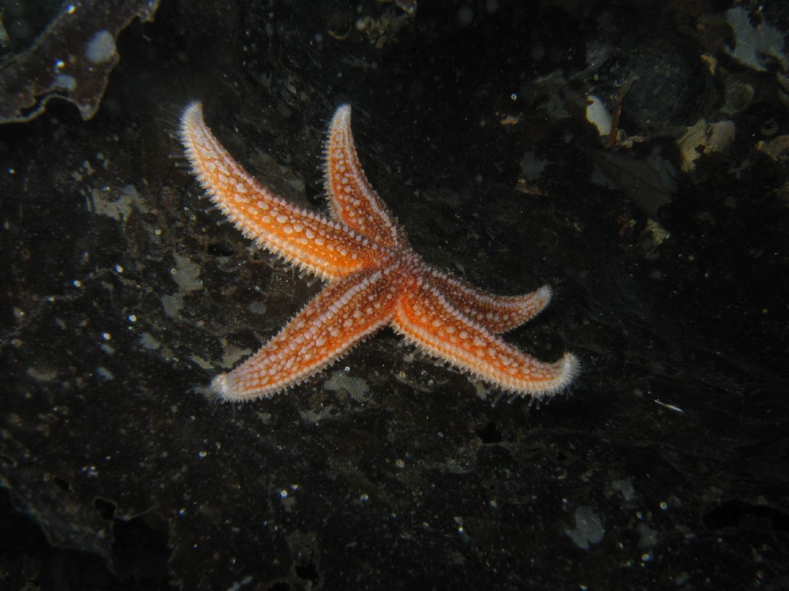
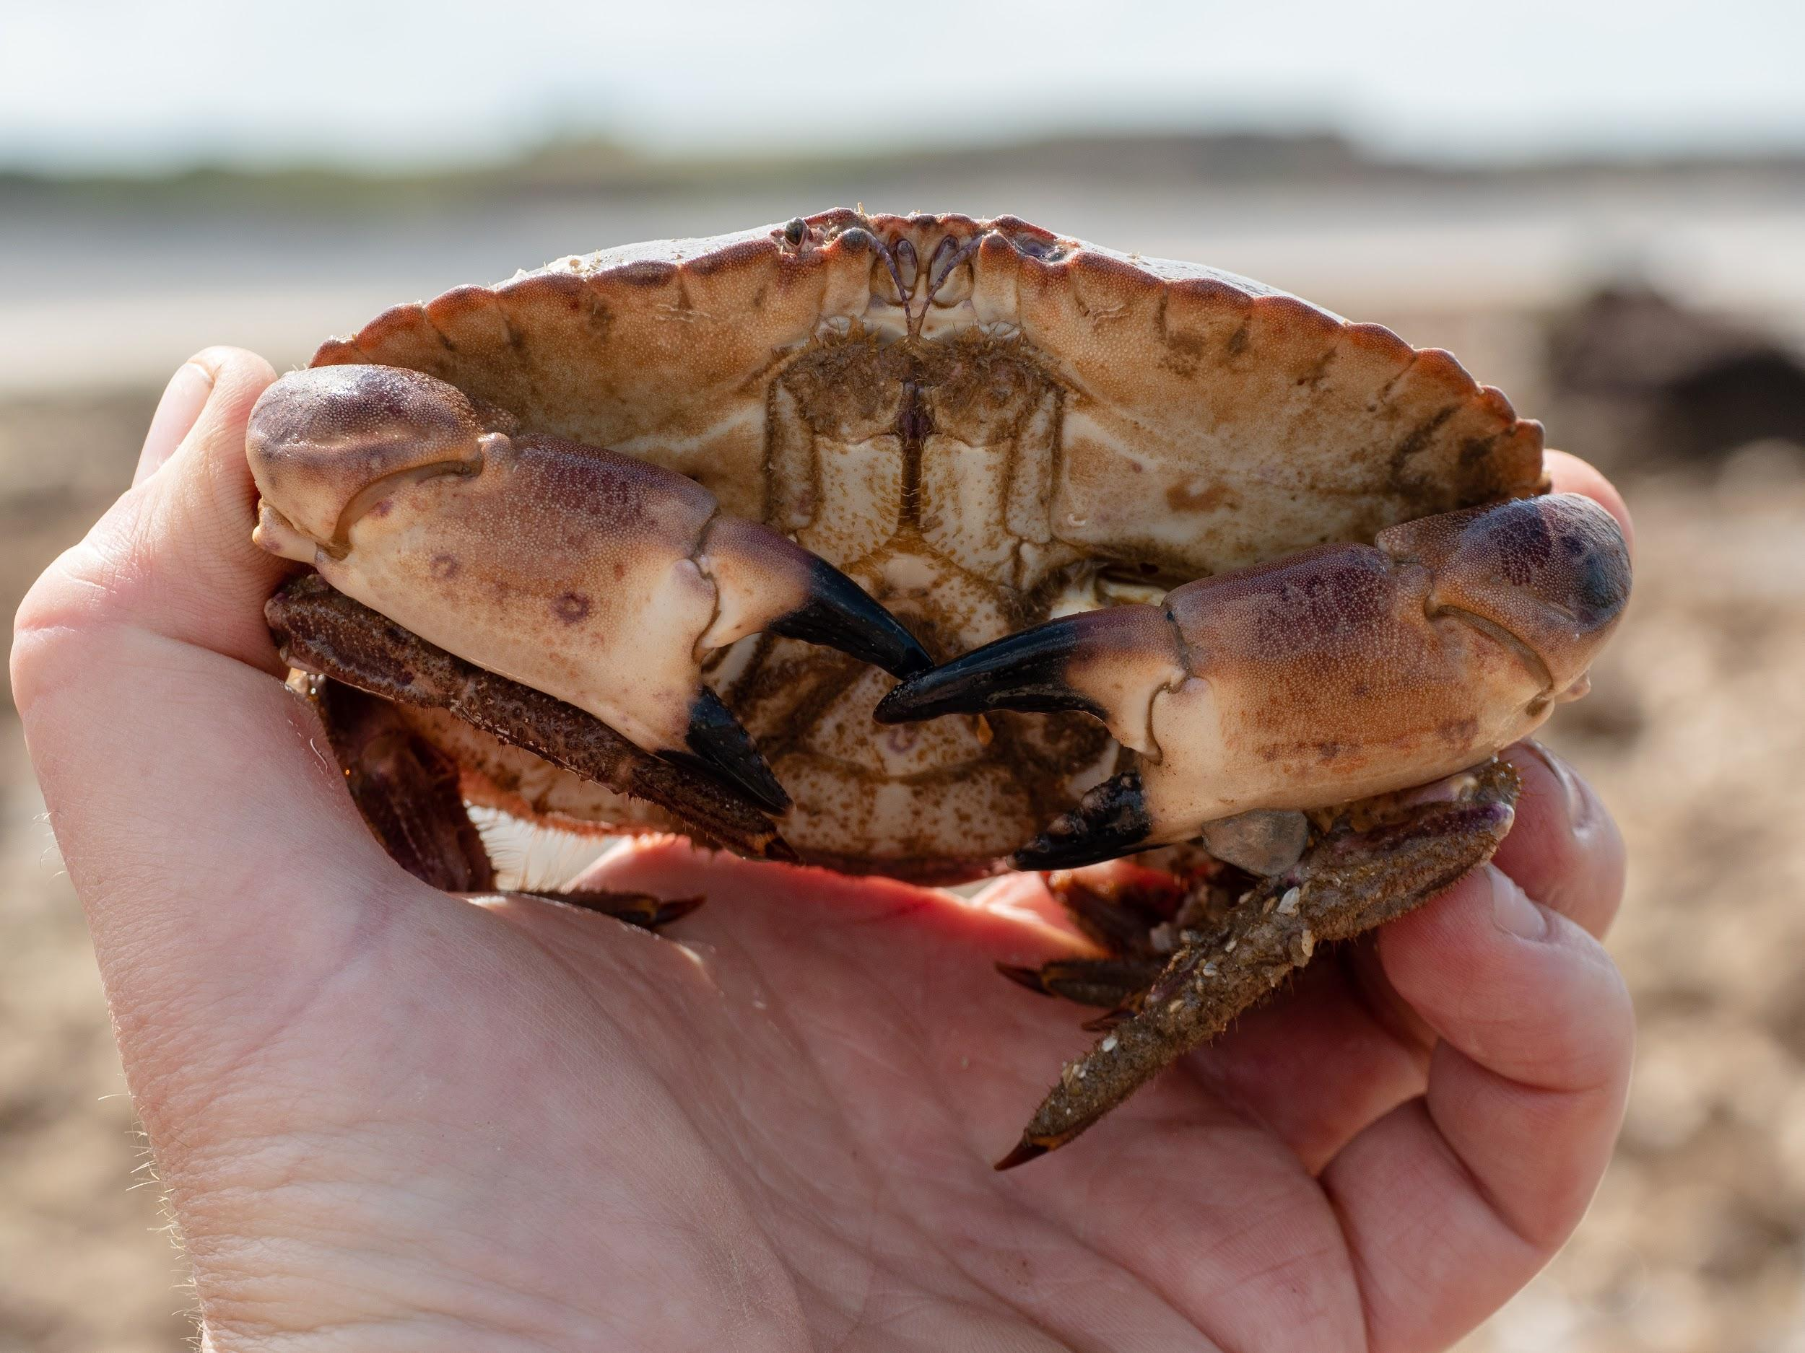
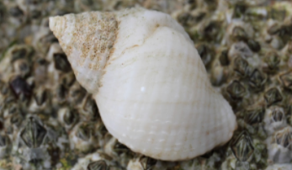
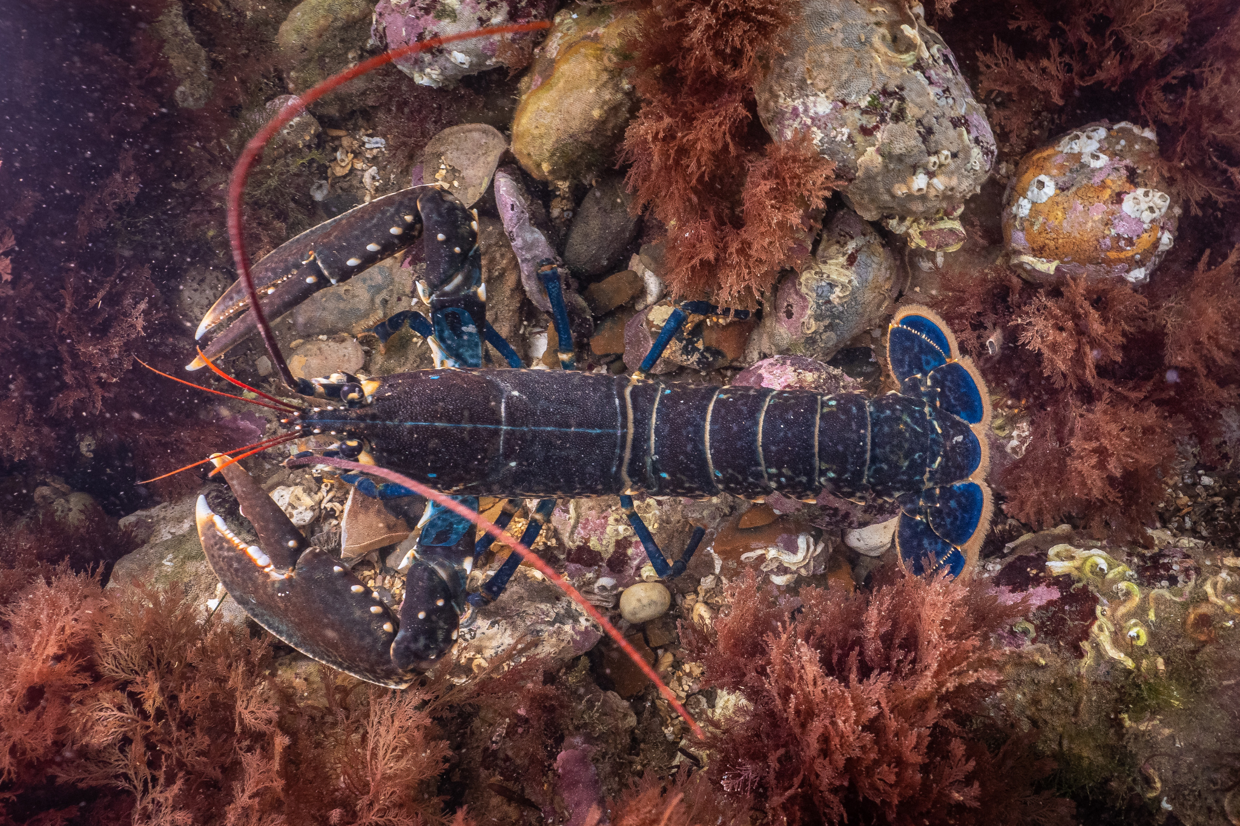
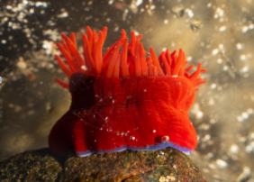
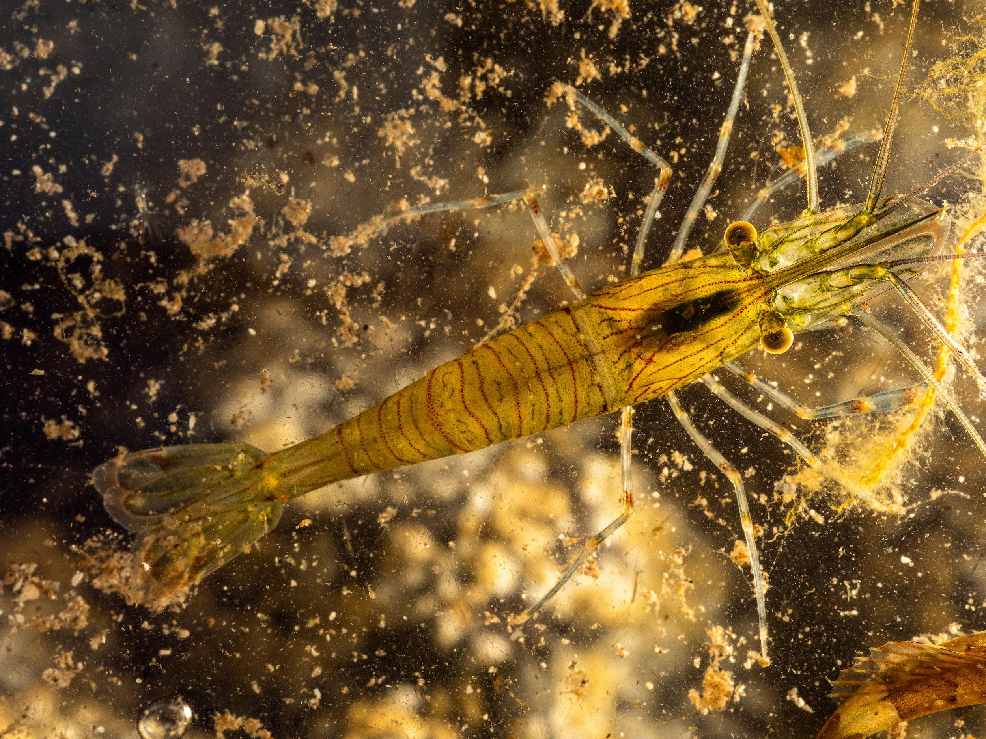
Grouping creatures from the MCZ
Photo: Rob Coleman
Photo: Rob Coleman
Photo: Rob Coleman
Photo: Rob Coleman

Slide 18
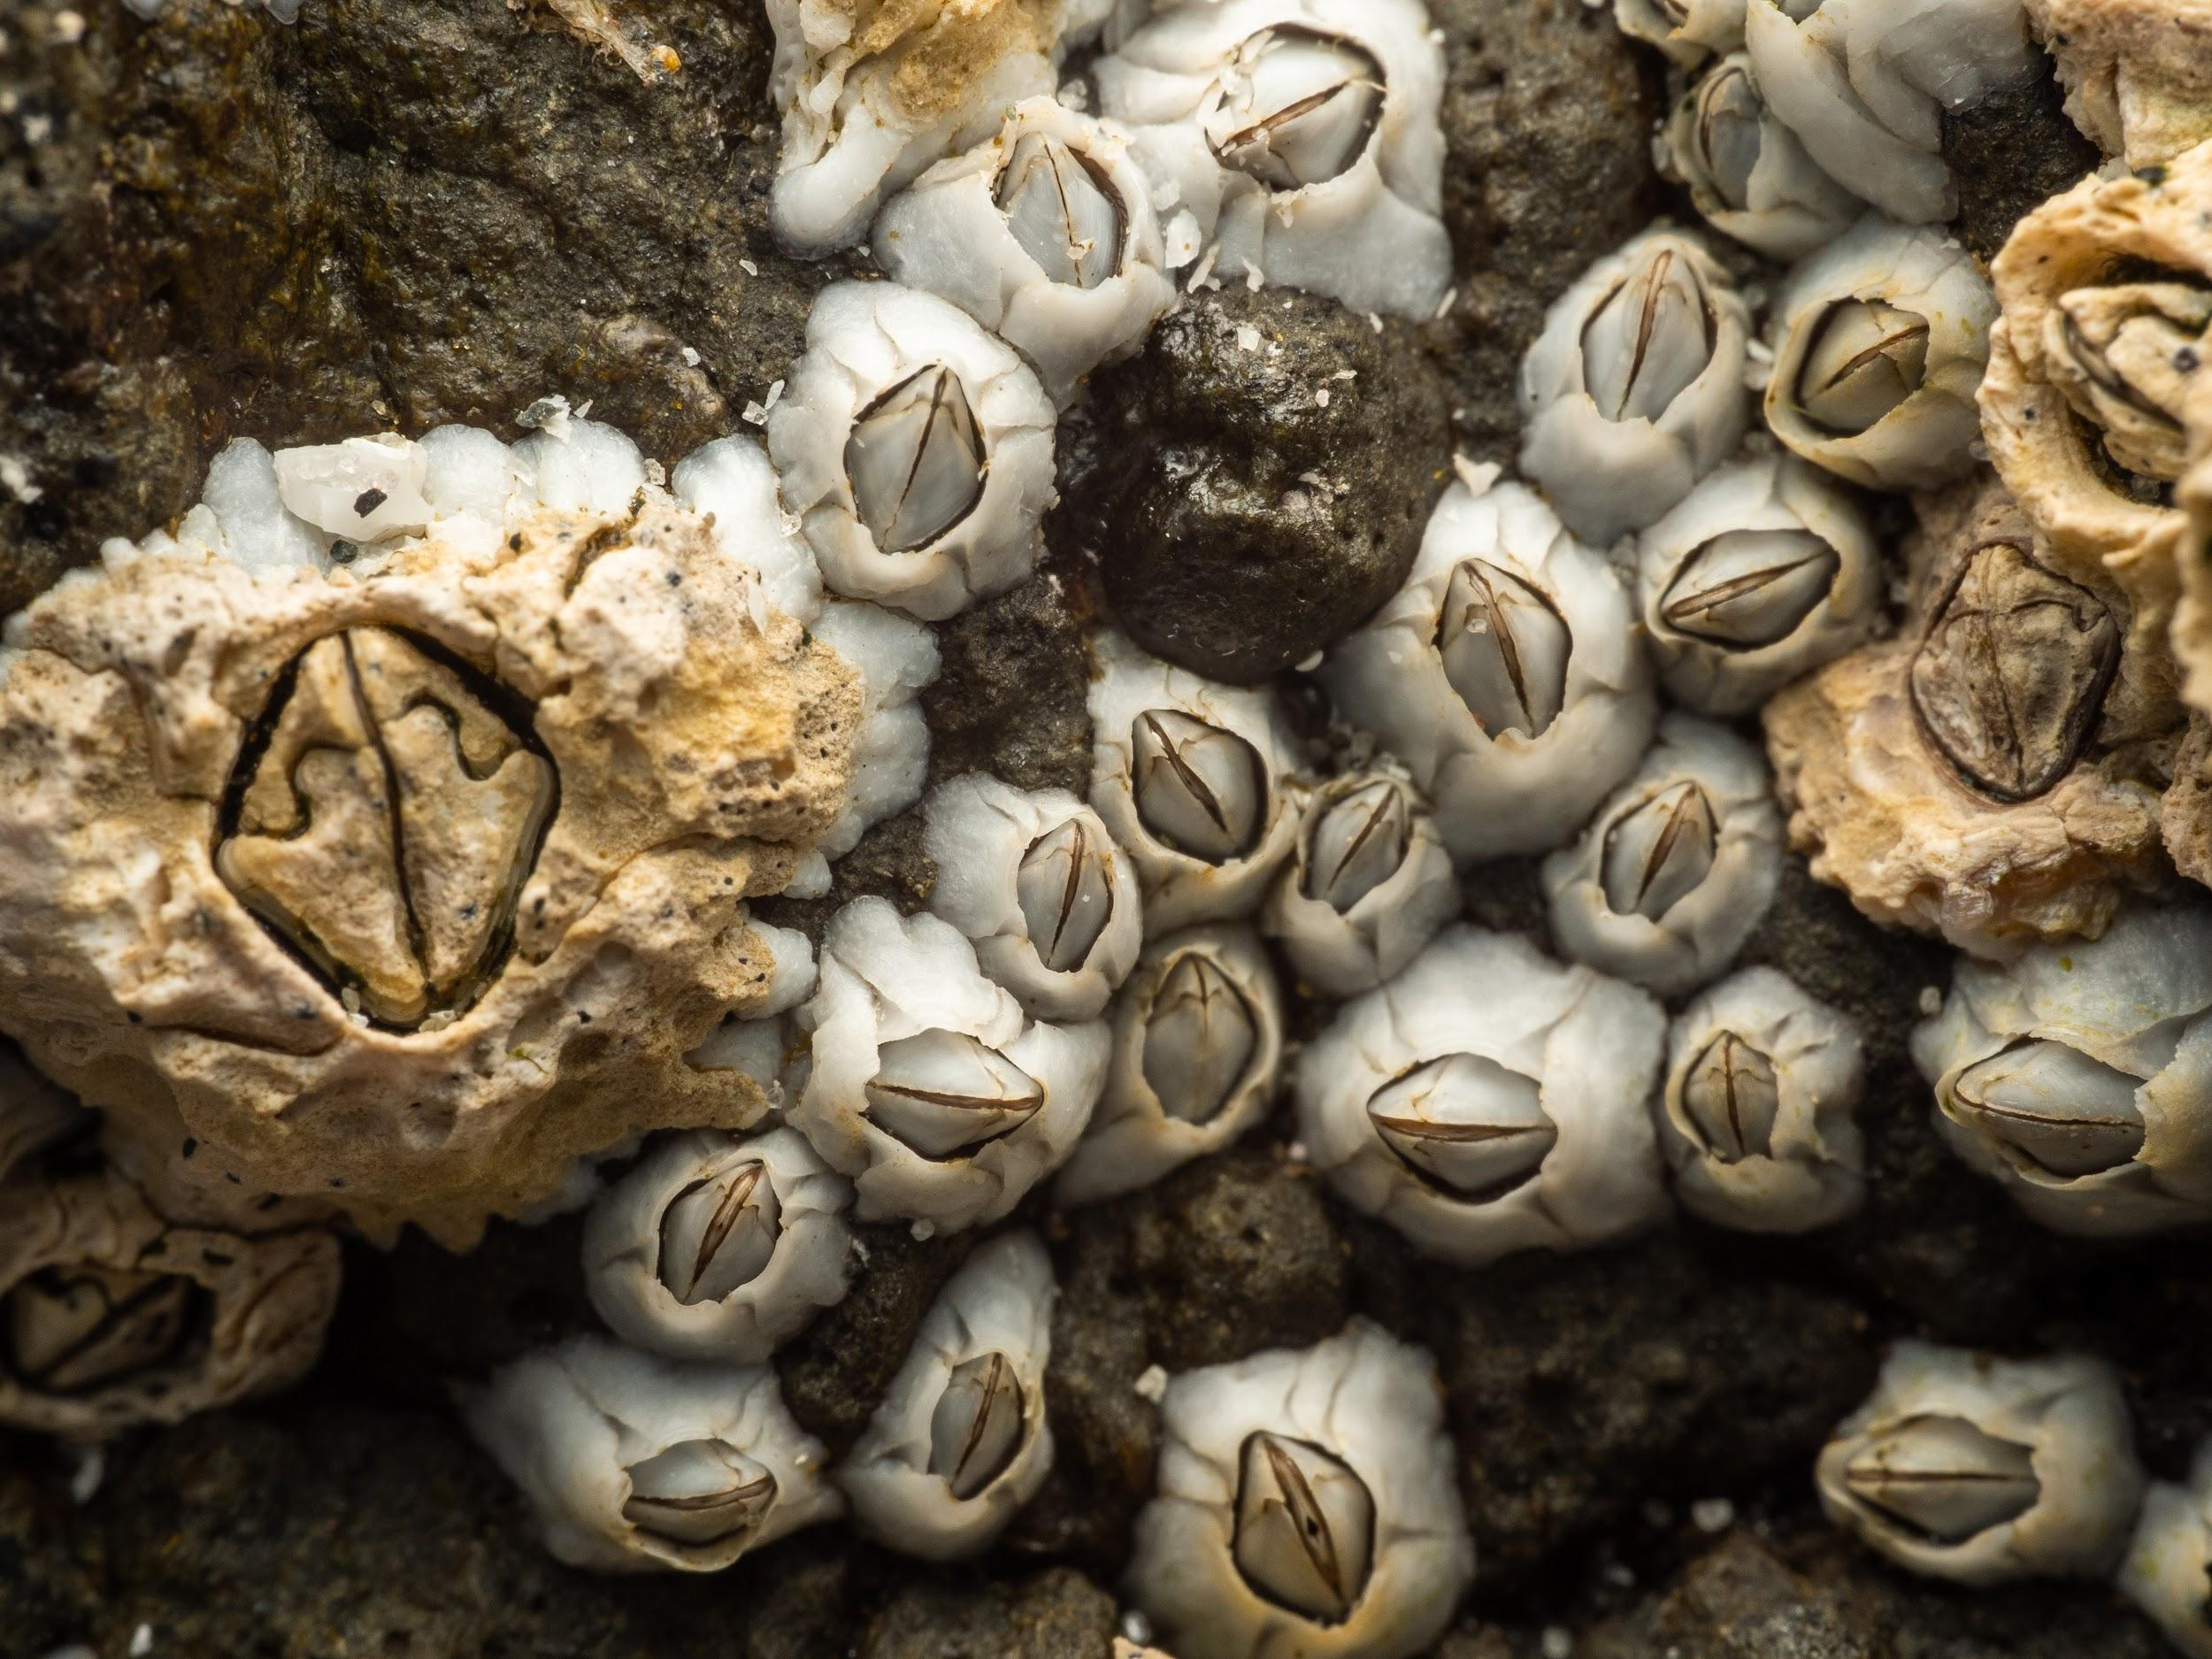
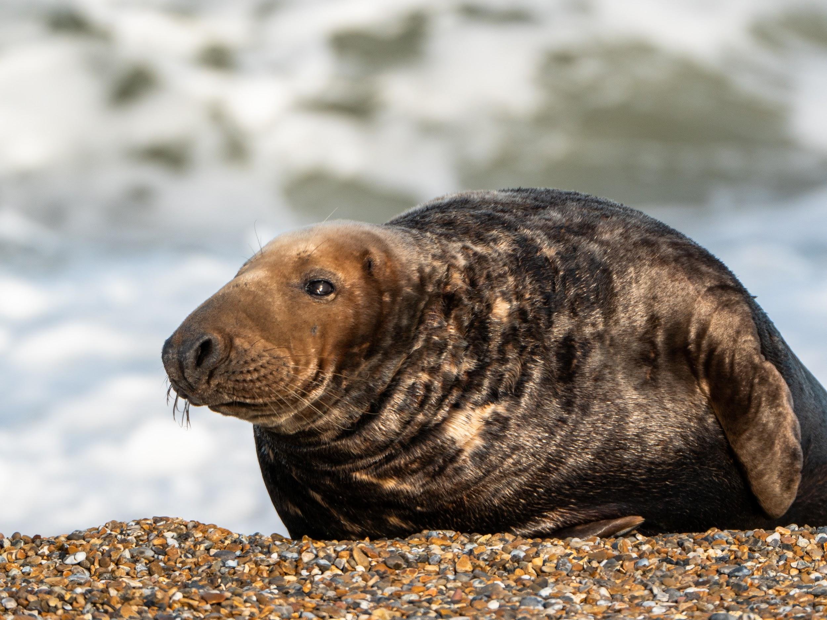
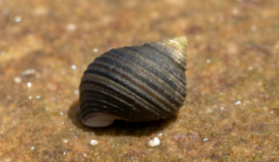
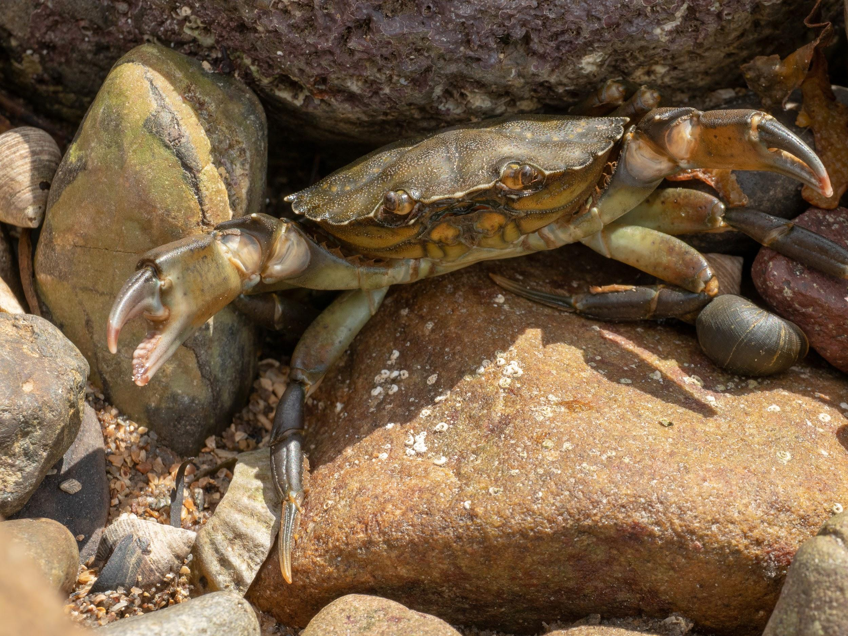
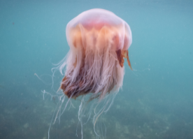
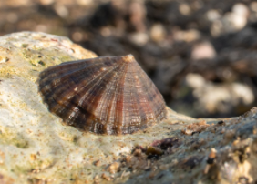
Grouping creatures from the MCZ
Photo: Rob Coleman
Photo: Rob Coleman
Photo: Rob Coleman
Photo: Rob Coleman
Photo: christaylorphoto.co.uk
Photo: Rob Coleman

Slide 19
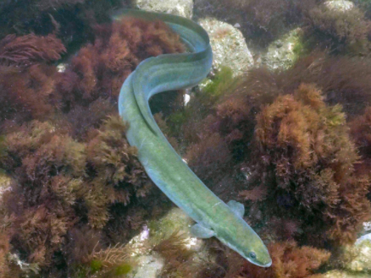
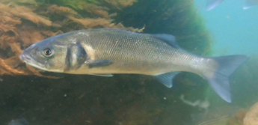
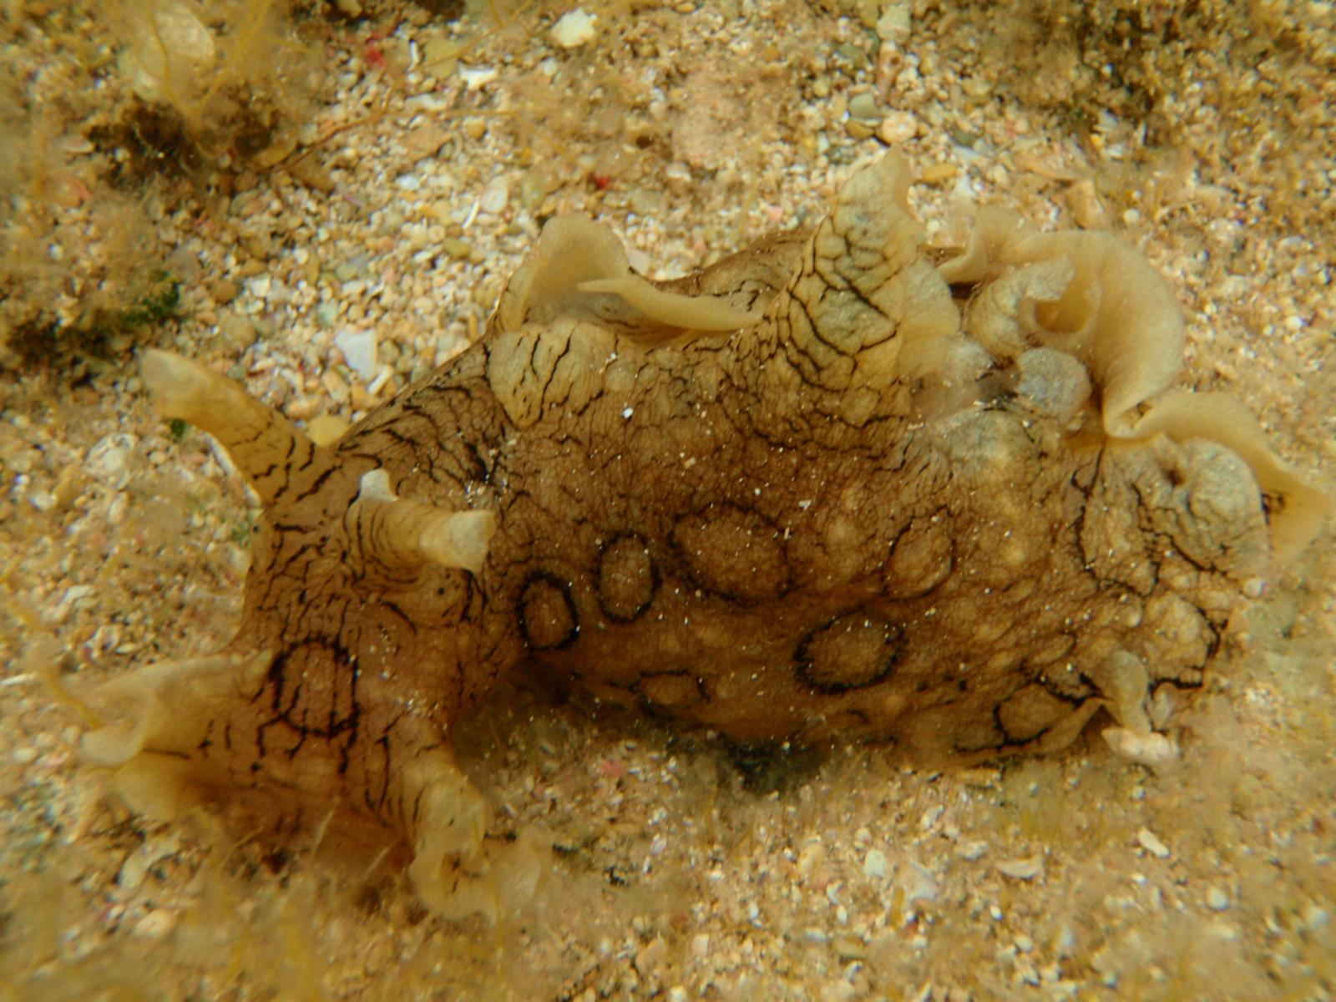
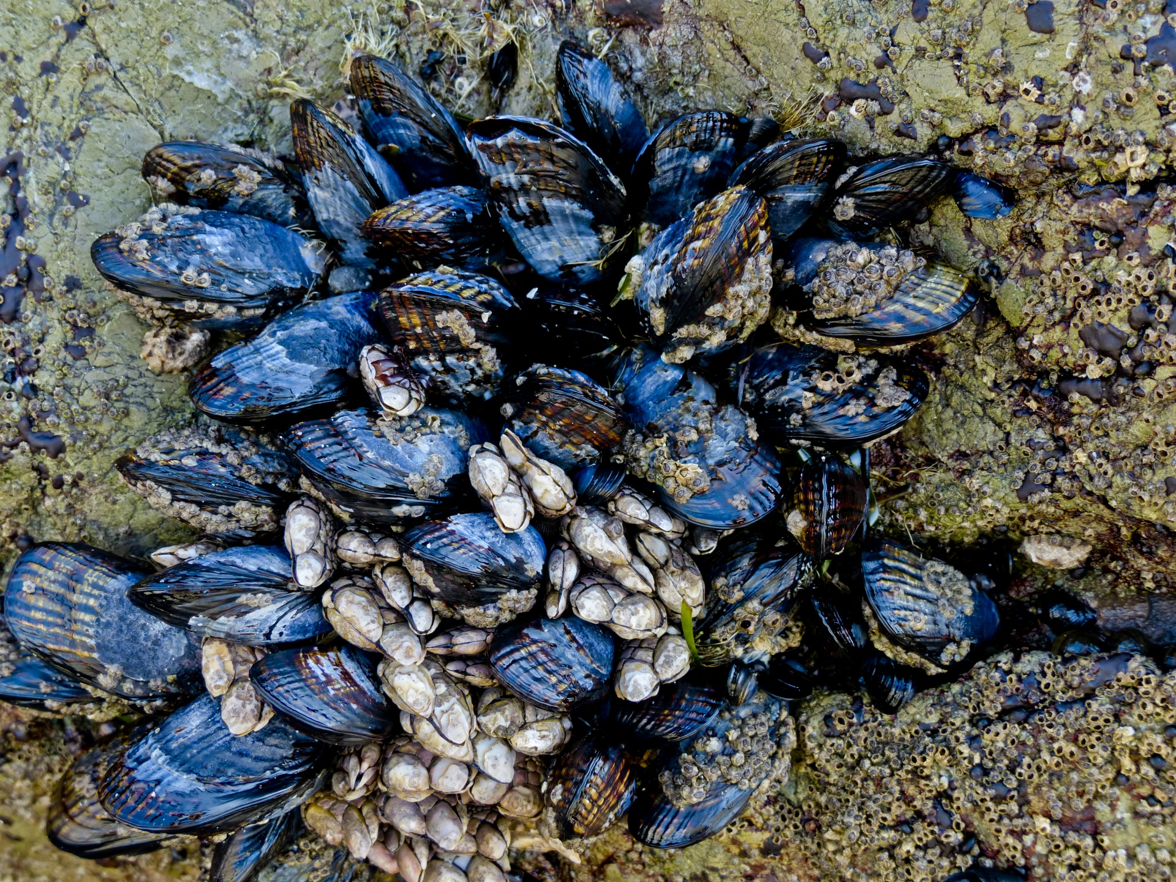
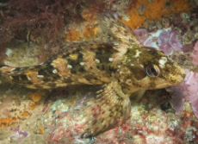
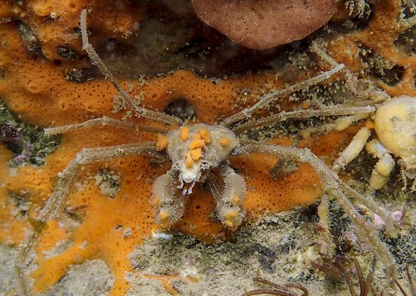
Grouping creatures from the MCZ
Photo: christaylorphoto.co.uk
Photo: christaylorphoto.co.uk
Photo: christaylorphoto.co.uk
Photo: Paul Naylor

Slide 20
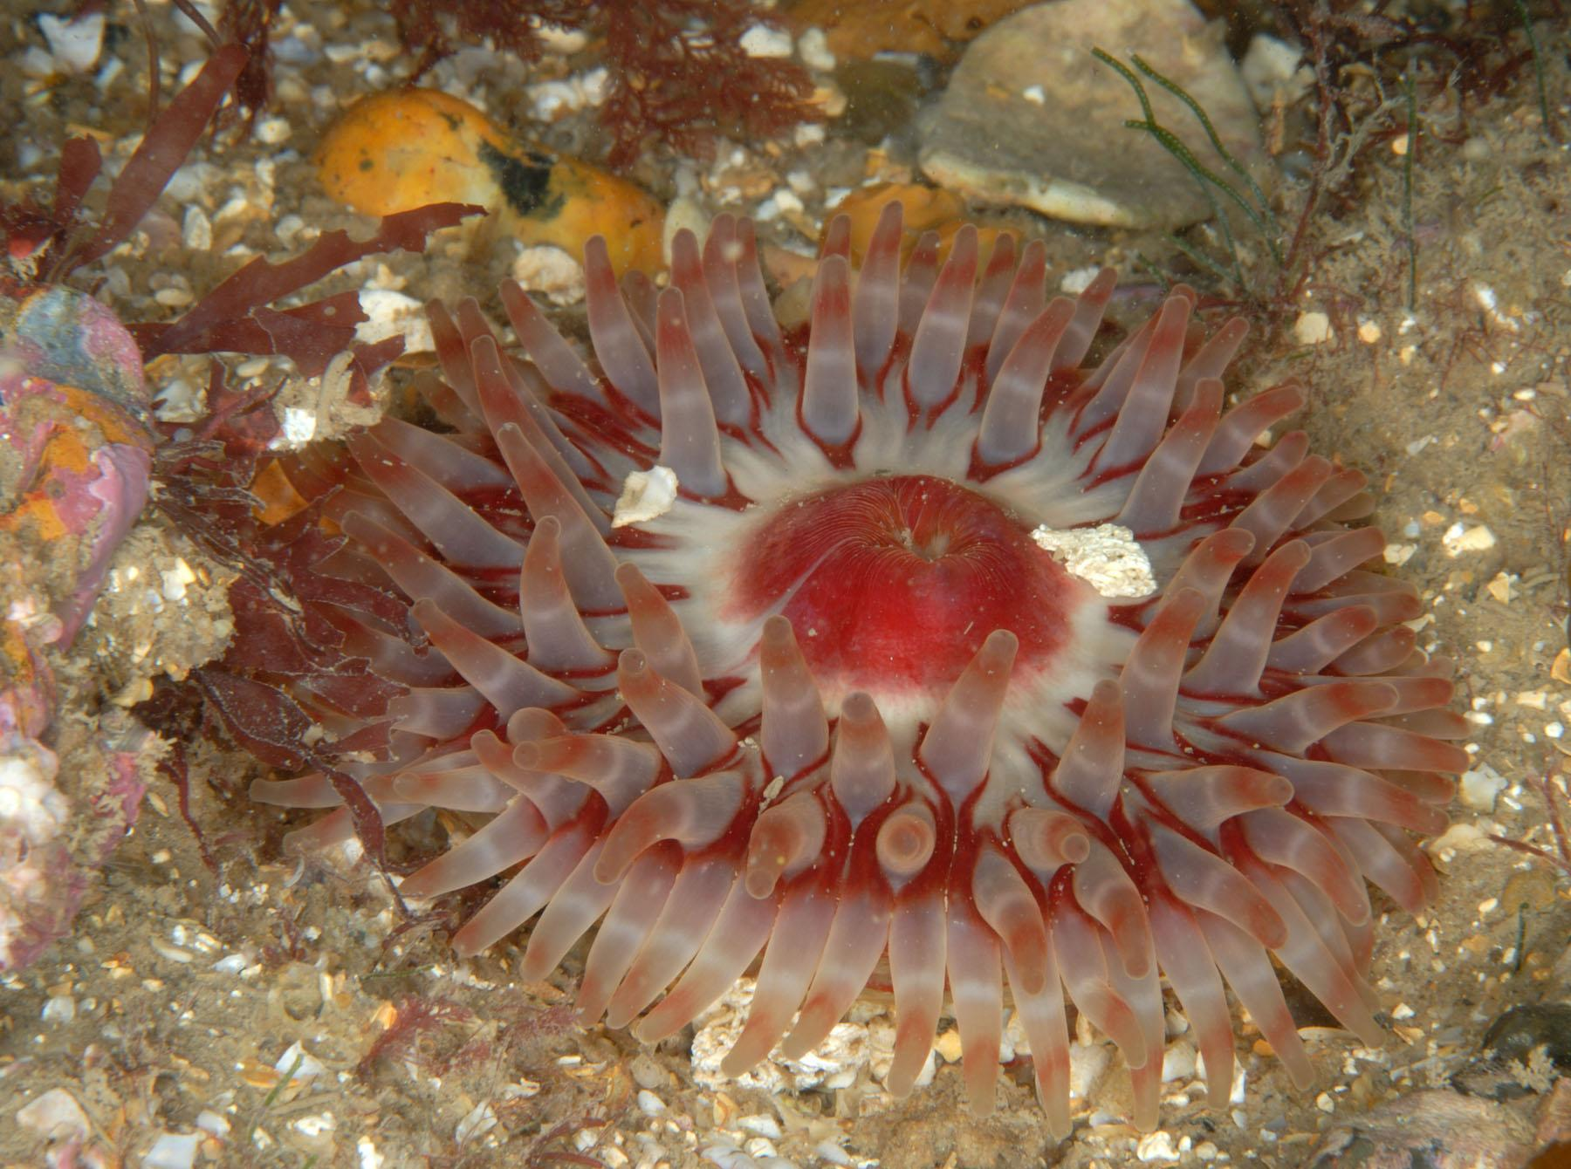
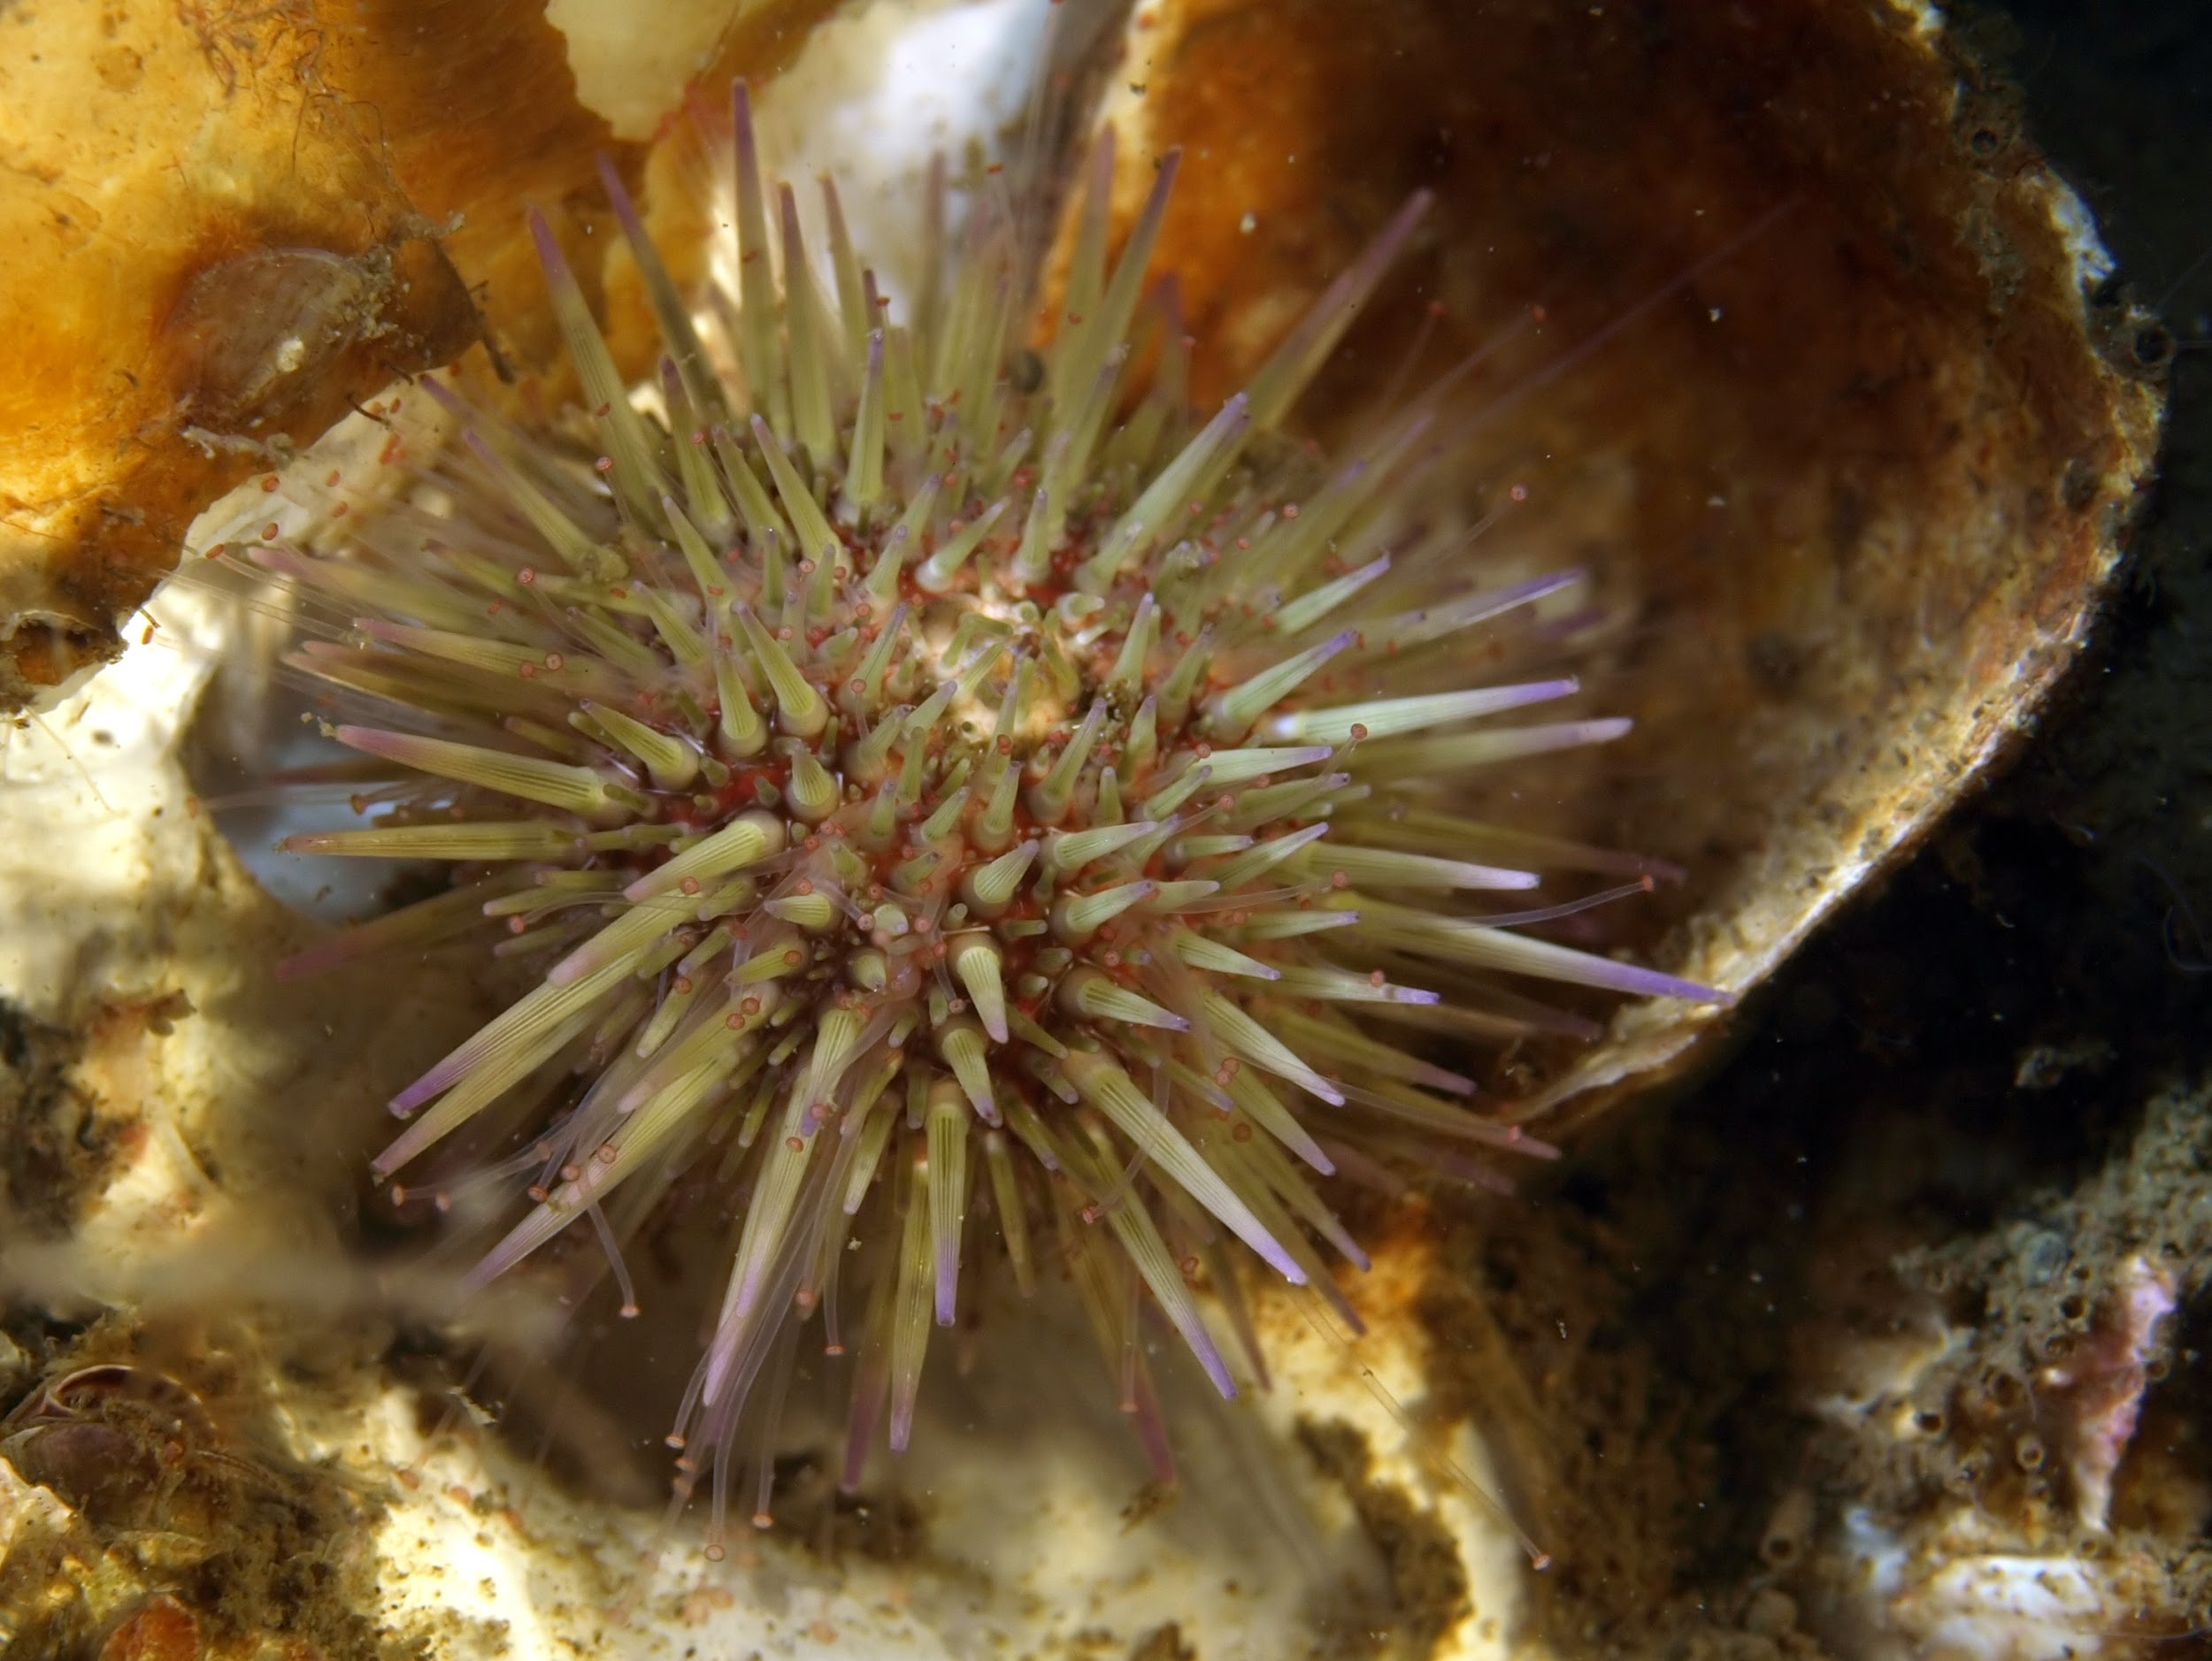
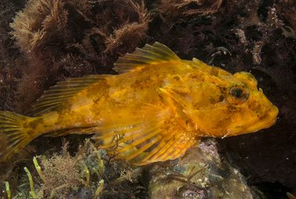
Grouping creatures from the MCZ
Photo: christaylorphoto.co.uk
Photo: christaylorphoto.co.uk

Slide 21
The phylums
molluscs, crustaceans and echinoderms
Common Starfish
Edible Crab
Mussels
Shore Crab
Limpet
Prawn
Periwinkle
Common Lobster
Dog Whelk
Green Sea Urchin
Barnacles

Slide 22
Molluscs
Crustaceans
Echinoderms
Mussels
Edible Crab
Prawn
Common Starfish
Limpet
Common Lobster
Shore Crab
Green Sea Urchin
Dog Whelk
Barnacles
Periwinkle

Slide 23
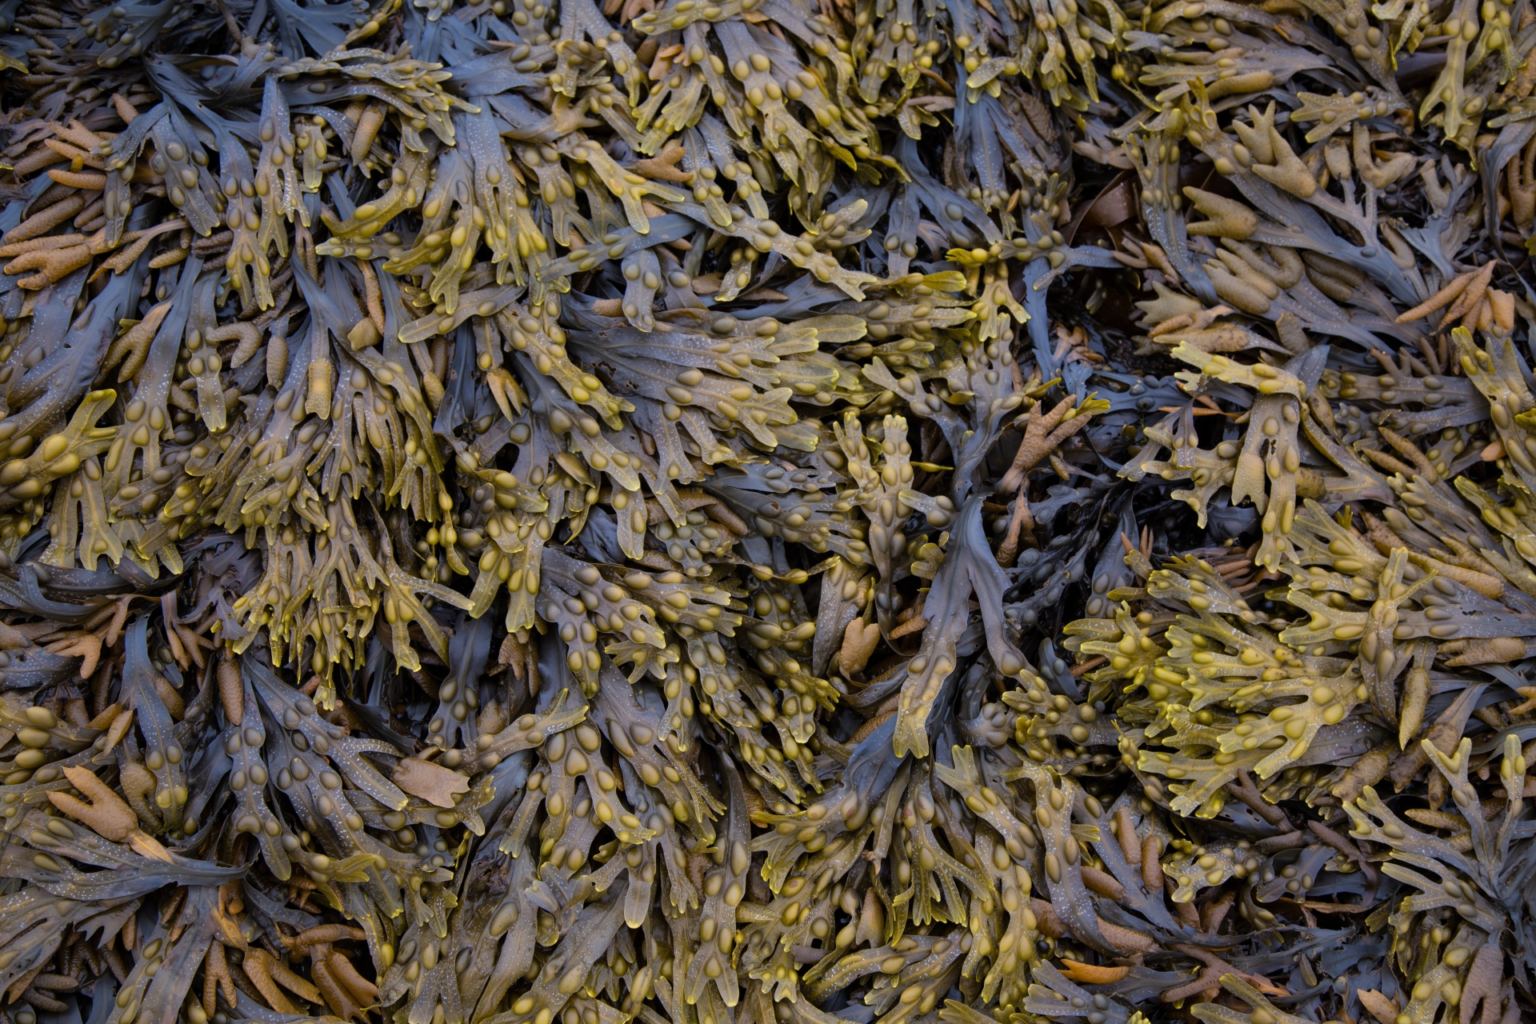
Photo: Rob Coleman
Photo: christaylorphoto.co.uk
Photo: Rob Coleman
Sea bass
I get my energy from shrimps, periwinkles, prawns, crabs and smaller fish. I am eaten by seals and humans.
Seaweed
I get my energy from the sun.
I am eaten by crabs, periwinkles, worms, prawns and shrimps.
Prawn
I get my energy from seaweed, carrion and small shrimp-like creatures. I am eaten by crabs, fish and sea anemones.
Seal
I get my energy from fish, crabs, squid and octopus. I don’t have any predators.

Slide 24
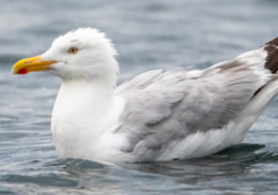
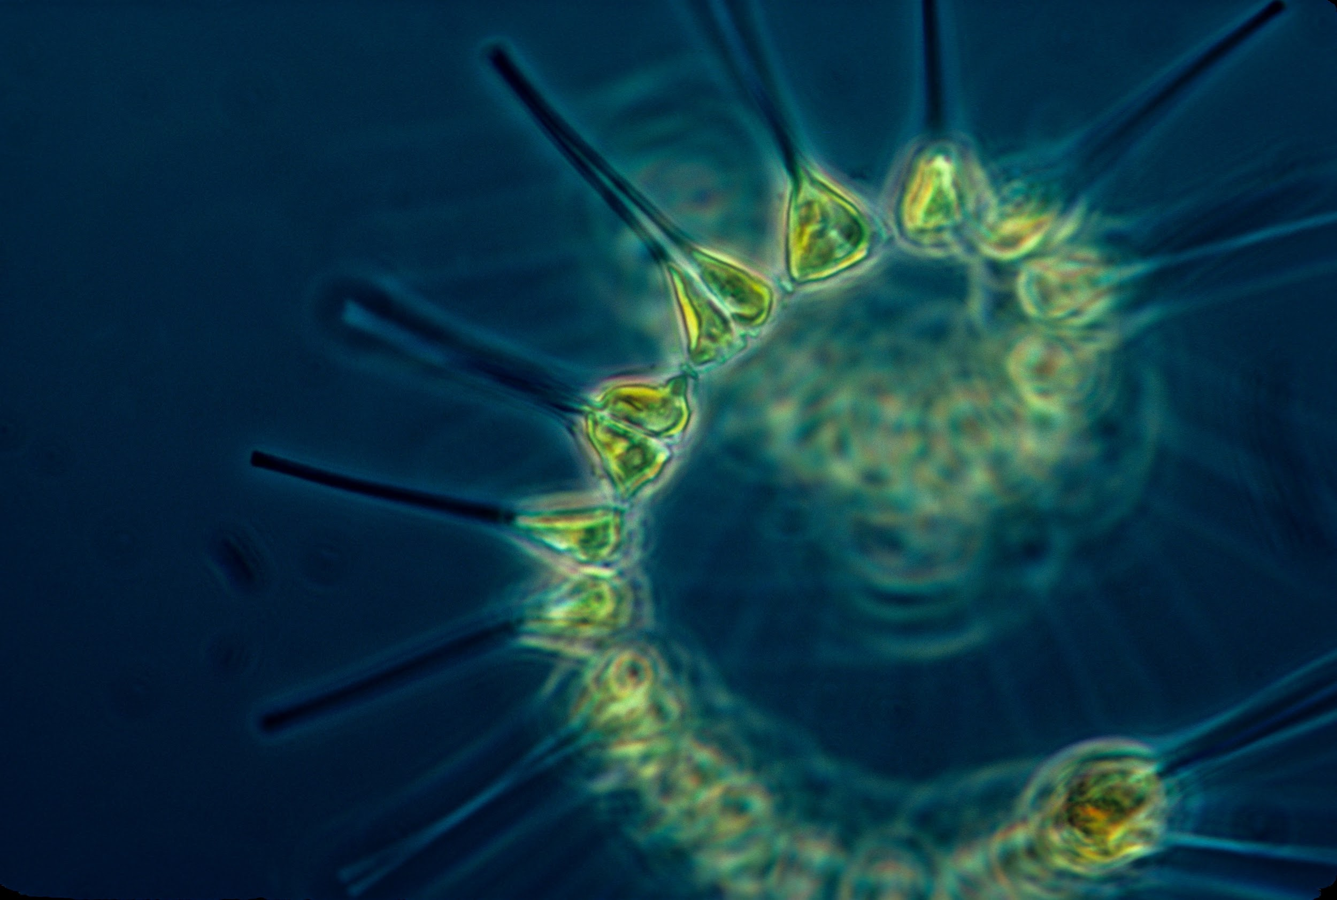
Photo: Rob Coleman
Photo: christaylorphoto.co.uk
Herring gull
I get my energy from eggs, starfish, crabs, fruit, grains and worms. I do not have any predators.
Phytoplankton
I get my energy from the sun.
I am eaten by barnacles and mussels.
Common starfish
I get my energy from periwinkle, mussels, barnacles and limpets.
I am eaten by crabs, seabirds and fish.
Mussels
I get my energy from plankton.
I am eaten by humans, dog whelks, seabirds and starfish.

Slide 25
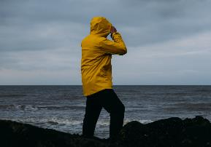
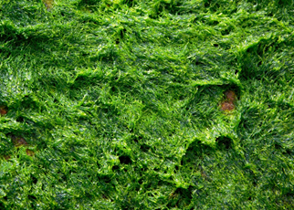
Photo: christaylorphoto.co.uk
Human
Lobster
I get my energy from crabs, sea snails, sea urchins and starfish.
I am eaten by humans.
Algae
I get my energy from the sun.
I am eaten by limpets and periwinkles
Periwinkle
I get my energy from algae on rocks and young seaweed.
I am eaten by crabs, lobsters, seabirds and fish.

Slide 26
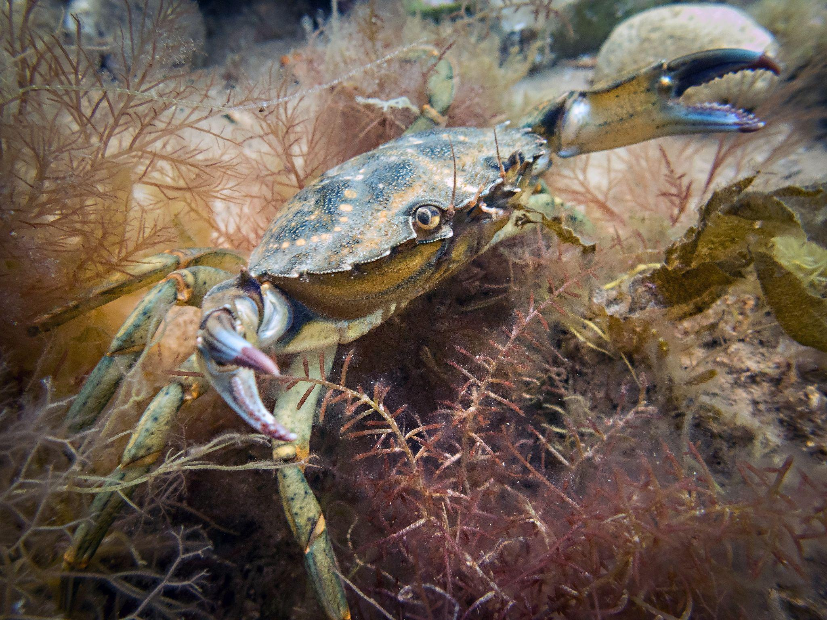
Photo: christaylorphoto.co.uk
Sea bass
I get my energy from shrimps, periwinkles, prawns, crabs and smaller fish. I am eaten by seals and humans.
Shore crab
I get my energy from seaweed, carrion, sea snails, shrimps and small fish. I am eaten by other crabs, fish, lobsters and sea anemones
Algae
I get my energy from the sun.
I am eaten by limpets and periwinkles
Photo: Rob Coleman
Periwinkle
I get my energy from algae on rocks and young seaweed.
I am eaten by crabs, lobsters, seabirds and fish.
Seal
I get my energy from fish, crabs, squid and octopus. I don’t have any predators.

Slide 27
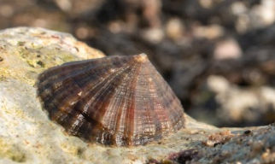
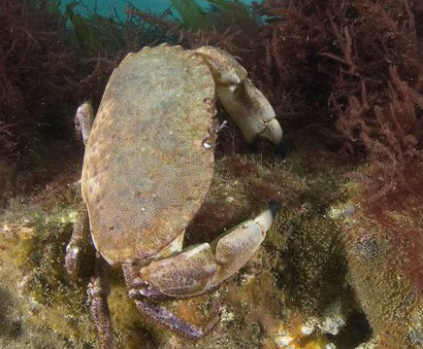
Human
Limpet
I get my energy from algae on rocks and young seaweed.
I am eaten by crabs, seabirds, starfish, dog whelks and fish.
Edible crab
I get my energy from crabs, sea snails, sea urchins and starfish.
I am eaten by humans and lobsters.
Seaweed
I get my energy from the sun.
I am eaten by limpets, periwinkles, worms, prawns and shrimps.
Dog whelk
I get my energy from periwinkle, mussels, barnacles and limpets.
I am eaten by crabs, seabirds and fish..

Slide 28
Photo: Rob Coleman
Photo: Rob Coleman
Photo: christaylorphoto.co.uk
Seaweed
I get my energy from the sun.
I am eaten by crabs, periwinkles, worms, prawns and shrimps.
Prawn
I get my energy from seaweed, carrion and small shrimp-like creatures. I am eaten by crabs, fish and sea anemones.
Sea Bass
I get my energy from shrimps, periwinkles, prawns, crabs and smaller fish. I am eaten by seals and humans.
Seal
I get my energy from fish, crabs, squid and octopus. I don’t have any predators.
Producer
Prey
Predator Prey
Predator

Slide 29
Photo: christaylorphoto.co.uk
Photo: Rob Coleman
Phytoplankton
I get my energy from the sun.
I am eaten by barnacles and mussels.
Mussels
I get my energy from plankton.
I am eaten by humans, dog whelks, seabirds and starfish.
Common Starfish
I get my energy from periwinkle, mussels, barnacles and limpets.
I am eaten by crabs, seabirds and fish.
Herring Gull
I get my energy from eggs, starfish, crabs, fruit, grains and worms. I do not have any predators.
Producer
Prey
Predator Prey
Predator

Slide 30
Photo: christaylorphoto.co.uk
Algae
I get my energy from the sun.
I am eaten by limpets and periwinkles
Periwinkle
I get my energy from algae on rocks and young seaweed.
I am eaten by crabs, lobsters, seabirds and fish.
Lobster
I get my energy from crabs, sea snails, sea urchins and starfish.
I am eaten by humans.
Human
Producer
Prey
Predator Prey
Predator

Slide 31
Photo: Rob Coleman
Photo: christaylorphoto.co.uk
Algae
I get my energy from the sun.
I am eaten by limpets and periwinkles
Periwinkle
I get my energy from algae on rocks and young seaweed.
I am eaten by crabs, lobsters, seabirds and fish.
Shore Crab
I get my energy from seaweed, carrion, sea snails, shrimps and small fish. I am eaten by other crabs, fish, lobsters and sea anemones
Sea Bass
I get my energy from shrimps, periwinkles, prawns, crabs and smaller fish. I am eaten by seals and humans.
Seal
I get my energy from fish, crabs, squid and octopus. I don’t have any predators.
Producer
Prey
Predator Prey
Predator Prey
Predator

Slide 32
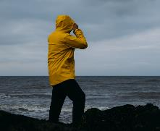
Seaweed
I get my energy from the sun.
I am eaten by limpets, periwinkles, worms, prawns and shrimps.
Limpet
I get my energy from algae on rocks and young seaweed.
I am eaten by crabs, seabirds, starfish, dog whelks and fish.
Dog Whelk
I get my energy from periwinkle, mussels, barnacles and limpets.
I am eaten by crabs, seabirds and fish..
Human
Algae
I get my energy from the sun.
I am eaten by limpets and periwinkles
Edible Crab
I get my energy from crabs, sea snails, sea urchins and starfish.
I am eaten by humans and lobsters.
Producer
Prey
Predator Prey
Predator Prey
Predator

Slide 33
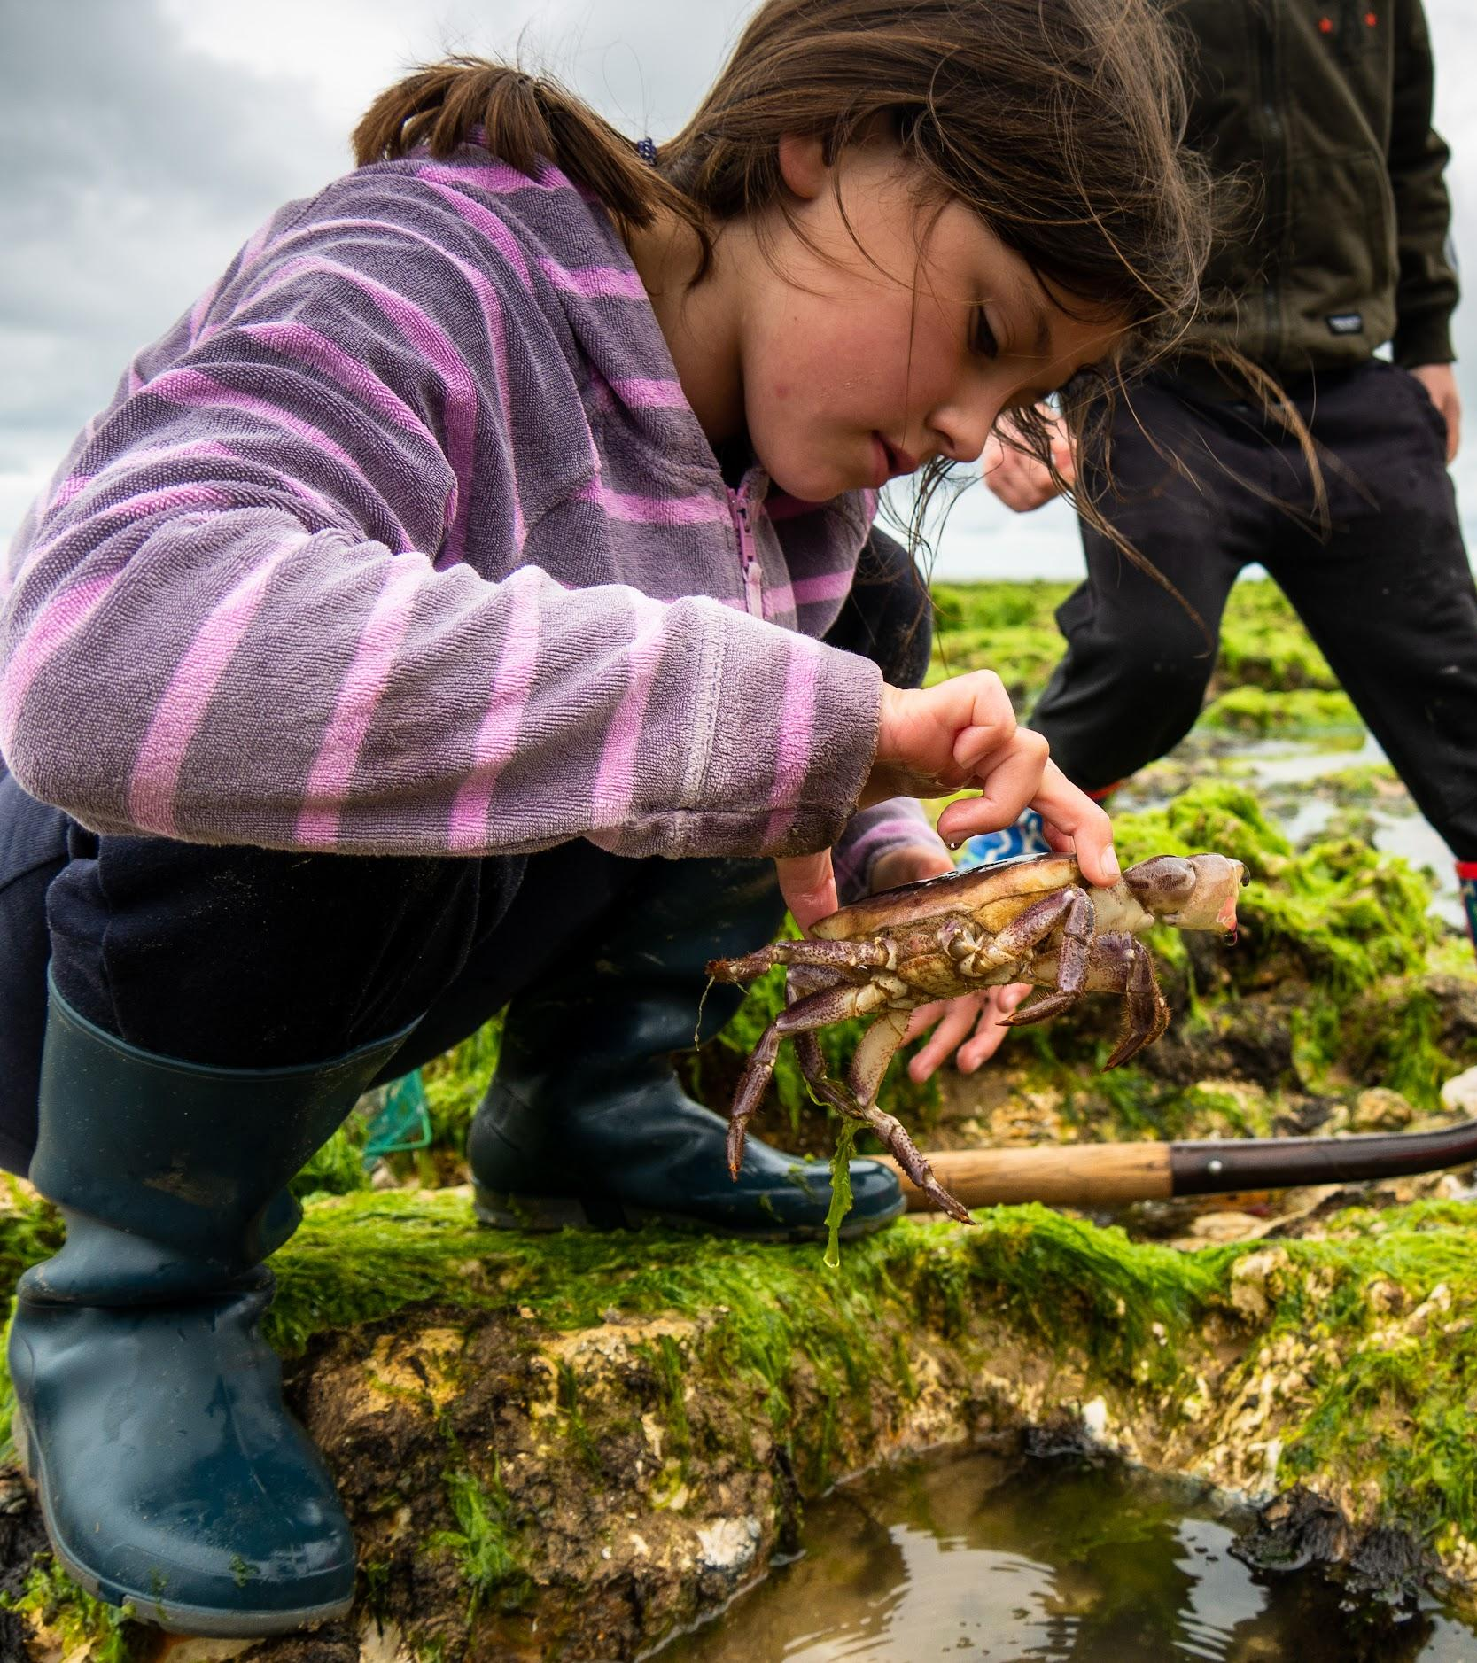
Rockpooling –
Adaptations
Plants
Don’t forget about the plants!
Seaweed lives on the rocks but doesn’t have roots to hold it in place. Seaweeds anchor to the rocks with ‘holdfasts.’ Ask the children to look closely at some.
Notice how some seaweeds have bubbles in them (e.g. bladderwrack). Why do they have this? The bubbles are full of air to help them float up towards the light.

Slide 34
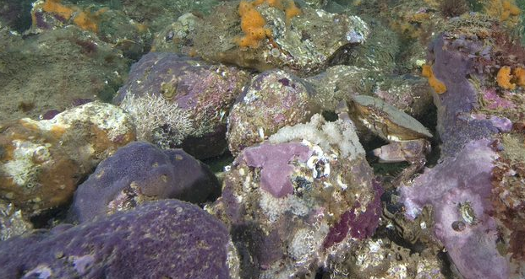
Parpal Dumplin (purple sponge)
Appearance
Parpal Dumplin was given its name because it is purple and looks a bit like a dumpling!
It is a type of encrusting sponge which means it forms a crust or layer over the rock on which it lives. Its shape depends on the shape of the rock. The distinctive purple colour of this sponge is quite unusual.
Survival
Sponges are animals that do not move! They are simple animals that form colonies.
They have toxins that make them unpalatable, so few animals eat them. Some sea slugs are able to eat them and incorporate the toxins into their own bodies for defence!
Some spider crabs tear off small pieces and use them to camouflage their backs where the sponge then grows!
Diet
Sponges are filter feeders. Tiny holes or pores cover the sponge and draw the sea water in. They take tiny pieces of food (mainly phytoplankton) out of the water that drifts by so help to keep sea water clear.
Did you know?
This sponge was only discovered in 2011 by some divers. It was new to science!

Slide 35
Edible crab
Appearance
Diet
Survival
Did you know?

Slide 36
Shore crab
Appearance
Diet
Survival
Did you know?

Slide 37
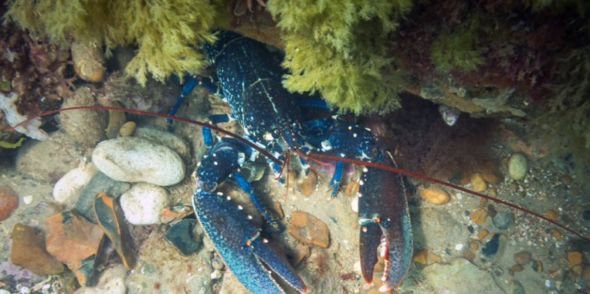
Common lobster
Appearance
Diet
Survival
Did you know?

Slide 38
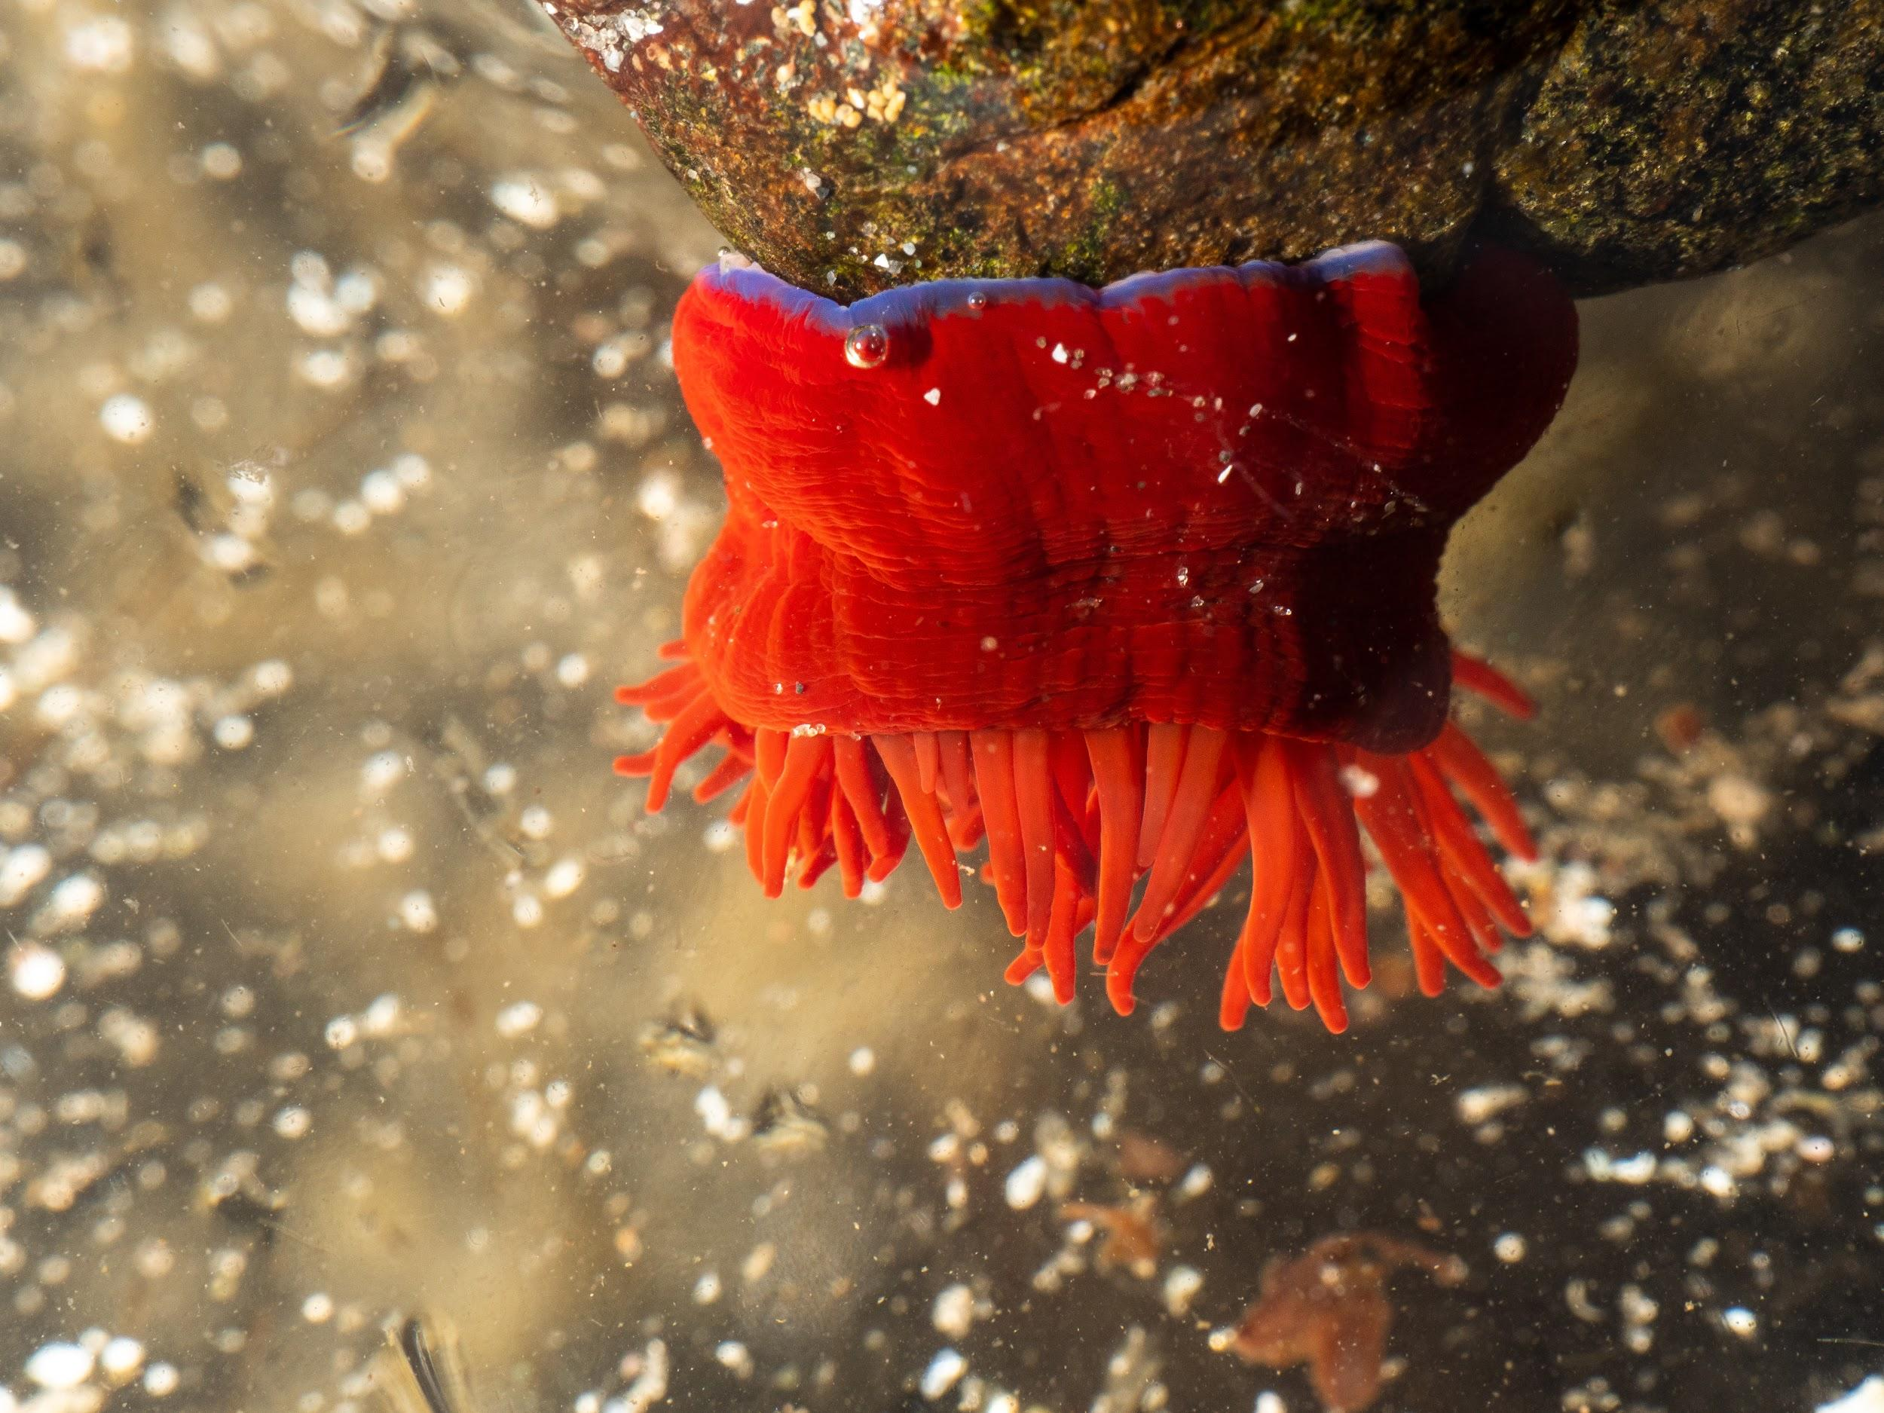
Beadlet Anemone
Appearance
Diet
Survival
Did you know?

Slide 39
Common Starfish
Appearance
Diet
Survival
Did you know?

Slide 40
Sea hare (Aplysia punctata)
Appearance
Diet
Survival
Did you know?

Slide 41
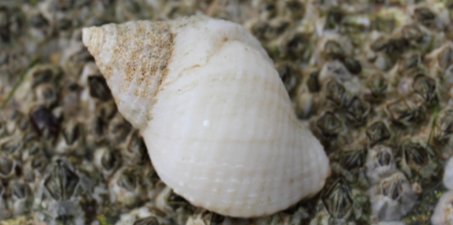
Dog whelk (Nucella lapillus)
Appearance
Diet
Survival
Did you know?

