Slide 1
Viewpoints and values
Ages 7-11

Slide 2
Shelly - Beach Clean Organiser
The sea and me
I grew up in Bacton and spent many hours on the beach; it’s like my second home. Since 2013, I have been a volunteer beach clean organiser covering the beaches from Trimingham to Sea Palling. I volunteer for the Marine Conservation Society and I have my own group called North Norfolk Beach Cleans. I also volunteer for Friends of Horsey Seals during the pupping season which includes doing early morning seal counts.
How I feel about the sea
I love the beach and sea. All my cleans are voluntary and I rely entirely on donations of beach clean equipment. Doing this benefits my wellbeing; I enjoy being on the beach with like-minded people and giving something back to nature. It’s good physical exercise too; walking up dunes and along the sand carrying heavy bags is quite a work out! I find it fun and relaxing too.
The MCZ
It is important to encourage sustainable use of surrounding areas, particularly fishing hot spots. People need to see and learn about the unusual and beneficial ecosystem of the MCZ with creatures like sea cucumbers, crabs, lobsters and fish. Marine plant life is vital for our carbon cycle and our food web; they all play an important part in balancing our marine ecosystem.
My message
- Go out and enjoy the beauty of a natural untouched environment.
- Learn about the marine ecosystem and how every creature and plant, from microscopic plankton to predators such as sharks and seals, play a vital part in the balance and health of our oceans. If we overfish and destroy habitats, it can have a knock on effect on the whole earth ecosystem. It could affect our food supplies, clean air and water supplies if unbalanced.
- Do little things like pick up litter, put litter in the bin, try to reuse wherever possible, avoid polystyrene and non-recyclable products and if you eat seafood make sure it is sustainably caught.

Slide 3
Shelly - Beach Clean Organiser
The sea and me
I grew up in Bacton and have spent many days on the beach. I run beach cleans as a volunteer, covering the beaches from Trimingham to Sea Palling. My group is called North Norfolk Beach Cleans. I also volunteer for Friends of Horsey Seals during the pupping season.
How I feel about the sea
I love the beach and sea. It makes me feel good when I am with other people helping nature. Walking up sand dunes and along the beach carrying heavy bags keeps me fit! It is fun and relaxing too.
The MCZ
It is important to look after the area. People need to see and learn about the habitat and wildlife in the MCZ. The sea plays an important part in looking after our planet so we need to look after it.
My message
Go out and enjoy the beauty of the beaches and sea. Learn about the sea and how every creature and plant plays an important part in the balance and health of our oceans and planet. Do little things like pick up litter, put litter in the bin, try to reuse wherever possible and avoid single-use plastic.

Slide 4
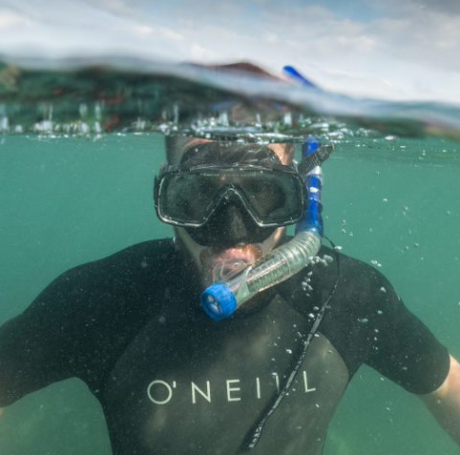
Chris - snorkeller, photographer and lifeboat crew member
The sea and me
I’ve lived in Sheringham all my life and enjoy walking along the tideline (usually with a bag for collecting any rubbish I find), swimming in the sea, surfing, kayaking or taking my boat out at Blakeney Point to see the seals and go fishing. I enjoy snorkelling when the sea is clear to see the amazing sea life and taking lots of photos and video.
In 2021, I found and filmed a 125 year old shipwreck (the SS Commodore) just off Sheringham which caused a lot of interest with local newspapers and I was even on an American TV show talking about the wreck. In 2000, I joined the lifeboat crew at Sheringham. I am currently the Deputy Senior Helmsman (meaning I drive the boat).
How I feel about the sea
I have always loved the way that the sea changes so much between the seasons. From snorkelling in inviting, clear, (fairly) warm water in summer to watching huge waves lash the shoreline in a winter storm. The drama and power of the sea is unrivalled for me. I really enjoy snorkelling and making the short films for other people to see what a special place the chalk reef is. I am on the lifeboat crew because I like to help people in trouble and it can also be fun to go out on the lifeboat.
The MCZ
It is important to find the balance between protecting the sea life of the MCZ and letting all of the users of the sea (crab fishermen, snorkellers, swimmers) do what they want to do. The wildlife and structure of the chalk reef are very hardy as they have to endure the winter storms. The fishermen are very good at protecting the reef to allow them to earn a living while the fishing regulations and laws ensure healthy populations are maintained. One of the biggest challenges is ensuring our Blue Flag beaches remain pollution-free and that our seas have as little plastic and rubbish thrown into them as possible as this harms the fish and other animals.
My message
If you get a chance to snorkel here in the summer you will be amazed by the wonderful animals that live in the shallow waters so close to the beach. The MCZ is a very special place and needs our help and protection so next time you go to the beach take a bag and pick up any rubbish you find, particularly any plastic. The fish will thank you!

Slide 5
Chris - snorkeller, photographer and lifeboat crew member
The sea and me
I’ve lived in Sheringham all my life and enjoy walking along the beach (often with a bag for any rubbish I find), swimming in the sea, surfing and taking my boat out at Blakeney Point to see the seals. I enjoy snorkelling when the sea is clear to see the amazing sea life and take lots of photos and video. I am also in the lifeboat crew at Sheringham.
How I feel about the sea
I love the way the sea changes so much between the seasons. From snorkelling in clear, warm water in summer to watching huge waves lash the beach in a winter storm. I really enjoy snorkelling and making the short films to show other people what a special place the chalk reef is. I am on the lifeboat crew because I like to help people in trouble and it can be fun to go out on the lifeboat.
The MCZ
It is important to find the balance between looking after the sea life of the MCZ and letting all of the users of the sea (crab fishermen, snorkellers, swimmers) do what they want to do. We need to make sure our Blue Flag beaches stay pollution-free and that our seas have as little plastic and rubbish thrown into them as possible as this harms the wildlife.
My message
The MCZ is a special place and needs our help so next time you go to the beach take a bag and pick up any rubbish you find. The fish will thank you!

Slide 6
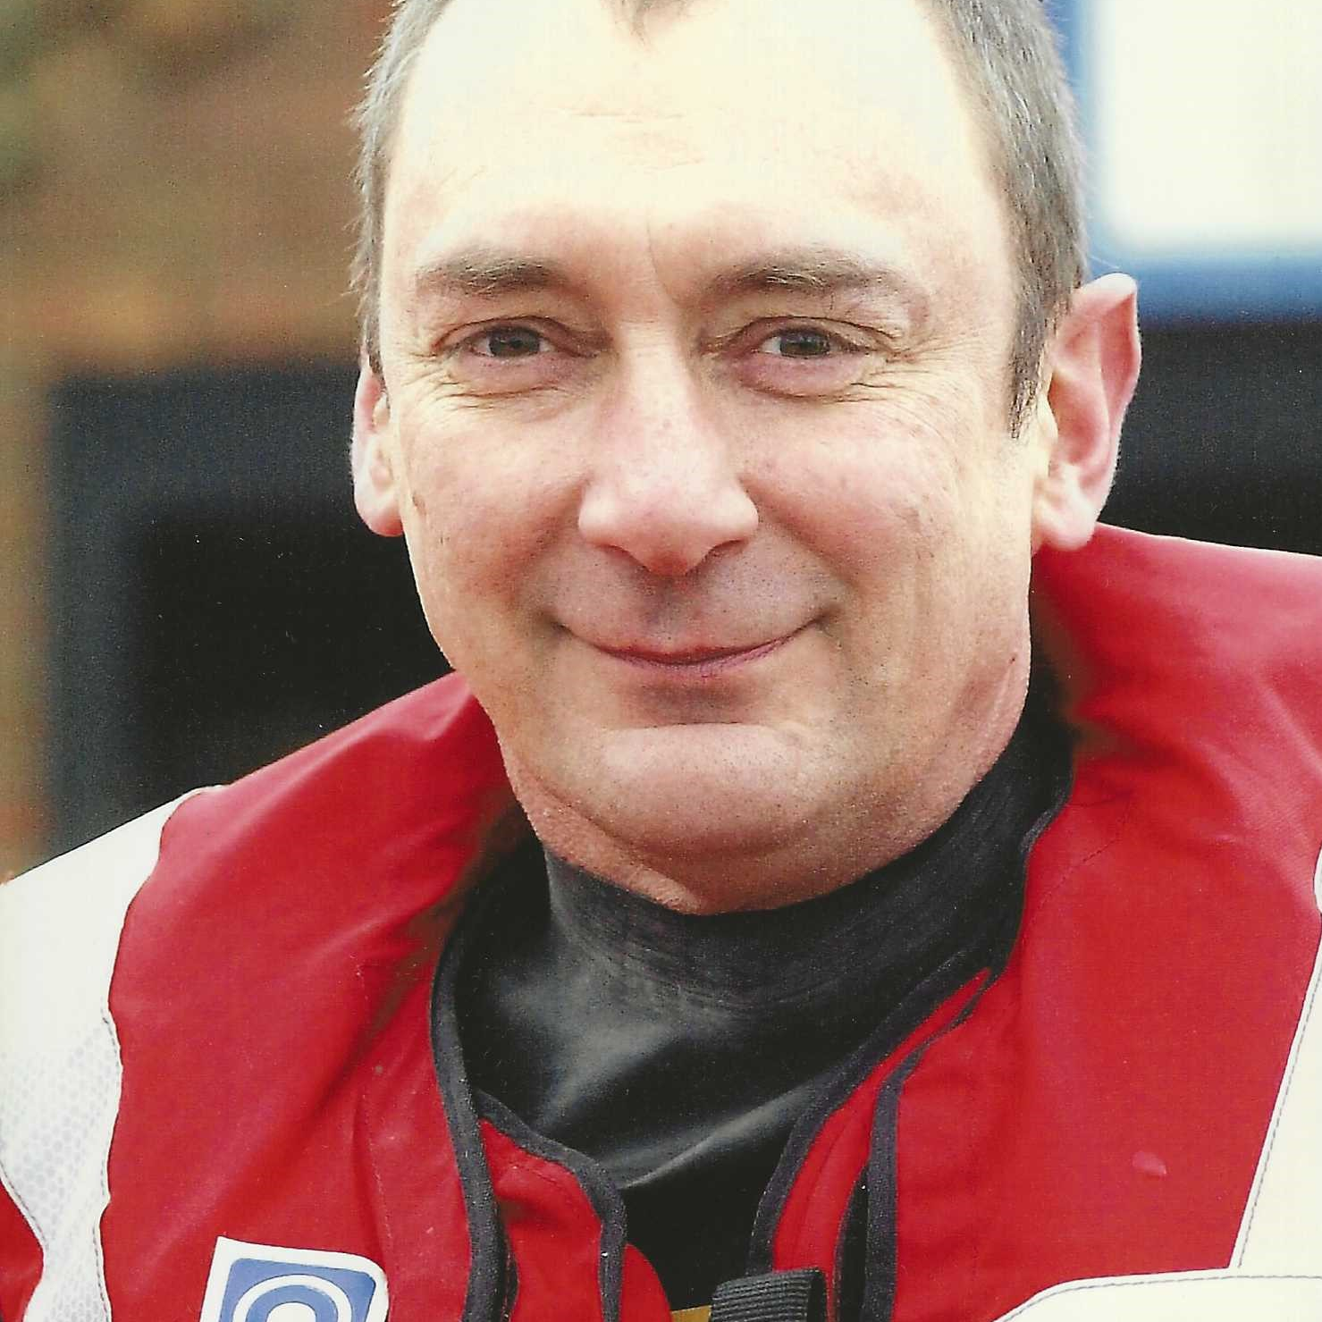
Philip - RNLI lifeboat volunteer
The sea and me
Quite a few years ago, I was a fisherman for a couple of years off Cromer, catching crabs, lobsters, whelk and herring. Through being a fisherman, I was encouraged to join the RNLI lifeboat where I crewed for thirty years. When I retired from the crew, I remained involved and am now chairman, press officer and community safety officer for RNLI Happisburgh Lifeboat Station.
I go to the lifeboat station at least once or twice a week to raise public awareness about water safety. I was also in the RAF on Air Sea Rescue Launches as a Coxswain in the seventies. I regularly walk my dog on the beach. My dog loves to swim in the sea!
How I feel about the sea
I love the beauty and power of the sea. I also love the way it is always changing; there is something different every time you visit whether it’s the beach, the colour of the sea or the weather. I want to help others to have fun whilst keeping safe. I also enjoy being part of the lifeboat team; the RNLI is like a big family of like-minded people.
The MCZ
I feel it is important that we protect and maintain the chalk reef so it can carry on as it has for many years. It is also important that fishermen can carry on and earn a living.
My message
My main message is to respect the sea and keep safe. Always have an adult with you when you swim. Learn how to float (starfish float on your back) - it’s the one thing that will save you if you unexpectedly end up in the water. Visit rnli.org to find out more about keeping safe during water based activities.

Slide 7
Philip - RNLI lifeboat volunteer
The sea and me
I was a fisherman at Cromer catching crabs, lobsters, whelk and herring. I joined the RNLI lifeboat and was on the crew for thirty years. Since I retired from the crew, I have taken on other roles at the RNLI Lifeboat Station. I go to the lifeboat station every week to raise public awareness about water safety. I was also in the RAF on Air Sea Rescue Launches. I walk my dog on the beach. My dog loves to swim in the sea!
How I feel about the sea
I love the beauty and power of the sea. I also love the way the beach, the colour of the sea and the weather are always changing. I volunteer for the RNLI because I want to help others to have fun whilst keeping safe. I also enjoy being part of the lifeboat team.
The MCZ
I feel it is important that we protect and maintain the chalk reef so it can carry on as it has for many years. It is also important that fishermen can carry on and earn a living.
My message
My main message is to respect the sea and keep safe. Always have an adult with you when you swim. Learn how to float (starfish float on your back) - it is the one thing that will save you if you end up in the water. Visit rnli.org to find out more about keeping safe at the beach.

Slide 8
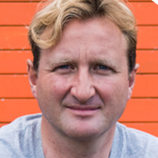
Ben - Surf school manager
The sea and me
I have been running a surf school and surf shop in Cromer since 2007. I am the head instructor of surf and stand up paddle board (SUP) lessons but most of the time I’m managing the business. I love surfing and aim to get out whenever there are waves! My love for the sea began when I was about 10 years old and started going sea fishing from Falmouth in Cornwall. I saw lots of people surfing so gave it a go and ended up getting my first board when I was about seventeen.
How I feel about the sea
I am lucky that I get to combine my hobby with my work! I love the sense of freedom I get when I go surfing. The sea is so vast. I also really appreciate the health benefits, both physical and mental, that I get from surfing, stand up paddleboarding and generally being in and by the sea. It really gives me an opportunity to find a space to relax, be refreshed and continue positively with life.
The MCZ
It is important that there is a balance in the way the MCZ is managed. Tourism is a really important part of the local economy that needs to be considered. People come here to surf, enjoy the view, see the wildlife and eat Cromer crabs.
My message
The North Norfolk coast is like a giant, free playground! Visit it and most importantly experience it. Take your shoes off and feel the water on your feet, go for a swim, try surfing lessons and make sure you keep safe. By experiencing it you will develop a natural love for it. The coast needs to be looked after and preserved for generations to come.

Slide 9
Ben - Surf school manager
The sea and me
I run a surf school and surf shop in Cromer. I teach surf and stand up paddle board lessons but most of the time I’m managing the business. I love surfing and aim to get out whenever there are waves! My love for the sea began when I was about 10 years old and started going sea fishing.
How I feel about the sea
I am lucky that I get to combine my hobby with my work! I love the sense of freedom I get when I go surfing. The sea is so vast. Surfing, stand up paddleboarding and generally being in and by the sea are good for my fitness and mental well-being. It really helps me relax, be refreshed and continue positively with life.
The MCZ
It is important that there is a balance in the way the MCZ is looked after. Tourism is a really important. People come here to surf, enjoy the view, see the wildlife and eat Cromer crabs.
My message
The North Norfolk coast is like a giant, free playground! Visit it and experience it. Take your shoes off and feel the water on your feet, go for a swim, try surfing lessons and make sure you keep safe. You will love it. The coast needs to be looked after for the future and the young people to come.

Slide 10
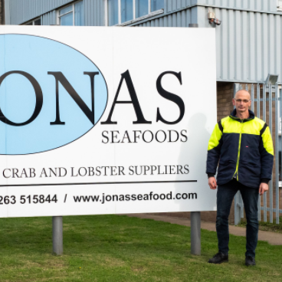
Kevin - Crab and lobster business manager
The sea and me
I grew up part of a fishing family, helping to dress crabs in our kitchen from a young age. I followed two of my brothers into trawler fishing when I left school and spent 9 years trawler fishing before wanting a change. I set up my crab and lobster business in 1995 as well as buying a boat and going out fishing for crabs and lobsters. In 2013, we moved into our current factory which meant I didn’t have time to go out on the boats anymore. The factory now processes up to one million crabs a year.
How I feel about the sea
Having grown up in a fishing family, the sea and crabs have always been part of my life. Trawler fishing was a job to earn money but now I enjoy the independence of running my own business. Although I no longer go out to sea, I enjoy keeping up with the fishermen when I go to collect the crabs.
The MCZ
It is important for everyone to take a balanced view and look at others’ points of view. We need to find a way for the fisheries to keep going. Without the Cromer Crab, we would lose a way of life for many, a tradition, jobs and the flavour of North Norfolk would change. Fishing practices may have to change a little to make sure they are sustainable.
My message
It is important to keep a perspective on the crabbing industry. The fishermen only take some of the crabs: lots of small ones are put back. Potting has a much lower impact on the marine environment than trawling. Try some crab and lobster!

Slide 11
Kevin - Crab and lobster business manager
The sea and me
I grew up part of a fishing family, helping to dress crabs in our kitchen when I was young. I was a trawler fisherman when I left school. In 1995, I set up my company and fished for crabs and lobsters. In 2013, we moved into our current factory which meant I didn’t have time to go out on the boat anymore. The factory now processes up to one million crabs a year.
How I feel about the sea
Having grown up in a fishing family, the sea and crabs have always been part of my life. Trawler fishing was a job to earn money but now I enjoy running my own business. I no longer go out to sea but I enjoy keeping up with the fishermen when I go to collect the crabs.
The MCZ
It is important for everyone to take a balanced view and look at others’ points of view. We need to find a way for the fishering to keep going. Without the Cromer Crab, we would lose a way of life for many, jobs and the flavour of North Norfolk would change. Fishing practices may have to change a little to make sure they can keep going.
My message
The fishermen only take some of the crabs: lots of small ones are put back. Potting has a much lower impact on the sea habitat than trawling. Try some crab and lobster!

Slide 12
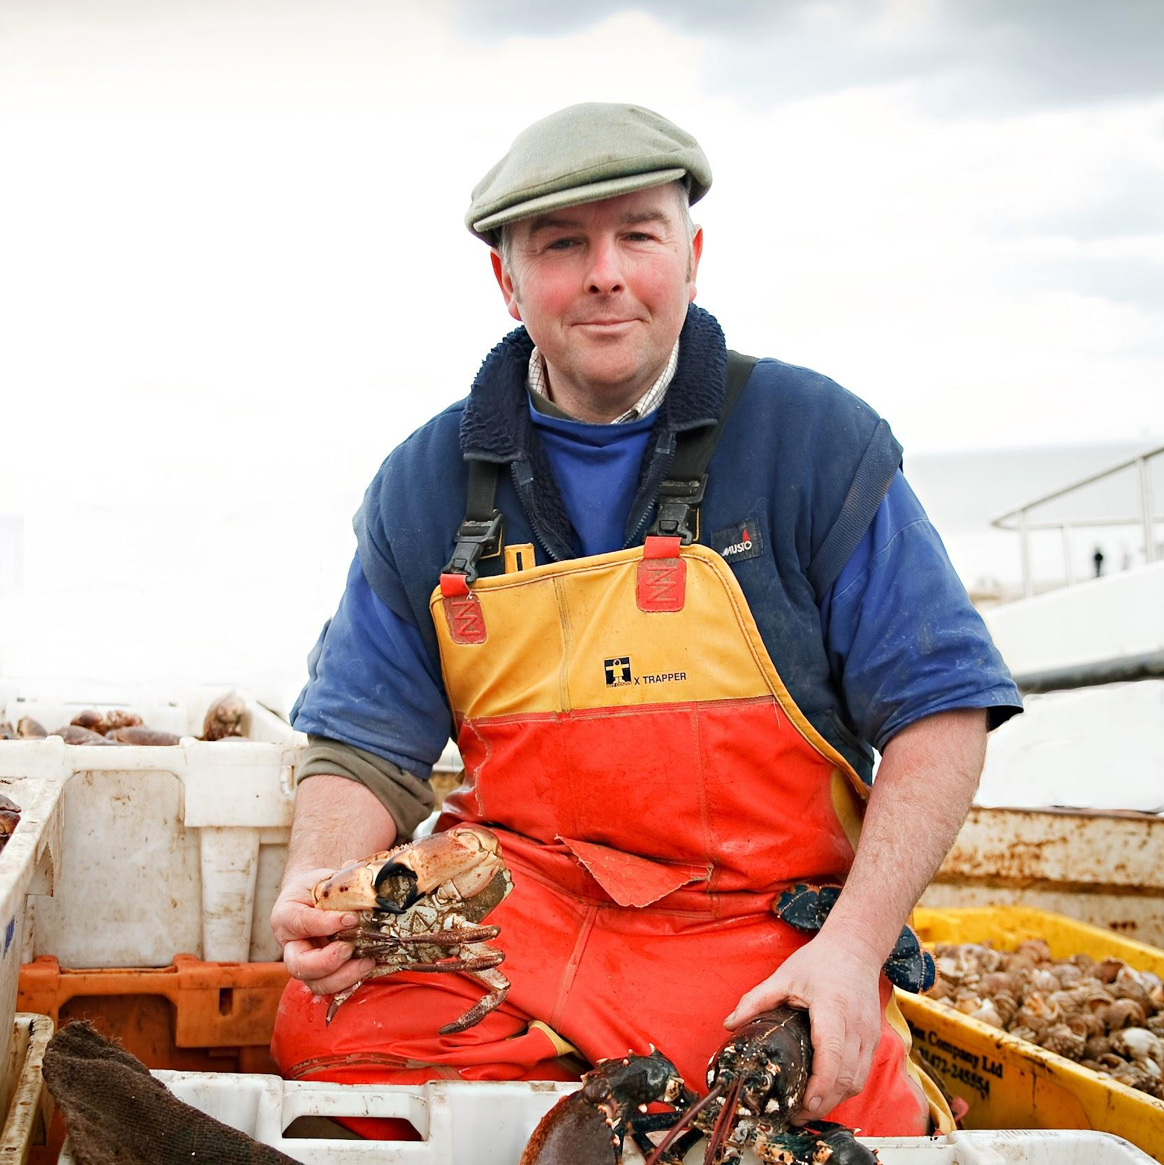
John - Fisherman with a fish shop
The sea and me
The sea has always been part of my life. I come from a family of eight generations of fishermen and I watched my father go out on his boat. I go out on my boat fishing several times a week, weather permitting. On the days I don’t go out, I go and look at the sea instead. The crabs, lobsters and fish I catch are sold in our fish shop in Cromer. I was in the crew on the RNLI Cromer lifeboat for 36 years.
How I feel about the sea
I am lucky that I enjoy my job. It is a rewarding but hard way to earn a living. There are days when being out on my boat is the best place in the world! The early mornings watching the sun come up are beautiful. There’s a real sense of freedom when you’re out on the sea but you have got to respect it.
The MCZ
It is important to protect the balance between nature and man. The MCZ needs protecting; I’d like it to stay as it is. There are not many youngsters getting into fishing these days and it would be a huge loss if the local crab industry ended. It is part of our local community and history, and is important for Cromer and Norfolk.
My message
Appreciate how lucky we are to have the chalk shoal here and be thankful. The MCZ is a place where people earn a living. The crabs and lobsters that live there are important for our local community and industry. There are very few food miles when you eat a Cromer crab; most are caught just a mile or two off the beach!

Slide 13
John - Fisherman with a fish shop
The sea and me
The sea has always been part of my life. My father was a fisherman and his father too. I go out on my boat fishing several times a week, weather permitting. On the days I don’t go out, I go and look at the sea instead. The crabs, lobsters and fish I catch are sold in our fish shop in Cromer. I was in the crew on the RNLI Cromer lifeboat crew for 36 years.
How I feel about the sea
I am lucky that I enjoy my job. There are days when being out on my boat is the best place in the world! The early mornings watching the sun come up are beautiful. There’s a real sense of freedom when you’re out on the sea but you have got to respect it.
The MCZ
It is important to protect the balance between nature and man. The MCZ needs looking after. It is also a place where people earn a living. There are not many young people getting into fishing these days and it would be a huge loss if the local crab industry ended. It is important for Cromer and Norfolk.
My message
We are lucky to have the chalk shoal here. There are very few food miles when you eat a Cromer crab because most are caught just a mile or two off the beach!

Slide 14
How do I feel about the sea? Why?
The Sea and Me by:
What do I like to do at the seaside?
What else is good about the sea?
Use this space to write and draw your thoughts about the sea:

Slide 15
Visiting the beach
A visit to the beach can be a great opportunity to get the children to consider their personal feeling about being there and the physical and mental well-being benefits of being by the sea. Point out the effort needed to walk on sand. Share your own feelings about being on the beach. Here are some other ideas:
Sit spots
Invite the children to spread out and sit in silence in their own space watching the sea. Encourage them to look, listen and feel - to experience it.
Explore their senses
Gather ideas, thoughts and words to describe each sense.
They could use this to write poetry about the sea.
Pebble pledge
A great activity if you have been learning about environmental issues relating to the sea.
Invite the children to hunt for a special pebble that they really like. Whilst hunting, encourage them to consider what they could do to help the oceans. Gather together and the children place the pebbles into a pile or circle whilst making a pledge. Invite them to share their pledge if they want to.

