Slide 1
Local geography
Ages 7-11

Slide 2
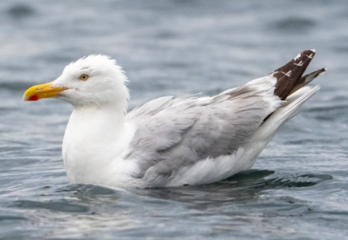
Meet Gus the gull!
Photo: Rob Coleman

Slide 3
