Slide 1
Fishing in the Cromer Shoal Chalk Beds Marine Conservation Zone
Ages 7-11

Slide 2
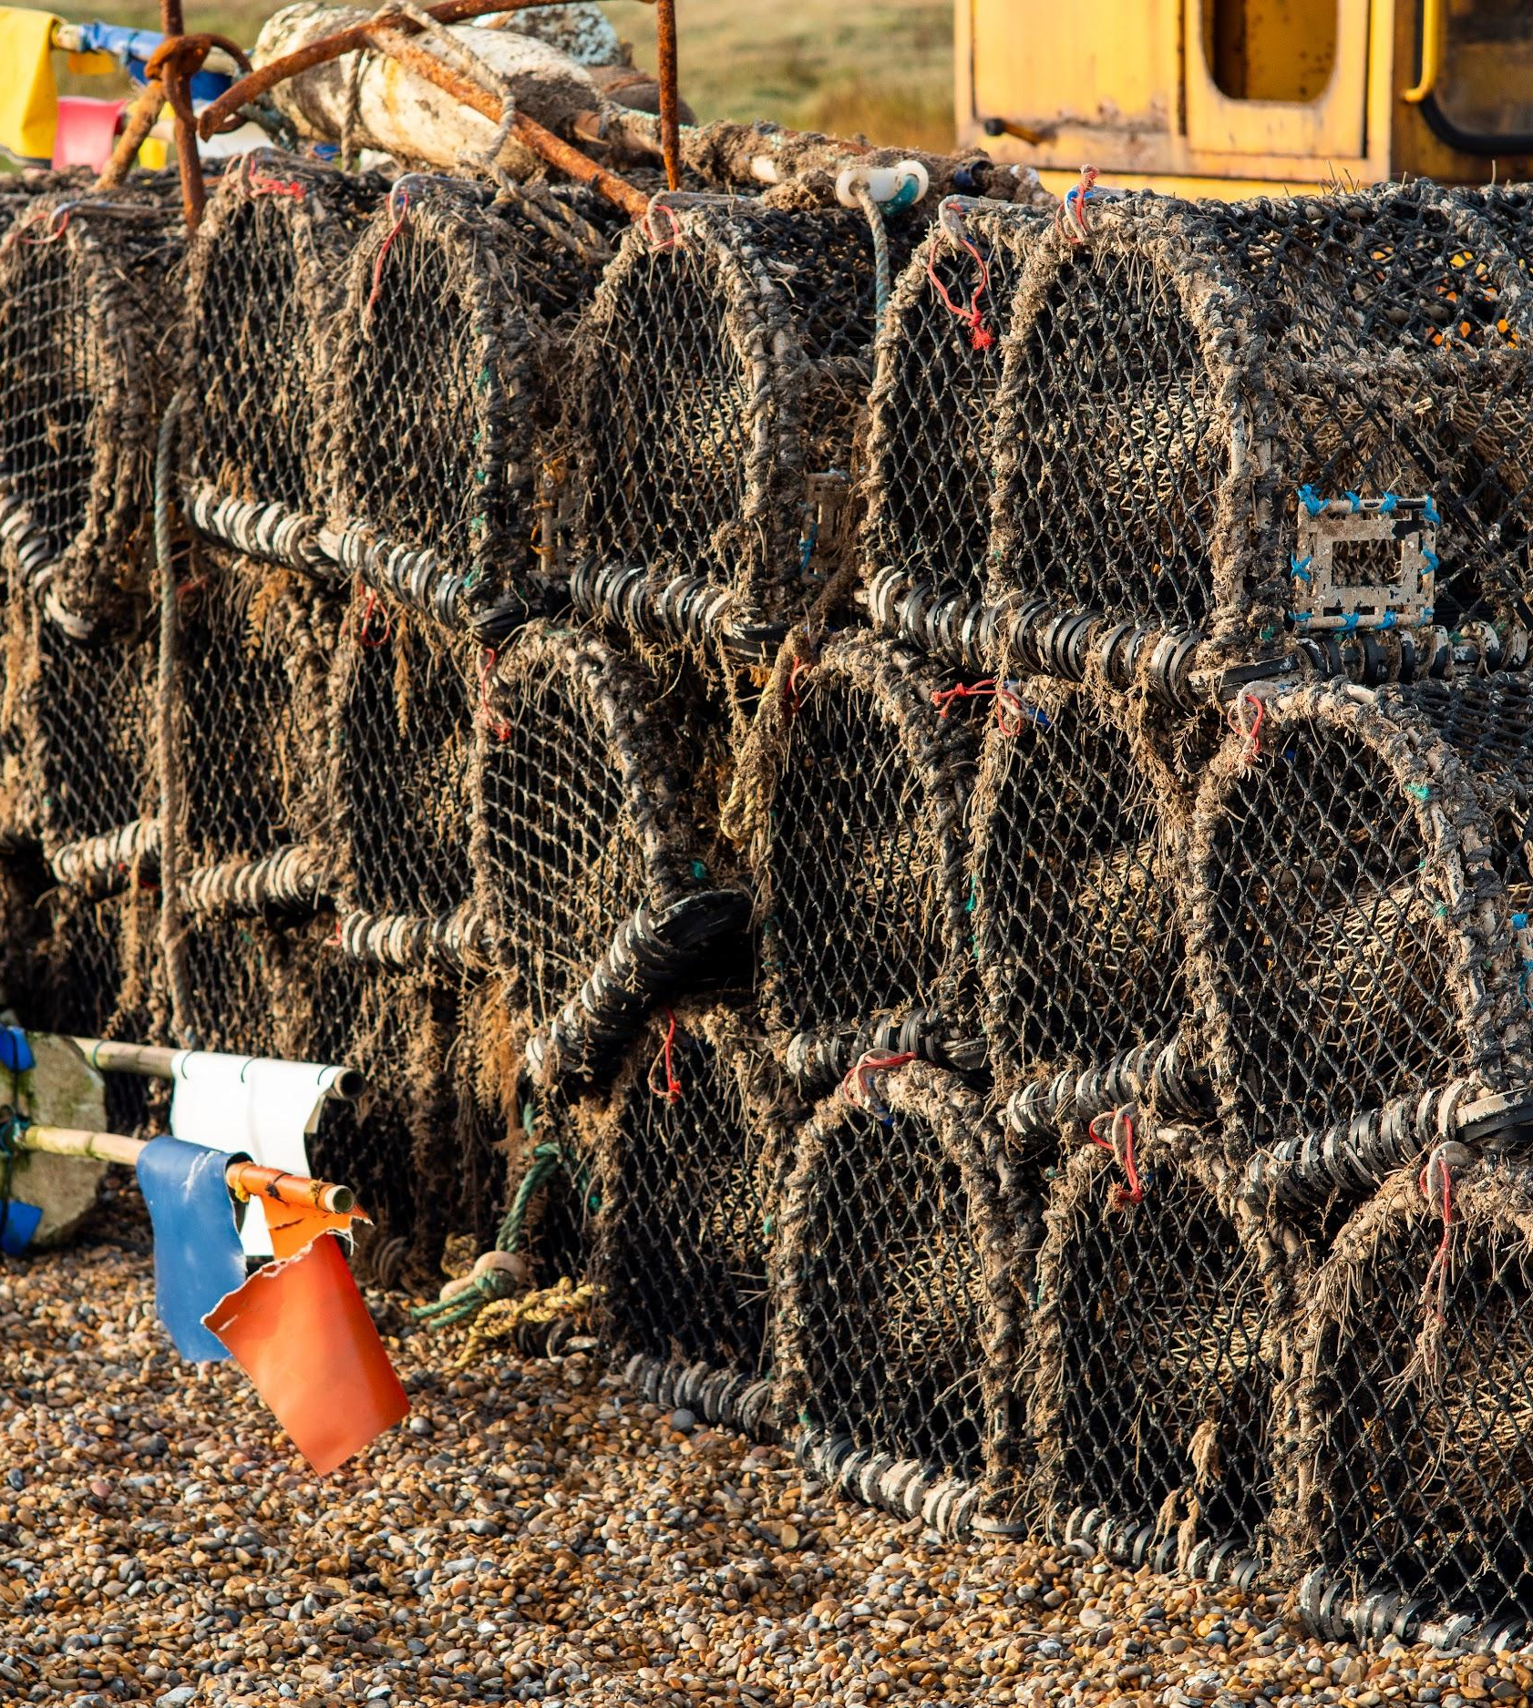
Have you ever seen crab pots stacked up by the sea?

Slide 3
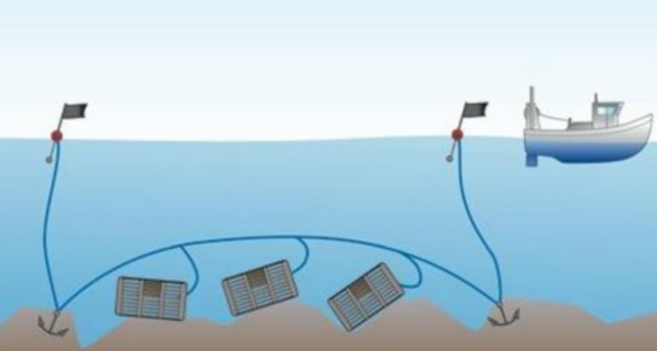
How do crab pots work?
The crab pots are laid in lines called shanks.
There are usually 10 to 25 pots per shank depending on the size of the boat.

Slide 4
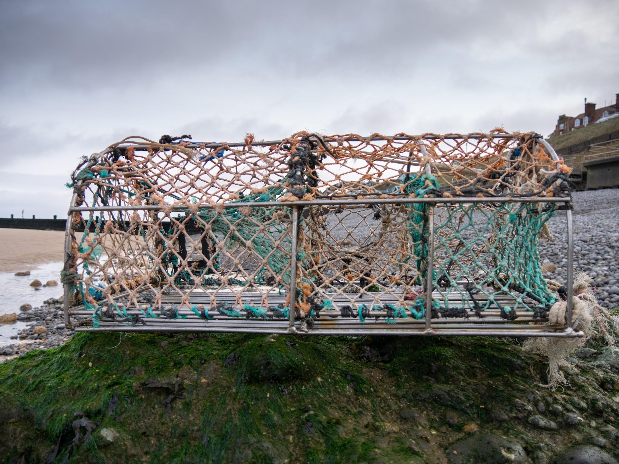
How a parlour (crab) pot works:
6. The slope leads into the ‘parlour’ which they drop into and stay until the pot is emptied by a fisher
1. Bait (dead fish) is secured inside the pot between two pieces of cord
2. Crabs and lobsters want to eat the bait so they move around the pot until they find a way in
5. They find a way to go, but this takes them up the net slope
Photo: Rob Coleman
3. The crabs and lobster find an entrance. It’s easy for them to crawl into the wide opening and drop into the pot
4. When they finish eating, they look for a way out. They can’t get out the way they came in because it’s narrow and high up

Slide 5
Life as a fisher
Crab fishers are out on the water most days, weather permitting, from March to October and less often during the winter.
Many have small boats that they operate single-handedly, though some have crew of up to four people. Depending on tides, they can have early morning starts in the dark. They go out in varying weather conditions so long as the wind and waves are not too strong.
In winter, the cold temperatures mean there are fewer crabs around so they use this time of year to fix damaged pots and carry out maintenance of their boats.
The video on the next slide shows a Cromer fisherman’s day at work out on his boat.

Slide 6
Life as a fisher
Notes:
Video link: https://www.youtube.com/watch?v=GxdOyWeSO4w

Slide 7
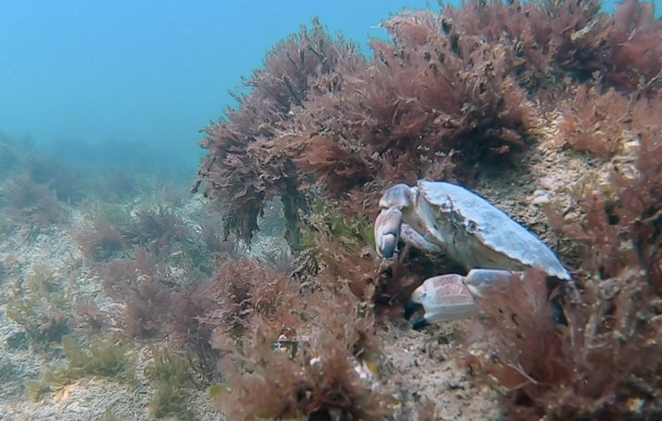
Sea to Sandwich
Edible (brown) crabs live in the sea.
Photo: christaylorphoto.co.uk

Slide 8
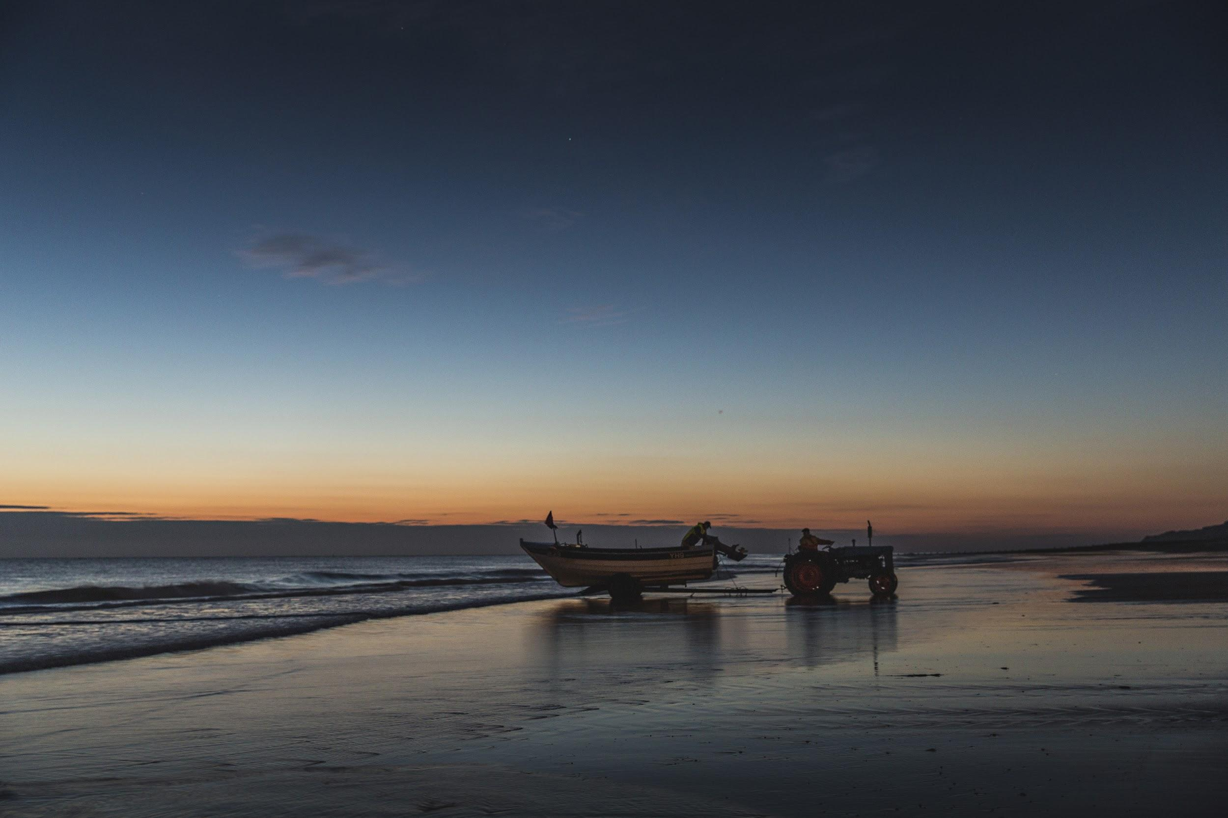
Photo: christaylorphoto.co.uk
Being a fisher can mean some early morning
starts depending on the tides.

Slide 9
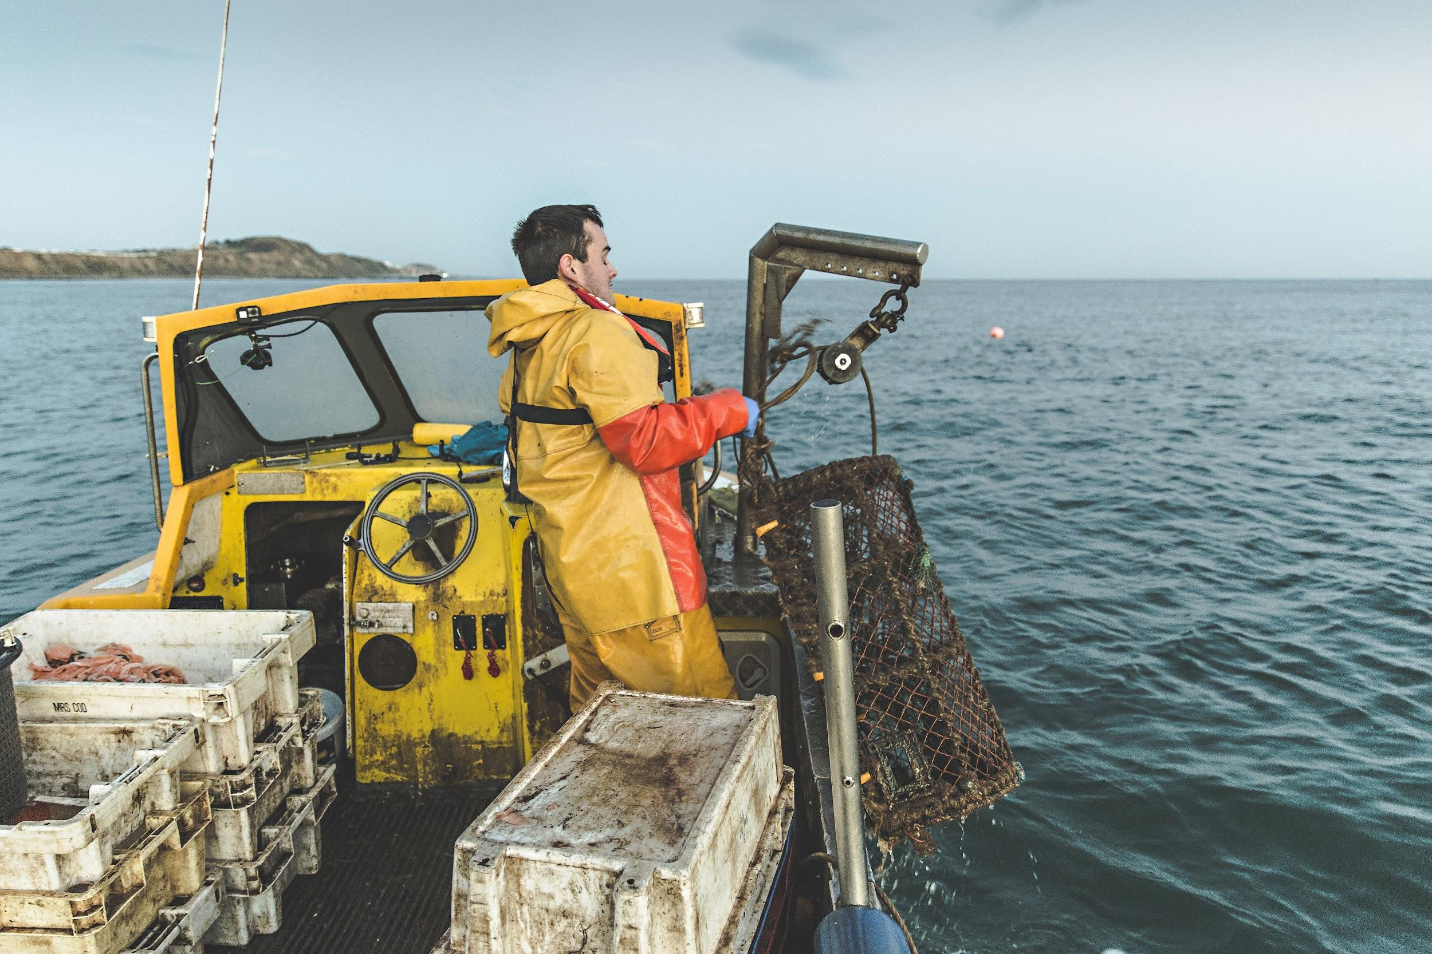
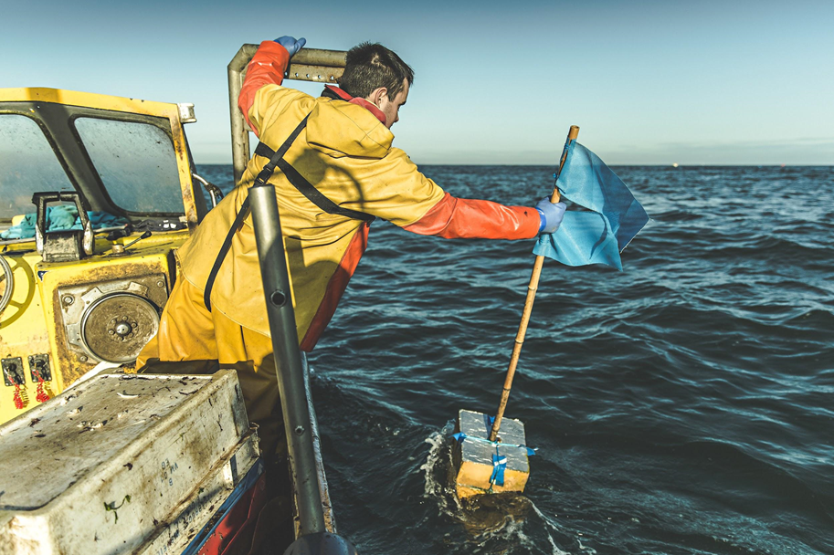
They go to their pots which are marked with flags.
They haul in their pots. The fishers use a winch to help raise the pots.
Photos: christaylorphoto.co.uk

Slide 10
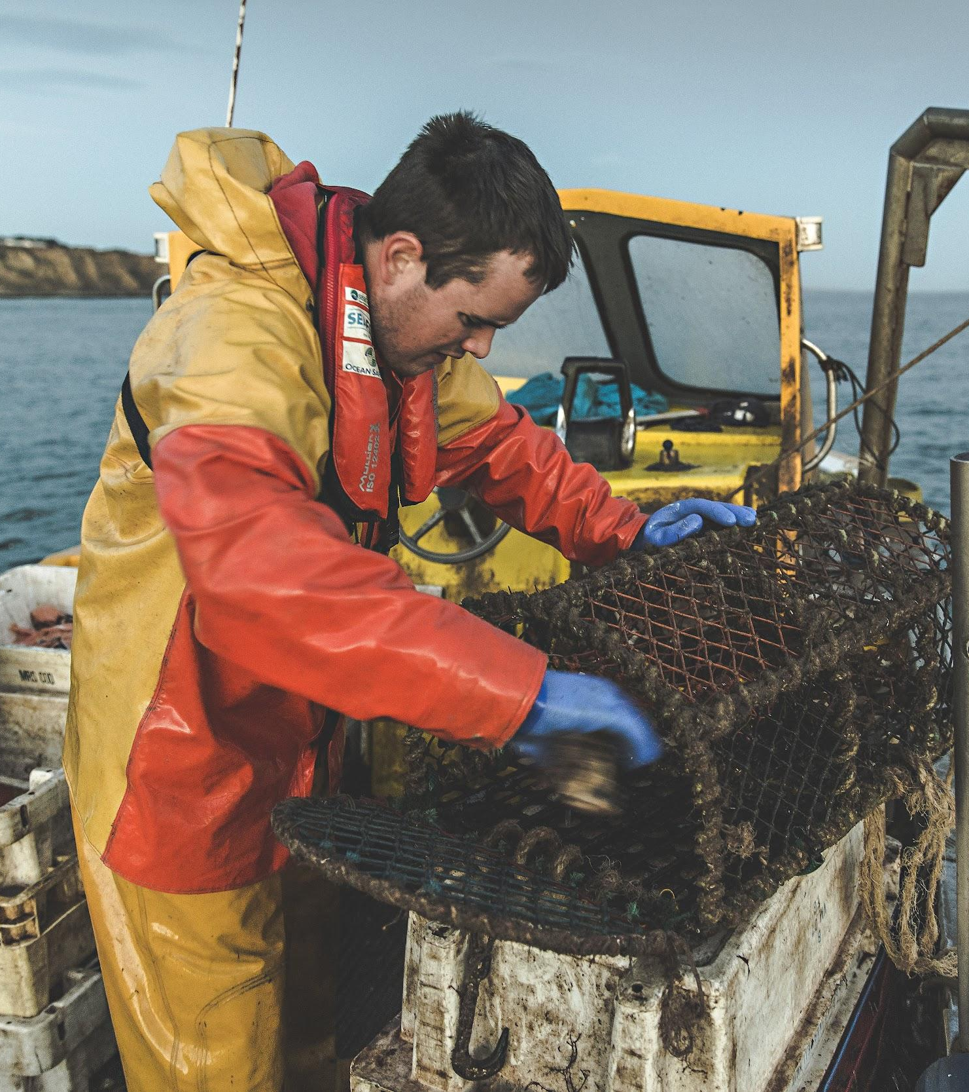
The pots are emptied.
Photo: christaylorphoto.co.uk

Slide 11
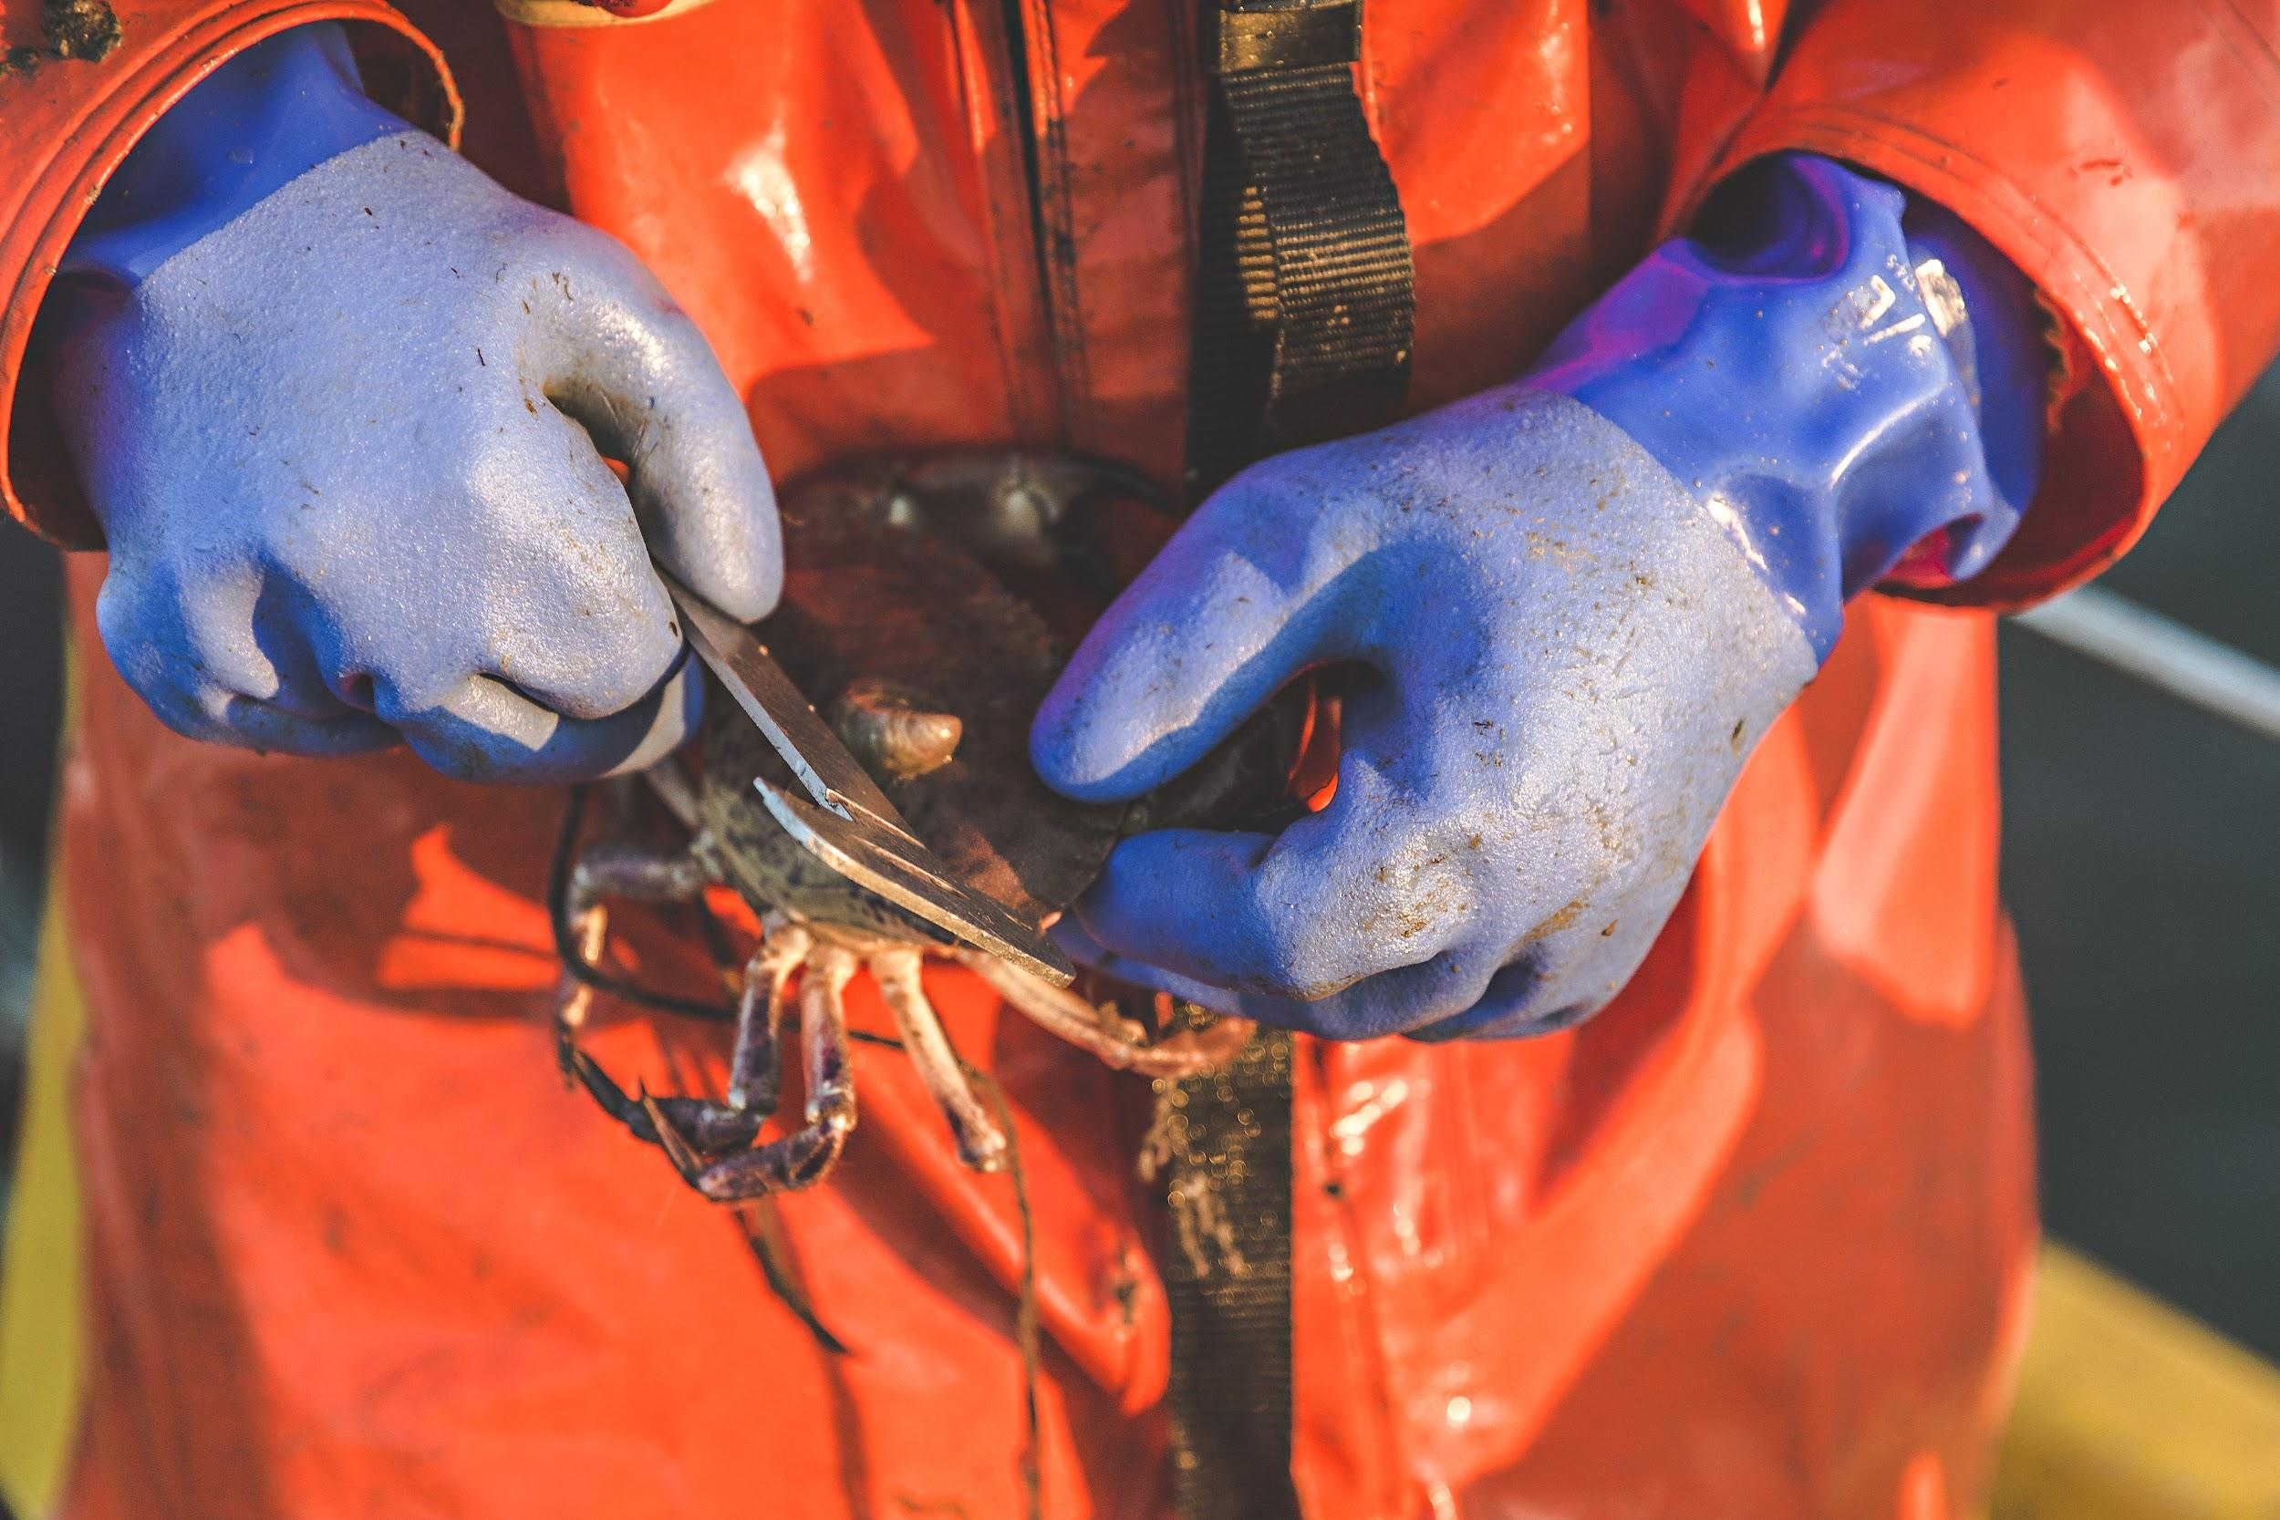
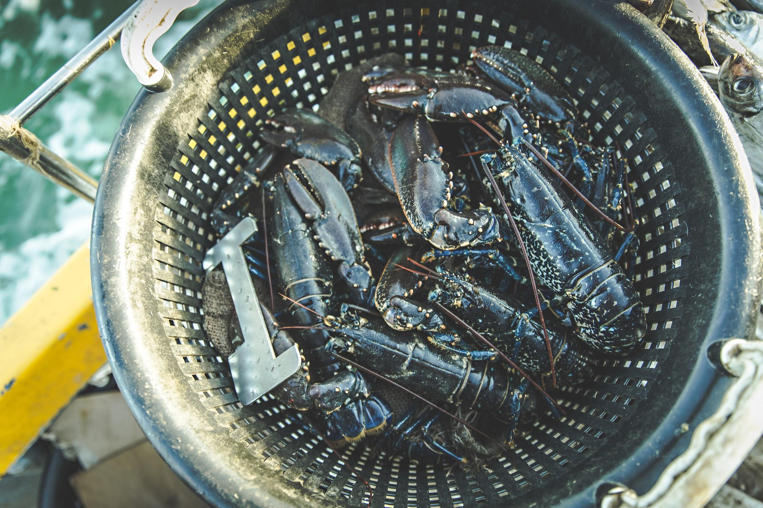
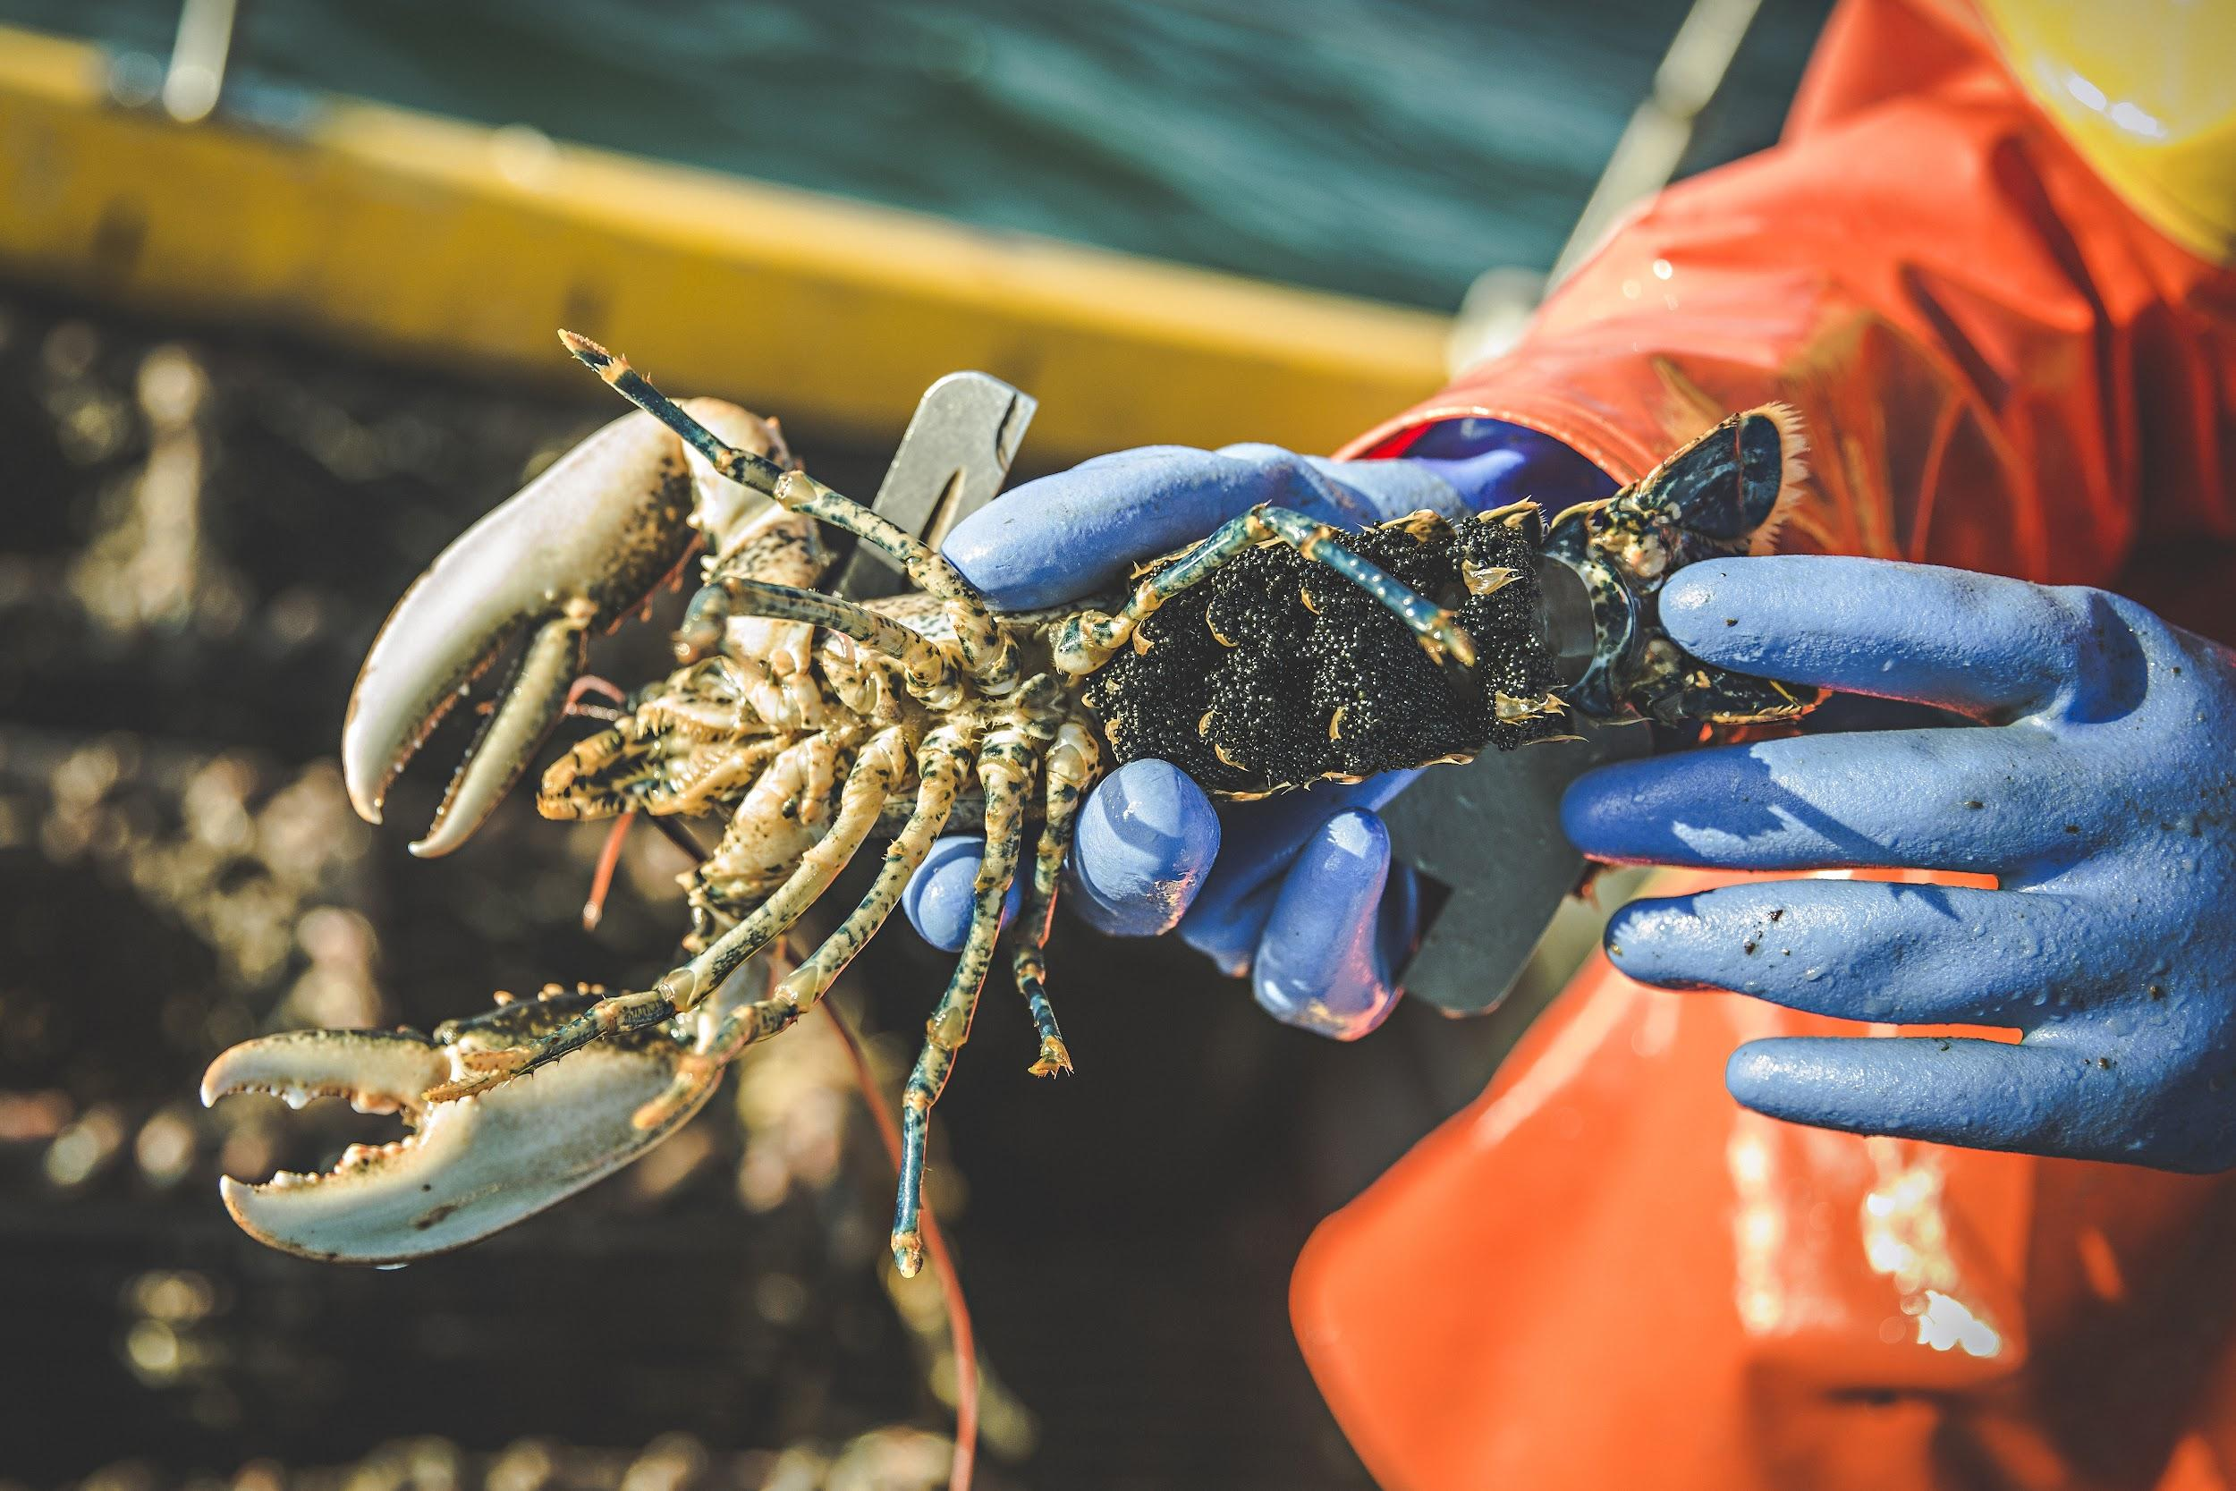
The crabs and lobsters are measured and checked.
Photos: christaylorphoto.co.uk
If they are too small or are berried (have eggs) they are
thrown back.

Slide 12
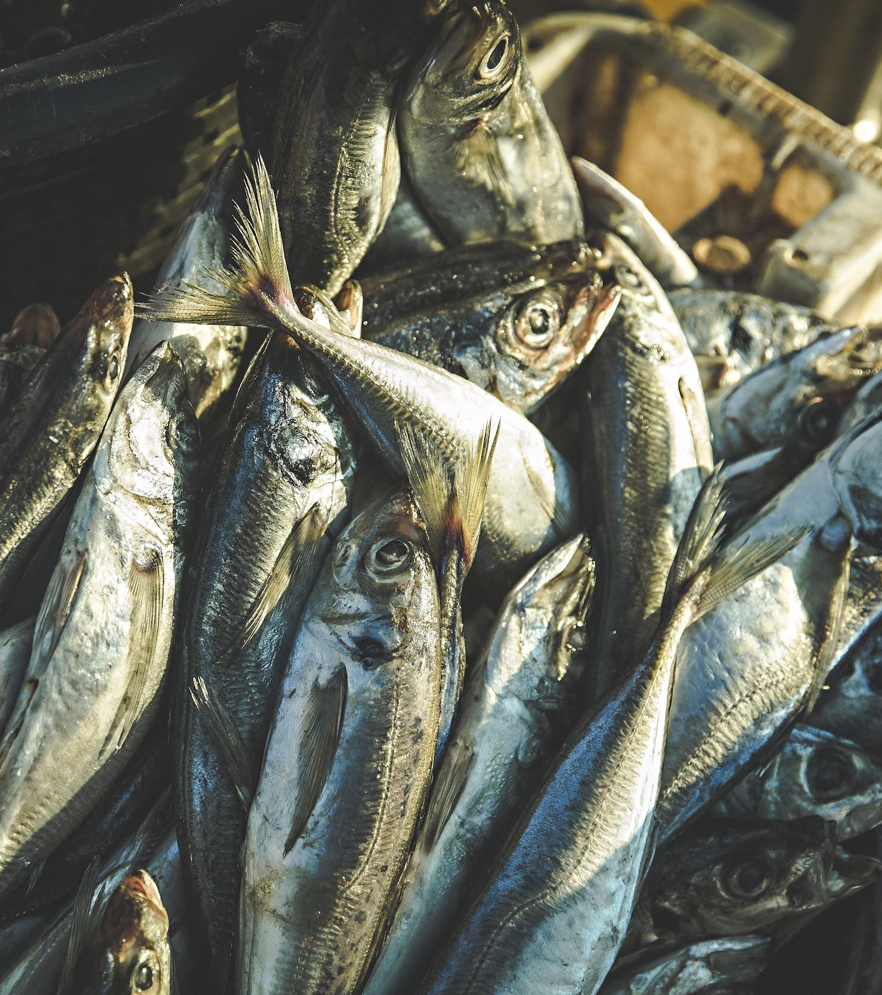
The crab pots are baited.
Fishers use a variety of bait - scad, flounder, gurnard and
salmon heads are commonly used.
Photo: christaylorphoto.co.uk

Slide 13
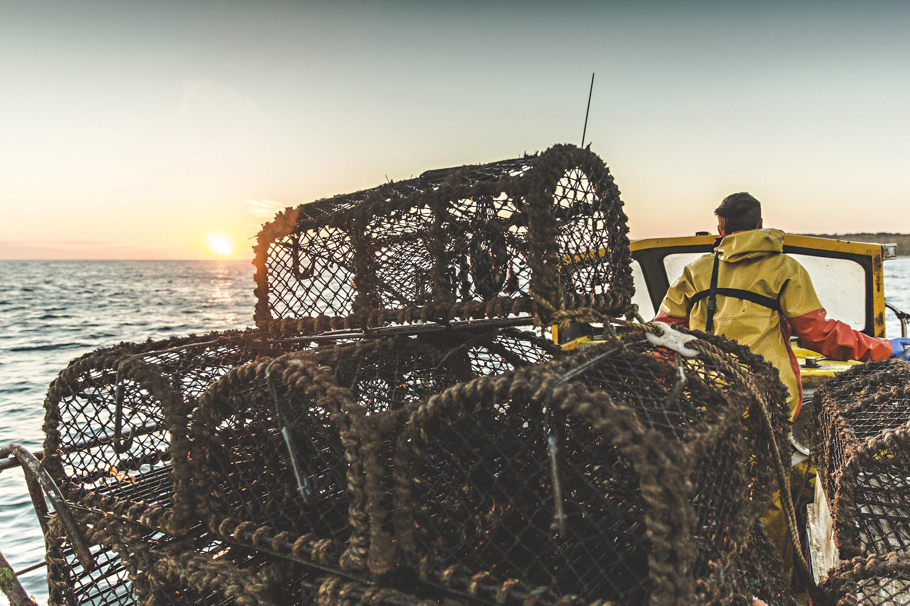
The pots are stacked in the boat then taken to another area.
Photo: christaylorphoto.co.uk

Slide 14
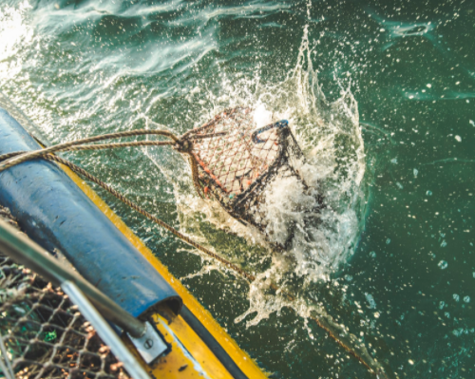
The pots are lowered back into the sea
Photo: christaylorphoto.co.uk
The fishers empty other shanks of pots then head back to shore with their catch.

Slide 15
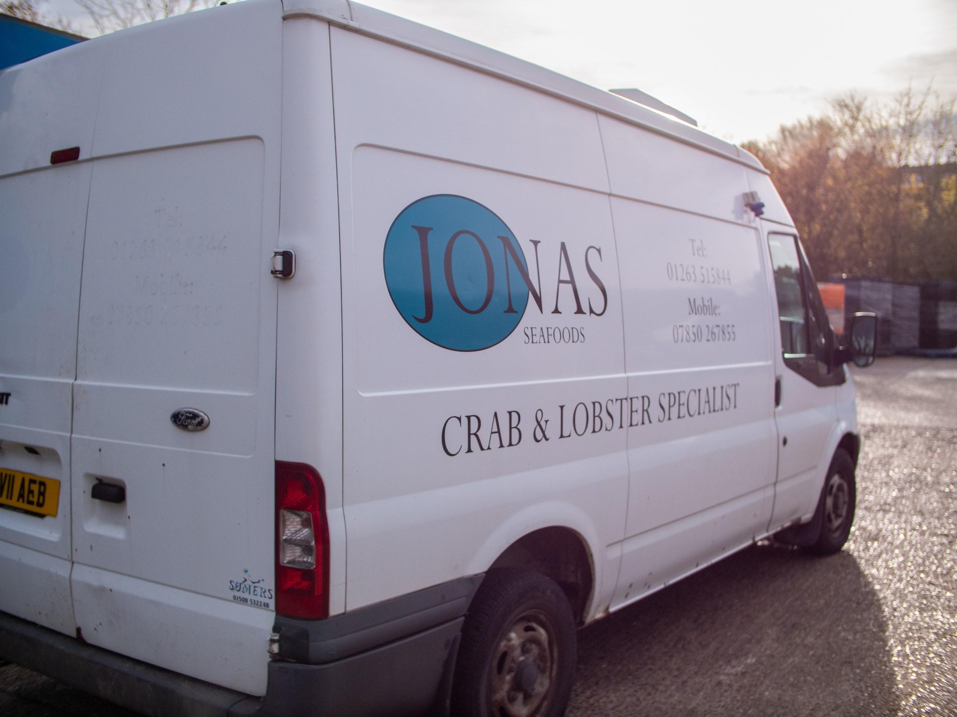
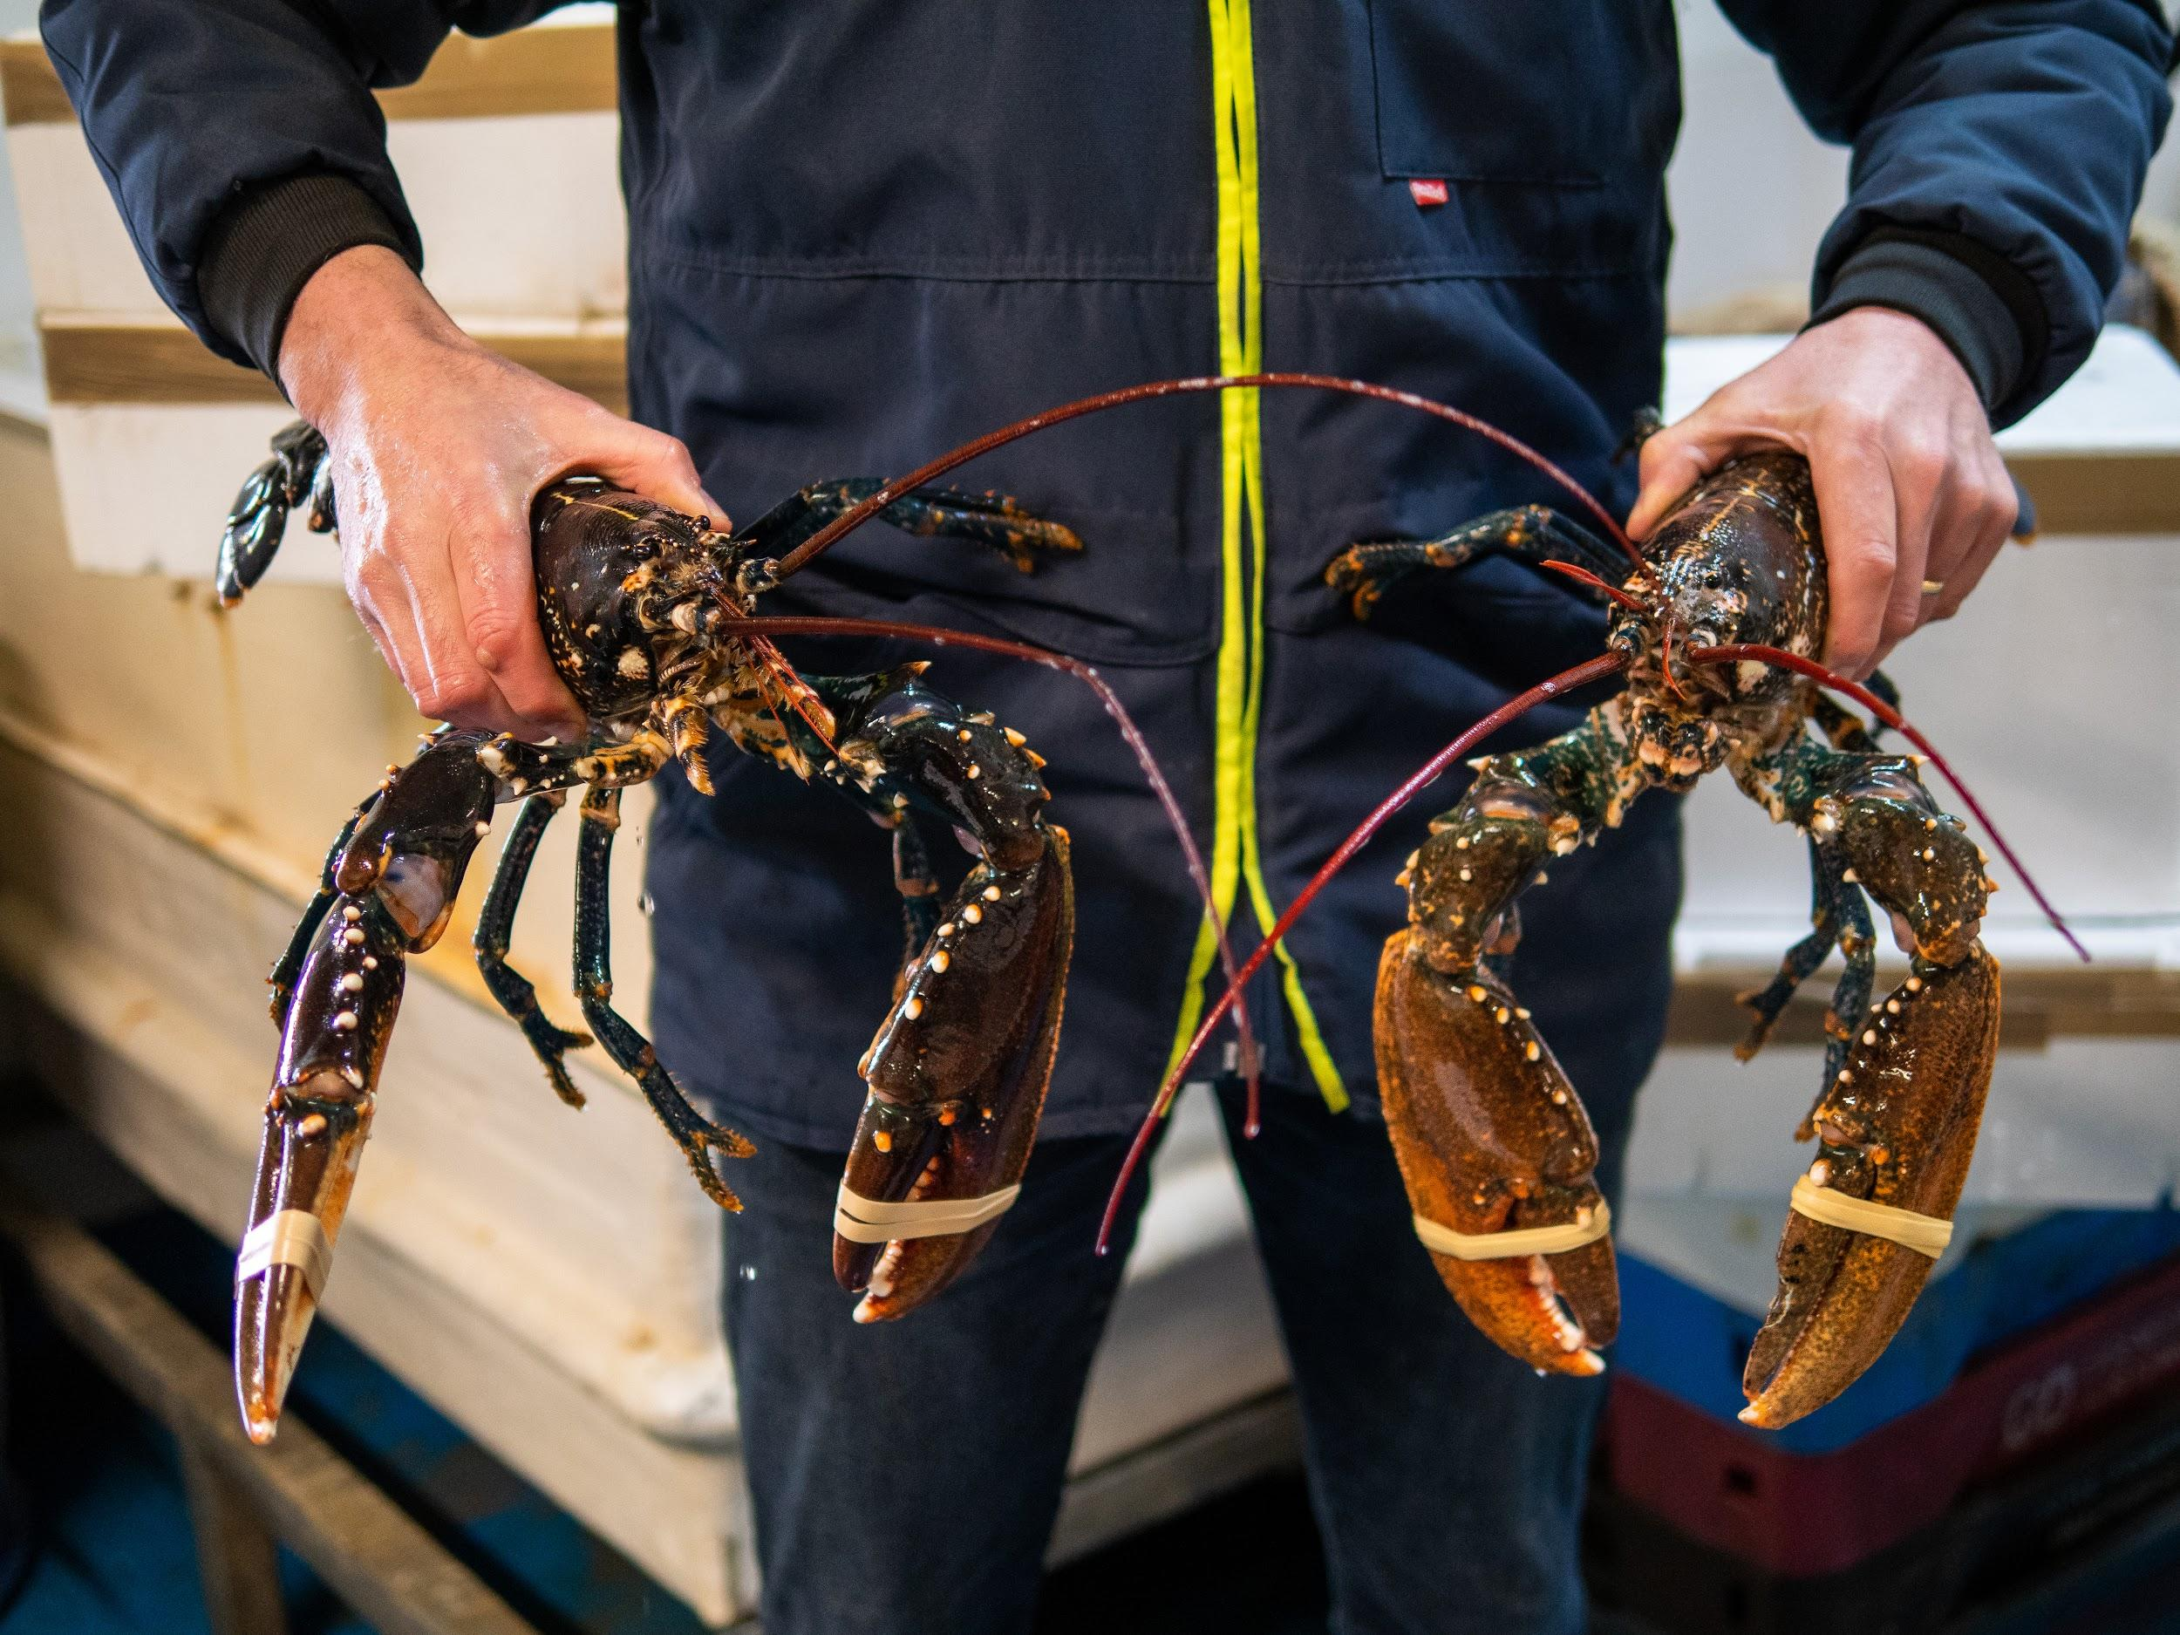
When back on shore, the crabs and lobsters are transported alive to the factory.
Photo: Rob Coleman
Photo: Rob Coleman

Slide 16
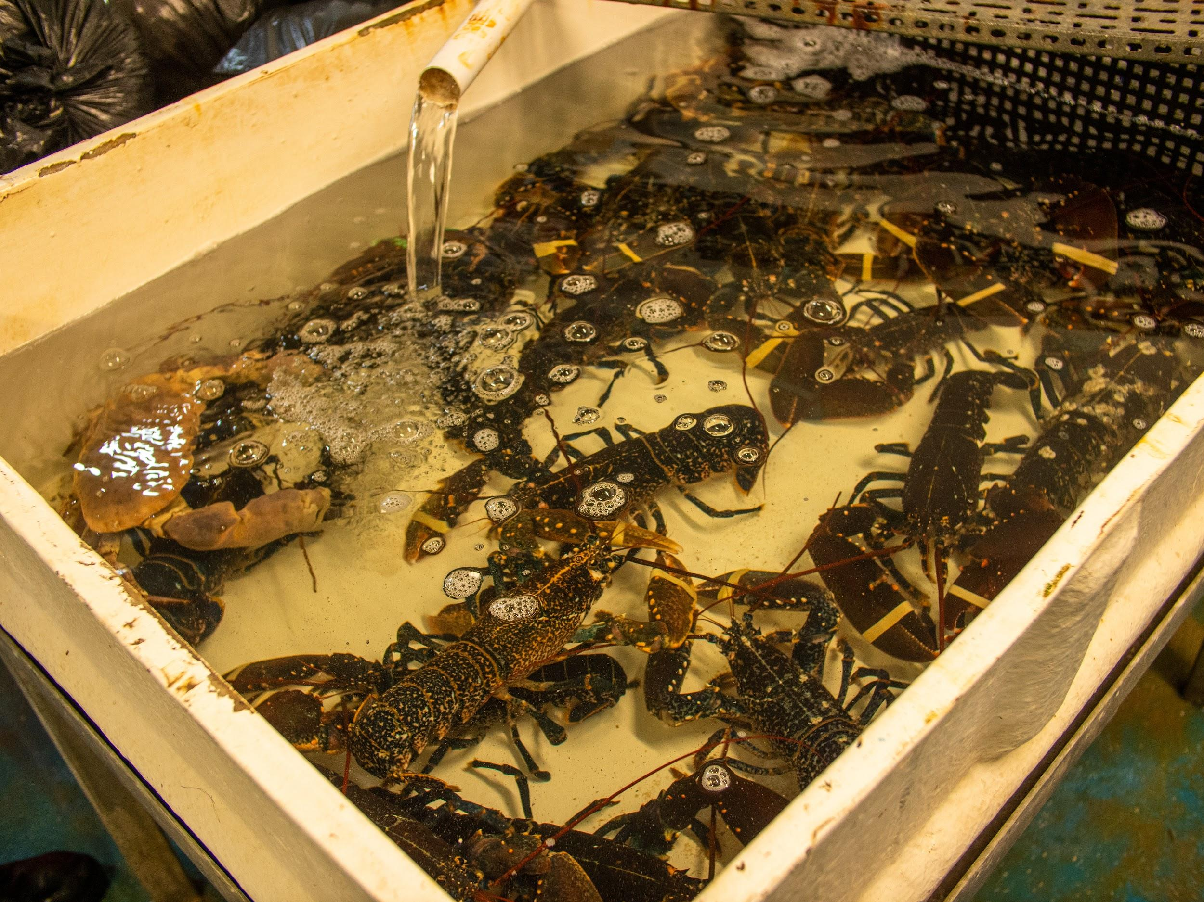
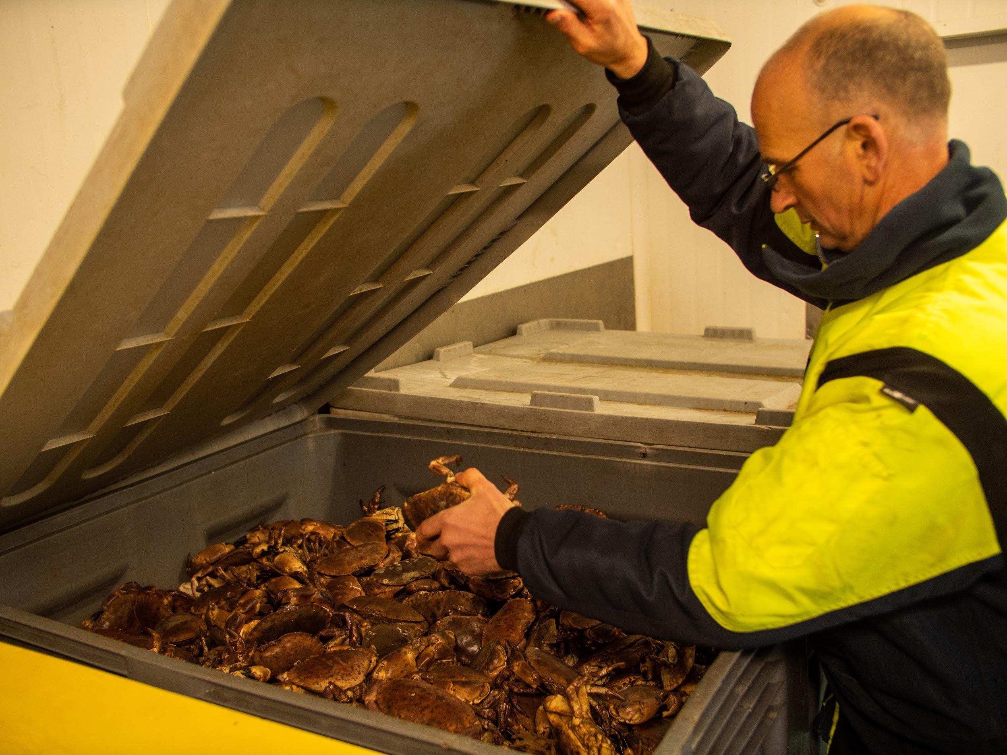
The crabs and lobsters are stored alive at the factory.
Photo: Rob Coleman
Photo: Rob Coleman
Lobsters are stored in tanks of circulating, filtered seawater.
Crabs are stored in large boxes.

Slide 17
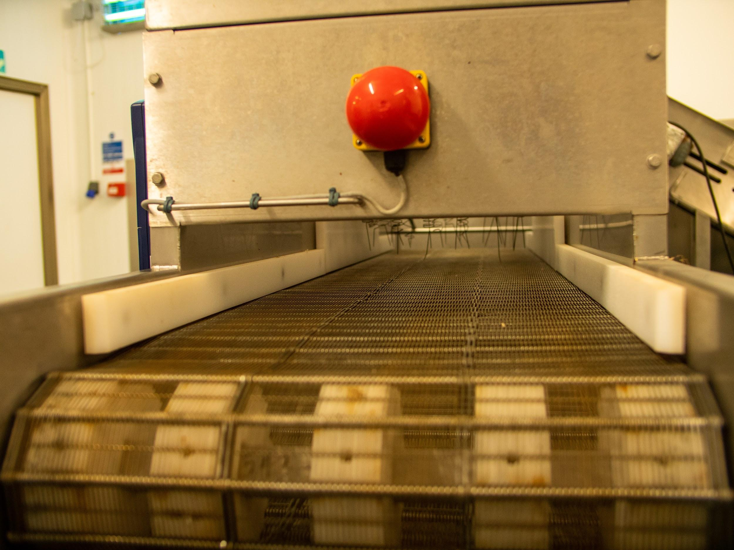
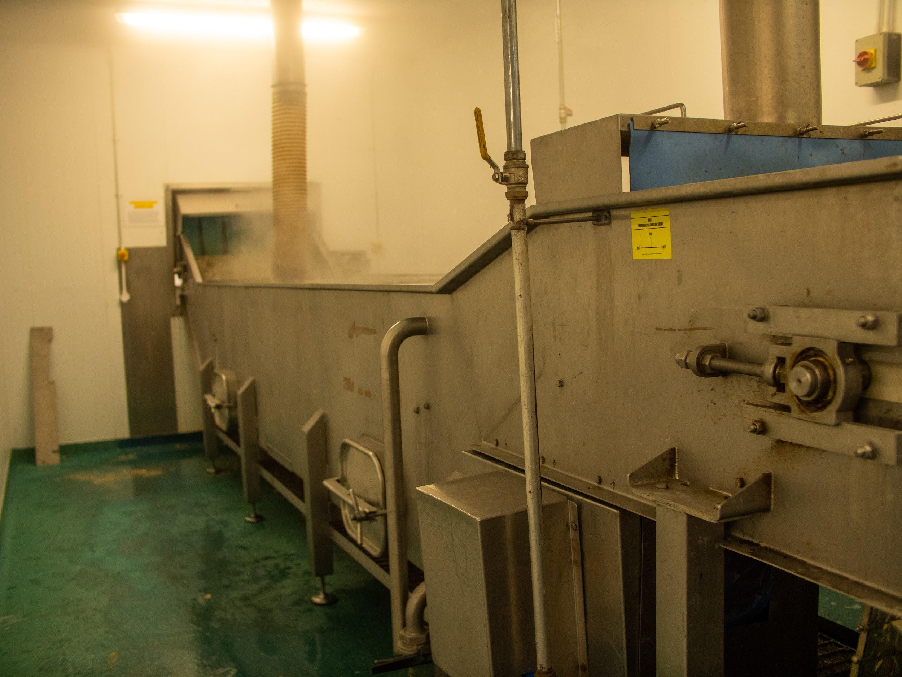
The crabs and lobsters are stunned and then cooked.
Photo: Rob Coleman
Photo: Rob Coleman
This all happens on a conveyor belt through the stunner and into the boiling water.

Slide 18
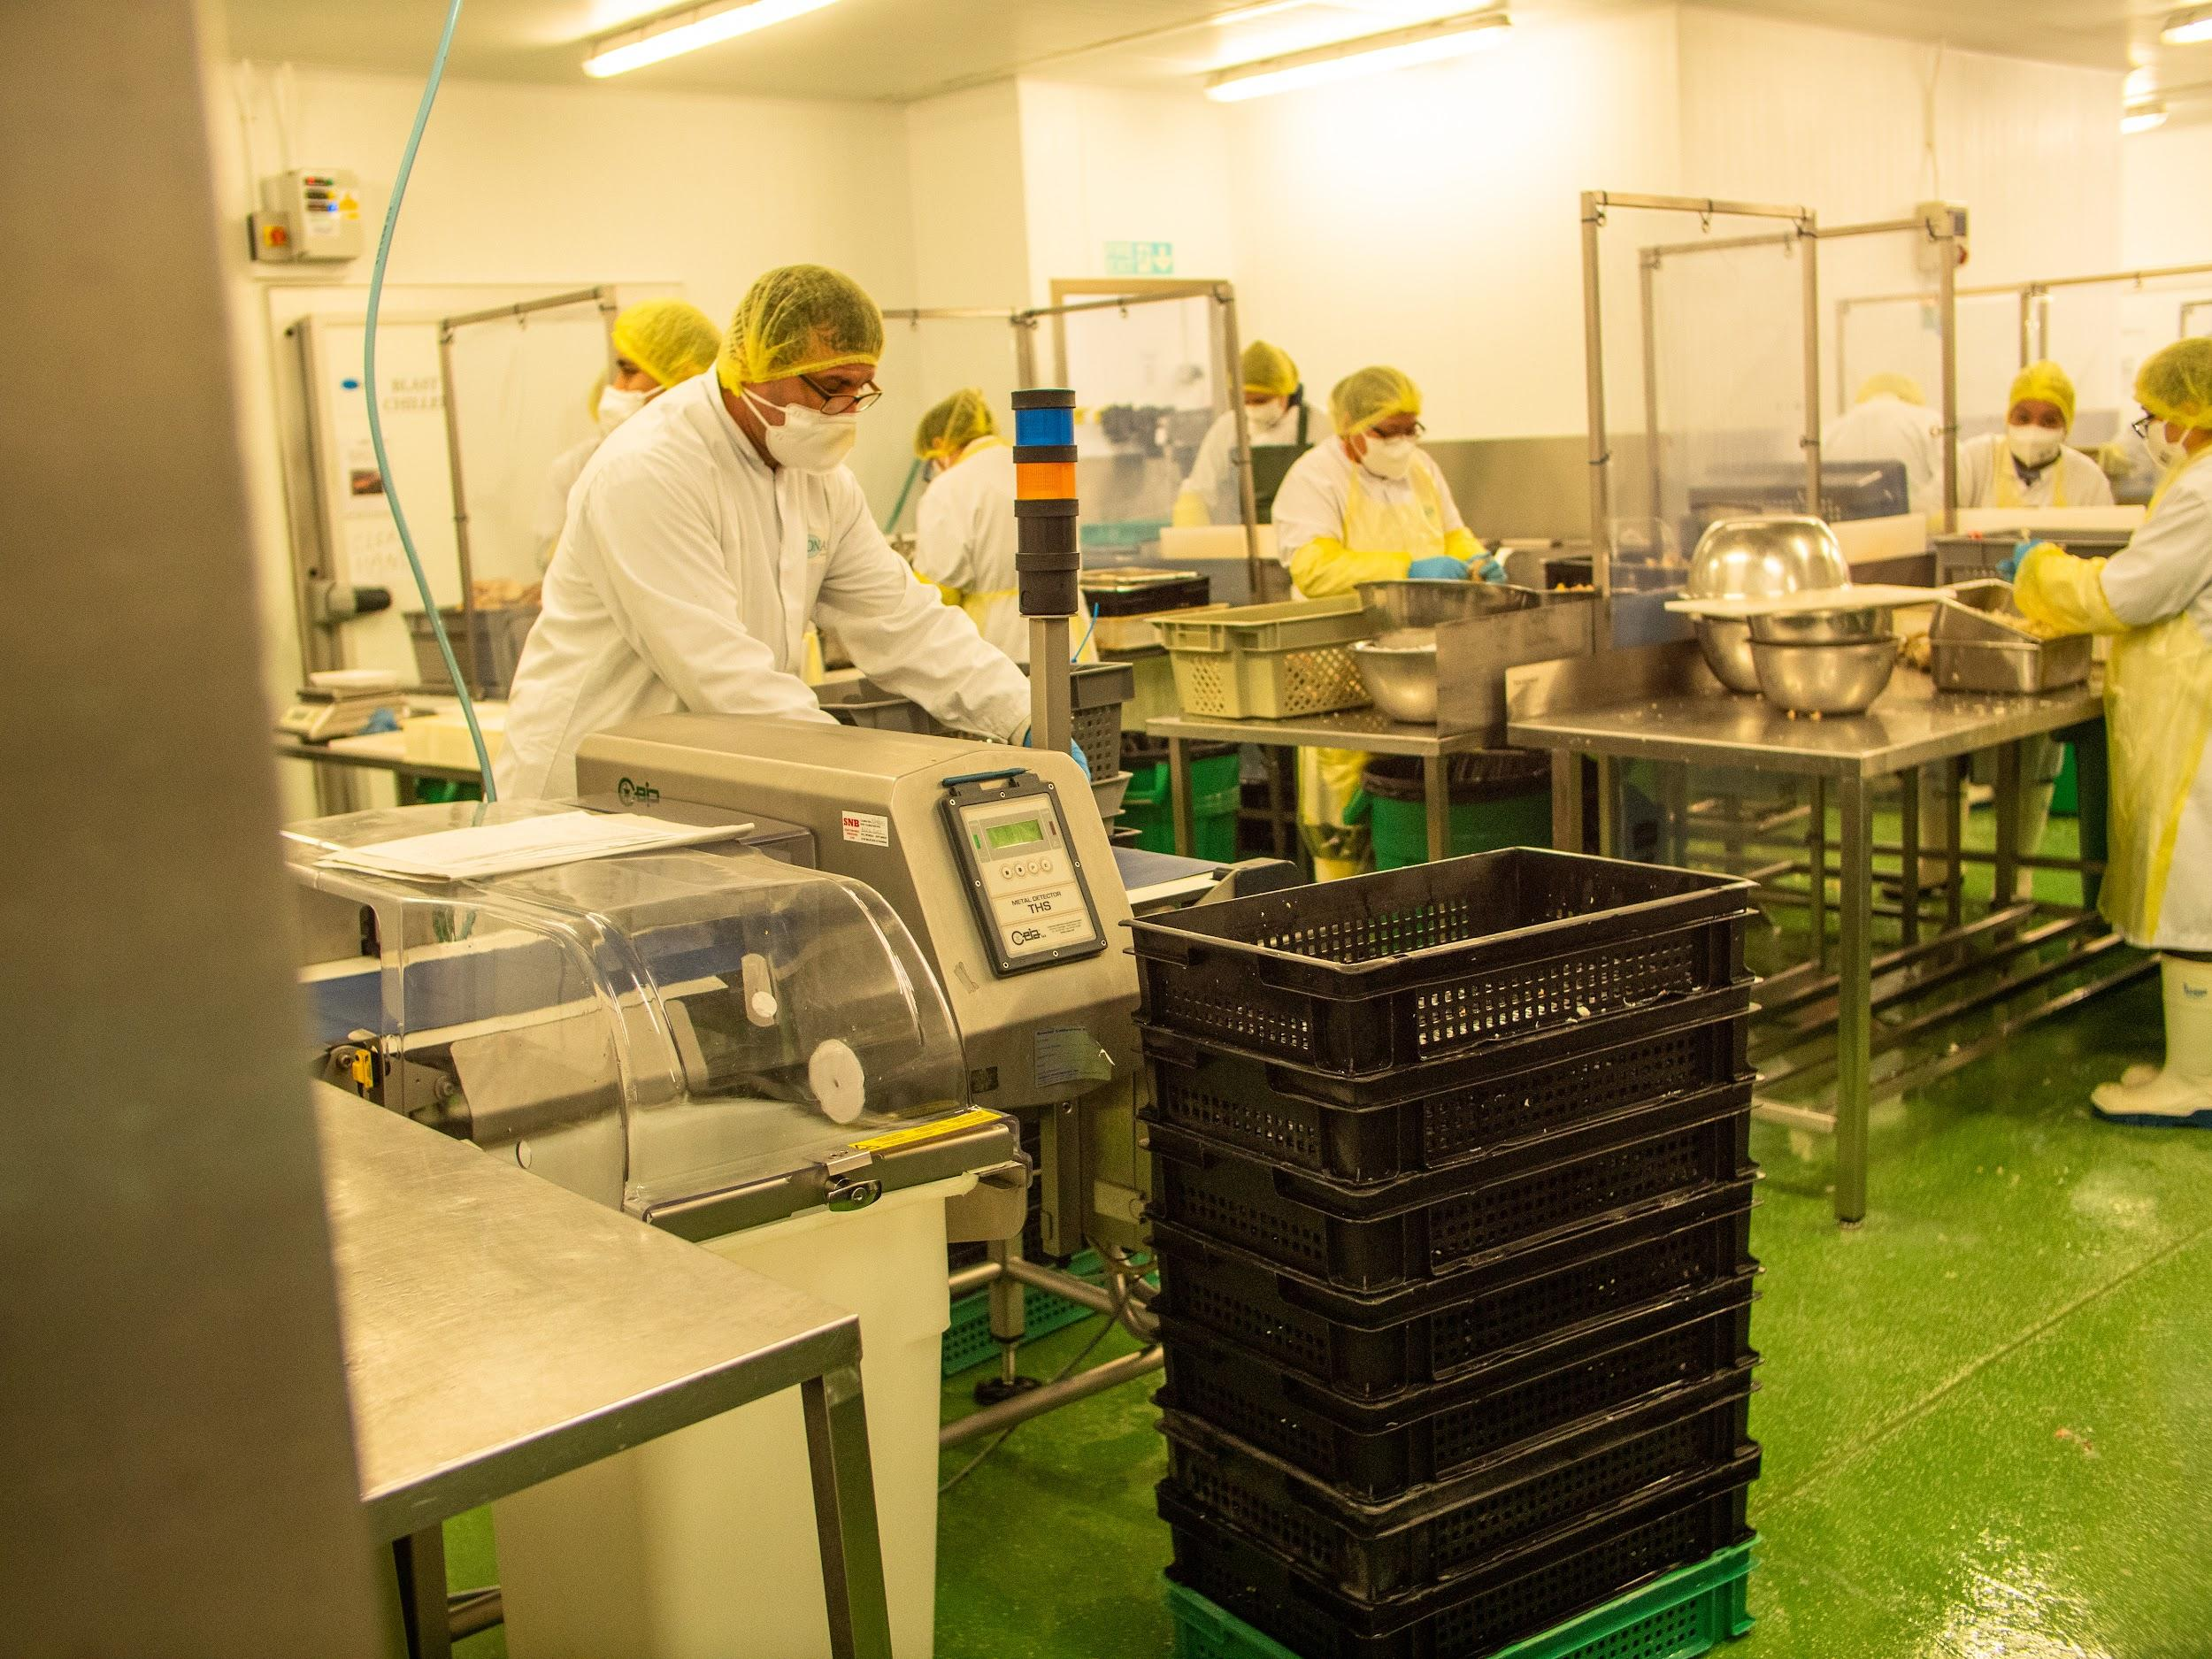
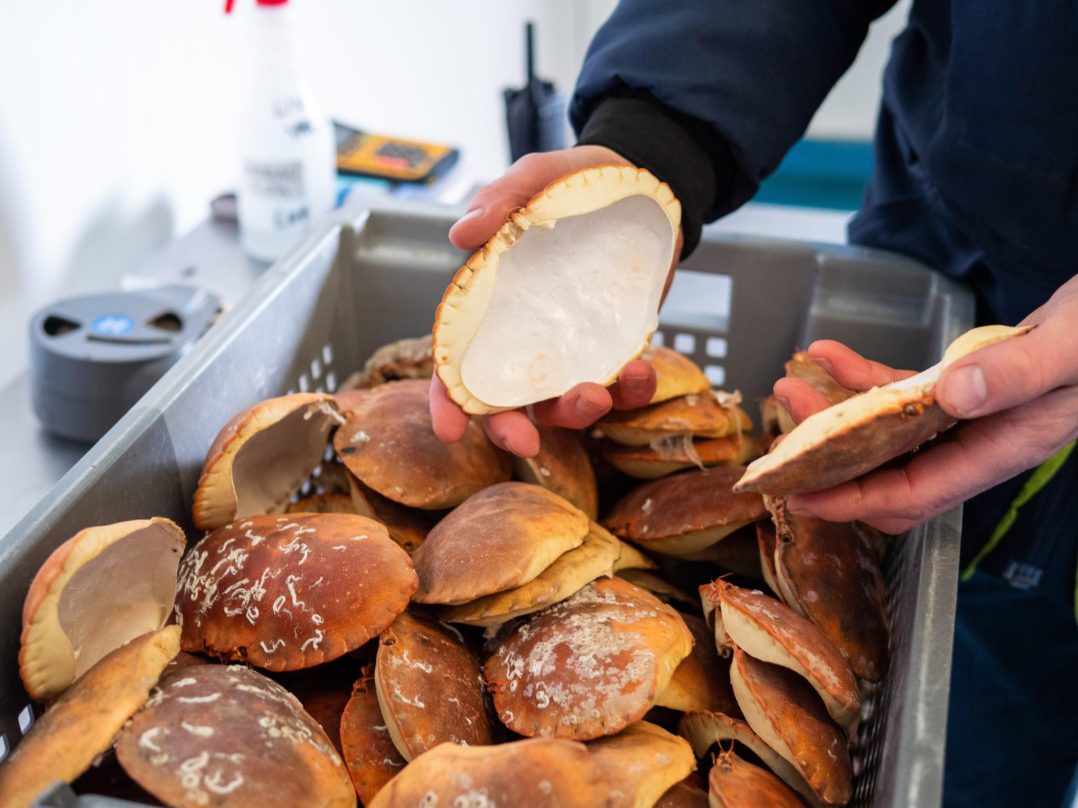
They are then chilled and stored before being ‘dressed.’
Photo: Rob Coleman
Photo: Rob Coleman
Dressing a crab means the meat is removed from the shell.
The meat is put back in shells that have been cleaned and sterilised in boiling water.

Slide 19
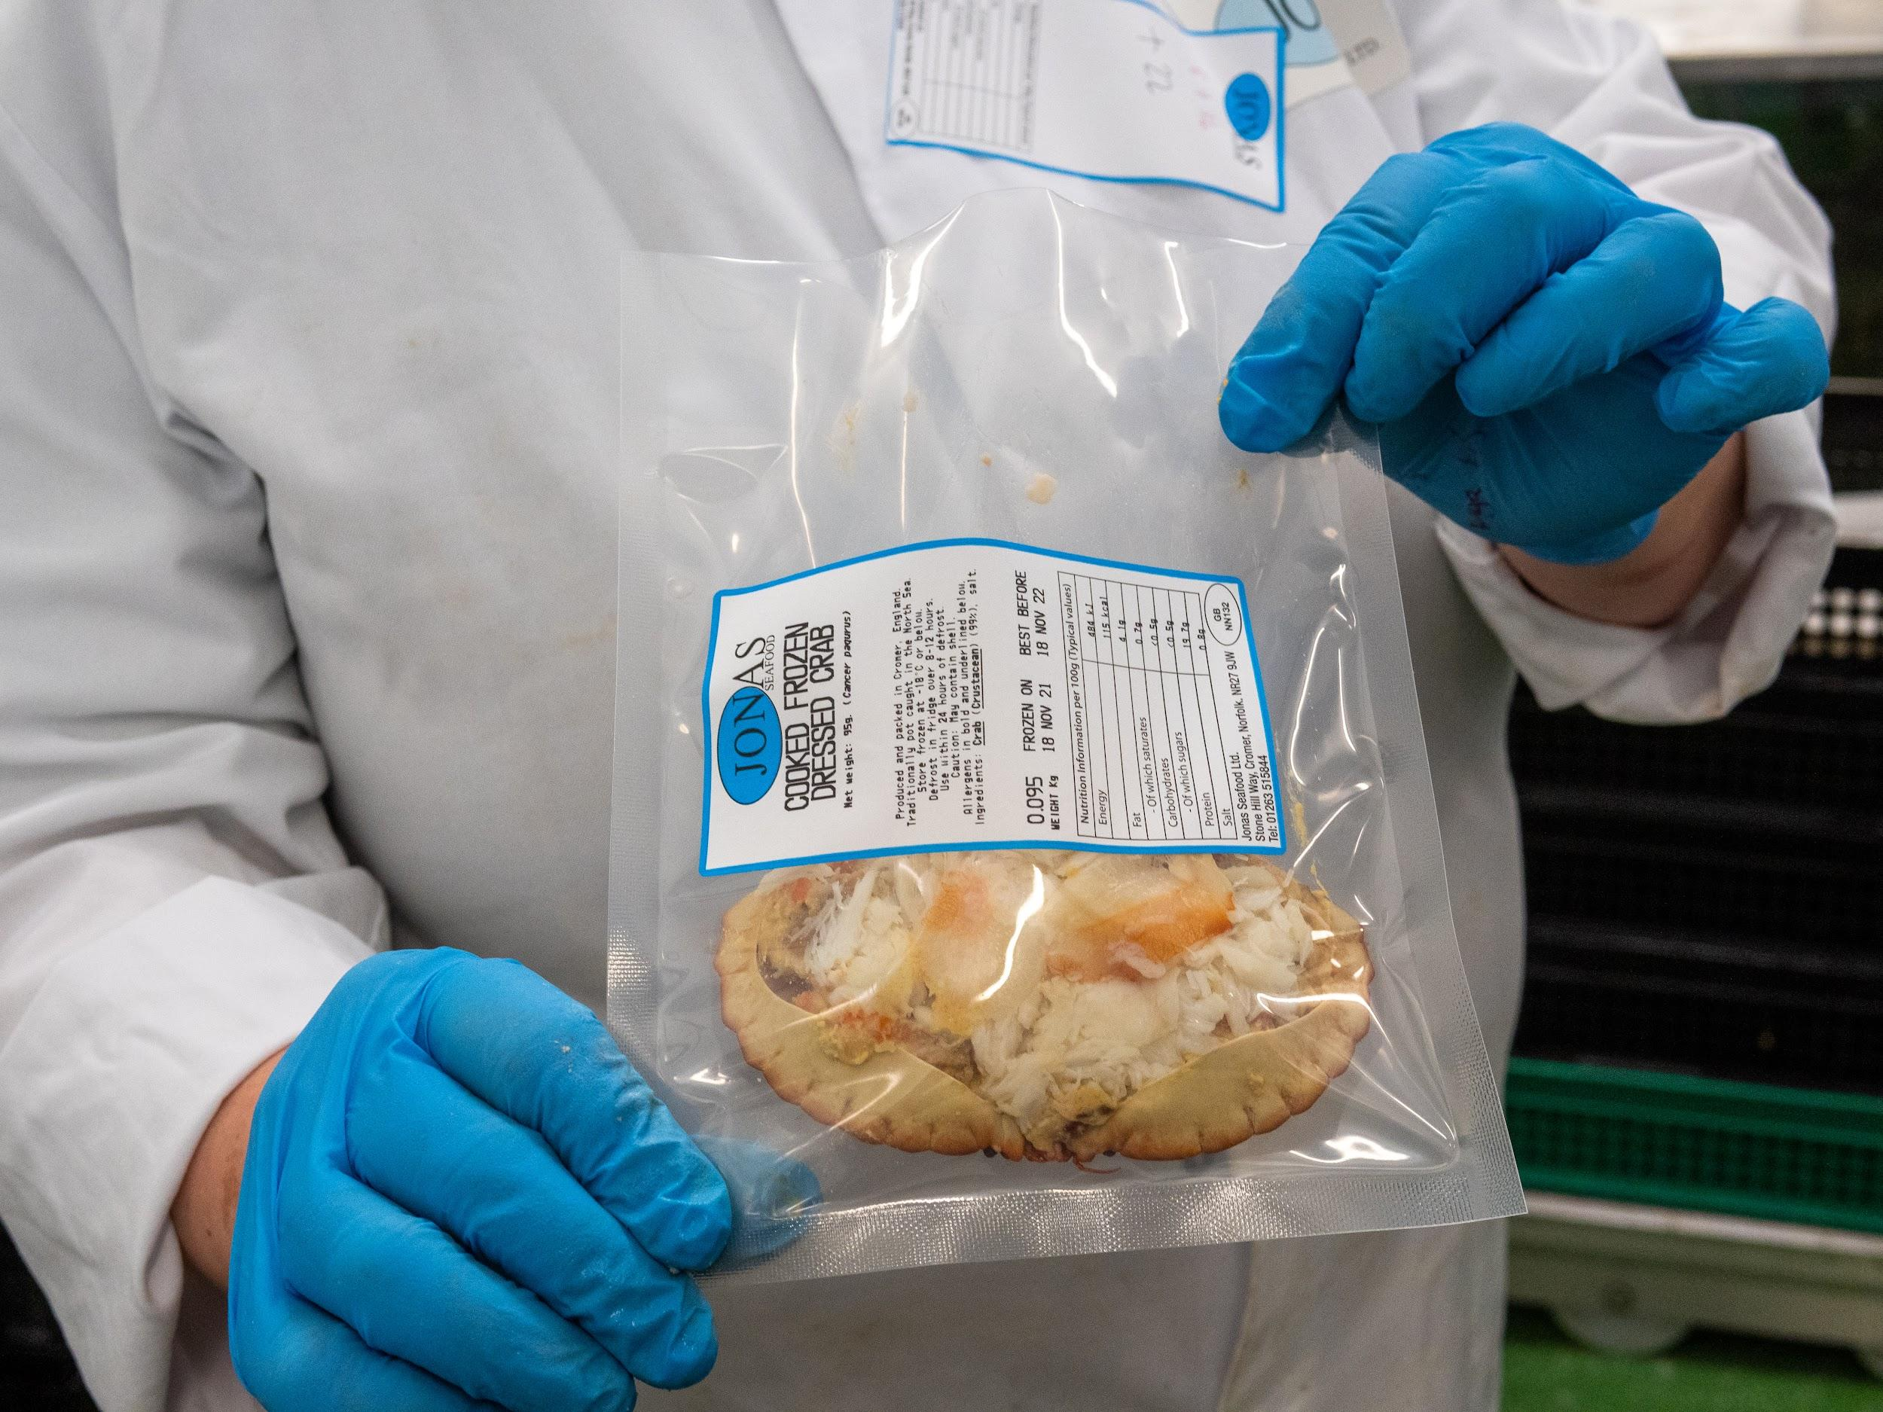
Dressing a crab!
See a crab being dressed at Davies Fish Shop in Cromer:
Photo: Rob Coleman
Notes:
Video link: https://youtu.be/PakFoEbdYMo

Slide 20
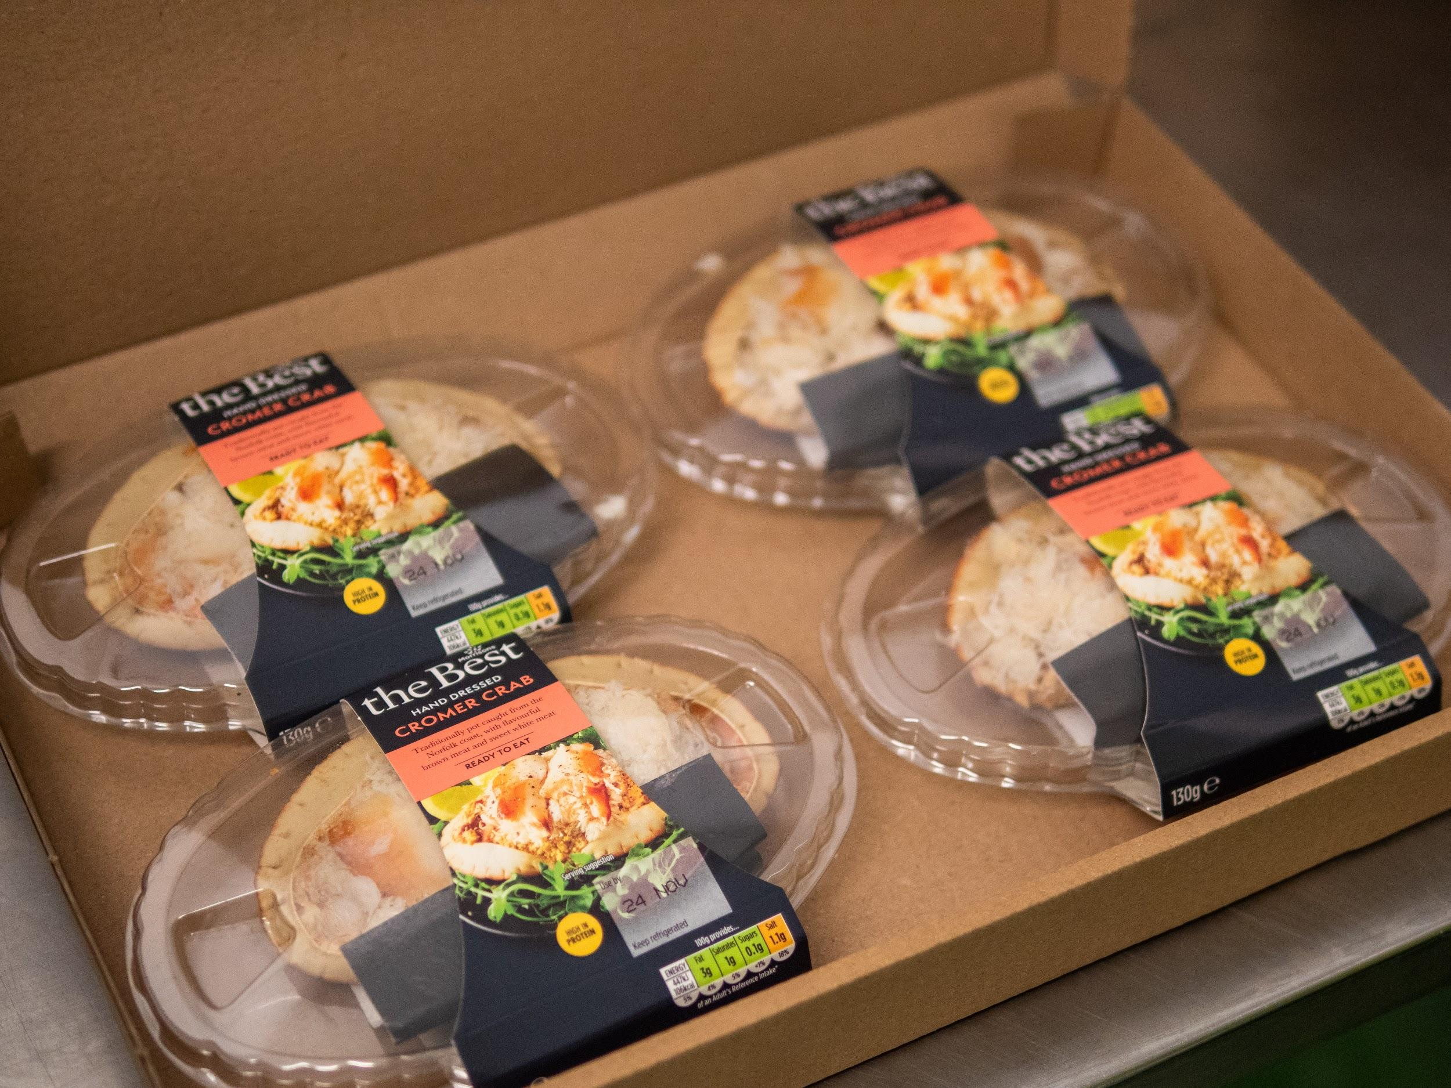
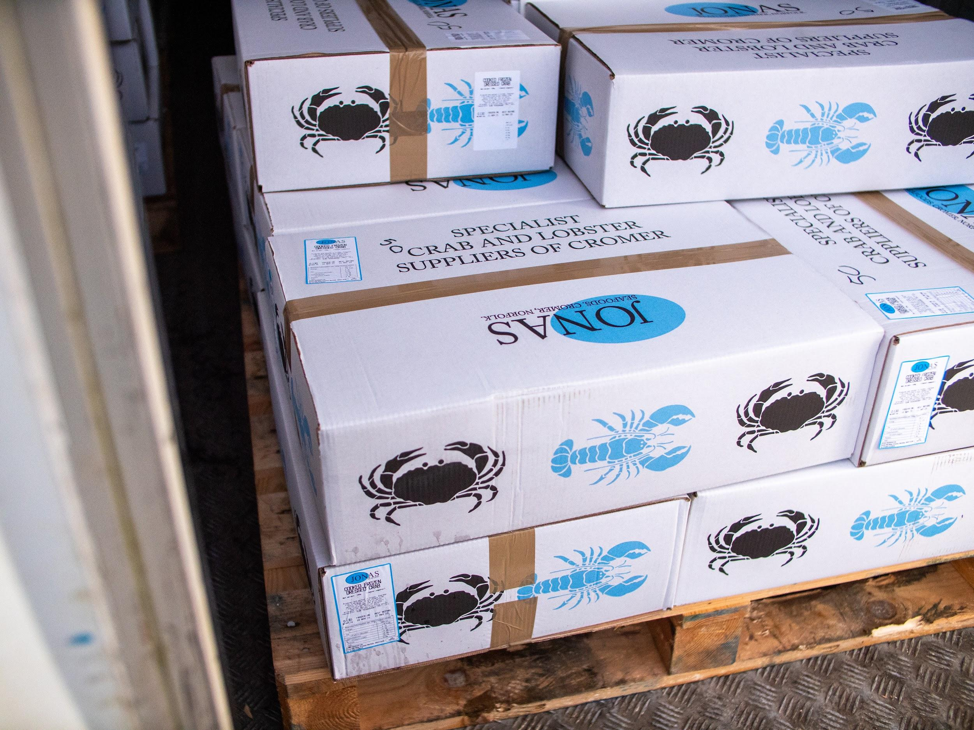
The dressed crabs are then labelled and boxed up ready to transport to the wholesaler, supermarket or restaurant.
Photo: Rob Coleman
Photo: Rob Coleman

Slide 21
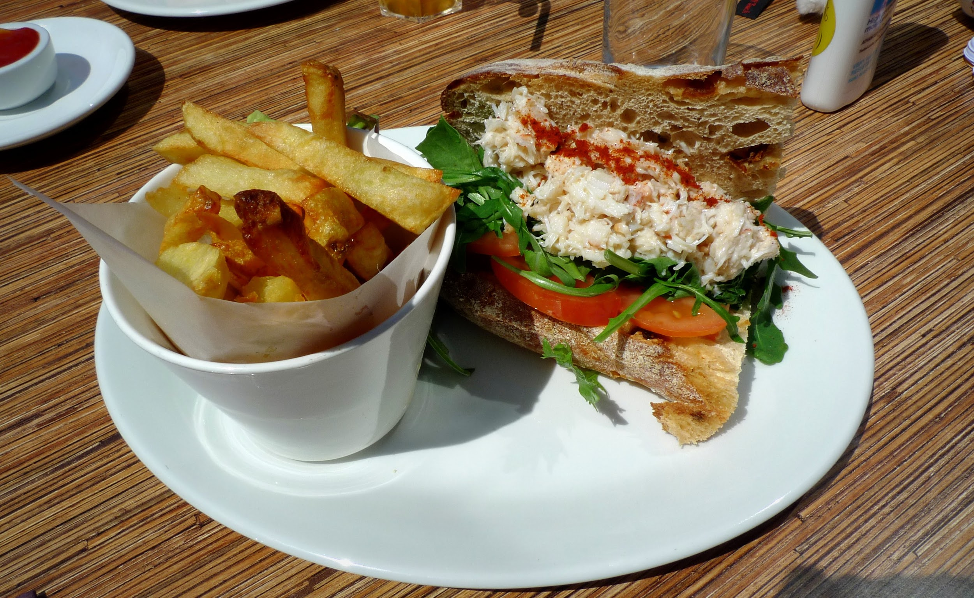
The crabs are ready to be bought and eaten!
Photo: Rob Coleman

Slide 22
Sea to Sandwich
Can you put the pictures in the correct order to show how a crab becomes a crab sandwich?
A crab sandwich ready to eat
The fisher collects the pots in
The crabs are cooked
Crabs are taken to the factory
Packed ready for sale
A crab is living in the sea
The crabs are dressed
Pots laid in shanks in the sea
Transported to supermarket or restaurant
The crabs are taken out of the pots and measured

Slide 23
Sea to Sandwich
Can you put the pictures in the correct order to show how a crab becomes a crab sandwich?

Slide 24
Sea to Sandwich
Did you get them in the right order?
1.
2.
3.
A crab is living in the sea
The pots are laid in shanks in the sea
The fisher collects the pots in
4.
5.
6.
The crabs are taken out of the pots and measured
The crabs are taken to the factory
The crabs are cooked

Slide 25
Sea to Sandwich
Did you get them in the right order?
7.
8.
The crabs are dressed
Packed ready for sale
9.
10.
Transported to the supermarket or restaurant
A crab sandwich ready to eat!

Slide 26
The North Norfolk crab fishery
This video shows crabs being dressed and served at Rocky Bottoms café:
Notes:
Video one: https://youtu.be/C6z8zArQ9VY?t=158
Video two: https://youtu.be/D3T2T0jM_MY

Slide 27
Sustainable fishing in the Cromer Shoal Chalk Beds Marine Conservation Zone

Slide 28
Fishing in the MCZ
Crab fishing is an important part of the economy in North Norfolk; it employs many people and brings money to the area.
People also feel that fishing for Cromer crabs is an important part of the local heritage. It has been happening here for centuries and crab pots have been used to catch crabs and lobsters since the 1860s.

Slide 29
What does the Marine Conservation Zone do?
The role of the MCZ is to:
Maintain it in favourable condition
Provide social, environmental and economic benefits

Slide 30
It is a ‘sustainable use site.’ This means that fishing and other activities can continue in a Marine Conservation Zone if they are sustainable.
What does sustainable mean?

Slide 31
Sustainable = Able to carry on without harming the environment
If humans damage or harm the place and its wildlife, they won’t be able to keep fishing, boating and diving here as there wouldn’t be crabs and lobsters to catch or wildlife to see.
There are laws and guidance that protect the area, and these may change over time.

Slide 32
Potting
Fishing for crabs using pots (potting) has been happening along the north Norfolk coast for over 150 years. To be sustainable it must be carried out in a way that means it can continue for many centuries to come.
In general, potting is considered 'low impact' as it is a selective form of fishing with very little bycatch . This is because other creatures are not caught, or if they are, they are released.

Slide 33
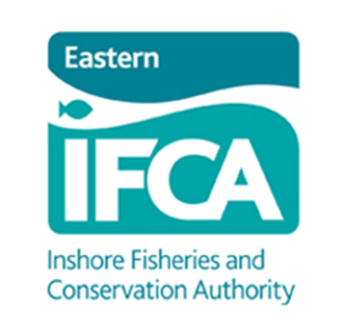
How is the Cromer Shoal Chalk Beds MCZ protected?
Eastern Inshore Fisheries and Conservation Authority (IFCA) manages the inshore marine environment and fisheries (to 6 miles off the coast) for Norfolk.
Their work includes:
Monitoring fishing and its impact on the environment.
Regulating fishing and enforcing fishing byelaws.
Working with many stakeholders with the aim of balancing conservation and fishery objectives.
Eastern IFCA has an Adaptive Risk Management approach to their management of the Cromer Shoal Chalk Beds Marine Conservation Zone. This means they will bring in new laws or amend existing laws if evidence suggests there is a need.
These slides state the regulations and laws in place in 2023.

Slide 34
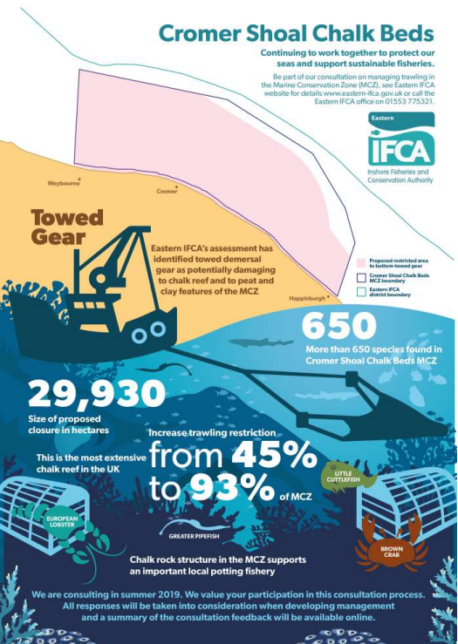
Damage from trawling and dredging in the MCZ
Trawling is a type of fishing where nets are dragged along the seabed, which can cause damage to the habitat.
Over 50 years ago, local fishermen recognised this and urged the fishing managers to introduce a trawler-free zone in the sea between Blakeney church and Mundesley church out 3 nautical miles.
This rule only covered 45% of the MCZ area so in 2021, the trawling byelaw was altered to increase this to 93% of the MCZ.

Slide 35
Overfishing
Overfishing is catching fish (or crabs!) faster than they can reproduce causing numbers to decline.
This is not sustainable. There are fishing regulations and laws to help prevent this.

Slide 36
Limits on sizes of crabs and lobsters taken
Fishers in this area are not allowed to land crabs that are smaller than 115mm across their shell. This is known as the Minimum Landing Size (MLS). Any that are smaller get thrown back.
This means the crabs have at least one chance to breed before they are caught.
A pot often catches up to 30-40 crabs, sometime more, but the fisher may only keep 3 or 4 of them!
In other parts of the sea, the MLS is bigger. It is 140mm for much of UK waters.

Slide 37
Berried and soft crabs
Any female crabs and lobsters that have eggs on them are described as being ‘berried’ and must be thrown back.
It is the same for soft-shelled crabs that have recently moulted. However, these are rarely caught because they tend to hide up until their shells harden.

Slide 38
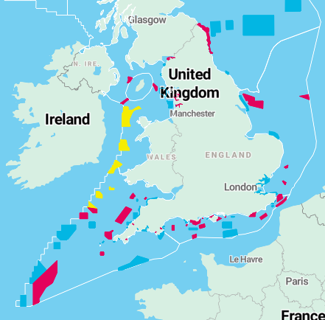
Understanding crab numbers
Fish and crabs can migrate large distances - there are no borders in the ocean!
This makes understanding crab populations tricky. International cooperation is needed to help understand populations more fully.
The crabs do not stay inside the MCZ!

Slide 39
Maximum Sustainable Yield
Currently (in 2023) there are no limits on:
the number of licences issued
the catch effort (number of pots or days of catching allowed)
quotas (the number of crabs and lobsters fishers are allowed to land).
In recent years, the number of fishers has decreased but the catch effort has increased.

Slide 40
Environmental impact of potting in the MCZ
In 2019 a study found that potting fisheries were linked to physical damage to chalk outcrops.
Chalk is a soft rock and the pots and ropes can rub it, wearing it away. The pots and anchors can also break the rock when they strike it. Though this damage is considered small, collectively it affects the conservation objectives of the MCZ. There have been up to 8000 pots counted on the chalk reef on one day.
In 2020, Natural England stated that management of lost and stored pots is required as they are thought to pose the most risk to the chalk beds.

Slide 41
Lost pots
Occasionally, pots may get separated from their shank or lose their markers during storms, by getting snagged on rocks or rope being cut by a boat propellor. Lost pots cause problems by:
Continuing to catch crabs and lobsters when they are lost. This is known as ghost fishing.
Scraping and wearing away the chalk seabed as the pots and ropes move in the currents. This can damage the life that is attached to the rocks.
Costing the fishers time and money when they replace lost pots.

Slide 42
Code of practice
A code of practice was drawn up in 2021 to help minimise the damage to chalk from pots. This is a voluntary agreement.

Slide 43
Cromer Shoal Chalk Beds Byelaw 2023
A new byelaw means that fishers must:
Have permits to use crab pots inside the MCZ.
Mark all their pots so they can be identified.
Retrieve pots they lose.
It is a flexible byelaw. This means new measures may be introduced if research and monitoring suggests they are needed to keep the chalk reef in good condition.

Slide 44
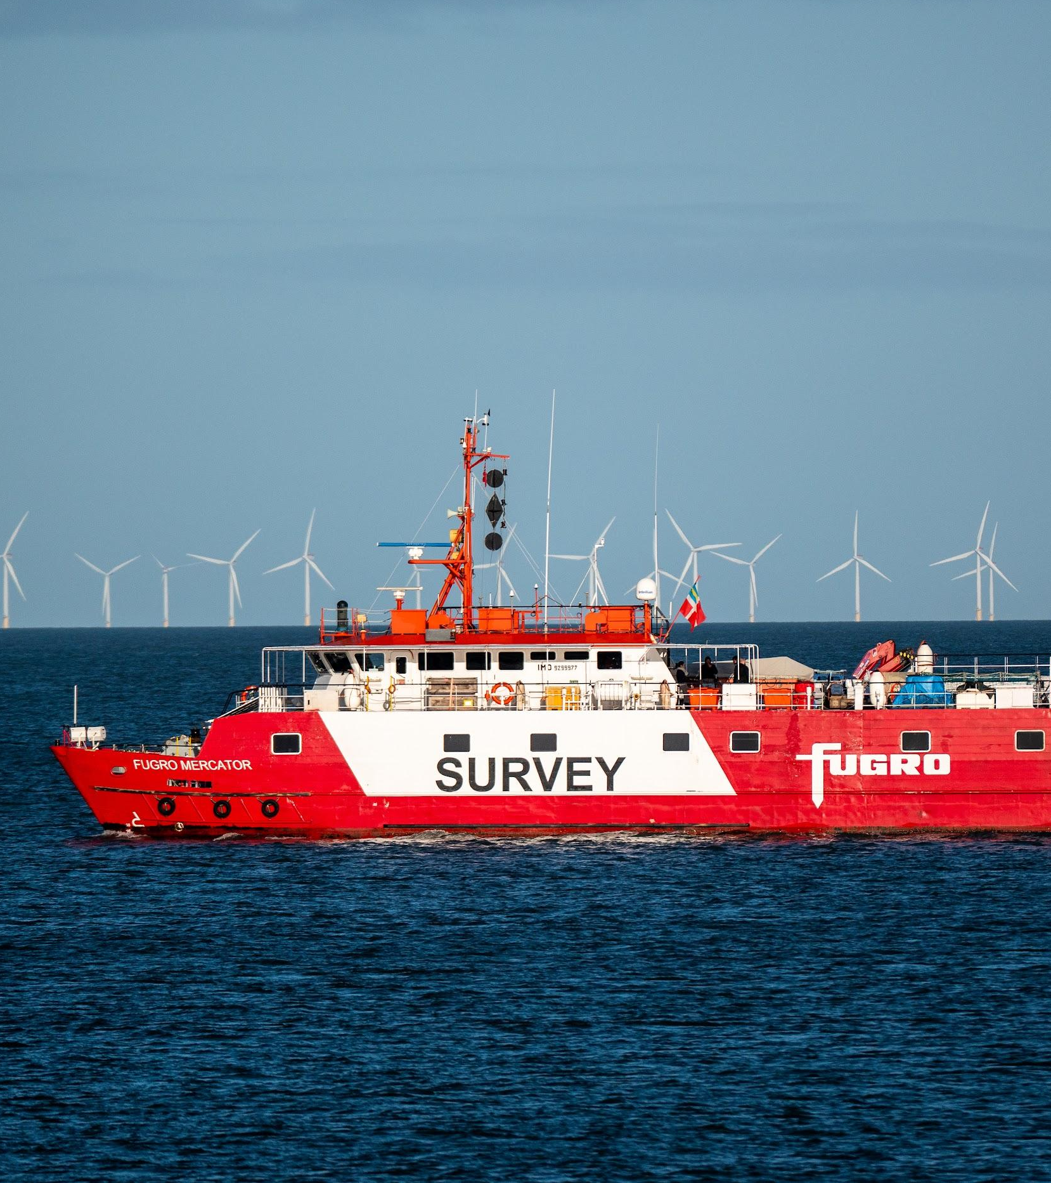
Research and monitoring
Research and monitoring is being carried out to better understand the issues:
Mapping the seabed and fishing activity to better understand the area and its use.
Remotely operated vehicles are being used to film pots on the chalk to help assess the extent of the damage.
No-fishing areas are being set up to compare the impact with areas that are fished.
The findings will help make decisions on how to manage the fishing in the MCZ.

Slide 45
The Good Fish Guide
The Marine Conservation Society's Good Fish Guide is updated each year.
It gives an idea of how sustainable the fishing is for different species in different parts of the sea.
The Cromer fishery is part of the Southern North Sea: Eastern IFCA district.
Find out more on the website: mcsuk.org/goodfishguide/

Slide 46
Crab recipes
Have a go at making some savoury recipes using Cromer Crab!
Recipes include:
Crab sandwich
Crab cakes (like fishcakes!)
Crab and sweetcorn chowder

Slide 47
Crab sandwich
Ingredients
Bread
Butter
Crab meat
Mayonnaise
Salt
Pepper
Lemon juice
Lettuce
Method
Butter the bread.
Mix the crab meat with some mayonnaise, a squeeze of lemon juice and season with salt and pepper.
Spread the mixture onto the bread.
Add some lettuce and top with another slice of bread.
Serve!

Slide 48
Crab cakes Makes 10 x 6cm crab cakes
Ingredients
3 spring onions
½ a bunch of fresh flat-leaf parsley
1 large free-range egg*
750g cooked crabmeat
300g potatoes
1 tsp ground pepper
1 tsp cayenne pepper
Pinch of salt
Plain flour*, for dusting
Olive oil
Method
Peel, boil and mash the potatoes and leave to cool.
Trim and finely chop the spring onions.
Pick and finely chop the parsley.
Beat the egg.
Combine the crab meat, potatoes, spring onion, parsley, pepper, cayenne and egg in a bowl with a little salt.
Shape into 6cm cakes.
Dust with flour.
Shallow-fry in oil over a medium heat for about 5 minutes each side or until golden brown.
*Recipe can be made gluten free by substituting gluten-free flour *The egg can be substituted by egg-free mayonnaise

Slide 49
Crab chowder
Ingredients
1 tbsp olive oil
1 small/medium onion, chopped
2 celery ribs, chopped
2 medium carrots, peeled + chopped
2 leeks, sliced into half-moons
2 large potatoes, peeled and diced into small cubes
1 bay leaf
1 tsp paprika
1 tsp ground pepper
1½ tsp salt
1 litre vegetable stock
2 large tins sweet corn
500g fresh crab meat
100ml milk
100ml single cream
¼ cup finely chopped fresh parsley
Method
In a large hob to oven dish, gently fry onions, celery, carrots, and leeks until soft.
Add potatoes, bay leaf, paprika, pepper, salt and vegetable stock. Cook for about 8-10 minutes until the potatoes are halfway done.
Puree 2 cups of the vegetable mixture in a food processor or blender until smooth. Stir the mixture back into the pot.
Add sweetcorn, crab meat, milk and cream. Cook uncovered for about 8 minutes.
Stir in parsley and serve!

