Slide 1
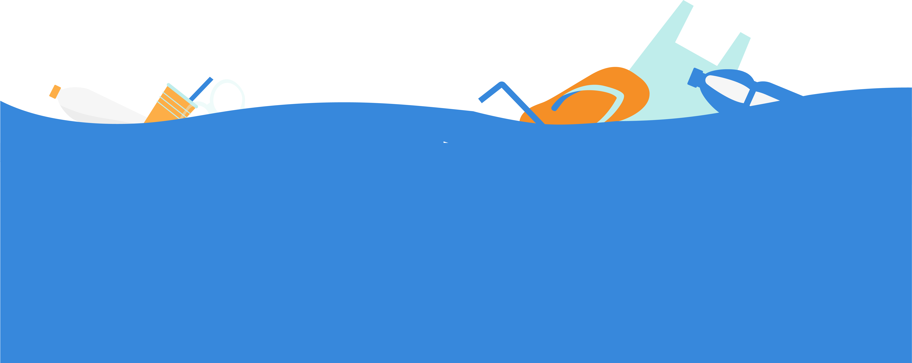
Source to Sea Litter Quest
Why your help matters
We know that litter from towns, parks and even the remotest country lanes often make their way into our ocean. Every item dropped in the street has the potential to pollute our seas by travelling down rivers and streams, being washed down drains or by being blown onto our beaches.
As part of our litter cleans, we collect data to track rubbish back to its source - our survey results are then used to find solutions to ocean pollution, and to campaign for measures to bring positive change.
We’ve used data collected in previous years to make the case for carrier bag charges across the UK, and are campaigning for Deposit Return Schemes for all types of drinks containers.
Great British Beach Clean
Take part in our Source to Sea Litter Quest as part of the Great British Beach Clean. Each September, there’s something for everyone, everywhere. No matter where you live across the UK, you can help keep our seas clean.

Slide 2
Source to Sea Litter Quest
The Litter Quest items
This year we’ve chosen 15 items to keep an eye out for. By taking part in inland cleans, we can work together to keep our seas safe and healthy – for us all to enjoy.
What we’re looking for – Food & drink containers
Plastic drink bottles ­- 9 billion drink containers are wasted each year by not being recycled, with many ending up in the ocean.
Loose plastic cases/lids - In the UK there is currently no legislation for lids to be tethered to bottles. We believe this small change could help reduce litter.
Plastic drink cups – An estimated 500 billion plastic cups are used each year around the world. They make their way from land sources into our ocean and harm marine life.
Glass bottles - Glass can be easily recycled back into glass. Bottles can easily get broken and become pieces which can harm us and wildlife.
Metal drink can - Scotland will introduce a deposit return scheme in 2023 on glass, metal and plastic (PET) bottles – but we want all governments across the UK to take urgent action and bring in their own schemes.

Slide 3
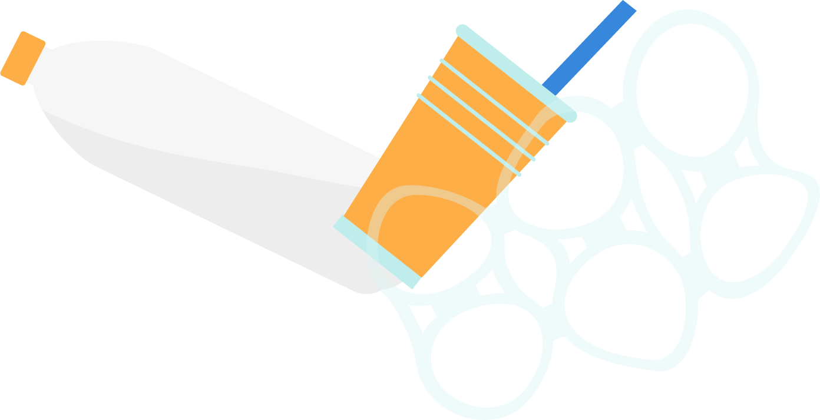
Source to Sea Litter Quest
Polystyrene fast-food container
Polystyrene cups
Paper cups - It is estimated that the UK uses over 7 million disposable coffee cups every day. Lots of paper cups have an inner plastic lining and can be difficult to recycle.
Disposable BBQ’s - They have the potential to cause damage to the environment particularly through (wild)fires as well as harm to people. We are interested in how often these are found in local parks and along rivers.
Polystyrene is a type of plastic. These containers break up into small pieces which are easily carried by the wind. Polystyrene can float at the surface and be eaten by marine wildlife.
Polystyrene can be difficult to recycle. Cups and food containers made from expanded polystyrene have been banned in Scotland. We want the rest of the UK to follow suit.
During last year’s Great British Beach Clean we found an average of 30 drinks-related litter items for every 100m of beach, and all these items were also found on 99% of inland cleans.
We want to see Deposit Return Schemes (DRS) introduced across the UK. A DRS works by charging consumers a small deposit on drinks-related items when they buy them. Customers then receive their money back when they return them for recycling, essentially giving these common litter items a value. Scotland will introduce a DRS in 2023, but England, Wales and Northern Ireland have yet to create the legislation.

Slide 4
Source to Sea Litter Quest
What we’re looking for – Plastic bags
Single-use plastic bags – Since carrier bag charges were introduced, there has been over a 50% drop in the amount we find on our surveyed beaches.
Plastic bags for life – Bags for life are made from thicker plastic and are designed to be used multiple times. Despite this, we think some are still being littered, and could find their way into the sea.
Since charges were introduced across the UK, we’ve seen an over 50% drop in single-use plastic carrier bags on our beaches. We want to know if this drop can also be seen inland. Although there’s been a charge on single-use plastic carrier bags for at least 5 years (Wales introduced it in 2011, Northern Ireland 2013, Scotland in 2014, England in 2015), 'bags for life' have been encouraged as a reusable alternative. But we suspect that these may still being used as single use and due to being thicker have an even greater impact on our environment.
What we’re looking for – Wet wipes
Wet wipes – Wet wipes are often found on beaches after being incorrectly flushed down the toilet, where they can sometimes make their way to our ocean through drains/pipes. But they’re also used and found around towns and cities.
In 2021, we found 18 wet wipes per 100m of beach during GBBC. By tracking them back through the sewage system and their journey from our streets and parks, we can put a stop to pollution.
1. Comparing 2015 litter data with 2020

Slide 5
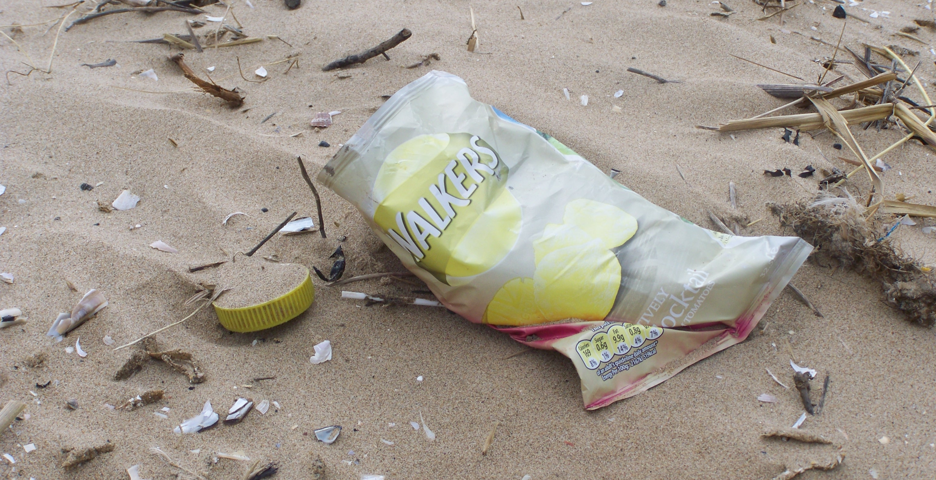
Source to Sea Litter Quest
What we’re looking for – Packets e.g. Sweets, crisps
Packets - Crisp and sweet packets are commonplace in almost all natural environments, spotted across the country in parks, rivers and school grounds. Our volunteers have been reporting them to us in great numbers on beaches for 30 years.
What we’re looking for – Vapes
Vapes – 14 million single use vapes are sold each month in the UK, with many ending up littering the environment. They can be really difficult to recycle as they contain many different materials. We’re interesting in recording the scale of the problem.
What we’re looking for – Balloons
Balloons – Over the past 5 years, we have found an average of 3 balloons per 100m of beach. Let us know how many you find.
Even balloons marketed as ‘biodegradable’ can last up to 4 years in the marine environment. Marine animals can ingest balloons or get tangled in balloon ribbons, restricting their movement and ability to eat. To reduce this threat, we want to get outdoor balloon and sky lantern releases stopped. Over 80 local authorities in the UK have banned balloon or sky releases on their land.

