Slide 1
Wildlife in the MCZ
Ages 4-7

Slide 2
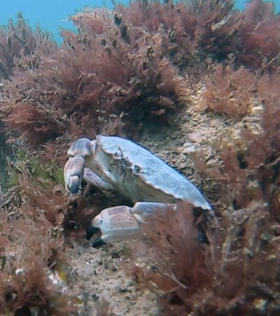
Wildlife in the MCZ
Much of the wildlife in the Marine Conservation Zone is hidden beneath the surface but it is pretty amazing!
Watch the video on the next slide to see some of the amazing creatures that live there. Many can be seen in the rockpools on Sheringham and West Runton beaches on a good low tide.
Photo: christaylorphoto.co.uk

Slide 3
Wildlife in the MCZ
Notes:
Video link: https://www.youtube.com/watch?v=16tExrrMktA

Slide 4
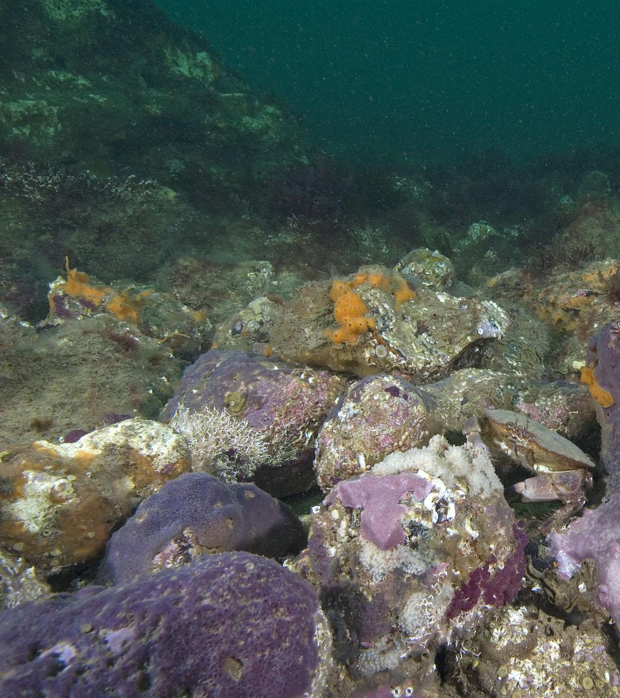
Photo: Paul Naylor
Parpal Dumplin
In 2011 some Seasearch divers noticed a purple sponge and with the help of scientists they realised it was new to science! It is the only place in the world where it is known to live.
In 2021 a competition was organised that a local schoolgirl won. She named it Parpal Dumplin because it’s purple and looks a bit like a dumpling!

Slide 5
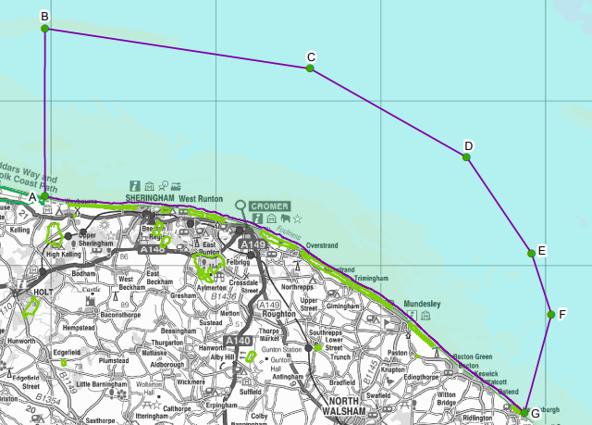
Threats to wildlife in the MCZ
Despite being hidden from view, the wildlife faces some threats.
The Marine Conservation Zone designation means that work is happening to protect the wildlife from these threats.
Threats include:
Litter
Wind farm development
Fishing

Slide 6
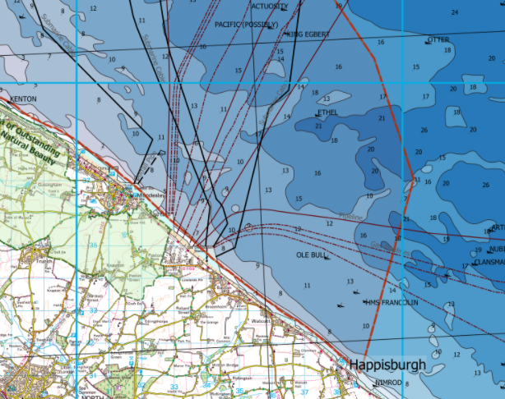
Oil, gas and windfarm development
The MCZ designation means special permission needs to be granted for development within the area.

Slide 7
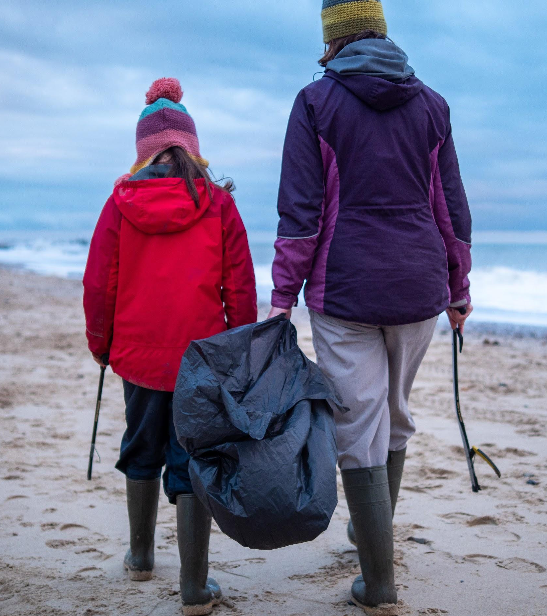
Beach cleans
Litter is sometimes dropped by visitors or fishing gear can get lost. This can cause a problems for wildlife, particularly with plastics.
People volunteer at beach cleans to collect rubbish to keep it out of the sea.
Photo: Rob Coleman

Slide 8
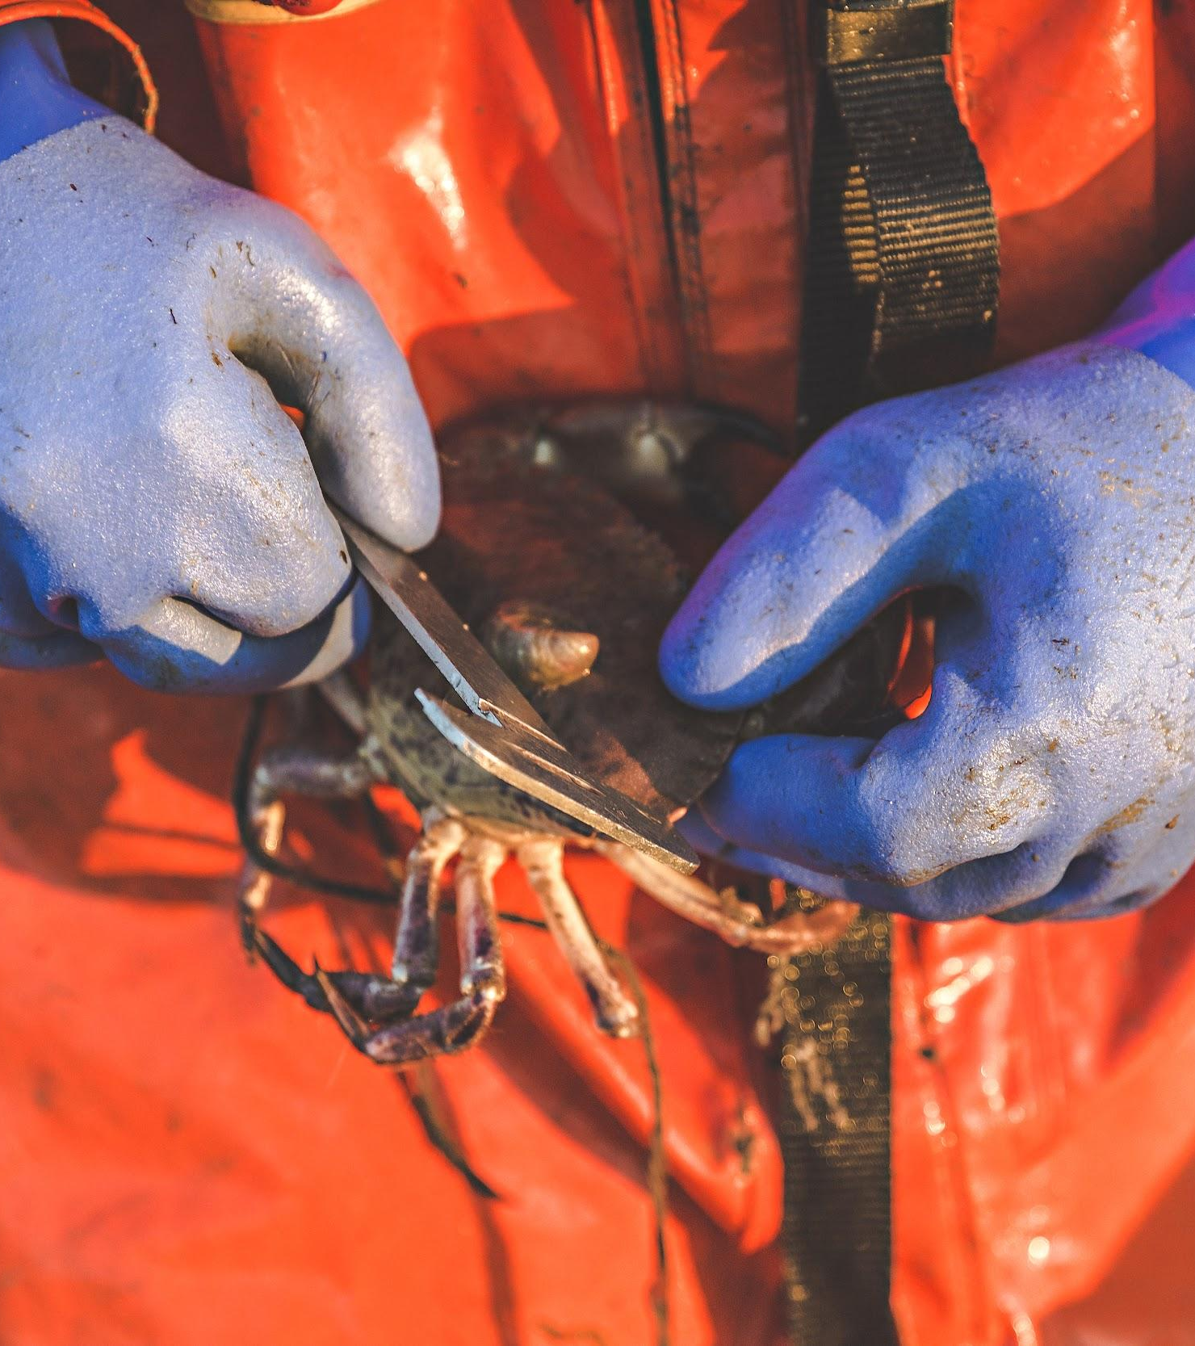
Fishing
The fishers need to be careful that they don’t harm the MCZ.
They must not keep crabs that are too small.
Crab numbers are monitored to make sure fishers aren’t catching too many.
There is guidance to lower the impact of the pots and ropes on the chalk and wildlife.
Photo: christaylorphoto.co.uk

Slide 9
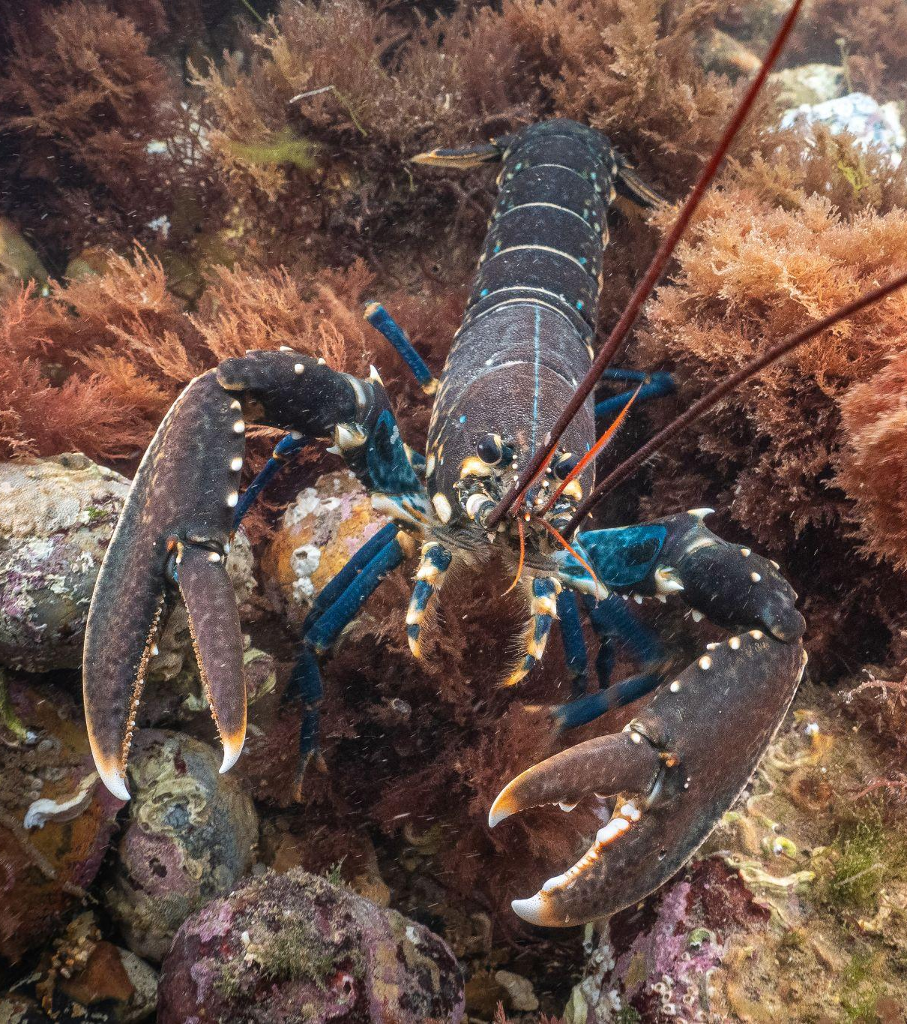
Amazing wildlife
There are lots of amazing creatures living in the Cromer Shoal Chalk Beds Marine Conservation Zone.
Threats to the wildlife that lives there are being monitored and new laws may be brought in to help the wildlife.
Photo: christaylorphoto.co.uk

Slide 10
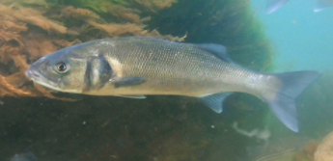
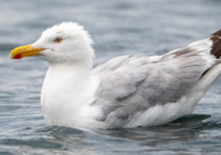
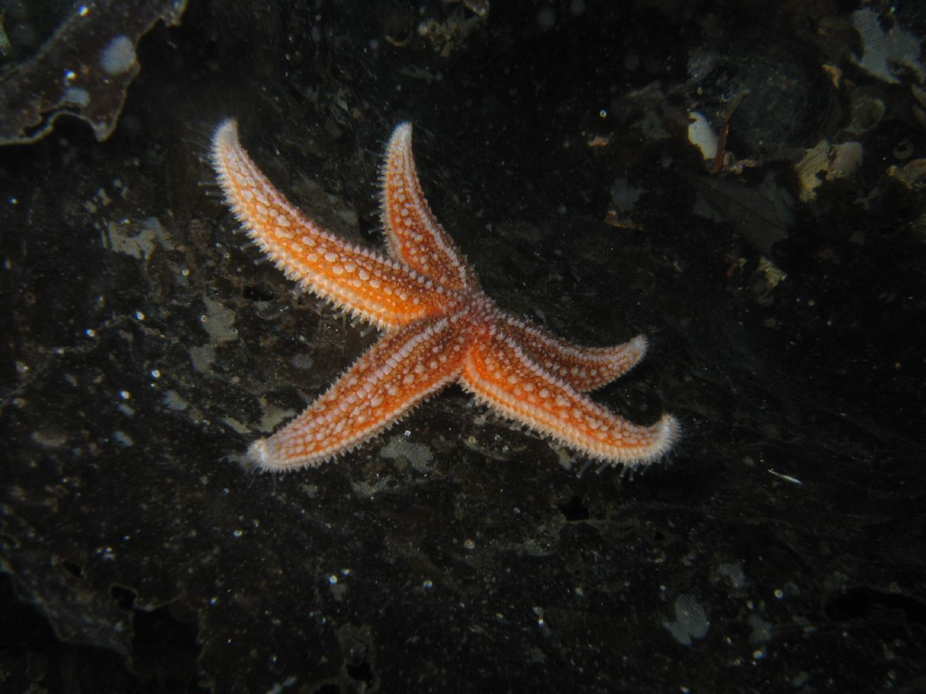
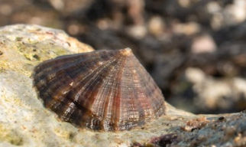
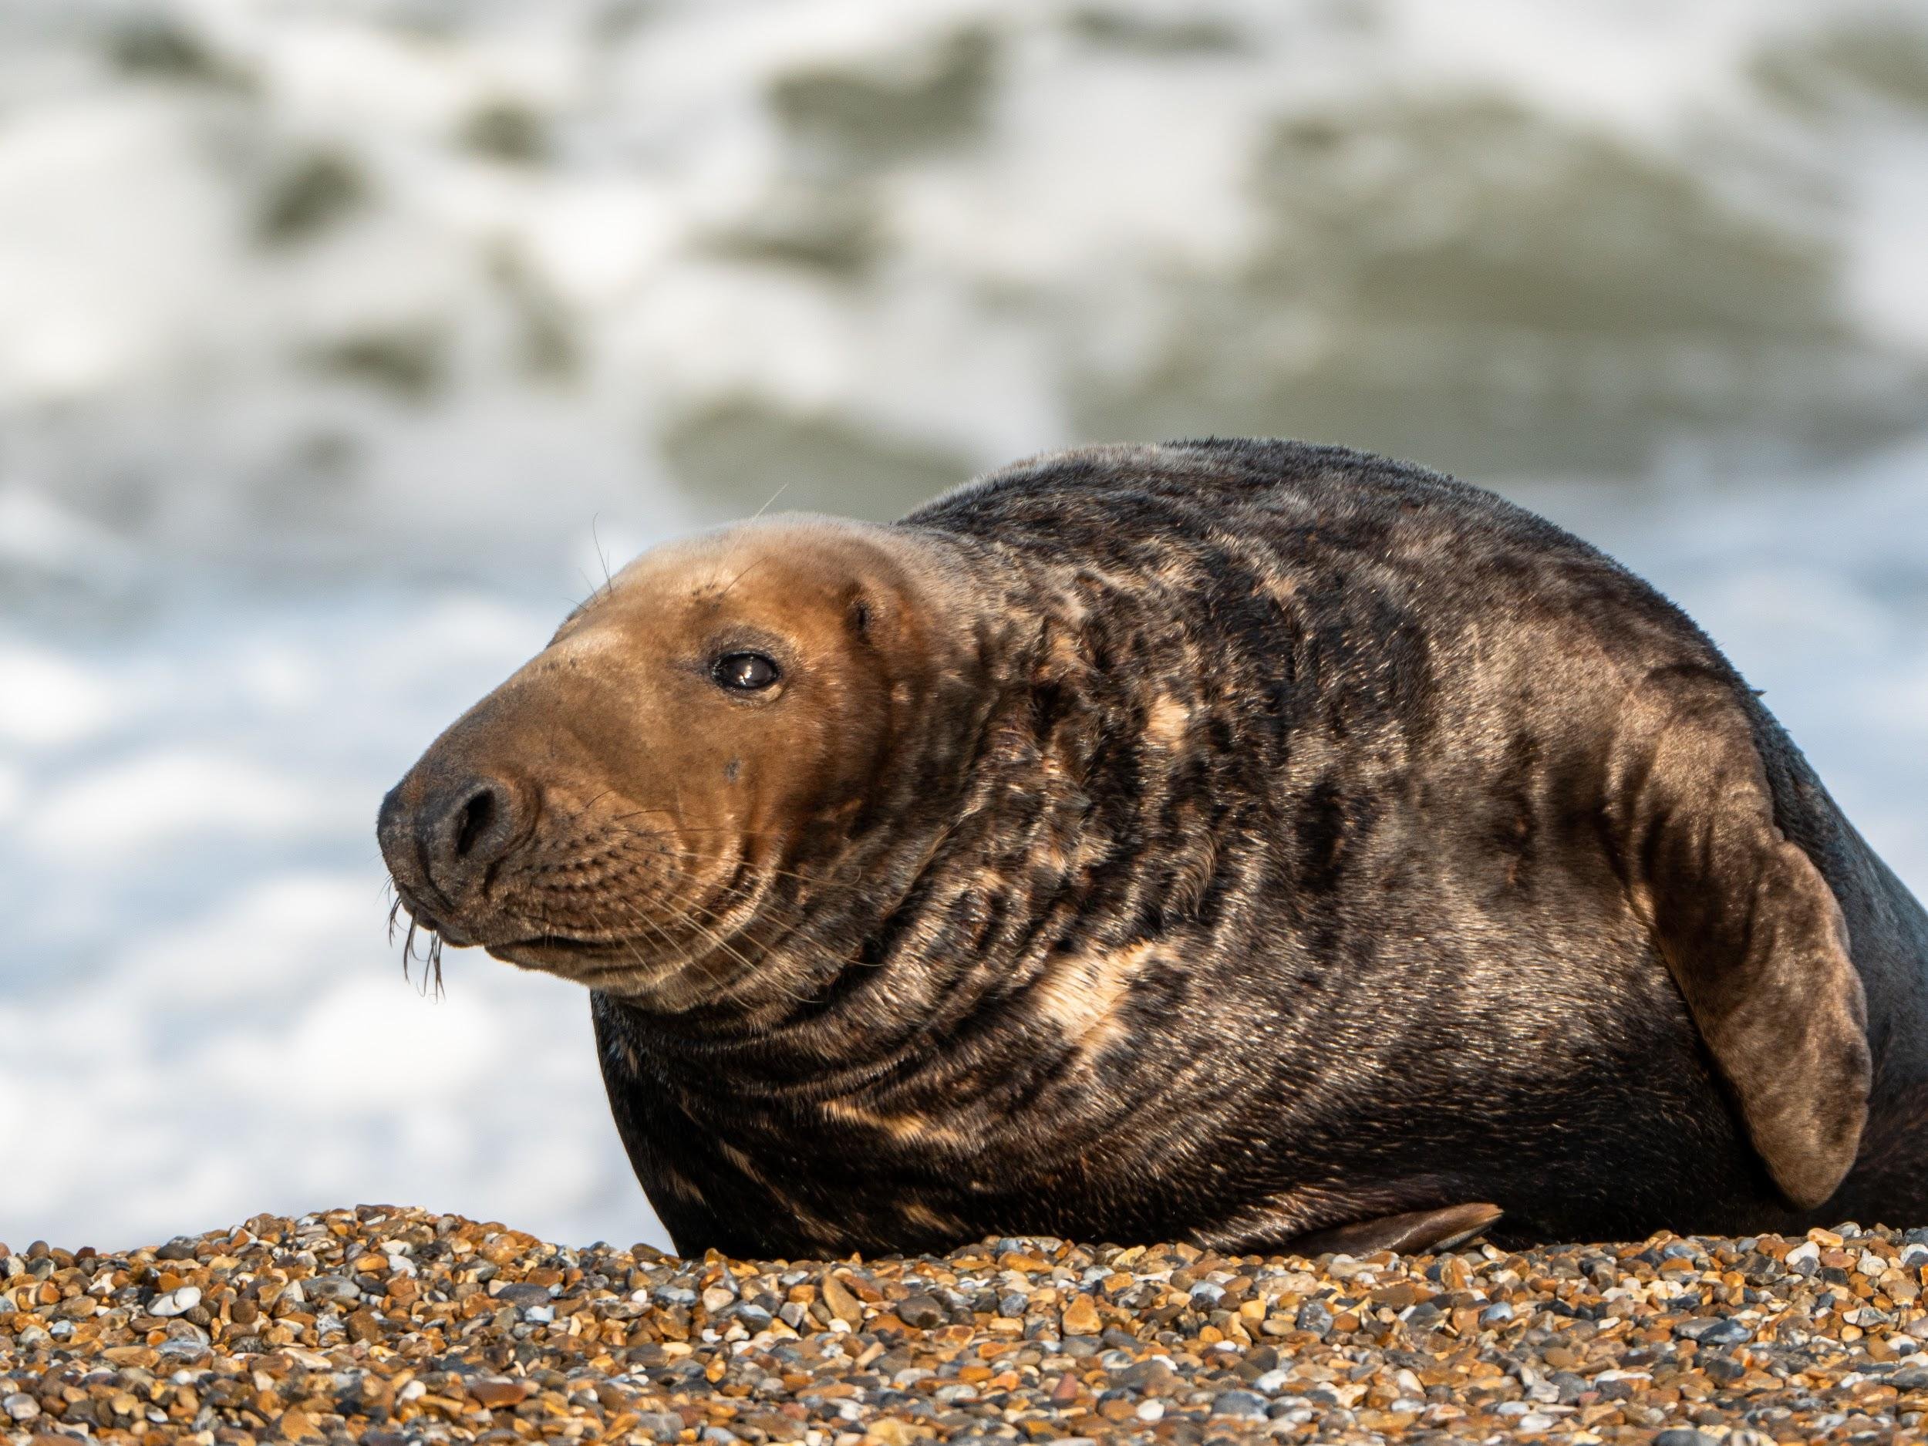
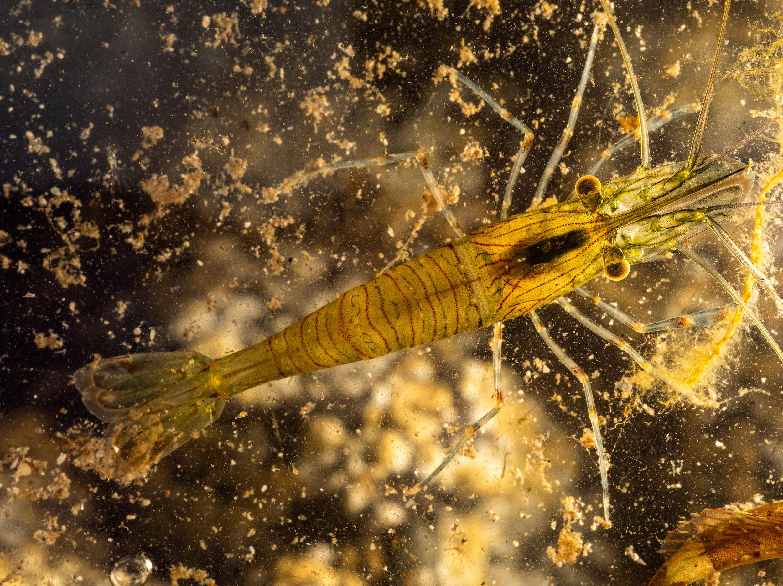
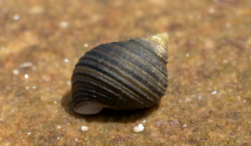
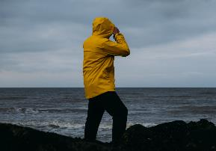
Herbivores, omnivores, or carnivores?
Photo: christaylorphoto.co.uk
Photo: Rob Coleman
Sea Bass
I eat shrimps, periwinkles, prawns, crabs and smaller fish.
Herring Gull
I eat eggs, starfish, crabs, fruit, grains and worms.
Common Starfish
I eat periwinkle, mussels, barnacles and limpets.
Limpet
I eat algae on rocks and young seaweed.
Photo: Rob Coleman
Photo: Rob Coleman
Photo: Rob Coleman
Seal
I eat fish, crabs, squid and octopus.
Prawn
I eat seaweed, carrion and small shrimp-like creatures.
Periwinkle
I eat algae on rocks and young seaweed.
Human

Slide 11
Herbivore
Omnivore
Carnivore
Photo: Rob Coleman
Photo: Rob Coleman
Photo: christaylorphoto.co.uk
Limpet
I eat algae on rocks and young seaweed.
Herring Gull
I eat eggs, starfish, crabs, fruit, grains and worms.
Prawn
I eat seaweed, carrion and small shrimp-like creatures.
Common Starfish
I eat periwinkle, mussels, barnacles and limpets.
Sea Bass
I eat shrimps, periwinkles, prawns, crabs and smaller fish.
Photo: Rob Coleman
Photo: Rob Coleman
Periwinkle
I eat algae on rocks and young seaweed.
Human
Seal
I eat fish, crabs, squid and octopus.

Slide 12
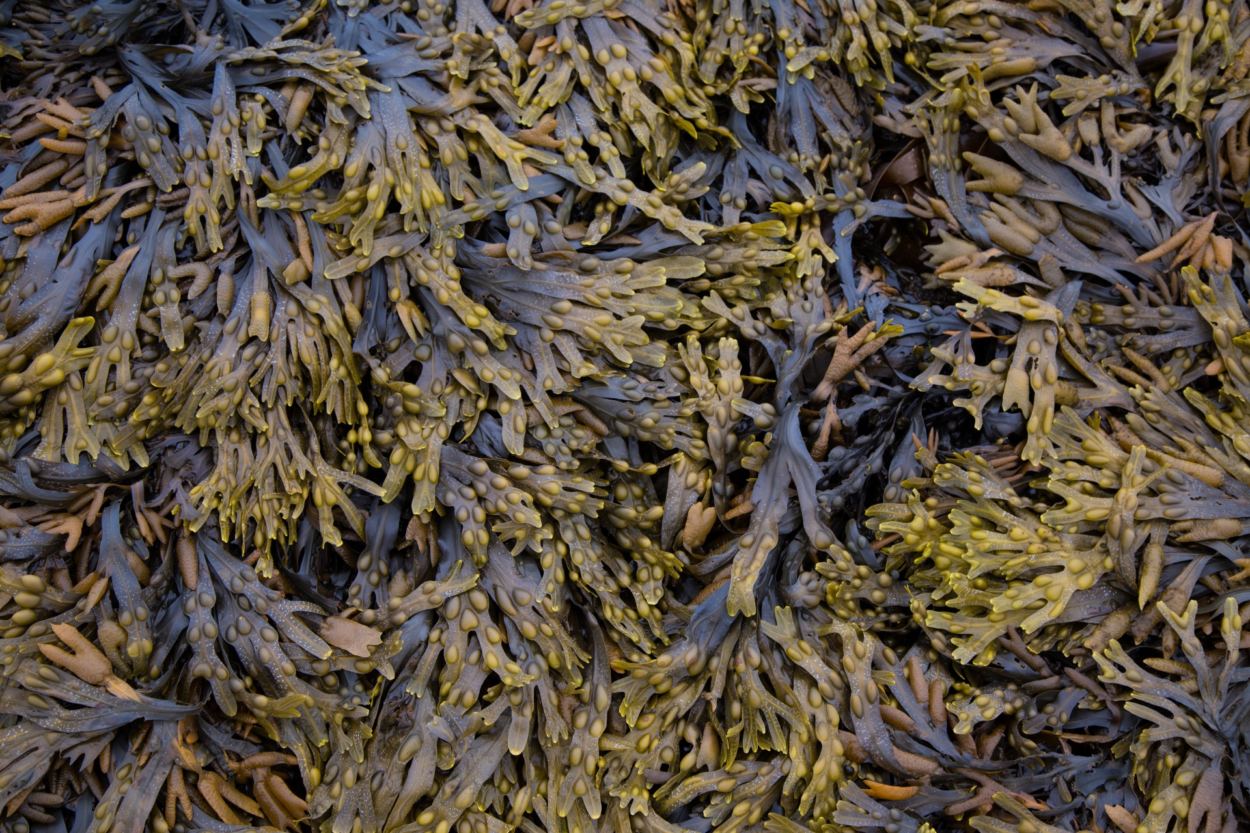
Photo: Rob Coleman
Photo: christaylorphoto.co.uk
Photo: Rob Coleman
Sea Bass
I get my energy from shrimps, periwinkles, prawns, crabs and smaller fish. I am eaten by seals and humans.
Seaweed
I get my energy from the sun.
I am eaten by crabs, periwinkles, worms, prawns and shrimps.
Prawn
I get my energy from seaweed, carrion and small shrimp-like creatures. I am eaten by crabs, fish and sea anemones.
Seal
I get my energy from fish, crabs, squid and octopus. I don’t have any predators.

Slide 13
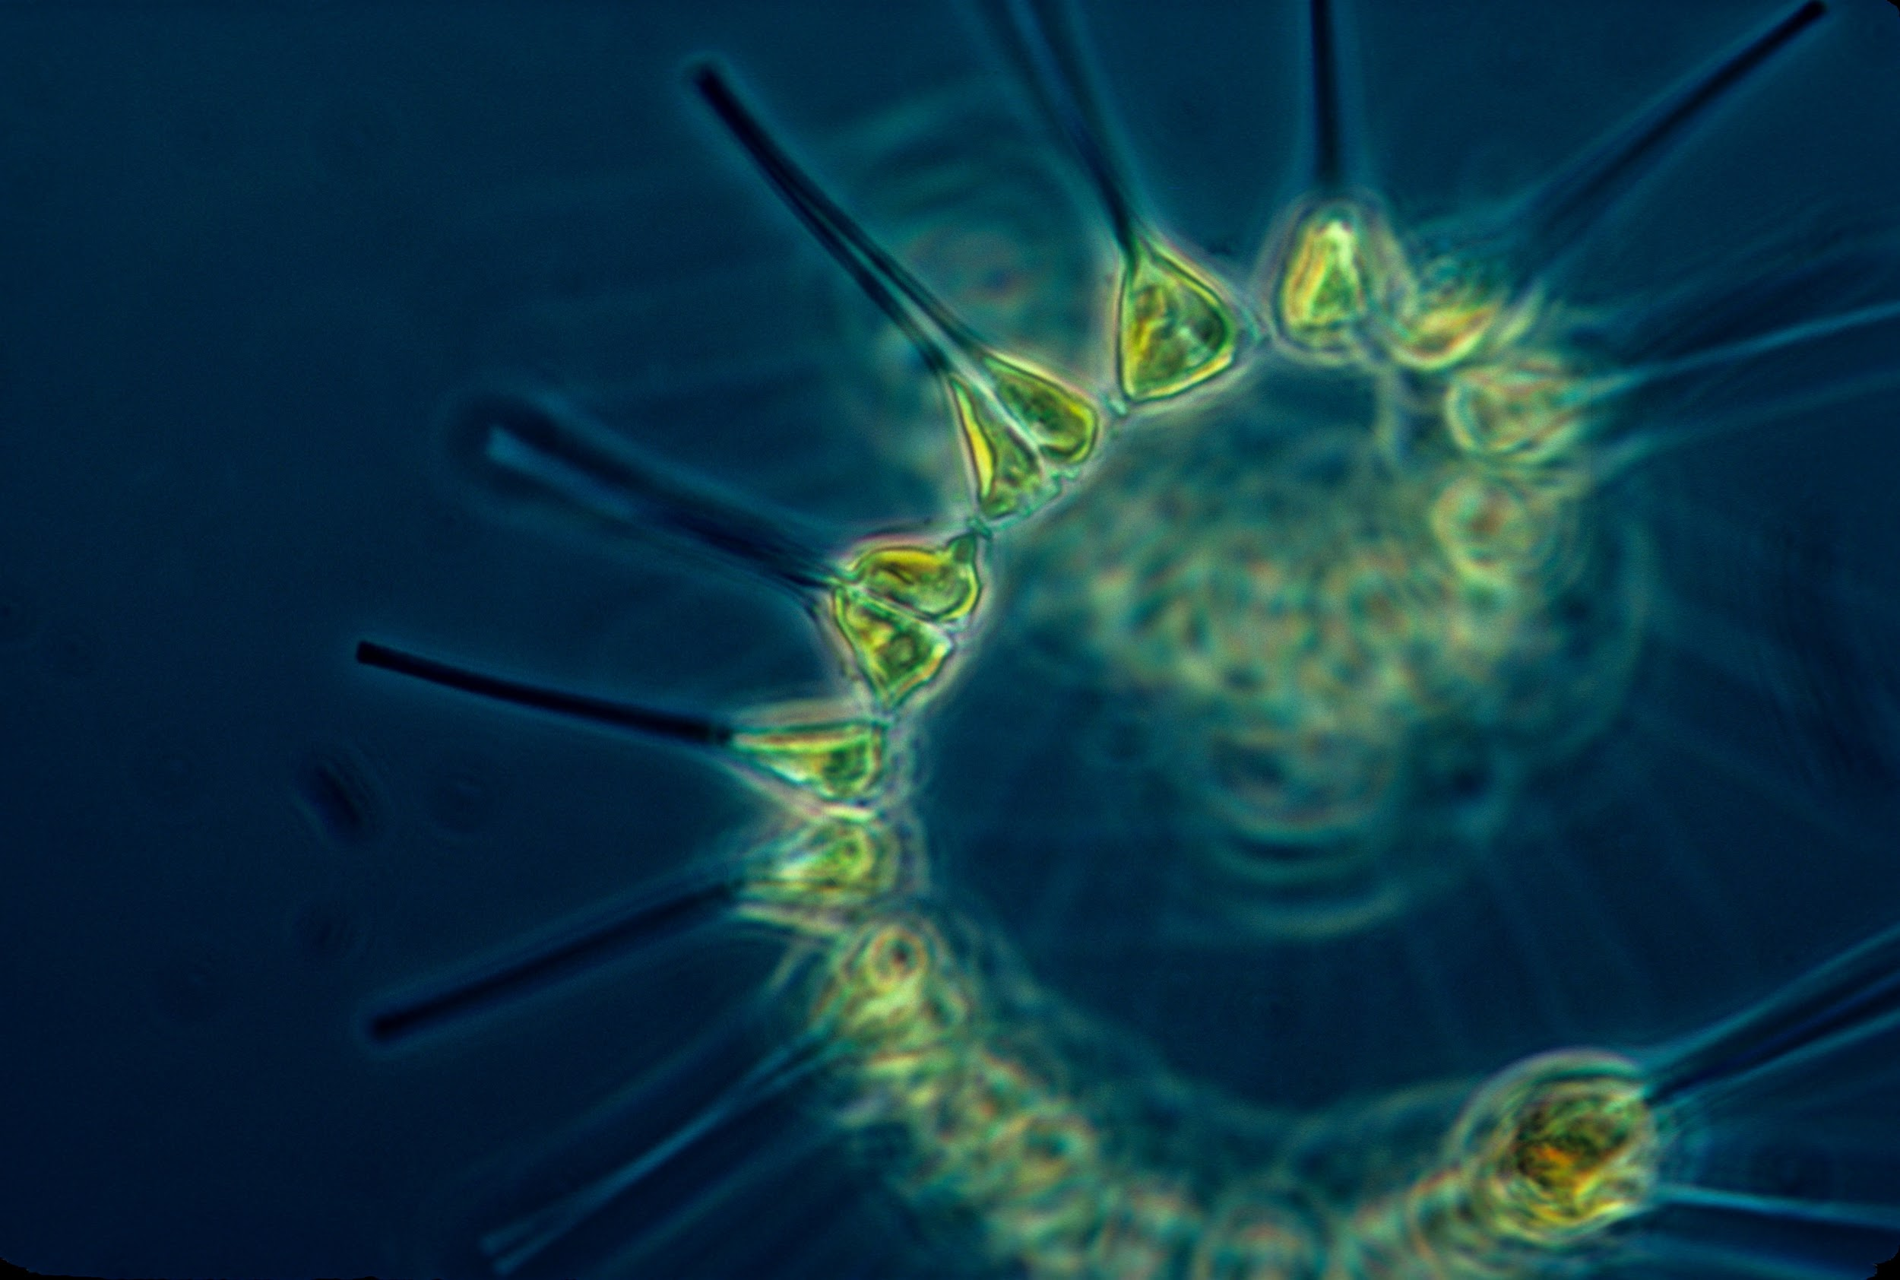
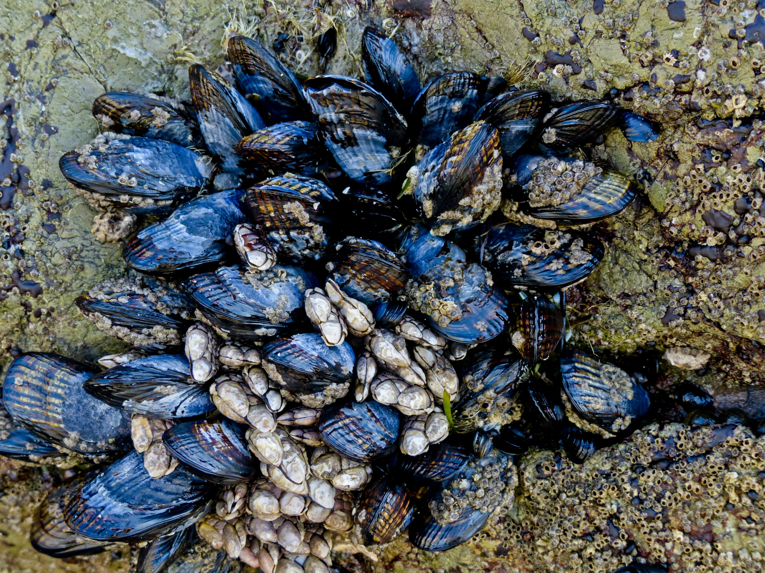
Photo: Rob Coleman
Photo: christaylorphoto.co.uk
Herring Gull
I get my energy from eggs, starfish, crabs, fruit, grains and worms. I do not have any predators.
Phytoplankton
I get my energy from the sun.
I am eaten by barnacles and mussels.
Common Starfish
I get my energy from periwinkle, mussels, barnacles and limpets.
I am eaten by crabs, seabirds and fish.
Mussels
I get my energy from plankton.
I am eaten by humans, dog whelks, seabirds and starfish.

Slide 14
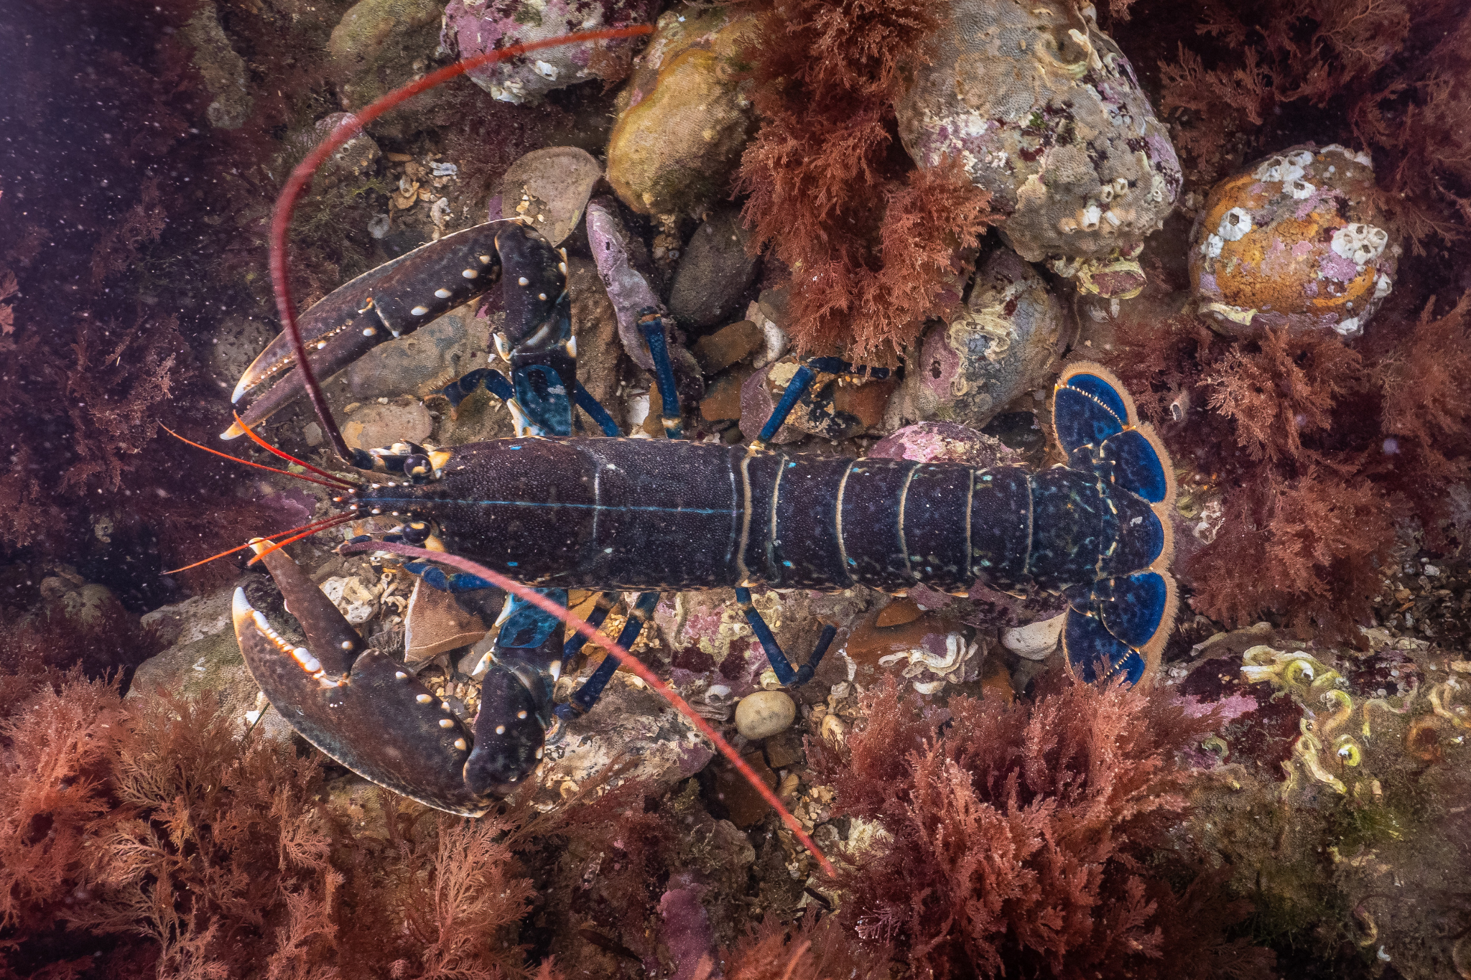
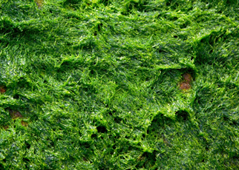
Photo: christaylorphoto.co.uk
Human
Lobster
I get my energy from crabs, sea snails, sea urchins and starfish.
I am eaten by humans.
Algae
I get my energy from the sun.
I am eaten by limpets and periwinkles
Periwinkle
I get my energy from algae on rocks and young seaweed.
I am eaten by crabs, lobsters, seabirds and fish.

Slide 15
Photo: Rob Coleman
Photo: Rob Coleman
Photo: christaylorphoto.co.uk
Seaweed
I get my energy from the sun.
I am eaten by crabs, periwinkles, worms, prawns and shrimps.
Prawn
I get my energy from seaweed, carrion and small shrimp-like creatures. I am eaten by crabs, fish and sea anemones.
Sea Bass
I get my energy from shrimps, periwinkles, prawns, crabs and smaller fish. I am eaten by seals and humans.
Seal
I get my energy from fish, crabs, squid and octopus. I don’t have any predators.
Producer
Herbivore
Carnivore
Carnivore

Slide 16
Photo: christaylorphoto.co.uk
Photo: Rob Coleman
Phytoplankton
I get my energy from the sun.
I am eaten by barnacles and mussels.
Mussels
I get my energy from plankton.
I am eaten by humans, dog whelks, seabirds and starfish.
Common Starfish
I get my energy from periwinkle, mussels, barnacles and limpets.
I am eaten by crabs, seabirds and fish.
Herring Gull
I get my energy from eggs, starfish, crabs, fruit, grains and worms. I do not have any predators.
Producer
Herbivore
Carnivore
Omnivore

Slide 17
Photo: christaylorphoto.co.uk
Algae
I get my energy from the sun.
I am eaten by limpets and periwinkles
Periwinkle
I get my energy from algae on rocks and young seaweed.
I am eaten by crabs, lobsters, seabirds and fish.
Lobster
I get my energy from crabs, sea snails, sea urchins and starfish.
I am eaten by humans.
Human
Producer
Herbivore
Carnivore
Omnivore

