Slide 1
Introduction to the Cromer Shoal Chalk Beds Marine Conservation Zone
Ages 4-7

Slide 2
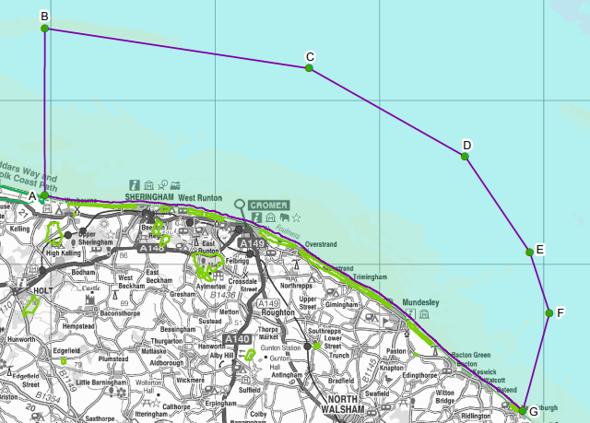
Cromer Shoal Chalk Beds
Marine Conservation Zone

Slide 3
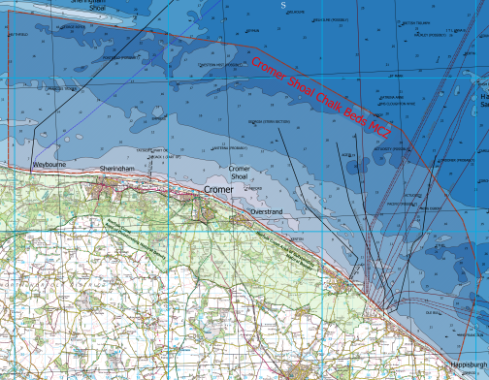
Cromer Shoal Chalk Beds
Marine Conservation Zone
A shoal is a shallow area of sea.
Can you see the different shades of blue on the map?
The pale parts on the map are shallow.

Slide 4
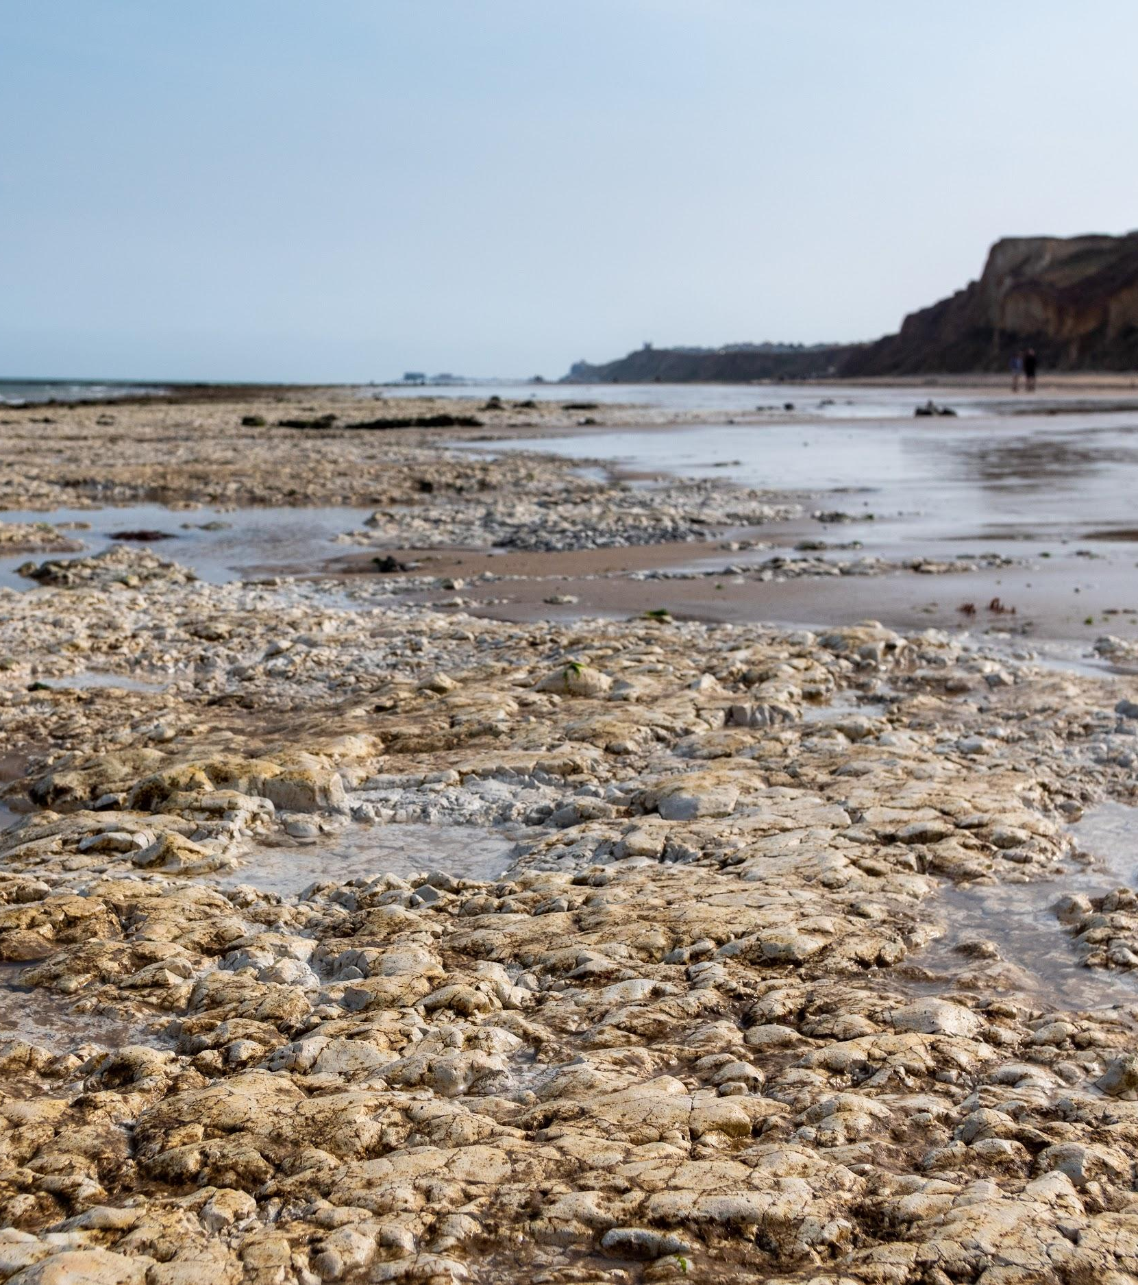
Photo: Rob Coleman
Cromer Shoal Chalk Beds
Marine Conservation Zone
Chalk is a type of rock.
It is a fragile, white rock.
You can see some of the chalk exposed at low tide at some beaches.

Slide 5
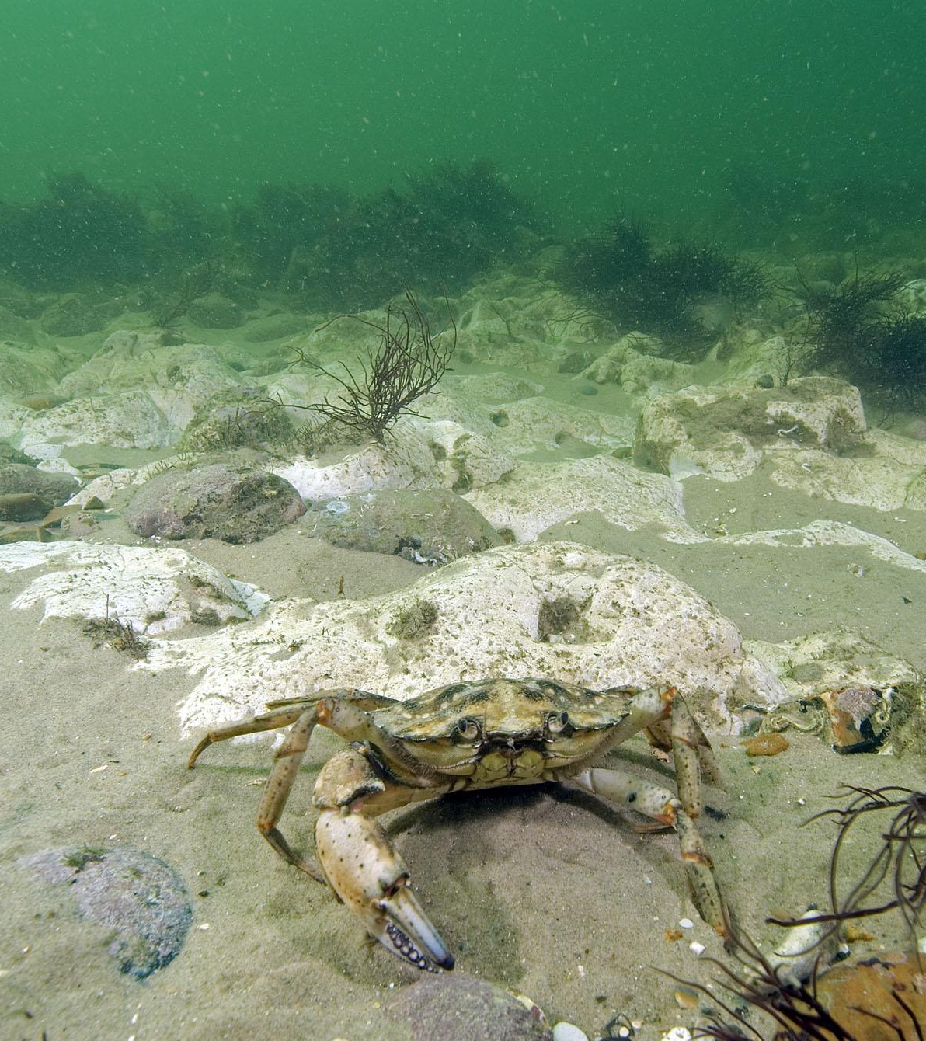
Photo: Paul Naylor
Cromer Shoal Chalk Beds
Marine Conservation Zone
This refers to the seabed or sea floor.
Part of the seabed here is made of chalk.
It is sometimes called the chalk reef.

Slide 6
Cromer Shoal Chalk Beds
Marine Conservation Zone
Marine is relating to the sea.
Where else have you heard the word ‘marine’?

Slide 7
Cromer Shoal Chalk Beds
Marine Conservation Zone
Root word = conserve
To keep it from being changed or spoiled by human activity

Slide 8
Cromer Shoal Chalk Beds
Marine Conservation Zone
An area
In this case: the area where marine conservation happens.

Slide 9
Let’s find out a bit more about the Cromer Shoal Chalk Beds
Marine Conservation Zone

Slide 10
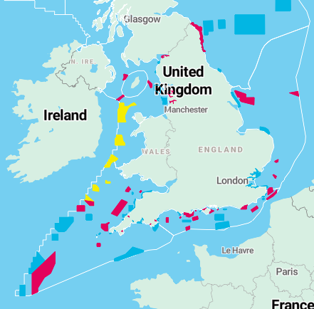
Cromer Shoal Chalk Beds Marine Conservation Zone was designated in 2016.
This map shows the 91 Marine Conservation Zones.
Can you spot the Cromer Shoal Chalk Beds MCZ?
Taken from: https://www.wildlifetrusts.org/marine-protected-areas/england

Slide 11
The Marine Conservation Zone starts 200m off the beach & extends about 10km out.

Slide 12
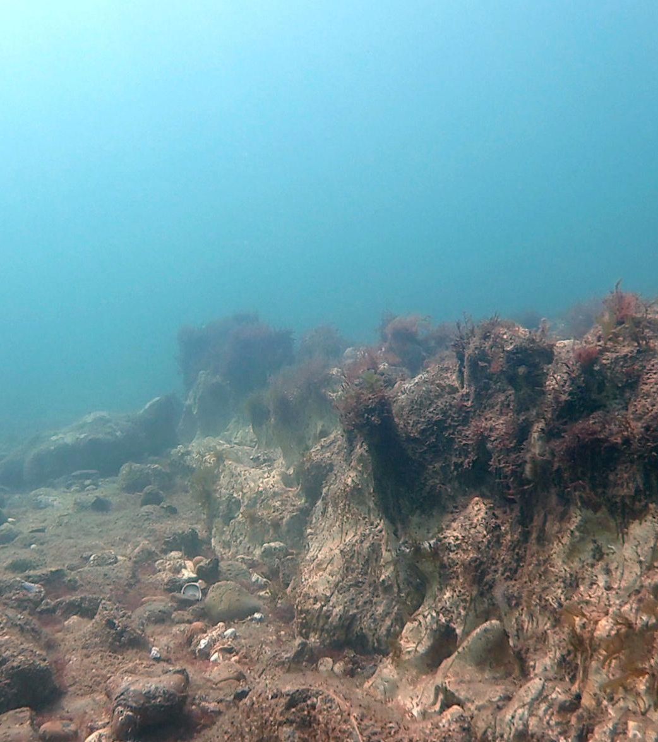
Photo: christaylorphoto.co.uk
The chalk beds have holes, arches and ridges up to 3m high. These provide great places for wildlife to live.
It is the largest chalk reef in Europe.

Slide 13
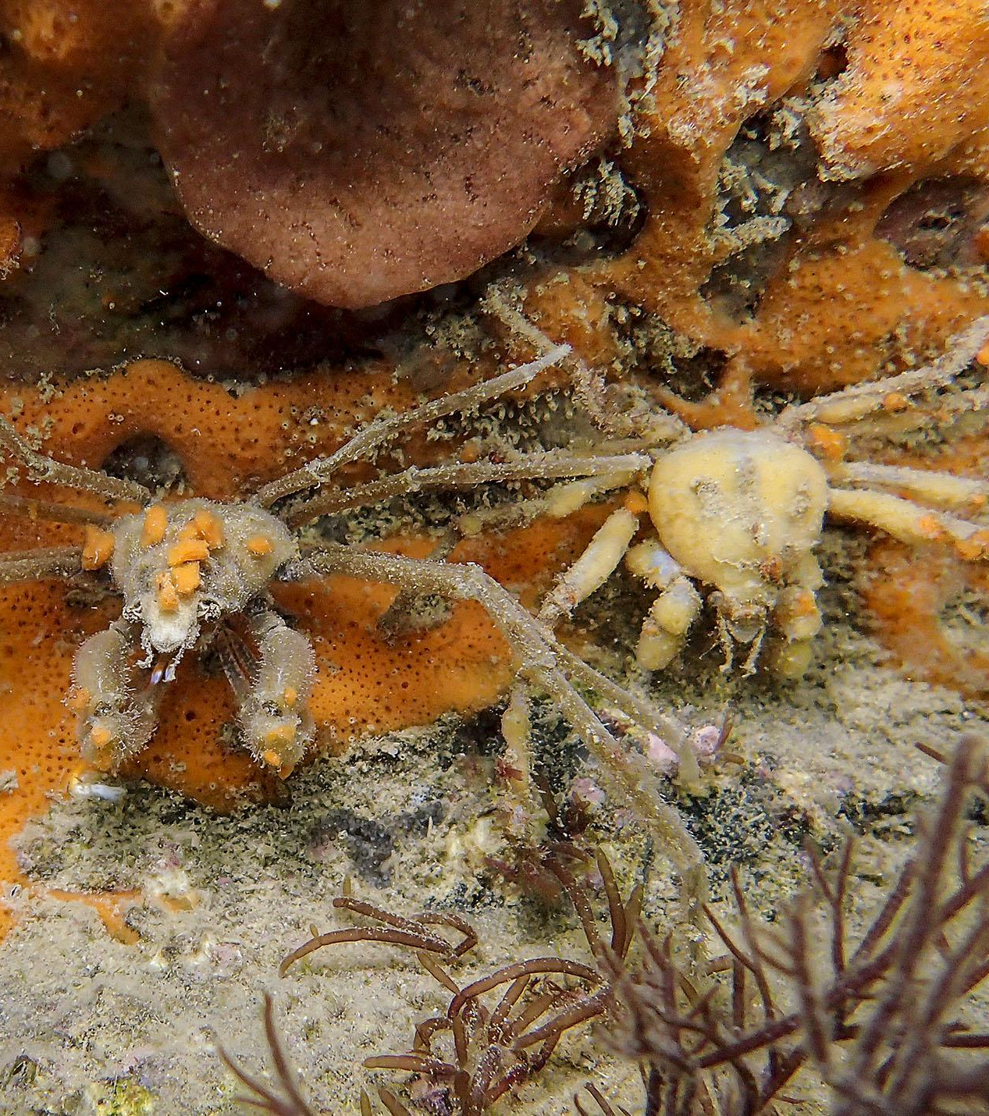
Photo: Paul Naylor
The chalk also provides a surface for marine life such as sponges and seaweeds to attach or burrow into.
These crabs attach pieces of sponge to their shells for camouflage!

Slide 14
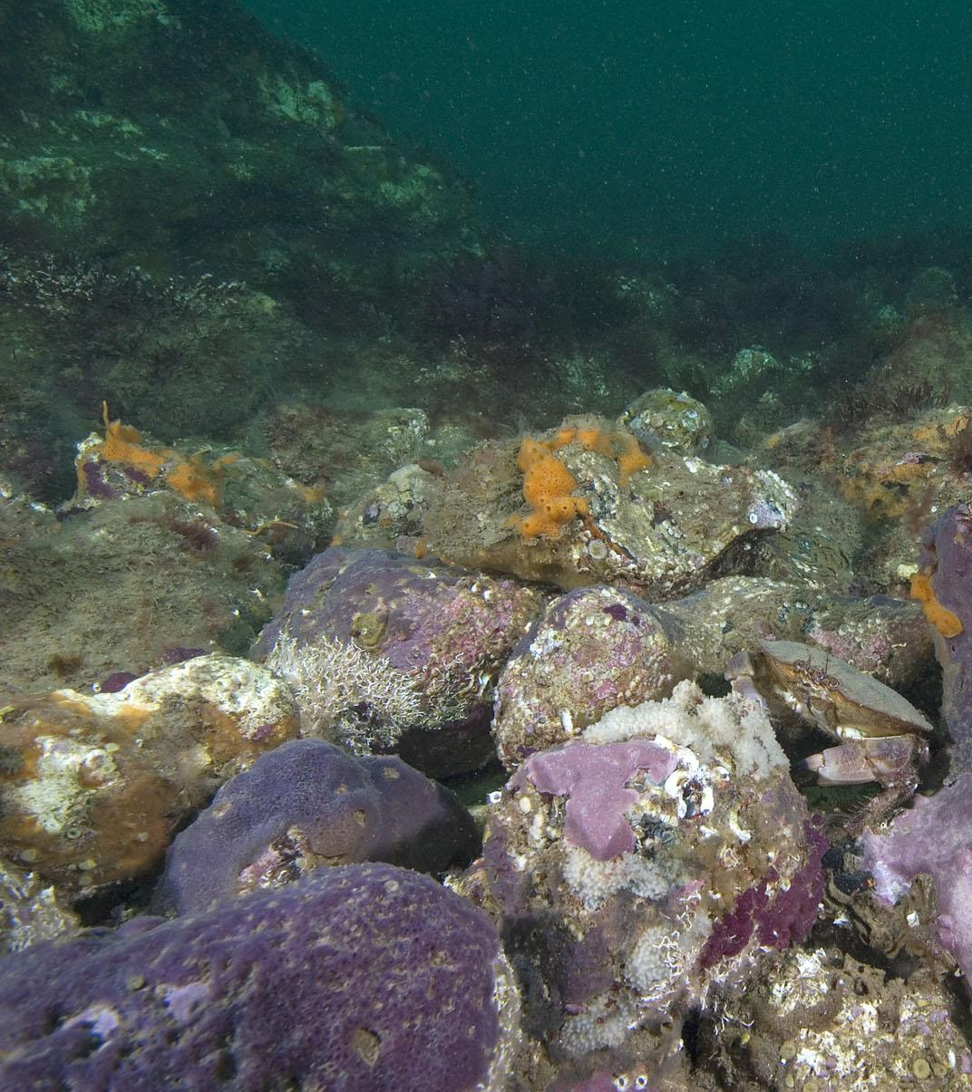
Photo: Paul Naylor
In 2011 some divers noticed a purple sponge, and with the help of scientists they realised it was new to science! It is the only place in the world where it is known to live.
In 2021 a competition was organised that a local schoolgirl won. She named it Parpal Dumplin because it is purple and looks a bit like a dumpling!

Slide 15
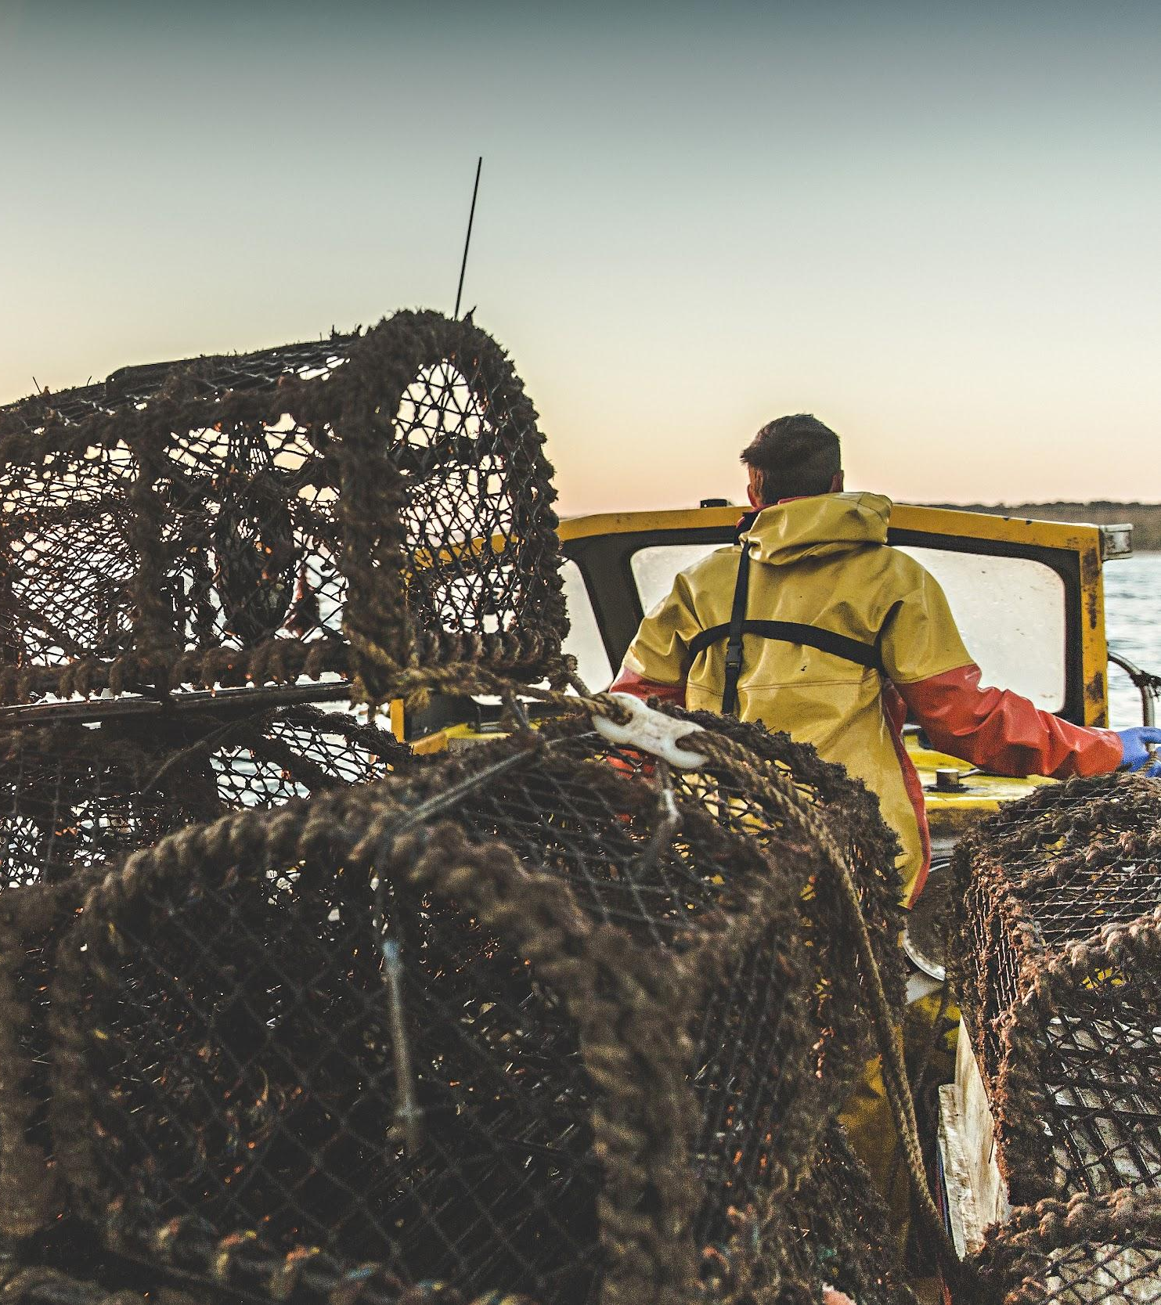
Photo: Paul Naylor
Photo: christaylorphoto.co.uk
Fishing
Fishing is the main activity in the MCZ but not for fish… for crabs and lobsters! There is a long history of fishing here and it is an important industry for the area.
Crab pots are the traps used for catching the crabs and lobsters.

Slide 16
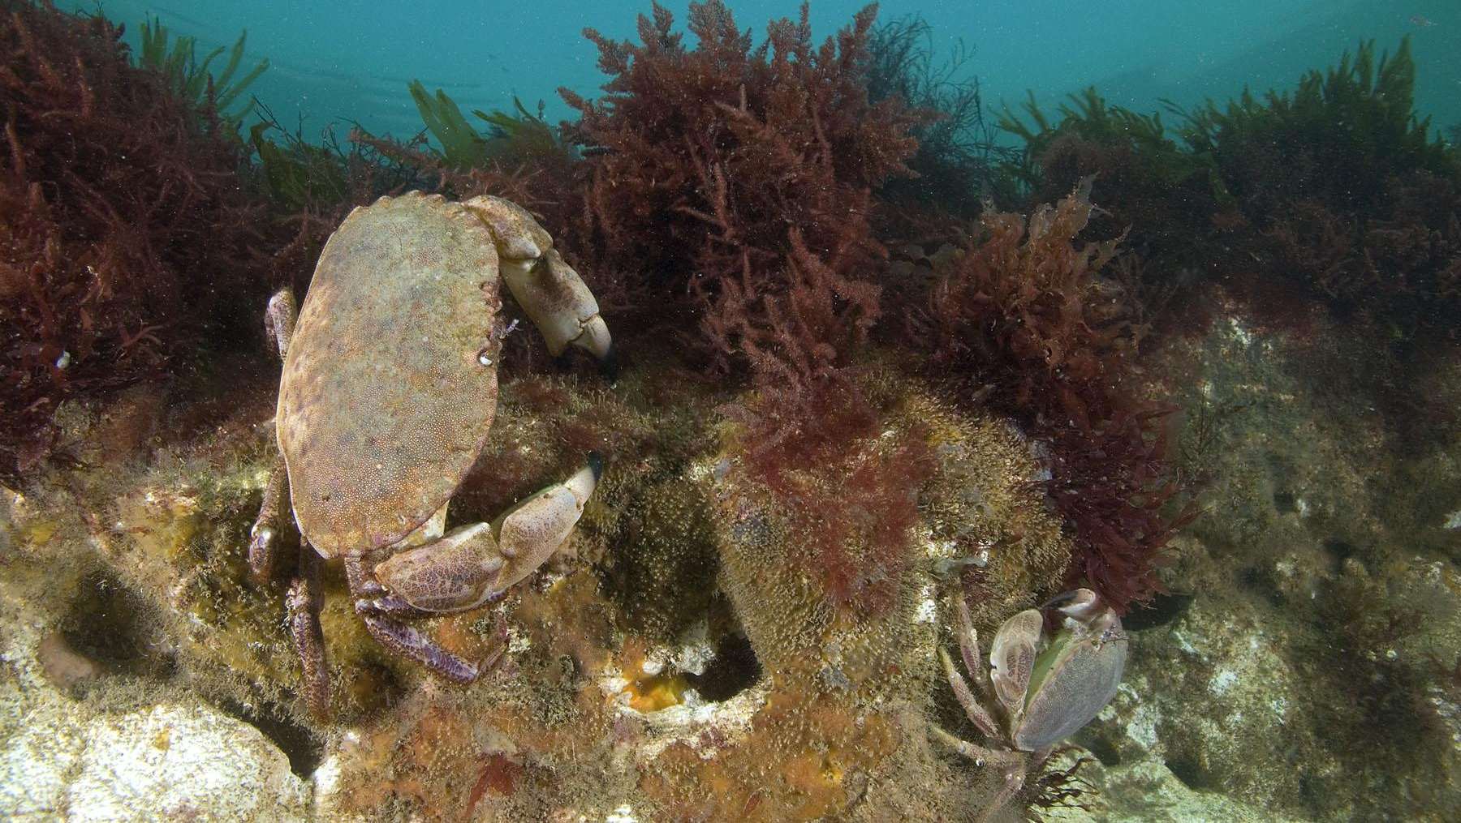
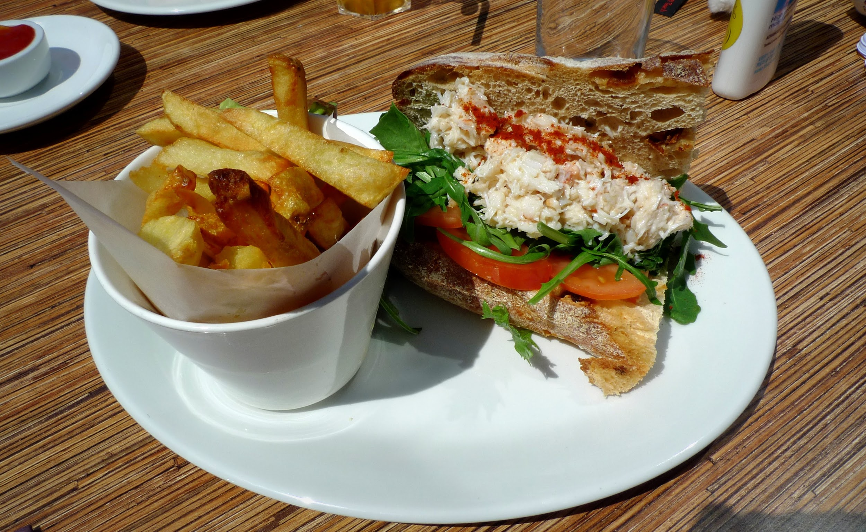
Photo: Paul Naylor
Crabs
Cromer crabs are famous! The crabs love hiding in the holes in the chalk.

Slide 17
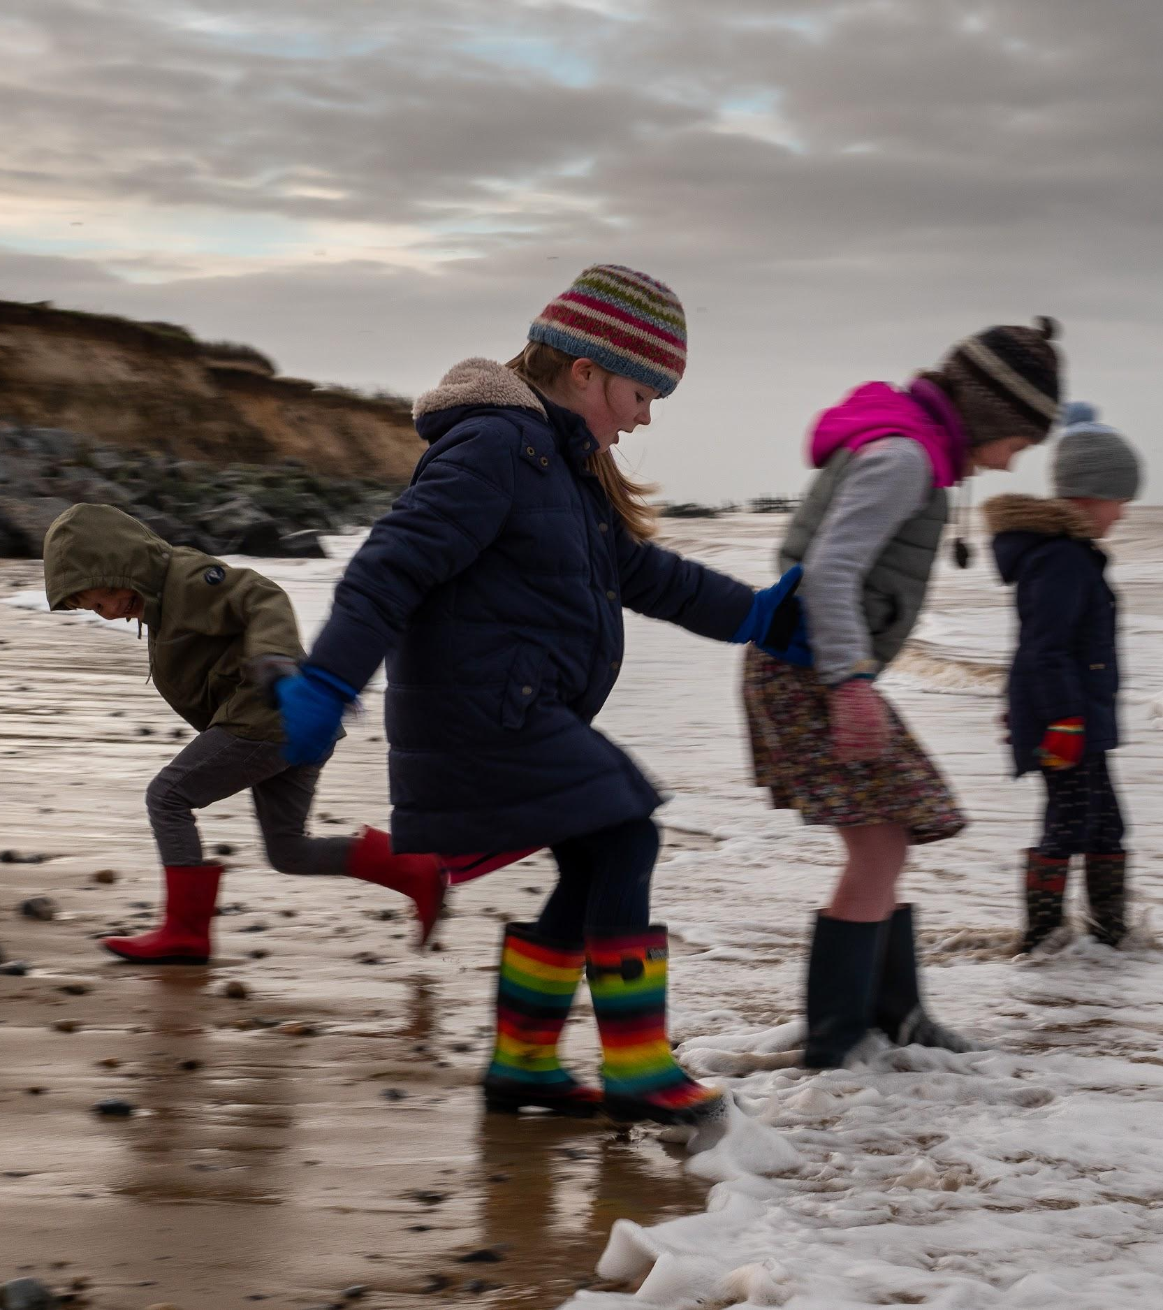
Photo: Paul Naylor
Tourism
Lots of people visit the area on day trips or for their holiday and visit the beach.

Slide 18
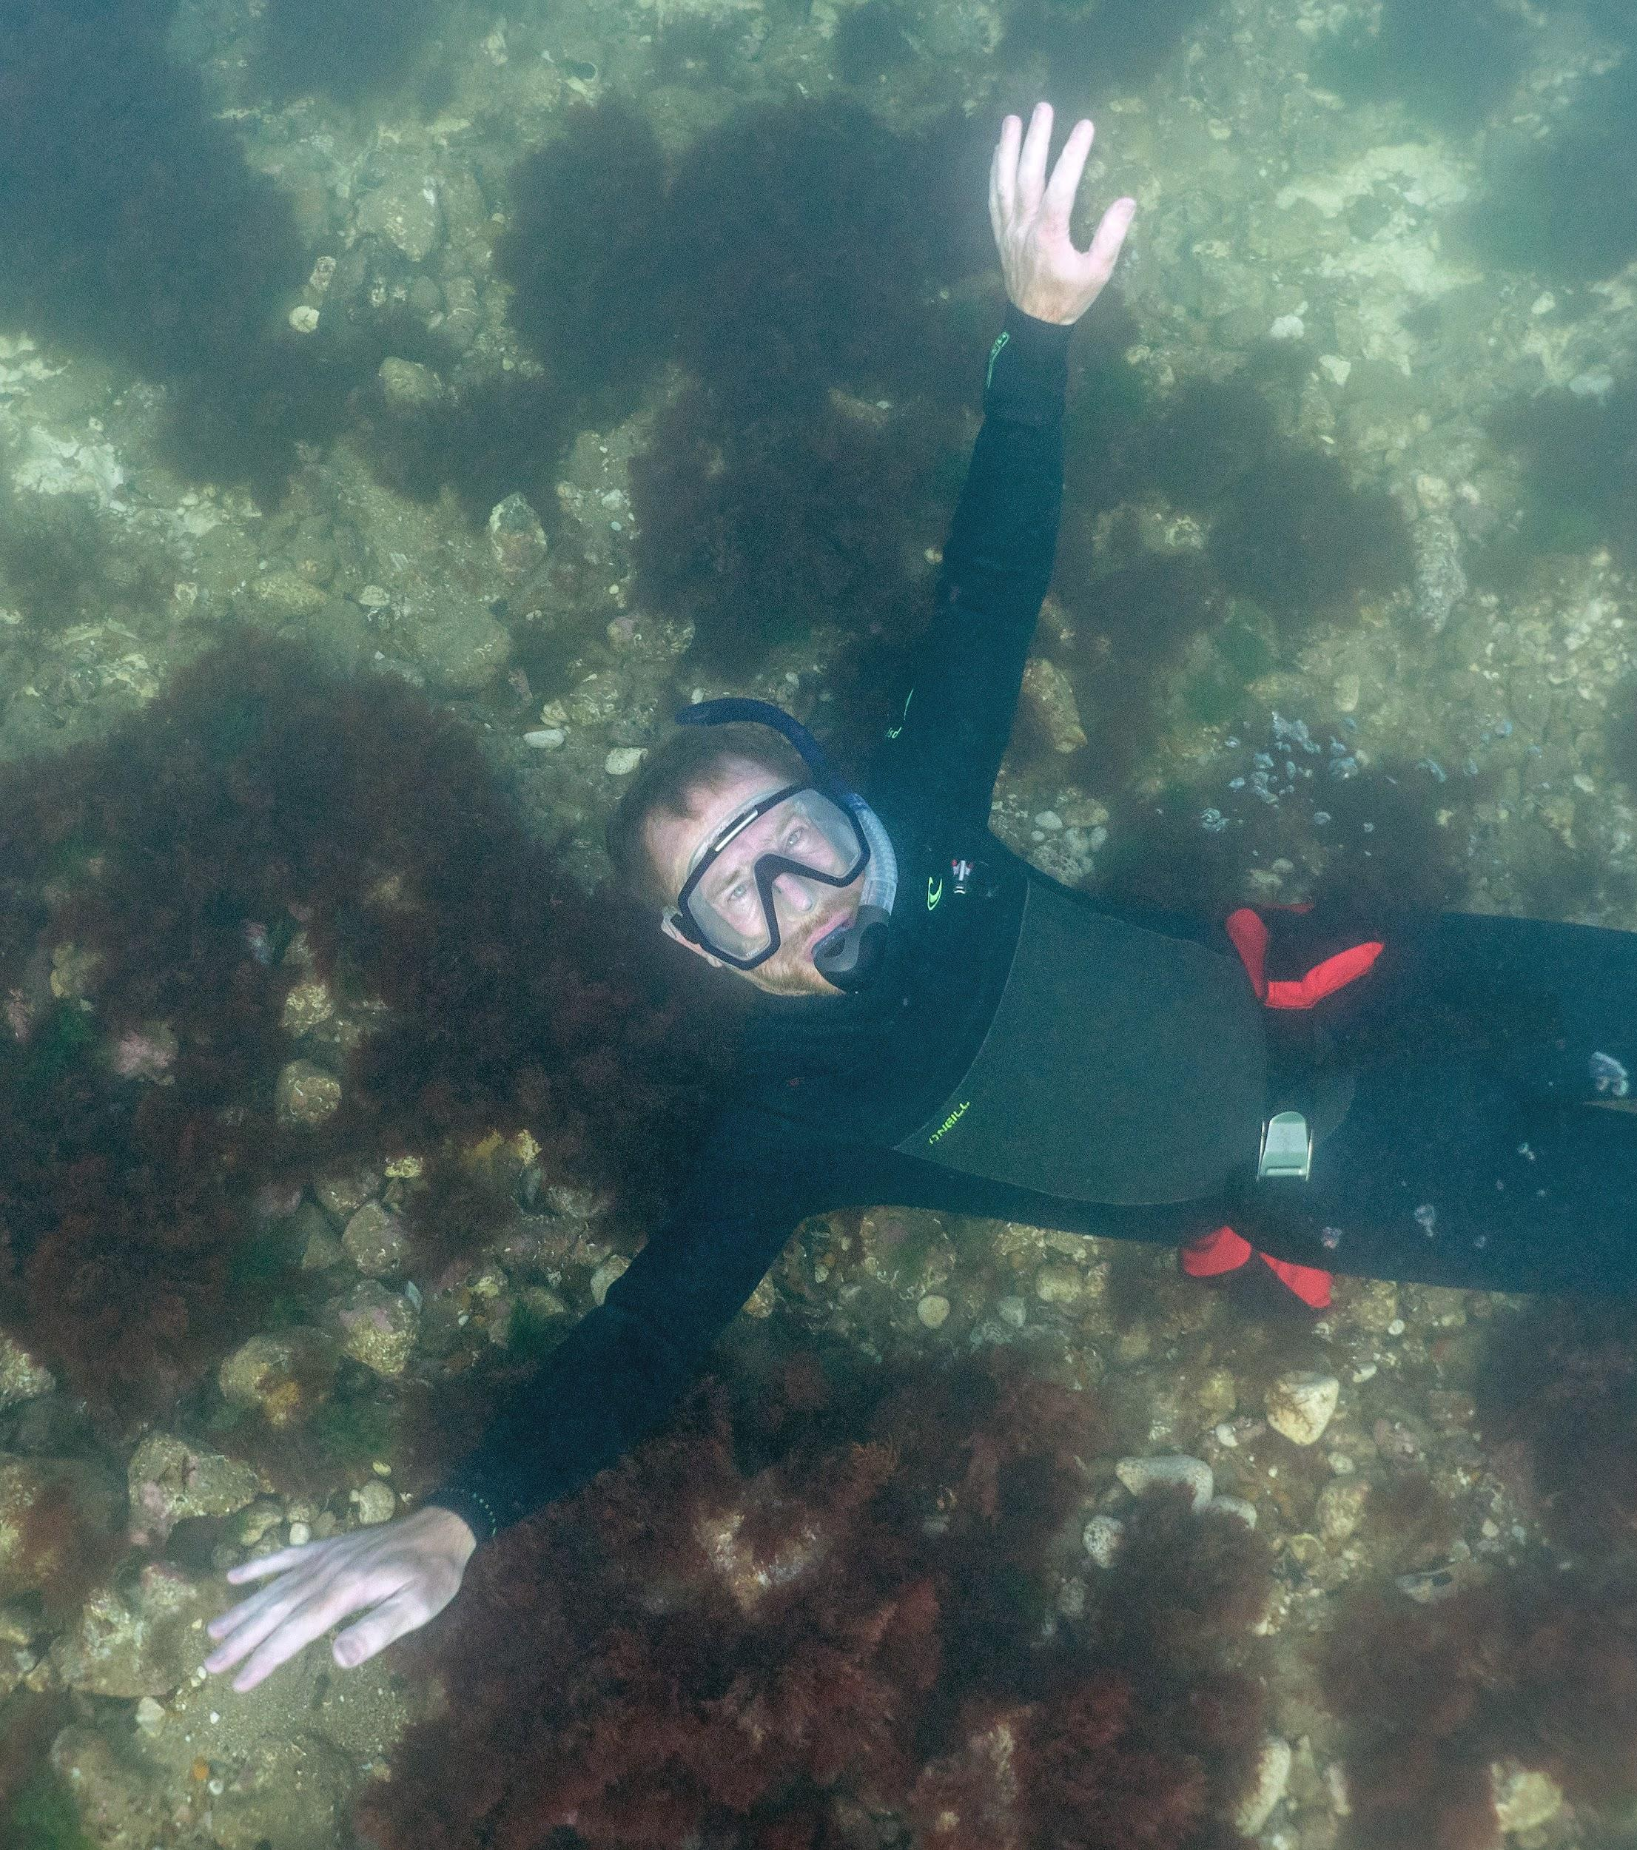
Photo: Paul Naylor
Photo: christaylorphoto.co.uk
Other activities in the area include boating, diving and snorkelling.

Slide 19
What does the Marine Conservation Zone do?
The MCZ aims to:
Keep the chalk reef in good condition
Provide benefits for people that live, work and visit the area
This means that activities can continue so long as they don’t harm the chalk beds or the wildlife that lives there.
There are laws and guidance that protect the area, and these may change over time.

Slide 20
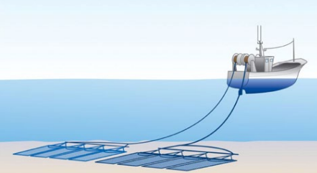
Damage from trawling and dredging in the MCZ
Trawling and dredging is banned in most of the MCZ.

Slide 21
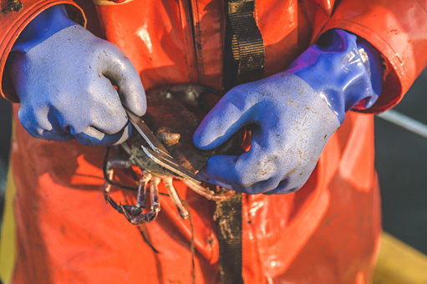
Overfishing
If too many crabs and lobsters are caught, there would be none left.
Fishermen measure the crabs they catch. Crabs that are too small must be put back. The bigger crabs that are allowed to be caught have lived long enough to lay eggs.
Photo: christaylorphoto.co.uk
Photo: Rob Coleman
Photo: Rob Coleman

Slide 22
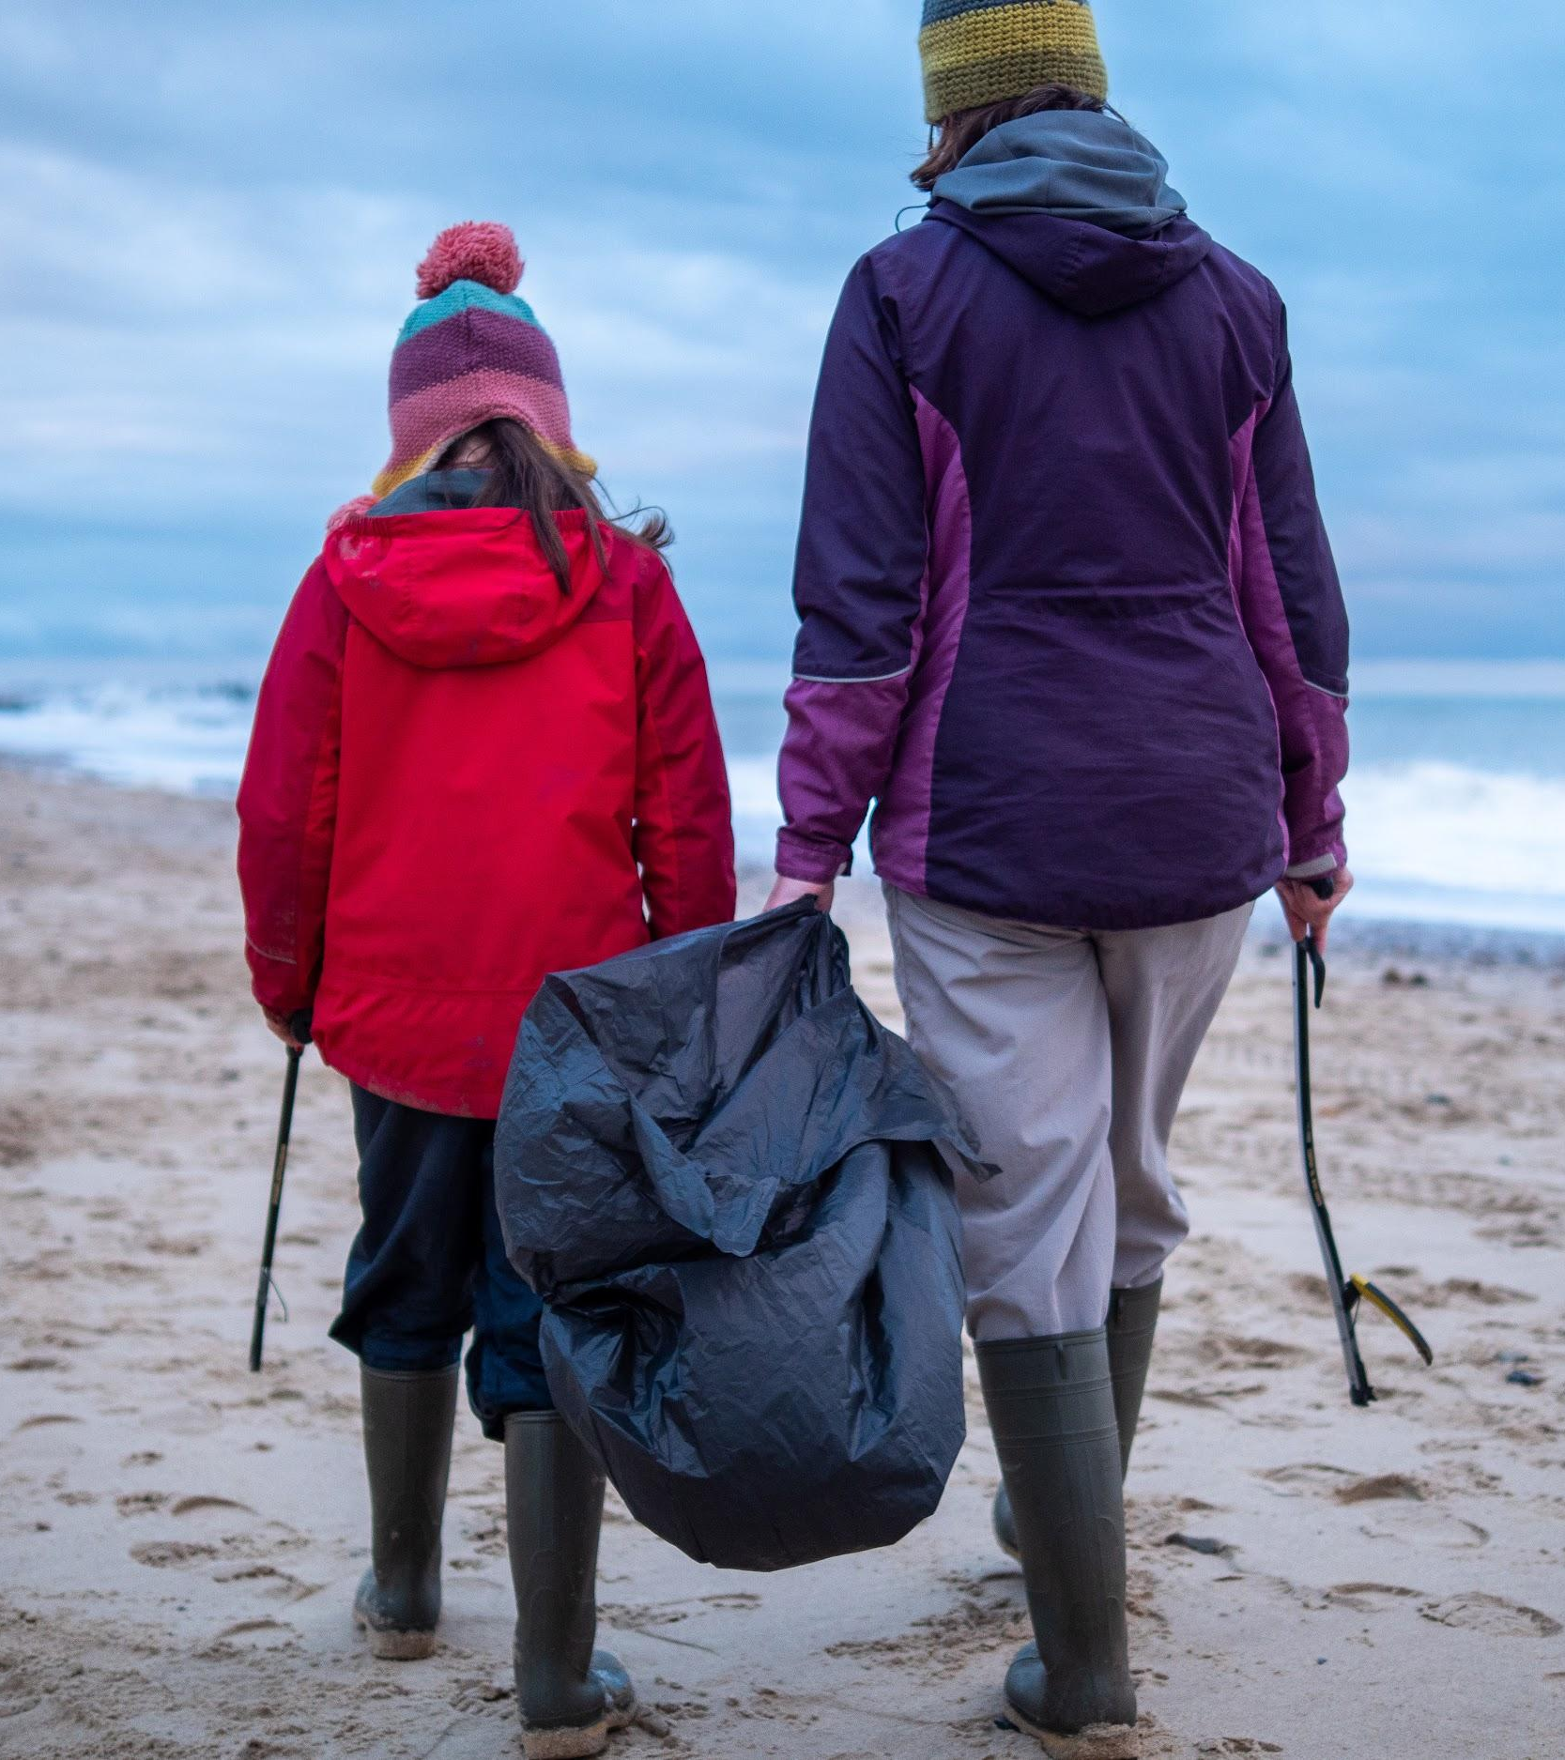
Beach cleans
Litter is sometimes dropped by visitors or fishing gear can get lost. This can cause problems for wildlife, particularly with plastics.
People volunteer at beach cleans to collect rubbish to keep it out of the sea.
Photo: Rob Coleman

Slide 23
Summary
Cromer Shoal Chalk Beds Marine Conservation Zone is a special place.
The chalk on the seabed provides a special habitat for lots of wildlife.
Fishing is an important industry in the area.
Humans need to make sure they do not damage or harm this place and its wildlife.

