Slide 1
Introduction to the Cromer Shoal Chalk Beds Marine Conservation Zone
Ages 7-11

Slide 2
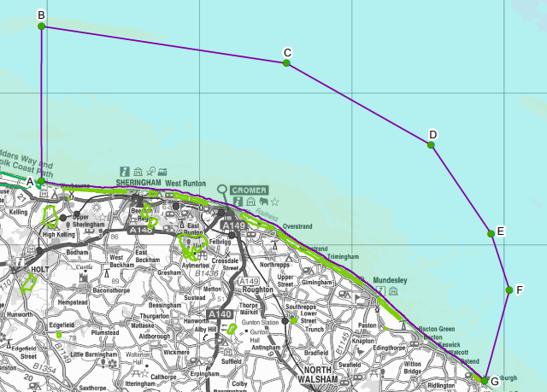
Cromer Shoal Chalk Beds
Marine Conservation Zone

Slide 3
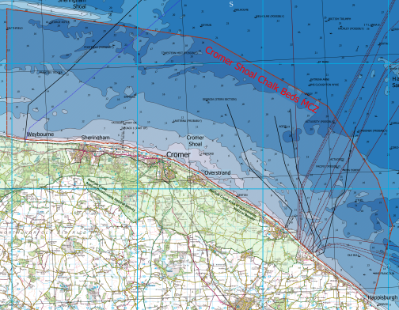
Cromer Shoal Chalk Beds
Marine Conservation Zone
A shoal is a shallow area of sea.
Can you see the different shades of blue on the map?
The pale parts on the map are shallow.
Cromer Shoal is the shallow area of sea near Cromer.

Slide 4
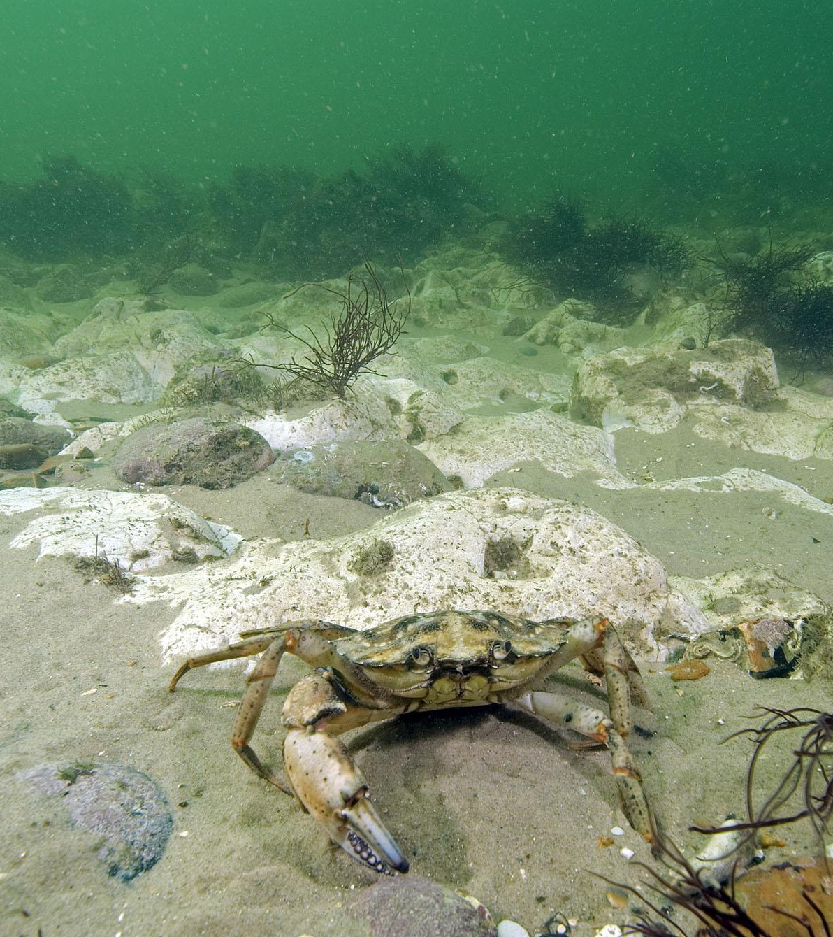
Photo: Paul Naylor
Cromer Shoal Chalk Beds
Marine Conservation Zone
Chalk is a fragile, white rock.
This refers to the seabed or sea floor that is made of chalk.
It is Europe’s largest chalk reef.
There is a mixture of chalk, other rocks, peat, clay and sand in the MCZ.

Slide 5
Cromer Shoal Chalk Beds
Marine Conservation Zone
Marine: relating to the sea.
Conservation: To keep it from being changed or spoiled by human activity

Slide 6
Cromer Shoal Chalk Beds
Marine Conservation Zone
Zone: An area with particular characteristics, purpose or use.
In this case: the area where marine conservation happens.

Slide 7
Let’s find out a bit more about the Cromer Shoal Chalk Beds
Marine Conservation Zone

Slide 8
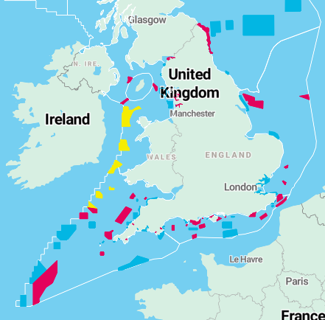
Cromer Shoal Chalk Beds Marine Conservation Zone was designated in 2016.
This map shows the 91 Marine Conservation Zones.
Can you spot the Cromer Shoal Chalk Beds MCZ?
Taken from: https://www.wildlifetrusts.org/marine-protected-areas/england

Slide 9
It starts 200m off the beach and extends about 10km out.
It covers over 300km².

Slide 10
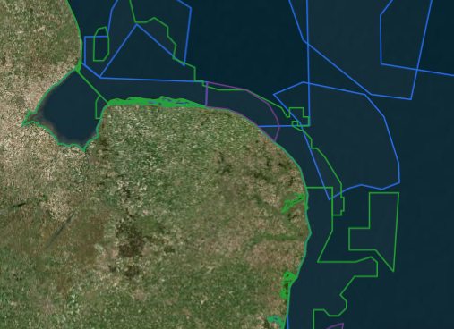
Cromer Shoal Chalk Beds Marine Conservation Zone is part of a network of Marine Protected Areas around the coast of the UK.
These are known as the ‘Blue Belt’.
All the Norfolk coast has designations to protect it.
Taken from: https://jncc.gov.uk/our-work/marine-protected-area-mapper/

Slide 11
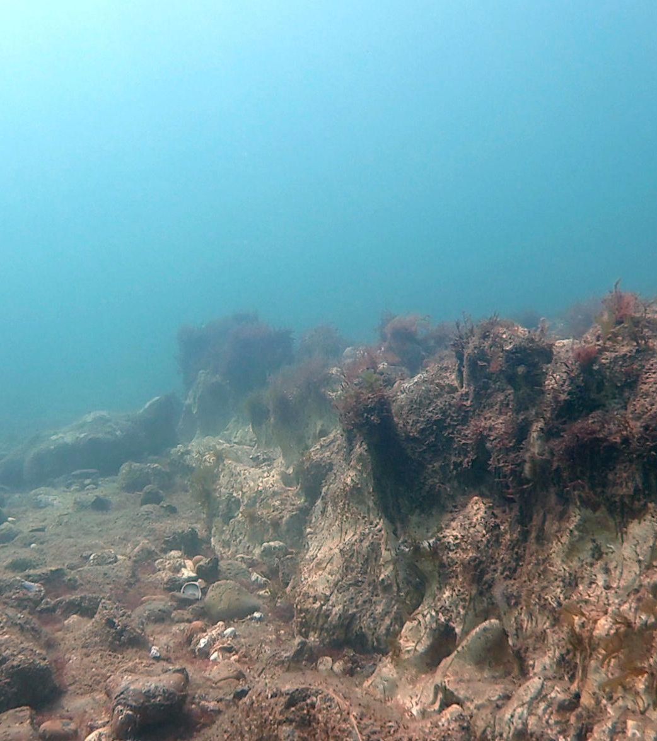
Photo: christaylorphoto.co.uk
The chalk beds have holes, arches and ridges up to 3m high. These provide great places for wildlife to live and hide from predators.

Slide 12
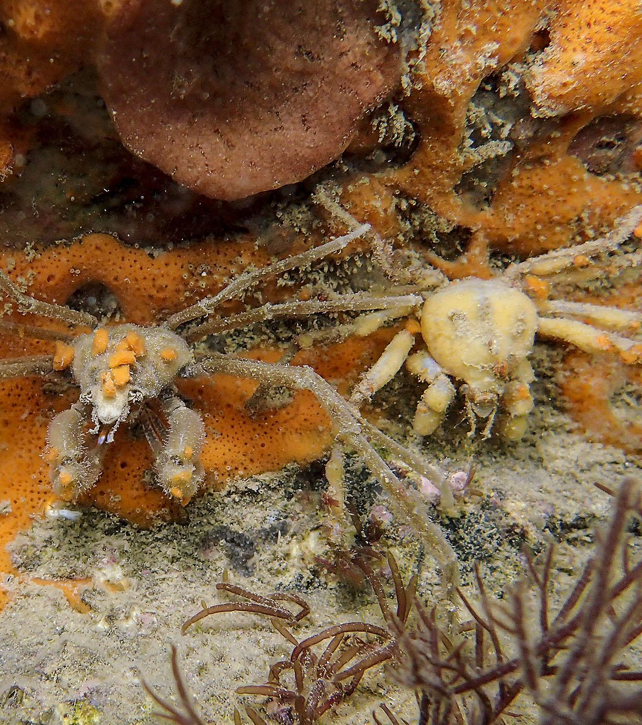
Photo: Paul Naylor
The chalk also provides a surface for marine life such as sponges and seaweeds to attach or burrow into.
These crabs attach pieces of sponge to their shells for camouflage!

Slide 13
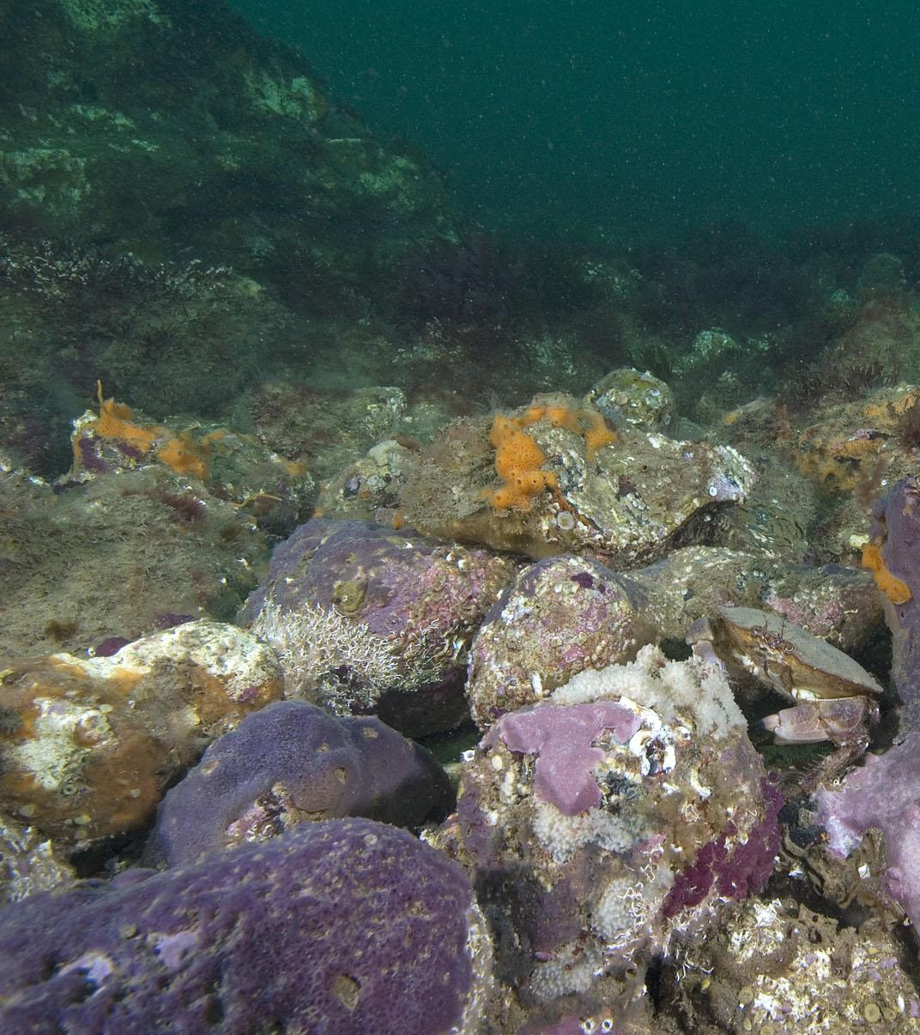
Photo: Paul Naylor
In 2011 some divers noticed a purple sponge and with the help of scientists they realised it was new to science! It is the only place in the world where it is known to live.
In 2021, a naming competition was organised that a local schoolgirl won. She named it Parpal Dumplin because it is purple and looks a bit like a dumpling!

Slide 14
This video shows lots of the amazing wildlife that lives in the Marine Conservation Zone:
Notes:
Video link: youtube.com/watch?v=ElWjGD82TvY

Slide 15
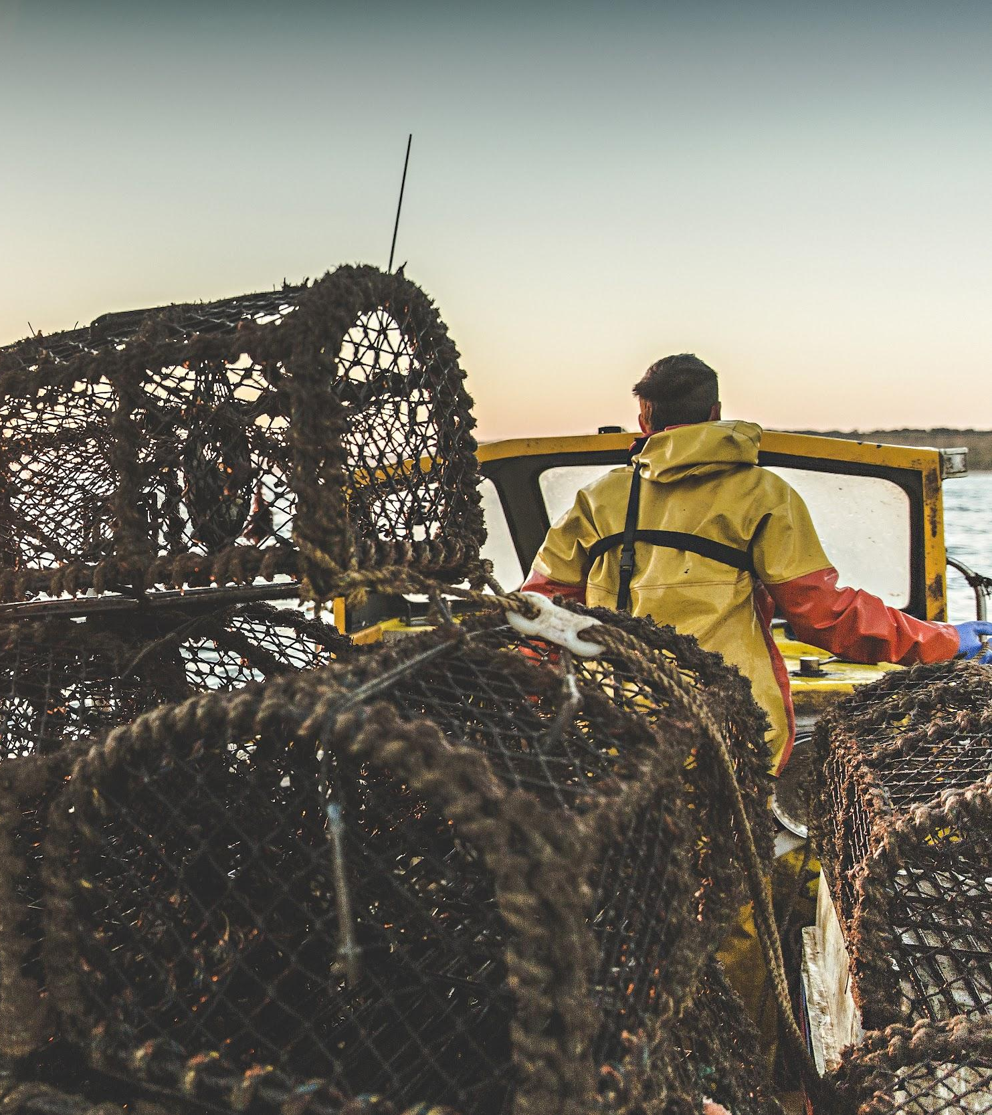
Photo: Paul Naylor
Photo: christaylorphoto.co.uk
Fishing
Fishing is the main activity in the MCZ but not for fish… for crabs and lobsters!
There is a long history of fishing here and it is an important industry for the area.

Slide 16
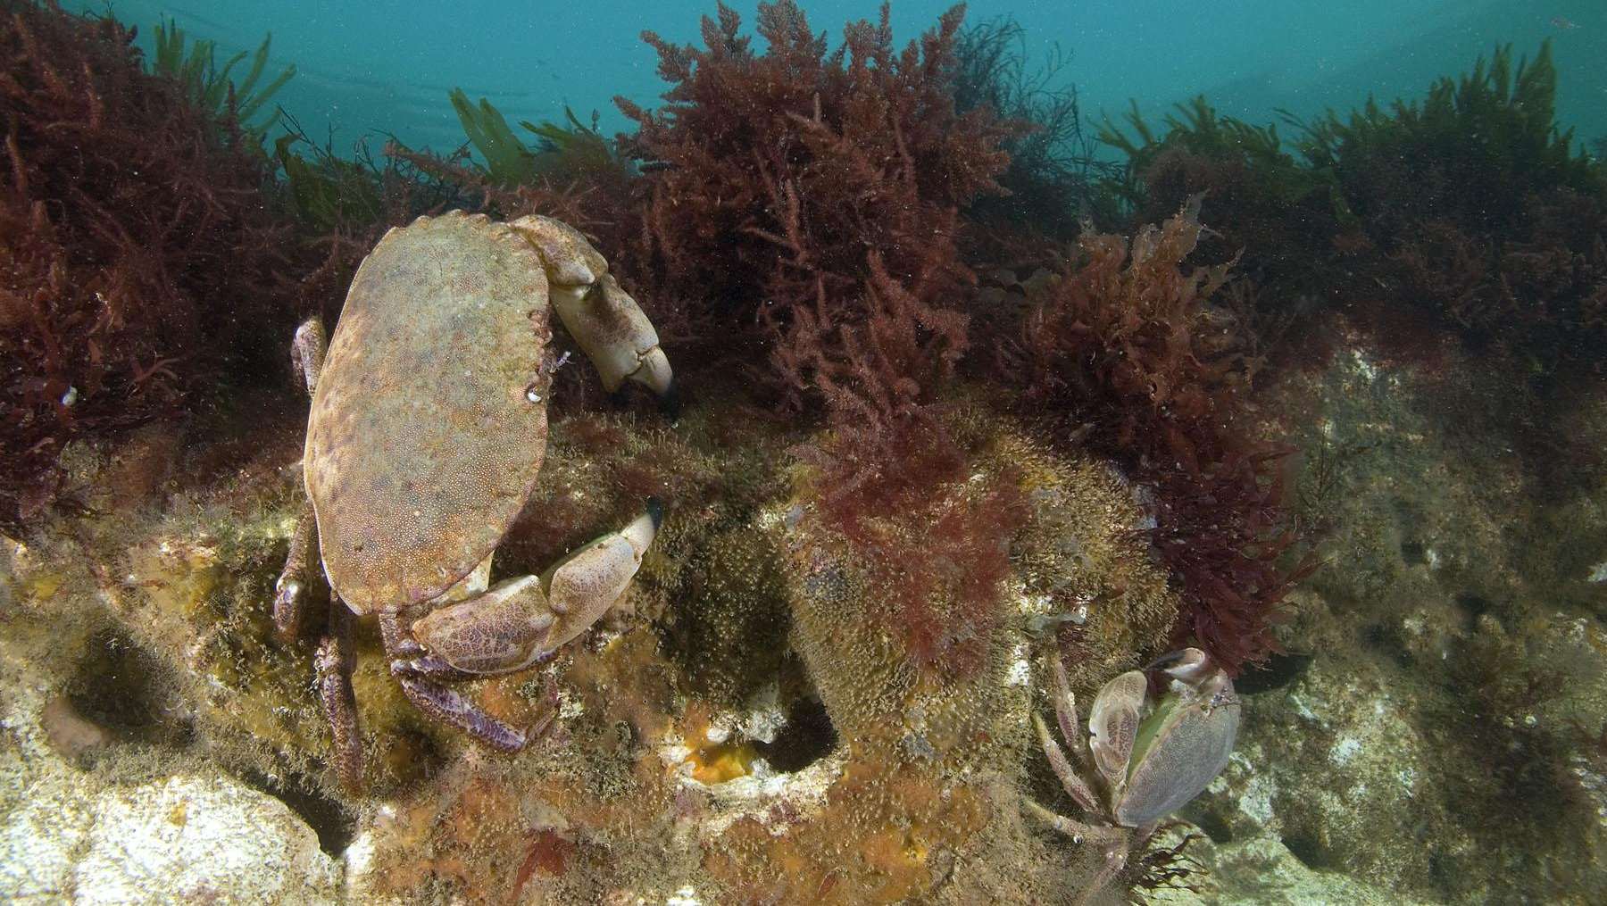
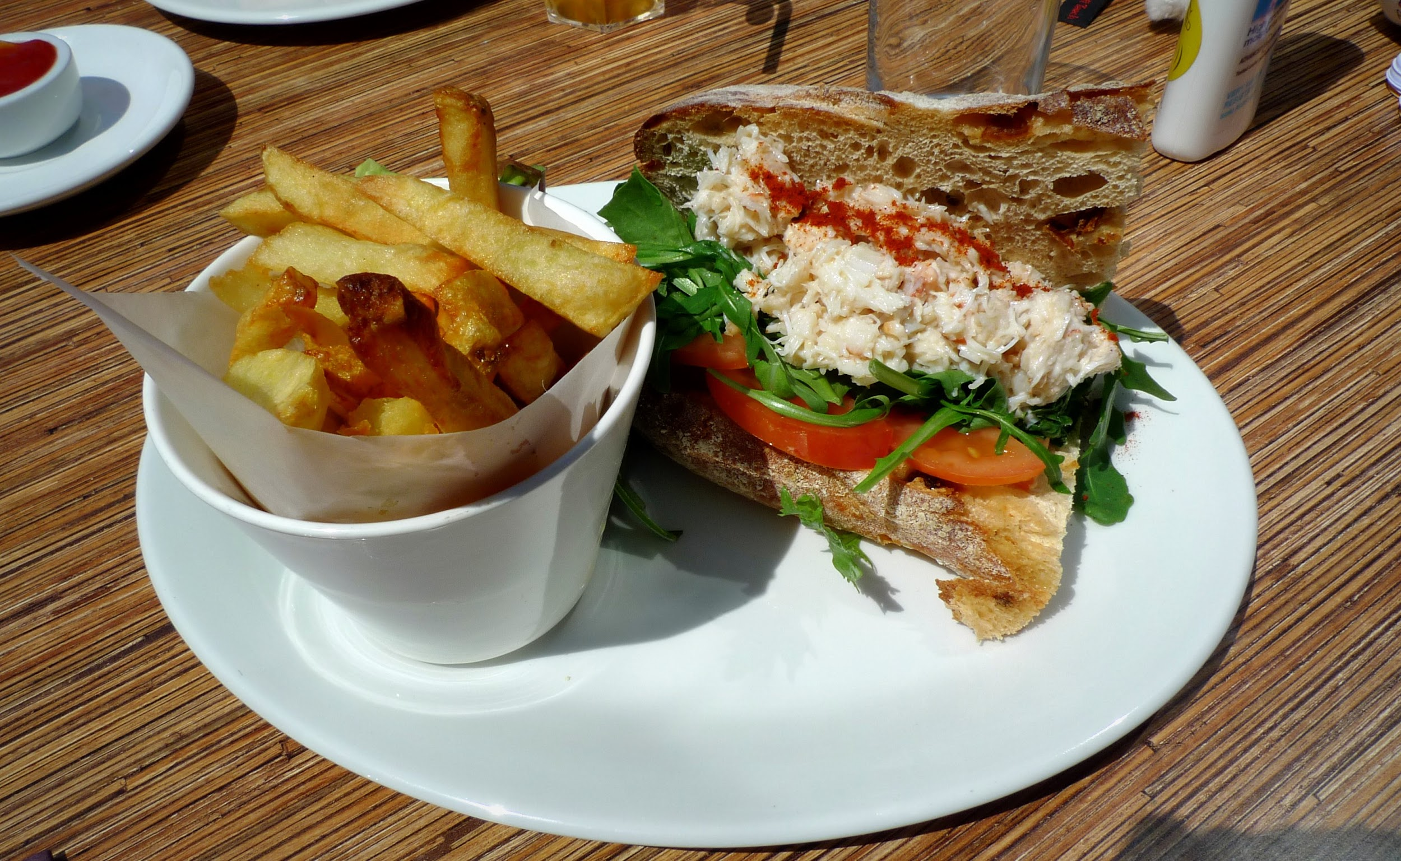
Photo: Paul Naylor
Crabs
Cromer crabs are famous! The crabs love hiding in the holes in the chalk.

Slide 17
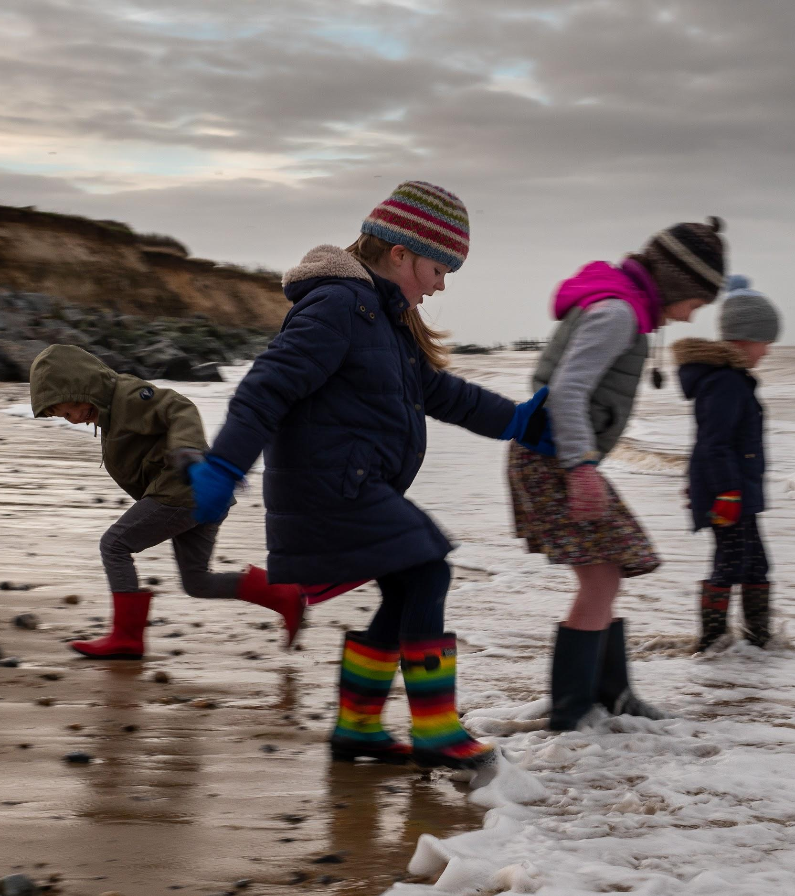
Photo: Paul Naylor
Tourism
Lots of people visit the area on day trips or for their holiday and visit the beach.

Slide 18
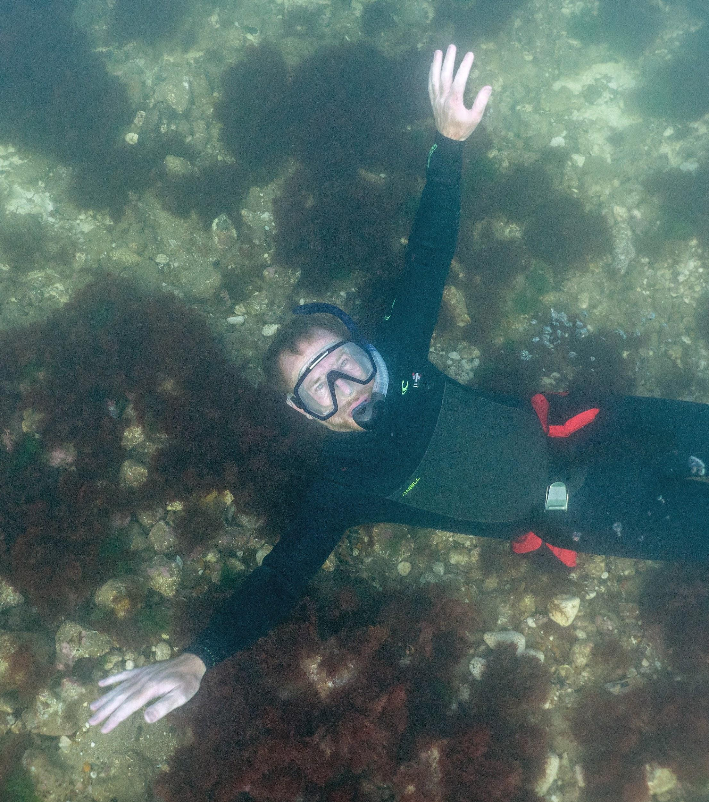
Photo: Paul Naylor
Photo: christaylorphoto.co.uk
Other activities in the area include boating, diving and snorkelling.

Slide 19
What does the Marine Conservation Zone do?
The role of the MCZ is to:
Maintain it in favourable condition
Provide social, environmental and economic benefits

Slide 20
It is a ‘sustainable use site.’ This means that fishing and other activities can continue in a Marine Conservation Zone if they are sustainable.
What does sustainable mean?

Slide 21
Sustainable = Able to carry on without harming the environment
If humans damage or harm the place and its wildlife, they won’t be able to keep fishing, boating and diving here as there wouldn’t be crabs and lobsters to catch or wildlife to see.
There are laws and guidance that protect the area, and these may change over time.

Slide 22
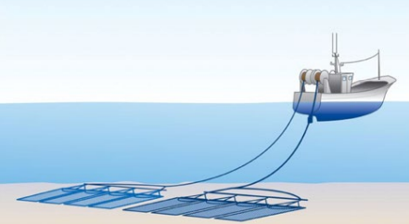
Damage from trawling and dredging in the MCZ
Most (93%) of the MCZ is a no-trawl and no-dredge area.

Slide 23
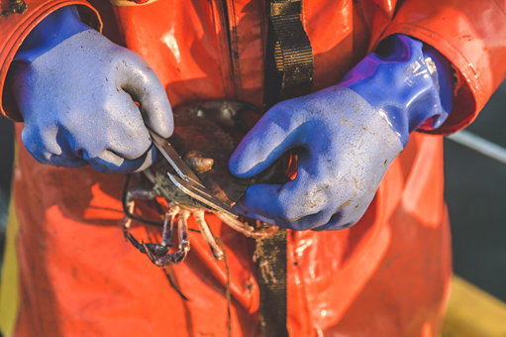
Overfishing
The crabs and lobsters could be at risk from overfishing. Crab numbers are measured to monitor the crab population.
Fishers measure the crabs they catch. Crabs that are too small must be put back. The bigger crabs that are allowed to be caught have lived long enough to lay eggs.
Photo: christaylorphoto.co.uk
Photo: Rob Coleman
Photo: Rob Coleman

Slide 24
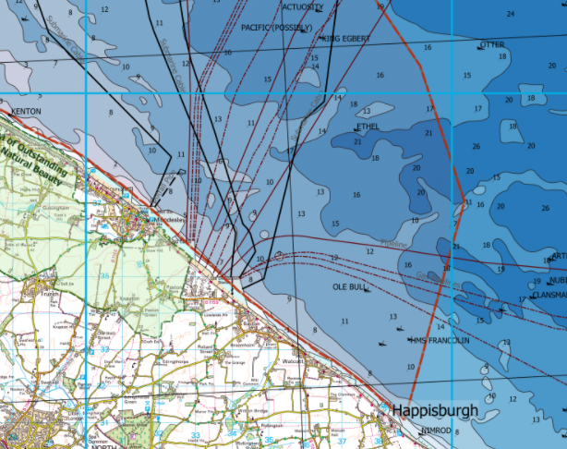
Oil, gas and windfarm development
The MCZ designation means extra considerations need to be made before permission is granted for development within the area.
A new wind farm altered its planned cable route to avoid the MCZ.

Slide 25
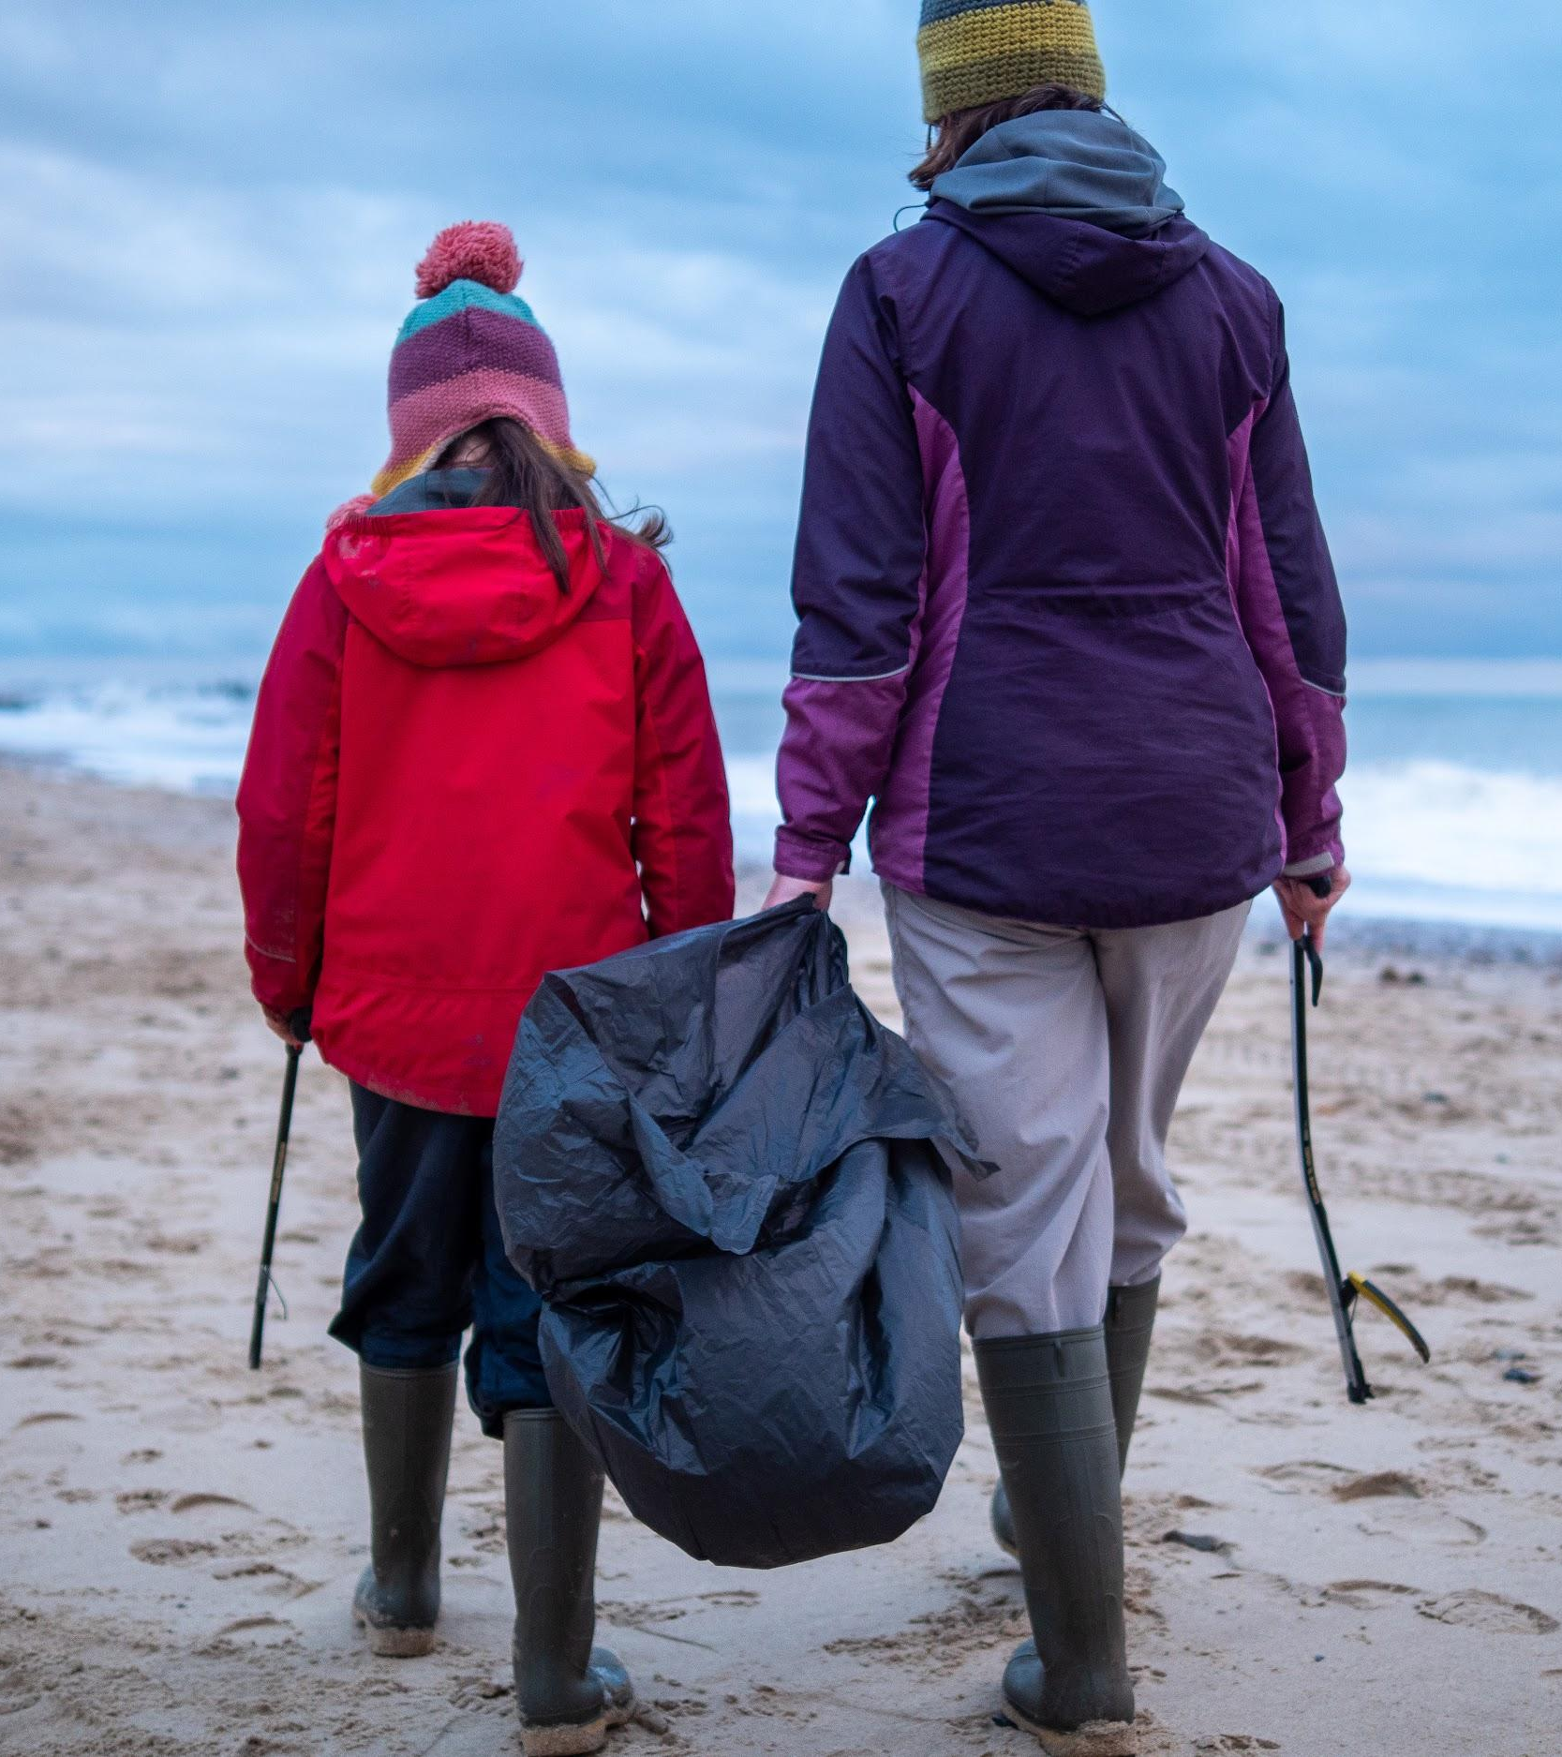
Beach cleans
Litter is sometimes dropped by visitors or fishing gear can get lost. This can cause a problems for wildlife, particularly with plastics.
People volunteer at beach cleans to collect rubbish to keep it out of the sea.
Photo: Rob Coleman

Slide 26
Summary
Cromer Shoal Chalk Beds Marine Conservation Zone is a special place.
The chalk on the seabed provides a special habitat for lots of wildlife.
Fishing is an important industry in the area.
Humans need to make sure they do not damage or harm this place and its wildlife.

